Slide 1


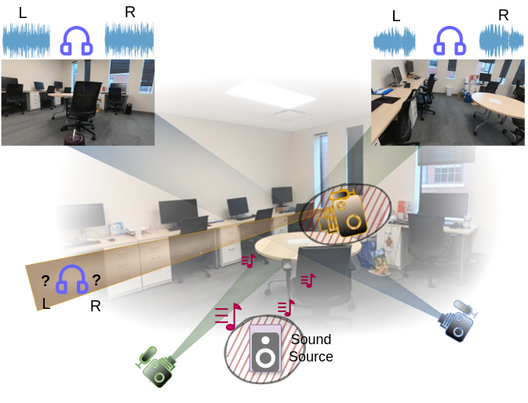
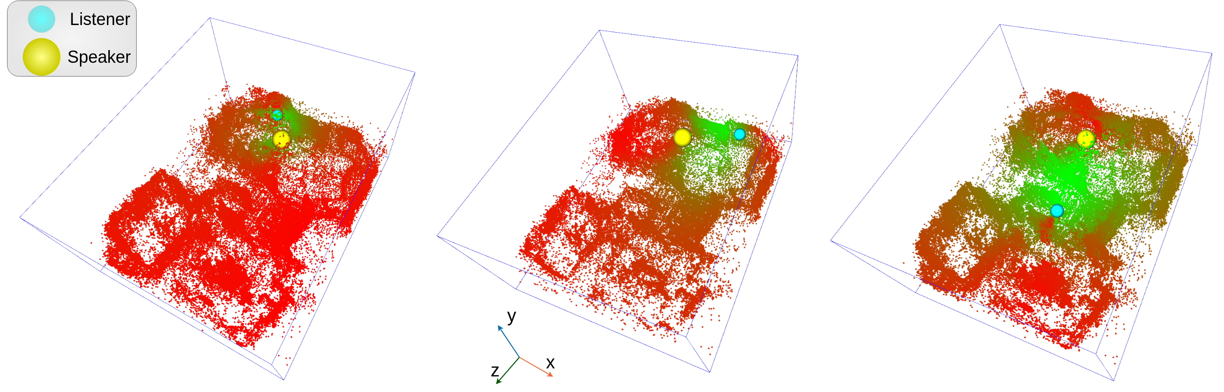
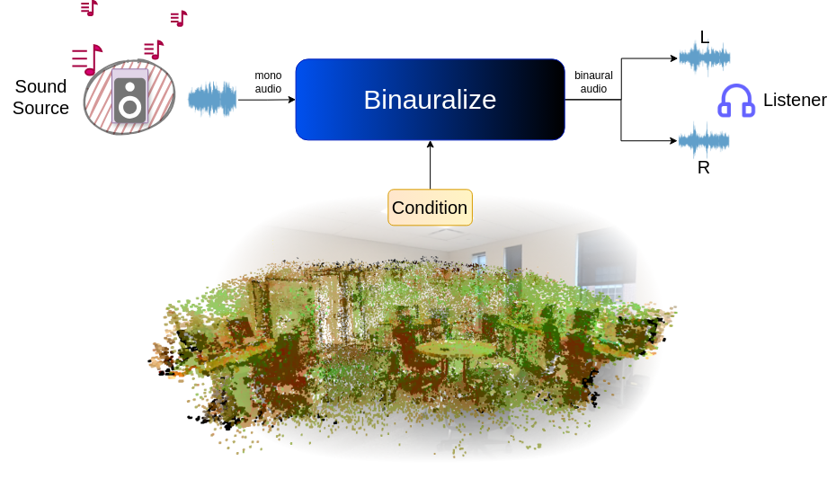
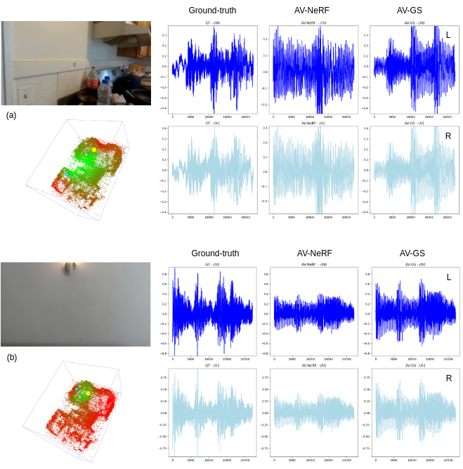
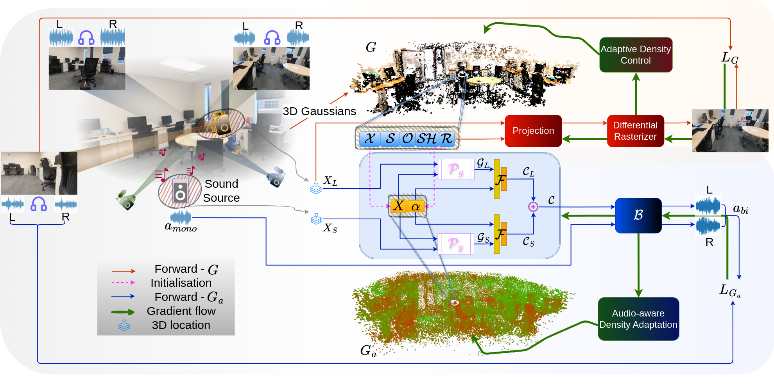
AV-GS: Learning material and geometry aware priors for Novel View Acoustic Synthesis
¹ University of Surrey, UK ² Imperial College London, UK
Swapnil Bhosale¹, Haosen Yang¹, Diptesh Kanojia¹, Jiankang Deng², Xiatian Zhu¹
Task: Novel View Acoustic Synthesis
Motivation: Binauralization with holistic conditioning
Highlights:
Incorporate comprehensive contextual knowledge (a holistic scene representation) beyond the listener’s field of view for an enhanced conditioning.
(i) Intuitive modeling of sound propagation
3D-GS already learns comprehensive scene representations, adopt directly for binauralization?
3D-GS point optimization driven by view-reconstruction loss (purely image domain):
Over-populate along object edges
Under-populate along texture-less regions (walls, doors etc.)
Rhetoric for learning sound propagation :(
major changes in sound paths (absorption and diversion) primarily happen around those texture-less regions.
Realistic binaural audios need,
Direction-awareness
Distance-awareness
Jointly model 3D geometry and material characteristics of the visual scene objects.
(We slice the scene into half along the y-axis, omitting the points from the ceiling, to facilitate better visibility.)
Points learn audio-guidance features for each listener-source pair. Points behind the speaker or rigid walls show lower values (red), indicating minimal contribution to sound propagation guidance.
(ii) Informative conditioning
In complex geometry (top) and meaningless views (bottom), errors occur in binaural synthesis in prior art^{[2]}. However, the holistic scene representation remains unaffected and provides informative conditions.
Given (1) A sound source emitting mono audio within the 3D scene.(2) Binaural audios recorded from viewpoints.
Task Synthesize the binaural audio at an unseen viewpoint.
Stage-1 Learning locally initialized 3D Gaussians (G) using 3D Gaussian Splatting^{[1]}.
P
R
O
P
O
S
A
L
Decoupling physical geometry Initializing audio-guidance parameters to obtain a holistic geometry-aware material-aware scene representation G_{a}
Stage-2 Fusing audio-guidance parameters for points in the vicinity of the listener and sound source.
References [1] Kerbl, Bernhard, et al. "3d gaussian splatting for real-time radiance field rendering." ACM Transactions on Graphics (2023). [2] Liang, Susan, et al. "Av-nerf: Learning neural fields for real-world audio-visual scene synthesis." NeurIPS 2023.

