Slide 1
Smart Alarm Clock
Baietta Filippo, Lancorai Daniel, Strozzi Chiara, Cannone Gaetano.
FreeRTOS
4 concurrent tasks: sensor, button, alarm and network client
I2C
AHT20 + ENS160
UART
DFPlayer Mini audio
HTTP
Local dashboard sync
GPIO
Button poll + debounce
Notes:
Smart Alarm Clock built on ESP32 with FreeRTOS. Four hardware interfaces: I2C sensors, UART audio, GPIO button, Wi-Fi networking.

Slide 2
Software Architecture
Module structure · FreeRTOS tasks · Shared state
FreeRTOS Tasks
main.c / FreeRTOS tasks
Sensor Task
i2c_sensors.c
network_client.c
every 2 s · I2C AHT20/ENS160
alarm_manager.c
Shared State + Mutex
Button Task
every 20 ms · GPIO poll
user_button.c
wifi_manager.c
Alarm Task
audio_player.c
every 1 s · scheduled alarms evaluation
Key data structure: alarm_entry_t — config fields (hour, minute, days_mask, volume, track) + runtime fields (active, snoozed_until_epoch, snoozed_until_uptime_ms, last_fired_day_key). Protected by FreeRTOS mutex.
Network Task
periodic · HTTP GET/POST
Notes:
alarm_manager.c is the central hub. Four FreeRTOS tasks run concurrently, all writing to shared alarm state guarded by a mutex. The alarm_entry_t struct carries both configuration and runtime state per alarm.

Slide 3
HW/SW Interaction & Interrupts
How the system senses, processes, and reacts
I2C
Sensor Acquisition (AHT20 / ENS160)
WIFI
Wi-Fi Events (ESP-IDF callbacks)
continuously polls every 2 seconds an AHT20 sensor (Temperature/Humidity) and an ENS160 sensor (Air Quality).
applies bit shifting converting the raw bytes into meaningful integer and float device. Applies specific sensor formulas to compute exact values and validates data readiness
outputs real-time readings to the web application
Monitors system-level ESP-IDF broadcast events rather than polling manually.
captures 3 network transitions: WIFI_EVENT_STA_START,WIFI_EVENT_STA_DISCONNECTED, IP_EVENT_STA_GOT_IP
translates raw events into thread-safe status flags for other software modules to read
Instantly triggers a fresh connection request (esp_wifi_connect()) the moment a disconnection event occurs.
GPIO
Button — Polling, NOT interrupts
UART
Audio Output (DFPlayer Mini)
Claims physical control of GPIO 17 (Transmit/TX) and GPIO 16
Translates standard commands (like volume or play) into strict 10-byte data packets required by the MP3 module chip.
Restricts software-driven requests to absolute safety thresholds, hard-clapping the volume limit at a maximum value of 30.
audio_player_alarm: Forces the player to execute command 0x12 to fire up a specific track from the SD card.
audio_player_stop: Forces command 0x16 to immediately kill any audio playback.
Reads physical voltage levels on GPIO 4
continuous polling every 20 milliseconds
Measures the time window between consecutive stable presses as the double pressing stops the alarm
1 press: snooze the alarm
Notes:
I2C requires a manual trigger then a wait before reading. Wi-Fi uses async event callbacks — the button deliberately does NOT use GPIO interrupts, using polling instead for deterministic debounce. DFPlayer commands are always sent outside the mutex lock.

Slide 4
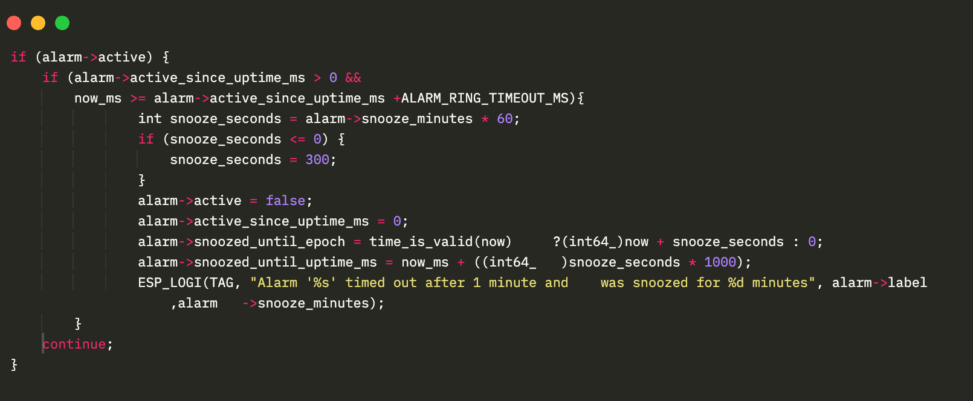
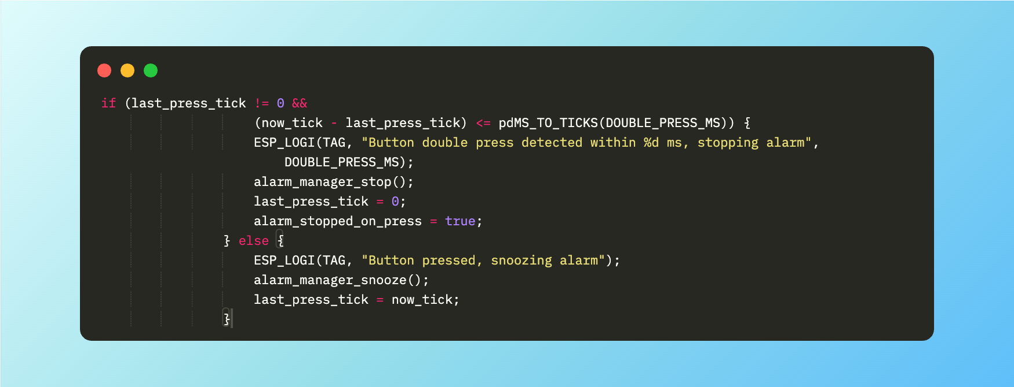
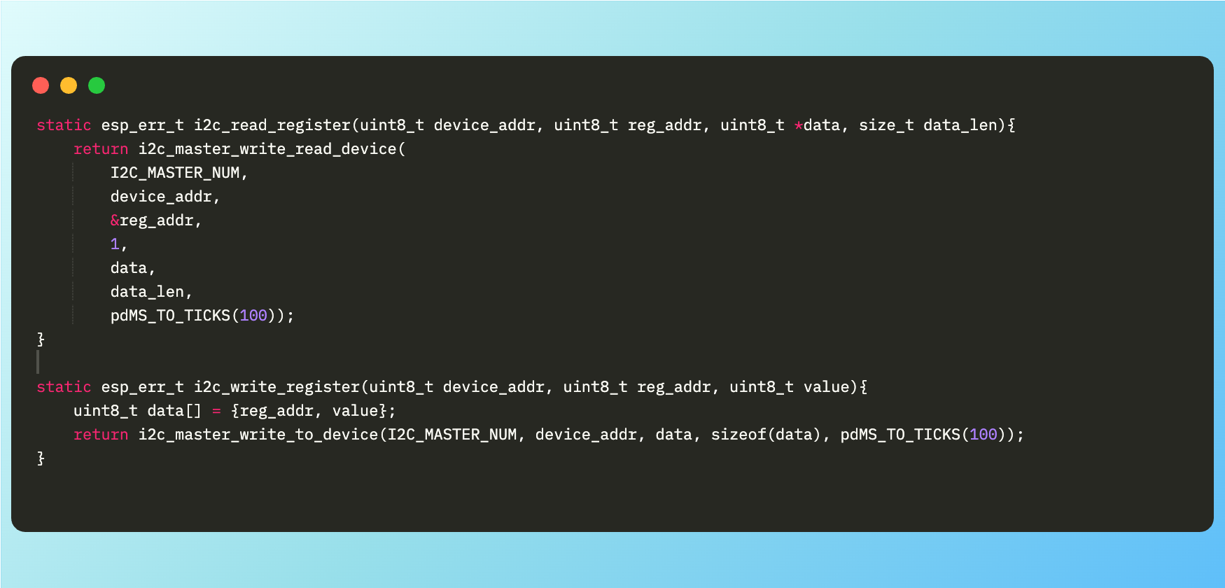
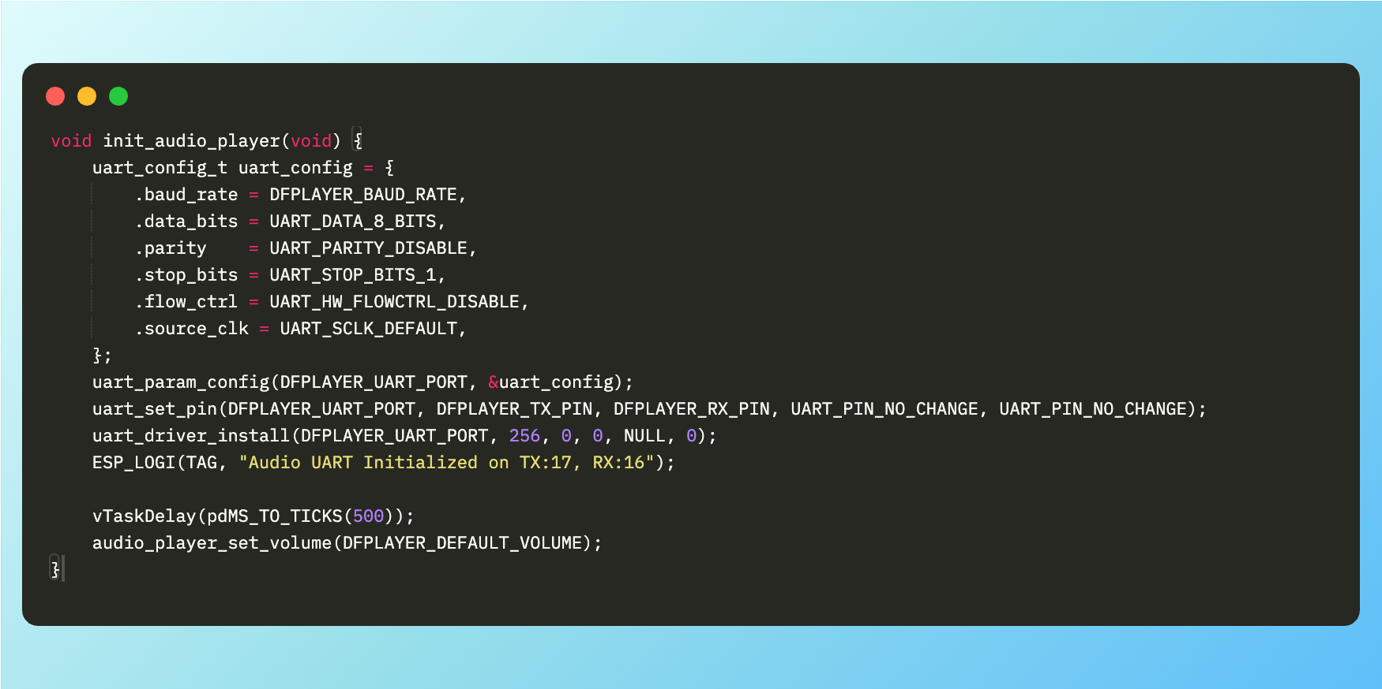
Representative Code
Alarm scheduling
Button debounce & press detection
// Fires once per day at configured time
if (alarm_runs_today(alarm, &local_now) &&
local_now.tm_hour == alarm->hour &&
local_now.tm_min == alarm->minute &&
alarm->last_fired_day_key != today_key) {
alarm->active = true;
alarm->last_fired_day_key = today_key;
}
AHT20 sensor decoding
DFPlayer UART packet + checksum
// AHT20: decode 20-bit raw values from 6 bytes
uint32_t hum_raw = ((uint32_t)data[1]<<12)
| ((uint32_t)data[2]<<4) | (data[3]>>4);
float humidity = hum_raw * 100.0f / 1048576.0f;
uint32_t tmp_raw = ((uint32_t)(data[3]&0x0F)<<16)
| ((uint32_t)data[4]<<8) | data[5];
float temp = tmp_raw * 200.0f / 1048576.0f - 50.0f;
Notes:
Four representative snippets: alarm scheduling with day-key dedup, button debounce with double-press, AHT20 fixed-point decoding, and DFPlayer 10-byte UART protocol with checksum.

Slide 5
Team Contributions & Testing
Contributions
Testing & Problems Solved
Daniel
audio_player.c
Multi-alarm audio conflicts
DFPlayer UART, packet framing
→ Cached audio state; oldest alarm wins; UART after unlock
Filippo
wifi_manager.c
Stop via 2-sec hold — unreliable
Station connect, event callbacks
→ Replaced with 2 quick presses within 2 s
Gaetano
user_button.c
Button bounce
GPIO poll, debounce, press logic
→ 80 ms debounce window, 20 ms poll interval
Chiara
i2c_sensors.c
AHT20 / ENS160 reliability
AHT20 & ENS160 polling, conversion
→ 100 ms conversion delay; ENS160 re-probed every 10 s
Shared
alarm_manager · main · network · dashboard
Race conditions on shared state
Equally developed by all
→ FreeRTOS mutex; hardware ops outside locked region
Notes:
Each member owned a hardware-interface module. Testing was done module-by-module then full integration. Key problems: multi-alarm audio state conflicts, unreliable long-press stop, and race conditions on shared state.

Slide 6
Conclusions & Future Work
Achieved
Hardware (future work)
Software (future work)
FreeRTOS multi-task firmware
Custom protective enclosure
OTA firmware updates
Mutex-protected shared alarm state
Better speaker system
Cloud sync & remote notifications
Multi-alarm scheduling with day masks
Improved power management
Multiple user profiles & alarm history
Sensor comfort alerts (temp/humidity/AQI)
Snooze & stop via button
Local dashboard alarm sync & monitoring
Notes:
System achieves all core goals. Future directions: OTA updates, cloud sync, custom alarm tracks, and additional sensors for richer context-awareness.

