Slide 1
[Planning a Travel Journey]
The problem
Develop a Prolog program that helps in planning a travel journey from one place to another. The travel journey can take place either by car, by train, by plane or by 'chaining together' any two or three of the previously mentioned transportation means. The developed program is used to determine the transportation means required to travel from one place to another and the intermediate places which are needed to pass through when getting from one place to another. The program also is used to decide the conditions which make the input operations are complaint with the program database. Suggest ten places that can be used in the different travel journeys. Use the suggested places to ask ten different queries to test the validity of the program. Five of the suggested queries should result in valid travel journeys, while the other five should result in invalid travel journeys. Describe in detail why each of the ten queries can either be valid or invalid

Slide 2
The problem that we want to solve .
1- go from place to another.
2- can go by train ,car , plane or ‘chaining together’
3- determine the transportation .
4- intermediate places.
5- Suggest ten places that can be used in the different travel journeys.
6- Five of the suggested queries should result in valid travel journeys.
7- other five should result in invalid travel journeys
8- Describe in detail why each of the ten queries can either be valid or invalid

Slide 3



places
new York
Los Angeles
San Francisco
Miami
Atlanta
Chicago
Houston
new Orleans
Dallas
Portland

Slide 4

Travel by Car (facts)
car(new York , loss Angeles).
car(loss Angeles , Atlanta).
car(loss Angeles , San Francisco).
car(San Francisco , Miami).
car(new York , new Orleans).
car(new Orleans , Chicago).
car(Chicago , Atlanta).
car(new Orleans , Dallas).
car(Dallas , Houston).
car(Houston , Miami).
car(Houston , San Francisco).

Slide 5
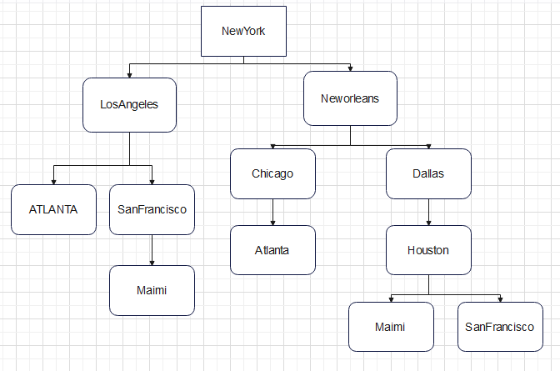
Diagram for car travel

Slide 6

Travel by Train (facts)
train(new York , loss Angeles).
train(loss Angeles , San Francisco).
train(San Francisco , Miami).
train(new York , Atlanta).
train(loss Angeles , Atlanta).
train(new York , Chicago).
train(Chicago , Atlanta).
train(new York , new Orleans).
train(new Orleans , Atlanta).
train(new York , Dallas).
train(Dallas , San Francisco).
train(San Francisco , Miami).

Slide 7
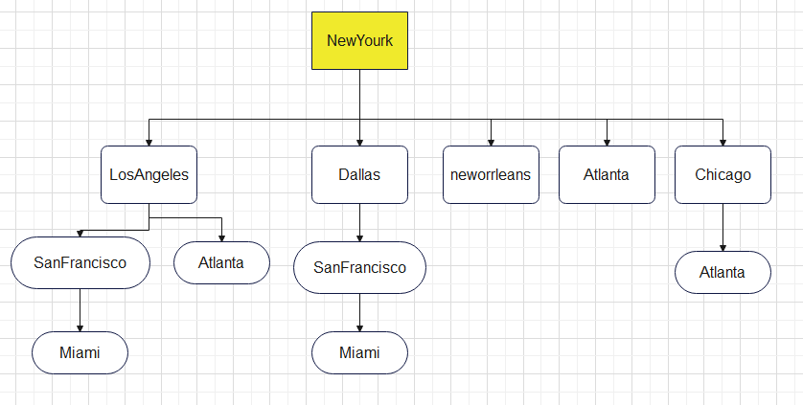
Diagram for train travel
New York

Slide 8

Travel by Plane (facts)
plane(new York , loss Angeles).
plane(new York , San Francisco).
plane(new York , Miami).
plane(loss Angeles , San Francisco).
plane(leangles , Miami).
plane(San Francisco , Miami).
plane(new York , Dallas).
plane(Dallas , Portland).
plane(Portland , Miami).
plane(Portland , San Francisco).
plane(Dallas , Houston).
plane(Houston , Miami).

Slide 9
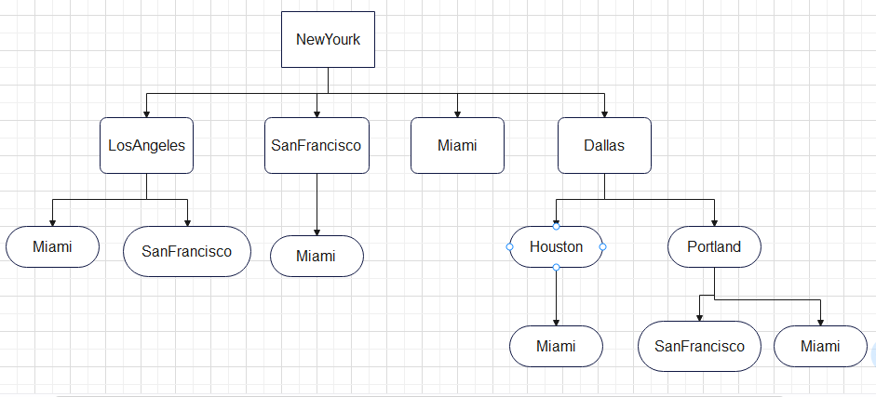
Diagram for plane travel

Slide 10
Rules
Part _1
travel(City1,City2, [travel(car(City1,City2))]) :-
car(City1,City2).
travel(City1,City2, [travel(train(City1,City2))]) :-
train(City1,City2).
travel(City1,City2, [travel(plane(City1,City2))]) :-
plane(City1,City2).

Slide 11
Rules
Part_2
travel(City1,City2, [travel(car(City1,Z))|G]) :-
car(City1,Z), travel(Z,City2,G).
travel(City1,City2, [travel(train(City1,Z))|G]) :-
train(City1,Z),travel(Z,City2,G).
travel(City1,City2, [travel(plane(City1,Z))|G]) :-
plane(City1,Z),travel(Z,City2,G).

Slide 12
How the rules work?
We enter the query : travel( new York , San Francisco , Journey).
The prolog go to dataset and match for this new York , San Francisco then he give you the answer and then check if there any path that can drive me to the goal so he make a Recursive rule to find it there other answer

Slide 13
Valid Query
travel(new York , San Francisco , Journey).
This is a valid query. There is a direct car route from network to San Francisco.
travel(loss Angeles, Miami, Journey).
This is a valid query. There is a direct train route from loss Angeles to Miami.
travel(new York , Houston, Journey).
travel(new Orleans, Atlanta, Journey).
travel(Dallas, San Francisco, Journey).

Slide 14
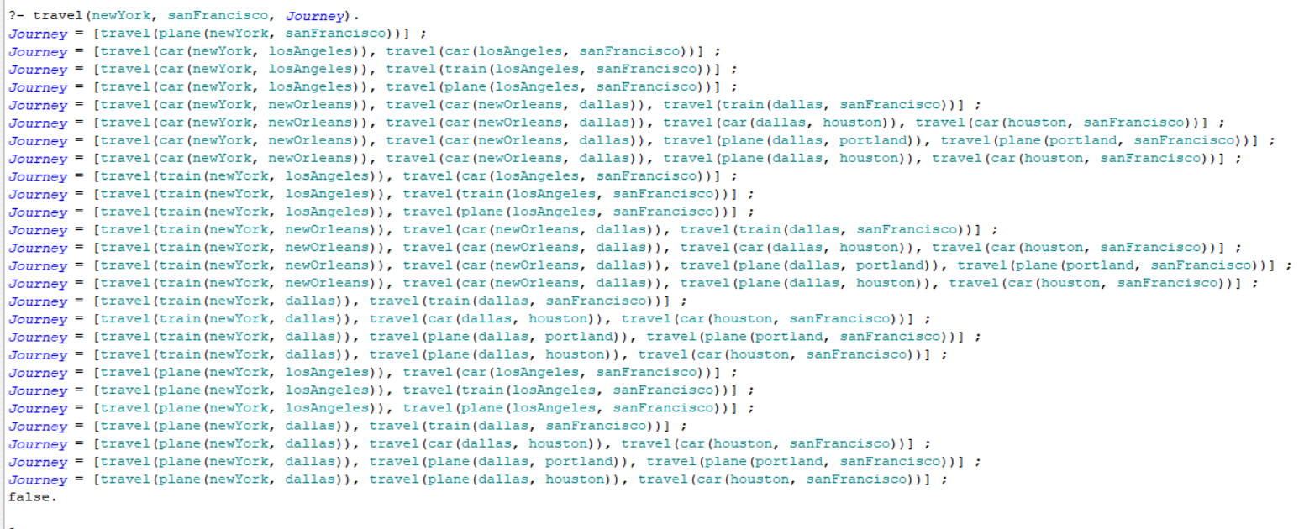
Valid Query and how it valid?

Slide 15
travel(new York, Atlanta, Journey).
By rule pr2
By rule pr1
car(new York, Atlanta).
car(new York, B),
car(B, Atlanta).
B=loss Angeles
car(loss Angeles, Atlanta).
travel(new York, Atlanta, Journey).
By car
Exist

Slide 16
Invalid Query
travel(Miami , loss Angeles, Journey).
This is an invalid query. There is no direct route from Miami to loss angles by car, train, or plane.
travel(Houston , Chicago , Journey).
This is an invalid query. There is no direct route from Houston to Chicago by car, train, or plane.
travel(loss Angeles , Portland, Journey).
travel(loss Angeles , Houston, Journey).
travel(Portland ,Atlanta , Journey).

Slide 17
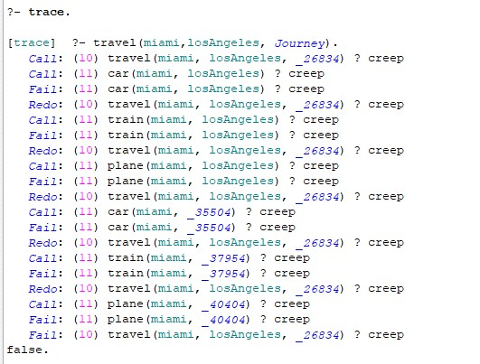
Invalid Query Trace and how it invalid? (after trace)

