Slide 1
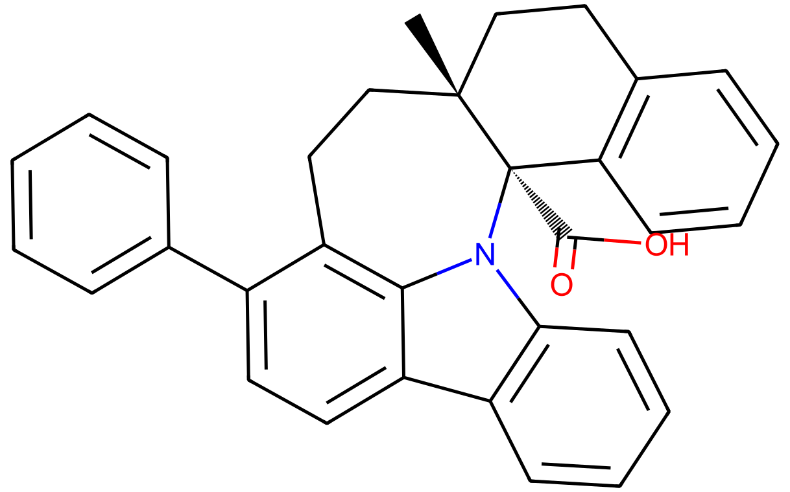
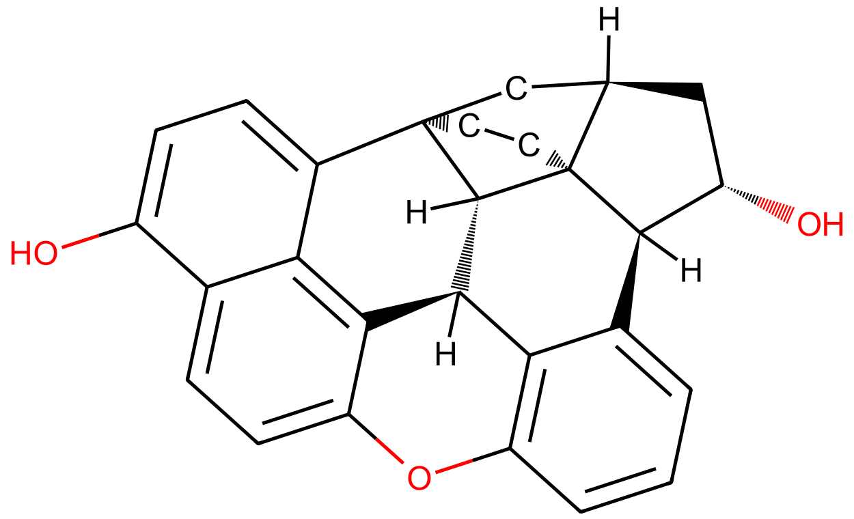
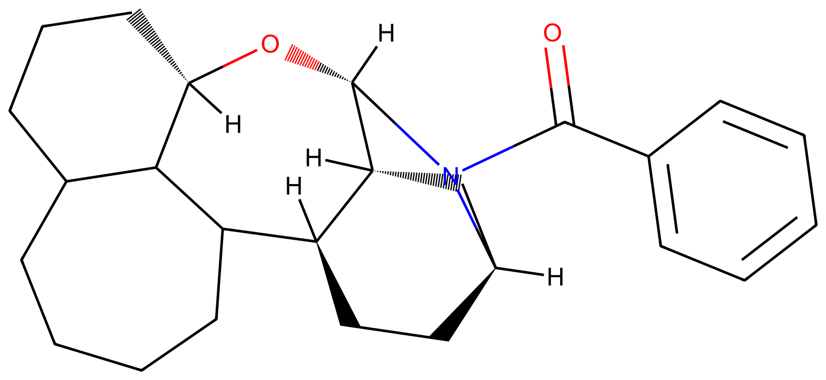
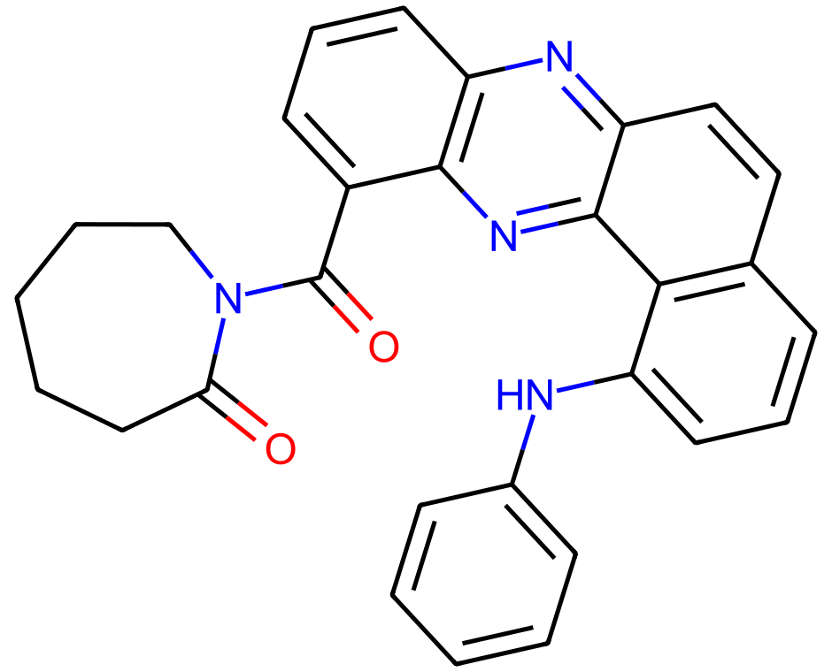
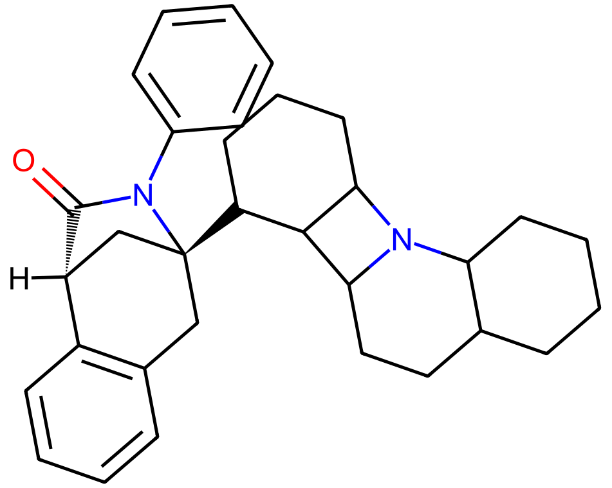
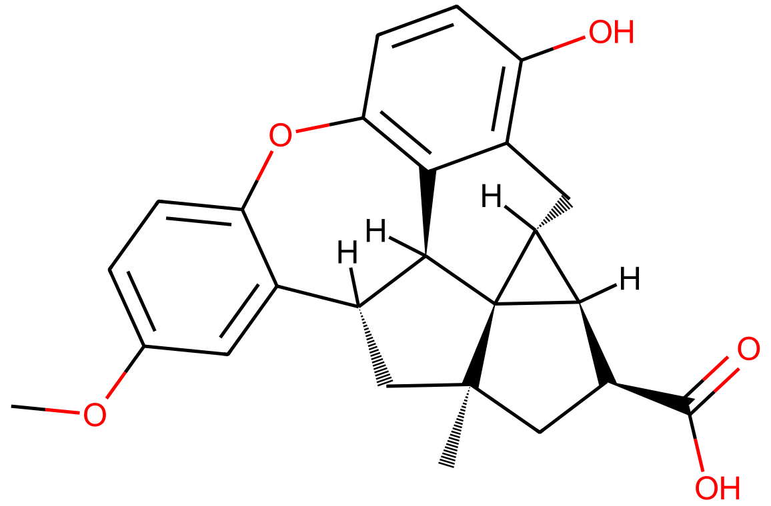
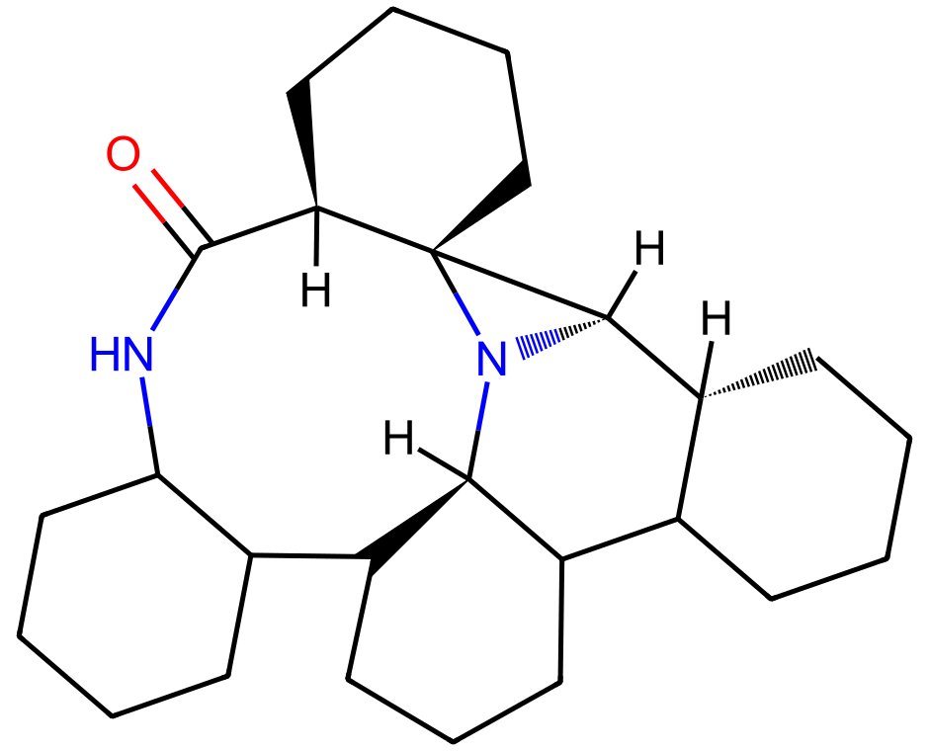
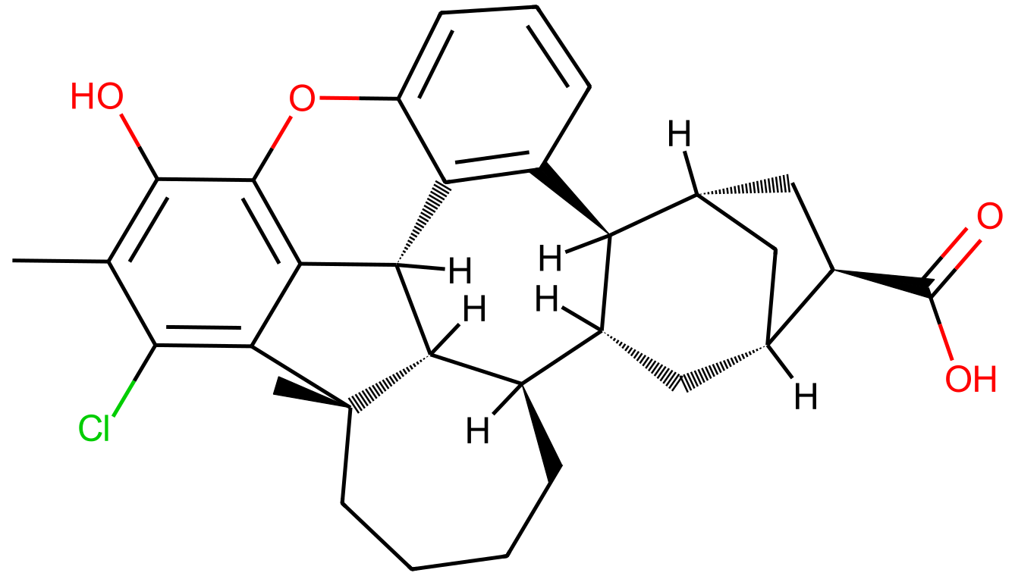
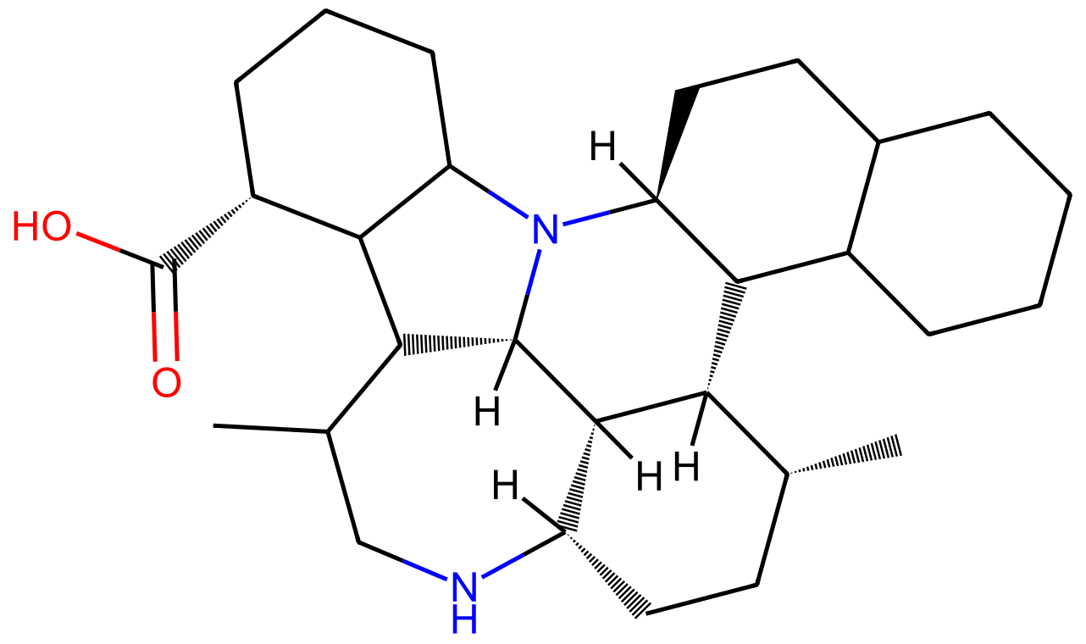
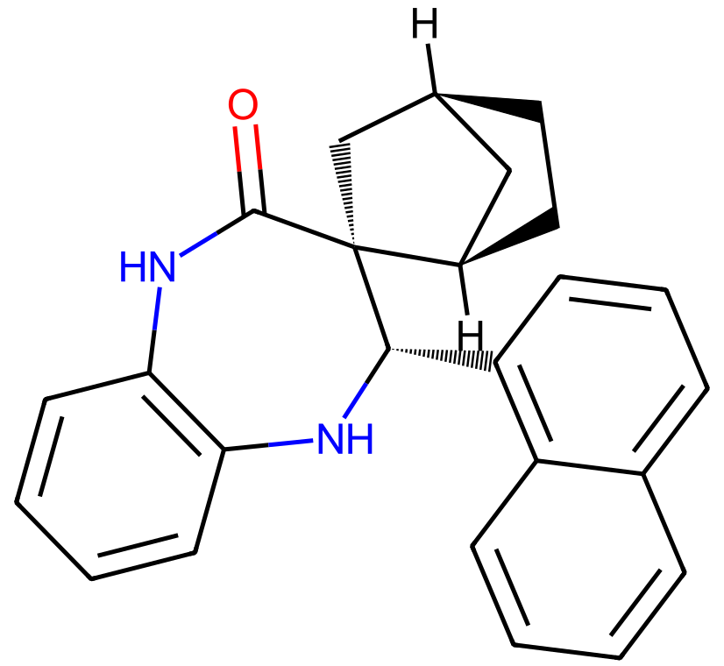
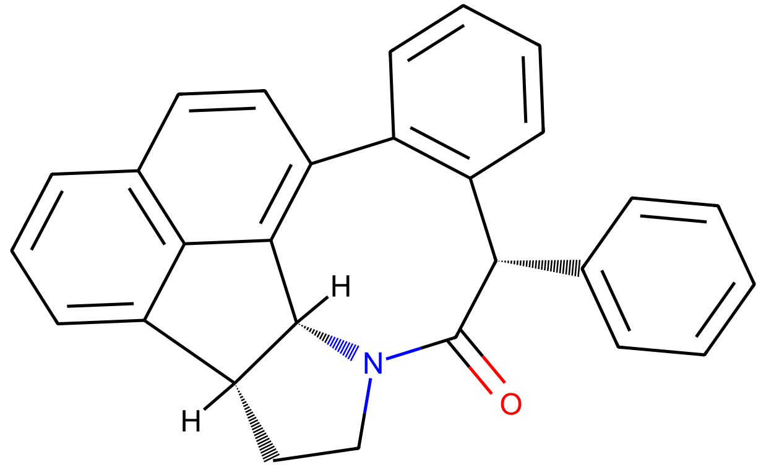
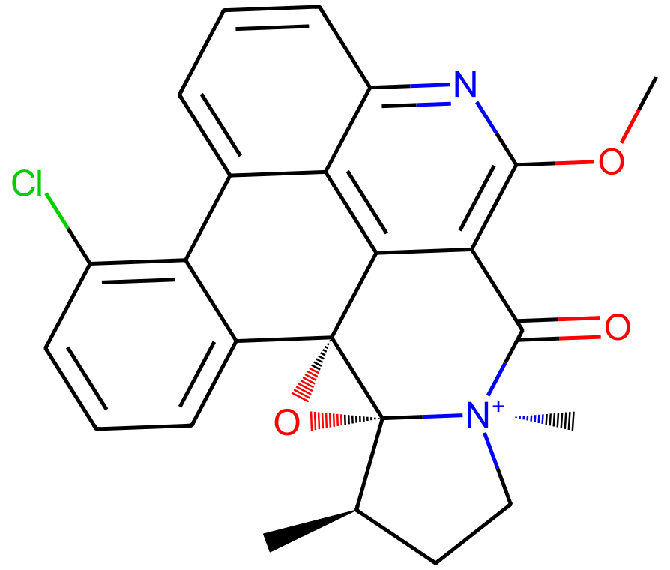
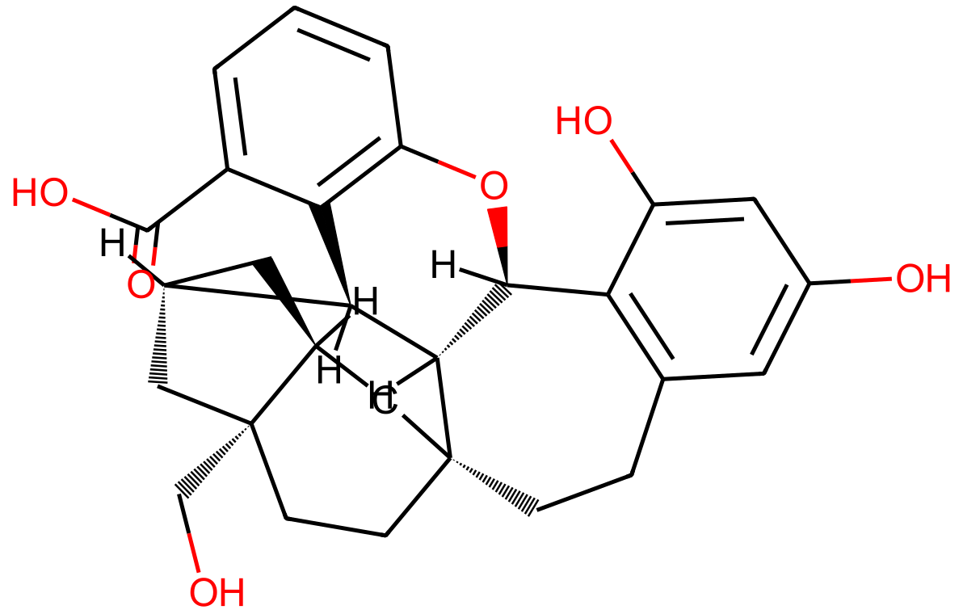
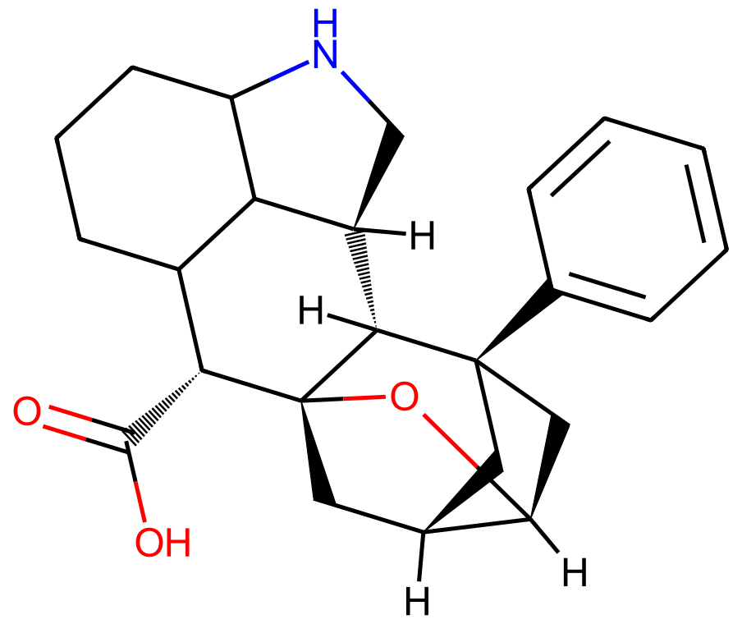
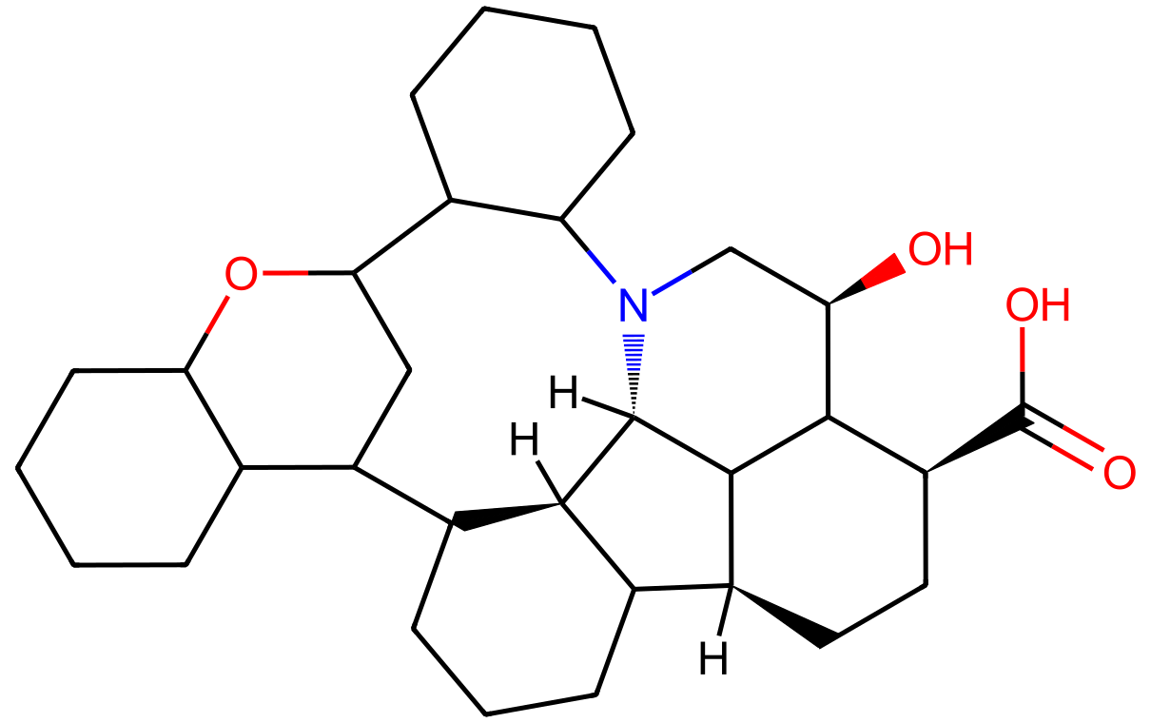
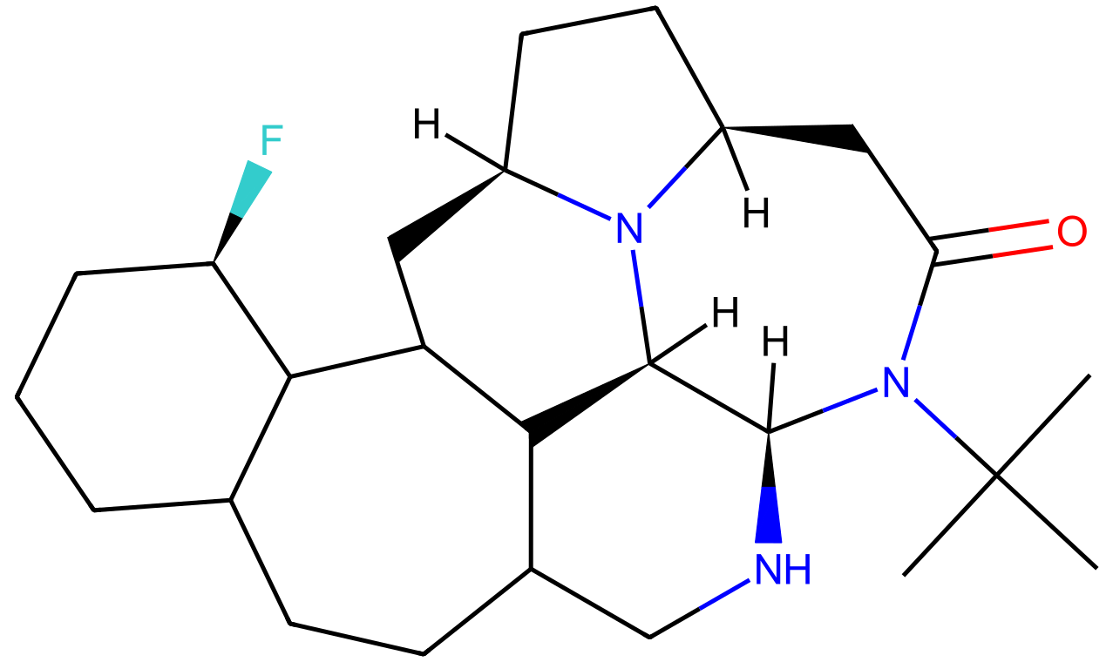
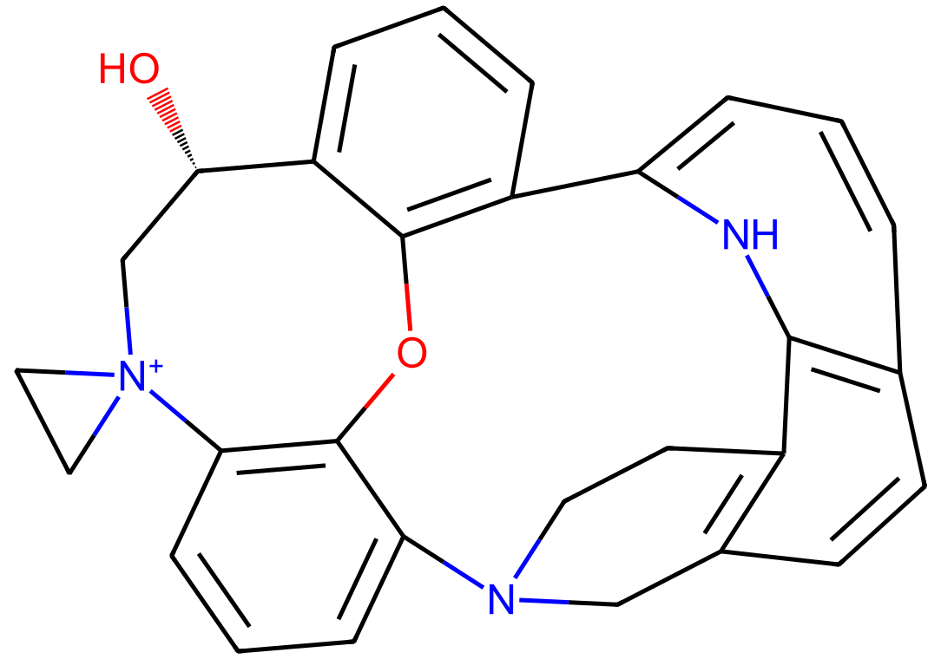
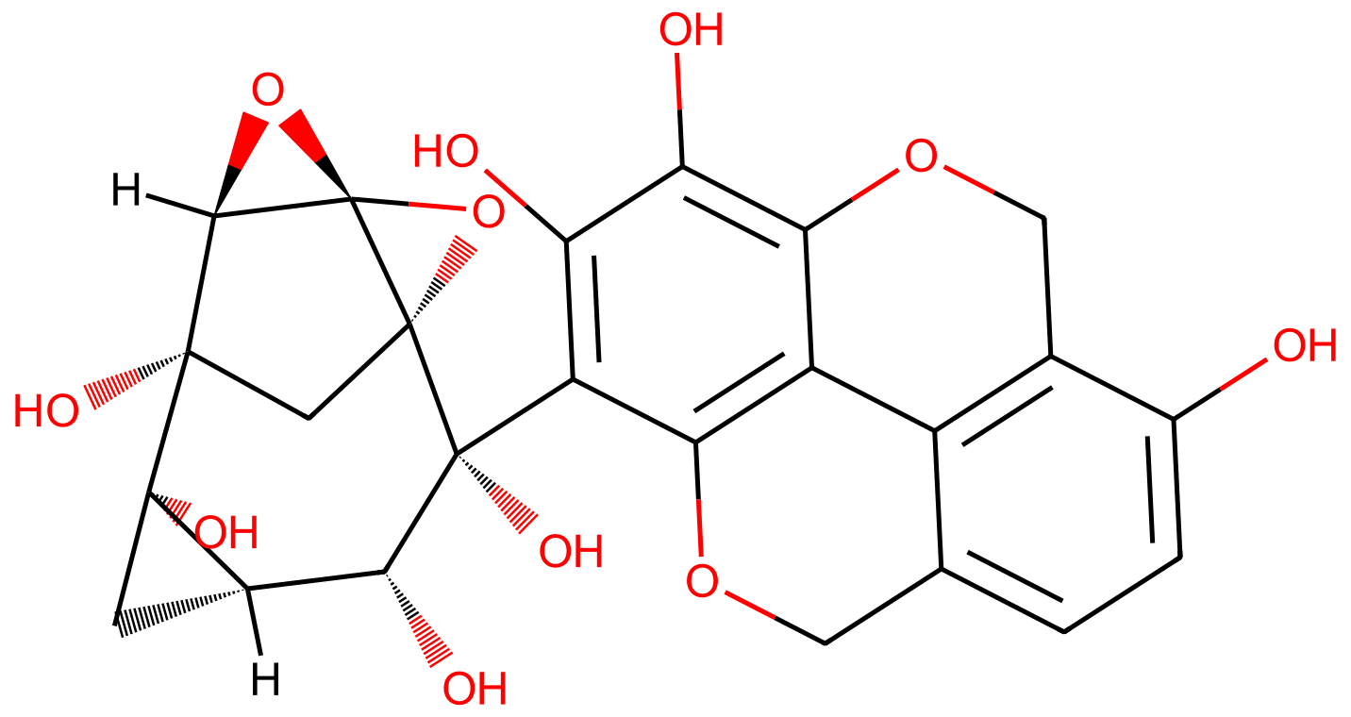
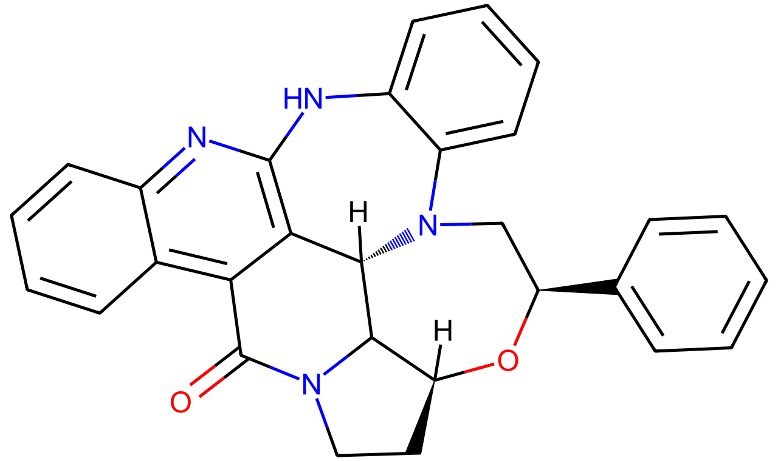
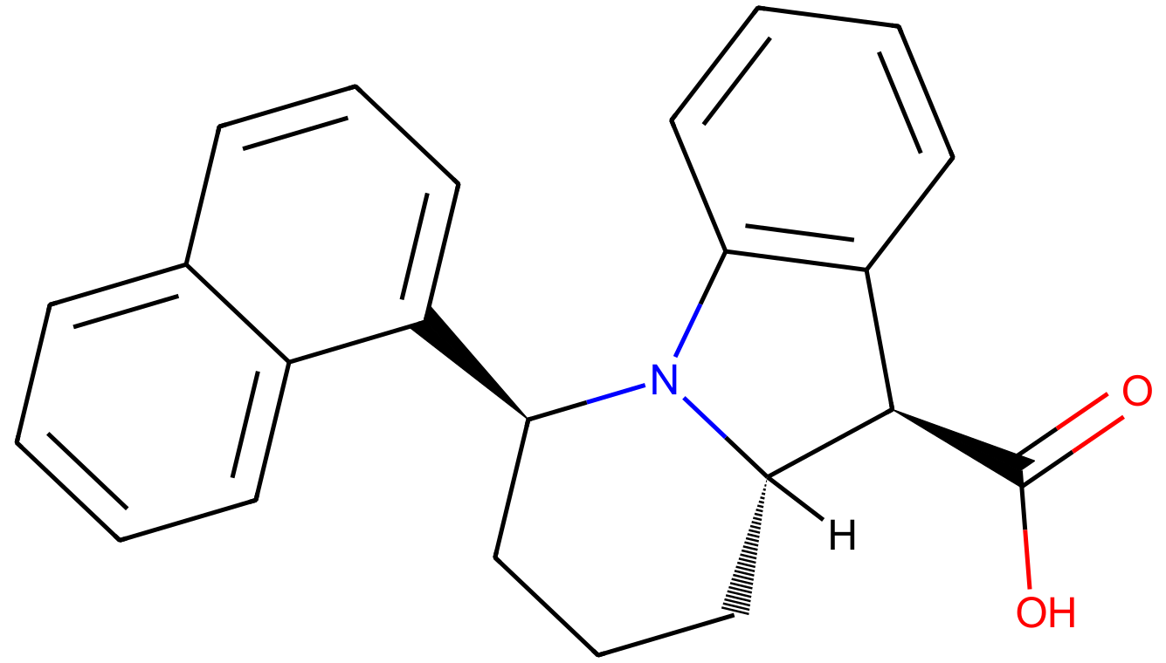
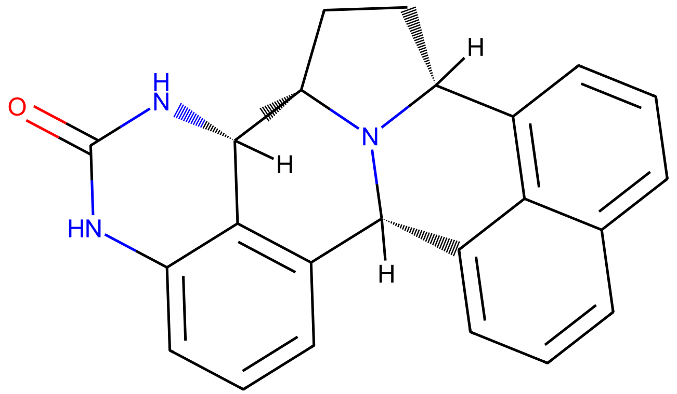
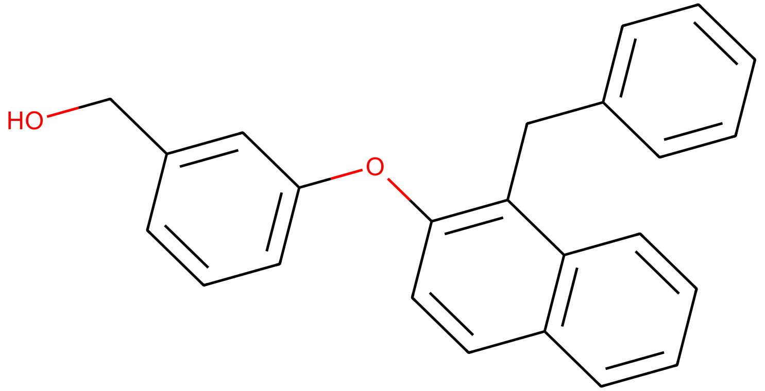
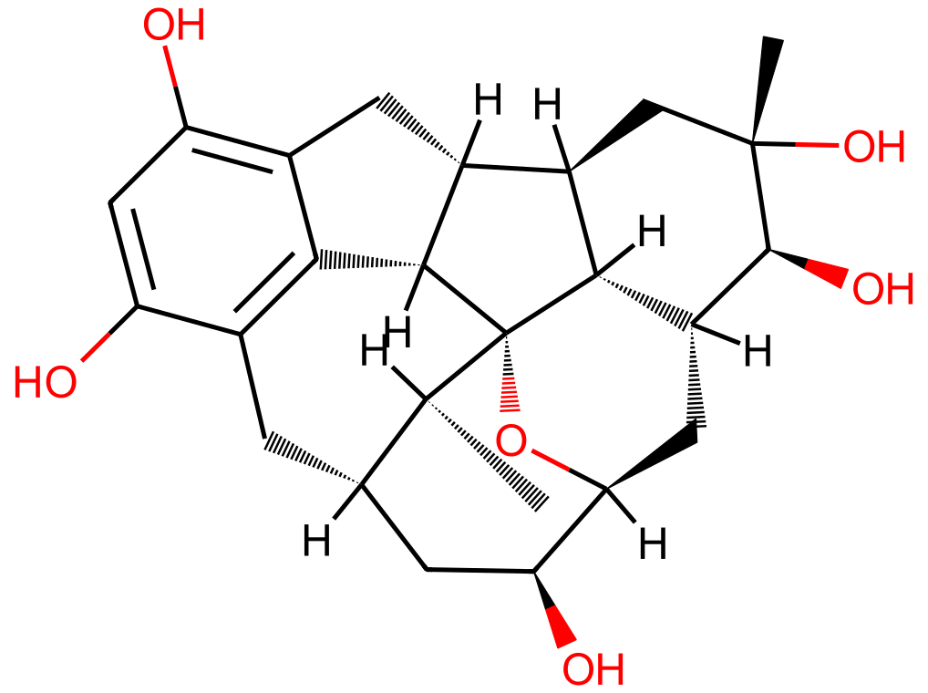
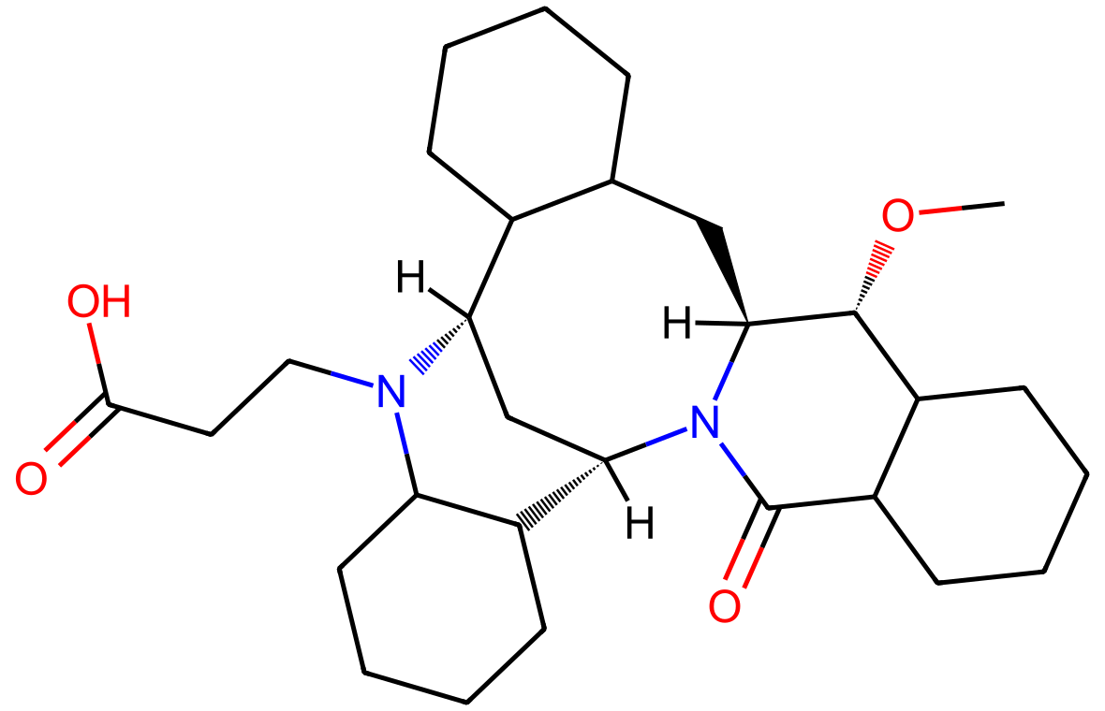
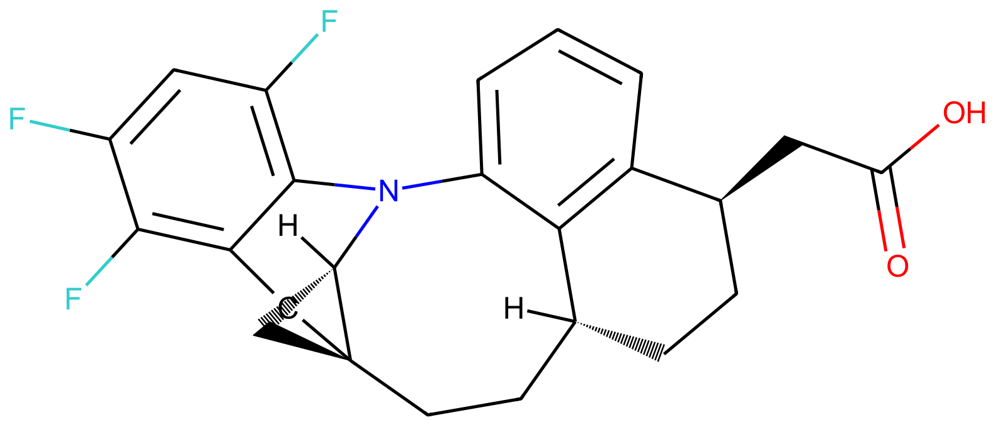
DiffGui Top 1-25
mol001
mol002
mol003
mol004
mol005
Docking score = -15.466
Docking score = -15.152
Docking score = -14.850
Docking score = -14.740
Docking score = -14.612
mol006
mol007
mol008
mol009
mol010
Docking score = -14.510
Docking score = -14.500
Docking score = -14.499
Docking score = -14.454
Docking score = -14.431
mol011
mol012
mol013
mol014
mol015
Docking score = -14.419
Docking score = -14.419
Docking score = -14.401
Docking score = -14.394
Docking score = -14.377
mol016
mol017
mol018
mol019
mol020
Docking score = -14.333
Docking score = -14.311
Docking score = -14.282
Docking score = -14.262
Docking score = -14.063
mol021
mol022
mol023
mol024
mol025
Docking score = -14.051
Docking score = -14.036
Docking score = -14.012
Docking score = -14.010
Docking score = -14.004

Slide 2
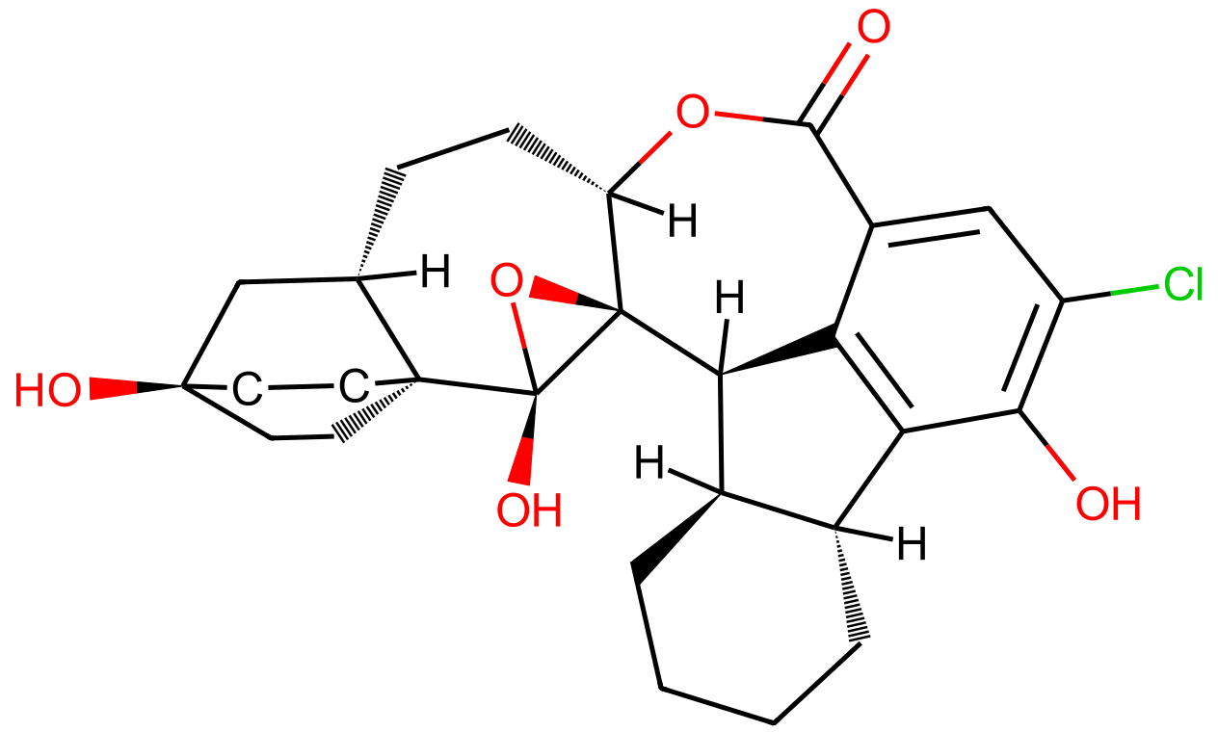
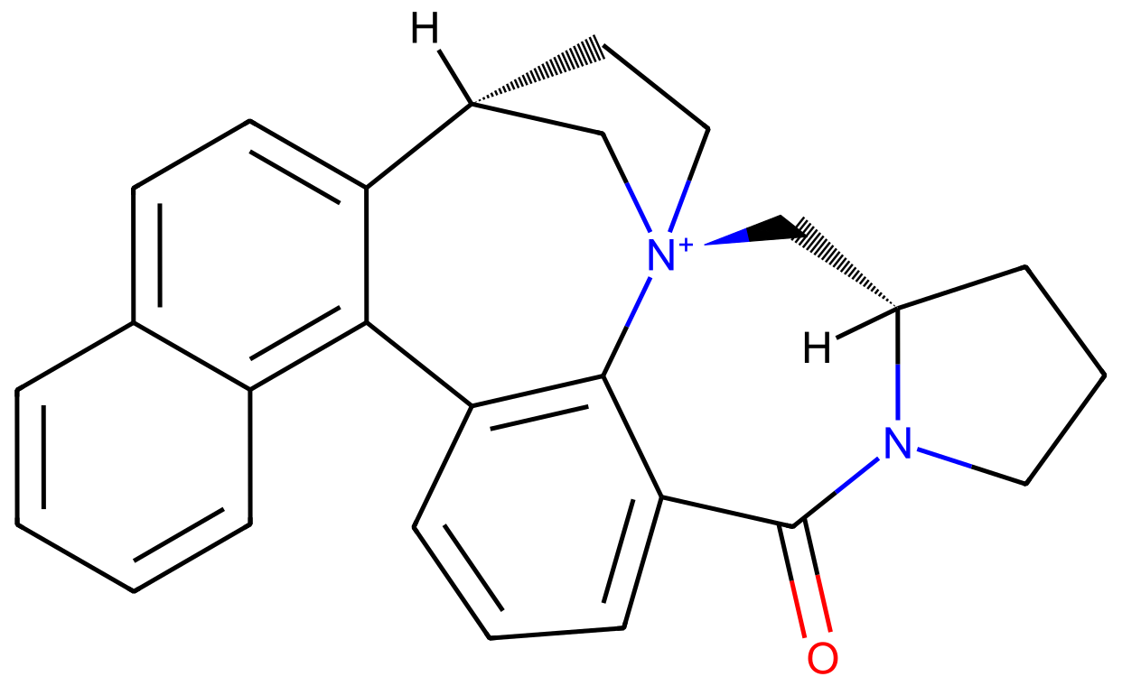
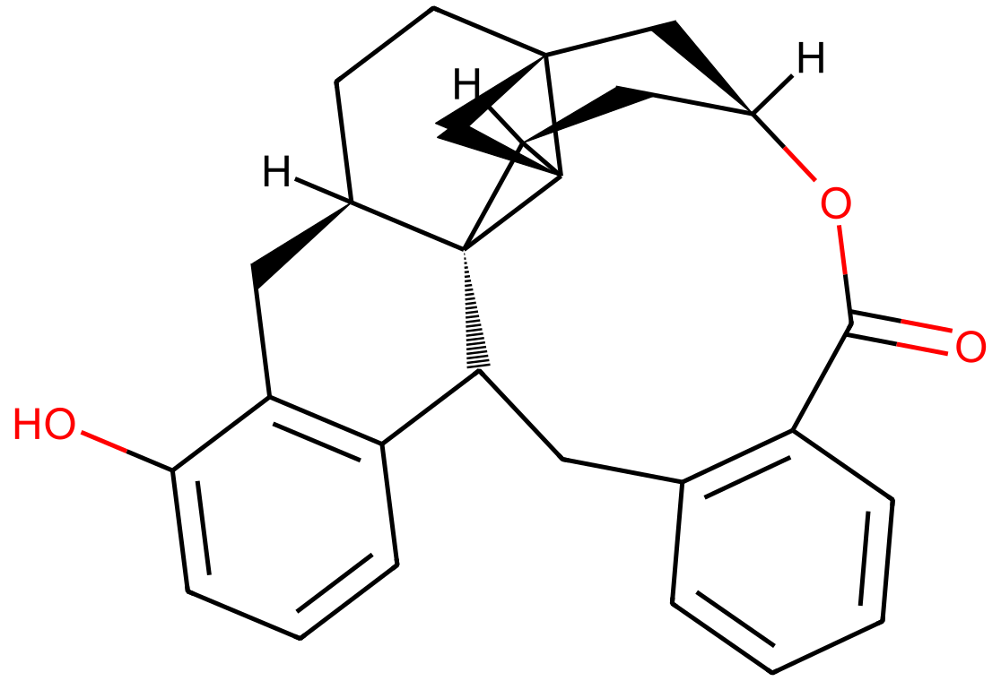
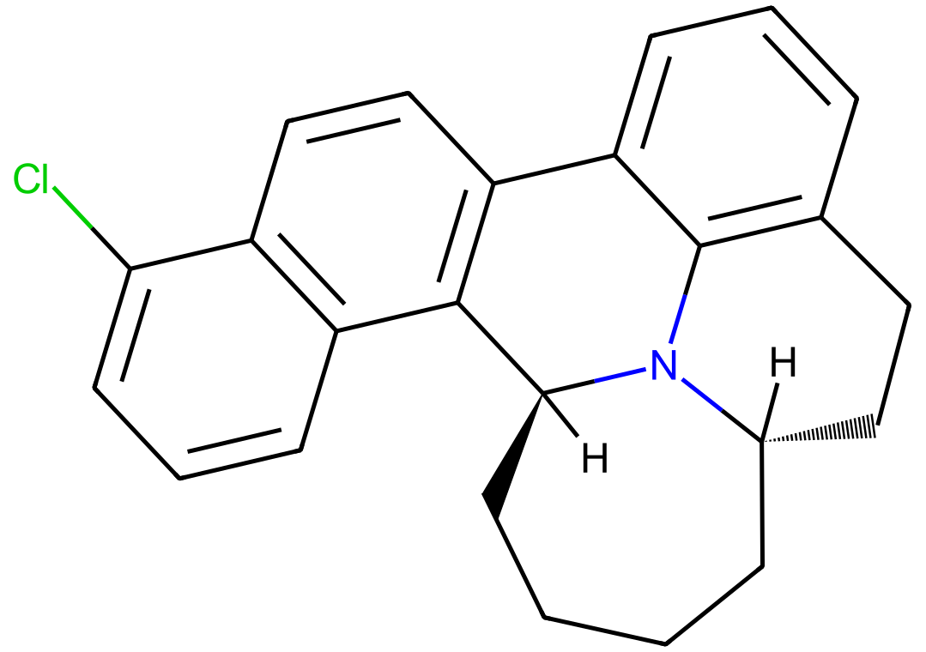
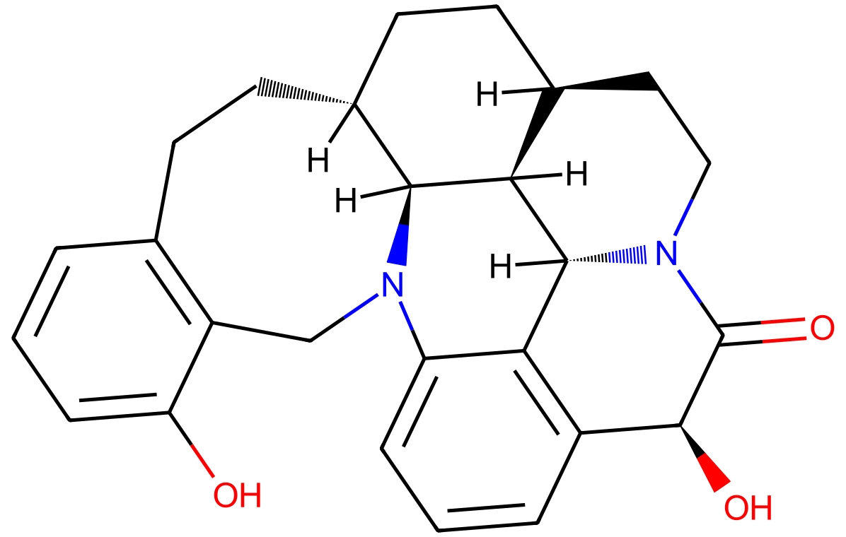
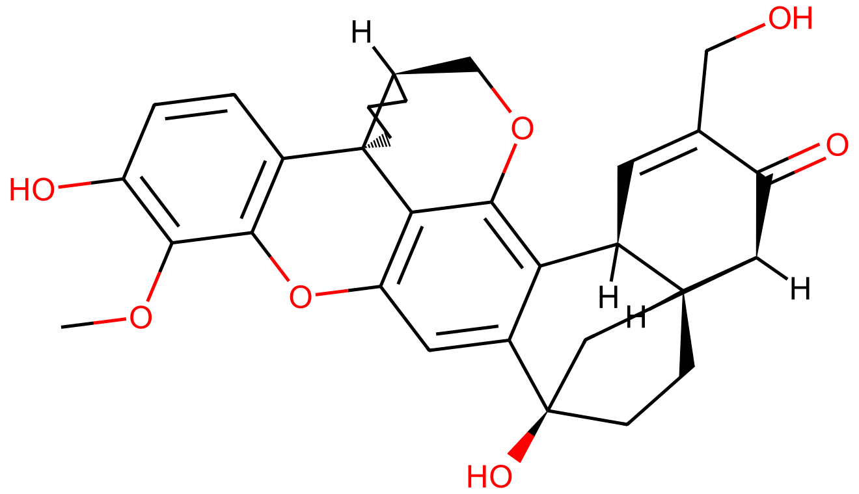
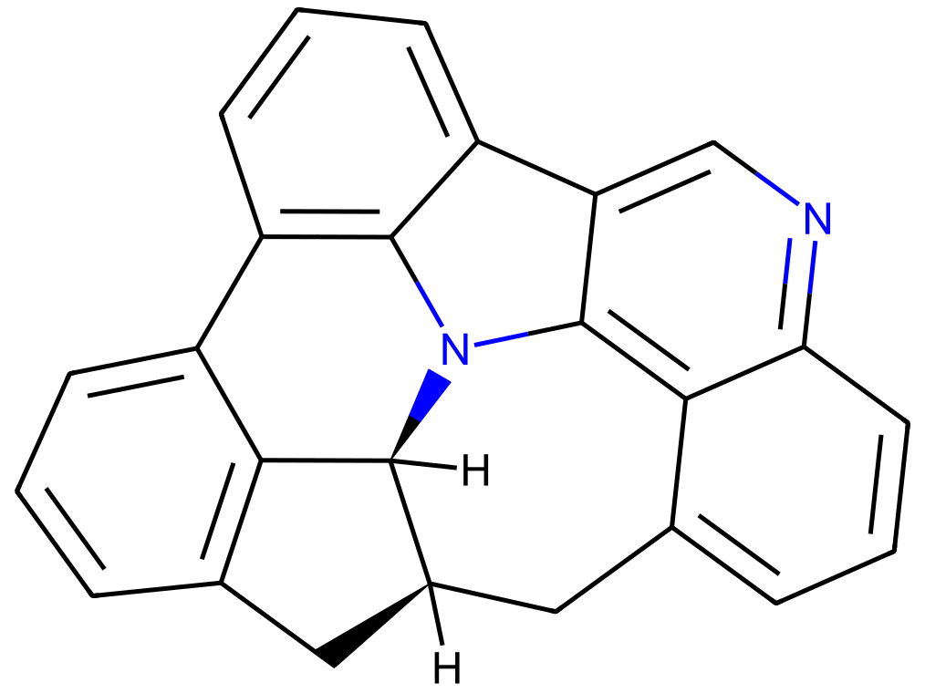
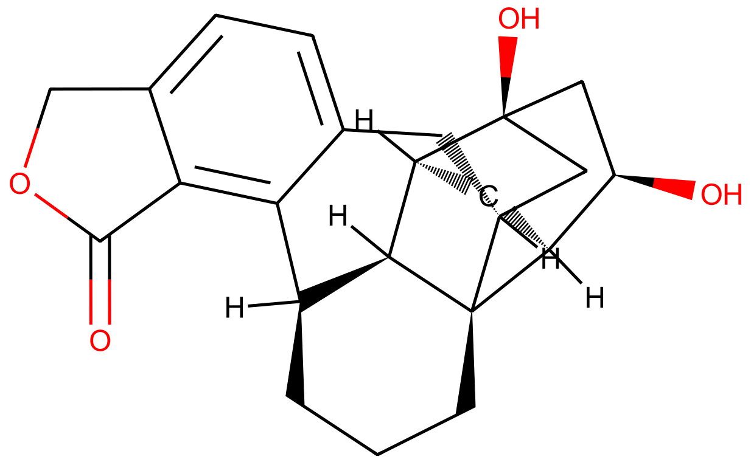
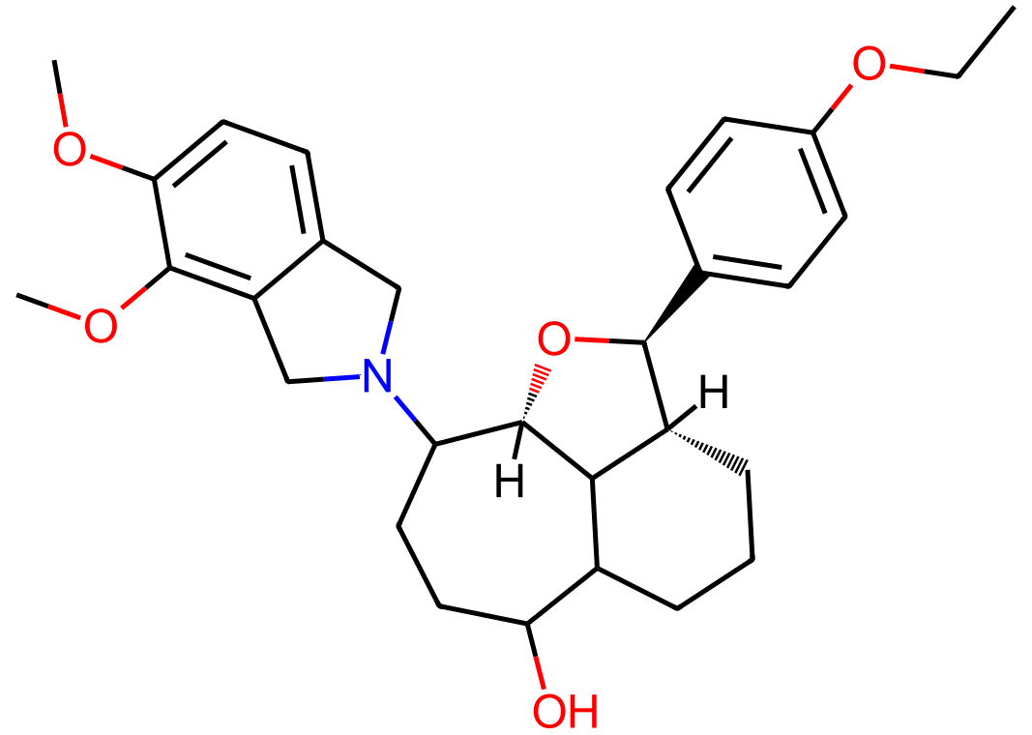
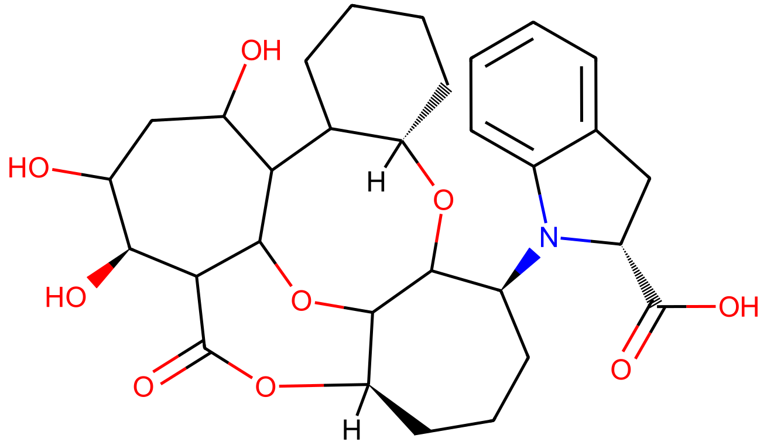
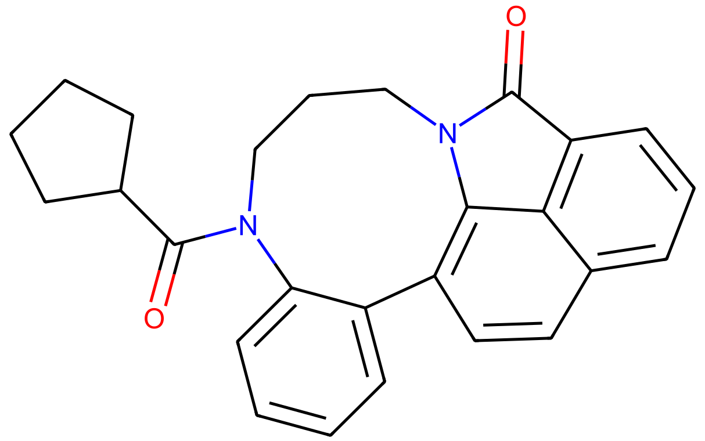
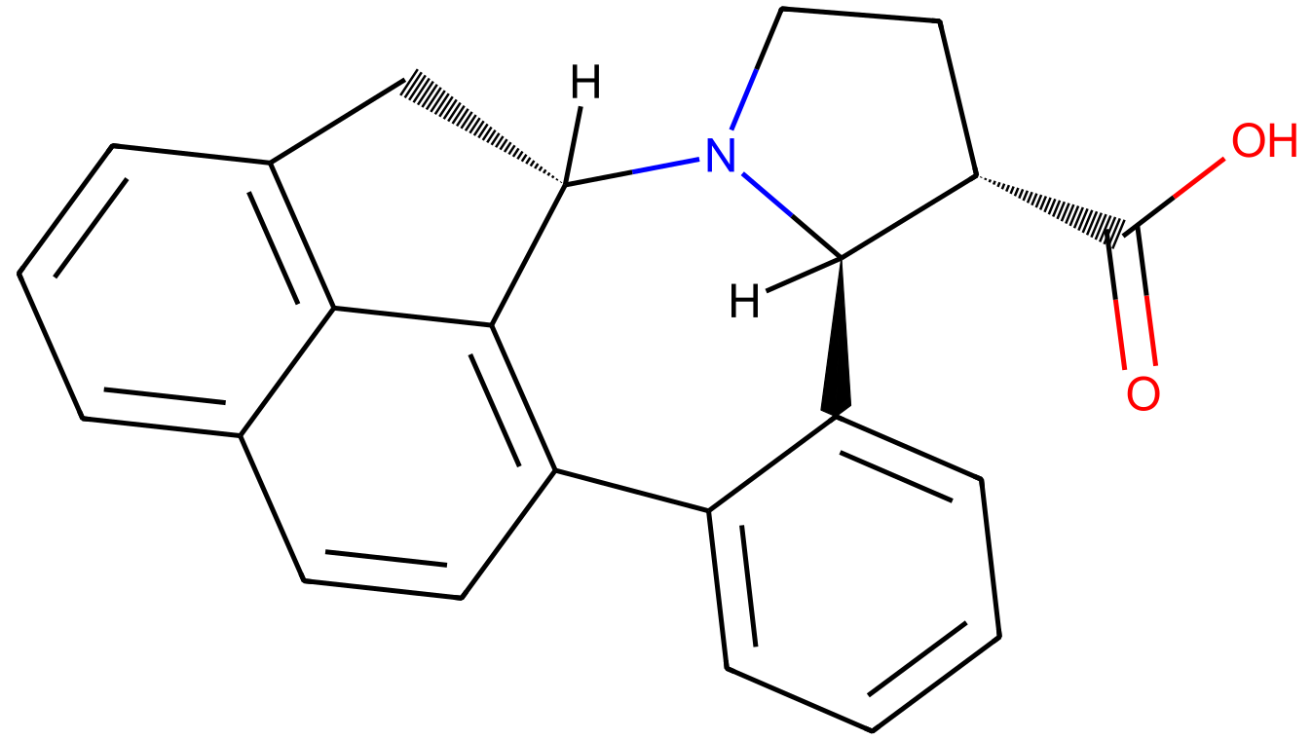
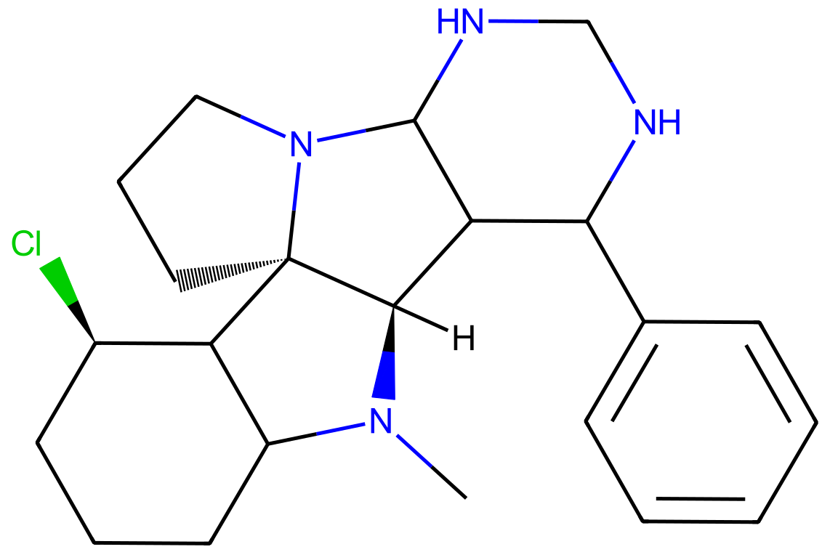
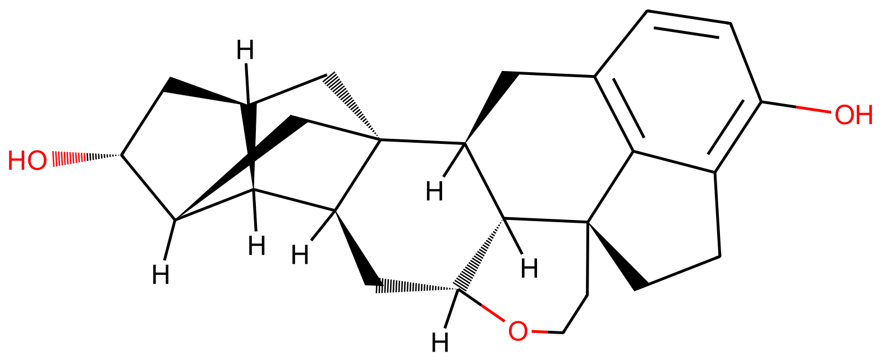
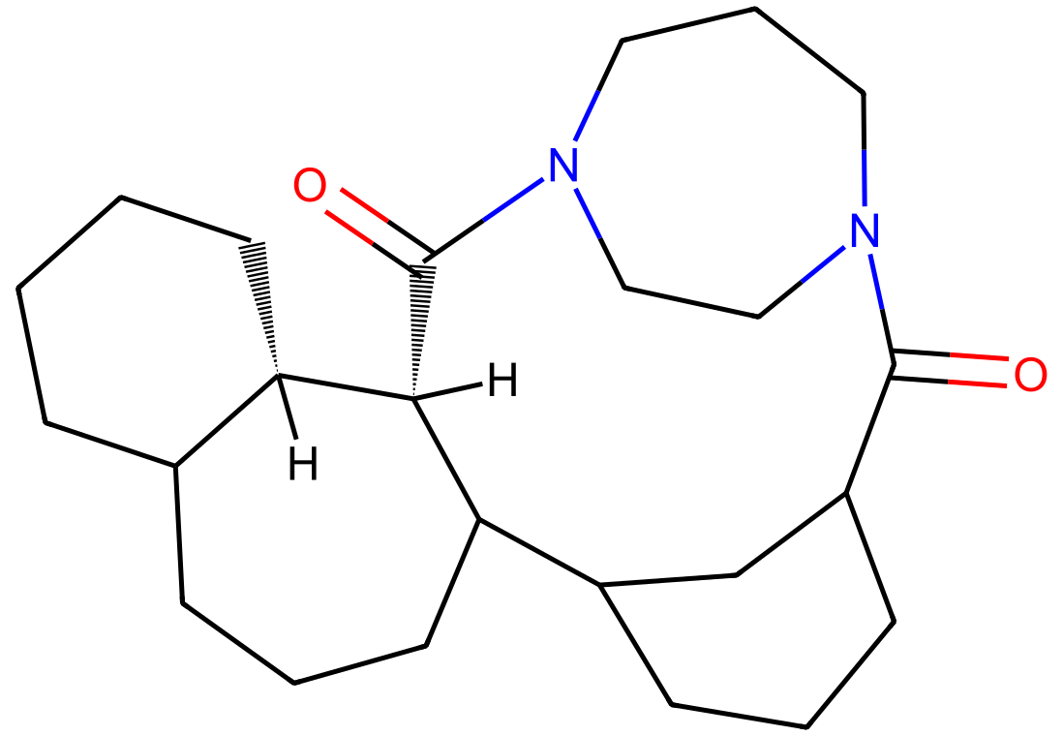
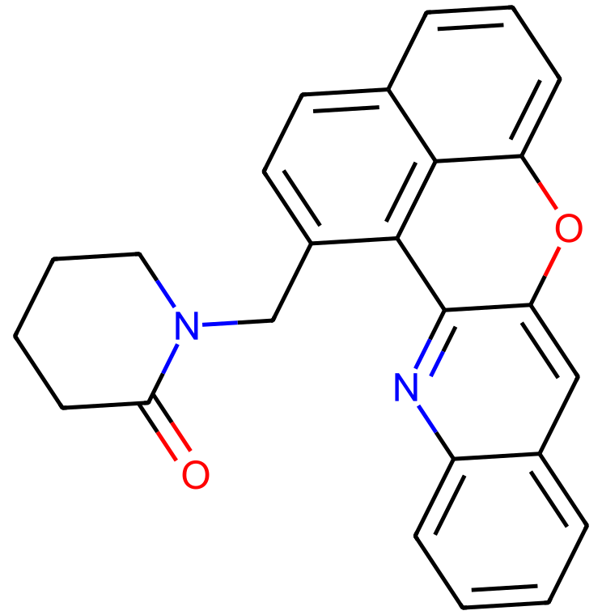
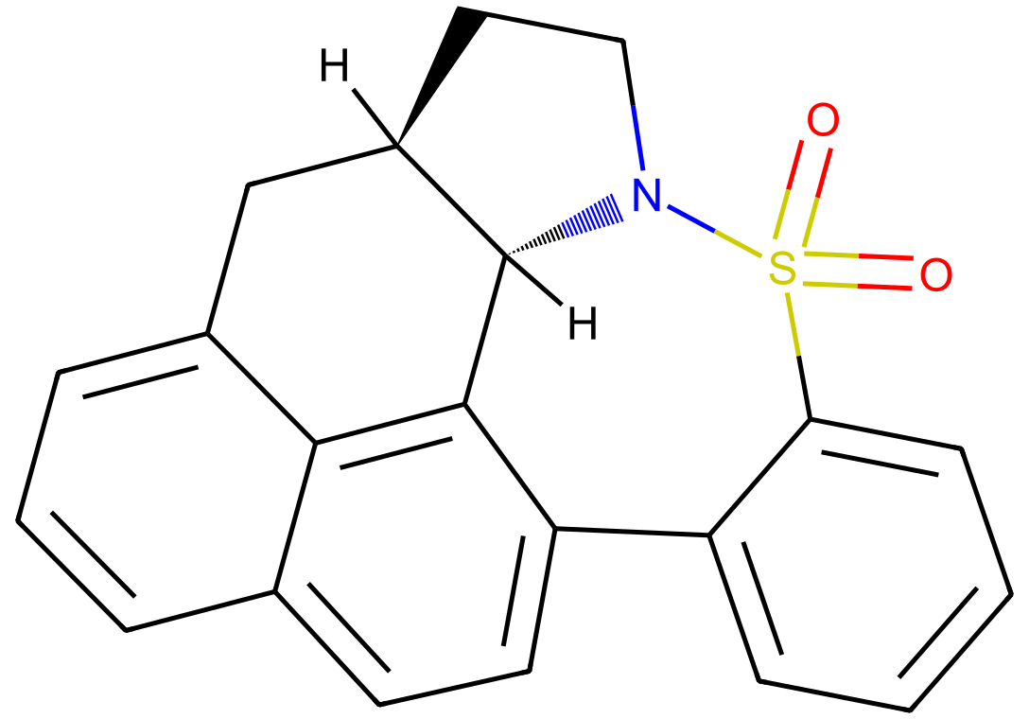
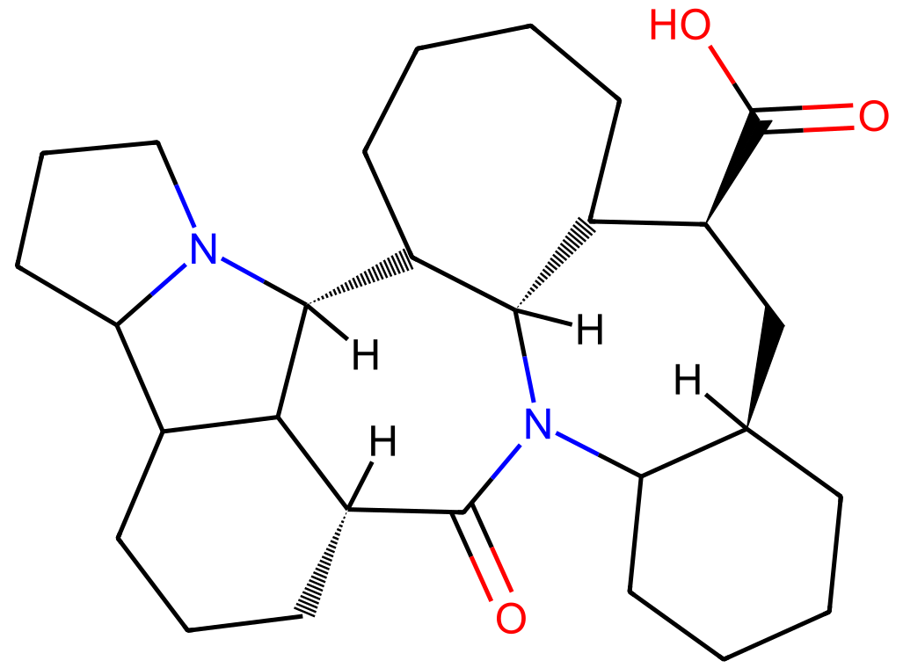
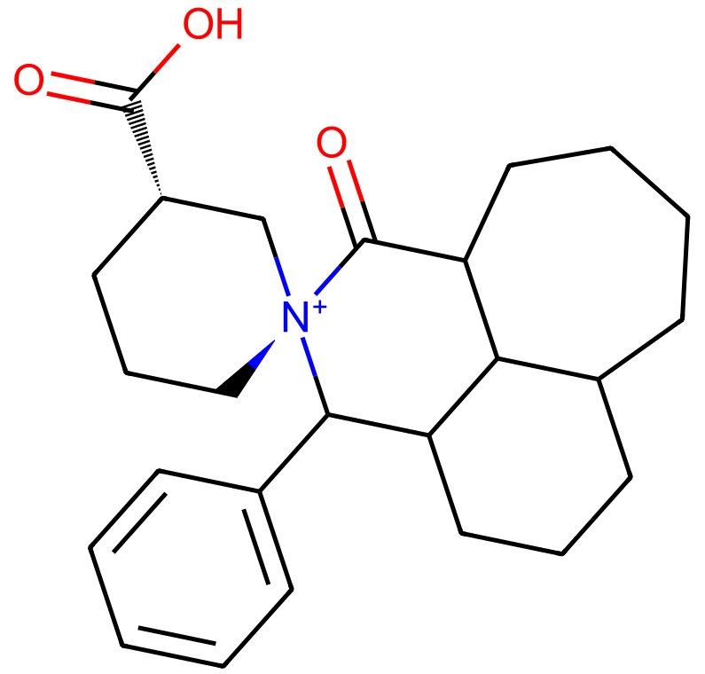
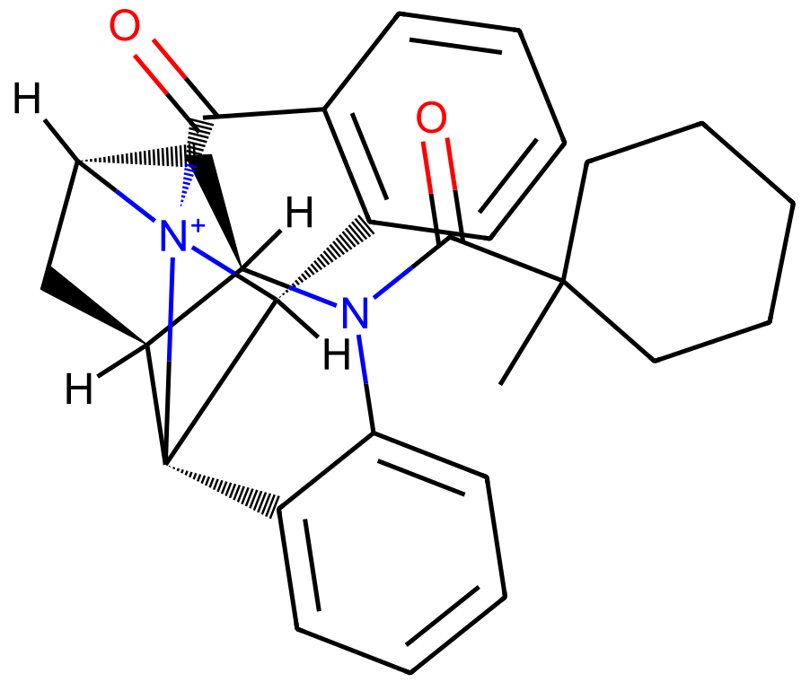
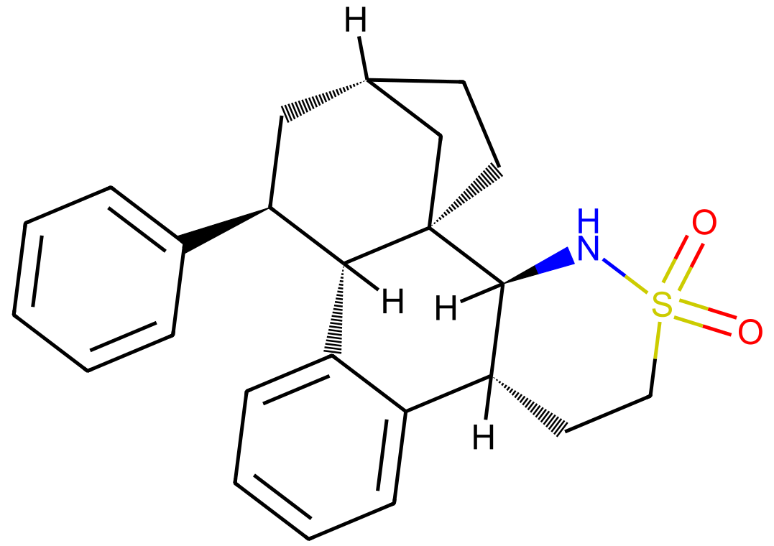
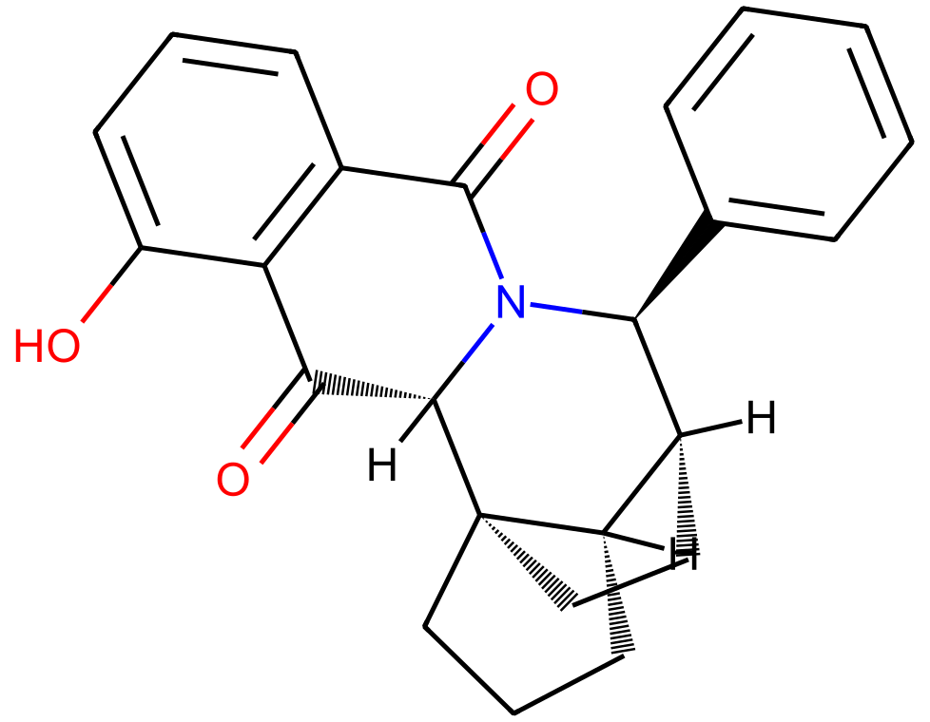
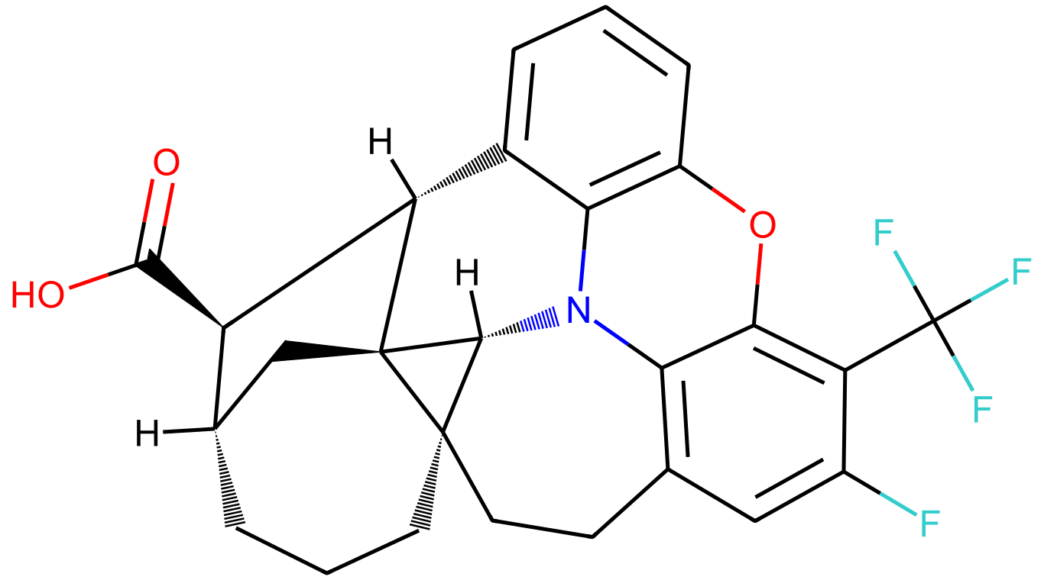
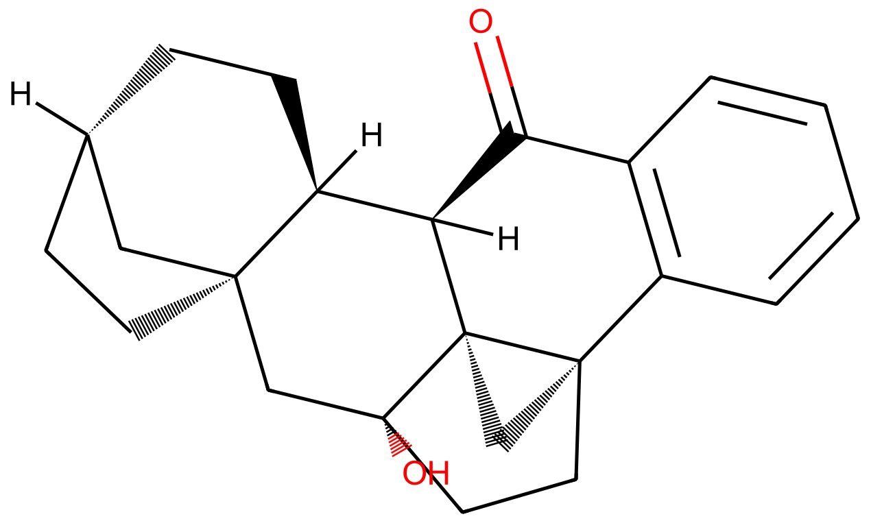
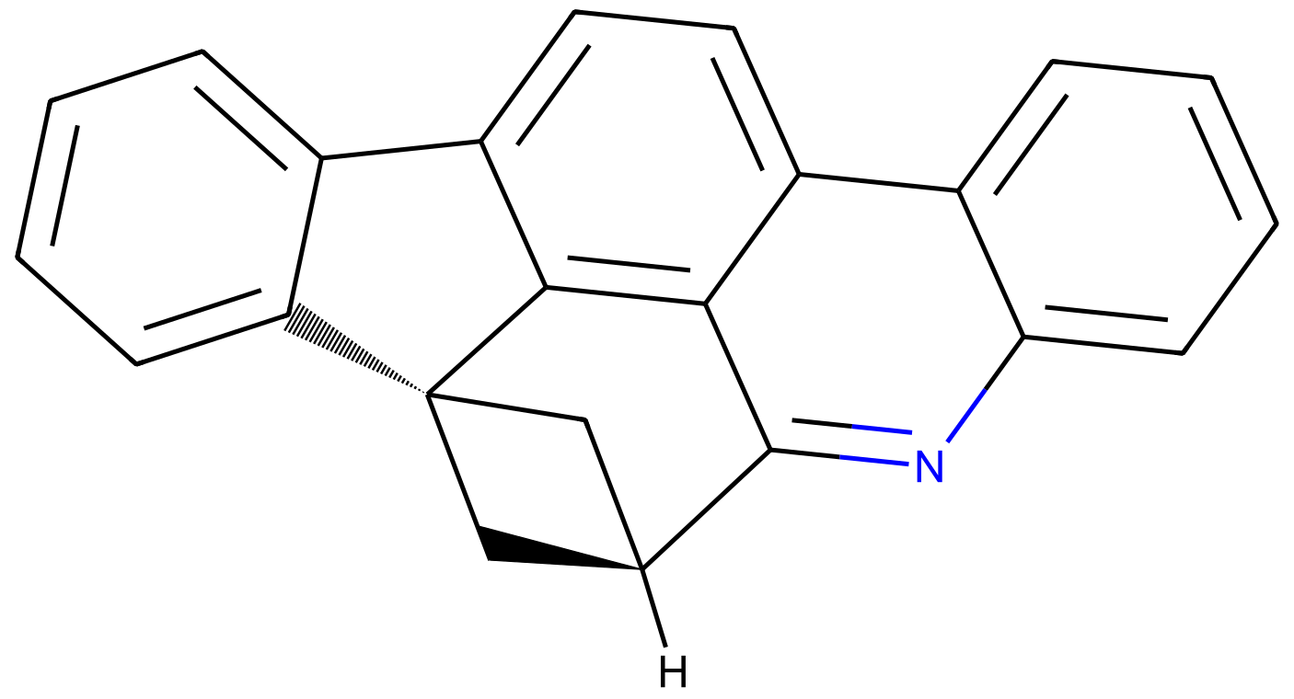
DiffGui Top 26-50
mol026
mol027
mol028
mol029
mol030
Docking score = -13.983
Docking score = -13.954
Docking score = -13.886
Docking score = -13.753
Docking score = -13.734
mol031
mol032
mol033
mol034
mol035
Docking score = -13.734
Docking score = -13.691
Docking score = -13.681
Docking score = -13.674
Docking score = -13.669
mol036
mol037
mol038
mol039
mol040
Docking score = -13.645
Docking score = -13.546
Docking score = -13.545
Docking score = -13.536
Docking score = -13.522
mol041
mol042
mol043
mol044
mol045
Docking score = -13.485
Docking score = -13.461
Docking score = -13.454
Docking score = -13.434
Docking score = -13.423
mol046
mol047
mol048
mol049
mol050
Docking score = -13.423
Docking score = -13.418
Docking score = -13.417
Docking score = -13.411
Docking score = -13.395

Slide 3

























DiffSBDD Top 1-25
mol001
mol002
mol003
mol004
mol005
Docking score = -13.850
Docking score = -13.468
Docking score = -13.050
Docking score = -12.998
Docking score = -12.878
mol006
mol007
mol008
mol009
mol010
Docking score = -12.686
Docking score = -12.510
Docking score = -12.484
Docking score = -12.451
Docking score = -12.347
mol011
mol012
mol013
mol014
mol015
Docking score = -12.265
Docking score = -12.228
Docking score = -12.222
Docking score = -12.202
Docking score = -12.186
mol016
mol017
mol018
mol019
mol020
Docking score = -12.108
Docking score = -12.089
Docking score = -12.068
Docking score = -11.949
Docking score = -11.928
mol021
mol022
mol023
mol024
mol025
Docking score = -11.914
Docking score = -11.901
Docking score = -11.885
Docking score = -11.836
Docking score = -11.794

Slide 4

























DiffSBDD Top 26-50
mol026
mol027
mol028
mol029
mol030
Docking score = -11.744
Docking score = -11.706
Docking score = -11.686
Docking score = -11.680
Docking score = -11.675
mol031
mol032
mol033
mol034
mol035
Docking score = -11.669
Docking score = -11.654
Docking score = -11.639
Docking score = -11.632
Docking score = -11.591
mol036
mol037
mol038
mol039
mol040
Docking score = -11.572
Docking score = -11.544
Docking score = -11.519
Docking score = -11.485
Docking score = -11.483
mol041
mol042
mol043
mol044
mol045
Docking score = -11.455
Docking score = -11.448
Docking score = -11.445
Docking score = -11.442
Docking score = -11.440
mol046
mol047
mol048
mol049
mol050
Docking score = -11.439
Docking score = -11.398
Docking score = -11.389
Docking score = -11.370
Docking score = -11.350

Slide 5




RE-CmeB(8GJL)_PAβN_vs_DiffGui_mol001
PAβN (cyan)
mol001 (yellow)
8GJL_PAβN_DiffGui_mol001 | PAβN -11.161 | mol001 -15.466
8GJL_DiffGui_mol001_2d_interaction

Slide 6



RE-CmeB(8GJL)_PAβN_vs_DiffSBDD_mol001
PAβN (cyan)
mol001 (yellow)
8GJL_PAβN_DiffSBDD_mol001 | PAβN -11.161 | mol001 -13.850
8GJL_DiffSBDD_mol001_2d_interaction

