Slide 1

Transformers, part 1
2021-01-12

Slide 2
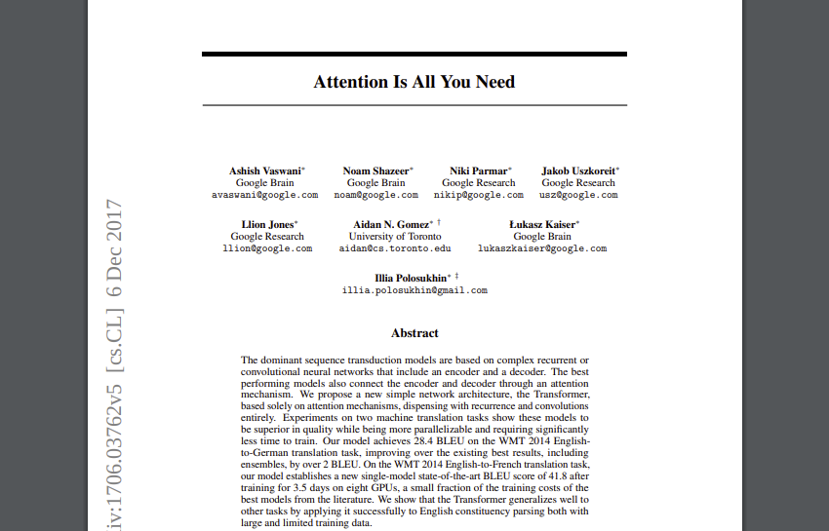
Paper, Vaswani et al. 2017
https://arxiv.org/pdf/1706.03762.pdf

Slide 3
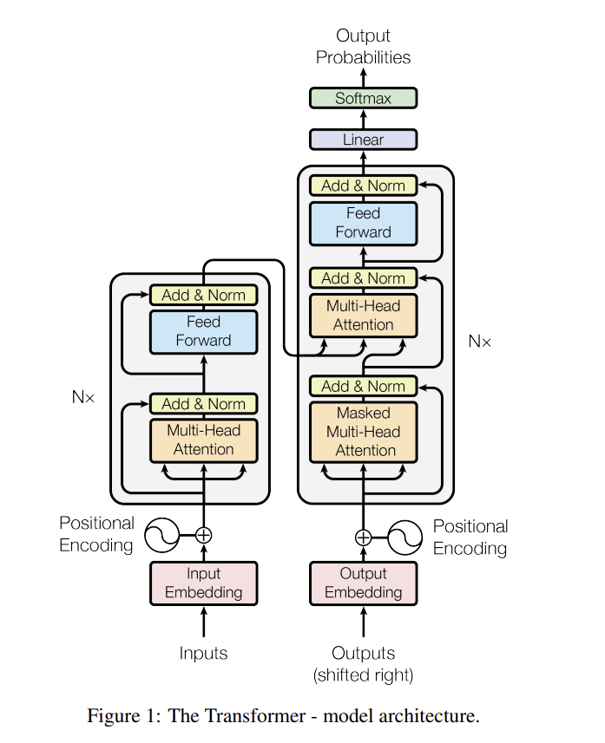
Architecture
Key features:
- Attention
- better results (translation)
- More parallelizable
- Less train-time
- Generalization to new
tasks
- ‘simple architecture’

Slide 4

Transformers in the news
Generative capabilities
https://mspoweruser.com/what-is-gpt-3-and-how-it-will-affect-your-current-job/

Slide 5
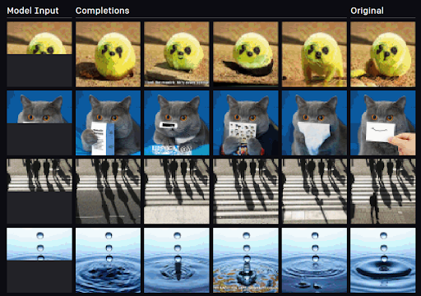
Transformers in the news

Slide 6
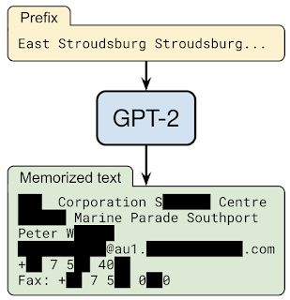
Privacy Considerations in Large Language Models
Trainend on large datasets that also contain sensitive data
including personally identifiable information names, phone numbers, addresses, etc.,

Slide 7
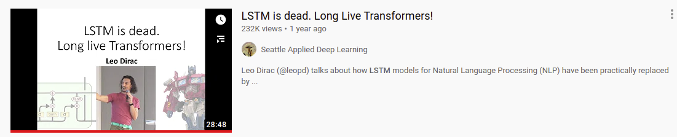
How does it work?

Slide 8
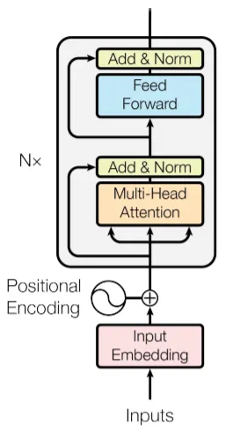
Step-by-step
Step-by-step
overview of
the encoder
part

Slide 9
Step-by-step
Transformer →
Pre-processing →

Slide 10
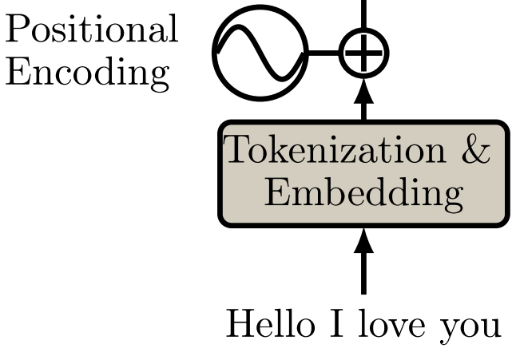
pre-processing

Slide 11
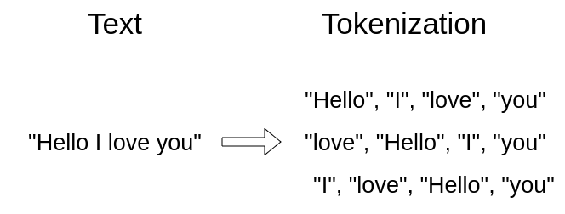
Input, variable size
Tokens represented as a ‘set’

Slide 12
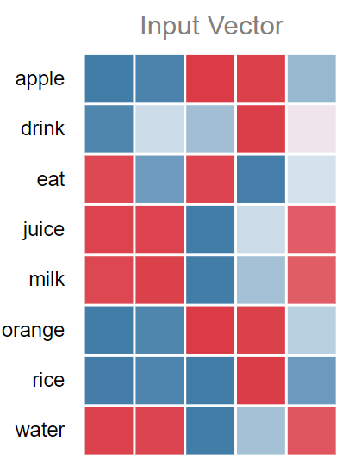
Word-embeddings
Words → vector embeddings
(list of learned numbers)
Pretrained on large text corpa:
  word2vec and Glove
Can also be learned by the
transformer!

Slide 13
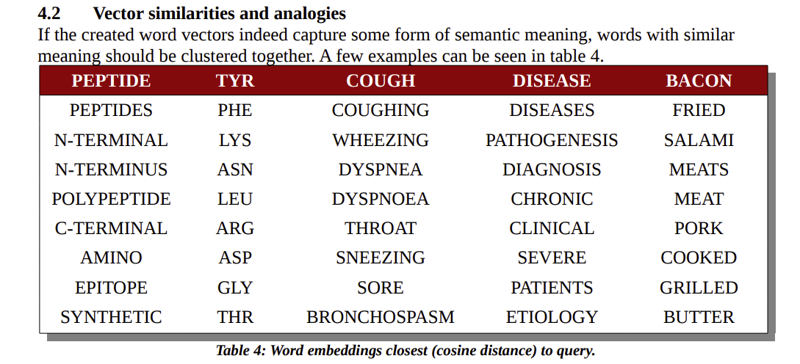
Similar words meanings, similar vectors

Slide 14
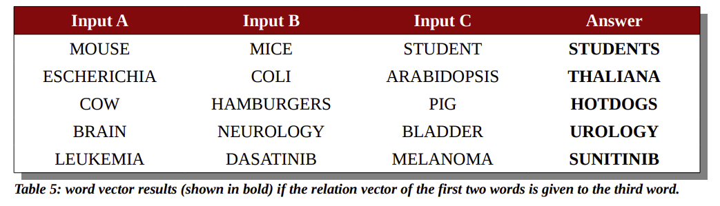
Wordvectors capture relations between words

Slide 15
Positional encoding

Slide 16
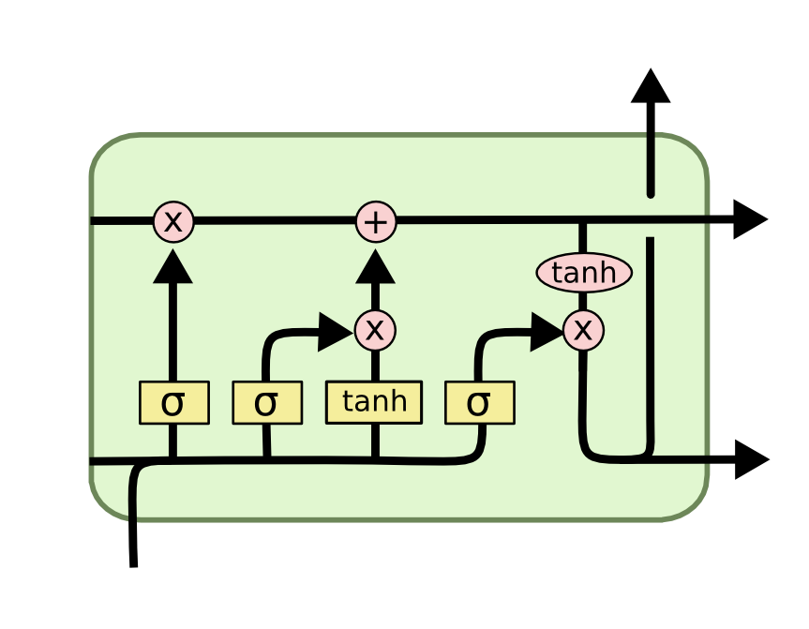
Location information
- RNNs process information sequentially using an internal memory
- first input, memory update, second input memory update…. last input, final memory

Slide 17
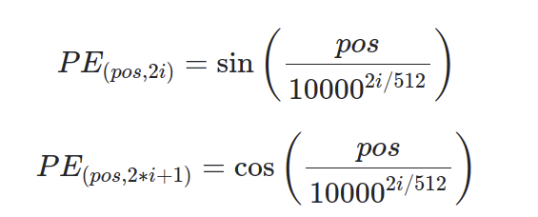
Location information
- Transformers use ‘positional encoding’
- Given the location of word in the sentence produce a vector representing that location
- This using Sin and Cos functions

Slide 18
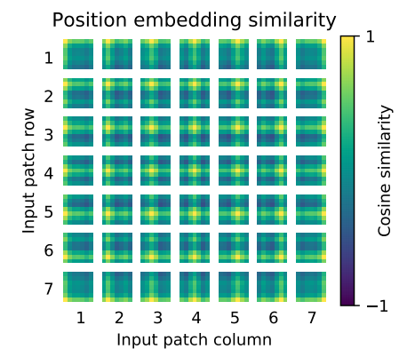
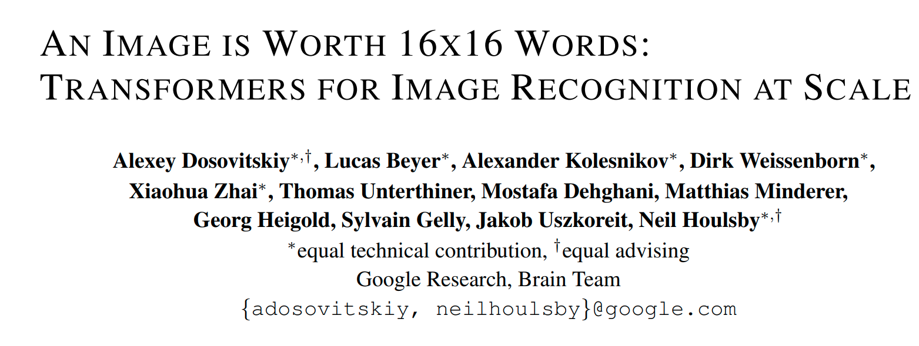
Location information
These ‘position embeddings’ can also be learned by the transformer

Slide 19
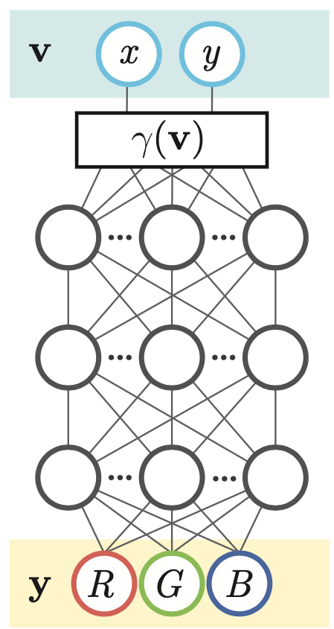
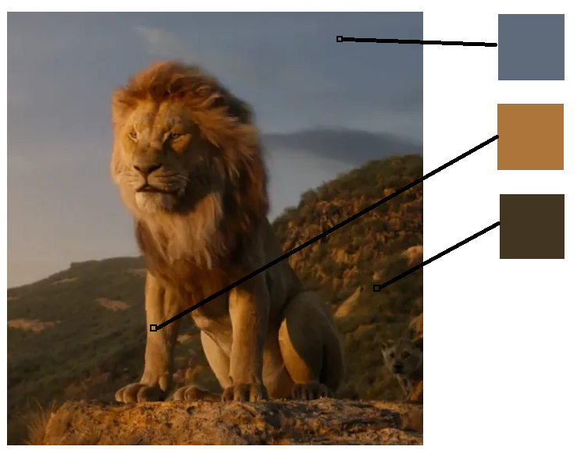
Neural networks have a "spectral bias" towards being smooth
Treat image as a ‘function’
Input: the x,y coordinates (normalize between 0-1)
Output: the RGB value on that location

Slide 20



Example
If position is represented as 2 real values (0-1)
GT output
Many many many neurons and parameters + weeks of training:

Slide 21

Example
If x and y positions are represented through random sin functions
GT output
takes seconds to train and much much better results!

Slide 22
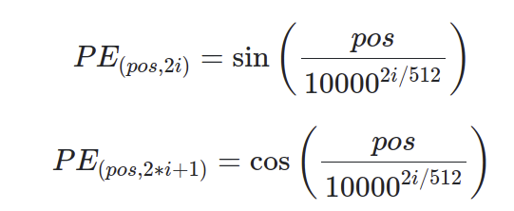
Formula

Slide 23
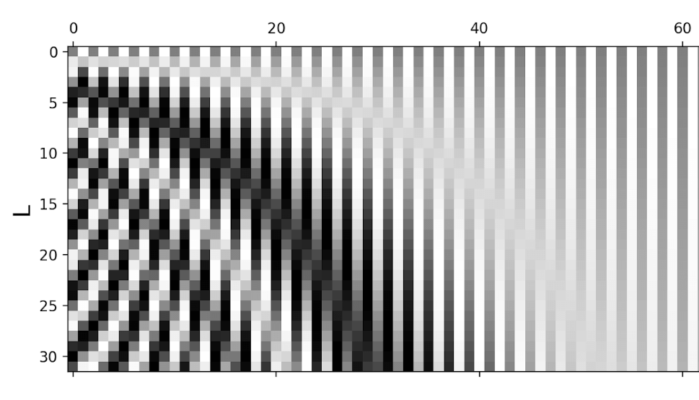
Make it visual
Visualization of the sinus function
https://lilianweng.github.io/lil-log/2020/04/07/the-transformer-family.html

Slide 24
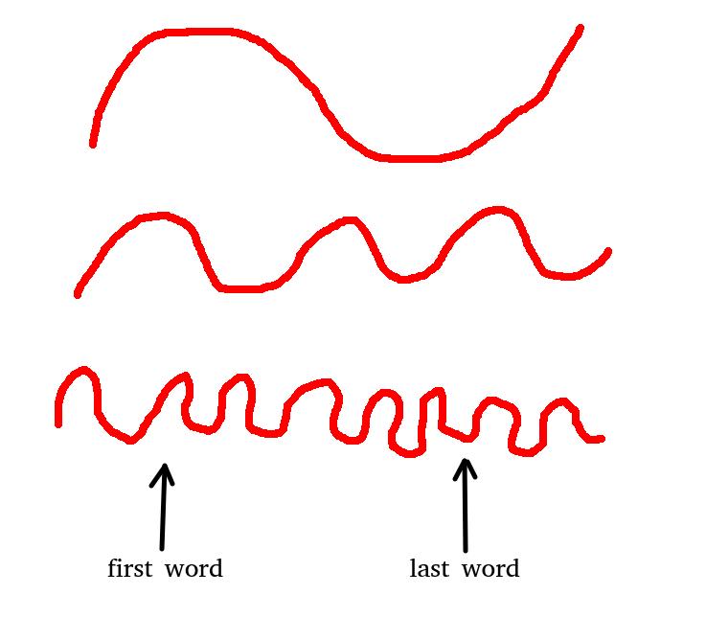
Different wavelengths
Give position information
Large wavelength gives rough estimation
Small wavelength precise information

Slide 25
Add the positional encodings to the word vectors
(not concatenate)

Slide 26
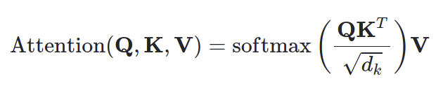
Next step
The actual transformer
This unit is often repeated multiple times
(no weight sharing!)

Slide 27
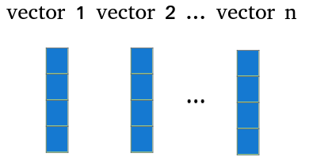
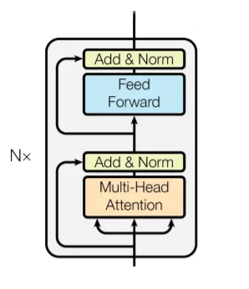
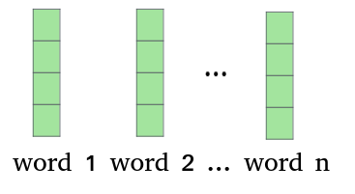
Input output
Before we go to the details
Same number of vectors come out as you put in with the same dimension!

Slide 28
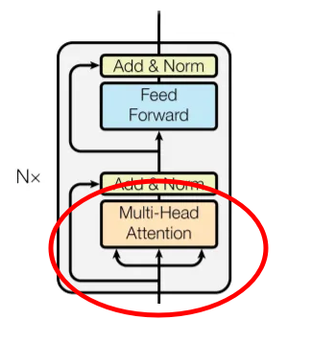
Next step
From the video we saw last week:
Key, query and value vectors were created for each of the inputs
Lets make it more intuitive before we go to the details

Slide 29

Keys queries values

Slide 30
Keys queries values

Slide 31
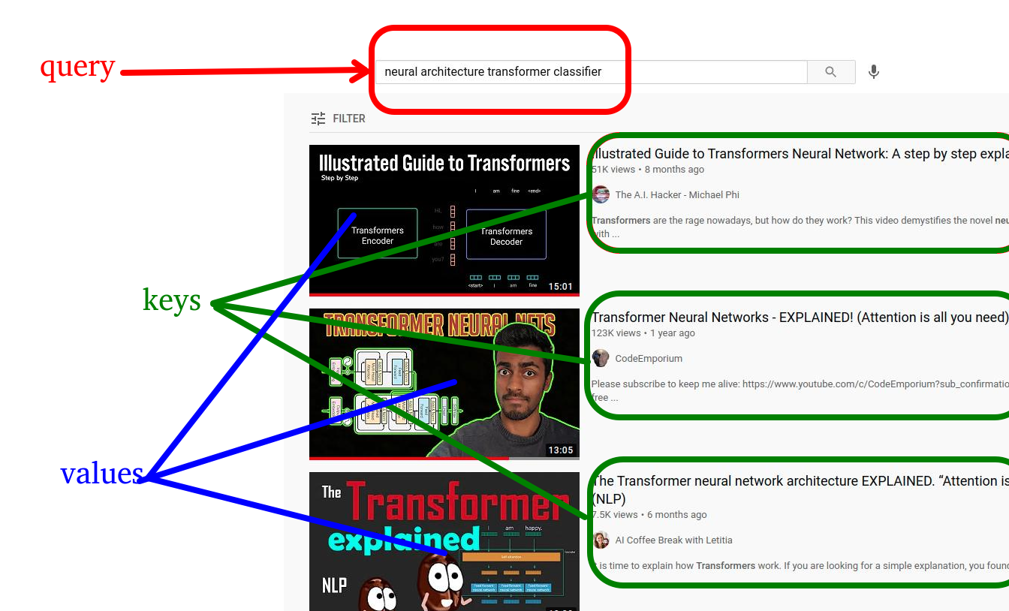
Keys queries values

Slide 32
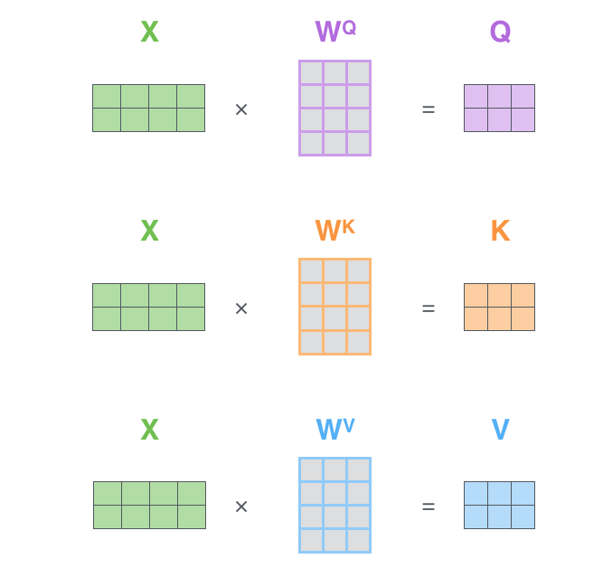
Query key value
For each input x (each word-embedding) create 3 vectors
One key vector, one query vector and one value vector
Can be done with simple linear layer
Mathematics to create these vectors is identical, only parameters differ
http://jalammar.github.io/illustrated-transformer/

Slide 33
Q K V
Video score is based on the overlap between key-words and query-words
The more your query matches the keys the better the video score
How to do this with vectors?

Slide 34
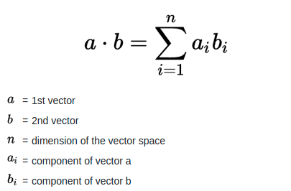
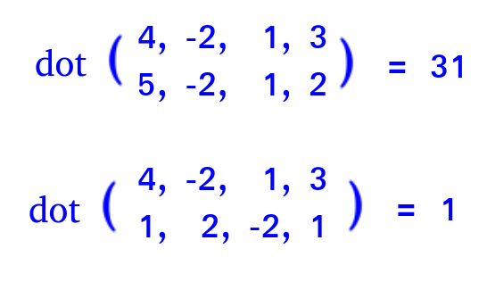
K Q
Simple, use the dot-product between the key and query vectors!
Example:

Slide 35
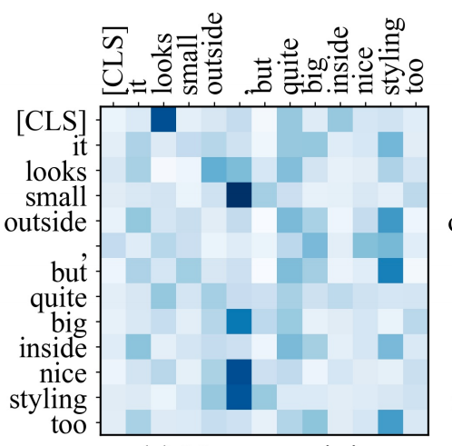
Match all key vectors against all query vectors
And use softmax to normalize the values between 0 and 1
https://www.aclweb.org/anthology/D19-1361.pdf

Slide 36
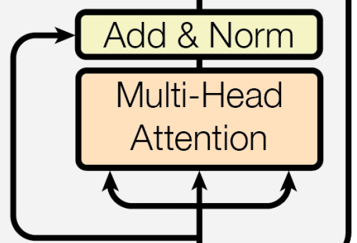
Multiheaded attention
Multi head?
Instead of three big vectors for key query and values
Make multiple small ones and concatenate the results together
Each subpart can learn to focus on something different
Each subpart has own softmax that sums to 1 which makes it harder to only focus on single value vector

Slide 37
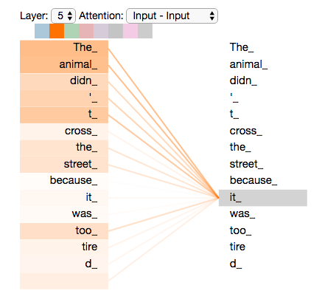
For each word, how much attention

Slide 38
Take
Use this as ‘attention’ to the value-vectors
(root(dk) is to stabilize the gradients)

Slide 39
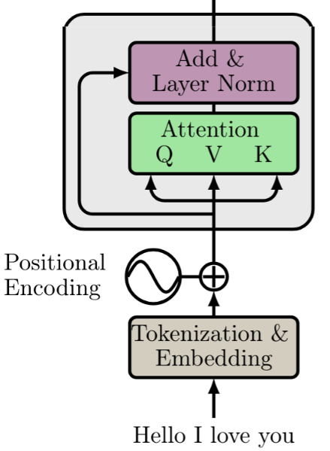
Skip connections
Add (not concatenate) these new vectors to the original input vectors and normalize

Slide 40
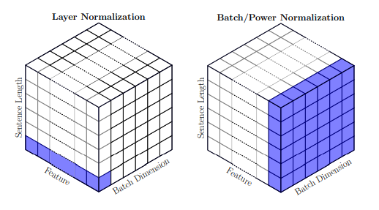
Layer normalization
With batch-norm: normalize over the batch
→ for each feature subtract mean and divide by std
With Layer-norm
Normalize over the layer
→ for each layer normalize all outputs (before activation)
Not dependent on batches, same output in training or evaluation mode

Slide 41
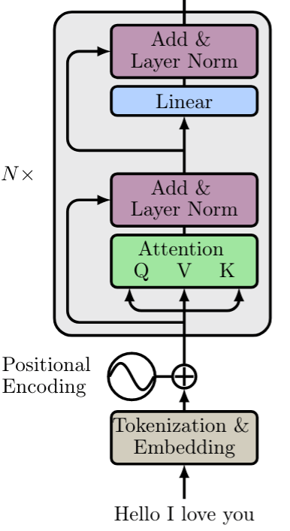
After attention part,
Linear layers part
Standard resnet architecture
Input → 2 or more layers →
skip connection → normalization

Slide 42
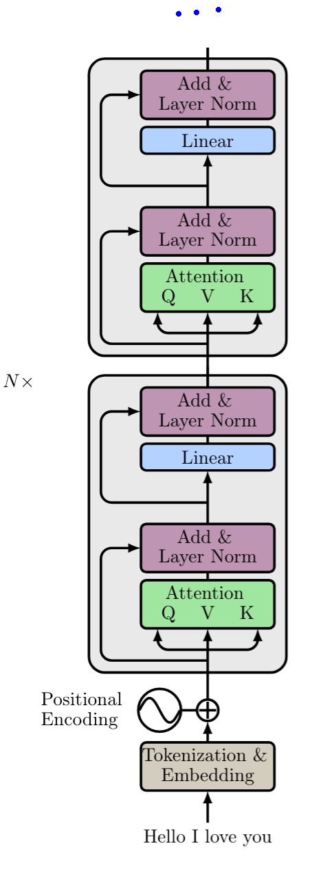
Often multiple transformer blocks are used
Original paper used 6 of these blocks

Slide 43
Classification
How many outputs?
How would you do classification?
(using this architecture)
?

Slide 44
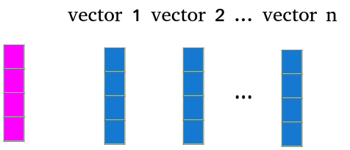
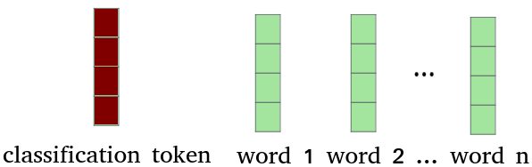
Classification
Add a ‘special classification token’
Take last representation of this token and use simple linear layer followed by softmax to get the classifier
(or without softmax for regression problems)

Slide 45
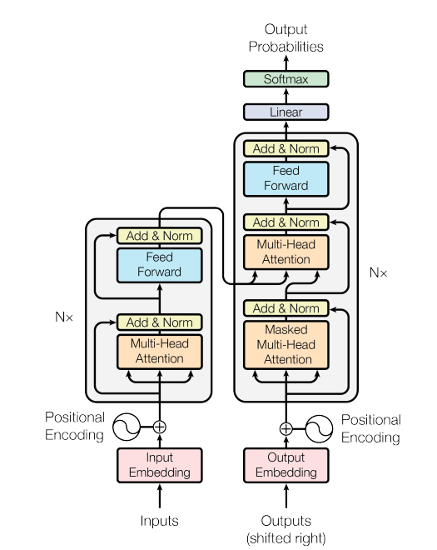
Next week
Generative transformers
Plus demo of how to code a
transformer in pytorch

