Slide 1
1D FT
Flatten 2D image to 1D signal

Slide 2







xyz vs. FT
FT on the input position and then provide FT waves to NN as input
NN input: position of pixels, e.g. 1, 2, …
Epoch 0
Epoch 1000
Epoch 3000
Epoch 100
Epoch 200
Epoch 400
Epoch 3000

Slide 3
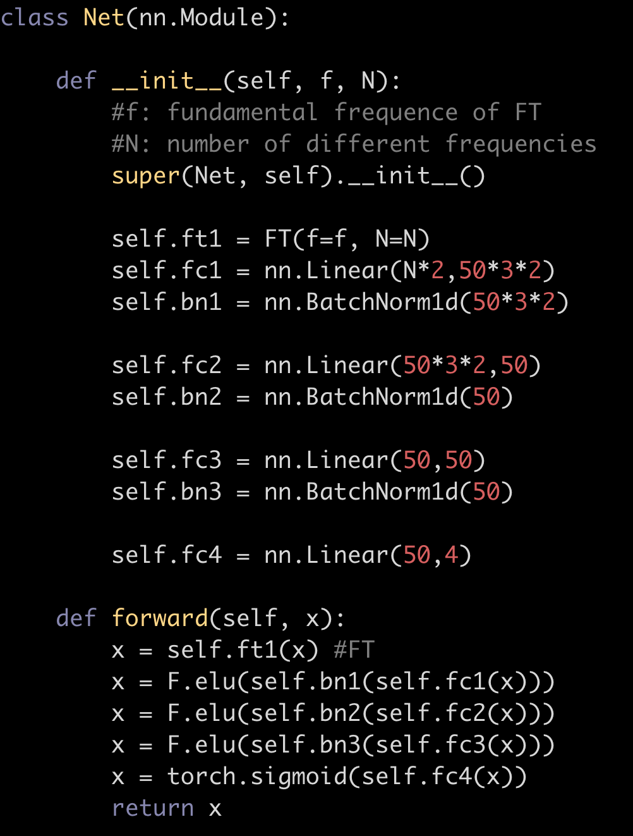
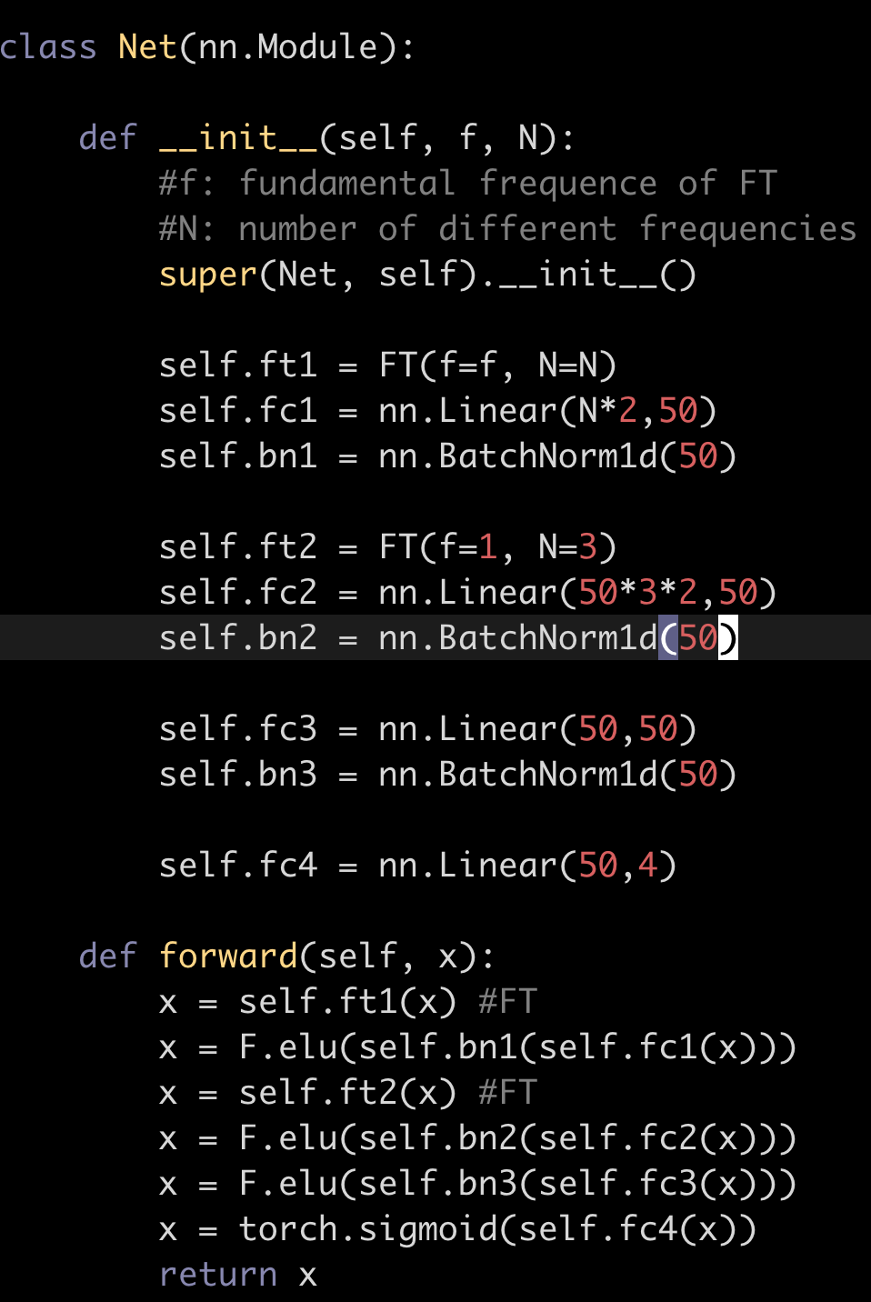



Use FT as filter to capture 2D correlations
FT on only the input layer
FT on two layers
Epoch 100
Epoch 200
Epoch 400
Epoch 3000

Slide 4



Complete wave vs. incomplete wave
Incomplete wave (big frequency)
Complete wave
Epoch 450
Fundamental frequency = 1
Input: 1, 2, …, 128 x 128
Epoch 450
Fundamental frequency = 1/(128x128) so that complete waves are used
Input: 1,2,...,128 x 128
Actual
The image (128 x 128) is first flattened into 1D vector V

Slide 5



Complete wave vs. incomplete wave
Incomplete wave (small frequency)
Complete wave
Fundamental frequency f = 1/(128x128x128x3)
Input: 1, 2, …, 128 x 128
Fundamental frequency f = 1/(128x128) so that complete waves are used
Input: 1,2,...,128 x 128
Epoch 100
Epoch 200
Epoch 400
The image (128 x 128) is first flattened into 1D vector V

