Slide 1
ResNets
Week 5

Slide 2
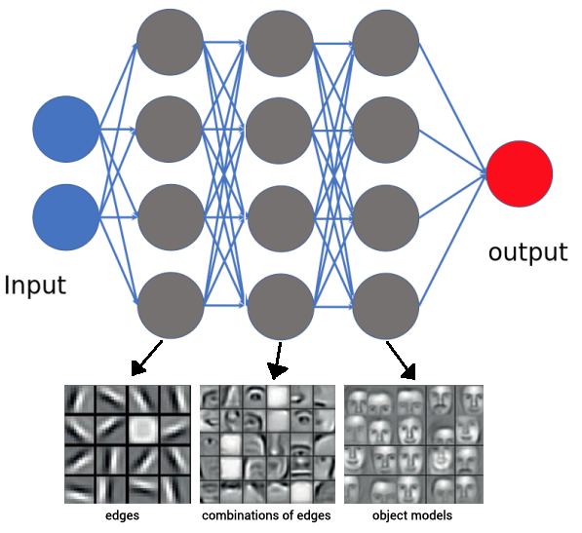
Standard neural network
Normally:
  Each hidden layer is a completely new representation of the input

Slide 3
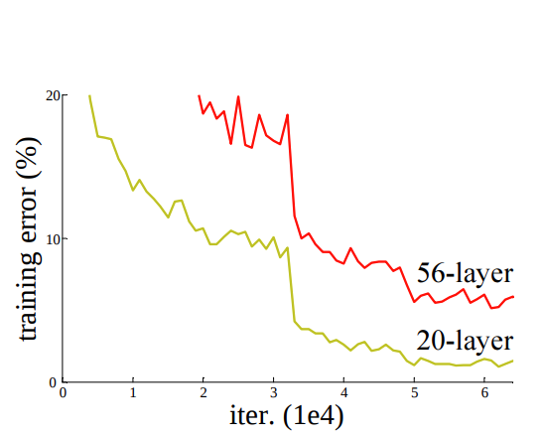
More layers
More layers, worse performance?
https://arxiv.org/pdf/1512.03385.pdf

Slide 4
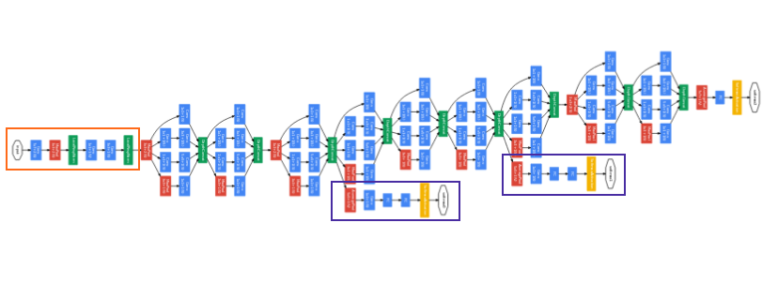
Limits
~20 layers = max performance
https://research.google/pubs/pub43022/

Slide 5
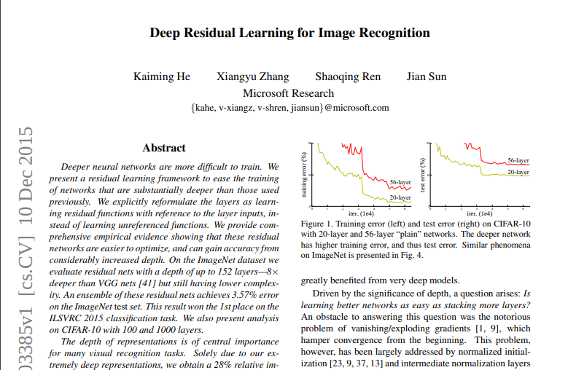
Paper 2015

Slide 6
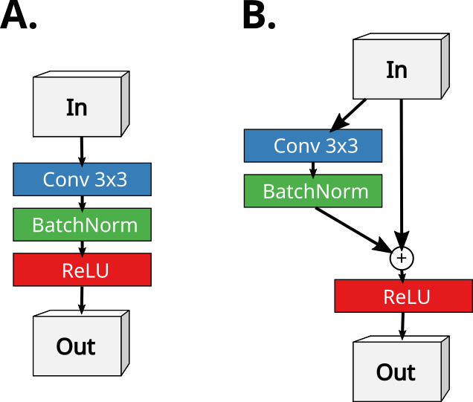
“Normal” vs residual networks
http://neural.vision/blog/article-reviews/deep-learning/he-resnet-2015/

Slide 7
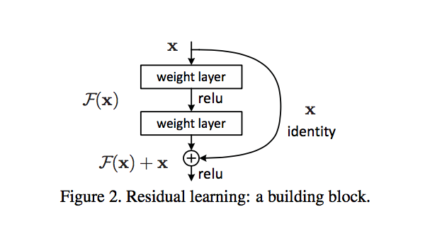
Residual network
With ResNets:
  Blocks, each block learns how to modify the input slightly.
  (in contrast to creating a completely new representation)
  input and output should have same dimension of course :)
https://arxiv.org/pdf/1512.03385.pdf

Slide 8
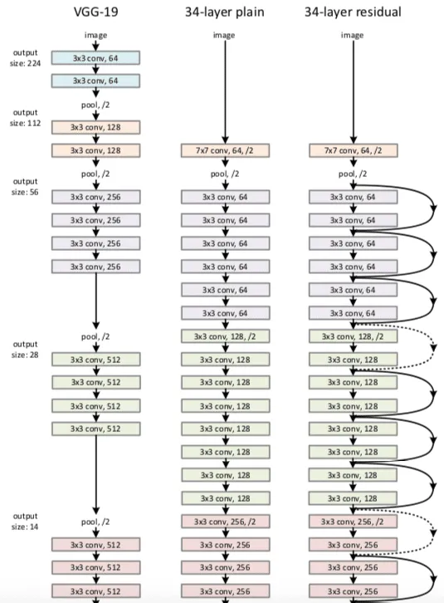
Resnet

Slide 9
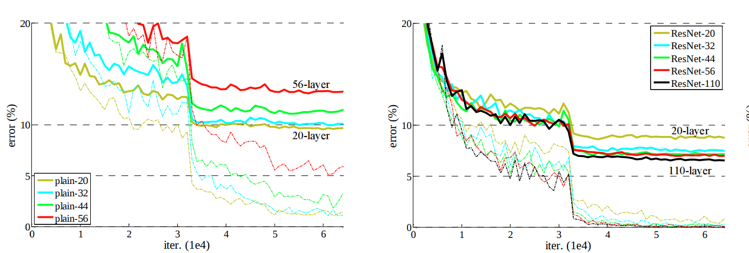
Normal vs ResNet
Normal network ResNet
https://arxiv.org/pdf/1512.03385.pdf

Slide 10
Why?
- You don’t need 100 layers of abstraction..
- Can learn identity function
- preserve the gradient(through identity func.)

Slide 11
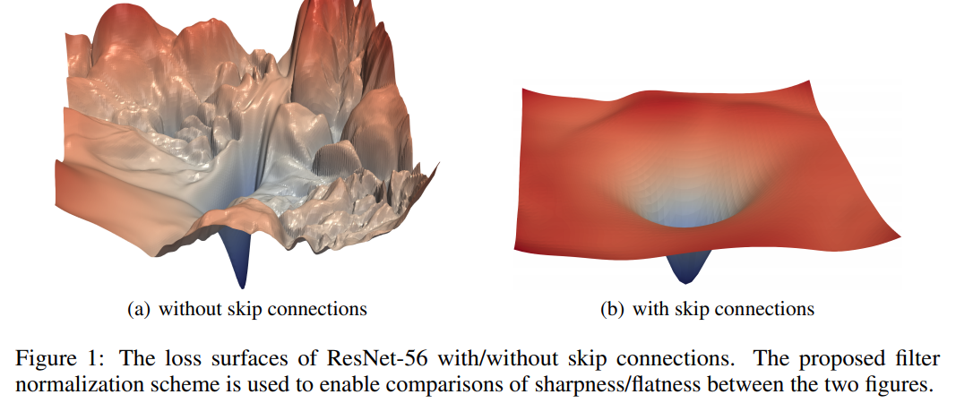
Loss space
https://papers.nips.cc/paper/7875-visualizing-the-loss-landscape-of-neural-nets.pdf

Slide 12
Summary
ResNet can help to build very ‘deep’ neural networks
In practice however, normal CNN’s will do fine
Next week, autoencoders?

