Slide 1
Week 7
VAE

Slide 2
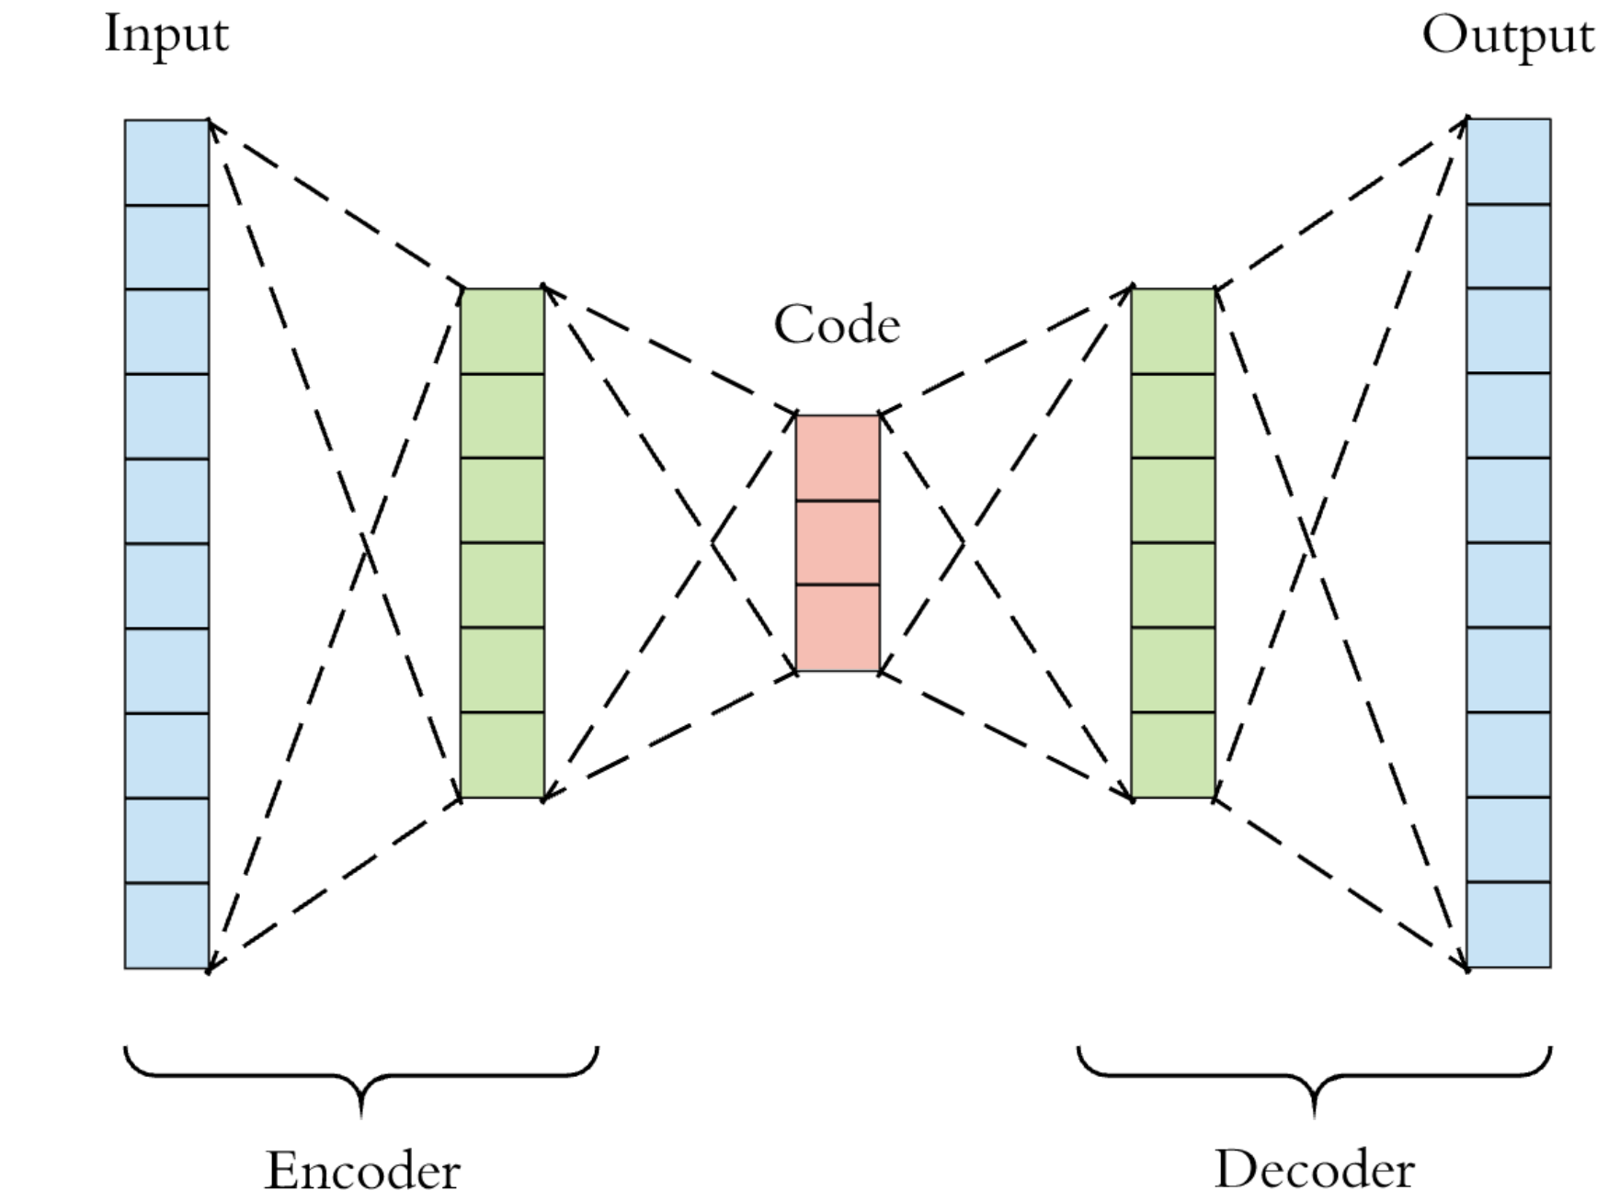
Autoencoder
https://blog.paperspace.com/autoencoder-image-compression-keras/

Slide 3
Autoencoder
Convolutional or linear layers
https://blog.paperspace.com/autoencoder-image-compression-keras/

Slide 4
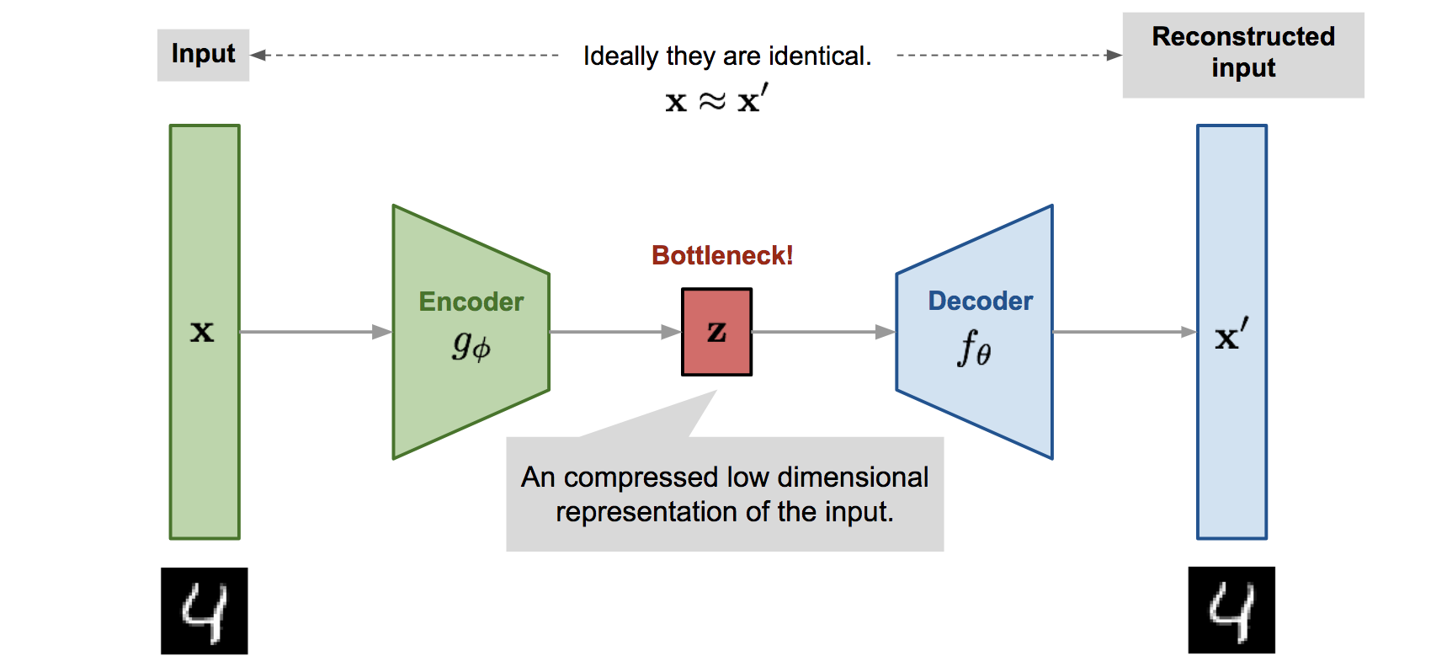
https://lilianweng.github.io/lil-log/2018/08/12/from-autoencoder-to-beta-vae.html

Slide 5
Many names:
  Code
  Embedding
  Feature-vector
  Latent-vector
  Z

Slide 6
Normal autoencoder
https://lilianweng.github.io/lil-log/2018/08/12/from-autoencoder-to-beta-vae.html

Slide 7
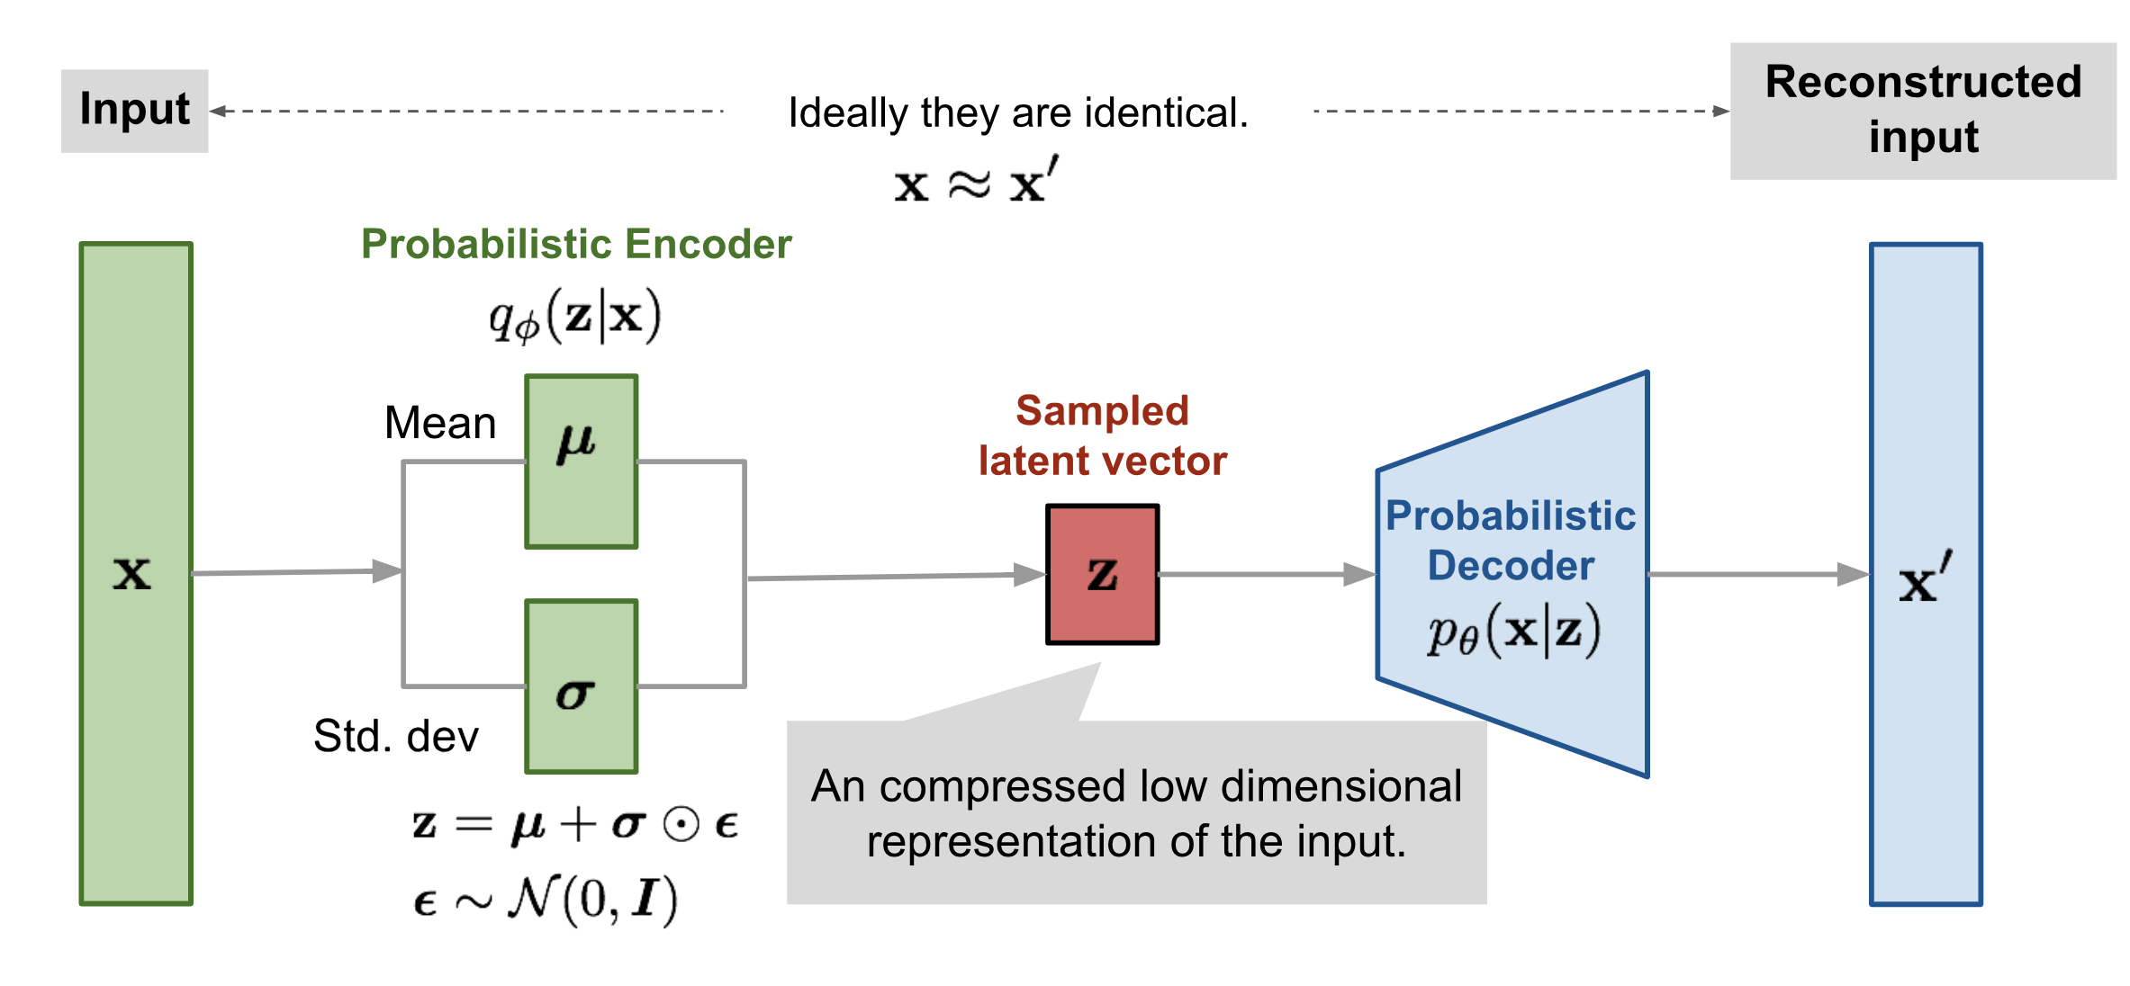
VAE
https://lilianweng.github.io/lil-log/2018/08/12/from-autoencoder-to-beta-vae.html

Slide 8
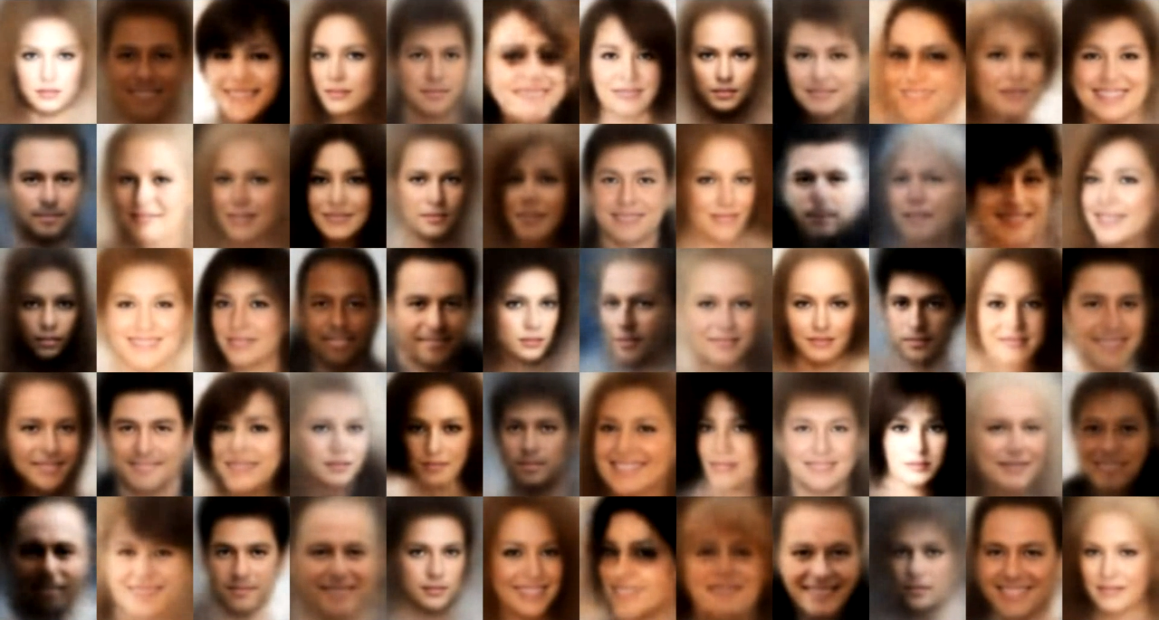
examples
https://github.com/WojciechMormul/vae

