Slide 1
Week 12
1x1 convolutions

Slide 2
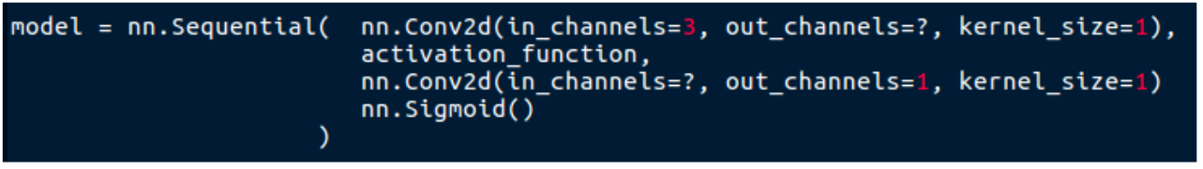
Last time
- Skin detection
- 1 label per photo
- Each pixels ‘votes’ if it is a skin pixel or not based on its (rgb) features
- Average vote determines the photo label
- NN learnes which pixels are skin

Slide 3
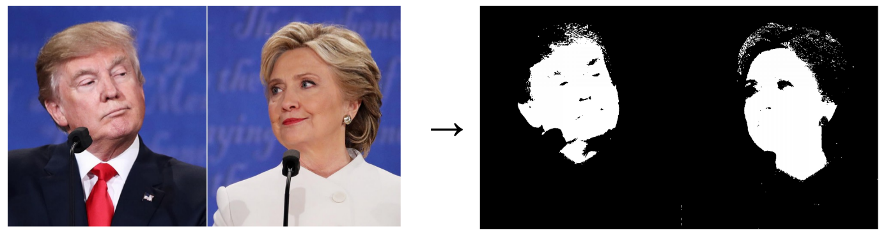
Homework
Data pre-processing

Slide 4
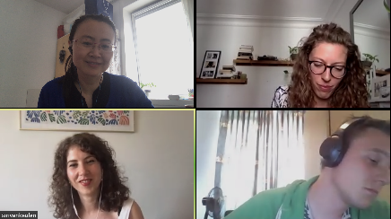
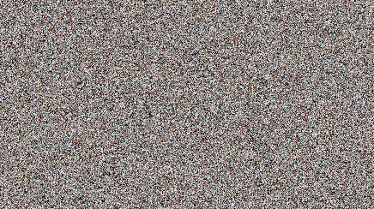
shuffling
Shuffling all the pixels randomly will result in exactly THE SAME learned network

Slide 5
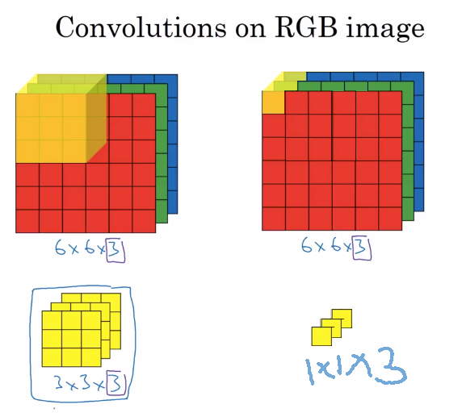
1x1 convolution

Slide 6
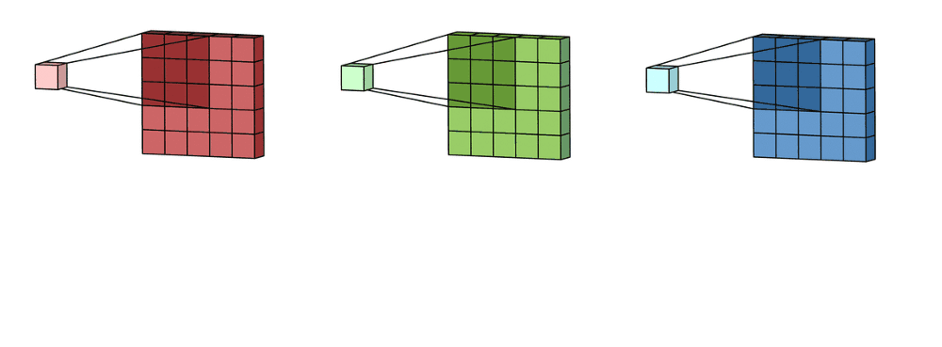
Normal convolutions
Input of image classification is always RGB.
But is RGB the best to represent colors?
Are there better color spaces?
https://towardsdatascience.com/a-comprehensive-introduction-to-different-types-of-convolutions-in-deep-learning-669281e58215

Slide 7
Colorspaces
RGB → red, green, and blue light are added together in various ways to reproduce a broad array of colors
LAB:
Defined by the International Commission on Illumination (CIE) in 1976
“predicts which spectral power distributions will be perceived as the same color”

Slide 8
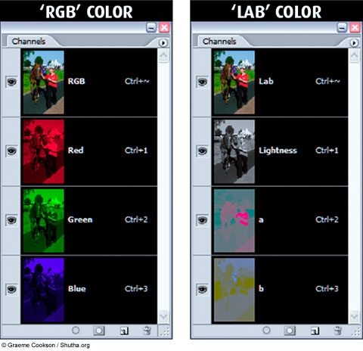
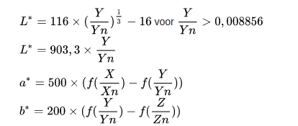
Color spaces
RGB → LAB

Slide 9
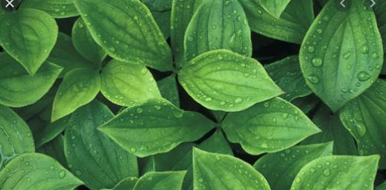
We see all these ‘greens’ as the same color with different brightness

Slide 10
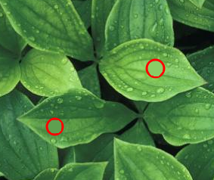
Colors RGB
Pixel values, visually very small differences
R G B
138 205 102
R G B
94 159 79
Range:
R 0 → 255
G 0 → 255
B 0 → 255

Slide 11


Colors LAB
Pixel values, in lab color space are now also similar :)
L A B
76 -39 44
L A B
59 -37 35
Range:
L : 1 → 100
A : -110 → +110
B : -110 → +110

Slide 12



Example use
With different colorspaces you can easily change only the ‘color’ information

Slide 13
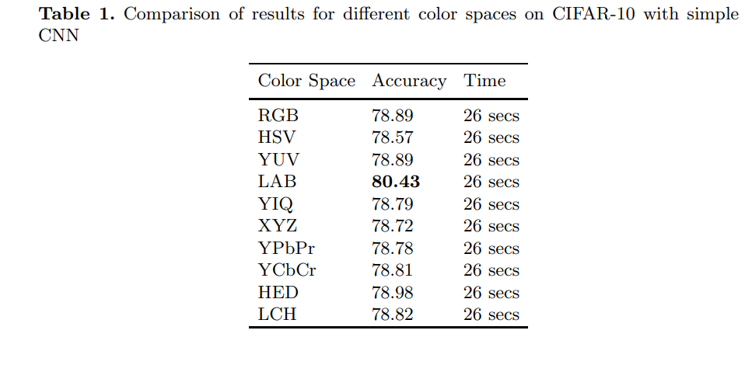
Helps also with deep learning
https://arxiv.org/pdf/1902.00267.pdf

Slide 14
Learning
Carefully designed...
But can also be learned by deep learning…
How? 1X1 convolutions

Slide 15
Example of learned colorspace

Slide 16


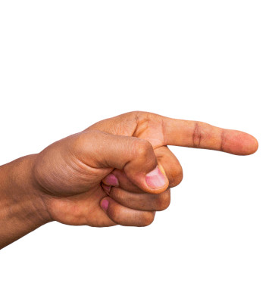
Example of skin detection
One example could be background removal to make gesture recognition easier...

Slide 17
Other use for 1x1 convolution

Slide 18
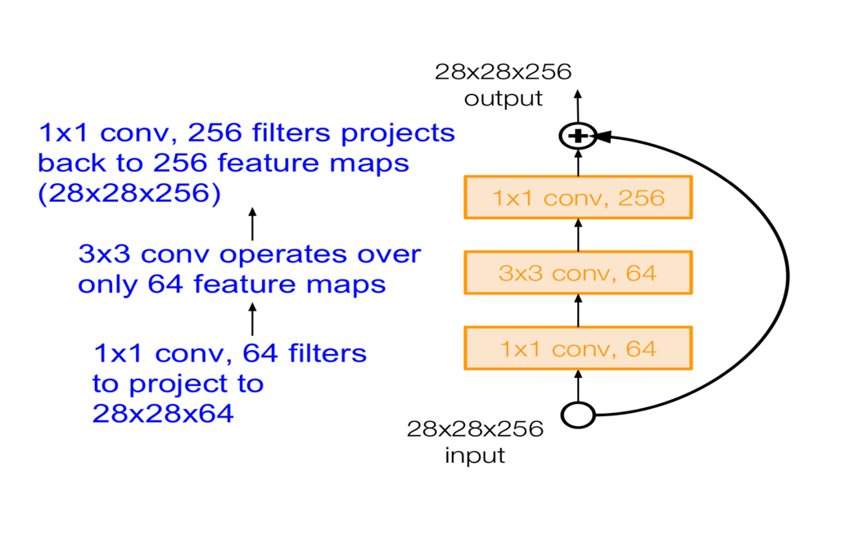
Data compression
https://medium.com/analytics-vidhya/talented-mr-1x1-comprehensive-look-at-1x1-convolution-in-deep-learning-f6b355825578

Slide 19
Dimension reduction
3x3 calculations
are expensive
Keeps height and
width of image
but reduce nmbr
of features

Slide 20
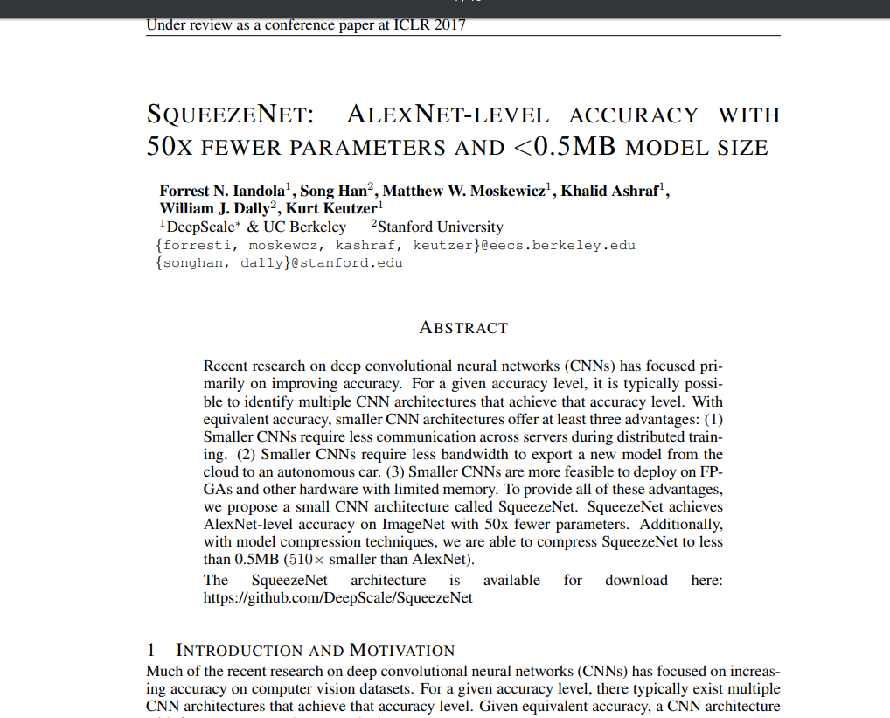

Slide 21
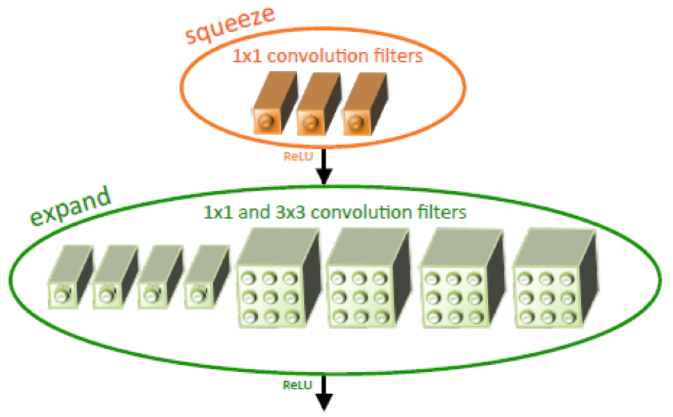
Paper
https://openreview.net/pdf?id=S1xh5sYgx

Slide 22
Results
Result:
50 times ! less parameters than AlexNet with same accuracy!!!

Slide 23
Last layers
Convolutional neural network:
  Part1: Multiple convolution layers with pooling and activation functions.
  Part 2: Followed by 1 or more fully connected layers

Slide 24
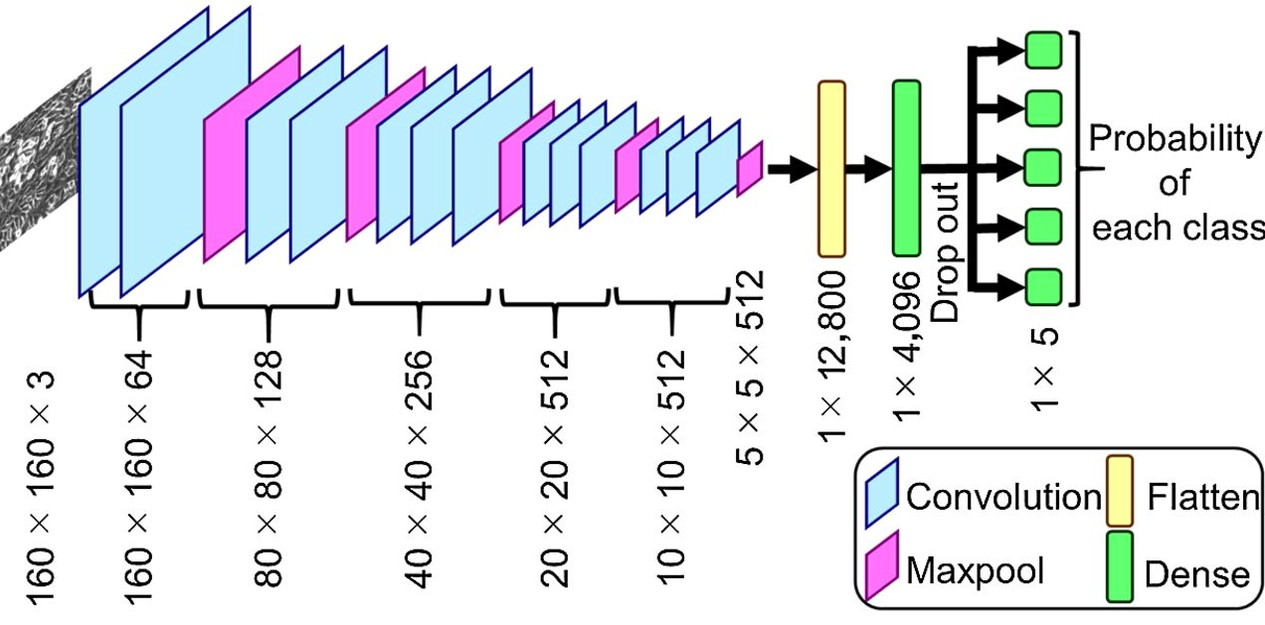
Last layers
Convolutional neural network:
  Part1: Multiple convolution layers with pooling and activation functions.
  Part 2: Followed by 1 or more fully connected layers
Img source: https://stackoverflow.com/questions/54943307/create-cnn-model-architecture-diagram-in-keras

Slide 25
Last layers
  Convolutional neural network:
  Downside: Input dimensions (input width and height) have to be fixed because of the linear layers...
Img source: https://stackoverflow.com/questions/54943307/create-cnn-model-architecture-diagram-in-keras

Slide 26
Last layers
Convolutional neural network:
  Part1: Multiple convolution layers with pooling and activation functions.
  Part 2: Followed by flattening and multiple fully connected layers
  Part 2: Use 1x1 convolution instead!

Slide 27

Last layers
Convolutional neural network:
  Part1: Multiple convolution layers with pooling and activation functions.
  Part 2: Use 1x1 convolution instead!
Img source:https://mc.ai/extract-features-visualize-filters-and-feature-maps-in-vgg16-and-vgg19-cnn-models/

Slide 28
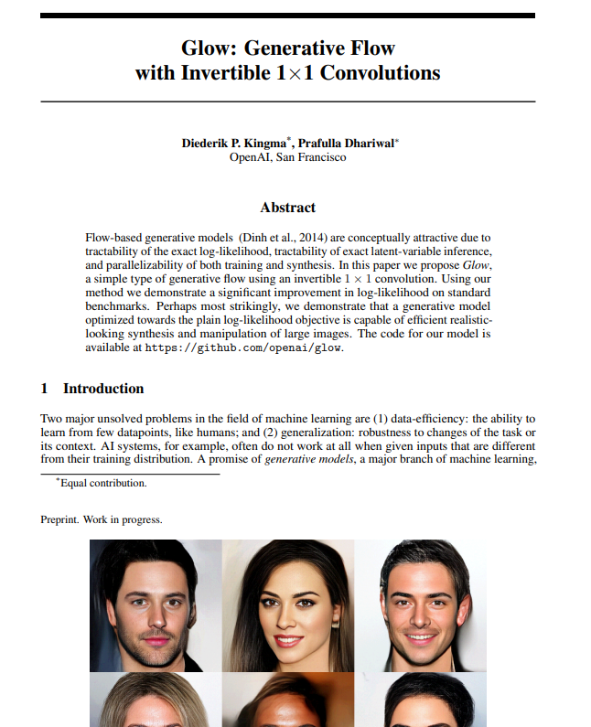
Other uses
?

