Slide 1
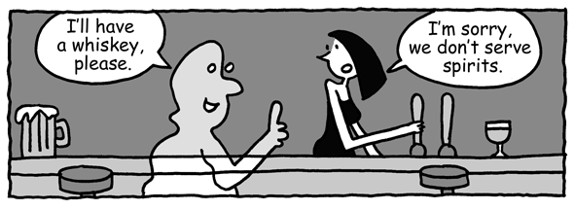
Word2Vec theory

Slide 2
Word as combination of aspects
Word are a representation of a concept
Concept can have certain aspects.
Characterize a concept behind a word:
 | alive | electrical | soft | big | ... | ... | ...
cat | yes | no | yes | yes | no | yes | no
table | No | no | no | no | no | yes | no
book | no | no | no | no | no | yes | yes
phone | no | yes | no | no | yes | no | yes

Slide 3
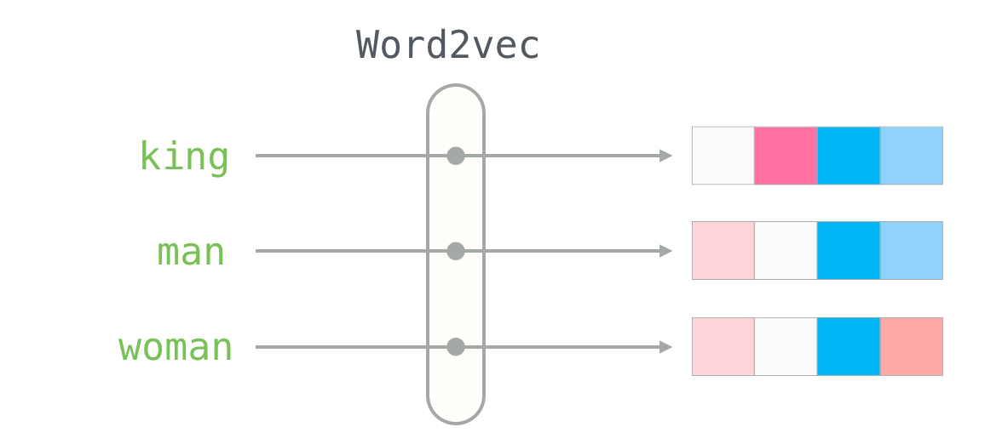
Word2vec: define aspects of a word
Create a vector to capture the aspects
Can have continuous (0 to 1) aspects instead of binary (yes/no)
Aspects can be abstract
http://jalammar.github.io/illustrated-word2vec/
 | alive | electrical | soft | big | likable | abstract | value
cat | 0.95 | 0.2 | 0.8 | 0.3 | 0.9 | 0.1 | 0.8
table | 0.0 | 0.1 | 0.2 | 0.4 | 0.2 | 0.1 | 0.1
book | 0.01 | 0.05 | 0.3 | 0.1 | 0.8 | 0.2 | 0.2
phone | 0.05 | 0.9 | 0.1 | 0.05 | 0.7 | 0.2 | 0.7
thought | 0.01 | 0.01 | 0.01 | 0.01 | 0.1 | 0.8 | 0.9

Slide 4
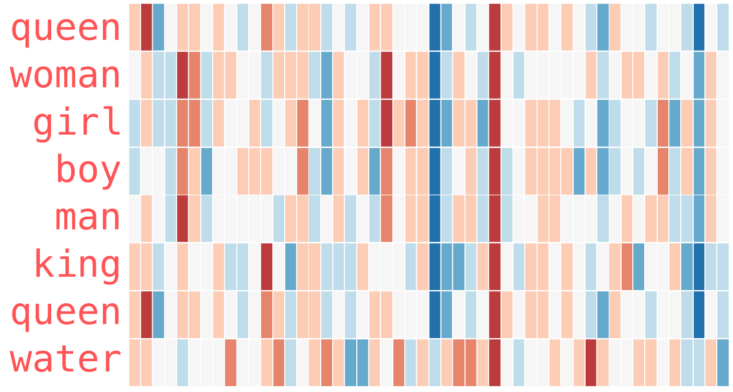
Exercise: look at some trends
Which feature is ‘human’ ?
What separates man from boy / woman from girl?
http://jalammar.github.io/illustrated-word2vec/

Slide 5
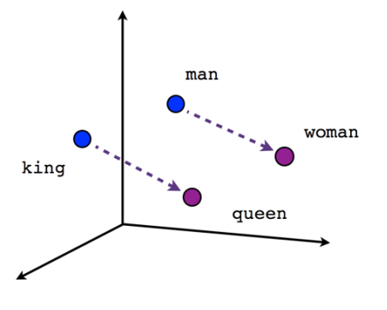
Properties to vectors
Create an N-dimensional graph
Can place each word on this N-dimensional graph
https://www.analyticsvidhya.com/blog/2017/06/word-embeddings-count-word2veec/

Slide 6
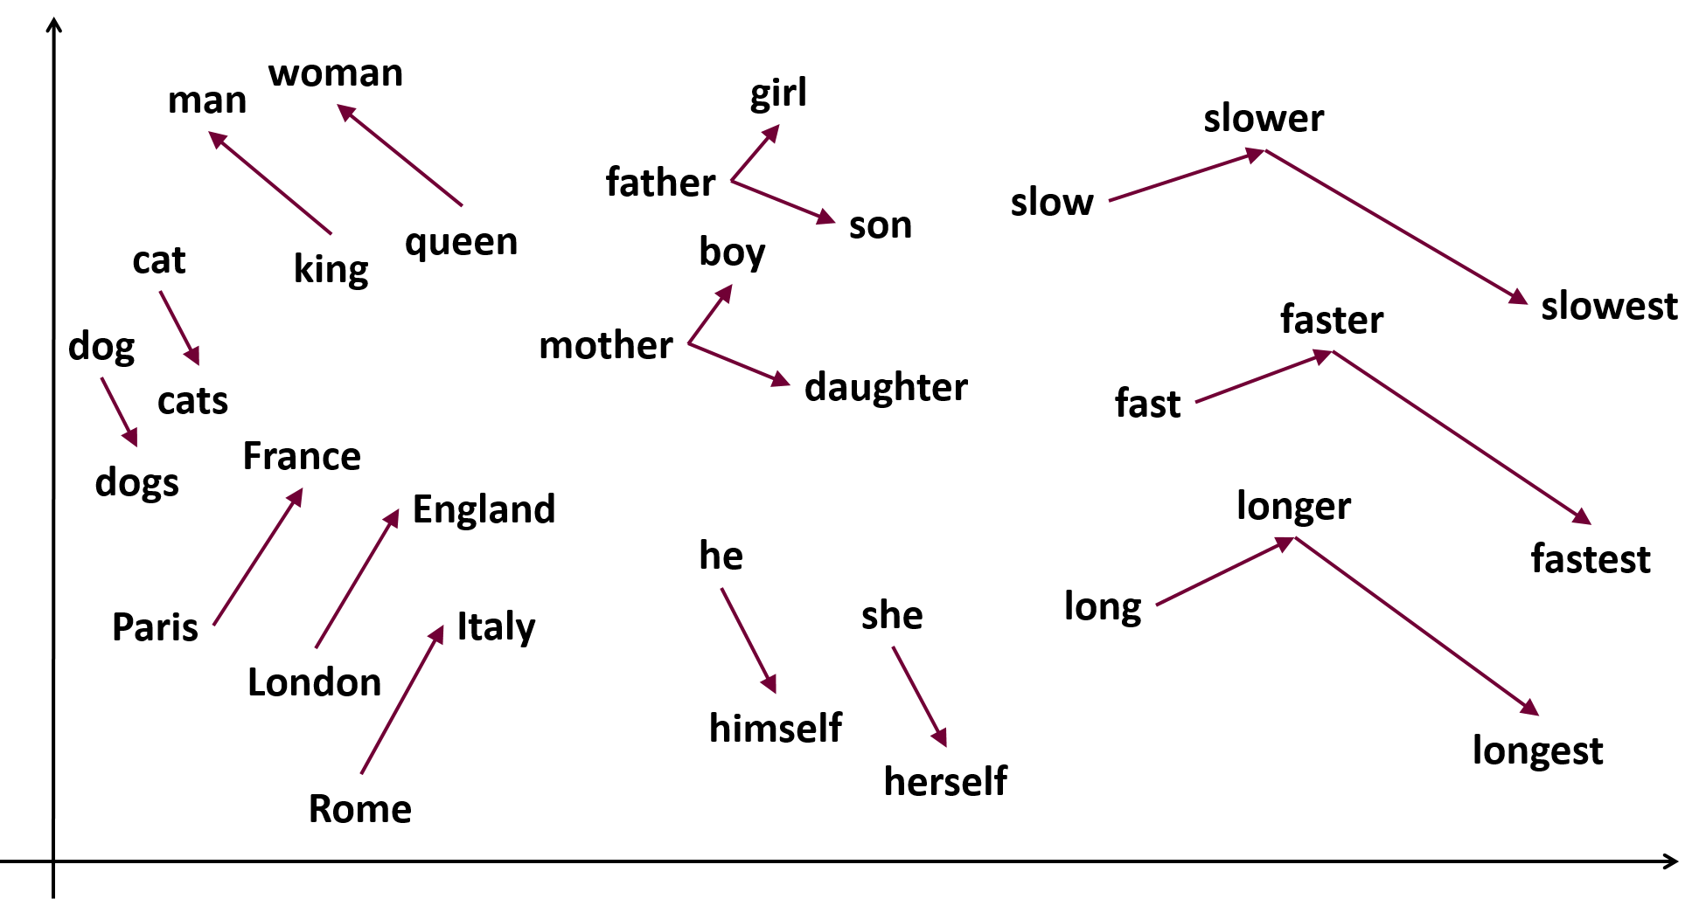
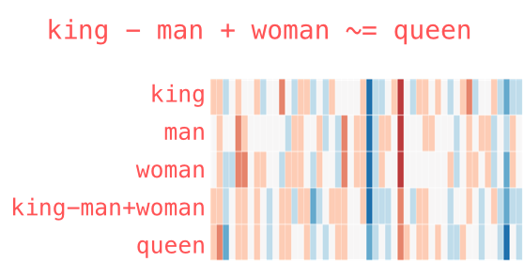
Relating properties / vectors
Can create vectors between concepts
  Mathematical operations possible (woman + vector_man→king = queen)
  Similar concepts have similar features (cosine similarity)
https://samyzaf.com/ML/nlp/nlp.html
http://jalammar.github.io/illustrated-word2vec/

Slide 7
How to do this?
In short: translate word to property space
Question: How will we do this?
  Need to think of features of a word
  Need to fill in these features for each word there is
  Sounds like a lot of work to do by hand...

Slide 8
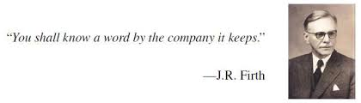
Whats in a name?
Word defined by its context
  A chair is something we sit on; A chair is something we work on
  A cat is something we love; A cat is something we feed; A cat has personality
Question: What is a spirit?
  A spirit is see trough; a spirit is scary; a spirit haunts
  A spirit is liquid; a spirit has alcohol; a spirit is nice
The context of a word will tell you about the properties of a word

Slide 9
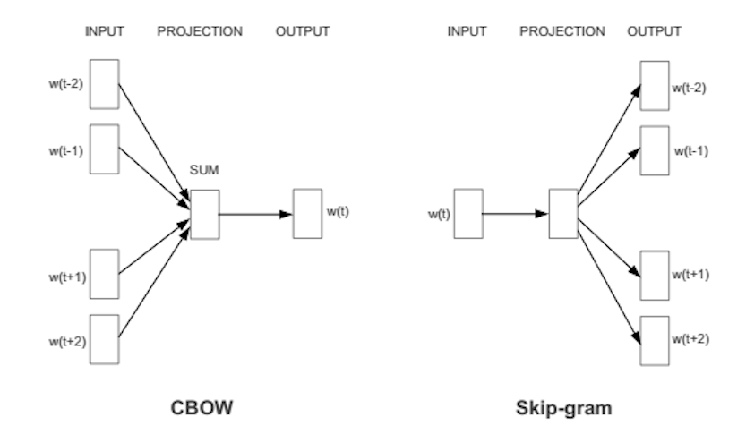
Methods to define words by context
Continuous Bag of Words
  Context to word
  Good for small dataset
Skip-gram
  Word to context
  Good for big dataset
https://israelg99.github.io/2017-03-23-Word2Vec-Explained/

Slide 10
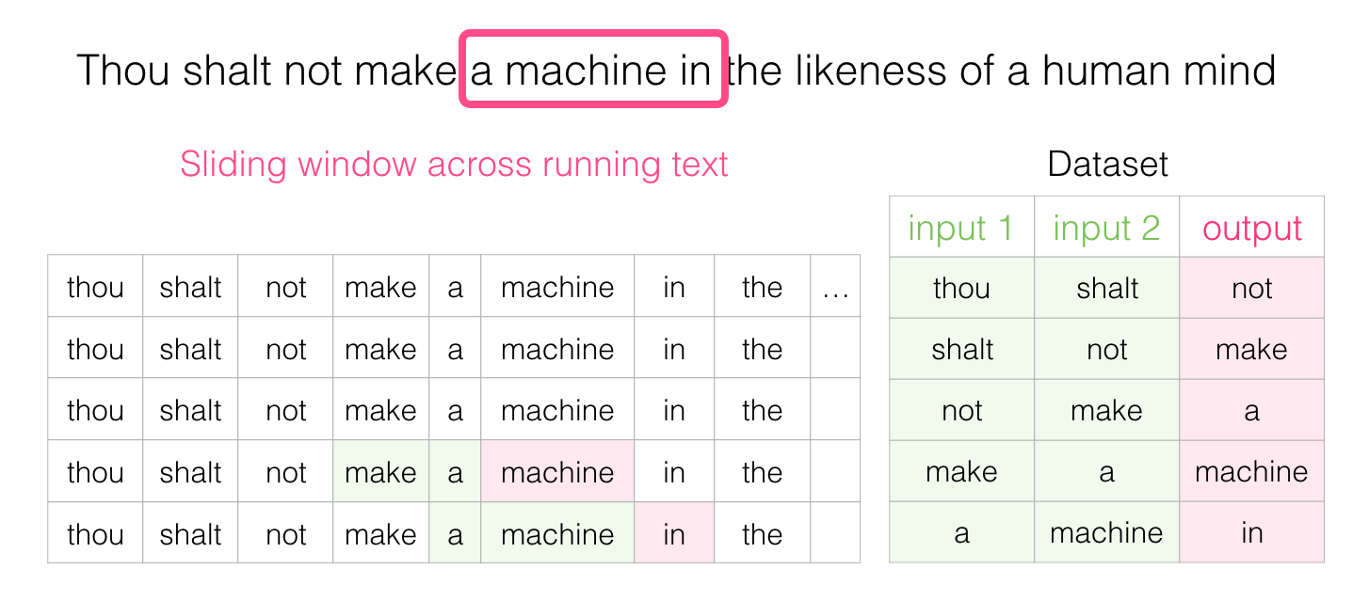
CBOW getting dataset
Multiple in → one out
Sliding window approach
http://jalammar.github.io/illustrated-word2vec/

Slide 11
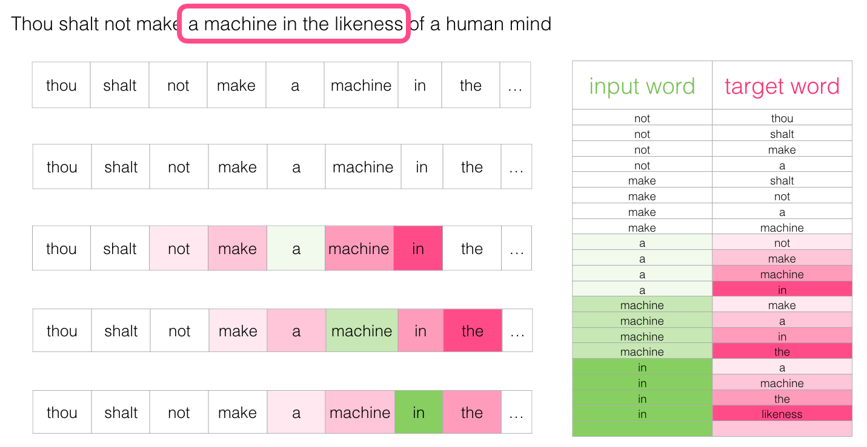
skipgram getting dataset
One in → multiple out
Sliding window approach
http://jalammar.github.io/illustrated-word2vec/

Slide 12
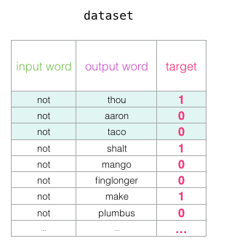
Add negative sampling
1: they are context
0: they are not context

Slide 13
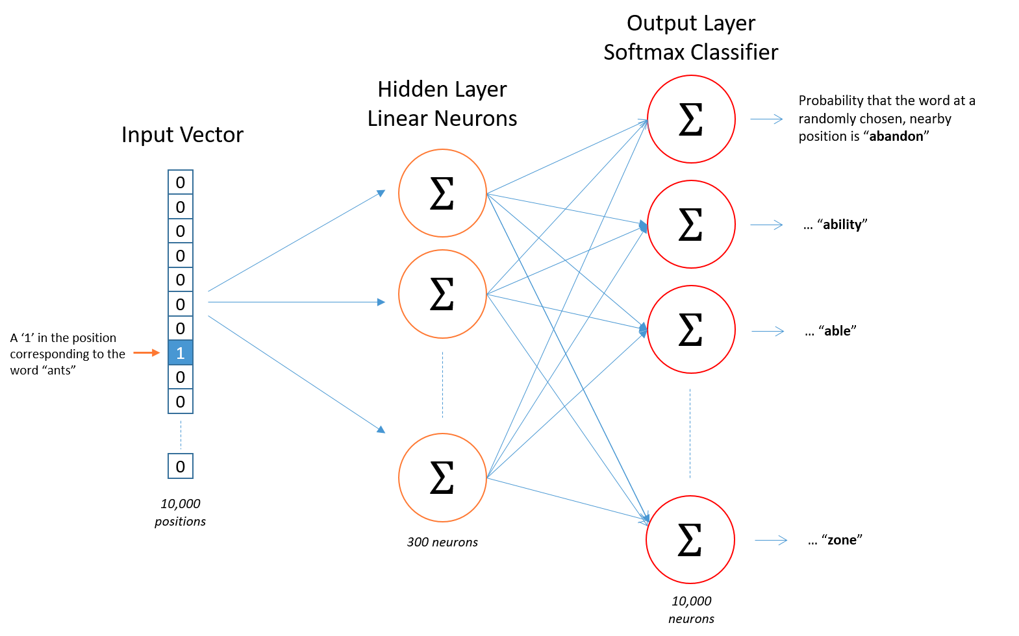
Architecture - skipgram
Hidden layer serves as embedding

Slide 14
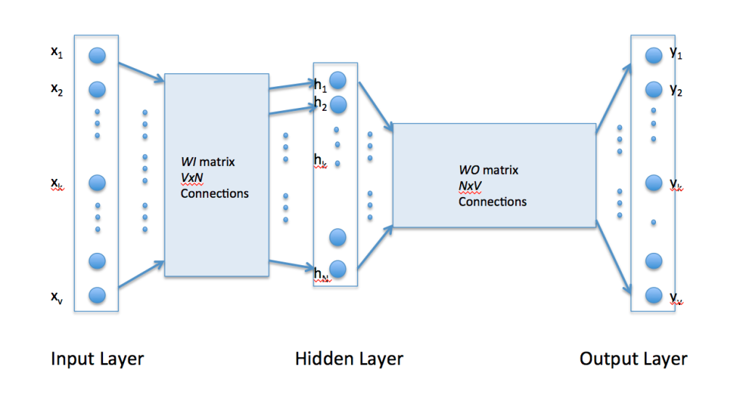
Architecture again
First layer: input to embedding
Second layer: embedding to output
https://iksinc.online/tag/word2vec/

Slide 15
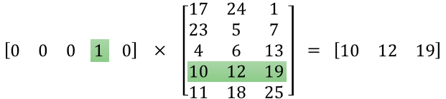
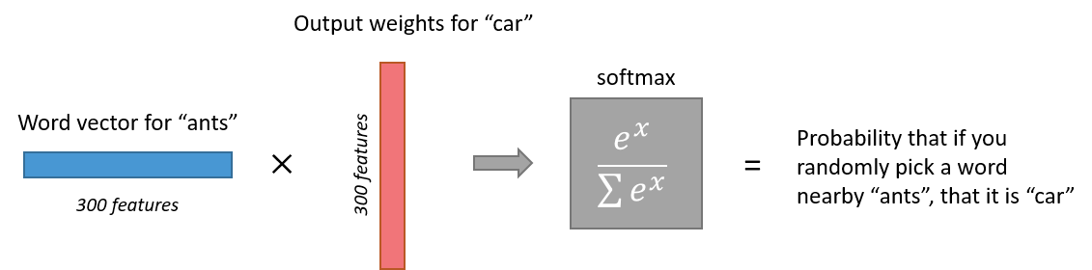
The embedding / hidden layer
One-hot X embedding = embedding
https://israelg99.github.io/2017-03-23-Word2Vec-Explained/

Slide 16
Training
Minimize the liklihood of a negative sample
Maximize the likelihood of a positive sample
https://israelg99.github.io/2017-03-23-Word2Vec-Explained/

Slide 17
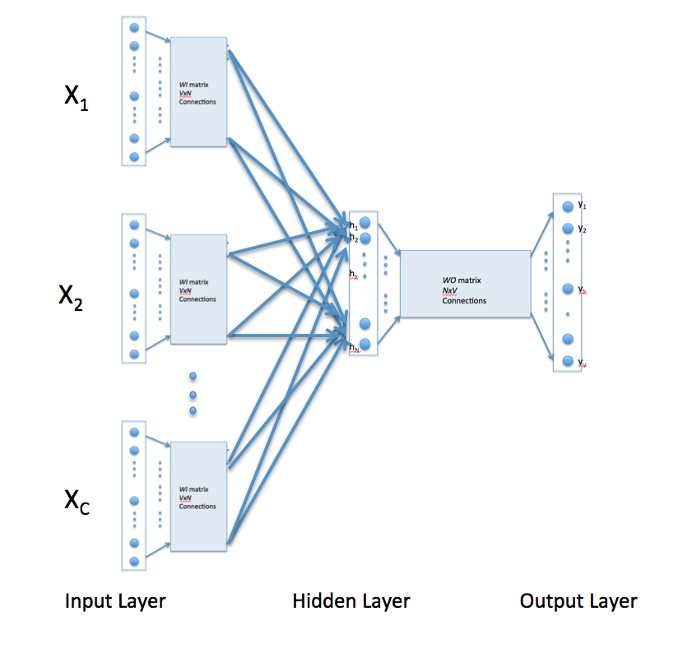
How to do it for CBOW?
Sum the input vectors, divide by the amount of input vectors
  Get the context as an average word
Train in the same way
https://iksinc.online/tag/word2vec/

Slide 18
End of presentation

