Slide 1
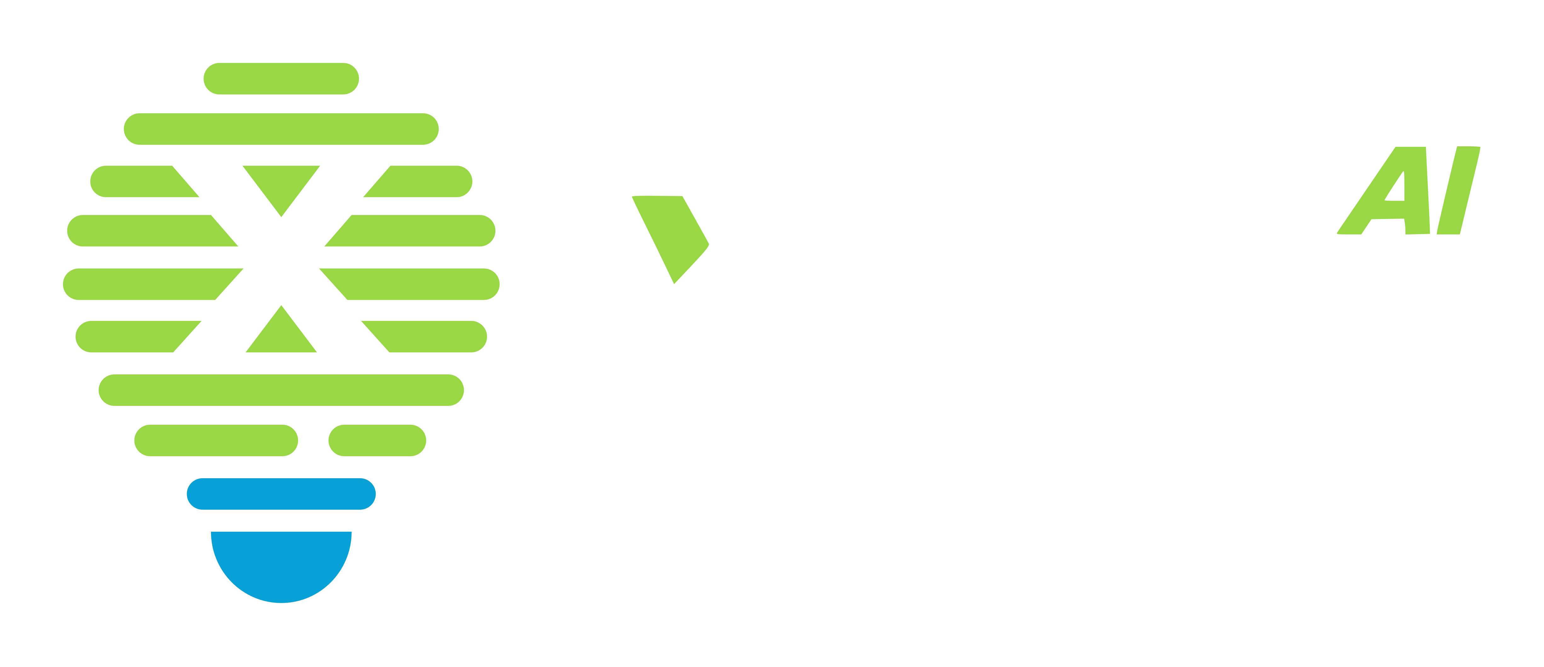
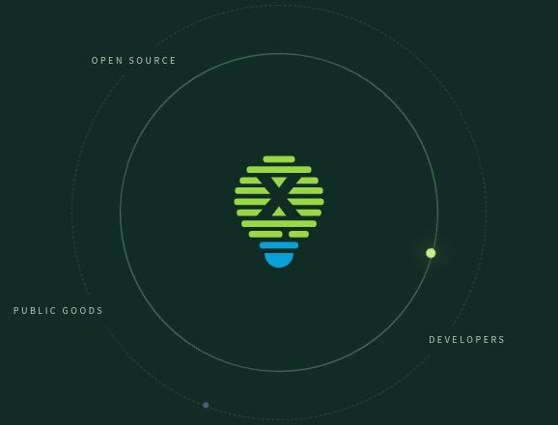
AI FOR ALL
01 / 10
AI for All Manifesto
Make AI affordable
and useful
Starting with developer communities,
turning open technology into opportunity and capability.
One goal · Two forces · One core · Two cycles · Three perspectives
AI for All Manifesto
X-lab AI
Notes:
AI for All is X-lab AI's long-term goal and a public invitation to act. We want more people to afford AI and develop the capability to use it well. Those are connected ambitions: access gives people an opportunity to begin, while learning and practical work help turn that opportunity into useful results. We begin with developer communities, broadly understood to include learners, builders and engineers. The framework in this presentation explains how open technology, human creativity, public goods and sustained support can work together.
Sources
https://www.x-lab.info/ai-for-all/en.html
https://www.x-lab.info/ai-for-all/presentation/assets/SOURCES.md
https://github.com/X-lab2017/ai-for-all
Edition: 2026-10-09

Slide 2

AI FOR ALL
02 / 10
35 years of Linux
Open collaboration, a shared foundation
Thirty-five years of Linux show what sustained collaboration can build.
1991 — 2026
35
YEARS
OF LINUX
A personal project.
A shared foundation.
Developers, communities and organizations
bring open work into everyday use.
Openness begins it. Continued collaboration sustains it.
Linux Foundation · 35-year report
AI for All Manifesto
X-lab AI
Notes:
Linux provides a historical reference for open collaboration. Its thirty-five-year journey shows how a project can become shared infrastructure through contributions, maintenance and adoption. The lesson is broader than making something available at no charge. Value depends on people continuing to improve, maintain and use it. We draw on that experience as we think about AI, while recognizing that AI brings its own technical and social challenges. The Linux anniversary material is an illustration of open collaboration, not an endorsement of this manifesto.
Sources
https://www.x-lab.info/ai-for-all/en.html
https://www.x-lab.info/ai-for-all/presentation/assets/SOURCES.md
https://github.com/X-lab2017/ai-for-all
Edition: 2026-10-09

Slide 3
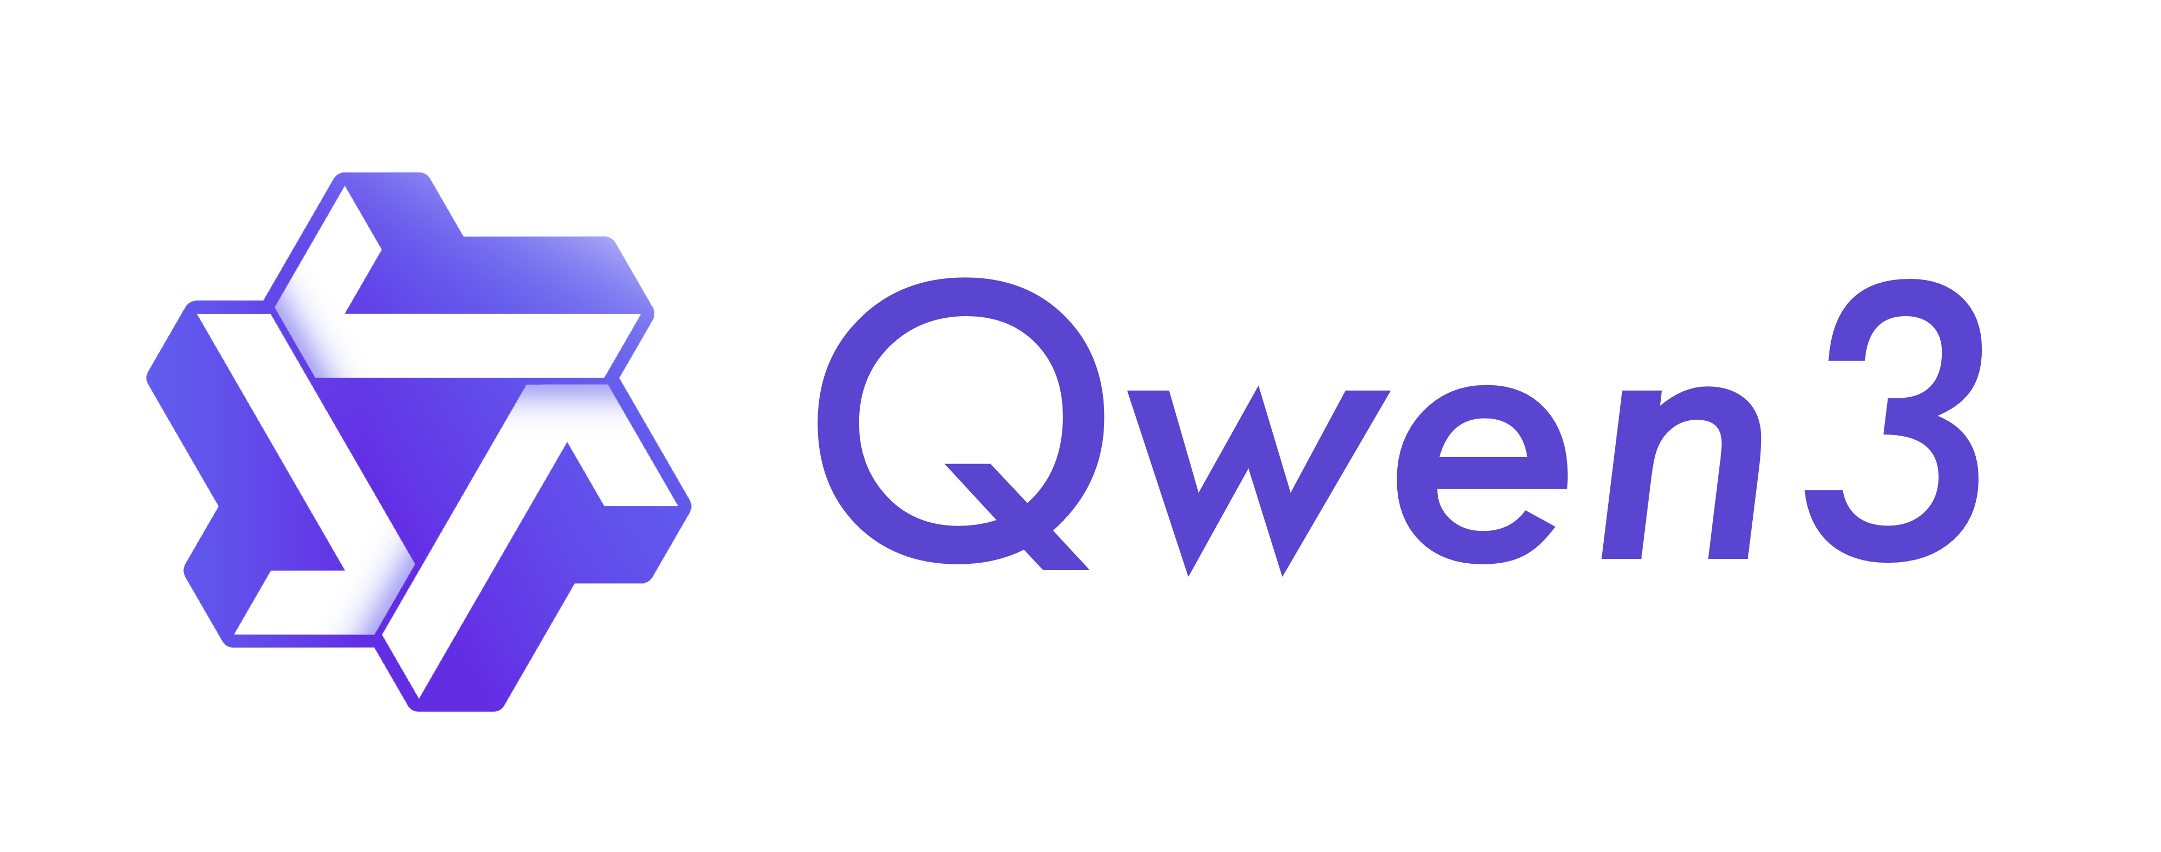




AI FOR ALL
03 / 10
Open models
Open capabilities, more people creating
Open collaboration continues through the ecosystem of open AI models.
Alibaba
DeepSeek
Zhipu AI
Moonshot AI
Tencent
Qwen
DeepSeek
GLM
Kimi
Hunyuan
Example release
Example release
Example release
Example release
Example release
Qwen3
DeepSeek-R1
GLM-4.5
Kimi K2
Hunyuan-A13B
Model capabilities
Developers build and adapt
Real settings
More people can learn, build and improve.
Examples, not a ranking. Licenses vary by release. No endorsement is implied.
AI for All Manifesto
X-lab AI
Notes:
Open AI models give more developers opportunities to learn, build and adapt. These examples are Alibaba's Qwen, DeepSeek, Zhipu AI's GLM, Moonshot AI's Kimi and Tencent's Hunyuan. The releases shown are examples, not a current ranking or an exhaustive list. Licenses differ across releases and should be checked for each use. What matters to our narrative is the connection between access to model capabilities, developers' applications and improvements, and real settings where people can benefit.
Sources
https://www.x-lab.info/ai-for-all/en.html
https://www.x-lab.info/ai-for-all/presentation/assets/SOURCES.md
https://github.com/X-lab2017/ai-for-all
Edition: 2026-10-09

Slide 4


AI FOR ALL
04 / 10
Two forces
Two forces reinforcing each other
Accessible technology opens the door; people turn it into useful applications.
OPEN SOURCE
DEVELOPERS
Open source
Developers
×
Lower barriers
Expand creativity
Open technology, knowledge and tools
enable learning, improvement and reuse.
Co-create
Start with real needs. Grow through
learning, projects, collaboration and feedback.
Infrastructure Models Agents and apps
Learners Builders Engineers
AI for All
=
Accessible technology
×
Developer creativity
Affordable access
Capable use
Multiplication expresses mutual reinforcement, not a quantitative impact formula.
AI for All Manifesto
X-lab AI
Notes:
Two forces reinforce each other. Open source lowers barriers by making technology, knowledge and tools available for learning, improvement and reuse. Developers bring judgment and creativity, turning those resources into useful applications. Developers include people exploring AI for the first time, building applications, or engineering systems for sustained use. Our multiplication formula expresses this mutual reinforcement. It is a conceptual statement, not a numerical formula for measuring social impact. Outcomes still need to be tested in practice.
Sources
https://www.x-lab.info/ai-for-all/en.html
https://www.x-lab.info/ai-for-all/presentation/assets/SOURCES.md
https://github.com/X-lab2017/ai-for-all
Edition: 2026-10-09

Slide 5

AI FOR ALL
05 / 10
The public-goods path
Shared results become real help
Digital public goods connect developer creativity with practical benefit.
01 / CAPABILITY
02 / SHARING
03 / ADOPTION
04 / BENEFIT
AI capabilities
Digital public goods
Adoption and adaptation
Real help
Technology and creativity
Tools, data and knowledge
Fit real needs
Feedback and outcomes
Shareable results need sustained care.
DPG
Open software, AI systems, data and knowledge
Open licenses, documentation, maintenance and local adaptation support real use.
AI for All Manifesto
X-lab AI
Notes:
Our path connects AI to inclusion through digital public goods. Developers can turn capabilities into reusable software, data and knowledge. Sharing is an important step, but real benefit also depends on documentation, maintenance, adoption and local adaptation. We need to understand the people who use a result, the conditions in which they use it, and the problems they still face. Digital public goods are an intended path; a particular solution's compliance with any formal standard requires evidence.
Sources
https://www.x-lab.info/ai-for-all/en.html
https://www.x-lab.info/ai-for-all/presentation/assets/SOURCES.md
https://github.com/X-lab2017/ai-for-all
Edition: 2026-10-09

Slide 6




AI FOR ALL
06 / 10
Data and evaluation
Visible contributions, evidence for support
Four kinds of work support judgment, decisions and improvement.
SHARED CORE
Platforms
Evidence
Data and
evaluation
Connect people and practice
Make evidence traceable
Recognize · Match · Verify
Methods
Research
Interpret contributions and outcomes
Examine the methods themselves
Evaluation supports growth
Use varied evidence, disclose limits and keep channels for correction open.
The four kinds of work interact. A single score cannot define a person's worth.
AI for All Manifesto
X-lab AI
Notes:
Data and evaluation form the shared core. Platforms connect people and practice. Data make evidence traceable. Evaluation methods help interpret contributions and outcomes. Research examines the methods themselves. These kinds of work interact rather than forming a fixed sequence. The aim is to make contributions visible, match resources with needs and examine whether action helps. Evaluation should support growth, with transparent limitations and channels for correction. A single score cannot define a person's worth.
Sources
https://www.x-lab.info/ai-for-all/en.html
https://www.x-lab.info/ai-for-all/presentation/assets/SOURCES.md
https://github.com/X-lab2017/ai-for-all
Edition: 2026-10-09

Slide 7
AI FOR ALL
07 / 10
Two reinforcing cycles
Two cycles, sustained action
Growth creates public value. Resources support the next round of practice.
Contribute
Resources
01
01
Public goods create value
Public goods
Growth
Recognition
Verify outcomes
Resources
Match support
Reinforce
04
02
04
02
Practice into creation
Support into continuity
Resources support growth
Capability
Create value
03
03
Evidence ↓ ↑ Evaluation
Evidence ↓ ↑ Evaluation
SHARED CORE
Data and evaluation
Recognize · Match · Verify
AI for All Manifesto
X-lab AI
Notes:
The growth cycle begins with contribution and practice. Recognition and learning help people build capability, improving public goods and applications. The resource cycle connects support with useful results and evidence for continued investment. The two cycles reinforce each other: public goods create value, while resources support people and sustained practice. Data and evaluation connect both cycles. Practice supplies evidence; evaluation informs the next decisions. These are relationships we intend to test and improve, not a promise of automatic growth or guaranteed returns.
Sources
https://www.x-lab.info/ai-for-all/en.html
https://www.x-lab.info/ai-for-all/presentation/assets/SOURCES.md
https://github.com/X-lab2017/ai-for-all
Edition: 2026-10-09

Slide 8



AI FOR ALL
08 / 10
Foundations for action
Practical foundations for a public commitment
Build on open data, methods and communities; report progress and limits.
DATA
METHODS
ECOSYSTEM
OpenDigger
OpenRank
OpenShare
Open-source data and metrics
Collaboration-network evaluation
Capabilities and resources
Data for understanding developer
collaboration, projects and communities.
Understand contributions through
collaboration networks and varied evidence.
Explore connections among contributions,
capabilities, needs and resources.
Explore the project ↗
Explore the method ↗
Explore the platform ↗
Current action: open co-creation of the manifesto
Publish the manifesto and materials; invite feedback and let practice test our commitments.
These are practical foundations, not evidence of inclusion outcomes already achieved.
AI for All Manifesto
X-lab AI
Notes:
We can build on practical foundations. OpenDigger provides open-source data and metrics. OpenRank offers methods for understanding contributions through collaboration networks. OpenShare explores connections among contributions, capabilities, organizational needs and resources. These existing projects provide ways to begin. They should not be presented as evidence that this initiative has already achieved its inclusion goals. Our current action is the public co-creation of the manifesto and its materials, with progress and limitations recorded openly.
Sources
https://www.x-lab.info/ai-for-all/en.html
https://www.x-lab.info/ai-for-all/presentation/assets/SOURCES.md
https://github.com/X-lab2017/ai-for-all
Edition: 2026-10-09

Slide 9



AI FOR ALL
09 / 10
Build together
Every real need can be a starting point
Developers, communities and partners can build results that others can reuse.
Developers
Communities
Partners
Share needs and feedback.
Contribute tools, documentation and cases.
Organize learning and collaboration.
Bring back adoption experience and feedback.
Offer resources and real settings.
Work together on verifiable practice.
Read the contribution guide ↗
Join the discussion ↗
Propose an action ↗
Open resources
Support creation
Public progress
No prior contribution score is needed to begin. Resources and conditions are defined for each action.
AI for All Manifesto
X-lab AI
Notes:
Participation can start with a real need. Developers can share feedback and contribute tools, documentation or cases. Communities can organize learning and collaboration, bringing back experience from adoption. Partners can offer resources and practical settings for work that can be evaluated. Basic participation does not require an existing contribution score. Resource conditions belong in each action's public description. The launch page brings the manifesto, materials and participation routes together, so audiences can choose a concrete next step.
Sources
https://www.x-lab.info/ai-for-all/en.html
https://www.x-lab.info/ai-for-all/presentation/assets/SOURCES.md
https://github.com/X-lab2017/ai-for-all
Edition: 2026-10-09

Slide 10
AI FOR ALL
10 / 10
The framework and invitation
A shared framework for action
Connect creativity, sustained support and practical benefit.
01 / ONE GOAL
AI for All
Affordable and useful
Digital public goods
Adoption and adaptation
Real help
02 / TWO FORCES
04 / TWO CYCLES
Open source × Developers
Value
Growth
Resources
Public value
Support
Sustained practice
Lower barriers. Expand creativity.
Evaluation informs both cycles ↑
Practice feeds evidence into the core ↓
03 / ONE CORE
Data and evaluation
Recognize · Match · Verify
05 / THREE PERSPECTIVES
Developers Public Global South
Complementary perspectives on benefit
AI for All Manifesto
Join us www.x-lab.info/ai-for-all/launch/
X-lab AI
Notes:
This is the complete framework: one goal, two forces, one shared core, two reinforcing cycles and three complementary perspectives on inclusion. Digital public goods connect creation to real help through adoption and local adaptation. Developers, the public and the Global South are complementary perspectives, not mutually exclusive groups or sequential stages. We invite people to begin with a need, a contribution or a practical setting. Visit the launch page, read the manifesto and help us turn a shared direction into accountable action.
Sources
https://www.x-lab.info/ai-for-all/en.html
https://www.x-lab.info/ai-for-all/presentation/assets/SOURCES.md
https://github.com/X-lab2017/ai-for-all
Edition: 2026-10-09

