Slide 1
INTRODUCTION TO ARTIFICIAL INTELLIGENCE
Introduction to Machine Learning cont’d

Slide 2
Outline
Types of learning problem
Classification vs regression
Performance metrics
Generalisation and overfitting
Train, validate, test

Slide 3

Classification
Not cats
Cats

Slide 4
What examples of classification problems can you think of?
Medical domain?
Robotics domain?
Finance domain?
Defence?

Slide 5
Performance Metrics: Classification
True positives (TP): The class is + and the prediction is +
True negatives (TN): The class is - and the prediction is -
False positives (FP): The class is - and the prediction is +
False Negatives (FN): The class is + and the prediction is -
Predicted
 | Cat | Not Cat
Cat | TP | FN
Not Cat | FP | TN
True

Slide 6

Accuracy =
Total number of datapoints
Number correctly classified
Accuracy
Not cats
Predicted
Cats
 | Cat | Not Cat
Cat
Not Cat
True

Slide 7
Accuracy =
Total number of datapoints
Number correctly classified
Accuracy
Not cats
Predicted
Cats
 | Cat | Not Cat
Cat | 5 | 1
Not Cat | 1 | 4
True

Slide 8
Precision =
True Pos. + False Pos.
True Positives
Precision
Not cats
Predicted
Cats
 | Cat | Not Cat
Cat | 5 | 1
Not Cat | 1 | 4
True

Slide 9
Recall =
True Pos. + False Neg.
True Positives
Recall
Not cats
Predicted
Cats
 | Cat | Not Cat
Cat | 5 | 1
Not Cat | 1 | 4
True

Slide 10
What is more important?
Think about the domain you chose. What is more important - precision or recall?

Slide 11
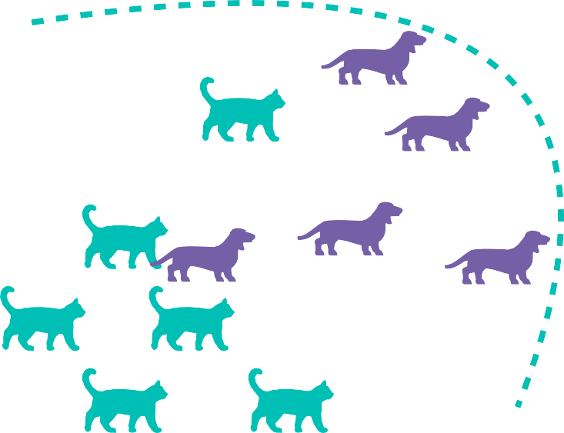
Recall =
True Pos. + False Neg.
True Positives
F1
Not cats
Predicted
Cats
 | Cat | Not Cat
Cat | 6 | 0
Not Cat | 5 | 0
True

Slide 12
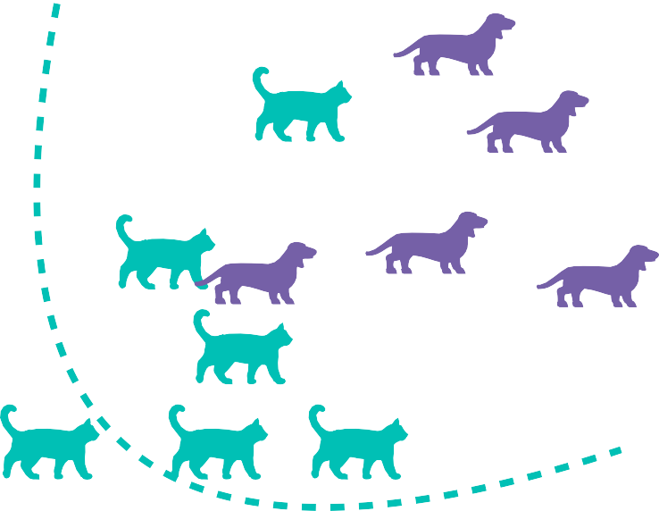
Precision =
True Pos. + False Pos.
True Positives
F1
Not cats
Predicted
 | Cat | Not Cat
Cat | 1 | 5
Not Cat | 0 | 5
Cats
True

Slide 13
F1
F1 is the harmonic mean of precision and recall:
2
^{F1 =} Precision⁻¹ + Recall⁻¹
_{= 2 ⋅} Precision ⋅ Recall
Precision + Recall

Slide 14
Metrics for more than two classes
Predicted
Number correctly classified
Accuracy =
Total number of datapoints
Dog
Cat
Bird
Dog
10
2
0
Actual
Cat
1
5
1
Bird
2
0
12

Slide 15
Metrics for more than two classes
Predicted
Macro-averaging:
k
Precision = ¹
Precision
Dog
Cat
Bird
_{k} ∑
j
j=1
Dog
10
2
0
Actual
Cat
1
5
1
Bird
2
0
12

Slide 16
Metrics for more than two classes
Predicted
Macro-averaging:
k
 | Dog | Cat | Bird
Dog | 10 | 2 | 0
Cat | 1 | 5 | 1
Bird | 2 | 0 | 12
Recall = ¹ Recall
_{k} ∑
j
j=1
Actual

Slide 17
Micro-averaging
Predicted
Predicted
Predicted
 | D | non D
D | 10 | 2
non D | 3 | 18
 | C | non C
C | 5 | 2
non C | 2 | 24
 | Dog | Cat | Bird
Dog | 10 | 2 | 0
Cat | 1 | 5 | 1
Bird | 2 | 0 | 12
Actual
Actual
 | B | non B
B | 12 | 2
non B | 1 | 18
 | + | -
+ | 27 | 6
- | 6 | 60
Actual

Slide 18
Interim summary
Performance metrics for classification problems.
Confusion matrices, TP, TN, FP, FN
Accuracy, Precision, Recall, and F1
Averages of these
Something to think about: When is accuracy not a good metric?

Slide 19
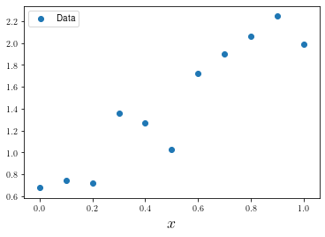
Performance metrics: Regression

Slide 20
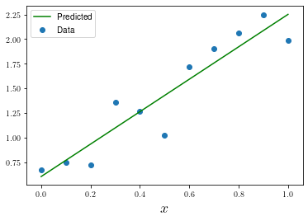
Performance metrics: Regression

Slide 21
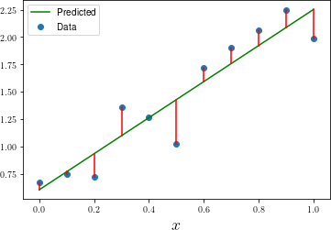
Mean Squared Error (MSE)
Error: y − f( x ⃗)
Squared error: (y − f( x ⃗))²
Mean Squared Error:
N
1
(y − f( x ⃗ ))²
_{N} ∑
i i
i=1

Slide 22
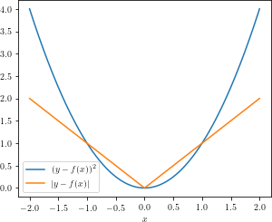
More metrics
Root Mean Squared Error
N
1
RMSE =
(y − f ( x ⃗ ))²
_{N} ∑
i i
i=1
Mean Absolute Error
N
MAE = ¹ | y − f ( x ⃗ ) |
_{N} ∑
i i
i=1

Slide 23
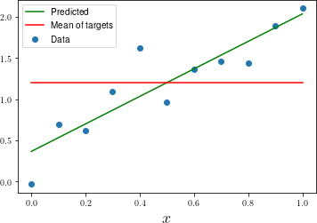
_{R}2
∑N
(y_{i} − f( x _{i}⃗ ))²
_{R}2 ₌ ₁ ₋ i=1
∑N
(y_{i} − y¯)²
i=1
where y¯ is the mean of the target values y_{i}

Slide 24
Interim summary
For regression problems, we take the difference between the predicted value and the true value.
We can calculate mean squared error (MSE), root mean squared error (RMSE), mean absolute error (MAE), R² to give a measure of the overall error.
MAE and RMSE give less weight to outliers than MSE

Slide 25
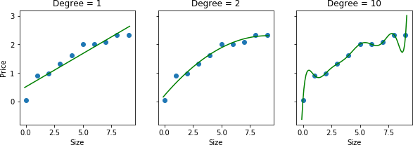
Generalization

Slide 26
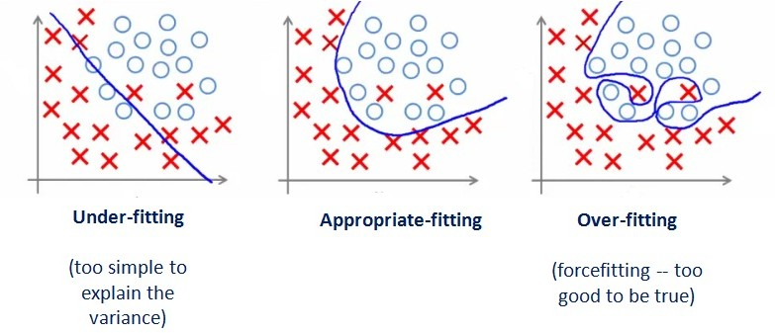
Generalization

Slide 27
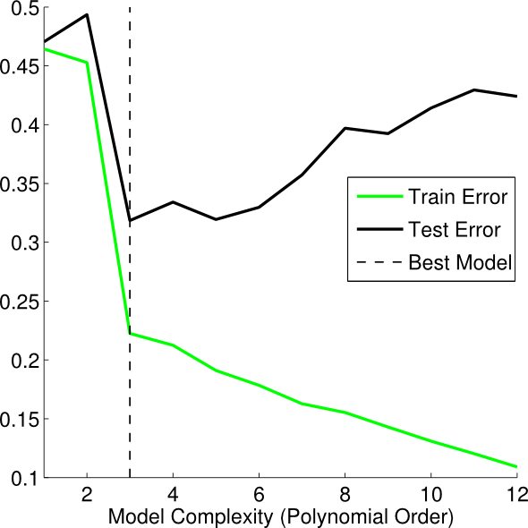
Train, validate, and test
To evaluate the generalisation of a model, data should be divided into training, validation, and testing sets

Slide 28
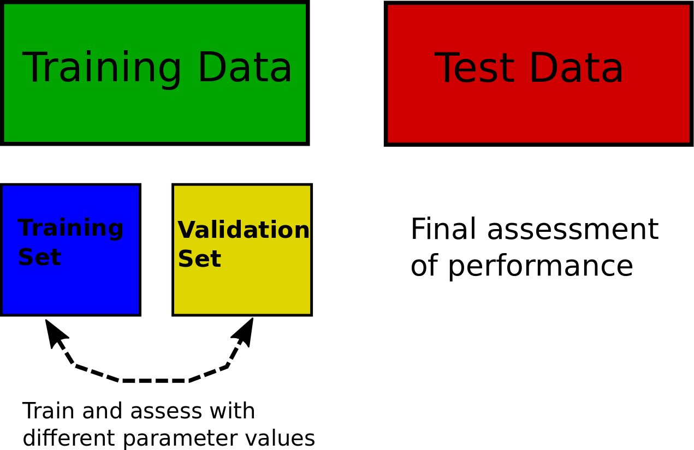
Train, validate, and test

Slide 29
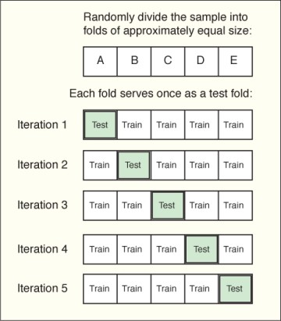
k-Fold Cross-validation
Reduce effects of luck in split by using cross-validation

Slide 30
Summary
As well as wanting our models to fit well, we need them to generalise.
We ensure this by splitting out our data into training, validation, and testing sets
We can use cross validation to help our models be more robust
We practice these concepts in the worksheet

Slide 31
Worksheet
Evaluation metrics, generalisation, overfitting
If you have questions, please ask in the discussion forums, in the lecture, or in an office hour

Slide 32
Next time
Supervised leaning algorithms
k-Nearest neighbours
Linear and logistic regression
Naive Bayes
Simple neural networks

