Slide 1
Neutron Diffusion in Weapons
Cartesian
Cylindrical
Spherical
Historical
Notes
Basics
1
18/07/2022

Slide 2
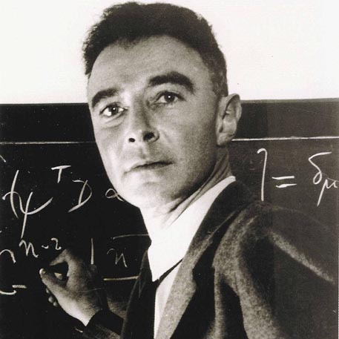
History of Nuclear Weapons
How Manhattan Project produced the first atomic bomb
1939
1942
1945
1945
1945
July
9 August
15 August
Start of the Project
New Director
Trinity
Little Boy, Fat Man
Japan Surrenders
A letter outlining concerns that Germany may be developing nuclear bomb technology causes the creation of Manhattan Project
J. Robert Oppenheimer, becomes the director of the Los Alamos National Laboratory
There is the first nuclear explosion, Trinity
Fat Man and Little Boy are dropped on Hiroshima and Nagasaki
After the Soviet Union’s declaration of war and the bombing, Japan surrenders
2022
02
Xotta Francesco
Notes:
2

Slide 3

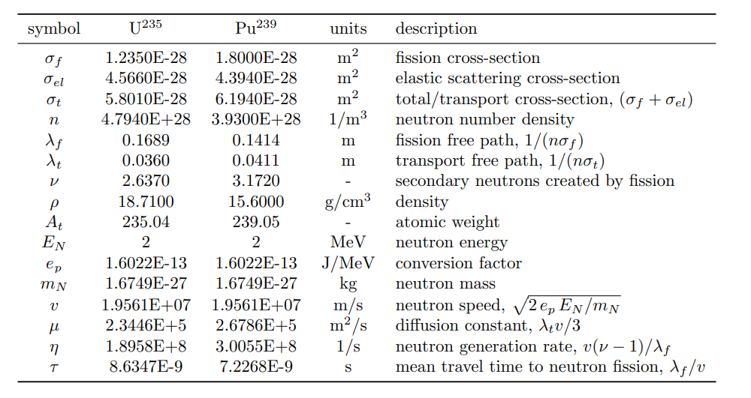
Conditions of this Work:
Dirichlet Boundary Conditions
Parameters taken from the following table
Graham W. Griffiths
18/07/2022
3
Xotta Francesco

Slide 4
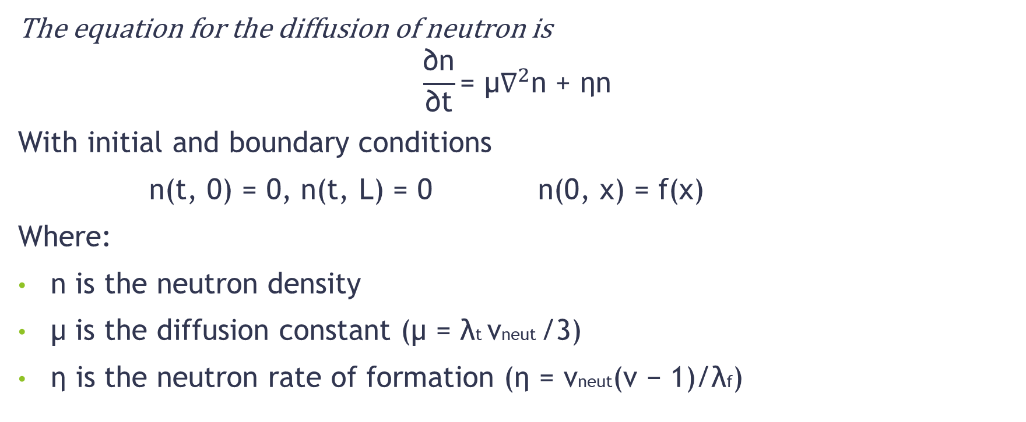
Critical Mass:
The equation for the diffusion of neutron is
$$\frac{\text{∂}\text{n}}{\text{∂}\text{t}}\text{= µ}{\text{∇}}^{2}\text{n}\text{ + }\text{ηn}$$
With initial and boundary conditions
$\text{n}\text{(}\text{t}\text{, 0) = 0, }\text{n}\text{(}\text{t}\text{, }\text{L}\text{) = 0 } \text{n}\text{(0, }\text{x}\text{) = }\text{f}\text{(}\text{x}\text{)}$
Where:
n is the neutron density
µ is the diffusion constant (µ = λt vneut /3)
η is the neutron rate of formation (η = vneut(ν − 1)/λf)

Slide 5
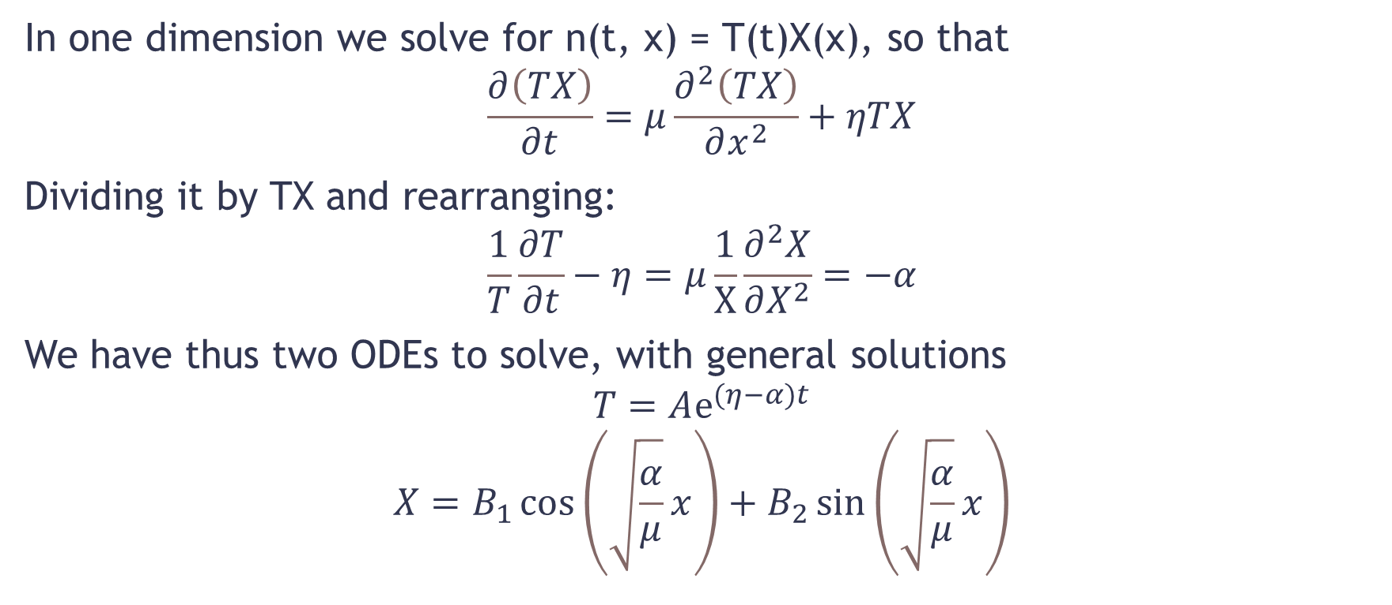
1-D Example:
In one dimension we solve for n(t, x) = T(t)X(x), so that
$$\frac{∂\left(TX\right)}{∂t}=μ\frac{∂^{2}\left(TX\right)}{∂x^{2}}+ηTX$$
Dividing it by TX and rearranging:
$$\frac{1}{T}\frac{∂T}{∂t}−η=μ\frac{1}{X}\frac{∂^{2}X}{∂X^{2}}=−α$$
We have thus two ODEs to solve, with general solutions
$$\begin{matrix}T=Aⅇ^{(η−α)t} \\ X=B_{1}\cos\left(\sqrt{\frac{α}{μ}}x\right)+B_{2}\sin\left(\sqrt{\frac{α}{μ}}x\right)\end{matrix}$$

Slide 6
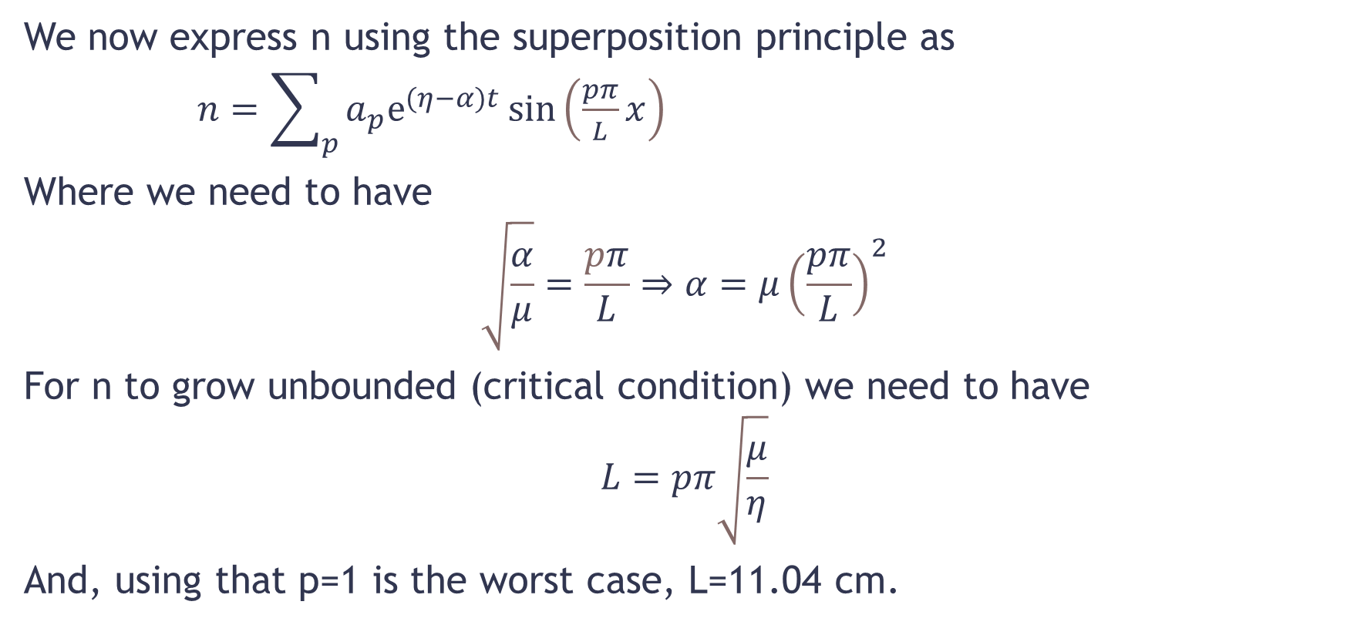
1-D Example:
We now express n using the superposition principle as
$n=\sum_{p}{a_{p}ⅇ^{(η−α)t}\sin\left(\frac{pπ}{L}x\right)}$
Where we need to have
$$\sqrt{\frac{α}{μ}}=\frac{pπ}{L}⇒α=μ{\left(\frac{pπ}{L}\right)}^{2}$$
For n to grow unbounded (critical condition) we need to have
$$L=pπ\sqrt{\frac{μ}{η}}$$
And, using that p=1 is the worst case, L=11.04 cm.

Slide 7
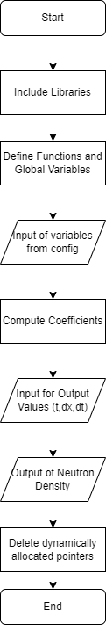
Numerical Solution:
We will need to:
Include Libraries:
#include <iostream>
#include <cmath>
#include <math.h>
#include <fstream>
#include "Numerics.h"
Define functions and global variables:
double L,A,lambda,mu,eta;
int N;
int p=0;
double Function (double x)
{
return A*exp( -lambda*(pow(((x-L/2)/(L/2)),2) ));
};
double Int (double x)
{
return 2*Function(x)*sin(p*M_PI*x/L)/L;
}
Read Input:
fstream newfile;
newfile.open("config.txt",ios::in);
if (newfile.is_open())
{
newfile >> L >> A >> lambda >> N >> mu >> eta; //0.111 1 100 31 2.3446e+05 1.8958e+8 are the suggested values
} else
{
exit(EXIT_FAILURE);
}
newfile.close(); //close the file object.

Slide 8
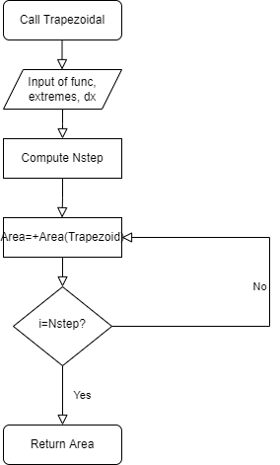

1-D Example: Coefficients
We need to compute the coefficients a, given by the equation
$$a_{p}=\frac{2}{L}\int_{0}^{L}{ⅆx}f\left(x\right)\sin\left(\frac{pπ}{L}x\right)$$
And for this we develop the following code:
double Numerics::trapezoidal(double (*f)(double), double a, double b, double h)
{
/**Integral solver that uses the trapezoidal method; it solves between a and b with step distance h*/
int Nstep=abs((b-a)/h);
double Area=0;
for (int i=0;i<Nstep;++i){
Area=Area+(f(a+(i+1)*h)-f(a+i*h))*h/2+f(a+i*h)*h;
}
return Area;
};
double *a=new double[N];
Numerics num;
double n;
for (p=0;p<N;++p)
{
a[p]=num.trapezoidal(Int,0,L,0.0001);
cout << a[p] << " ";
}

Slide 9
1-D Example: Functions
Where
double Function (double x)
{
return A*exp( -lambda*(pow(((x-L/2)/(L/2)),2) ));
};
double Int (double x)
{
return 2*Function(x)*sin(p*M_PI*x/L)/L;
}

Slide 10
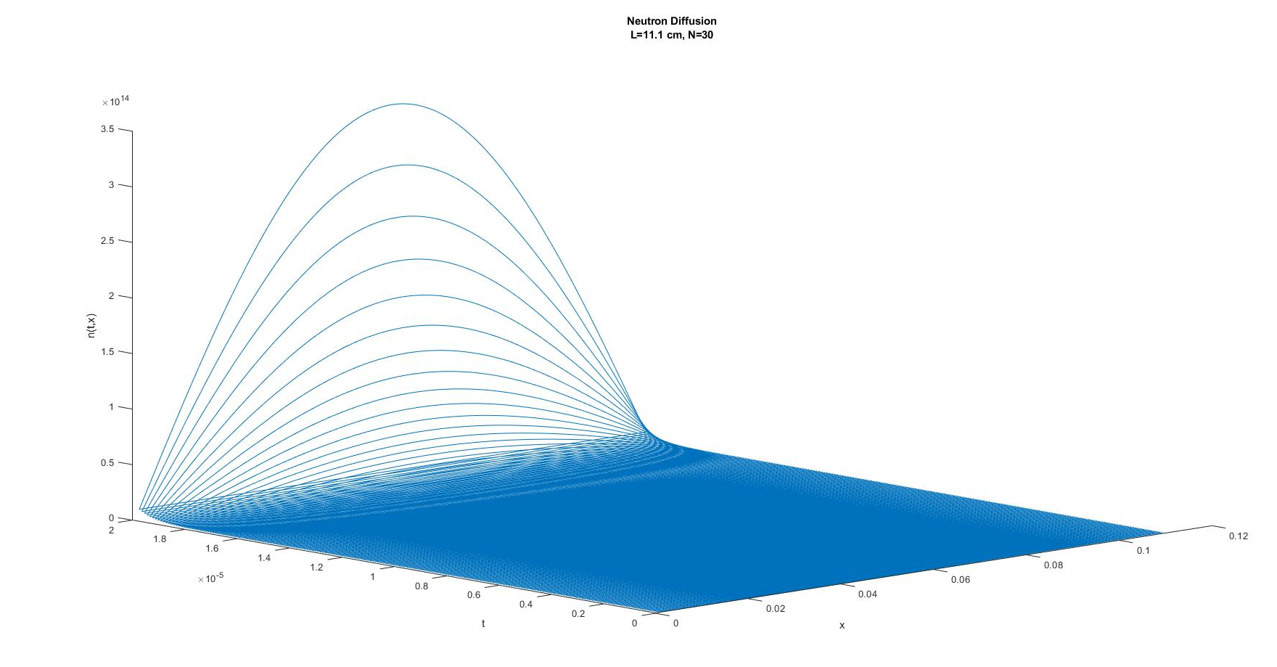
1-D Example: Neutron Density
int NPoints=abs(L/dx);
int NStep=abs(tfin/dt);
newfile.open("output.txt",ios::out);
newfile << "n(x,t)" << " " << "t" << " " << "x" << endl;
for (int c=1; c<NStep; ++c)
{
for (int i=1; i<NPoints; ++i)
{
n=0;
for (p=1;p<N;++p)
{
n=n+a[p]*exp(eta*(c*dt)-mu*(p*M_PI/L)*(p*M_PI/L)*(c*dt))*sin(p*M_PI*i*dx/L);
}
newfile << n << " " << c*dt << " " << 0+i*dx << endl;
};
};
Matlab Script:
data = readtable('output.txt’);
A=table2array(data(:,1:3));
plot3(A(:,3),A(:,2),A(:,1));

Slide 11
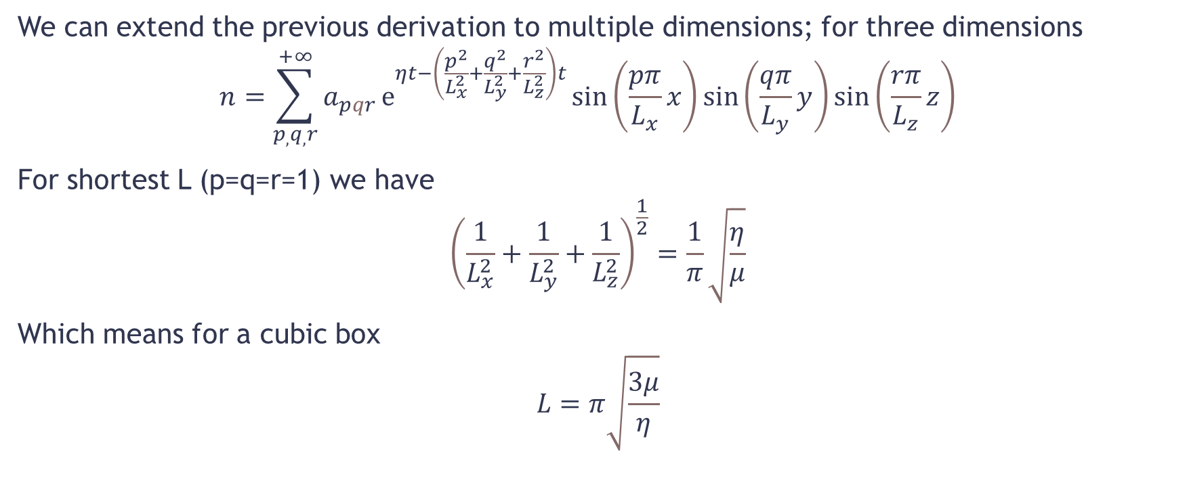
Cartesian 3D:
We can extend the previous derivation to multiple dimensions; for three dimensions
$$n=\sum_{p_{,}q_{,}r}^{+∞}{a_{pqr}}ⅇ^{ηt−\left(\frac{p^{2}}{L_{x}^{2}}+\frac{q^{2}}{L_{y}^{2}}+\frac{r^{2}}{L_{z}^{2}}\right)t}{\sin\left(\frac{pπ}{L_{x}}x\right)\sin\left(\frac{qπ}{L_{y}}y\right)\sin\left(\frac{rπ}{L_{z}}z\right)}_{}^{}$$
For shortest L (p=q=r=1) we have
$${\left(\frac{1}{L_{x}^{2}}+\frac{1}{L_{y}^{2}}+\frac{1}{L_{z}^{2}}\right)}^{\frac{1}{2}}=\frac{1}{π}\sqrt{\frac{η}{μ}}$$
Which means for a cubic box
$$L=π\sqrt{\frac{3μ}{η}}$$

Slide 12
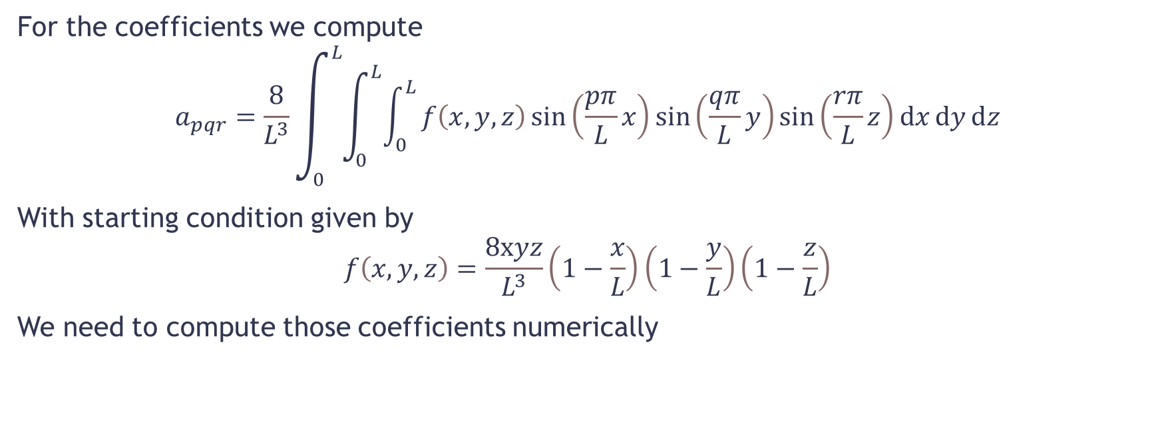
Cartesian 3D: Coefficients
For the coefficients we compute
$$a_{pqr}=\frac{8}{L^{3}}\int_{0}^{L}{\int_{0}^{L}{\int_{0}^{L}{f\left(x,y,z\right)\sin\left(\frac{pπ}{L}x\right)\sin\left(\frac{qπ}{L}y\right)\sin\left(\frac{rπ}{L}z\right)ⅆx}ⅆy}ⅆz}$$
With starting condition given by
$$f\left(x,y,z\right)=\frac{8xyz}{L^{3}}\left(1−\frac{x}{L}\right)\left(1−\frac{y}{L}\right)\left(1−\frac{z}{L}\right)$$
We need to compute those coefficients numerically

Slide 13
Cartesian 3D: Functions
We define the following functions:
double Function (double x, double y, double z)
{
return (1 -( x / L ) ) *(1 -( y / L ) ) * (1 -( z / L ) ) * x * y * z /pow(( L /2),3); //The initial condition were different this time
};
double Int (double x, double y, double z) //It's way easier to define the integrand like this
{
return 8*Function(x,y,z)*sin(p*M_PI*x/L)*sin(q*M_PI*y/L)*sin(r*M_PI*z/L)/(L*L*L);
}

Slide 14
Cartesian 3D: Coefficients
double Numerics::trapezoidal(double (*f)(double, double, double), double ax, double bx, double ay, double by, double az, double bz, double h)
{
/**Integral solver that uses the trapezoidal method; it solves between [ax,bx], [ay,by], [az,bz] with step distance h; it solves for z for each step of y, which solves for each step of x*/
int Nstepx=abs((bx-ax)/h);
int Nstepy=abs((by-ay)/h);
int Nstepz=abs((bz-az)/h);
double Area=0;
for (int i=0;i<Nstepx;++i)
for (int c=0; c<Nstepy; ++c)
for (int k=0; k<Nstepz; ++k)
Area=Area+(f(ax+(i+1)*h,ay+(c+1)*h,az+(k+1)*h)-f(ax+i*h,ay+c*h,az+k*h))*h*h*h/2+f(ax+i*h,ay+c*h,az+k*h)*h*h*h;
return Area;
};
Numerics num;
double n;
for (p=0;p<N;++p)
{
for (q=0; q<N; ++q)
{
for (r=0; r<N; ++r)
{
a[p][q][r]=num.trapezoidal(Int,0,L,0,L,0,L,0.01);
cout << a[p][q][r] << " ";
};
cout << endl;
}
};

Slide 15
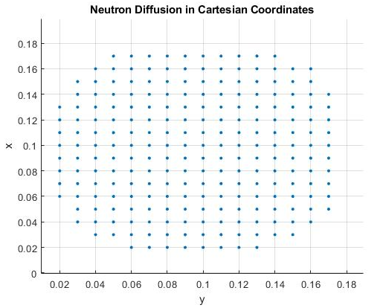
Cartesian 3D: Neutron Density
int NPoints=abs(L/dx); //it's a cubic box L*L*L
newfile.open("output.txt",ios::out);
newfile << "n(" << t <<",x,y,z)" << " " << "x" << " " << "y" << " " << "z" <<endl;
for (int i=1; i<NPoints; ++i)
for (int k=1; k<NPoints; ++k)
for (int l=1; l<NPoints; ++l)
{
n=0; //At the end of every loop in p,q,r, n must be reset
for (p=1;p<N;++p)
for (q=1; q<N;++q)
for (r=1; r<N; ++r)
n=n+a[p][q][r] * exp( eta*(t)-mu*( pow((p*M_PI/L),2)+ //INDENTATION CHANGED FOR PPT
pow((q*M_PI/L),2)+
pow((r*M_PI/L),2) )*(t)) * sin(p*M_PI*i*dx/L) * sin(q*M_PI*k*dx/L) * sin(r*M_PI*l*dx/L);
newfile << n << " " << 0+i*dx << " " << 0+k*dx << " " << 0+l*dx << endl;
};

Slide 16
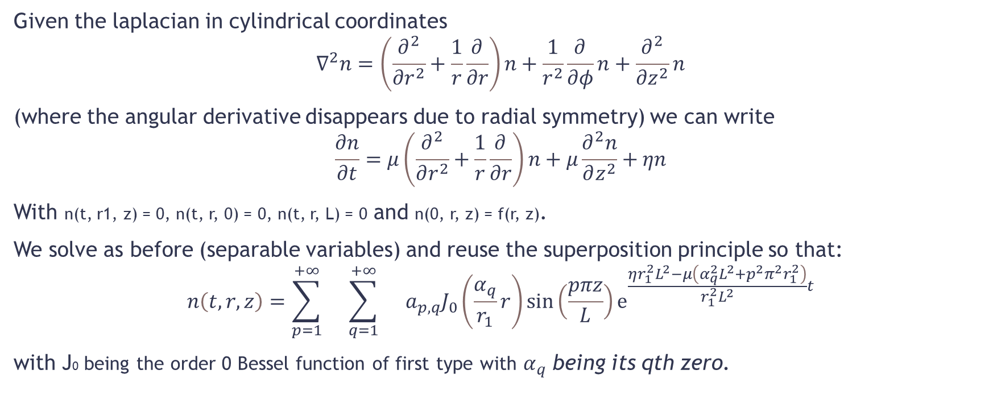
Cylindrical 3D:
Given the laplacian in cylindrical coordinates
$$∇^{2}n=\left(\frac{∂^{2}}{∂r^{2}}+\frac{1}{r}\frac{∂}{∂r}\right)n+\frac{1}{r^{2}}\frac{∂}{∂φ}n+\frac{∂^{2}}{∂z^{2}}n$$
(where the angular derivative disappears due to radial symmetry) we can write
$$\frac{∂n}{∂t}=μ\left(\frac{∂^{2}}{∂r^{2}}+\frac{1}{r}\frac{∂}{∂r}\right)n+μ\frac{∂^{2}n}{∂z^{2}}+ηn$$
With n(t, r1, z) = 0, n(t, r, 0) = 0, n(t, r, L) = 0 and n(0, r, z) = f(r, z).
We solve as before (separable variables) and reuse the superposition principle so that:
$$n\left(t,r,z\right)=\sum_{p=1}^{+∞}{}\sum_{q=1}^{+∞}{}a_{p,q}J_{0}\left(\frac{α_{q}}{r_{1}}r\right)\sin\left(\frac{pπz}{L}\right)ⅇ^{\frac{ηr_{1}^{2}L^{2}−μ\left(α_{q}^{2}L^{2}+p^{2}π^{2}r_{1}^{2}\right)}{r_{1}^{2}L^{2}}t}$$
with J0 being the order 0 Bessel function of first type with $α_{q}$ being its qth zero.

Slide 17
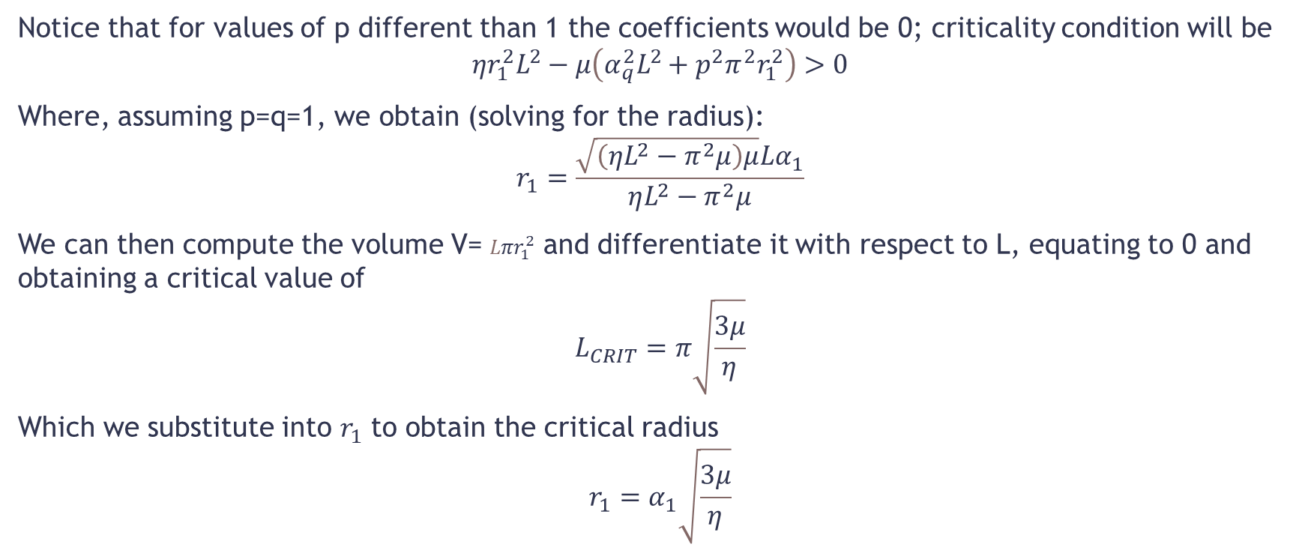
Cylindrical 3D:
Notice that for values of p different than 1 the coefficients would be 0; criticality condition will be
$$ηr_{1}^{2}L^{2}−μ\left(α_{q}^{2}L^{2}+p^{2}π^{2}r_{1}^{2}\right)>0$$
Where, assuming p=q=1, we obtain (solving for the radius):
$$r_{1}=\frac{\sqrt{\left(ηL^{2}−π^{2}μ\right)μ}Lα_{1}}{ηL^{2}−π^{2}μ}$$
We can then compute the volume V= ${Lπr}_{1}^{2}$ and differentiate it with respect to L, equating to 0 and obtaining a critical value of
$$L_{CRIT}=π\sqrt{\frac{3μ}{η}}$$
Which we substitute into $r_{1}$ to obtain the critical radius
$$r_{1}=α_{1}\sqrt{\frac{3μ}{η}}$$

Slide 18
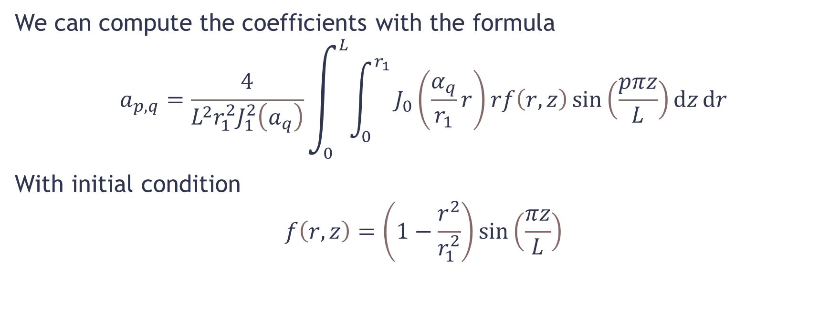
Cylindrical 3D: Coefficientss
We can compute the coefficients with the formula
$$a_{p,q}=\frac{4}{L^{2}r_{1}^{2}J_{1}^{2}\left(a_{q}\right)}\int_{0}^{L}{\int_{0}^{r_{1}}{J_{0}\left(\frac{α_{q}}{r_{1}}r\right)rf\left(r,z\right)\sin\left(\frac{pπz}{L}\right)ⅆz}ⅆr}$$
With initial condition
$$f\left(r,z\right)=\left(1−\frac{r^{2}}{r_{1}^{2}}\right)\sin\left(\frac{πz}{L}\right)$$

Slide 19
Cylindrical 3D: Functions
We define
double Function (double r, double z)
{
return A*(1-pow(r/r1,2))*sin(M_PI*z/L);
};
double Int (double r, double z) //It's way easier to define the integrand like this
{
return 4* Function(r,z)*r* sin(M_PI*z*p/L) * j0(r*alpha[q]/r1) /(L*pow(j1(alpha[q])*r1,2));
}

Slide 20
Cylindrical 3D: Bessel Functions
We need to define Bessel Functions’ zeros by reading them in an array:
alpha=new double[N];
newfile.open("besselzeros.txt",ios::in);
for (int i=0; i<N; ++i)
{
newfile >> alpha[i];
};
newfile.close();

Slide 21
Cylindrical 3D: Coefficients
double Numerics::trapezoidal(double (*f)(double, double), double ax, double bx, double ay, double by, double h)
{
/**Integral solver that uses the trapezoidal method; it solves between [ax,bx] and [ay,by] with step distance h; it solves for y for each step of x*/
//We want to integrate by strings, so for constant x we integrate over y
int Nstepx=abs((bx-ax)/h);
int Nstepy=abs((by-ay)/h);
double Area=0;
for (int i=0;i<Nstepx;++i)
for (int c=0; c<Nstepy; ++c)
Area=Area+(f(ax+(i+1)*h,ax+(c+1)*h)-f(ax+i*h,ay+c*h))*h*h/2+f(ax+i*h,ay+c*h)*h*h;
return Area;
};
Using p=1 (as we said before):
double* a=new double [N];
Numerics num;
double n;
for (q=0;q<N;++q)
{
a[q]=num.trapezoidal(Int,0,r1,0,L,0.001);
cout << a[q] << " ";
cout << endl;
};

Slide 22
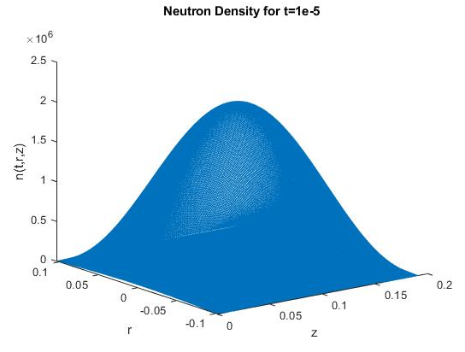
Cylindrical 3D: Neutron Density
int NPoints=abs(L/dx);
int NPointsr=abs(r1/dx);
newfile.open("output.txt",ios::out);
newfile << "n(" << t <<",r,z)" << " " << "r" << " " << "z" <<endl;
for (int i=1; i<2*NPointsr; ++i)
for (int k=1; k<NPoints; ++k)
{
n=0; //At the end of every loop in p,q,r, n must be reset
for (q=0;q<N;++q)
n=n+a[q] * j0((-r1+i*dx)*alpha[q]/r1) * sin(p*M_PI*k*dx/L) * exp( t * ((eta*pow(r1*L,2)-mu*( pow(alpha[q]*L,2) + pow(M_PI*p*r1,2) )) )/pow(r1*L,2));
newfile << n << " " << -r1+i*dx << " " << 0+k*dx << endl;
};
newfile.close();

Slide 23
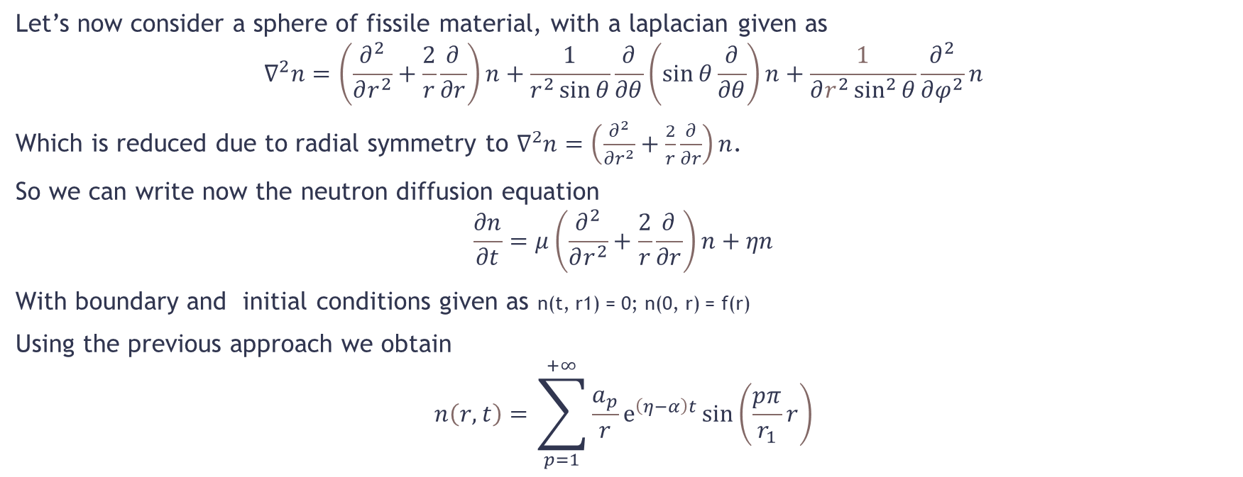
Spherical 3D:
Let’s now consider a sphere of fissile material, with a laplacian given as
$$∇^{2}n=\left(\frac{∂^{2}}{∂r^{2}}+\frac{2}{r}\frac{∂}{∂r}\right)n+\frac{1}{r^{2}\sin{θ}}\frac{∂}{∂θ}\left(\sin{θ\frac{∂}{∂θ}}\right)n+\frac{1}{∂r^{2}\sin^{2}{θ}}\frac{∂^{2}}{∂φ^{2}}n$$
Which is reduced due to radial symmetry to $∇^{2}n=\left(\frac{∂^{2}}{∂r^{2}}+\frac{2}{r}\frac{∂}{∂r}\right)n$.
So we can write now the neutron diffusion equation
$$\frac{∂n}{∂t}=μ\left(\frac{∂^{2}}{∂r^{2}}+\frac{2}{r}\frac{∂}{∂r}\right)n+ηn$$
With boundary and initial conditions given as n(t, r1) = 0; n(0, r) = f(r)
Using the previous approach we obtain
$$n\left(r,t\right)=\sum_{p=1}^{+∞}{\frac{a_{p}}{r}ⅇ^{\left(η−α\right)t}\sin\left(\frac{pπ}{r_{1}}r\right)}$$

Slide 24

Spherical 3D:
With $α=μ{\left(\frac{Pπ}{r_{1}}\right)}^{2}$so that
$$n\left(r,t\right)=\sum_{p=1}^{+∞}{}\frac{a_{p}}{r}ⅇ^{\left(η−μ{\left(\frac{Pπ}{r_{1}}\right)}^{2}\right)t}\sin\left(\frac{pπ}{r_{1}}r\right)$$
The critical condition will be
$$r>pπ\sqrt{\frac{μ}{η}}$$
Which gives, for p=1, the critical radius $r_{crit}=π\sqrt{\frac{μ}{η}}$ which is 11.04 cm for Uranium-235.
For the coefficients
$$a_{p}=\frac{2}{r_{1}}\int_{0}^{r_{1}}{rn\left(0,r\right)\sin\left(\frac{pπ}{r_{1}}r\right)ⅆr}$$
With $n\left(0,r\right)=1−{\left(\frac{r}{r_{1}}\right)}^{2}$

Slide 25
Spherical 3D: Functions
We define
double Function (double r)
{
return 1-pow(r/r1,2); //
};
double Int (double r) //It's way easier to define the integrand like this
{
return 2*Function(r) *r* sin(p*M_PI*r/r1) / r1; //we get 2 times the results given in the paper, which seems to be wrong
}

Slide 26
Spherical 3D: Coefficients
double* a=new double [N];
Numerics num;
for (p=0;p<N;++p)
{
a[p]=num.trapezoidal(Int,0,r1,0.01);
cout << a[p] << " ";
cout << endl;
};

Slide 27
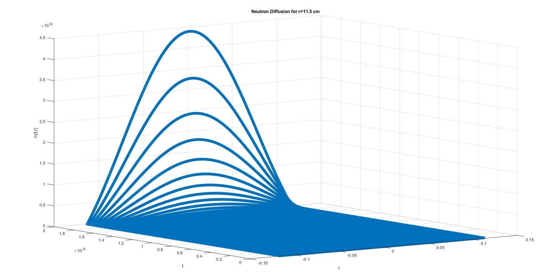
Spherical 3D: Neutron Diffusion
int Nstep=abs(t/dt);
int NPointsr=abs(r1/dx);
newfile.open("output.txt",ios::out);
newfile << "n(t,r)" << " " << "t" << " " << "r" <<endl;
for (int i=1; i<2*NPointsr; ++i)
{
for (int k=1; k<Nstep; ++k)
{
n=0;//At the end of every loop in p,q,r, n must be reset
//if (-r1+i*dx!=0) If we want to avoid infinities in the denominator this is a rather expensive method
{
for (p=1;p<N;++p)
n=n+ (a [ p ]/ (-r1+i*dx) ) * exp ( eta *k*dt - mu *pow((( p ) * M_PI / r1 ),2) *k* dt ) * sin (( p ) * M_PI * (-r1+i*dx) / r1 );
newfile << n << " " << 0+k*dt << " " << -r1+i*dx << endl;
};
};
};

Slide 28
Brief Summary:
For Dirichlet Boundary condition we can see that
Vsphere : Vcyl : Vcube = 1 : 1.142 : 1.241
How much different would be the critical radius assuming Neumann Boundary Condition?

Slide 29
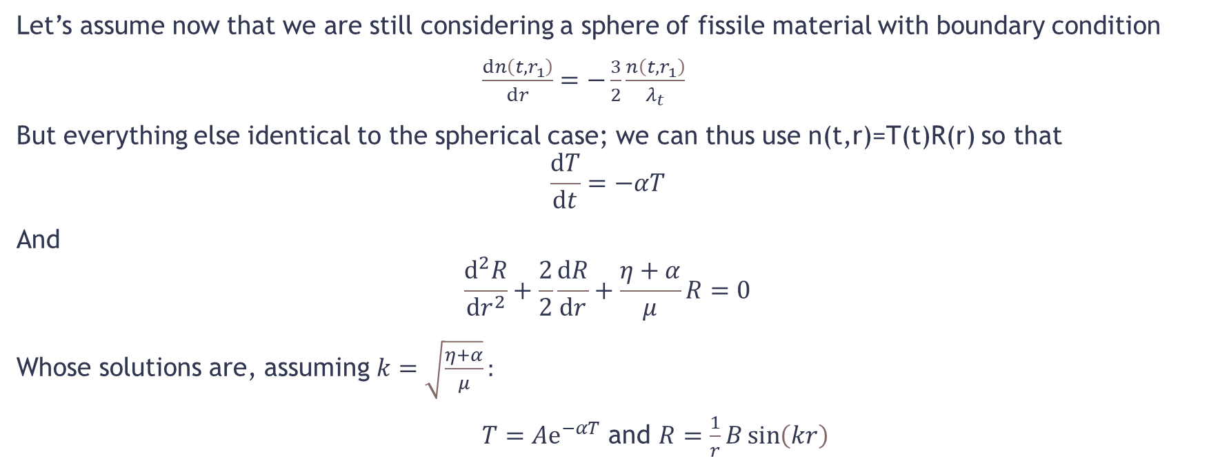
Neumann BC:
Let’s assume now that we are still considering a sphere of fissile material with boundary condition
$\frac{ⅆn\left(t,r_{1}\right)}{ⅆr}=−\frac{3}{2}\frac{n\left(t,r_{1}\right)}{λ_{t}}$
But everything else identical to the spherical case; we can thus use n(t,r)=T(t)R(r) so that
$$\frac{ⅆT}{ⅆt}=−αT$$
And
$$\frac{ⅆ^{2}R}{ⅆr^{2}}+\frac{2}{2}\frac{ⅆR}{ⅆr}+\frac{η+α}{μ}R=0$$
Whose solutions are, assuming $k=\sqrt{\frac{η+α}{μ}}:$
$T=Aⅇ^{−αT}$ and $R=\frac{1}{r}B\sin\left(kr\right)$

Slide 30

Neumann BC:
We then solve for $α$=1 to get the critical radius:
$\frac{ⅆR}{ⅆr}=−\frac{3}{2}\frac{R}{λ_{t}}$
We can do this numerically, defining R as its general solution:
double Rfunc (double r){
return (A*sin(k*r))/r;
};
double Rfuncprime (double r){
Numerics num;
return num.derivative(Rfunc,0.00001,r);
}
double neumannBC(double r)
{
return Rfuncprime(r)+3*Rfunc(r)/(2*lambdat);
};
double Numerics::derivative (double (*func)(double), double dx, double pointx){
/**A simple 5 points formula that gives the derivative of func in pointx using dx as small distance*/
return (func(pointx-2*dx)-8*func(pointx-dx)+8*func(pointx+dx)-func(pointx+2*dx))/(12*dx);
};

Slide 31
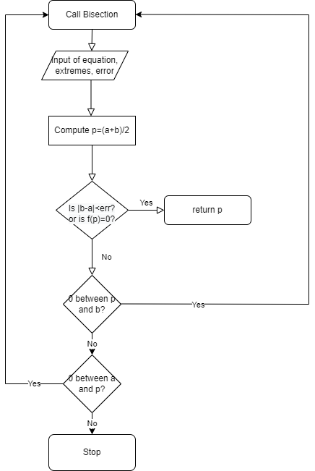
Neumann BC:
double Numerics::bisection(double (*f)(double), double a, double b, double error)
{
/**Simple Root Finding algorythm that uses bisection; it solves between a and b; if f has more than one 0 between a and b it may not give any result*/
double newpar=a+(b-a)/2;
if (b<a)
{
swap(a,b);
}
if (abs(b-a)<abs(error) || abs(f(newpar))==0)
return newpar;
if (f(a)*f(newpar)<=0) //Recursive condition
return bisection(f,a,newpar,error);
else if (f(newpar)*f(b)<=0)
return bisection(f,newpar,b,error);
else
{
cout << "Error: number of zeros in the selection is not 1"<<endl;
return a;
}
};
We then solve the equation to get r1:
r1=num.bisection(neumannBC,0,10,1e-5);
Obtaining a radius of 8.369 cm.
We can then compute what happens for R>r

Slide 32
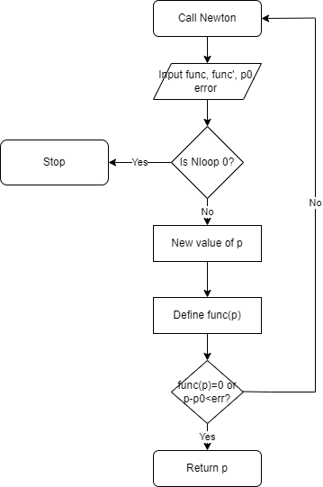
Neumann BC:
We define for R=8.5 cm:
double newalpha (double a)
{
return -1 + 3*R/lambdat/2 + R*sqrt((eta+a)/mu)*cos(R*sqrt((eta+a)/mu))/sin(R*sqrt((eta+a)/mu));
};
double alphaprime(double r)
{
Numerics num;
return num.derivative(newalpha, 0.00001, r);
};
So that in the main:
R=8.5;
alpha=num.newton(newalpha,alphaprime, 0, 1e-7,100);
double Numerics::newton(double (*func)(double), double (*funcprime)(double), double p0, double err, int Nloop)
{
/**Simple Root Finding algorythm that uses Newton method; it requires a function func and its derivative funcprime. It also wants a starting point p0*/
double p=p0-func(p0)/funcprime(p0);
if (Nloop==0)
{
cout <<"There is no 0 that could be found in the suggested number of loops"<<endl;
return p0;
};
if ((func(p) == 0) || (abs(p-p0) < err))
return p;
else
return newton(func,funcprime,p,err,Nloop-1);
};

Slide 33
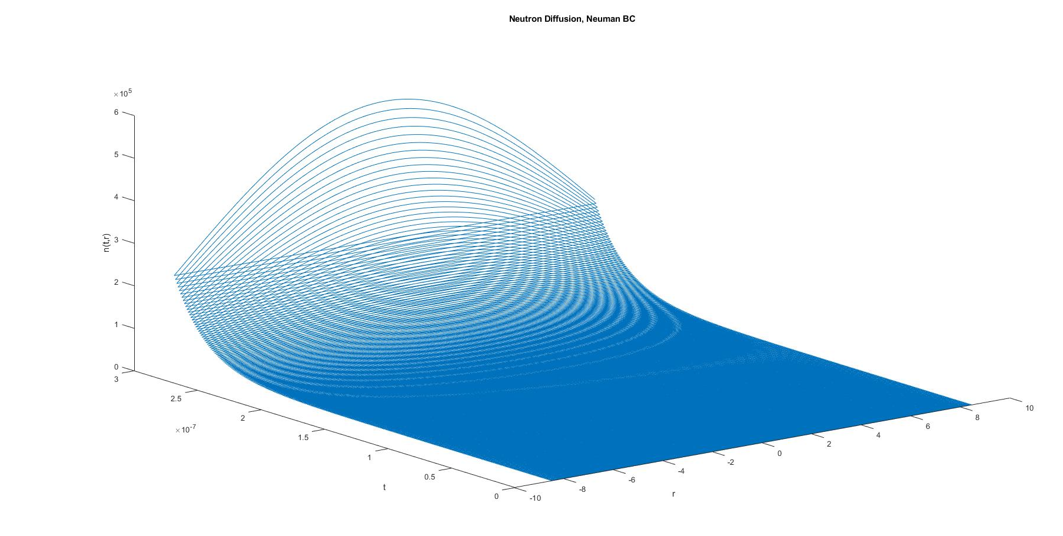
Neumann BC: Neutron Diffusion
The initial conditions don’t need to be too precise, so we can just set n=1 at the surface (n(t=0,r=8.5)=1), then we compute n:
int NPoints=2*abs(R/dx);
int NStep=abs(tfin/dt);
A=1/ (sin ( k * R ) / R);
cout <<k<< " "<<alpha<< " "<<R<<" "<< A << endl;
newfile.open("output.txt",ios::out);
newfile << "n(r,t)" << " " << "t" << " " << "r" << endl;
for (int c=1; c<NStep; ++c)
{
for (int i=1; i<NPoints; ++i)
{
n=A*exp(- alpha *c*dt)*sin(k*(-R+i*dx))/(-R+i*dx);
newfile << n << " " << c*dt << " " << -R+i*dx << endl;
};
};

Slide 34
Tamper
Since fissile material is expensive we need to use it efficiently!
We surround the fissile material with a reflector material (generally heavy elements) that can reflect escaping neutrons back inside.
This is called a ‘tamper’ or ‘containment shell’
It also prevents the fissile material from increasing too much in size, avoiding the premature end of the chain reaction.

Slide 35
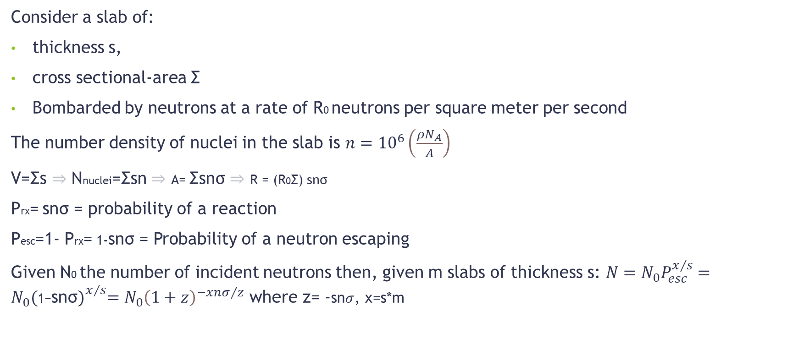
Mean Free Path:
Consider a slab of:
thickness s,
cross sectional-area Σ
Bombarded by neutrons at a rate of R0 neutrons per square meter per second
The number density of nuclei in the slab is $n={10}^{6}\left(\frac{ρN_{A}}{A}\right)$
V=Σs ⇒ Nnuclei=Σsn ⇒ A= Σsnσ ⇒ R = (R0Σ) snσ
Prx= snσ = probability of a reaction
Pesc=1- Prx= 1-snσ = Probability of a neutron escaping
Given N0 the number of incident neutrons then, given m slabs of thickness s: $N=N_{0}P_{esc}^{x/s}=$ $N_{0}{(\text{1−}\text{sn}\text{σ})}_{}^{x/s}=N_{0}{\left(1+z\right)}^{−xnσ/z}$ where z= -sn$σ$, x=s*m

Slide 36
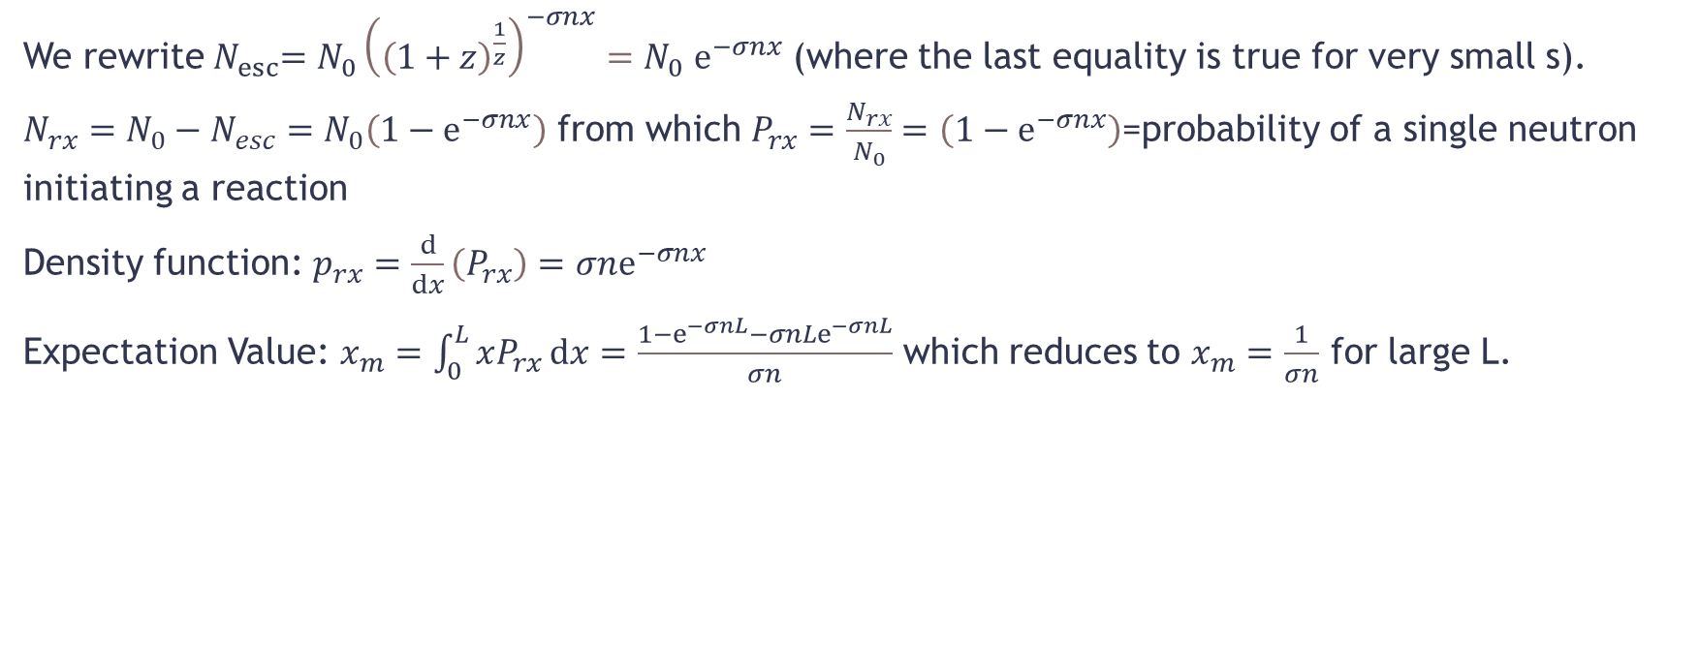
Mean Free Path:
We rewrite${ N}_{esc}=N_{0}{\left({\left(1+z\right)}^{\frac{1}{z}}\right)}^{−σnx}{=N}_{0}ⅇ^{−σnx}$ (where the last equality is true for very small s).
$N_{rx}=N_{0}−N_{esc}=N_{0}\left(1−ⅇ^{−σnx}\right)$ from which $P_{rx}=\frac{N_{rx}}{N_{0}}=\left(1−ⅇ^{−σnx}\right)$=probability of a single neutron initiating a reaction
Density function: $p_{rx}=\frac{ⅆ}{ⅆx}\left(P_{rx}\right)=σnⅇ^{−σnx}$
Expectation Value: $x_{m}=\int_{0}^{L}{xP_{rx}ⅆx}=\frac{1−ⅇ^{−σnL}−{σnLⅇ}^{−σnL}}{σn}$ which reduces to $x_{m}=\frac{1}{σn}$ for large L.

Slide 37
Mean Free Path: Numerics
We use a script to compute the probability and number of neutron reacting or escaping:
cout << "How thick will the slab be?"<<endl<<"x: ";
cin>>x;
cout << endl;
Nesc=N0*pow(Pesc, x/s);
z=s*n*sigma;
cout << Nesc<<" ";
Nesc=N0*pow(1+z,-sigma*n*x/z); //Nesc=N0*pow(pow(1+z,1/z),-sigma*n*x);
cout << Nesc << " "<<endl;
Nesc=N0*exp(-sigma*n*x);
Nreact=N0-Nesc;
cout << "The number of reactions is: "<< Nreact << endl;
And we compare the different formulas derived above

Slide 38
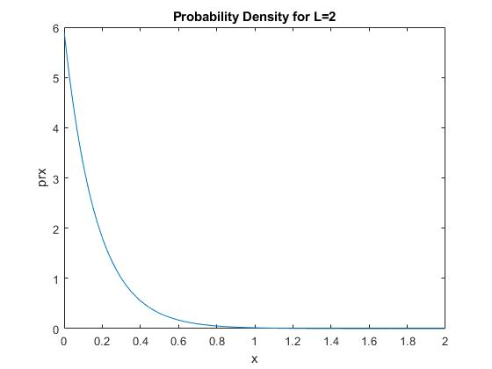
Mean Free Path: Numerics
We then plot the probability density and derive the mean free path:
int NStep=abs(x/dx);
xm=num.integration(Int,0,x,1e-3);
cout<<"The expectation value is: "<<xm<<endl;
for (int c=1; c<NStep; ++c)
{
newfile << prx(c*dx) <<" "<< c*dx<<endl;
};
We find then that the mean free path is 16.89 cm

