Slide 1
Sub-GeV Hadrophilic Dark Matter at Neutrino Detectors
Dipartimento di Fisica e Astronomia, Università di Bologna
Second Cycle Degree in Physics
Presented by: francesco xotta
Supervised by: filippo sala
Co-supervised by: silvia pascoli

Slide 2
Summary
Introduction to Dark Matter
Dark Matter from Air Showers
Flux and Event Rate
Results and New Prospects

Slide 3
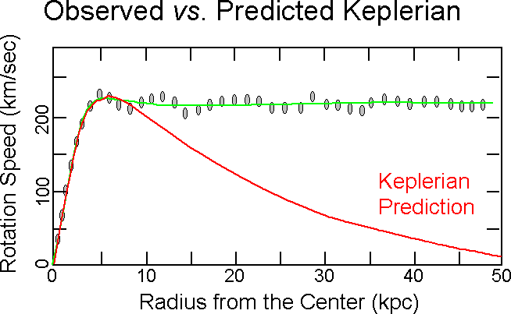
Discovery of Dark Matter
Velocity Rotation Curves
Bullet Clusters
CMB
Incomplete Standard Model
Cosmology
Source: https://www.astronomy.ohio-state.edu/thompson.1847/1101/lecture_darkmatter_darkenergy.html
Francesco Xotta
3

Slide 4
Dark Matter Main Properties
Dark Matter can’t be baryonic
Dark Matter can’t be hot (must be cold or warm)
Dark Matter must be Dark
Dark Matter must be stable
Assume non gravitational interactions to explain its production
Francesco Xotta
4

Slide 5
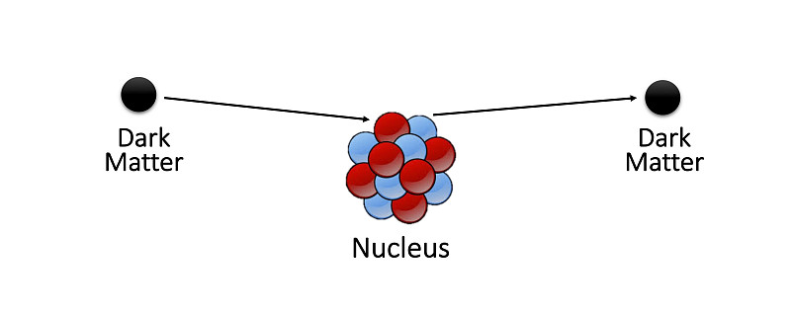
The Search for Dark Matter
Direct Detection based on interactions between nuclei and DM
DM’s velocity in the galaxy is 10⁻³ c
Detectable mass greater than 10 GeV
But if the flux of DM is relativistic?

Slide 6
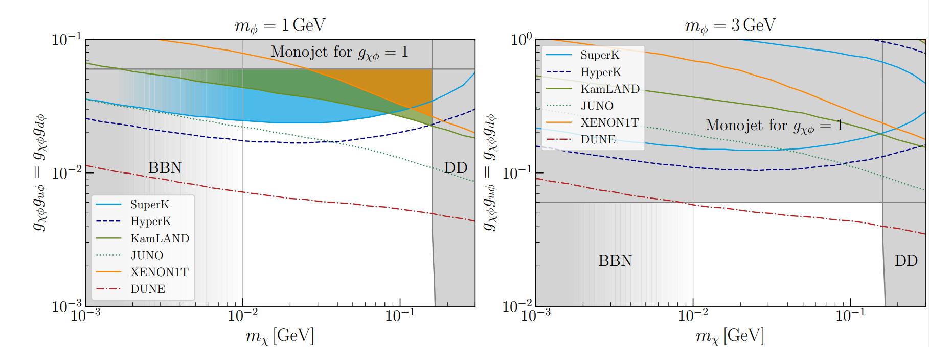
State of the Art for Light Dark Matter
2011.01939
Component of the flux upscattered by cosmic rays

Slide 7
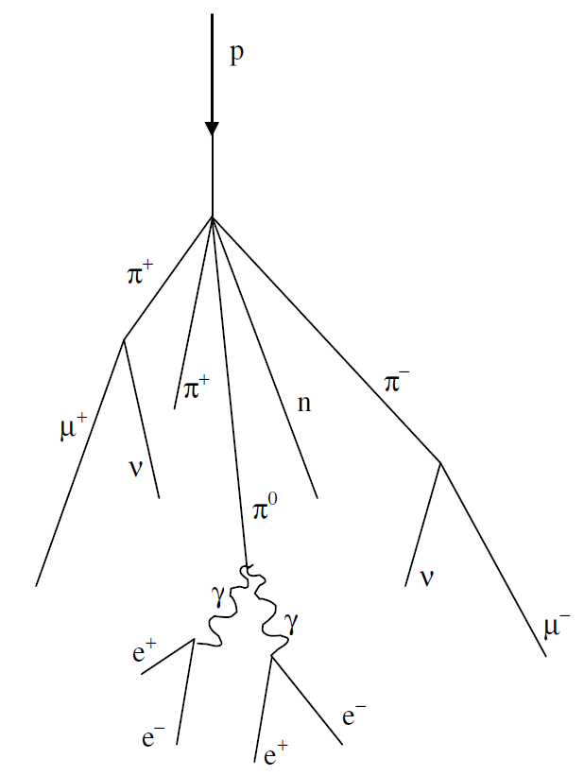
Air Showers
Primary cosmic ray collides with the atmosphere producing energetic hadrons
Shower is divided in
Hadronic Shower
Electromagnetic Shower
Very energetic flux of mesons
1905.05776
Francesco Xotta
7
Hadrons will interact depending on their decay length dP and their interaction length λP

Slide 8
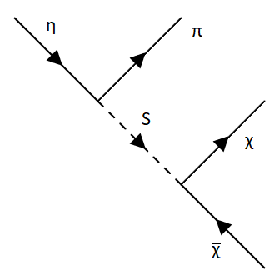
Hadrophilic DM in Air Showers
Lagrangian given as
Mediator coupling to mesons at low energies (Chiral Perturbation Theory)
Mesons decay to Dark Matter Flux of relativistic DM
Francesco Xotta
8

Slide 9
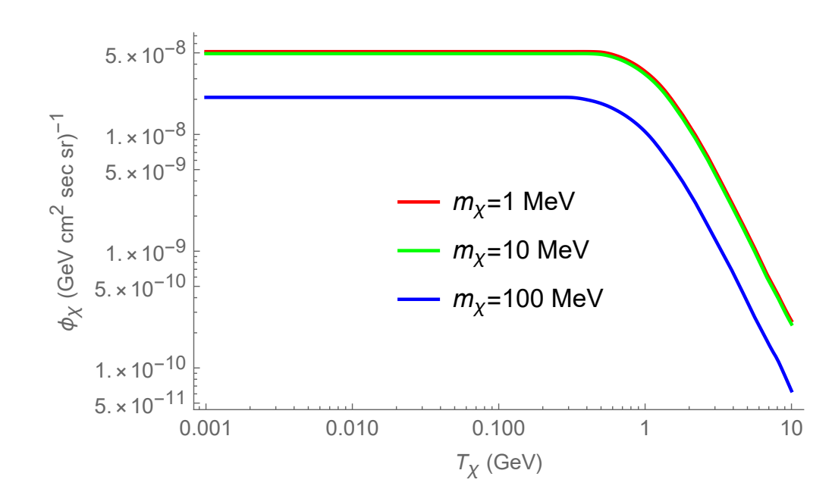
Flux of Dark Matter
For DM flux:
Flux of Mesons
Distribution of particles dn/dE
Fix the mass of mediator to 1 GeV
Francesco Xotta
9

Slide 10
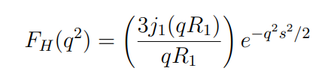
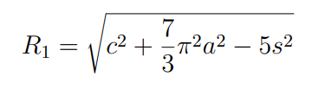

Interaction with Nuclei in Detectors
DM interacts with nuclei in detectors
DM can resolve nuclear structure
For DM’s energies below 100 MeV DM collides with nuclei.
For DM’s energies above 100 MeV DM resolves nuclear stucture
Francesco Xotta
10

Slide 11
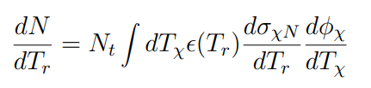
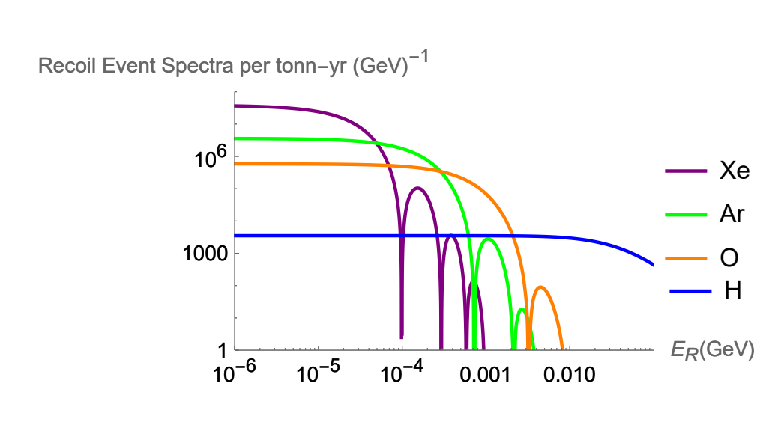

Number of Events
Event-Rate:
Limits and sensitivities:
Francesco Xotta
11

Slide 12
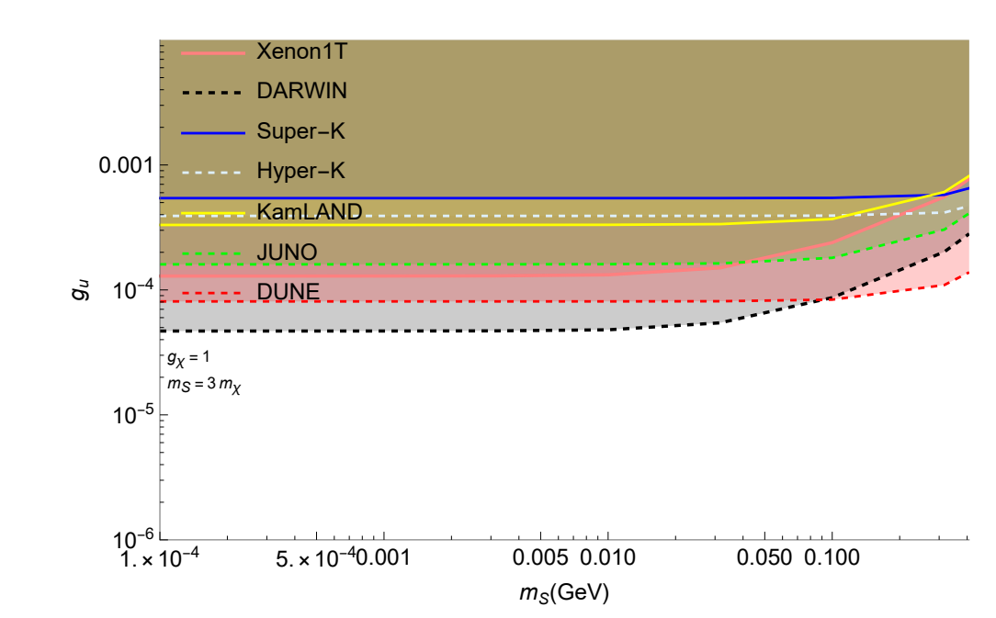


New Limits
Fix DM-Mediator coupling to 1
Fix mediator mass to 3 times the DM mass
η meson decaying on-shell as
Francesco Xotta
12

Slide 13
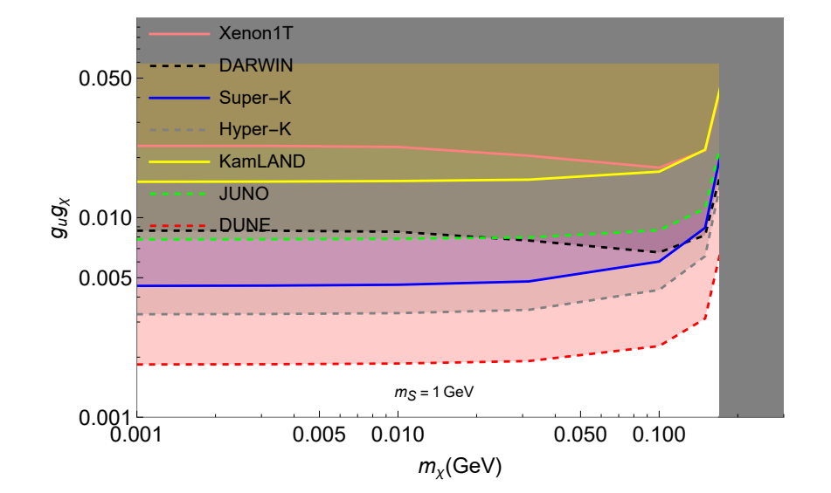

New Limits
Fix mediator mass to 1 GeV
η meson decaying off-shell as
Francesco Xotta
13

Slide 14
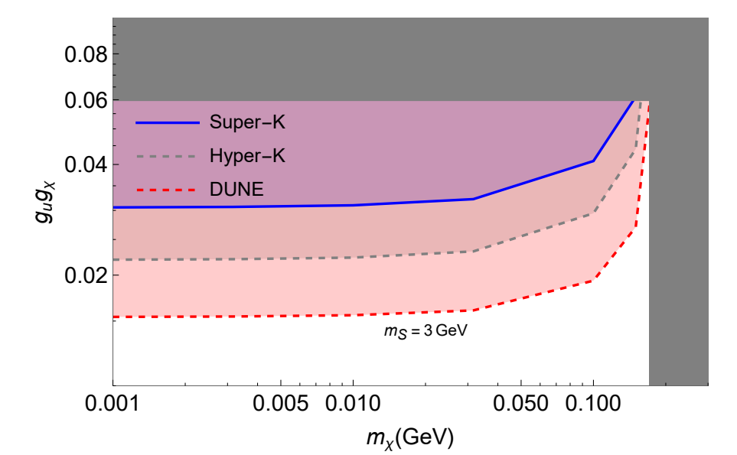
New Limits
Fix mediator mass to 3 GeV
η meson decaying off-shell as
Francesco Xotta
14

Slide 15
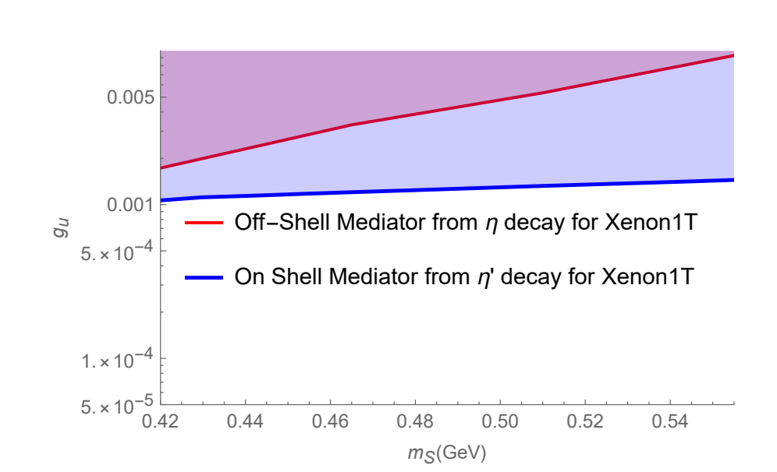
Future Prospects
Introduce the decay of the η′ meson
Include more effects (e.g. direct production of DM from CRs interacting with atmosphere)

