Slide 1

Francesco Xotta
Master Student at the University of Bologna
PhD candidate for
High-energy emission from compact objects in globular clusters
Supervisors: Dr. Pasquale Serpico (LAPTh)
Dr. Francesca Calore (LAPTh)
Dr. Maica Clavel (ipaG)

Slide 2
2018-2021: Bachelor Degree in Physics at University of Bologna (110/110)
2021-On Going: Master Degree in Theoretical Physics at University of Bologna
MASTER THESIS:
Sub-GeV Dark Matter at Neutrino Detectors
Supervisor: Filippo Sala, Co-Supervisor: Silvia Pascoli
Discussion: 14/07/2023
PAST RESEARCH ACTIVITIES:
Study of a sample of stars from the HYG catalog by using network analysis
Simulation in C++ of the diffusion of neutrons in a nuclear weapon
Francesco Xotta
2

Slide 3
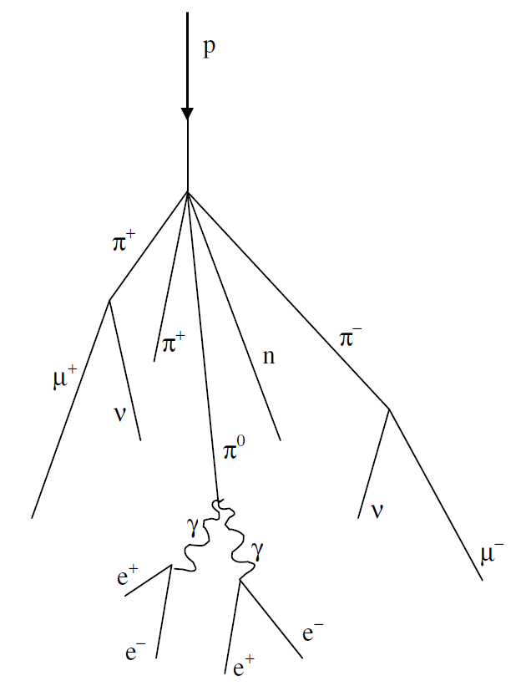
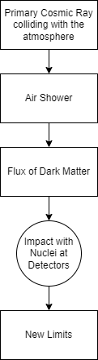
Detection of Sub-GeV Dark Matter Candidate
1812.05103
2203.12630
Meson decays in air shower result in a flux of dark matter which arrives to earthbound detectors
Dark matter can interact with the nuclei of Neutrino Detectors
Interaction between dark matter χ and up quark through a scalar mediator S
Developed with Mathematica; lasted from december 2022 to June 2023
Francesco Xotta
3

Slide 4
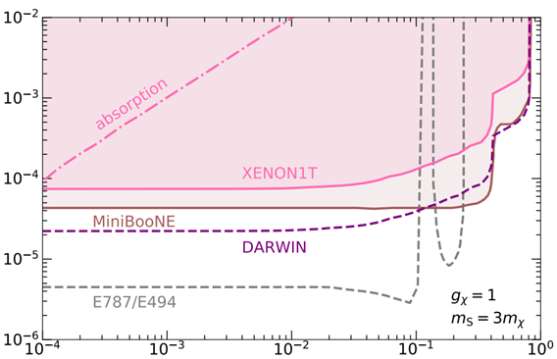

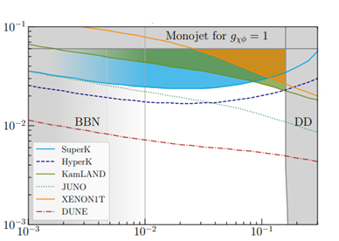
Results from Literature
gu
gugχ
By comparing observed events for Xenon1T to the expected number of events
mS=1 GeV
2203.12630
2011.01939
mS [GeV]
mχ
Francesco Xotta
4
It was investigated the η, η’, K mesons decay into a pion and the mediator S

Slide 5
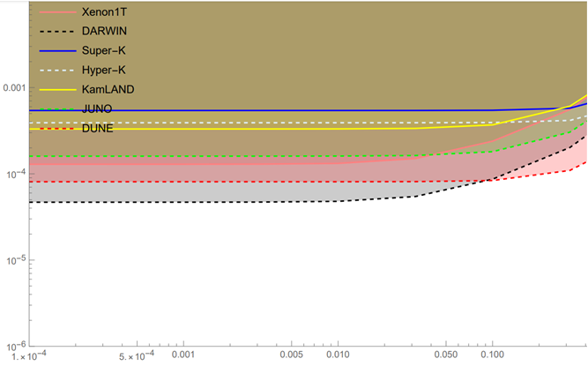
My contribution 1
gu
Numerically integrate to obtain the flux and then the events at detectors
We consider several neutrino detectors; obtain number of free protons, use Birks’ Law to convert electron equivalent to recoil energy in scintillators
We prove neutrino detectors are more sensitive for higher masses of the mediator
mS [GeV]
Francesco Xotta
5

Slide 6
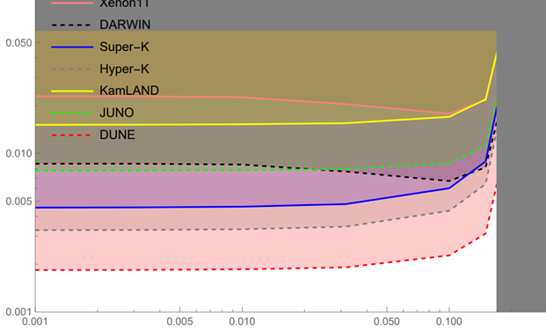

My contribution 2
gugχ
We consider the possibility of a three-body decay off-shell (mediator produced as a virtual particle)
Compute matrix element from Feynman Diagram
Compute phase space for a three body decay, then distribution using
mS=1 GeV
mχ
Francesco Xotta
6

Slide 7
Francesco Xotta

Slide 8
PhD Project
High-energy emission from compact objects in globular clusters
LAPTH - Laboratoire d'Annecy-le-Vieux de Physique Théorique
Supervisors: Dr. Francesca Calore, Dr. Maica Clavel, Dr. Pasquale Serpico
Purpose: Explaining the Galactic Center Excess at GeV energies in Fermi-LAT data with cumulative emissions from unresolved point sources (mainly Millisecond Pulsars)
Deriving the luminosity function from the analysis of several globular clusters with multiwavelength analysis
Francesco Xotta
7

Slide 9
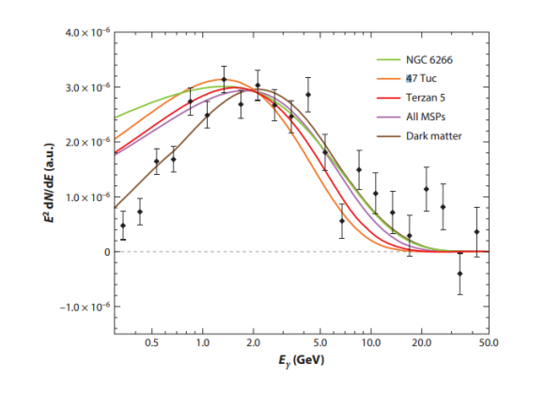
Galactic Center Excess
Excess of gamma-ray radiation measured by FermiLAT in 2009 in the Galactic Center
Spherical Shape
Spectrum Peaked at 2 GeV
Spectrum Regular in the distance
Intepretations:
Dark Matter Annihilation
Collective emission from point sources
Cosmic Ray Outbursts
Galactic Center Excess Spectrum
Francesco Xotta
8

Slide 10
Simulation of Luminosity Functions
The purpose was to reproduce results from ‘Luminosity functions consistent with a pulsar-dominated Galactic Center Excess’ (Arxiv: 2112.09699)
Fit datas to obtain GCE Integrated Flux
For three benchmarks, reproduce number of point sources
Reproduce also number of resolved sources
BENCHMARK LUMINOSITY FUNCTION | TOTAL SOURCES | RESOLVED SOURCES
AIC (2106.00222) | 3.6e5 | 60
GLC (1606.09250) | 670 | 310
DISK (1805.11097) | 2.7e4 | 130
For more informations: https://github.com/X0774
Francesco Xotta
9

Slide 11
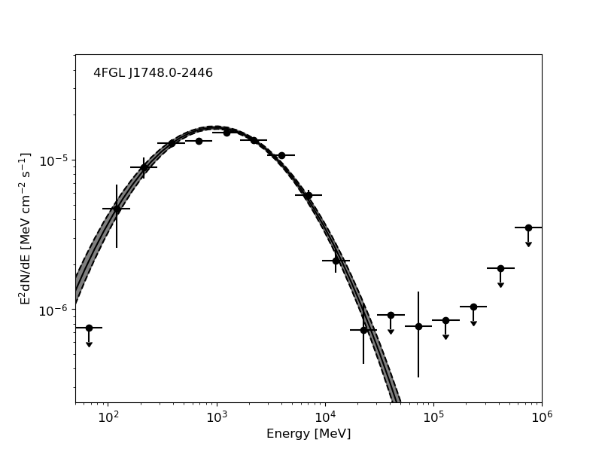
Globular clusters
It’s hard to obtain more informations on source population in the Galactic Center.
Why? Globular clusters host large populations of compact objects, with gamma-ray emissions coming from MSPs
How? Multi-wavelength study of globular cluster emission:
their spatial distribution in the Galaxy
their emission in radio, X-ray and gamma
Radio and X-Ray have better angular resolutions
Fit with FermiPy
Francesco Xotta
10
; they could have a similar environment to the Galactic Center due to their density
More specifically:
We study gamma-ray emission and derive luminosity function from the combined analysis of various globular clusters. We work with FermiPy at this step
Study on correlation between emissions in various wavelengths; Derive Luminosity Function and apply to Galactic Center Excess, then we can compare number of resolved sources to observed value and see if our benchmark can effectively describe the GCE.

Slide 12
Why me?
Francesco Xotta
Master Student in Theoretical Physics
Master Thesis: Sub-GeV Dark Matter at Neutrino Detectors
PhD Thesis: High-energy emission from compact objects in globular clusters
Supervisors: Dr. Francesca Calore, Dr. Maica Clavel, Dr. Pasquale Serpico
Competences:
I am experienced with star catalogs
Experienced with programming languages
Strong knowledge on theoretical astroparticle physics (including the galactic center excess and the mechanisms at the core of gamma-ray production)
Francesco Xotta
11

Slide 14
Other Existing Limits from Literature
Limits can be derived from
Cosmology (Dark Matter Abundance, BBN)
Astrophysics (Supernova Remnants Cooling)
Collider Physics
Direct Detection
2011.01939
Francesco Xotta
Bonus Slide

