Slide 1

Francesco Xotta
Master Student at the University of Bologna
P H D C A N D I D A T E F O R
H I G H - E N E R G Y E M I S S I O N F R O M C O M P A C T O B J E C T S I N G L O B U L A R C L U S T E R S
S U P E R V I S O R S : D R . F R A N C E S C A C A L O R E ( L A P T H)
D R . M A I C A C L AV E L ( I PA G )
D R . PA S Q U A L E S E R P I C O ( L A P T H )

Slide 2
2018-2021: Bachelor Degree in Physics at University of Bologna (110/110) 2021-On Going: Master Degree in Theoretical Physics at University of Bologna MASTER THESIS:
Sub-GeV Dark Matter at Neutrino Detectors Supervisor: Filippo Sala, Co-Supervisor: Silvia Pascoli Defense Date: 14/07/2023
PAST RESEARCH ACTIVITIES:
Study of a sample of stars from the HYG (Hipparcos-Yale-Gliese) catalog by using network analysis
Simulation in C++ of the diffusion of neutrons in a nuclear weapon
CURRENT RESEARCH:
Short Remote Project with Dr. Calore and Dr. Clavel

Slide 3
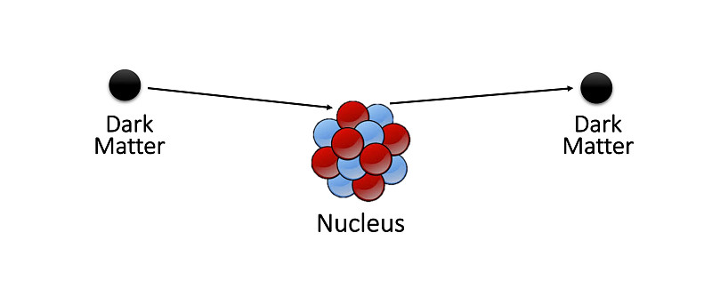
The Search for Light Dark Matter
Direct Detection is based on the interaction between DM and heavy nuclei
It considers Dark Matter with the velocity of the DM wind in the galaxy (1e-3 c)
The mass it can detect is generally greater than 10 GeV
But if the flux of DM is relativistic?

Slide 4

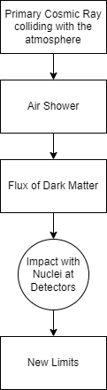
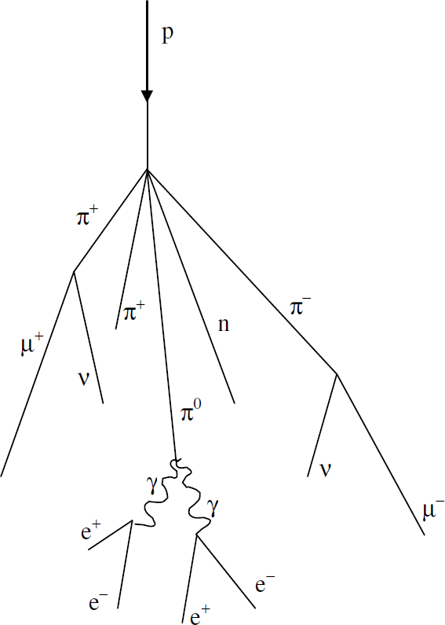
Detection of Sub-GeV Dark Matter Candidate
from December 2022 to June 2023
Meson decays in air shower result in a flux of dark matter which arrives to earthbound detectors
Dark matter can interact with the nuclei of
Neutrino Detectors
Interaction between dark matter χ and up quark through a scalar mediator S
1812.05103
2203.12630
Complementary limits can also be obtained for example from collider physics or cosmology

Slide 5
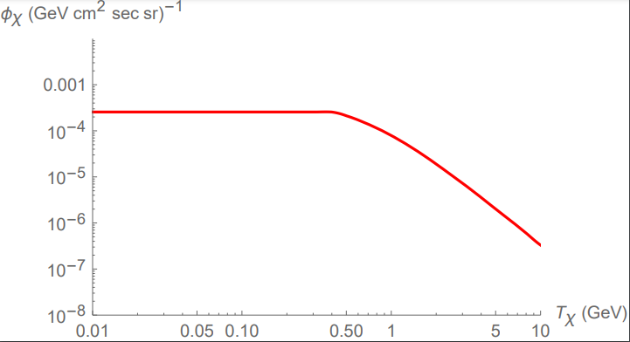

The flux of mesons is obtained from the literature (Corsika8 simulations)
Numerically integrate to obtain the flux
Compute the cross section for the interaction of DM and nucleus at detectors
By comparing observed events to the expected number of events we obtain limits
Developed with Mathematica

Slide 6
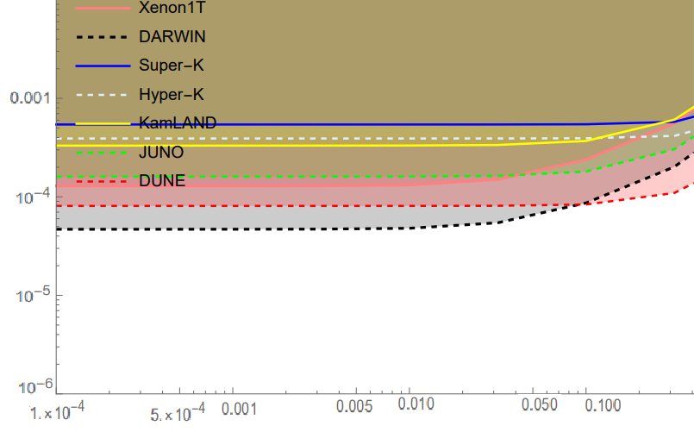
My contribution 1
Thick lines are limits from currently running detectors (or detectors that aren’t running anymore)
Dashed lines are sensitivities from future detectors
We consider several neutrino detectors
Obtain number of free protons
Use Birks’ Law to convert electron equivalent to recoil energy in scintillators
We prove neutrino detectors are more sensitive for higher masses of the mediator
gu
mS [GeV]

Slide 7
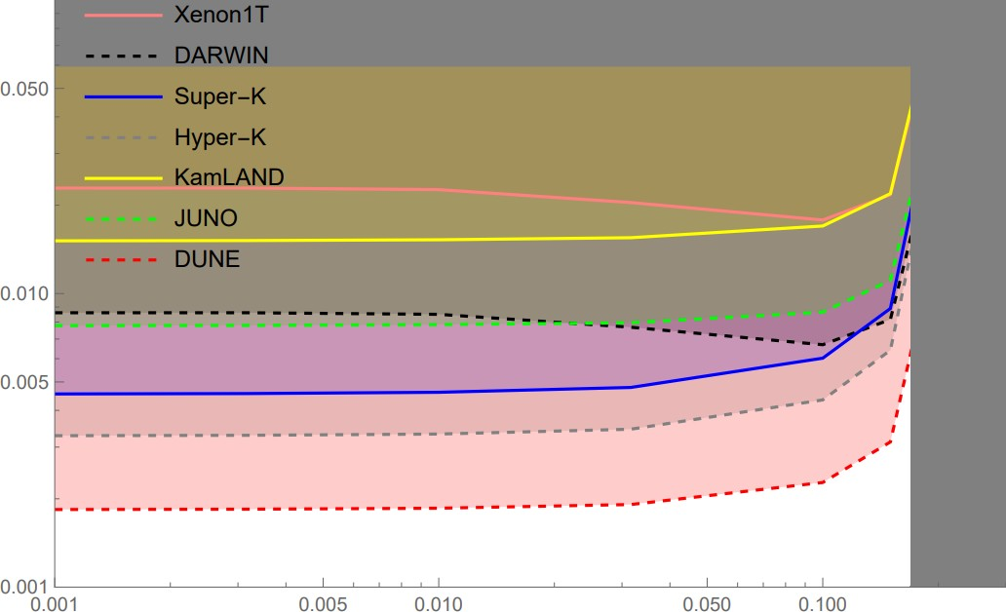

My contribution 2
We consider the possibility of a three-body decay off-shell (mediator
mS=1 GeV
produced as a virtual particle)
Compute matrix element from
Feynman Diagrams
Compute phase space for a three body decay
Compute distribution using
gugχ
mχ [GeV]

Slide 8
PhD Project
High-energy emission from compact objects in globular clusters LAPTh - Laboratoire d'Annecy-le-Vieux de Physique Théorique
IPAG - Institut de Planétologie et d’Astrophysique de Grenoble
Supervisors: Dr. Francesca Calore, Dr. Maïca Clavel, Dr. Pasquale Serpico
Purpose: Explaining the Galactic Center Excess at GeV energies in Fermi-LAT data with cumulative emissions from unresolved millisecond pulsars
Deriving the luminosity function from the analysis of several globular clusters with a multi-wavelength approach
8

Slide 9
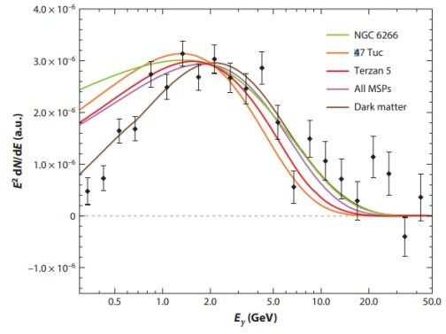
Galactic Center Excess
Excess of gamma-ray radiation measured by Fermi-LAT since 2009 from the direction of the Galactic center
Spherical morphology
Spectrum peaked at 2 GeV
Uniform with distance from GC
Interpretations:
Dark Matter annihilation
Collective emission from point sources
Cosmic-ray outbursts
Galactic Center Excess Spectrum
Source:
Annual Review of Nuclear and Particle Science
The Fermi–LAT Galactic Center Excess: Evidence of Annihilating Dark Matter?
Simona Murgia
2020
9

Slide 10
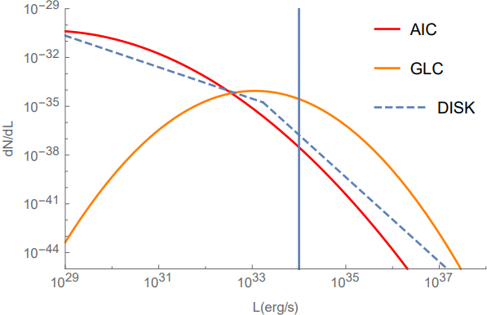
Collective emission from point sources
May 2023
Resolved Sources
Unresolved Sources
Luminosity Function is a distribution of sources per luminosity interval
From the distance of the sources and the luminosity function, we can derive the flux
Flux=Luminosity/4 πd²
We can then compare to the threshold for the flux from FermiLAT
Project:
For three benchmarks luminosity function, reproduce number of point sources
3.6e5
2.7e4
310
130
670
60
For more informations: https://github.com/X0774
‘Luminosity functions consistent with a pulsar- dominated Galactic Center Excess’ (Arxiv: 2112.09699)
Francesco Xotta
10

Slide 11
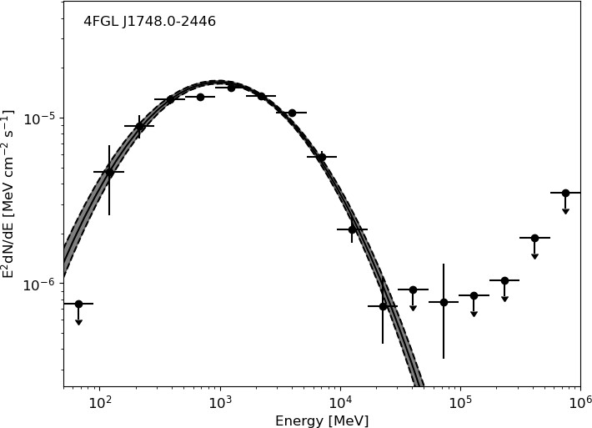
Globular clusters
It’s hard to obtain more information on source population in the Galactic center.
Why? Globular clusters host large populations of compact objects, with gamma-ray emissions coming from MSPs
How? Multi-wavelength study of globular cluster emission:
their spatial distribution in the Galaxy
their emission in radio, X and gamma rays
FermiLAT Spectrum of Terzan5
(My gamma-ray data analysis)
Radio and X rays have better angular resolutions
11

Slide 12
Why me?
Francesco Xotta
Master Student in Theoretical Physics
Master Thesis: Sub-GeV Dark Matter at Neutrino Detectors
PhD Thesis: High-energy emission from compact objects in globular clusters
Supervisors: Dr. Francesca Calore, Dr. Maïca Clavel, Dr. Pasquale Serpico
Competences:
I am experienced with star catalogs Experienced with programming languages
Strong knowledge on theoretical astroparticle physics (including the Galactic center excess and the mechanisms at the core of gamma-ray production)
Contact Informations:
E-Mail: francesco.xotta@studio.unibo.it
Country: Italy
City: Bologna
Street: Viale Alfredo Oriani 38/2
12

Slide 14
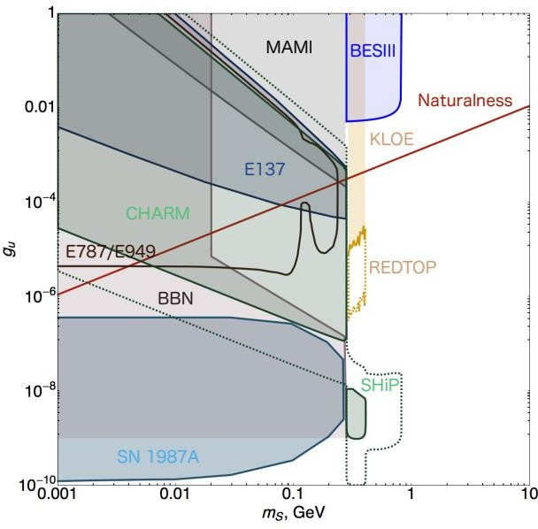
Other Existing Limits from Literature
Limits can be derived from
Cosmology (Dark Matter Abundance, BBN)
Astrophysics (Supernova Remnants
Cooling)
Collider Physics
Direct Detection
1812.05103
2011.01939
Francesco Xotta
Bonus Slide

Slide 15
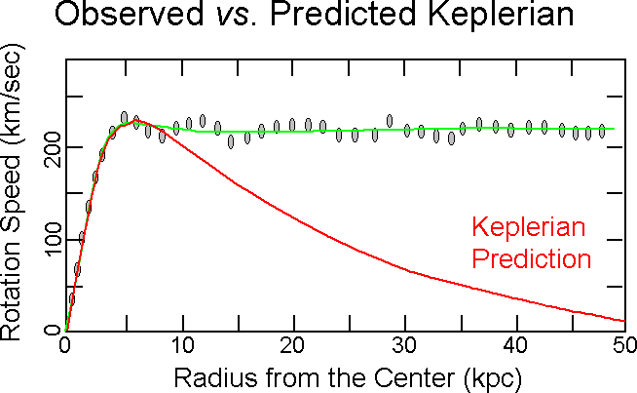
Why Dark Matter?
Velocity Rotation Curves
Bullet Clusters
CMB
Incomplete Standard Model
Cosmology
Dark Matter can’t be baryonic
Dark Matter can’t be hot (must be cold or warm)
Assume non gravitational interactions to explain its production
Source: https://www.astronomy.ohio-state.edu/thompson.1847/1101/lecture_darkmatter_darkenergy.html
Bonus Slide

Slide 16
Why Light Dark Matter?
No results from Direct Detection Experiments (which lose sensitivity at ~10 GeV)
Could explain the positron excess (511 keV line) in the galactic center
Could explain some discrepancies in the measured value of the fine structure constant
Warm Dark Matter seems more likely than Cold Dark Matter from numerical simulations
Theoretically easier to obtain in models linking DM production to the baryon asymmetry
The requirement for new and innovative technologies also made light DM very interesting
Francesco Xotta
Bonus Slide

Slide 17
2011.01939
2203.12630

