Slide 1
INF 574: Mesh Parameterization
CUI Zhipu, XIA Junkai

Slide 2
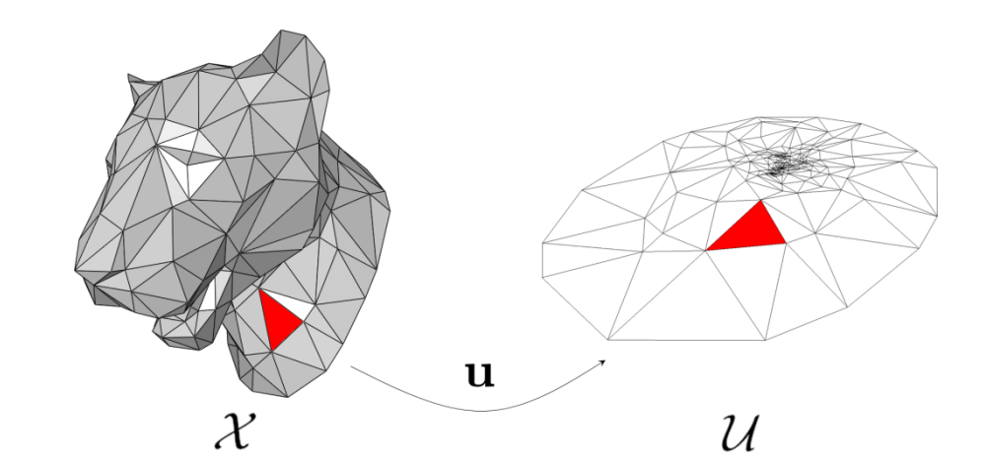
Introduction of the project
Spectral Conformal Parameterization[P.Mullen et al.]

Slide 3
Procedure
Segmentation: We try to divide the 3d object into several components, each of which is isometric to a disk.
Parameterization: For each component, we have implemented the algorithm to project the 3d meshes on to a plane by solving linear equations.
Packing: After we have calculated the 2d projection of each components in their own coordinate system, we then tried to unify these meshes into one general coordinate system and then put in on a plane.

Slide 4



Parameterization
C
$$\vec{n}$$
(x2,y2)
$$\vec{e_{2}}$$
B
$$\vec{e_{1}}$$
(0,0)
(x1,0)
A

Slide 5






(x2,y2)
(0,0)
(x1,0)
Minimize:

Slide 6
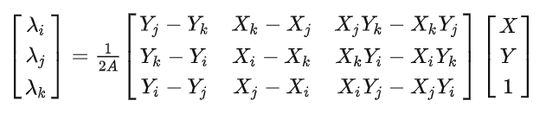
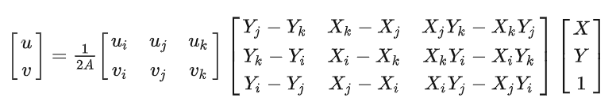
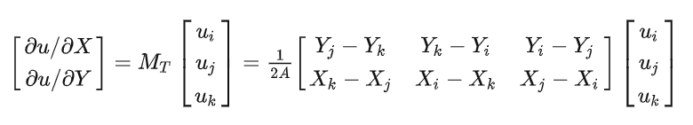
(uk,vk)
(u,v)
(ui,vi)
(uj,vj)
u(X, Y) = λ1ui + λ2uj + λ3uk
v(X, Y) = λ1vi + λ2vj + λ3vk

Slide 7
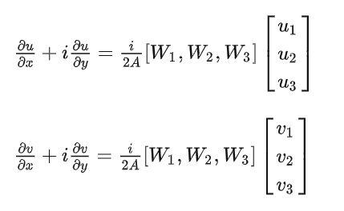
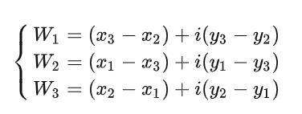
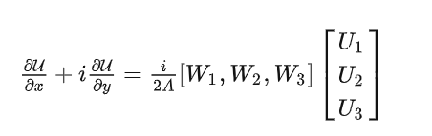


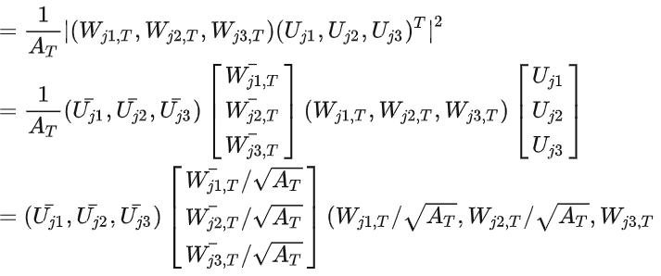
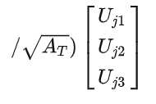

Slide 8
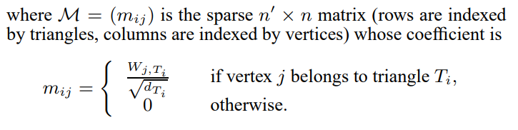

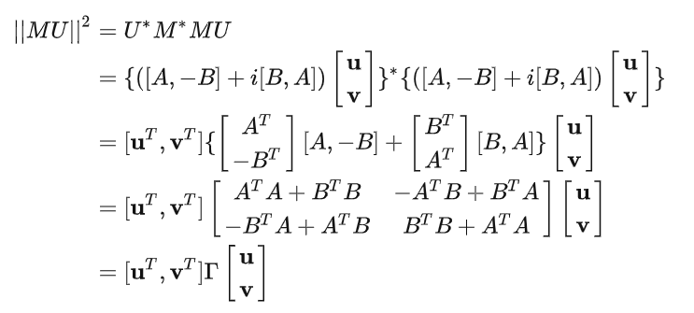

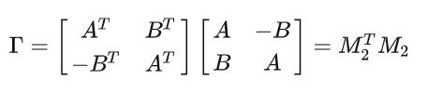
M=A+iB
U=u+iv

Slide 9
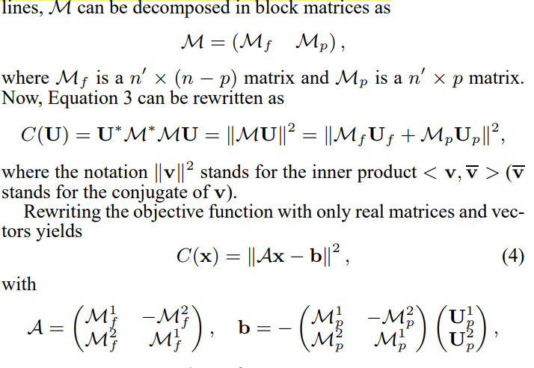
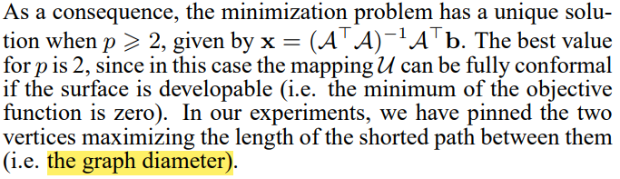

Slide 10
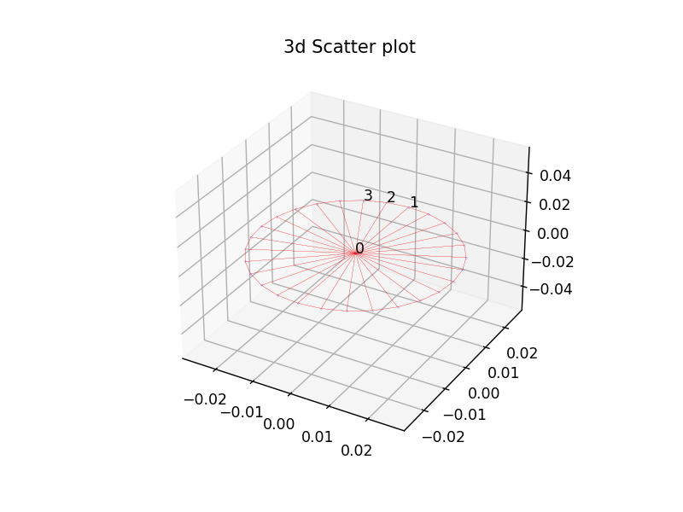
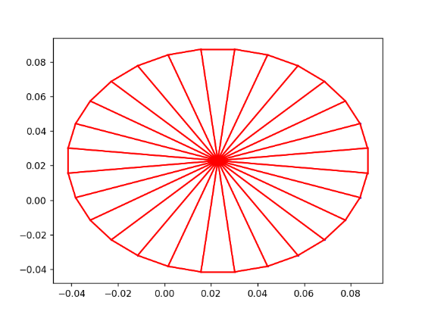

Slide 11
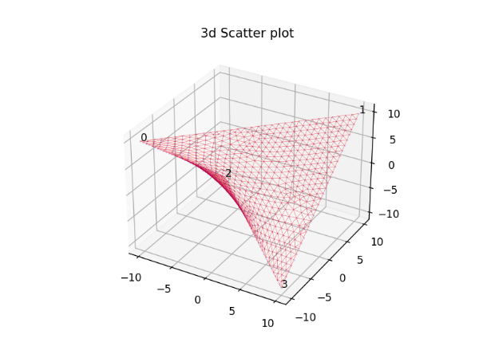
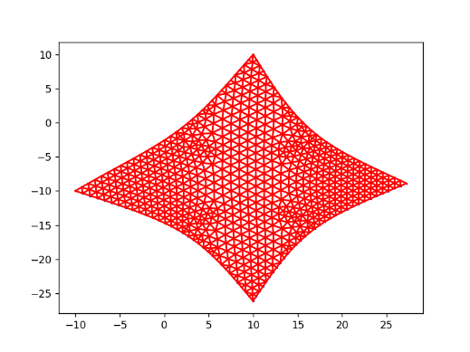

Slide 12
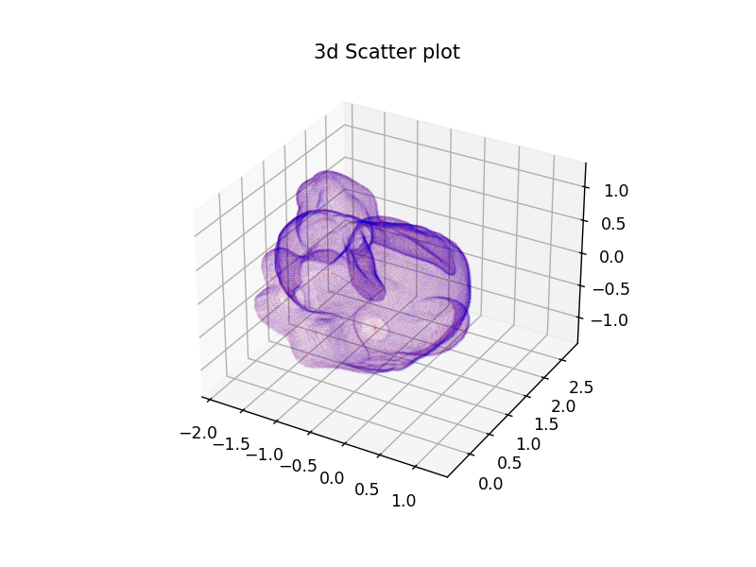
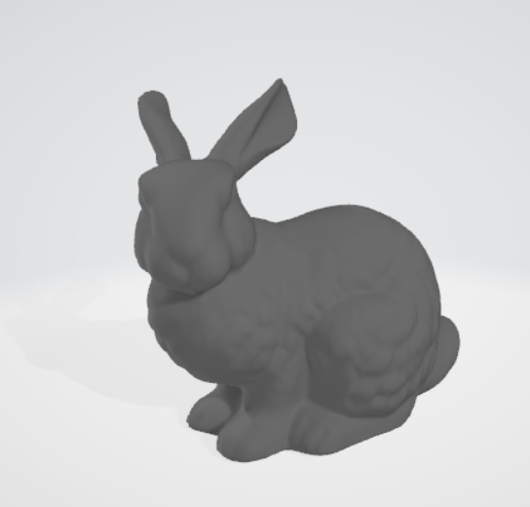

Slide 13
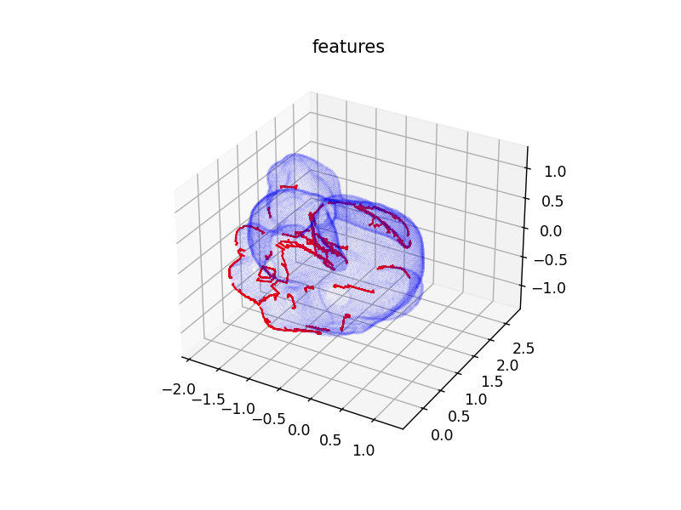
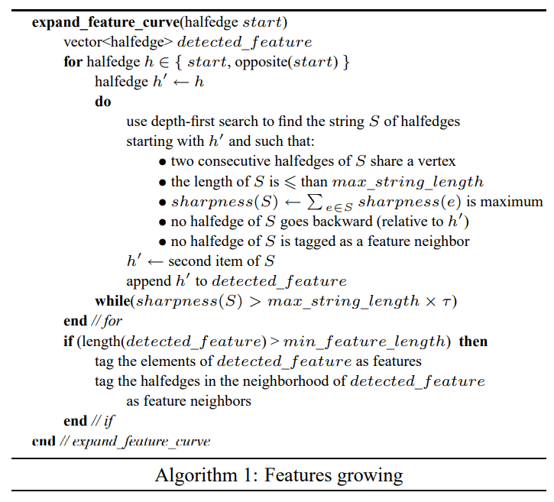



$$\vec{n1}$$
$$\vec{n2}$$
$$α$$

Slide 14
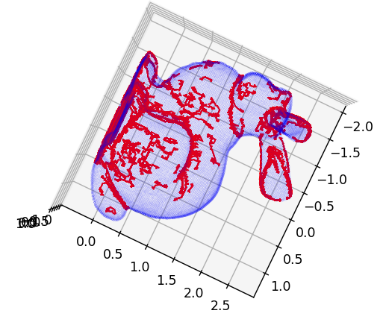

Slide 15
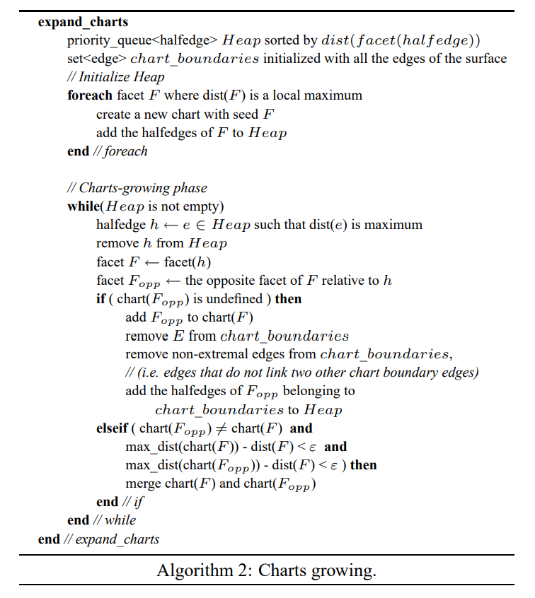

Slide 16
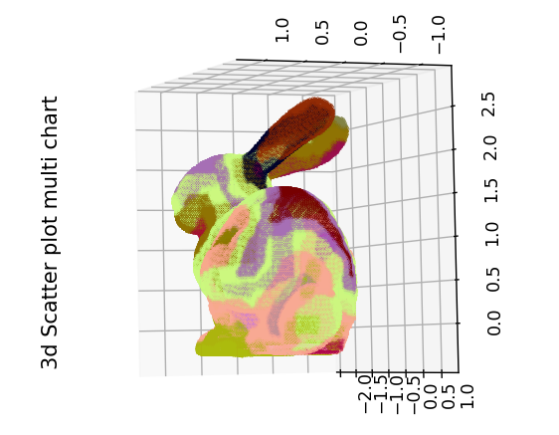

Slide 17
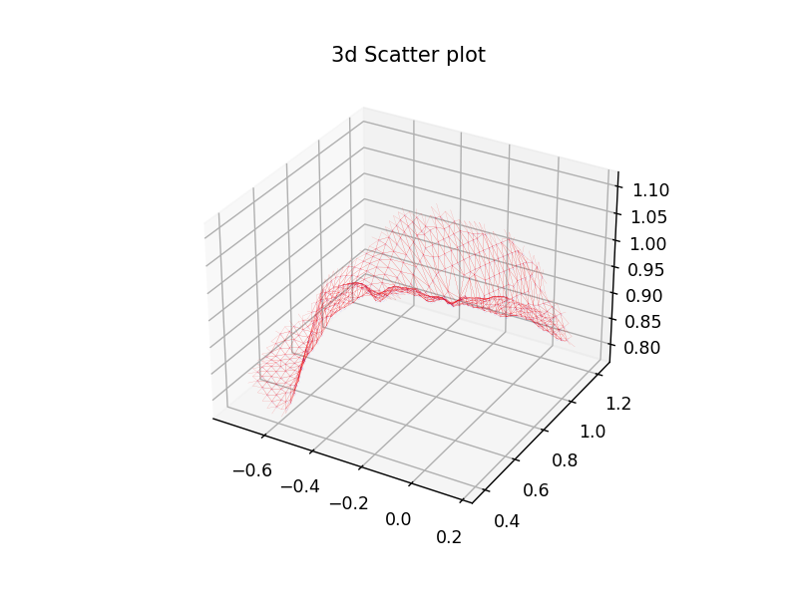
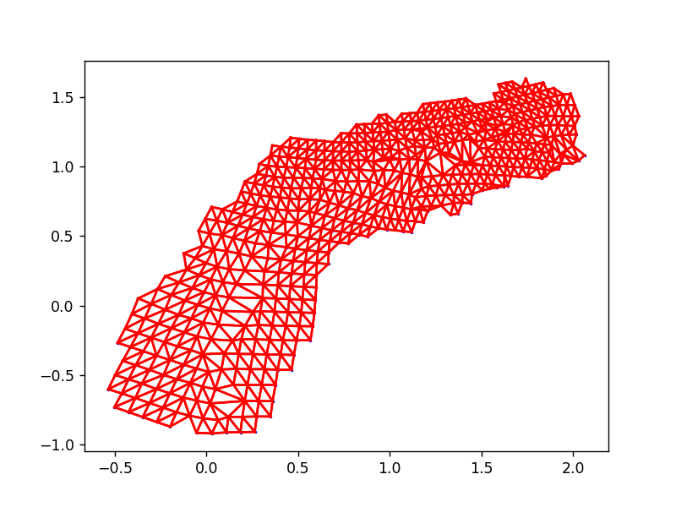

Slide 18
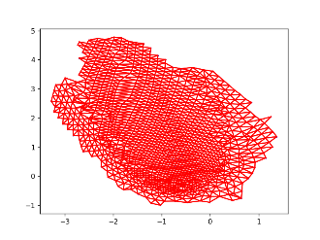
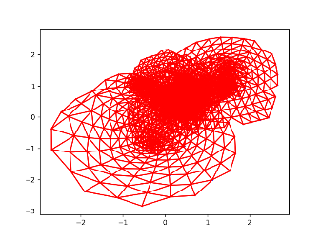
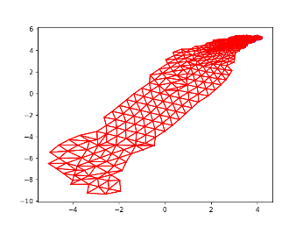
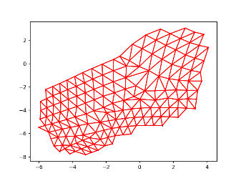

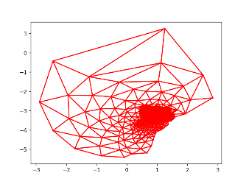
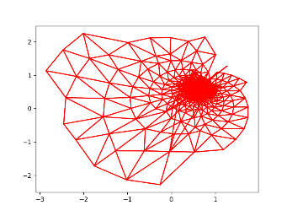
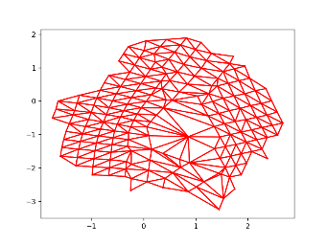
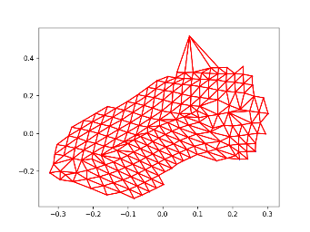
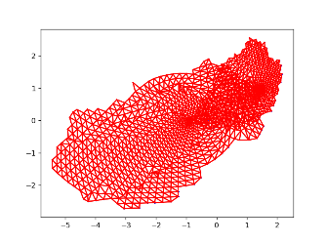
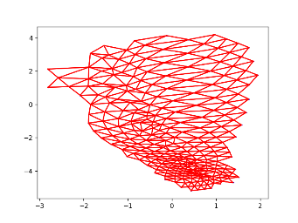
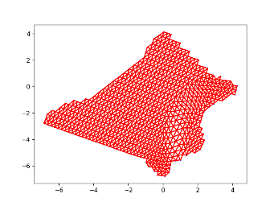
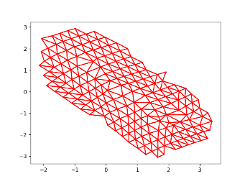

Slide 19
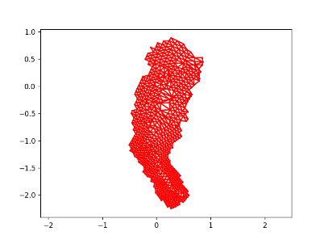

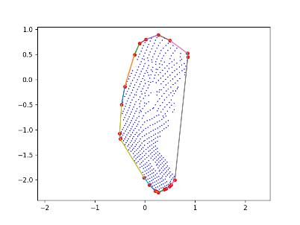

Slide 20
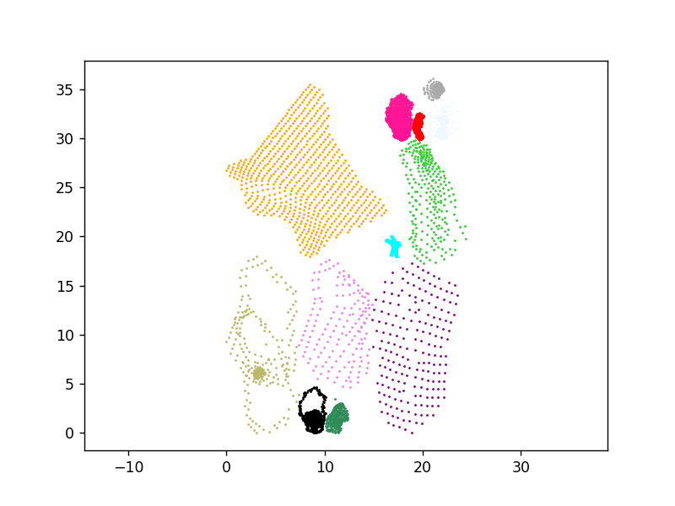

Slide 21
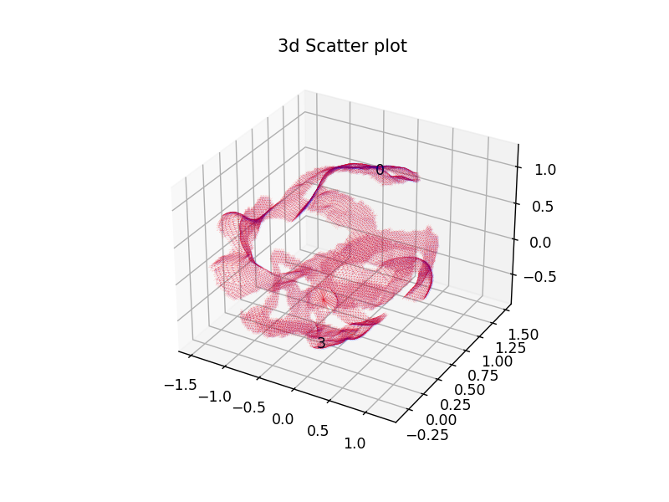
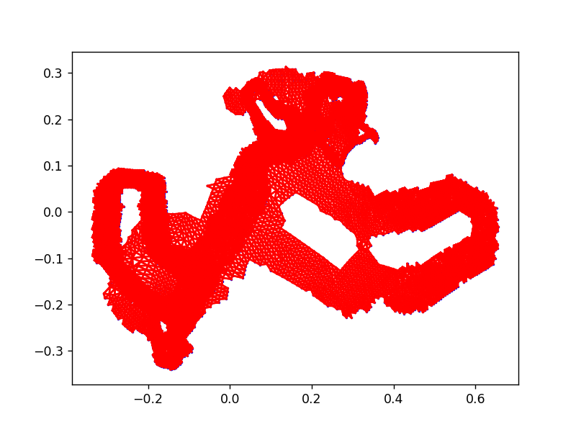

Slide 22
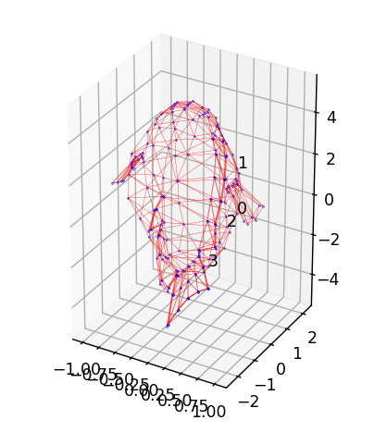
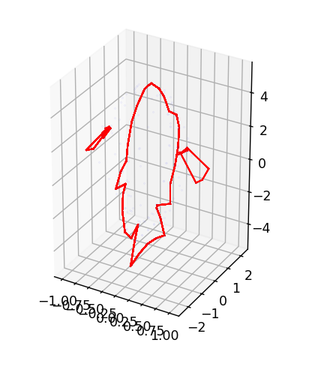
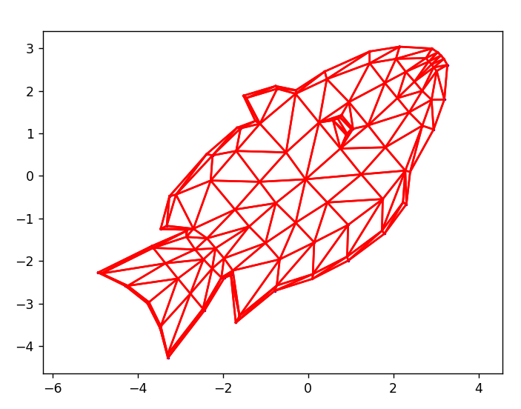
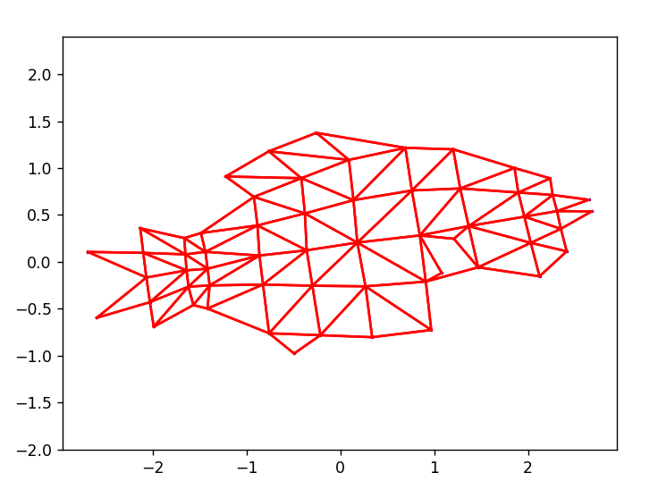
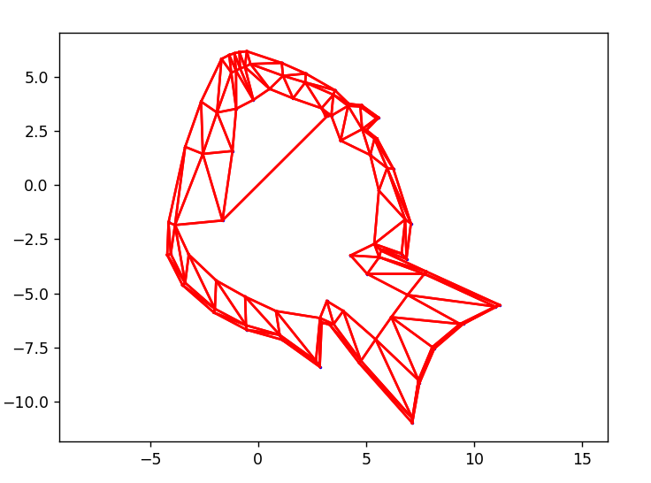
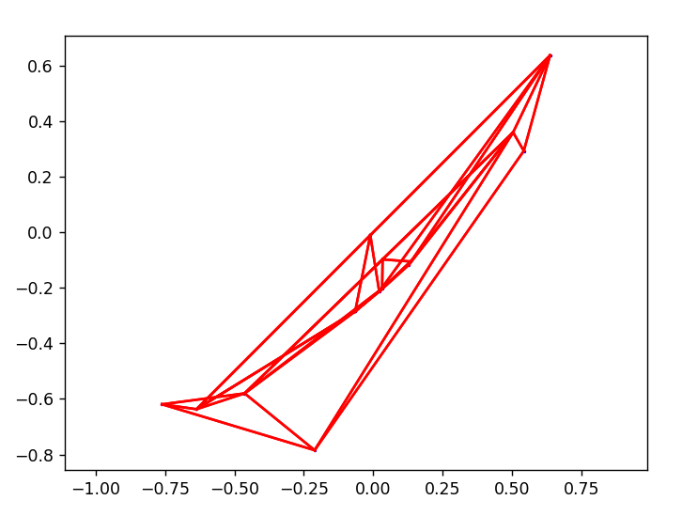



3d representation of a fish
Skeleton of the fish obtained by feature extraction
Projections of the charts respectively of the fish on 2d surface
Different charts obtained by curve expansion algorithm

Slide 24



Slide 26


Slide 27
Source
1. Lévy B, Petitjean S, Ray N, et al. Least squares conformal maps for automatic texture atlas generation[J]. ACM transactions on graphics (TOG), 2002, 21(3): 362-371.
2. Floater M S, Hormann K. Surface parameterization: a tutorial and survey[J]. Advances in multiresolution for geometric modelling, 2005: 157-186.
3. Hormann K, Lévy B, Sheffer A. Mesh parameterization: Theory and practice[J]. 2007.

