Slide 1
Tabular AI for Excel
Bringing Predictive AI to Where Banking Work Already Happens
Jerry Li
November 2026
ARC (AI+, Research and Commercialization)
BMO Institute for Applied AI & Quantum
Notes:
[~15 sec] Hi everyone, I'm Jerry from ARC. Today I'll walk through Tabular AI for Excel, a Proof of Concept that brings a tabular foundation model directly into Excel. I'll cover why this matters, the five ideas behind it, how it works, and then show a short demo.

Slide 2
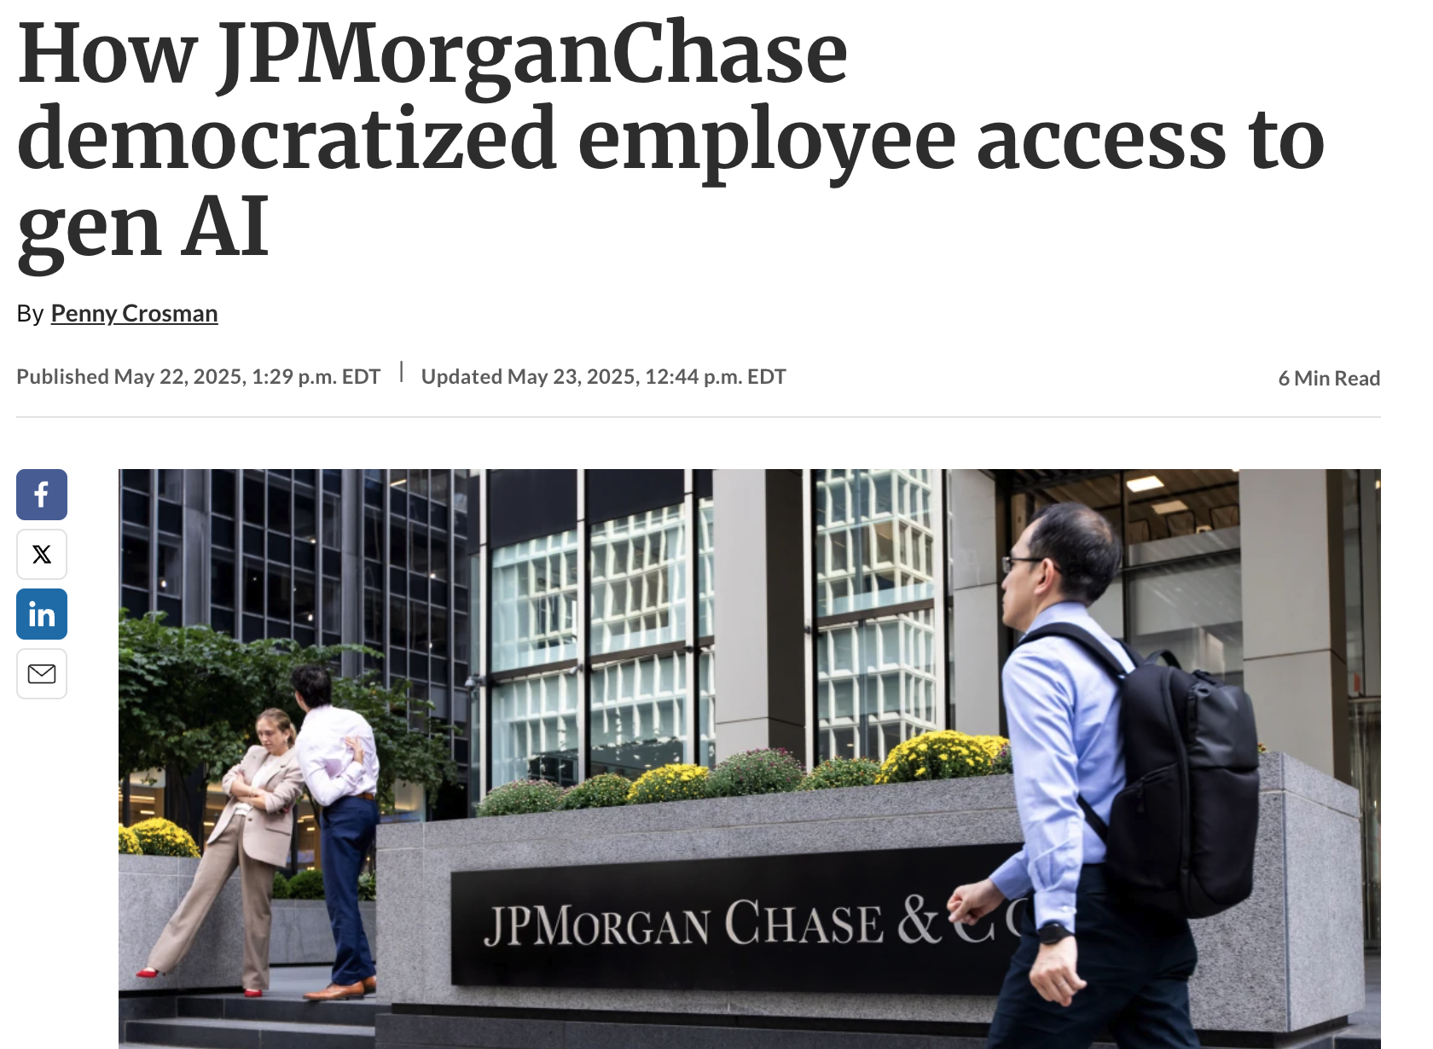
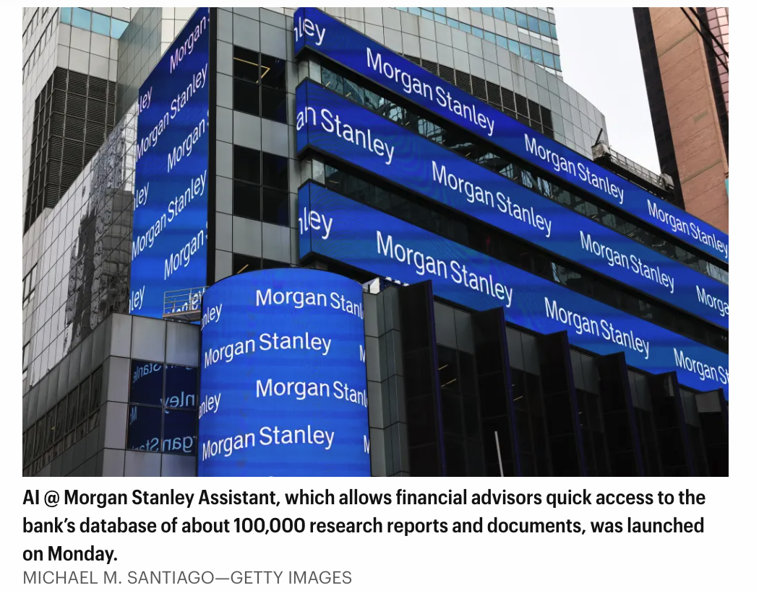
AI Adoption in Banking: The Next Frontier
01 / 11
PART I · BACKGROUND
Banks are putting AI directly into employees' hands. So far, most of it is generative.
WHERE EMPLOYEE AI IS CONCENTRATED
JPMorganChase employees using LLM Suite, its internal generative AI assistant, as of May 2025¹
TODAY Generative AI
~200K
Drafting
Summarizing
Knowledge retrieval
Q&A
research reports and documents Morgan Stanley advisors can query via the AI @ Morgan Stanley Assistant
NEXT Predictive AI on structured data
Classify, score and estimate directly from the business tables employees already maintain.
~100K
TAKEAWAY The next opportunity: embed predictive intelligence in the tools employees already use.
¹ American Banker, "How JPMorganChase democratized employee access to gen AI," May 22, 2025. ² Fortune, "Morgan Stanley AI assistant," Sept 20, 2023. Examples illustrate the adoption trend only.
Notes:
[~1 min] Let me start with where the industry is. Large banks are now putting AI directly into employees' hands, not just into back-end systems. JPMorganChase reports around two hundred thousand employees using LLM Suite, its internal generative AI assistant. An internal memo reported in 2024 even listed solving problems in Excel among its intended uses. Morgan Stanley gave its financial advisors an assistant that answers questions over roughly a hundred thousand internal research reports and documents.
Notice what these have in common: they are generative AI, focused on writing, summarizing and retrieving knowledge. That is valuable. But a large share of banking work runs on structured data in tables: customers, accounts, exposures, transactions. Predictive AI on that kind of data has mostly stayed with specialist teams.
To be clear, I am not saying these banks have built what we are about to show. They illustrate the broader adoption trend.
Transition: Recent advances in foundation models are creating a similar opportunity for structured data.

Slide 3

An Introduction to Tabular Foundation Models
02 / 11
PART I · BACKGROUND
One pretrained model that learns each new prediction task from examples supplied at inference time.
Age
Income
Util.
Tenure
Default
Labeled
context
34
72K
0.41
6
N
51
48K
0.88
2
Y
29
95K
0.12
4
N
Predictions for
the query rows
45
61K
0.67
9
N
Pretrained tabular foundation model
38
39K
0.93
1
Y
Unlabeled
queries
42
55K
0.79
3
?
Weights stay fixed
Y · 0.81
27
83K
0.22
5
?
N · 0.07
60
44K
0.58
12
?
N · 0.23
Illustrative sample data
Class · probability
Pretraining
Learned once, upstream, from a large and diverse collection of tables, often synthetic.
In-context learning
Labeled rows travel with each request. No task-specific weight updates.
Prediction
Outputs for the query rows, for classification or regression tasks.
1
2
3
TAKEAWAY A pretrained model can predict new tabular tasks without task-specific training.
Notes:
[~1 min] So what is a tabular foundation model? In traditional machine learning, every new dataset means a new model: you engineer features, choose an algorithm, train it, tune it and validate it.
A tabular foundation model changes that. It is pretrained once, upstream, typically on a very large and diverse collection of synthetic tables, so it learns general patterns of how features relate to a target.
At prediction time, you give it labeled rows as context, the rows where you already know the answer, together with unlabeled query rows. It uses the context to predict the queries, with no task-specific weight updates. This is called in-context learning: the same idea that made large language models so flexible, applied to tables.
It does not mean the model wins on every dataset. It means the effort needed to try predictive AI on a new problem becomes much lower.
Transition: The technology is promising, but the real question is how to make it useful in employees' everyday workflows.

Slide 4




Why Tabular AI for Excel?
03 / 11
PART II · WHY TABULAR AI FOR EXCEL?
Five design principles, each addressing a practical barrier to predictive AI adoption.
MODELING BARRIER
ADOPTION BARRIER
RESPONSIBLE AT BANK SCALE
01
02
03
04
05
No Task-Specific Training
Excel-Native Experience
Internal Data Control
Broad Applicability
Human-in-the-Loop
Predictions come from a pretrained model conditioned on labeled examples, not a new model per dataset.
Predictive AI runs inside the spreadsheets employees already use, with no code.
Designed for hosting, data processing and inference within bank-controlled infrastructure.
One reusable foundation can support many structured-data prediction tasks.
Predictions are previewed in place and kept only when the employee accepts them.
CENTRAL MESSAGE Remove two barriers to adoption: training models, and using ML tools.
Notes:
[~30 sec] That question led us to five design principles.
The first two are the heart of the story. No task-specific training removes the modeling barrier. An Excel-native experience removes the adoption barrier.
The other three make the idea responsible at bank scale: control over where data and models live, one foundation reusable across many problems, and a human who stays in charge of the final worksheet.
Let me take each one briefly.

Slide 5


From Model Training to In-Context Prediction
04 / 11
VALUE 1 OF 5 · NO TASK-SPECIFIC TRAINING
A new dataset no longer has to become a new model-development project.
Traditional ML · per dataset
Tabular foundation model · pretrained once
1
Prepare and engineer features
1
Provide labeled rows as context
2
Select a model family
2
Run inference on the query rows
3
Train on this dataset
3
Review the predictions
4
Tune hyperparameters
Pretraining happens once, upstream. No task-specific parameter training per dataset.
5
Validate and compare
6
Deploy and maintain this model
Inference still uses compute and may run an ensemble of several passes. Results vary by dataset and should be benchmarked against existing approaches.
Repeat for every new dataset or question
TAKEAWAY Removes the modeling barrier: from a training project to an inference request.
Notes:
[~50 sec] On the left is the familiar workflow. For every new dataset, someone with ML skills prepares features, picks a model, trains, tunes, validates, and then has to maintain that model. Each new question becomes a small project.
On the right, with a pretrained tabular foundation model, the employee provides labeled rows as context, runs inference, and reviews the predictions. The model was trained once by its developers. We are not training anything per dataset.
Two honest caveats. Inference still uses compute, and TabICLv2 can run an ensemble of several passes to improve robustness. And it will not beat a carefully built model on every dataset, so for anything important you still benchmark.
What changes is how quickly someone can get a first credible prediction.

Slide 6




Predictive AI Without Leaving Excel
05 / 11
VALUE 2 OF 5 · EXCEL-NATIVE EXPERIENCE
Instead of bringing employees to a new ML platform, we bring the model into their worksheet.
Familiar environment
Work stays in the worksheets employees already know.
Portfolio_Sample.xlsx · Excel
Home
Insert
Data
Review
Tabular AI
A
B
C
D
E
Tabular AI
No code required
No Python, notebooks or separate analytics application.
1
Customer
Tenure
Balance
Util.
Default
2
C-1041
6
12.4
0.41
N
TARGET COLUMN
3
C-1042
2
3.1
0.88
Y
Default ▾
4
C-1043
4
27.9
0.12
N
TASK
Less tool switching
No export, upload and re-import cycle.
5
C-1044
9
8.6
0.67
N
Classification
Regression
6
C-1045
1
1.9
0.93
Y
MODE
7
C-1046
3
5.2
0.79
Prediction
Evaluation
Predictions in place
Results appear in the original target cells.
8
C-1047
5
18.3
0.22
EXCLUDE COLUMNS
9
C-1048
12
9.7
0.58
Customer ×
Run
Illustrative mockup with sample data, not a product screenshot
TAKEAWAY Removes the adoption barrier: predictive AI arrives inside a familiar workflow.
Notes:
[~50 sec] The second barrier is tooling. Even when a model is easy to use, most employees will not open a notebook or learn a new analytics platform. But they already work in Excel every day.
So instead of bringing users to the model, we bring the model to the worksheet. On the right is an illustrative mockup: the workbook stays open, and a compact task pane lets the user pick a target column, the task type and the mode.
There is no code and no export and re-import, and the results land in the original target cells. There is still a little to learn, but it is one panel, not a new tool.

Slide 7
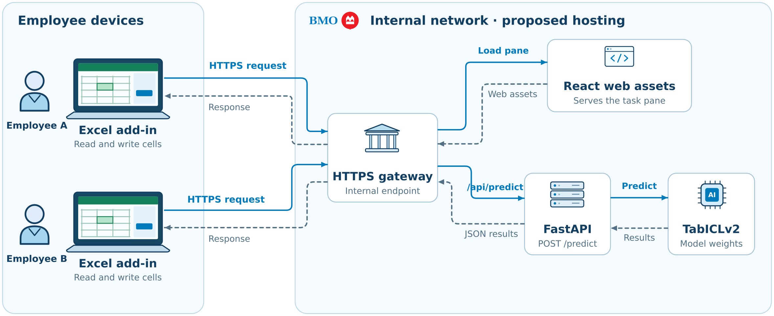





Designed for Bank-Controlled Deployment
06 / 11
VALUE 3 OF 5 · INTERNAL DATA CONTROL
Proposed architecture: model hosting, data processing and inference stay inside the bank's environment.
Bank-controlled environment (proposed)
Employee desktop
Excel + Add-in
Internal service
FastAPI inference
TabICLv2
Hosted internally
Not required
Externally hosted prediction API
TAKEAWAY Control over hosting, data flows and inference, with no dependence on an external prediction API.
Notes:
[~50 sec] The third principle is control. For banking data, where the model runs matters as much as what it predicts.
Our target architecture keeps everything inside a bank-controlled environment: the Add-in on the employee's desktop, an internal inference service, and the model hosted on bank infrastructure, all under bank-defined identity, access and security policies. In that design there is no need to send data to an externally hosted prediction API.
This is not a criticism of commercial platforms. Several vendors, H2O.ai for example, also offer private or on-premises deployment options. The point is control over our own inference infrastructure and data flows.
And I want to be precise about where we are. Today this is a local Proof of Concept on a developer workstation. It is not deployed on BMO infrastructure, and it has not been through security certification, model validation or production approval. The proposed next step is internal hosting with centralized Microsoft 365 deployment, subject to those reviews.

Slide 8

One Foundation, Multiple Banking Applications
07 / 11
VALUE 4 OF 5 · BROAD APPLICABILITY
The same pretrained engine could serve many teams and datasets. All use cases shown are potential, not yet tested.
Credit Default Prediction
Credit risk
Customer Upsell
Personal and commercial banking
Financial Distress Prediction
Commercial banking
Customer Cross-Sell
Personal and commercial banking
TabICLv2
Customer Risk Classification
Risk and KYC
One pretrained
foundation
Model Validation Benchmarking
Challenger experiments
AML-Related Exploration
Financial crime analytics
Would complement, not replace, specialized validated models.
TAKEAWAY A reusable prediction engine opens opportunities across teams, with each use validated.
Notes:
[~50 sec] Fourth, because nothing is trained per task, one foundation can be pointed at many different tables.
Here are some illustrative possibilities across the bank: credit default and financial distress prediction, customer risk classification, upsell and cross-sell propensity, exploratory analysis related to AML, and challenger benchmarking in model validation.
I want to stress that these are potential use cases. We have not tested them, and we have no performance numbers to share for them. A general model would not replace specialized, validated models in production. The value is in fast exploration, prototyping and benchmarking, with each use going through the appropriate model risk governance.

Slide 9


AI Suggests. Employees Decide
08 / 11
VALUE 5 OF 5 · HUMAN-IN-THE-LOOP
Predictions land in the original target cells as a preview. The employee explicitly accepts or discards them.
PREVIEW · provisional values in gray
ACCEPT · values confirmed
Customer
Util.
Default
Customer
Util.
Default
Why it matters
AI assists rather than silently overwriting.
Review happens in context, next to the real data.
C-1041
0.41
N
C-1046
0.79
Y
C-1042
0.88
Y
C-1047
0.22
N
TabICLv2
prediction
C-1043
0.12
N
C-1048
0.58
N
C-1046
0.79
Y
C-1047
0.22
N
DISCARD · target cells cleared
C-1048
0.58
N
Customer
Util.
Default
PoC note: Preview writes provisional values to the actual cells. It is not a virtual overlay with automatic recovery.
C-1046
0.79
C-1047
0.22
C-1048
0.58
TAKEAWAY Predictions become part of the worksheet only when the employee accepts them.
Notes:
[~50 sec] The fifth principle is that the employee stays in control.
When the model runs, predictions are written into the original blank target cells in a distinct gray preview style, so they are visibly provisional. The employee can inspect them in context, right next to the real data. Then they explicitly accept, which turns them into regular values, or discard, which clears them.
One limitation to be transparent about: in this Proof of Concept, the preview writes provisional values to the actual cells. It is not a fully virtual overlay with automatic recovery.
Transition: These five considerations shaped the prototype we built.

Slide 10
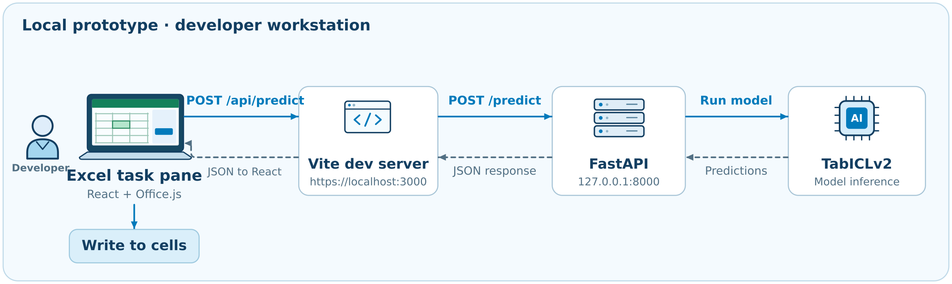

Solution Overview: Excel Add-in
09 / 11
PART III · OUR SOLUTION
A thin Excel front end, a Python inference service and a pretrained model, running locally as a Proof of Concept.
Microsoft Excel + Add-in
Office.js · React · Vite
table + settings
predictions
FastAPI Backend
Python
Back in the original worksheet: Office.js writes predictions into the target cells as a preview, then applies Accept or Discard.
TabICLv2 Inference Engine
Classification · Regression
Technical Reference: Excel Add-in Implementation Guide (Confluence) [Confluence URL to be added]
Notes:
[~1 min] Here is the architecture at a high level.
The front end is an Excel Add-in built with React and Vite, using Office.js to read the worksheet and write back to it. When the user runs a prediction, the Add-in sends the selected table and the settings, meaning the target column, task type, mode and excluded columns, to a FastAPI backend in Python.
The backend calls TabICLv2, which uses the labeled rows as context and predicts the remaining rows, for either classification or regression. Predictions come back to the Add-in, and Office.js places them in the original worksheet as a preview, ready to accept or discard.
Today all of this runs locally on a workstation. Setup and implementation details are in the Excel Add-in Implementation Guide on Confluence.

Slide 11

TabICLv2: Backbone and Preprocessing
10 / 11
PART III · OUR SOLUTION
An open, pretrained tabular foundation model with preprocessing built into its inference pipeline.
Built-in preprocessing at a glance²
Pending alignment with the six points in the Confluence guide
Why TabICLv2
Open model; code publicly released¹
01
02
03
Categorical encoding
Missing categories
Numeric imputation
Pretrained on synthetically generated tables¹
Text, category and boolean columns are ordinal-encoded.
Missing categorical values become their own category.
Missing numerical values are mean-imputed.
Supports classification and regression¹
Context: labeled rows. Queries: rows to predict
04
05
06
Outlier handling
Feature scaling
Ensemble diversity
Configurable ensemble size (n_estimators)²
Values beyond a z-score threshold are clipped.
Features are normalized; several normalizations can be ensembled.
Features and classes are shuffled across ensemble members.
Technical Reference: TabICLv2 Preprocessing Guide (Confluence) [Confluence URL to be added]
¹ Qu, Holzmüller, Varoquaux and Le Morvan, "TabICLv2: A better, faster, scalable, and open tabular foundation model," arXiv:2602.11139, ICML 2026. ² tabicl package documentation (PyPI, v2.0.1). Items 01 to 03 apply to pandas DataFrame input.
Notes:
[~1 min] A word on the model itself. We chose TabICLv2, an open tabular foundation model published this year by researchers at Inria. It supports both classification and regression, it was pretrained on synthetically generated tables, and its code is publicly available, which matters if we want to host it internally.
A practical advantage for an Excel tool is that much of the preprocessing is built in. Given a pandas DataFrame, it encodes categorical columns, treats missing categories as their own value, and mean-imputes missing numbers. It also clips outliers, scales features, and builds diversity across its ensemble by shuffling features and classes. That reduces the data preparation an employee needs before a first prediction.
This overview follows the package documentation; the detailed six-point breakdown is in the TabICLv2 Preprocessing Guide on Confluence.
Transition: Rather than discussing more implementation details, let's see what this looks like inside Excel.

Slide 12


Demo: Predictive AI Without Leaving Excel
11 / 11
PART IV · DEMO
DEMO FLOW
1
Open the Excel workbook
2
Read the worksheet data
3
Select target column and task type
4
Exclude columns if needed
5
Run TabICLv2 inference
Demo video placeholder
6
Preview predictions in the original cells
7
Accept or discard
Backup: live walkthrough
Notes:
[~2 to 3 min, including the video] Rather than discussing more implementation details, let's see what this looks like inside Excel.
[Play the 90 to 120 second recording. If the video fails, switch to the live walkthrough.]
We start in a normal Excel workbook with structured data: some rows are labeled and some target cells are blank. I open the Tabular AI Add-in, which reads the current worksheet. I select the target column, choose classification or regression, and choose prediction or evaluation mode. If some columns should not be used, such as identifiers, I exclude them. Then I run TabICLv2. The predictions appear as gray previews directly in the original blank cells. I review them, and accept or discard. At no point did we leave Excel or write any code.
[After the demo] To close: this is an early Proof of Concept, but it shows a practical path to making predictive AI accessible in the tool employees already use. Happy to take questions.

