Slide 1

Fluid Simulation
Term Project

Slide 2
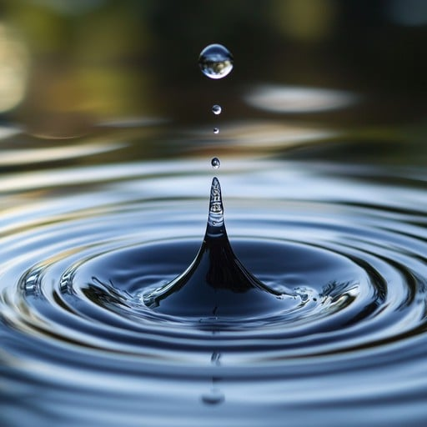
Motivation
Physics Simulation!
Optimization

Slide 3
How?
Smoothed
Particle
Hydrodynamics

Slide 4
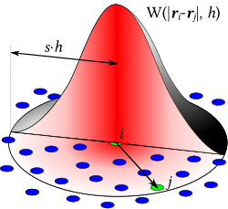


Slide 5

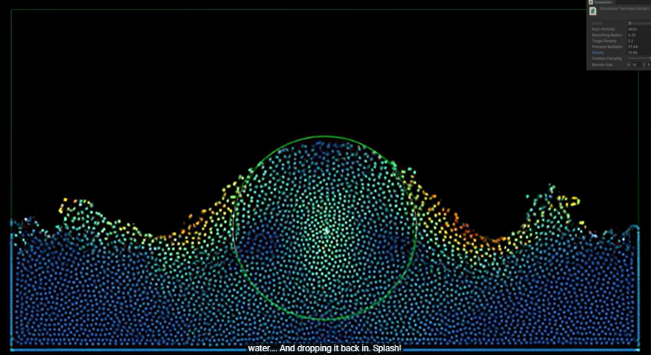

What I’m using:

