Slide 1
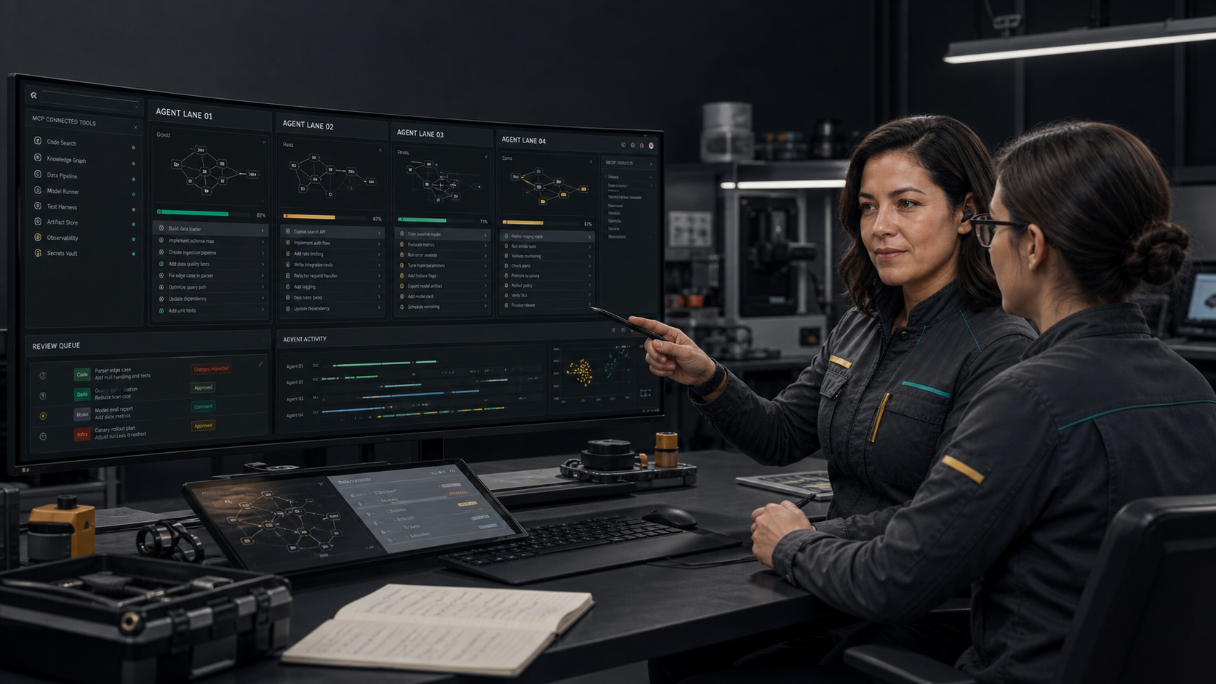

Win the bridge, not the category war
A strategic assessment of coding agents, automation platforms, agent frameworks, and Tlamatini’s credible wedge.
JULY 2026
COMPETITION / THREATS / OPPORTUNITIES

Slide 2
DECISION FRAME
Where can XAIHT win before incumbents absorb the feature set?
The answer must combine differentiated capability, customer pain, distribution, and a supportable operating model.
QUESTION 1
QUESTION 2
QUESTION 3
Which workflows require codebase context and real-world tool execution in the same bounded run?
Where does human-commanded local operation matter enough to affect purchase or adoption?
Which wedge can produce paid, repeatable workflows before broad platforms close the gap?
XAIHT / TLAMATINI
COMPETITION / THREATS / OPPORTUNITIES
02

Slide 3
MARKET STRUCTURE
Three established categories converge on agentic work.
XAIHT should cooperate with them where possible and compete only where its cross-surface operating layer matters.
CODING AGENTS
AUTOMATION PLATFORMS
AGENT FRAMEWORKS
OpenAI Codex · Claude Code · GitHub Copilot · Cursor
Core advantage: Repository depth, software delivery, developer distribution
n8n · Dify
Core advantage: Business connectors, workflow builders, deployment surfaces
LangGraph and adjacent ecosystems
Core advantage: Programmable orchestration, state, evaluation, developer extensibility
Sources: official product and documentation pages listed in the campaign claims ledger.
XAIHT / TLAMATINI
COMPETITION / THREATS / OPPORTUNITIES
03

Slide 4
CODING AGENTS
The strongest competitors own developer attention and repository workflows.
Their distribution and model quality are existential threats; their narrower physical-tool focus creates room.
OpenAI Codex
Cloud coding agent ecosystem and strong model distribution
Partner through ACPX/MCP; do not compete on raw coding model quality
Claude Code
Terminal-first coding and broad developer trust
Use as an external agent while Tlamatini supplies wider tool surfaces
GitHub Copilot
Deep IDE and GitHub workflow distribution
Differentiate beyond code completion and repository operations
Cursor
Agentic editor and background-agent workflow
Compete on local cross-surface orchestration, not editor ergonomics
Sources: OpenAI Codex, Anthropic Claude Code, GitHub Copilot, and Cursor official pages/documentation.
XAIHT / TLAMATINI
COMPETITION / THREATS / OPPORTUNITIES
04

Slide 5
AUTOMATION AND FRAMEWORKS
Workflow incumbents own connectors; frameworks own programmable orchestration.
XAIHT’s answer is integration depth across local project context, engines, devices, voice, and human command.
n8n
Dify
LangGraph
Large workflow/connectors surface and AI-agent nodes
Strategic reading: Hard to beat on general SaaS automation
Open-source LLM application and workflow platform
Strategic reading: Strong adjacent open-source distribution
Stateful agent orchestration for developers
Strategic reading: Powerful framework; more building block than packaged operator
Sources: n8n AI Agents, Dify, and LangGraph official product pages.
XAIHT / TLAMATINI
COMPETITION / THREATS / OPPORTUNITIES
05

Slide 6

WEDGE
XAIHT can own the moment software reaches an engine, board, instrument, or voice loop.
This is narrower than “all AI work” and broader than a code editor.
Project-aware context before action
Direct Unreal, Blender, STM32, ESP32, ESPHome, and Arduino paths
Voice, image, video, desktop, browser, messaging, and external agents
Explicit approvals, execution evidence, and user jurisdiction
Successful work captured as reusable .flw orchestration
XAIHT / TLAMATINI
COMPETITION / THREATS / OPPORTUNITIES
06

Slide 7
FEATURE MATRIX
Tlamatini is differentiated by surface combination, not by winning every column.
Directional assessment based on public product positioning; verify during customer discovery.
Capability
Coding agents
Automation
Frameworks
Tlamatini
Repository coding depth
HIGH
MED
MED
MED-HIGH
Business connectors
LOW-MED
HIGH
LOW
MED
Creative engines
LOW
LOW
LOW
HIGH
Embedded hardware
LOW
LOW-MED
LOW
HIGH
Visual reusable flows
LOW-MED
HIGH
CODE
HIGH
Human approval surface
VARIES
VARIES
CUSTOM
EXPLICIT
Local-first project operator
VARIES
VARIES
CUSTOM
CORE
Directional assessment from official public product descriptions; no benchmark or hands-on parity test is implied.
XAIHT / TLAMATINI
COMPETITION / THREATS / OPPORTUNITIES
07

Slide 8
STRENGTHS
The current product already demonstrates unusual integration breadth.
These strengths become commercial only when packaged into reliable, repeatable outcomes.
BREADTH
INSPECTABILITY
HUMAN COMMAND
85 agents and 94 Multi-Turn tools across software, media, engines, devices, messaging, desktop, browser, and MCP.
MIT core, readable Python agents, visible workflows, and source-grounded claims.
Approval gates, Step-by-Step pacing, reports, cancellation, and explicit responsibility.
LOCAL-FIRST CONTEXT
PHYSICAL PROOF
ECOSYSTEM BRIDGE
Project retrieval and local application state reduce dependence on a single cloud surface.
Robotics, firmware, video verdicts, and engine outputs make demonstrations tangible.
ACPX and MCP allow external agents to become collaborators rather than only competitors.
XAIHT / TLAMATINI
COMPETITION / THREATS / OPPORTUNITIES
08

Slide 9
WEAKNESSES
Breadth creates reliability, onboarding, and support debt.
The strategy must narrow the promise before scaling the company.
No verified commercial traction or retained-use baseline yet
Many external dependencies, credentials, toolchains, and local environment assumptions
Broad test and documentation surface increases release burden
Windows-first installed experience limits initial platform reach
No shipped enterprise identity, fleet policy, signed channel, or formal support SLA
Brand must prove calm utility instead of looking like a generalized science-fiction assistant
XAIHT / TLAMATINI
COMPETITION / THREATS / OPPORTUNITIES
09

Slide 10
THREATS
Incumbents can copy features faster than XAIHT can copy distribution.
The response is focus, evidence, and interoperability.
PLATFORM BUNDLING
MODEL COMMODITIZATION
Coding and cloud platforms add workflow, browser, desktop, and connector surfaces.
Response: Win a vertical process before horizontal parity arrives.
Base-model quality converges and reduces perceived product differentiation.
Response: Make validated tool execution and workflow evidence the product.
SECURITY INCIDENT
SUPPORT OVERLOAD
A powerful connector or modified agent causes harm or exposes private information.
Response: Keep jurisdiction explicit; narrow scopes; publish incident and recovery discipline.
Heterogeneous local setups consume founder time and erase service margin.
Response: Standardize three hero stacks and refuse unsupported combinations.
XAIHT / TLAMATINI
COMPETITION / THREATS / OPPORTUNITIES
10

Slide 11
OPPORTUNITIES
Open-source distribution can turn specialist integrations into a trust network.
The highest-value opportunities pair visible proof with paid implementation.
VERTICAL WORKFLOW PACKS
PARTNER-LED DELIVERY
HUMAN-COMMAND STANDARD
Validated packs for embedded bring-up, robotic verification, game-production steps, and operational readiness.
Makerspaces, systems integrators, educators, and studios extend reach without centralizing every support burden.
Publish practical patterns for approval, evidence, cancellation, credential scope, and agent responsibility.
XAIHT / TLAMATINI
COMPETITION / THREATS / OPPORTUNITIES
11

Slide 12
EXTERNAL SIGNALS
The market rewards augmentation, but access and infrastructure remain uneven.
This favors adaptable systems that expose constraints instead of hiding them.
25%
34%
2.2B
4 Cs
workers with some GenAI exposure
gain for novice/low-skilled workers in one field study
people offline in 2025
connectivity, compute, context, competency
Strategic consequence
Product value will vary sharply by region, sector, infrastructure, language context, and operator skill. XAIHT should measure local activation conditions as carefully as model quality.
Sources: ILO 2025; NBER w31161; ITU 2025; World Bank Digital Progress and Trends Report 2025.
XAIHT / TLAMATINI
COMPETITION / THREATS / OPPORTUNITIES
12

Slide 13
SCENARIOS
Three plausible futures require the same first move: prove a narrow workflow.
Planning horizon: 2026-2028. These are scenarios, not forecasts.
A · PLATFORM ABSORPTION
B · OPEN ECOSYSTEM
C · VERTICAL TRUST
Incumbents bundle most horizontal agent functions.
XAIHT survives through specialist engine/device workflows, local deployment expertise, and interoperability.
Models and connectors commoditize while open agent standards grow.
XAIHT becomes the human-commanded operating shell and workflow marketplace.
Safety, sovereignty, and reliability push buyers toward bounded vertical systems.
XAIHT wins with validated packs and operational readiness services.
XAIHT / TLAMATINI
COMPETITION / THREATS / OPPORTUNITIES
13

Slide 14
90-DAY RESPONSE
Package three proofs and measure one commercial funnel.
The priority is learning velocity, not feature count.
0-30
31-60
61-90
ALIGN
ACTIVATE
CONVERT
Ship the identity, claims ledger, security boundary, and three reproducible demos.
Recruit 10 design partners; measure time to first bounded success and first saved workflow.
Offer Launch Lab and integration sprints; measure paid conversion, delivery time, and margin.
XAIHT / TLAMATINI
COMPETITION / THREATS / OPPORTUNITIES
14

Slide 15
PROOF SCORECARD
A wedge is real only when operators repeat it and pay for it.
Use one scorecard across product, commercial, and trust outcomes.
ACTIVATION
Installer completion · time to first bounded action · setup interventions
REUSE
Time to first saved .flw · workflows reused per active operator
RETENTION
Weekly retained operators · second use case adopted
ECONOMICS
Paid conversion · delivery hours · gross margin · support burden
TRUST
Denied actions · cancel recovery · credential findings · incident severity
XAIHT / TLAMATINI
COMPETITION / THREATS / OPPORTUNITIES
15

Slide 16
ECOSYSTEM STRATEGY
Turn major agents into tools inside the wider operating layer.
Interoperability reduces direct model competition and lets XAIHT focus on orchestration, physical surfaces, and trust.
EXTERNAL CODING AGENTS
MCP SERVERS
ACPX delegates to supported CLIs when the operator chooses.
Universal transports connect third-party tools while expanding the attack surface.
TLAMATINI OVER MCP
WORKFLOW PACKS
External clients can use enabled Tlamatini tools and agents.
Validated .flw processes become the shared operational asset.
XAIHT / TLAMATINI
COMPETITION / THREATS / OPPORTUNITIES
16

Slide 17
RISK REGISTER
The highest risks are operational, not rhetorical.
Assign owners and evidence before scaling promotion.
Security / privacy
HIGH
Scope controls, secret handling, release guards, incident response
Integration reliability
HIGH
Three supported stacks, reproducible tests, dependency diagnostics
Support economics
HIGH
Measure delivery hours, refuse unsupported combinations, partner network
Platform competition
MED
Interoperate, focus vertical, accumulate workflow evidence
Brand credibility
MED
Current counts, real demos, no fabricated traction, no autonomous fantasy
Energy / access
MED
Measure local hardware, connectivity, model, and language constraints
XAIHT / TLAMATINI
COMPETITION / THREATS / OPPORTUNITIES
17

Slide 18

XAIHT / TLAMATINI
Focus the promise. Expand the proof.
Tlamatini should not challenge every coding agent or automation platform. It should become the trusted operator for workflows that cross code, engines, devices, media, and human approval.
Win one vertical workflow, then earn the right to widen.
XAIHT / TLAMATINI
COMPETITION / THREATS / OPPORTUNITIES
18

