Slide 1
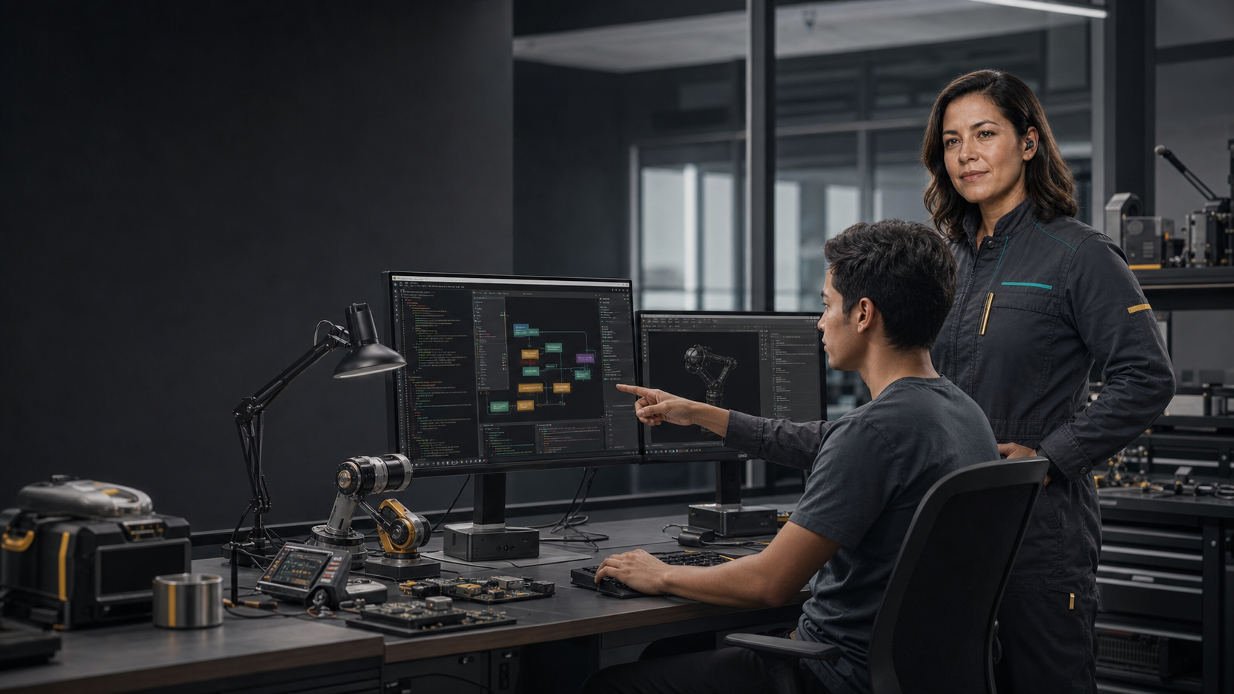

The human-commanded operations layer for builders
Tlamatini connects project intelligence, guarded action, creative engines, embedded hardware, and reusable workflows.
JULY 2026
INVESTOR BRIEF

Slide 2
CATEGORY SHIFT
AI is moving beyond the chat box.
The valuable unit is no longer an answer. It is an inspectable action across the systems where work happens.
Coding agents
Automation platforms
Physical toolchains
The open space
Deep code execution, but commonly optimized around repositories and software delivery.
Broad business integrations, but often distant from project context, creative tools, and device work.
Powerful engines and boards, but fragmented across specialists, commands, and local setup.
A local-first operator that knows the project, crosses these surfaces, and keeps the human in command.
XAIHT / TLAMATINI
INVESTOR BRIEF
02

Slide 3
PROBLEM
Builders still orchestrate the whole stack by hand.
Context is copied, approvals are implicit, successful sequences disappear, and each tool keeps a separate operational vocabulary.
01
CONTEXT
Code, docs, credentials, and environment knowledge drift between tools.
02
EXECUTION
Actions cross files, browsers, CLIs, engines, boards, and networks.
03
GOVERNANCE
Teams need explicit approval, evidence, cancellation, and responsibility.
04
REUSE
A successful run rarely becomes an editable operational asset.
XAIHT / TLAMATINI
INVESTOR BRIEF
03

Slide 4
PRODUCT THESIS
Command the whole workspace.
Tlamatini is designed as the operating layer between human intent and a heterogeneous technical workspace.
Know the project with hybrid retrieval and source context.
Act across enabled tools, agents, skills, MCPs, and external CLIs.
Preserve human approval, reports, and hard cancellation.
Turn successful Multi-Turn work into visible .flw workflows.
XAIHT / TLAMATINI
INVESTOR BRIEF
04

Slide 5
OPERATING MODEL
Know. Act. Capture.
The product compounds when a successful bounded action becomes a reusable, inspectable workflow.
01
02
03
KNOW
ACT
CAPTURE
>
>
Project files, retrieval, source maps, selected folders, and self-knowledge.
Multi-Turn coordinates enabled tools with approvals and execution evidence.
The operator can preserve successful work as a .flw process for reuse.
XAIHT / TLAMATINI
INVESTOR BRIEF
05

Slide 6
CURRENT PRODUCT
The breadth is already real; the commercial wedge is the next proof.
Live source inventory from the v1.41.3 repository snapshot, 15 July 2026.
85
94
27
176,259
workflow agents
Multi-Turn tools
inspectable skills
effective authored lines
Local-first core
Cross-surface execution
Bounded operation
Django/Channels, SQLite, FAISS/BM25 retrieval, native project context, and MIT-licensed source.
Files, desktop, browser, engines, embedded toolchains, voice, media, messaging, and MCP.
Ask Execs, Step-by-Step, execution reports, cancellation, and explicit user jurisdiction.
Source: live Tlamatini generator collect_context(); git describe v1.41.3-1-gc7c3fa10-dirty.
XAIHT / TLAMATINI
INVESTOR BRIEF
06

Slide 7
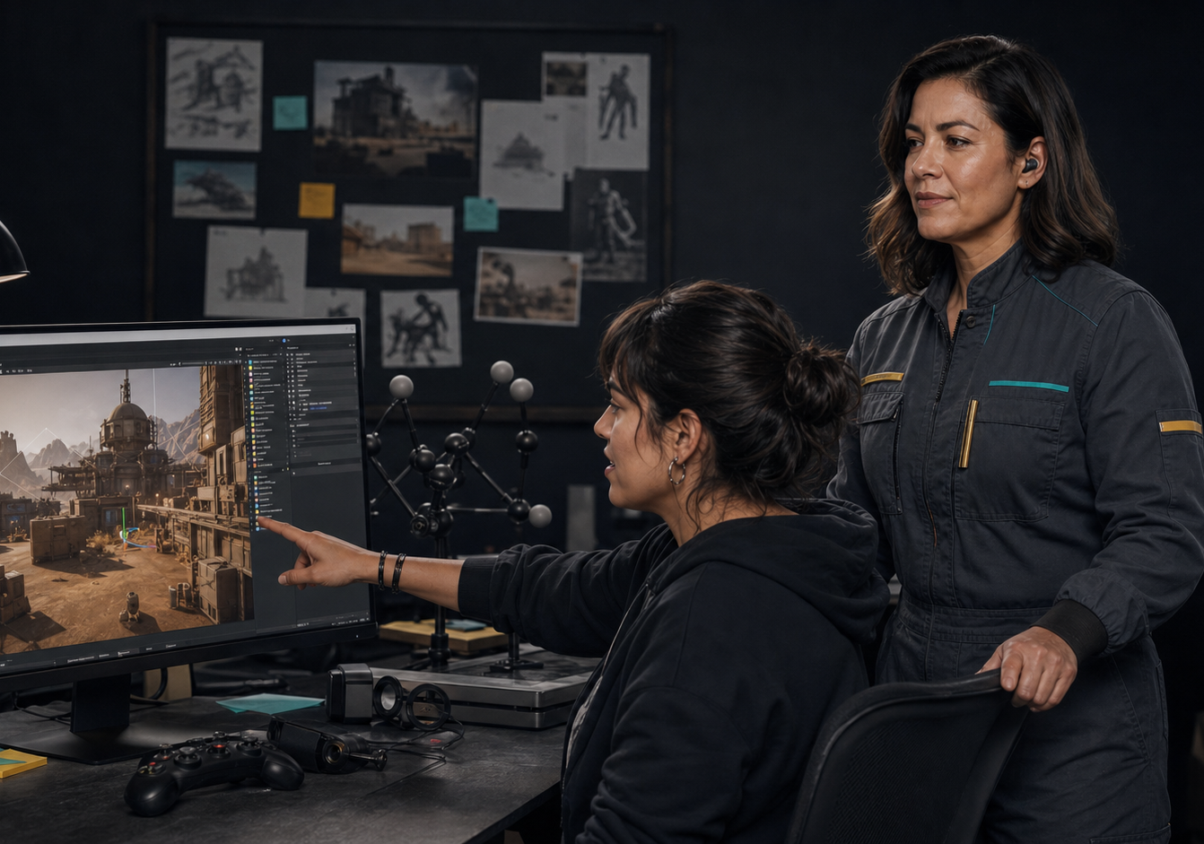

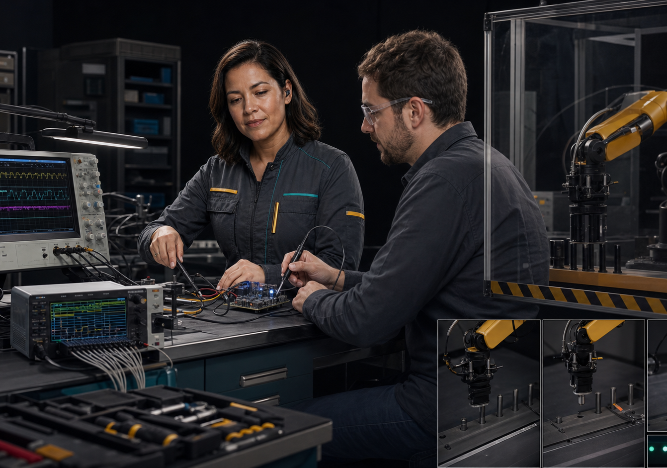
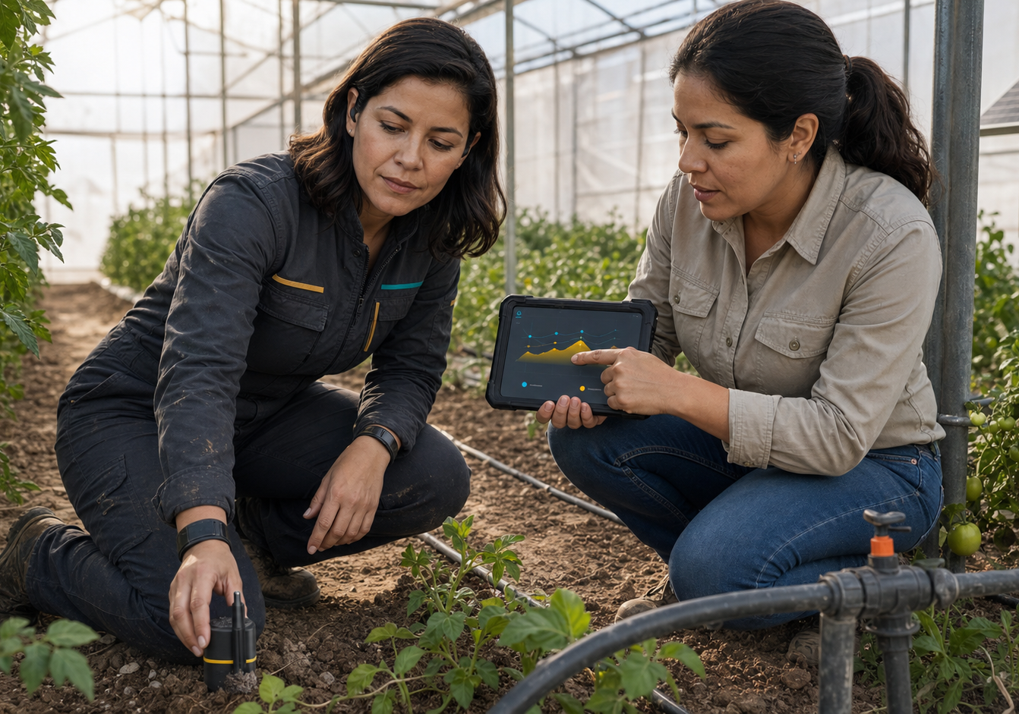
CROWN JEWELS
Tlamatini reaches where software touches the real world.
Four high-value surfaces make the category concrete.
Unreal Engine
Blender
STM32er
ESP32er
Direct control and one-prompt C++ project scaffolding.
Editable scenes, materials, screenshots, and renders.
Build, flash, observe, and preflight embedded work.
PlatformIO firmware workflows tied to field evidence.
XAIHT / TLAMATINI
INVESTOR BRIEF
07

Slide 8
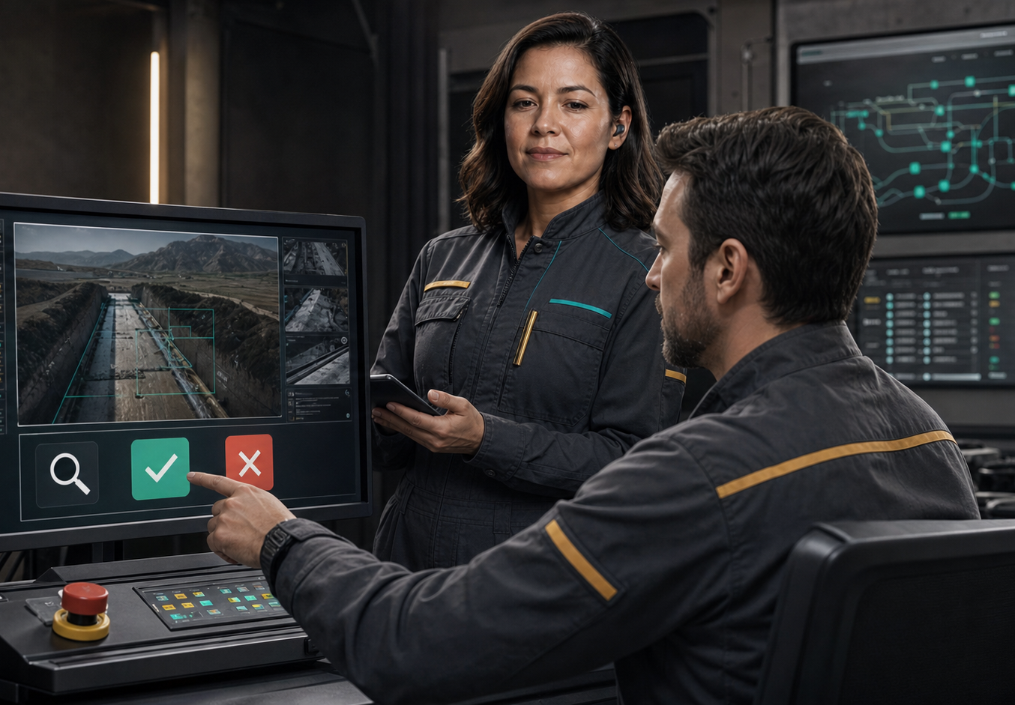
TRUST POSITION
Capability is not permission.
Human command is a product principle and an explicit operating boundary.
INSPECT
See the planned action, selected tool, and operating context before execution.
APPROVE OR DENY
Ask Execs can pause state-changing work; Step-by-Step can pace setup.
CANCEL AND REPORT
Hard cancellation and execution reporting preserve operator control and evidence.
Plain-Python agents remain under the user’s jurisdiction and responsibility.
XAIHT / TLAMATINI
INVESTOR BRIEF
08

Slide 9
BEACHHEAD
Start with teams where one person already carries the whole system.
Technical founders, embedded teams, robotics labs, and creative-technology studios feel the integration tax most acutely.
TECHNICAL FOUNDERS
EMBEDDED / ROBOTICS
CREATIVE TECHNOLOGY
Codebase + deployment + automation
Launch hypothesis: Fastest path to a complete bounded workflow
Firmware + instruments + observed motion
Launch hypothesis: Distinctive proof beyond code-only agents
Code + Unreal/Blender + assets
Launch hypothesis: Visible outputs and repeatable production steps
Commercial discipline: select the primary vertical after measured activation, retention, support burden, and paid conversion.
XAIHT / TLAMATINI
INVESTOR BRIEF
09

Slide 10
OFFER DESIGN
Keep the MIT core open; sell implementation and trust.
Launch-now offers create revenue without pretending enterprise roadmap features already ship.
Community
CURRENT
Launch Lab
LAUNCH NOW
Workflow Pack
LAUNCH NOW
MIT source and public releases
Installation, model setup, workflow design, operator training
Customer-specific .flw design and validation
Integration Sprint
LAUNCH NOW
Readiness Review
LAUNCH NOW
Enterprise Layer
ROADMAP
Unreal, Blender, STM32, ESP32, ESPHome, or Arduino support
Configuration, permissions, connector scope, and recovery
Signed channel, policy, fleet, identity, support SLAs
XAIHT / TLAMATINI
INVESTOR BRIEF
10

Slide 11
GO TO MARKET
Lead with reproducible proof, then convert expertise into engagements.
Every campaign claim should point to a demo, workflow file, build log, or bounded result.
PROOF
DESIGN
CONVERT
FOCUS
3 hero demos
10 partners
Paid services
1 vertical wedge
Unreal/Blender · robotics loop · project-to-workflow
Embedded · creative technology · small engineering teams
Launch Lab · integration sprint · readiness review
Choose by retention, revenue, margin, and repeatability
XAIHT / TLAMATINI
INVESTOR BRIEF
11

Slide 12
MARKET TAILWINDS
Exposure is broad; the winning systems will improve work without erasing agency.
External evidence supports the category need, not a claim of measured Tlamatini impact.
1 in 4
+14%
2.2B
~945 TWh
workers in occupations with some GenAI exposure
average productivity in a customer-support field study
people still offline in 2025
projected data-centre electricity demand in 2030
Implication
Human-commanded, adaptable, local-first operating layers can capture productivity while making infrastructure, skills, and accountability visible.
Sources: ILO (2025); Brynjolfsson, Li & Raymond, NBER w31161; ITU Facts and Figures 2025; IEA Energy and AI (2025).
XAIHT / TLAMATINI
INVESTOR BRIEF
12

Slide 13
COMPETITIVE POSITION
Tlamatini occupies the bridge between code depth and real-world surface breadth.
Positioning is a strategic hypothesis; it is not a benchmark or market-share claim.
HIGH PROJECT DEPTH
Tlamatini
Coding agents
Agent frameworks
Automation platforms
LOW PROJECT DEPTH
NARROW SURFACE
BROAD SURFACE
XAIHT / TLAMATINI
INVESTOR BRIEF
13

Slide 14
DEFENSIBILITY
The moat must become accumulated operational proof.
Breadth alone is replicable; trusted workflows, validated integrations, and retained operators compound.
Integration depth
Inspectable operating model
Direct engine and hardware paths create hard-earned implementation knowledge.
Readable agents, explicit user jurisdiction, and local-first context support trust.
Workflow capture
Proof network
Reusable .flw assets can encode customer-specific processes and operating evidence.
Demos, case studies, validated packs, and partner expertise become the real distribution advantage.
XAIHT / TLAMATINI
INVESTOR BRIEF
14

Slide 15
ILLUSTRATIVE CAPITAL PLAN
$1.5M can fund 18 months of commercial proof.
Assumption for investor discussion, not a current financing commitment or forecast.
45%
Product + reliability
25%
Design-partner delivery
15%
Security + release trust
10%
Developer marketing
5%
Operations + legal
Milestone: 10 activated design partners, paid service conversion, one retained vertical wedge, and measured workflow reuse.
XAIHT / TLAMATINI
INVESTOR BRIEF
15

Slide 16

XAIHT / TLAMATINI
Invest in the proof, not the promise.
Tlamatini already demonstrates the breadth. The company-building task is to turn that breadth into a narrow, repeatable, trusted commercial system.
Build the human-commanded operations layer with us.
XAIHT / TLAMATINI
INVESTOR BRIEF
16

