Slide 1
OPERATING SYSTEM CONCEPTS
CSI 309
Introduction

Slide 2
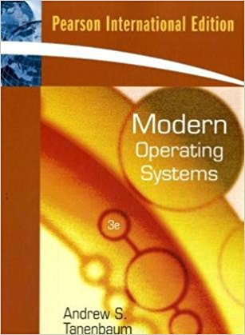
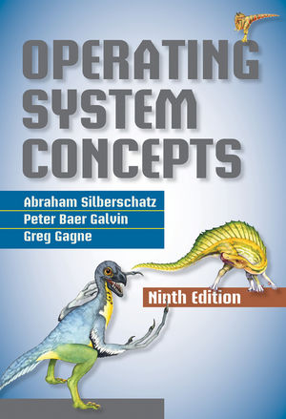
Text Books
Modern Operating Systems
- Andrew S. Tanenbaum
Operating System Concepts
- Silberschatz, Galvin, and Gagne

Slide 3
Assessment
Assessment Types | Marks
Attendance | 5%
Assignments | 5%
Class Tests | 20%
Mid Term | 30%
Final Exam | 40%

Slide 4
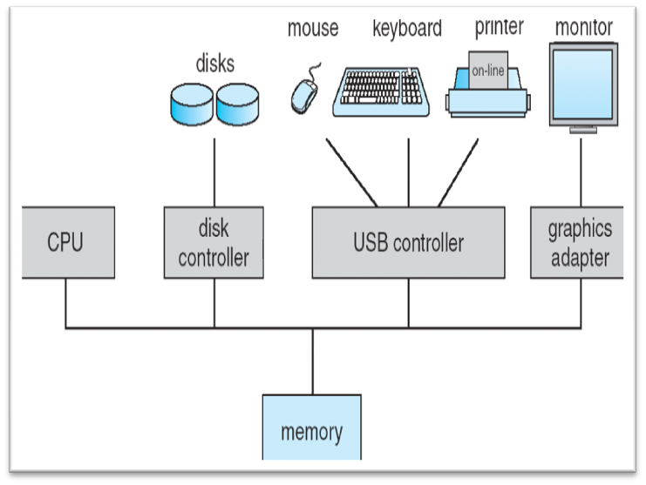
Modern Computer System
Complex system
  Many H/W components
  Many programs running
  simultaneously
Each running program
  Executed in the CPU
  Resides in the Memory
  May Interact with several devices

Slide 5
Modern Computer System
To ensure the correct operation someone needs to
  Understand how all these components work
  Manage them wisely
  Allocate them efficiently
A very challenging task!!!
If application programmer had to consider everything
  No code would ever get written
So, computers are equipped with a special software
  THE OPERATING SYSTEM

Slide 6
What is an Operating System?
Lots of hardware !!
One or more processors
Main memory
Disks
Printers
Various input/output devices
Managing all these components requires a layer of software – the operating system

Slide 7
What is an Operating System?
  An operating system is a program that manages a computer’s hardware.
  It also provides a basis for application programs and acts as an intermediary between the computer user and the computer hardware.
  Others:
    “The software that the rest of the software depends on to make the computer functional.”

Slide 8
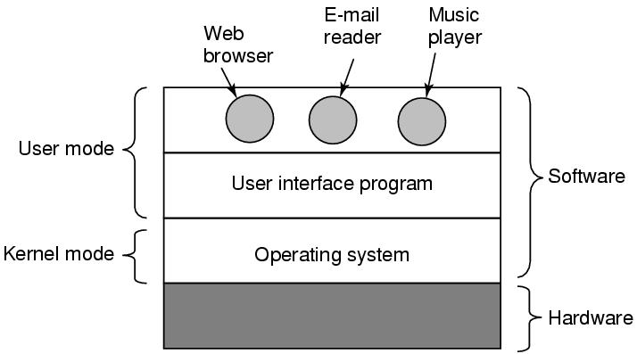
Where is the software?
Where the operating system fits in.

Slide 9
Popular Operating Systems
Some popular modern operating systems for personal computers include
    Microsoft Windows
    Mac OS X
    Linux
    Solaris
    Minix (study OS developed by Andrew S. Tanenbaum)
For embedded systems and small devices popular OSs are
    Symbian (successor to Symbian OS)
    Windows Mobile (recently changed to Windows Phone )
    iPhone OS (a subset of Mac OS X)
    Android, Mobilinux, Limo platform (Embedded Linux )
Notes:
Early versions of MINIX were created by Andrew S. Tanenbaum for educational purposes. Starting with MINIX 3, the primary aim of development shifted from education to the creation of a highly reliable and self-healing microkernel OS. MINIX is now developed as open-source software.

Slide 10
Role of OS
Extended Machine
Resource Manager

Slide 11
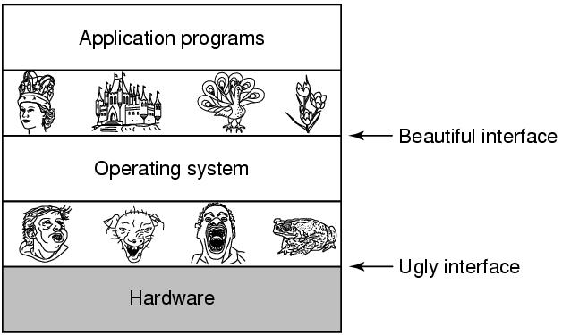
The Operating System as an Extended Machine
  Provide application programmers a clean abstract set of resources instead of the messy hardware ones

Slide 12
The Operating System as an Extended Machine
Direct communication with hardware is very difficult
  Need to understand the operation
  Need low level programming
  Consider direct read write to hard disk
Programmer wants is a simple, high-level abstraction to deal with hardware
The job of the OS
  Create good abstractions
  Implement and manage the abstract objects
Example:
  OS abstracts hard disk by the file-system
  Allow programmers to read write files without concern for how precisely they get stored

Slide 13
The Operating System as a Resource Manager
Allow multiple programs to run at the same time
Manage and protect memory, I/O devices, and other resources
Multiplexes (shares) resources in two different ways:
  In time
  In space

Slide 14
The Operating System as a Resource Manager
Allows multiple programs to run at the
same time
Provide an orderly and controlled
allocation of
  Processors
  Memories
  I/0 devices
Among the competing programs
Example:
  3 programs running on some computer
  All tried to print their output simultaneously on the same printer
  The OS can bring order to the potential chaos by buffering all the output on the disk

Slide 15
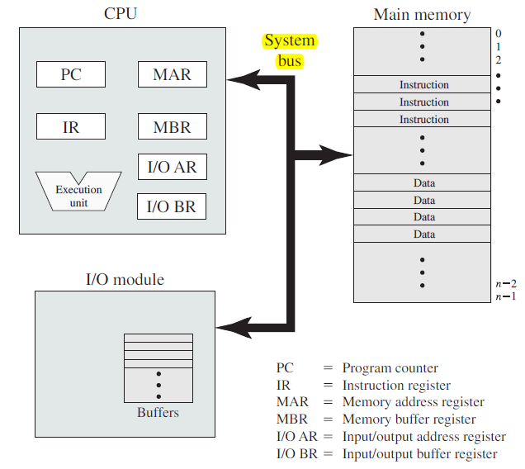
The Operating System as a Resource Manager
Allows multiple programs to run at the
same time
Provide an orderly and controlled
allocation of
  Processors
  Memories
  I/0 devices
Among the competing programs
Example:
  3 programs running on some computer
  All tried to print their output simultaneously on the same printer
  The OS can bring order to the potential chaos by buffering all the output on the disk

Slide 16
The Operating System as a Resource Manager
Resources can be shared in two different ways:
  Time multiplexing:
    In a single CPU system, several running programs take turns
  Space multiplexing:
    main memory is divided up among several running programs
OS has to implement these multiplexing

Slide 17
Kernel
The most fundamental part of an OS
Running at all times on the computer
Often used as another name of OS
Typical components
  interrupt handlers
    to service interrupt requests
  a scheduler
    to share processor time among multiple processes
  a memory management system
    to manage process address spaces
  system services
    Networking, inter-process communication …

Slide 18
Dual-Mode Operations
CPU executes in 2 Modes
  Kernel mode
    CPU can execute all machine instructions
    CPU can use every hardware feature
  User mode
    permits only a subset of the instructions and a subset of the hardware features to CPU

Slide 19
Dual-Mode Operations
OS runs in kernel mode, user programs in user mode
  Allows OS to protect itself and other system components
OS is Boss, the applications are laborers
Mode bit provided by hardware
  Provides ability to distinguish when system is running user code or kernel code

Slide 20
Dual-Mode Operations
When CPU starts executing in kernel mode?
  System Boot
    Starting a computer
  Hardware Interrupt
    generated by hardware devices to signal that they need some attention from the OS
  Trap
    a software-generated interrupt caused by
      an error (i.e. division by 0 or invalid memory access)
      a specific request from a user program for an operating-system service

Slide 21
Dual-Mode Operations
To obtain services from the operating system,
  a user program must make a system call, which traps into the kernel and invokes the operating system.
The TRAP instruction switches from user mode to kernel mode and starts the operating system.
When the work has been completed, control is returned to the user program at the instruction following the system call.

Slide 22
Operating System Concepts
Processes
Address spaces
Files
Input/Output
Protection
The shell

Slide 23
Processes
Program in execution
Lives in address space
Process table
  Keeps info about process
  Used to re-start process
Shell (command interpreter) reads commands from terminal

Slide 24

A Process Tree
Process creates child processes
Tree structure

Slide 25
Process
Can communicate with one another
Have UID’s and group ID’s (GID)
Can communicate with one another (IPC)

Slide 26
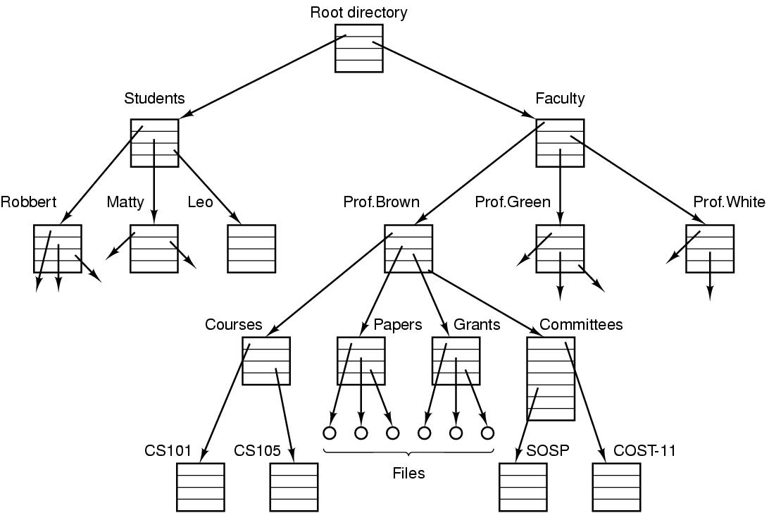
File directory
  The directory is organized as a tree
  Root directory at the top. Path proceeds from the root (e.g. faculty/prof brown/courses)

Slide 27
System Calls
Interface between user programs and OS
Varies from OS to OS
System call issued by user program
Call uses a library call of the same name
Library routine puts machine into kernel modes (by issuing a special instruction)
Finds actual routine for system call in a table
Does the work involved in the call
Returns to user program

Slide 28

System Calls
read(fd, buffer, nbytes).

Slide 29
Look at System Calls
Start with process management
  See how they are used in shell
  Then you write a shell
Then do a brief summary of calls for
  File management
  Other useful calls

Slide 30
Operating Systems Structure
Monolithic systems
A main program that invokes the requested service procedure.
A set of service procedures that carry out the system calls.
A set of utility procedures that help the service procedures.

Slide 31
Topics
Operating System
  Its role in computer systems
  Operating system concepts
  Operating system structure
Process and Threads
  Process model and implementation
  Threads
  Inter-Process Communication (IPC)
  Classical IPC Problems

Slide 32
Topics
Memory Management
  Swapping
  Paging
  Segmentation
  Virtual Memory
File Systems
  Files
  Directories
  File System Implementation

Slide 33
Topics
Scheduling
  Scheduling in Batch Systems
  Interactive Systems Scheduling
  Real-Time Systems Scheduling
  Thread Scheduling
Deadlock
  Resource allocation & Deadlock
  Deadlock Detection
  Avoidance
  Prevention And Recovery

Slide 34
Topics
Introduction to the Kernel
The Buffer Cache
Internal representation of Files
System calls for the File system
The Structure of Processes

