Slide 1


Vidya Vikas Institute of Engineering and Technology
Alanahalli, Mysore – 570010
“Ocean bed Scene 3D”
Submitted by
ABHISHEK S (4VM12CS002)
Under the Guidance of
Mrs. MEENAKSHI H.N
Assoc. Professor,
Dept. of CSE,
VVIET, Mysore

Slide 2
MOTIVATION
I am interested in the field of computer graphics. I wanted the project to combine the concepts that we learned from the "Foundation of Computer Graphics" course which helps us to understand some of its underlying principles.
The main source of motivation in the computer network projects is to be found in the fact that most of the experiments are close to students’ hearts.
Because these projects are useful and applicable to the learners in their daily lives and activities, they not only motivate and encourage students in learning the computer networking concepts, but also promote self-motivation in the learners.

Slide 3

TABLE OF CONTENT
ABSTRACT
INTRODUCTION
REQUIREMENT SPECIFICATION
DESIGN
IMPLEMENTATION
SNAPSHOTS
CONCLUSION
APPLICATION AND LIMITATIONS
8. REFERENCES

Slide 4

ABSTRACT
Sea Bed Animation:
This mini project implements Ocean bed Scene 3D animation using Opengl interface. The development of this project would improve the user’s knowledge about computer graphics and Opengl and this project provides good understanding of Opengl prominent functions like transformation, rotation and 3D Modelling.
Aim of the project is about creating a colorful environment between the user and the program through suitable interaction which would be provided by necessary event based driven function included in code.

Slide 5

objectives
Designing and implementation of 3D animation.
Creation of geometric objects using OpenGL functions.
Colouring of geometric objects using OpenGL functions.
Translating a particular object from one point to another point.
User interface using mouse as a input device.

Slide 6

INTRODUCTION
AIM :
To create a colorful environment between the user and the program through suitable interaction which would be provided by necessary event based driven functions.
OPENGL:-
As a software interface for graphics hardware, OpenGL's main purpose is to render two- and three-dimensional objects into a frame buffer. These objects are described as sequences of vertices (which define geometric objects) or pixels (which define images). OpenGL performs several processing steps on this data to convert it to pixels to form the final desired image in the frame buffer.
OpenGL advantages:-
It is very popular in the video games development industry where it competes with Direct3D (on Microsoft Windows).
OpenGL is also used in CAD, virtual reality, and scientific visualization programs

Slide 7

REQUIREMENT SPECIFICATIONS
HARDWARE REQUIREMENTS
Minimum hardware specification
Microprocessor: 1.0 GHz and above CPU based on either AMD or INTEL
Microprocessor Architecture
Main memory: 512 MB RAM
Hard Disk : 4 GB
Hard disk speed in RPM: 5400 RPM
Mouse: 2 or 3 Button mouse
Monitor: 1024 x 768 display resolution

Slide 8

SOFTWARE REQUIREMENTS
Minimum software specification
Operating system: Linux Operating System
C Compiler (Default)
OPENGL Library
Key Board Driver
Graphics Driver
C Libraries

Slide 9
DESIGN
MAIN
DRAWSCENE
CAMERA
MENU
I/0 INTERFACE
MOUSE
OBJECT CREATION
STARFISH
TRANSFORMATION
ENVIRONMENT CREATION
CRAB
Translation
LIGHTING
KEYBOARD
FISH
Rotation
RESIZE WINDOW
OBJECT MOVEMENT
OCTOPUS
RANDOMIZE
PLANT

Slide 10
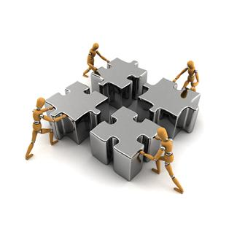
IMPLEMENTATION
OBJECT CREATION :
addObject(OBJ_STTARFISH) : this function calls the constructor of the Starfish Class, which adds a new starfish to the screen.
addObject(OBJ_CRAB) : this function calls the constructor of the Crab Class, which adds a new crab to the screen.
addObject(OBJ_FISH) : this function calls the constructor of the Fish Class, which adds a new fish to the screen.
addObject(OBJ_OCTOPUS) : this function calls the constructor of the Octopus Class, which adds a new octopus to the screen.
addObject(OBJ_PLANT) : this function calls the constructor of the Plant Class, which adds a new plant to the screen.

Slide 11

ATTRIBUTE SETTINGS
void glRasterPos3f(float x, float y, float z);
We can render the character in any raster position of the window. The raster position can be set using family of functions glRasterPos from OpenGL library.
glColor3f (0.0, 1.0, 1.0);
Using glColor3f function it is possible to color vertices of 3 dimensional primitives.

Slide 12

TRANSFORMATIONS
void glMatrixMode( Glenum mode)
specifies which matrix will be affected by subsequent transformations. Mode can be GL_MODELVIEW, GL_PROJECTION.
void glLoadIdentity( )
sets the current transformation matrix to an identity matrix.

Slide 13

INPUT/OUTPUT INTERFACE
glutKeyboardFunc(keyboard)
The glutKeyboardFunc sets the keyboard callback the current window. When a user types into the window, each key press generating an ASCII character will generate a keyboard callback. The key callback parameter is the
generated ASCII character.
glutMouseFunc(button)
The glutMouseFunc sets the mouse callback for the current window. When a user presses and releases mouse buttons in the window, each press and each release generates a mouse callback. The button parameter is one
of GLUT_LEFT_BUTTON, GLUT_MIDDLE_BUTTON, or GLUT_RIGHT_BUTTON.

Slide 14
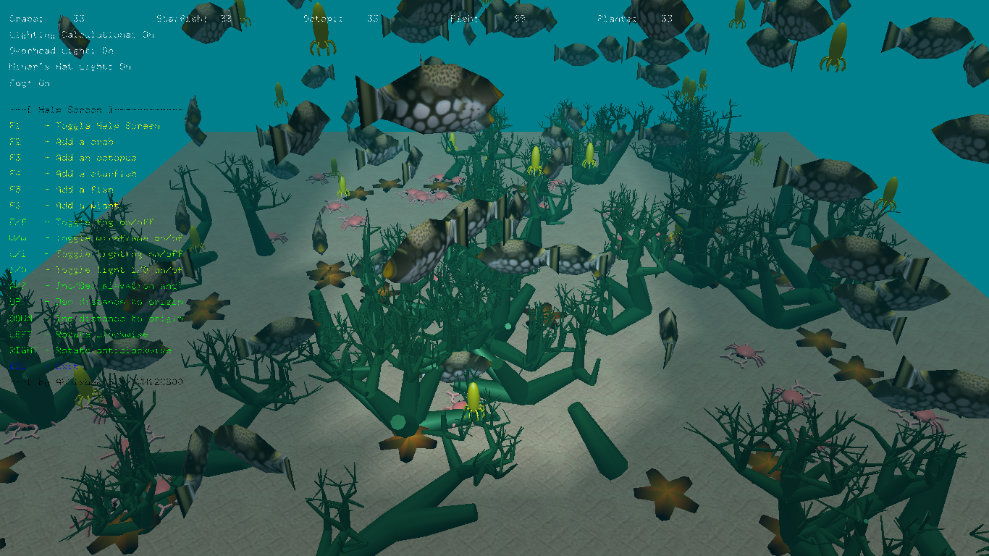
Snapshot

Slide 15

CONCLUTION
The images defined by our openGL program will be formed automatically by the hardware and software implementation of the image formation process. In this project we have generated images composed of simple geometric objects- points, line segments and polygons. With the completion of this project we can conclude that it has helped us to understand various topics of computer graphics and also computer networks practically. The program also has user friendly interface that may be simply pressing two basic keys that are available with minimum complexity.

Slide 16
APPLICATIONS and Limitations
This mini project is helpful in understanding the various topics in computer graphics using opengl programming, like usage of many geometric primitives, rasterisation in graphics, approximation of objects and rendering 2D-3D objects onto the screen, effective usage of keys and mouse buttons for interfacing, 3D transformations.
This project also helps in knowing to code for the aquarium that has been designed so that it gives an interactive approach to the user or the programmer
The translation, rotation and scaling features have been successfully incorporated in our project, animating it and producing real time graphics.
This mini project can also be used as a screensaver.
Limitations
1. If Double buffering is not used flickering will be experienced.
2. It is used in virtual implementation only.

Slide 17


