Slide 1

BEYOND
40°C
ARHAANSH JHINGAN 25BCE0541 (SCOPE)
QUANTIFYING THE HUMID-HEAT BLIND SPOT
IN INDIA'S HEATWAVE WARNINGS
PROBABILITY & STATISTICS LAB
[BUILT END-TO-END IN R]
Notes:
Beyond 40 °C. India declares a heatwave using dry temperature alone. Our project asks how much dangerous humid heat that rule never sees, whether the blind spot is growing, and whether probability models can close it. Everything, from the data download to this deck's charts, is built in R.

Slide 2

PROBLEM STATEMENT
India declares a heatwave only when the dry-bulb temperature crosses a fixed line: 40 °C on the plains or 37 °C on the coast, plus a 4.5 °C departure from normal. That declaration is what switches on city and state Heat Action Plans.
But the body cools itself by evaporating sweat, and humid air shuts that down. A 36 °C day at 60% humidity has a wet-bulb temperature of about 29.4 °C, close to the limit at which healthy young adults can no longer stabilise their core temperature. Yet it never triggers an alert.
A dependable, probabilistic way to detect and forecast this humid heat is needed.
Notes:
IMD's heatwave rule is purely dry-bulb: 40 °C on the plains, 37 °C on the coast, plus a 4.5 °C departure from normal. That declaration activates Heat Action Plans. But the body cools by evaporating sweat, and humidity shuts that down. A 36 °C day at 60% humidity has a wet-bulb near 29.4 °C, close to the limits measured in the lab, yet it raises no alert.

Slide 3
LITERATURE REVIEW
Official criteria. IMD declares a heatwave when a station reaches 40 °C (plains), 37 °C (coast) or 30 °C (hills) with a departure of at least 4.5 °C from normal, on two stations for two consecutive days. IMD's experimental Heat Index (NOAA equation; green < 35, yellow 36–45, orange 46–55, red > 55 °C) is guidance only and is not part of the declaration.
Physiology. Vecellio et al. (2022, J. Appl. Physiol.) measured critical wet-bulb limits of about 30–31 °C for young, healthy adults in warm-humid air, well below the theoretical 35 °C. Raymond et al. (2020, Science Advances) report that extreme humid heat has more than doubled in frequency since 1979.
Policy. A Centre for Policy Research review (2023) of 37 Heat Action Plans across 18 states found that only 10 set local thresholds. Plans focus on dry heat and largely ignore humid heat and warm nights.
Statistics. Extreme-value theory (Coles, 2001), Mann–Kendall/Sen trend tests and probabilistic verification (Brier, ROC) are standard climate tools. To our knowledge, they have not been combined into a day-by-day audit of the Indian rule against a physiological humid-heat criterion.
Notes:
Three strands of literature. IMD's criteria are dry-bulb; its Heat Index is experimental guidance only. Lab physiology puts the humid limit near 30 to 31 °C wet-bulb. The CPR review found most heat action plans use national thresholds and ignore humid heat. Extreme-value theory and trend tests are standard climate statistics, but we found no day-by-day probabilistic audit of the Indian rule against humid heat.

Slide 4

The Gap
Dry-bulb only trigger: 40 °C plains, 37 °C coast
Humid heat and warm nights ignored by most plans
How does our project close it?
Audits the official rule day by day, 10 cities × 45 years
Judges danger by physiology (wet-bulb), not dry-bulb
Only 10 of 37 Heat Action Plans use local thresholds
No probabilities, return periods or uncertainty
Quantifies uncertainty: CIs, posteriors, bootstrap
Tests whether the blind spot is growing (trends, EVT)
Ships a calibrated next-day warning + dashboard, in R
Notes:
The gap has four parts, on the left. On the right is how our project addresses each one: a 45-year, 10-city audit; a physiological wet-bulb criterion; uncertainty quantified everywhere; a test of whether things are getting worse; and a working probabilistic warning, all in R.

Slide 5

OUR PROJECT
RQ1
What share of dangerous humid-heat days does the IMD rule miss?
Interval estimation · χ², McNemar, κ · Bayesian posterior
RQ2
Are danger days becoming more frequent?
Mann–Kendall · negative-binomial GLM · ANOVA · permutation
RQ3
How extreme can humid heat get, and is the tail moving?
GEV maximum likelihood · return levels · likelihood-ratio test
RQ4
Do dangerous days cluster into spells?
Two-state Markov chain · geometric law · Monte Carlo
RQ5
Can we warn a day ahead with honest probabilities?
Logistic regression · Brier skill · ROC/AUC · reliability
RQ6
Can baseline ML warn 1–3 days ahead, even in a city it never saw?
Decision tree · random forest · hybrid IMD + ML alert · leave-one-city-out
Notes:
Six research questions drive the project. Each maps onto a block of the probability and statistics syllabus: interval estimation and hypothesis testing; trend tests and regression; distribution fitting and extreme-value theory; Markov chains and Monte Carlo; and logistic regression with probabilistic verification.

Slide 6

DATA, METHODS
&
BLOCK DIAGRAM
Notes:
Data, methods and the pipeline.

Slide 7

PIPELINE BLOCK DIAGRAM
ERA5 reanalysis
Open-Meteo API · 10 cities · 1981–2025
01 Fetch
jsonlite · retries · cache
02 Features
harmonic normals · IMD rule · Tw · HI
03 EDA
correlation · regression
04 Fits
MLE · AIC · KS/AD
05 Blind spot
CIs · χ² · κ · Bayes
06 Trends
MK · NB GLM · ANOVA
07 Extremes
GEV · return levels
08 Spells
Markov · Monte Carlo
09 Warning
logistic · ROC · Brier
outputs/ · 30+ tables · 14 figures × 2 themes
CSV + RDS, every number traceable
10 Report
knitr + markdown → HTML / PDF
Shiny dashboard
bslib · 5 tabs · risk calculator
This deck
figures from ggplot2
Rscript run_all.R reproduces everything from raw data in under a minute.
Notes:
One command, Rscript run_all.R, runs the pipeline. It downloads 45 years of ERA5 reanalysis for 10 cities through the Open-Meteo API, builds features (harmonic-regression normals, the IMD rule, wet-bulb and heat index), runs seven analysis modules, and renders the report. The Shiny dashboard reads the same outputs.

Slide 8

DATA
164,360
10
45
6
city-days, no missing values
cities: 7 plains, 3 coastal
years, 1981–2025 (ERA5)
daily variables per city
Plains rule (≥ 40 °C): Delhi, Lucknow, Ahmedabad, Nagpur, Kolkata, Bhubaneswar, Vellore
Coastal rule (≥ 37 °C): Chennai, Mumbai, Visakhapatnam
Variables: Tmax, Tmin, daily max and mean wet-bulb, RH min and mean
Danger day: daily max wet-bulb ≥ 29 °C
Critical day: wet-bulb ≥ 31 °C (Vecellio 2022)
IMD heatwave day: rule met on ≥ 2 consecutive days, departure from a harmonic-regression normal
Physics check: Stull wet-bulb vs ERA5, r = 0.96–0.99
Notes:
164,360 city-days with no missing values. Seven cities are judged by the plains rule and three by the coastal rule. A danger day has a daily maximum wet-bulb of at least 29 °C; critical is 31 °C. We implement the IMD rule on one grid cell, which is more generous than IMD's two-station rule, so every miss rate is a lower bound. Recomputing wet-bulb independently with Stull's formula correlates at 0.96–0.99 with ERA5.

Slide 9
HOW R POWERS THE PROJECT
WRITTEN FROM SCRATCH
BASE R STATISTICS
PACKAGES
GEV log-likelihood + MLE (optim, Hessian)
Return levels: delta method + bootstrap
Mann–Kendall test + Sen's slope
Wilson CI · Cohen's κ · Beta posterior
Year-block bootstrap · permutation test
Markov chain + Monte Carlo simulator
IMD rule engine · Stull wet-bulb · NWS HI
lm · glm (binomial, Poisson) · aov
TukeyHSD · friedman.test · kruskal.test
chisq · fisher · mcnemar · prop · binom
t.test · wilcox.test · ks.test
shapiro.test · bartlett.test · cor.test
optim · optimHess · uniroot · rle
dplyr · tidyr: wrangling 164k rows
ggplot2 · patchwork · ggridges: 14 figures
fitdistrplus · MASS::glm.nb · evd (check)
pROC: ROC + DeLong intervals
jsonlite: API download
shiny · bslib: dashboard
knitr · markdown: report
≈ 1,700 lines of R · 10 modules · 1 command · our MLE matches evd::fgev to every printed digit
Notes:
R does the whole job. The left column was written from first principles: the GEV likelihood and its optimiser, delta-method and bootstrap intervals, Mann-Kendall, Wilson intervals, kappa, the Markov chain and its simulation. Each was cross-checked against a reference package; for example, our GEV estimates match evd::fgev to every printed digit.

Slide 10
RESULTS
Notes:
Results, one research question at a time.

Slide 11
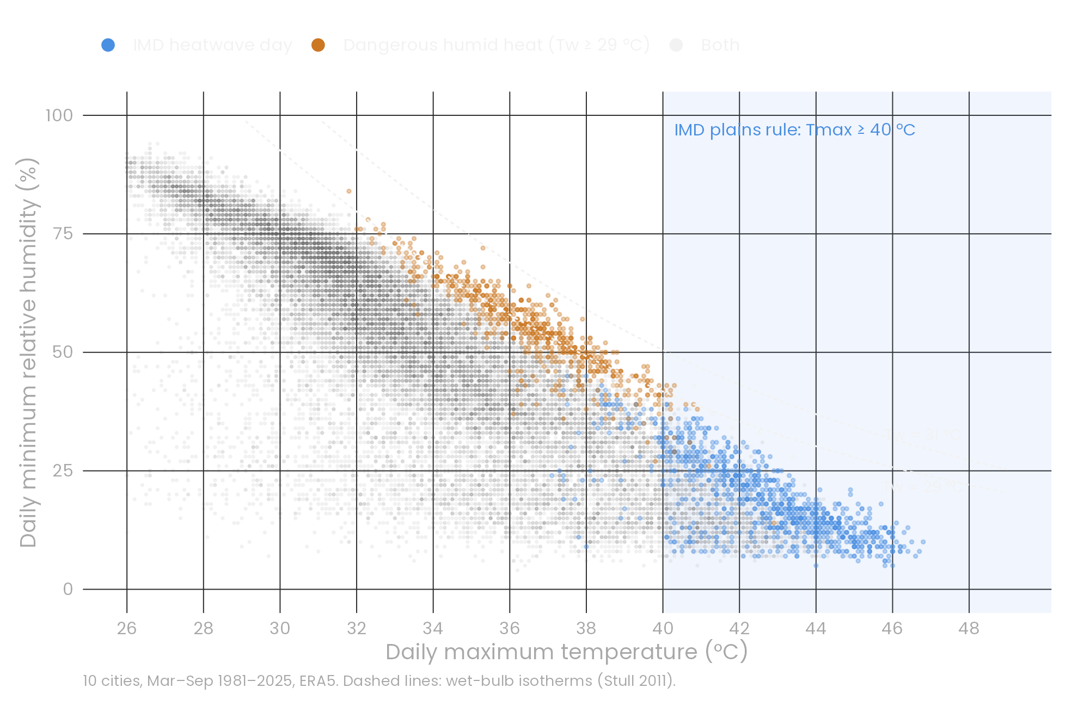
WHY A DRY-BULB RULE CANNOT SEE HUMID HEAT
r = -0.61 to -0.91
Tmax vs RH in every city (p < 0.001): the hottest days are the driest
+1.5–2.1 °C
wet-bulb rise per +10% humidity at the same temperature (regression)
27 of 990
IMD heatwave days were also humid-danger days
Notes:
Every dot is a city-day. Blue days are IMD heatwaves: hot and dry, bottom right. Orange days are dangerous humid heat: 32–39 °C at 40–70% humidity, sitting on the 29 °C wet-bulb isotherm. The two clouds barely touch. Temperature and humidity are strongly negatively correlated, so a temperature threshold automatically selects dry days.

Slide 12
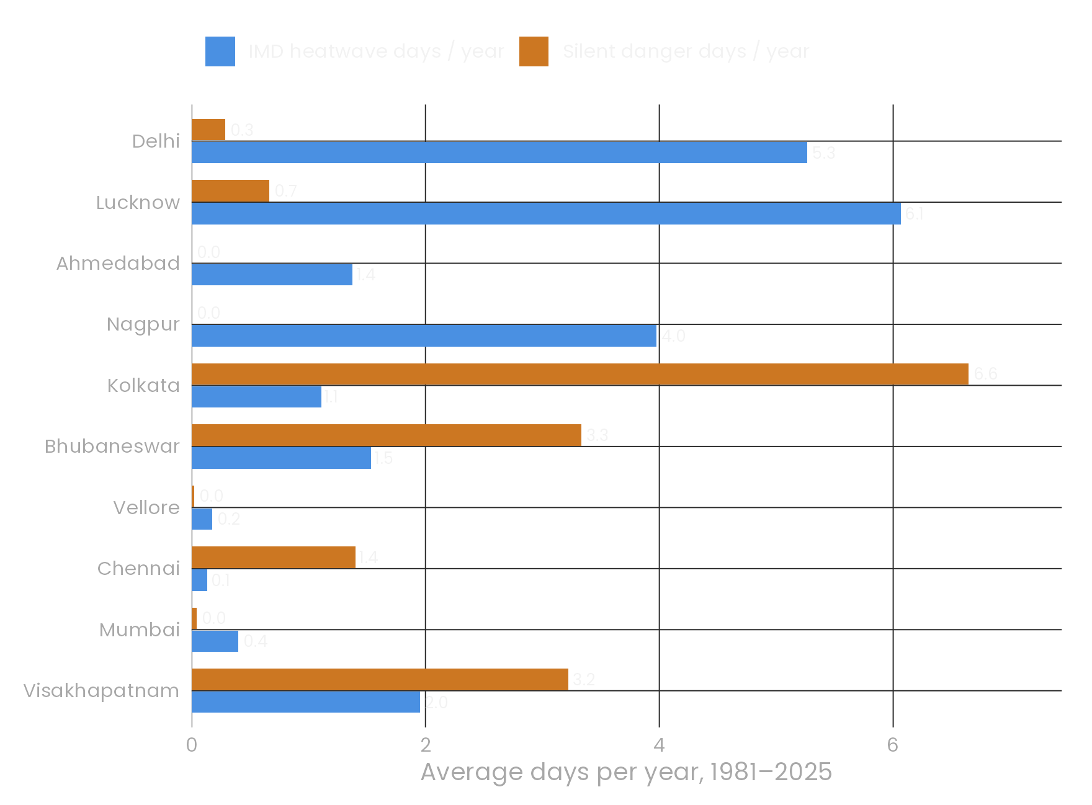
RQ1 · THE BLIND SPOT
96.3%
of dangerous humid-heat days (703 of 730) were never IMD heatwave days
Wilson 95% CI 94.7%–97.4%
Our rule is more generous than IMD's, so this is a lower bound
Notes:
Our central result. Of 730 dangerous humid-heat days, 703 were not IMD heatwave days: 96.3%, with a Wilson interval of 94.7 to 97.4%. On the right, per year: in Kolkata, Bhubaneswar, Visakhapatnam and Chennai, silent danger days outnumber official heatwave days.

Slide 13
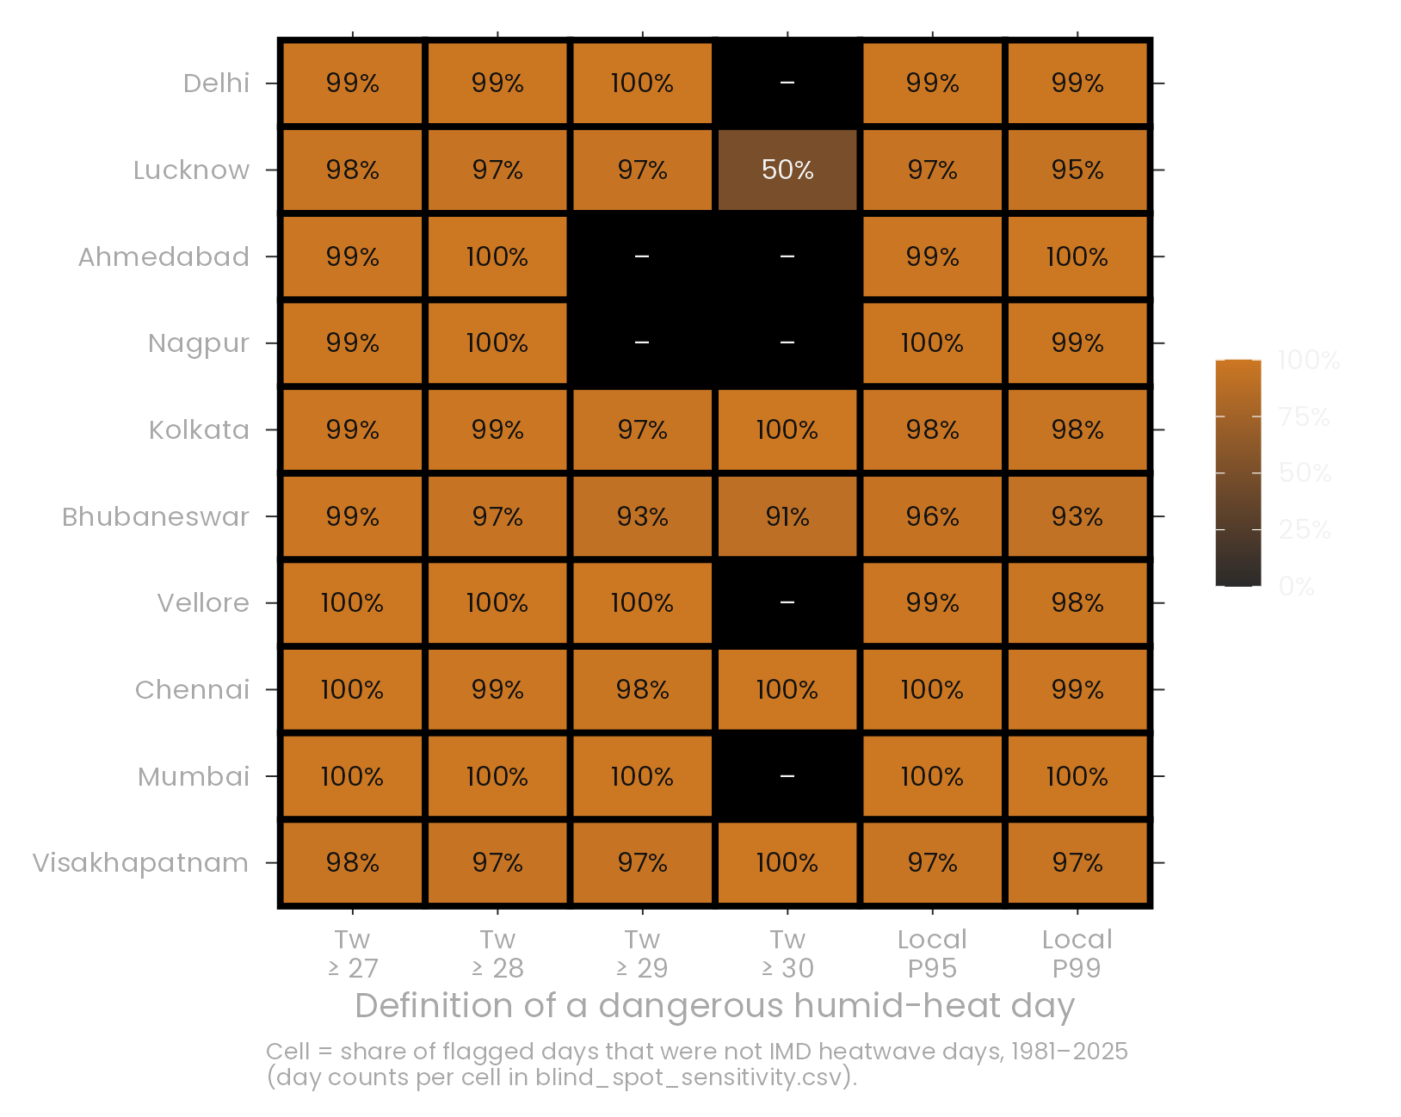
RQ1 · IS IT REAL? THE STATISTICAL EVIDENCE
Cohen's κ ≈ 0 (at most 0.09): no agreement between the two definitions
McNemar p < 0.05 in every city: the disagreement is systematic
χ² homogeneity p = 0.33: same miss rate in every city
Coastal vs plains p = 0.52: a property of the rule, not the region
Bayesian Beta(1,1) prior: posterior miss rate > 88% in every city
Heat Index IMD's own experimental index was orange/red on 81% of these days
Notes:
Is it real? Cohen's kappa is essentially zero: the two definitions measure different hazards. McNemar says the disagreement is systematic. The miss rate is the same across cities and between coastal and plains rules. The heatmap shows it stays at 96–99% whatever definition we use, including each city's own 95th and 99th percentile. IMD's own experimental Heat Index was orange or red on 81% of these days.

Slide 14
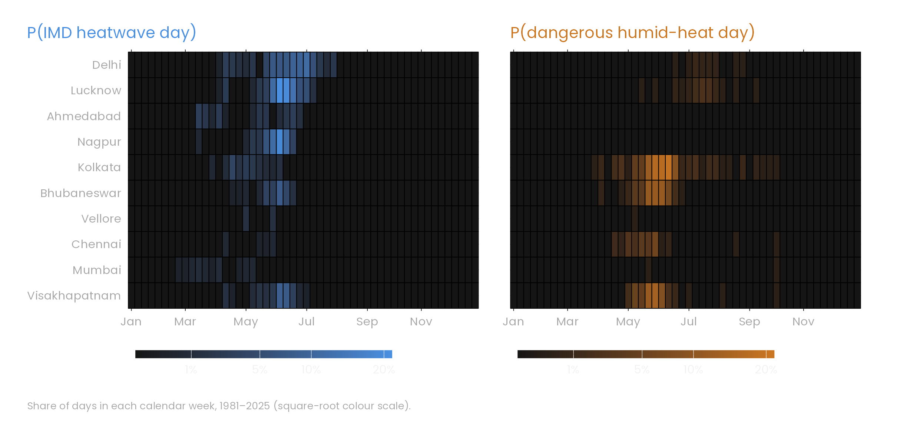
TWO HAZARDS, TWO SEASONS, TWO GEOGRAPHIES
Notes:
When does each hazard happen? IMD heatwaves cluster in April to June over north and central India. Humid danger peaks in May to July along the east coast and in Kolkata. The two hazards rarely share a city-week.

Slide 15
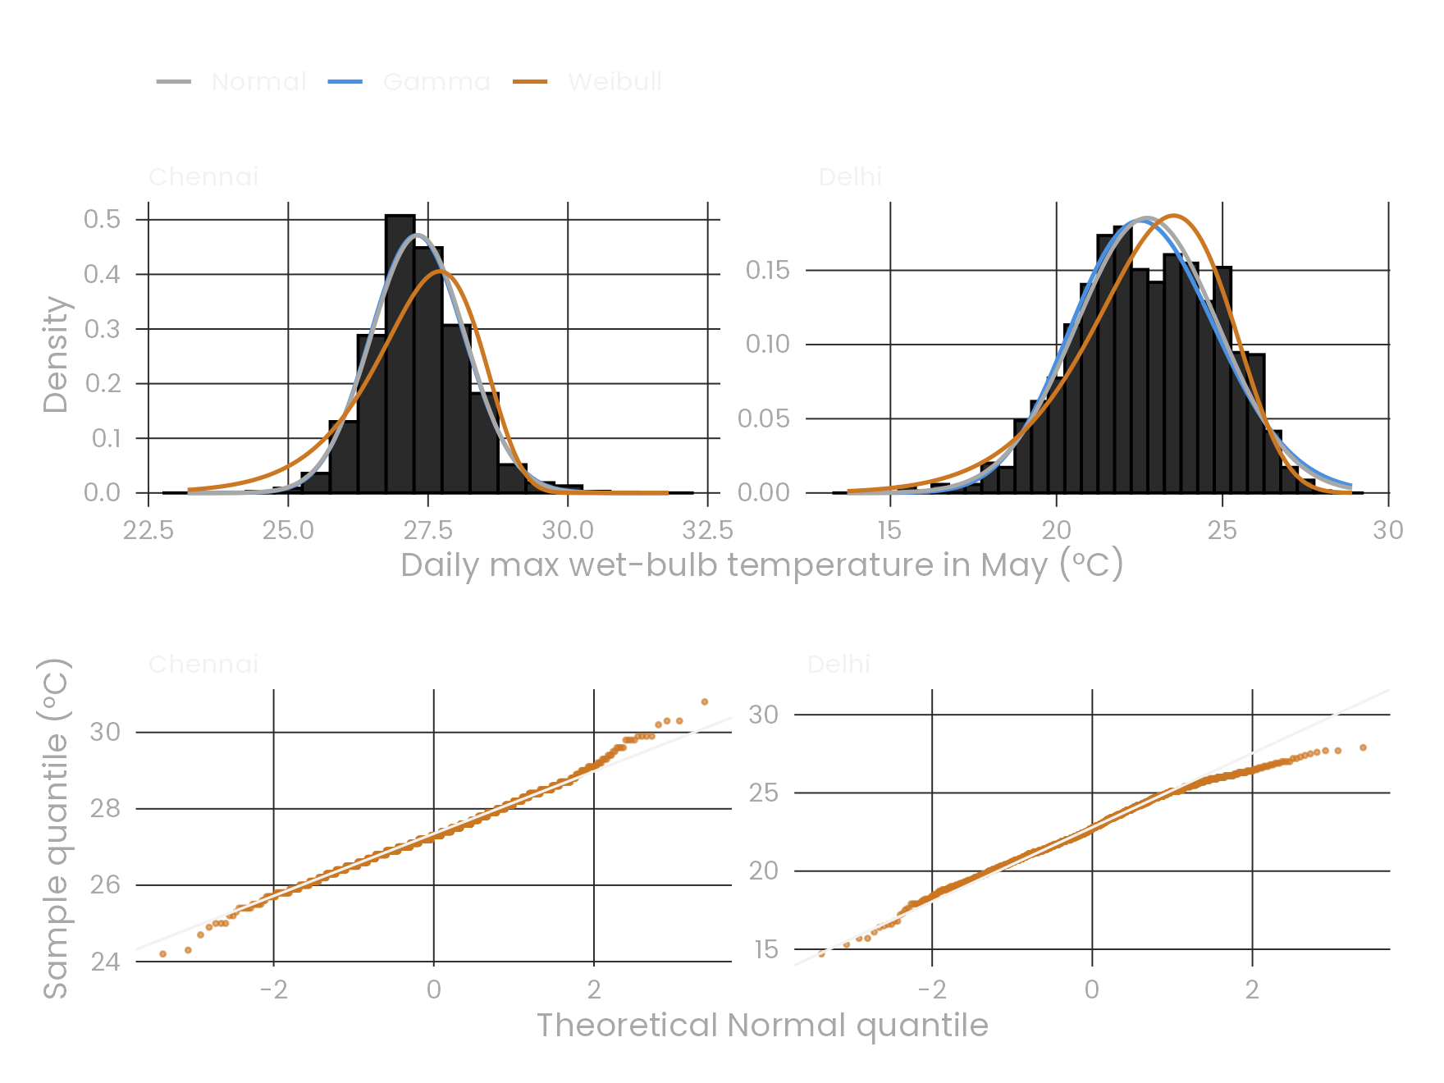
WHICH PROBABILITY MODEL FITS?
Daily wet-bulb (May)
MLE fits of Normal, Gamma, Weibull and Lognormal. Best by AIC: Normal 6, Weibull 2, Lognormal 1, Gamma 1.
Large Anderson–Darling statistics: the bulk fits, the tail does not, so we model the tail with extreme-value theory.
Annual danger-day counts
Variance/mean = 2.0–9.0. Dispersion test rejects Poisson (p < 0.001 everywhere); negative binomial wins on AIC and LRT.
Notes:
Which probability model fits? For daily wet-bulb in May, the best family by AIC varies by city, and Anderson-Darling statistics stay large because the tails misfit. That motivates extreme-value theory for the tail. Annual counts of danger days are overdispersed, with variance 2 to 9 times the mean, so the Poisson model is rejected and we use the negative binomial.

Slide 16
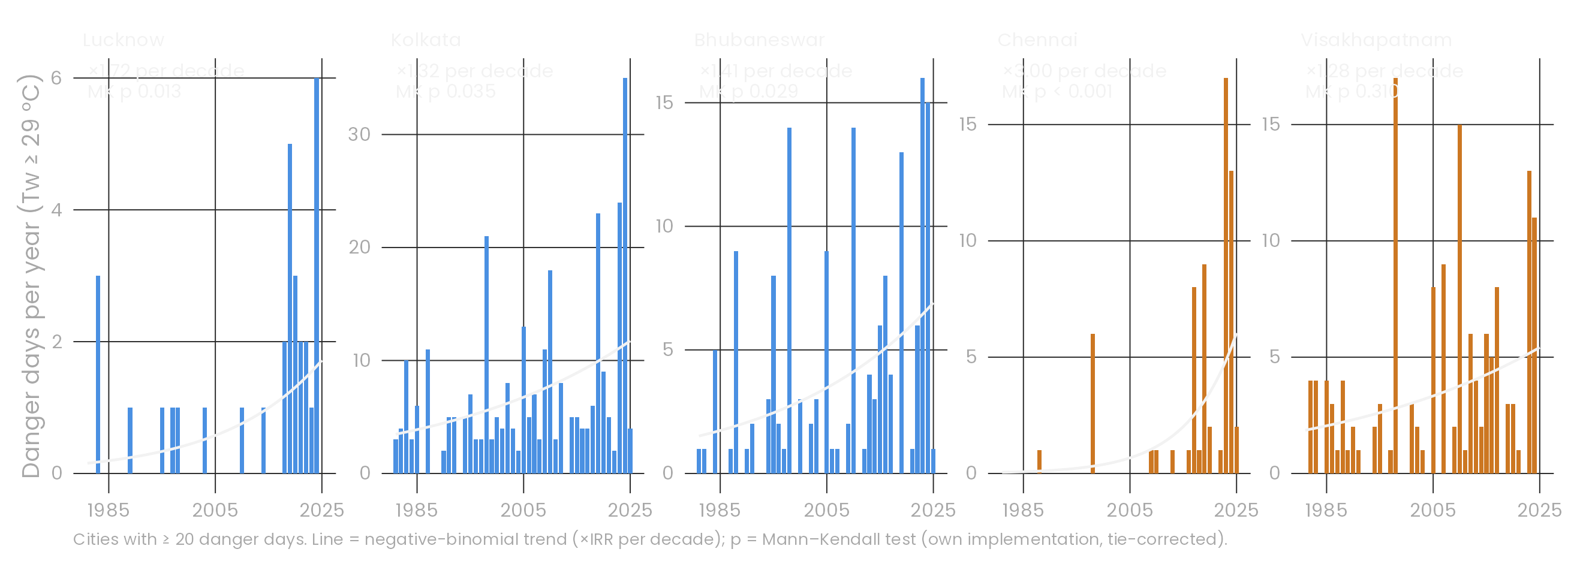
RQ2 · IS IT GETTING WORSE?
×1.54 / decade
+0.53 °C
0.35 → 2.85
danger days, NB GLM, 95% CI 1.34–1.77
Apr–Jun wet-bulb, 2021–25 vs 1981–90 (Tukey; Friedman p < 0.001)
Chennai danger days/yr, 1981–2000 vs 2006–25 (perm. p = 0.033)
Notes:
Is it getting worse? In a negative-binomial model with city effects, danger days grow by a factor of 1.54 per decade. The Tukey comparison puts the early-2020s 0.53 °C above the 1980s, and the blocked Friedman test confirms it. Chennai went from 0.35 to 2.85 danger days a year.

Slide 17
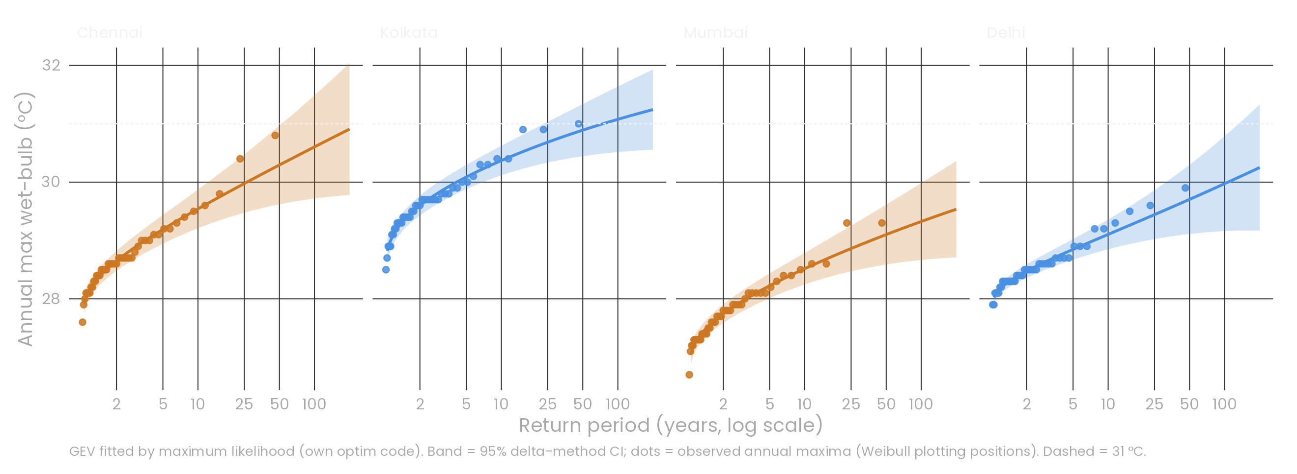
RQ3 · EXTREMES ARE SHIFTING (GEV)
1-in-50 → 1-in-2.6
7 of 10 cities
35%
Chennai: 1985's 50-year humid-heat extreme, under today's climate
significant upward shift of the GEV location (LRT p < 0.05)
chance Kolkata sees a ≥ 31 °C wet-bulb day in 2026–35 (trend GEV)
Notes:
Extremes. We fit the generalised extreme value distribution to 45 annual maxima per city with our own likelihood code. Letting the location drift with time is a significant improvement in seven of ten cities. Under that model, the annual maximum that was a 1-in-50-year event in Chennai in 1985 now comes about once every 2.6 years.

Slide 18
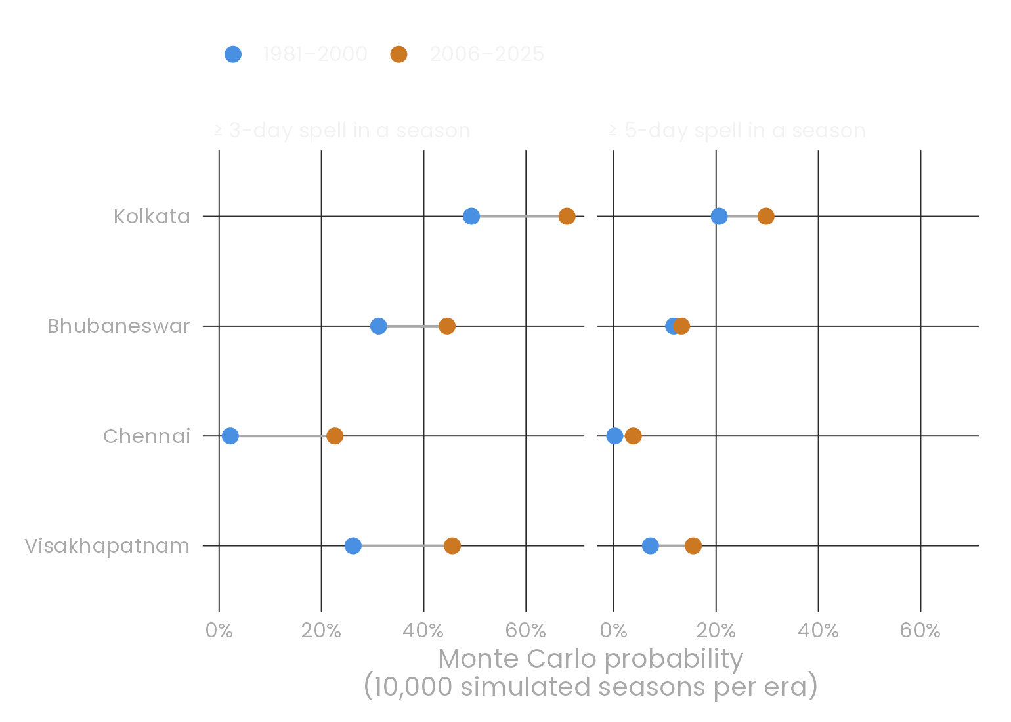
RQ4 · DANGER COMES IN SPELLS (MARKOV CHAIN)
Kolkata, peak season (5 May – 4 Jul)
stay 0.953
stay 0.568
0.047
CALM
DANGER
0.432
Independence rejected: χ² and G² p < 0.001; persistence odds ratio 27–41
Spells are geometric: mean = 1/(1 − p₁₁); goodness-of-fit p = 0.10–0.67
Monte Carlo, 10,000 seasons/era: P(≥ 3-day spell) in Chennai 2% → 23%, in Kolkata 49% → 68%
Notes:
Danger days come in spells. Within Kolkata's peak season, a danger day is followed by another 57% of the time, versus 5% after a calm day. Independence is rejected everywhere. The chain implies geometric spell lengths, which the data do not reject. Simulating 10,000 seasons per era, the chance of a 3-day spell in Chennai went from about 2% to about 23%.

Slide 19
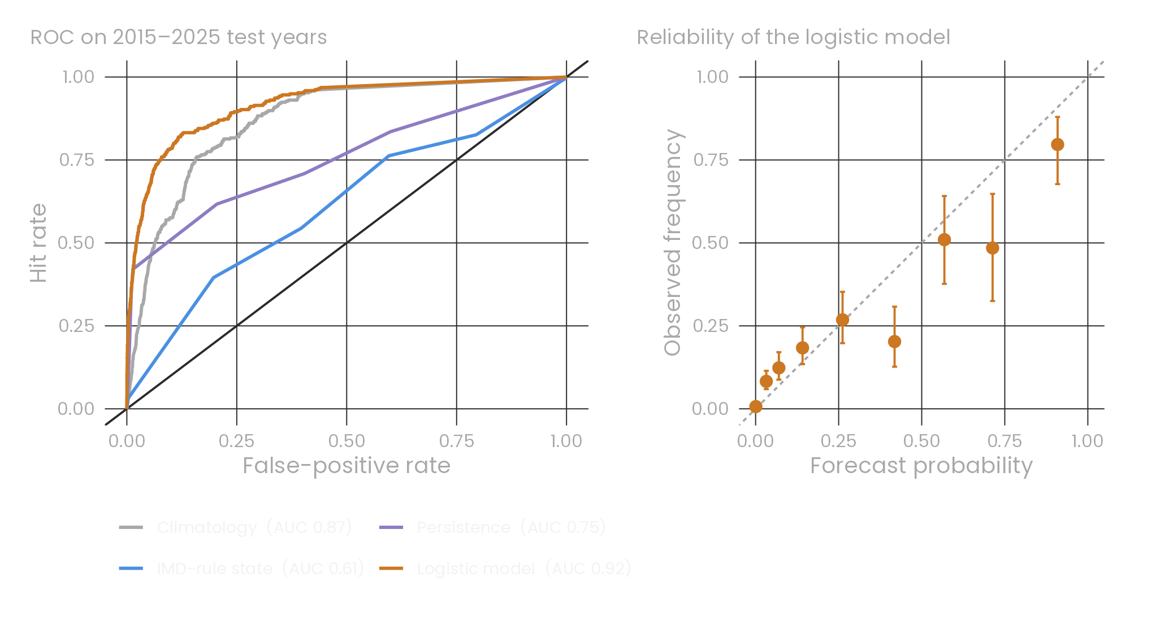
RQ5 · A CALIBRATED NEXT-DAY WARNING
AUC 0.92
logistic model vs 0.61 for the IMD-rule state (test years 2015–25)
+17%
Brier skill over climatology
4%
of next-day danger days caught by 'IMD heatwave today'
Each +1 °C of today's wet-bulb multiplies tomorrow's odds of danger by 11.3 (95% CI 7.5–17.1).
Notes:
Can we warn a day ahead? We trained a logistic model on 1981–2014 and tested it on the unseen years 2015–2025. Its AUC is 0.92, against 0.61 for the IMD-rule state. Its Brier skill is 17% better than climatology, and the reliability diagram stays close to the diagonal. Used as a warning, the IMD rule catches only 4% of next-day danger days.

Slide 20
RQ6 · BASELINE ML, AND WHAT IS NEW
Set-up
Target: will the day +1, +2 or +3 ahead be a danger day (wet-bulb ≥ 29 °C)?
Baselines: climatology, IMD rule, logistic regression, decision tree (rpart), random forest (ranger, 400 trees)
24 features: today's weather, 3–7-day wet-bulb history, season, city
Train 1981–2014 · alert thresholds tuned on 2010–14 · test 2015–25, never seen
What is new
Physiology-informed features
headroom to the 29 °C limit · closing speed · days-to-limit
Hybrid alert, not a replacement
IMD rule OR ML layer, scored on blind-spot recovery
Zero-history cities
leave-one-city-out: warn where no labelled past exists
Notes:
RQ6 pushes the warning further with standard baseline machine-learning models: a decision tree and a random forest, next to the logistic model and climatology. We forecast one, two and three days ahead with the same unseen test years. Three things are new: features built from physiology, a hybrid alert that keeps the IMD rule and adds an ML layer, and a test of whether the model works in a city it was never trained on.

Slide 21
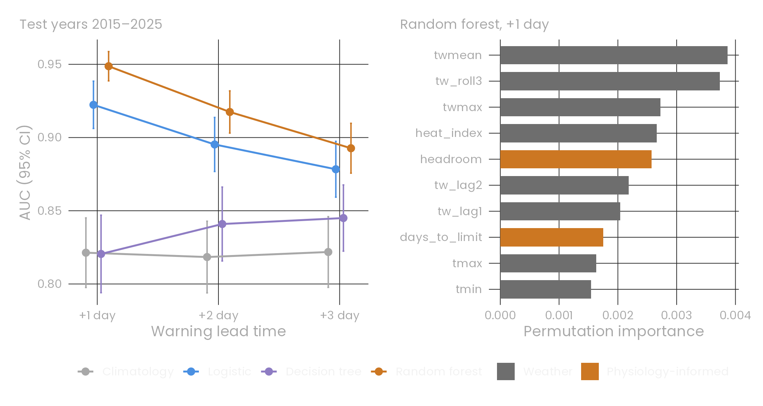
RQ6 · RANDOM FOREST LEADS AT EVERY LEAD TIME
AUC 0.95
random forest, +1 day (logistic 0.92, IMD rule 0.61)
AUC 0.89
still at +3 days, vs 0.82 for climatology
+22%
Brier skill over climatology, +1 day
Headroom to the physiological limit ranks #5 of 24 features. One tree is the weakest model; a forest of 400 fixes its variance.
Notes:
On the unseen years the random forest is best at every lead time: AUC 0.95 one day ahead against 0.92 for logistic regression and 0.61 for the IMD rule, and still 0.89 three days ahead. A single decision tree is the weakest model; averaging many trees removes its variance. Our physiology-informed headroom feature ranks 5 of 24.

Slide 22
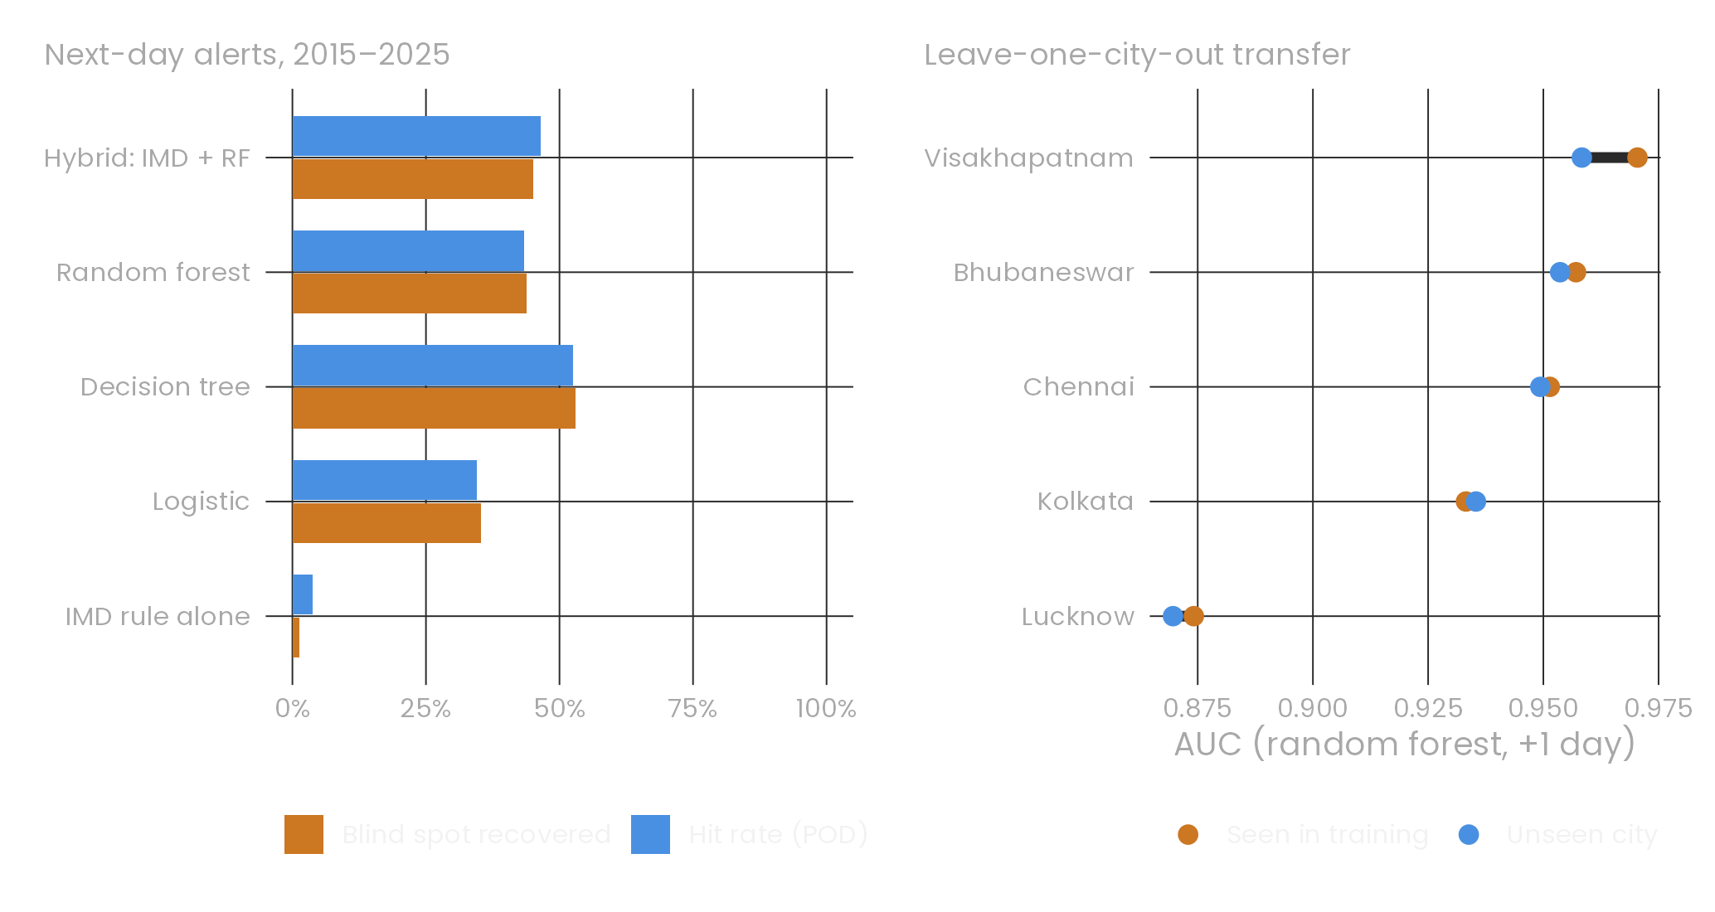
NOVELTY · CLOSING THE BLIND SPOT, ANYWHERE
45%
of the blind spot recovered by the hybrid alert (IMD rule alone: 1%)
47%
of next-day danger days caught (IMD rule: 4%)
0.93 / 0.94
mean AUC in an unseen city / a trained city
Honest cost: 64% of hybrid alerts are false alarms. That suits a cheap hydrate-and-rest advisory, not school closures.
Notes:
The hybrid alert keeps the IMD rule and adds the random-forest layer. It recovers 45% of the next-day danger days the IMD rule cannot see, against 1% for the rule alone. On the right, each city is held out completely: trained on the others, the forest still reaches a mean AUC of 0.93, almost the 0.94 it gets with local data. The cost is false alarms, which suits a cheap advisory such as hydrate-and-rest messaging.

Slide 23
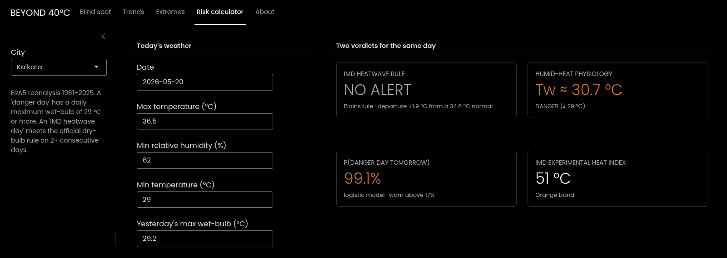
SHINY DASHBOARD: THE GAP IN ONE SCREEN
Risk calculator, Kolkata on 20 May: the IMD rule says NO ALERT, the wet-bulb (30.7 °C) says DANGER, and the model gives 99% for tomorrow.
Rscript -e 'shiny::runApp("app")' · 5 tabs: blind spot, trends, extremes, risk calculator, about
Notes:
Everything is explorable in a Shiny dashboard. The risk calculator shows the problem in one screen: the IMD rule says no alert, while the wet-bulb is 30.7 °C and the model gives a 99% chance of a danger day tomorrow. Other tabs show each city's barcode of missed days, its trend, and its return levels.

Slide 24

CONCLUSIONS & RECOMMENDATIONS
RQ1
The IMD rule misses 96% of dangerous humid-heat days, in every city
RQ2
Danger days grow ×1.54 per decade; Apr–Jun wet-bulb is up 0.53 °C
RQ3
Tail shifting in 7/10 cities; Chennai's 1985 50-year extreme is now 1-in-2.6
RQ4
Danger persists in spells; 3-day spells are now far more likely
RQ5
A logistic warning reaches AUC 0.92 vs 0.61, and is calibrated
RQ6
A random forest reaches AUC 0.95, recovers 45% of the blind spot, and transfers to unseen cities
Add a humidity-aware trigger (wet-bulb or Heat Index) to heatwave declarations
Replace fixed national cut-offs with local, probabilistic thresholds and return periods
Prioritise Kolkata, Bhubaneswar, Visakhapatnam and Chennai, where silent days dominate
Notes:
To answer the six questions: the rule misses 96% of dangerous humid heat; danger days grow about 54% per decade; extremes are shifting in seven of ten cities; danger comes in persistent spells; a simple calibrated model warns far better than the rule; and a random forest extends the warning to three days and to cities with no history. Three recommendations follow.

Slide 25
LIMITATIONS & FUTURE WORK
Limitations
ERA5's 0.25° grid smooths peaks: only 2 grid-days reached 31 °C; Mumbai's cell is sea-moderated
One grid cell stands in for IMD's two stations, which flatters IMD, so our miss rates are lower bounds
Thresholds come from young, healthy adults; older people and outdoor workers are at risk sooner
Day-level tests are approximate under autocorrelation (mitigated with block bootstrap and Markov models)
Future work
Repeat with IMD station observations and finer reanalysis (ERA5-Land, IMDAA)
Link to hospital or mortality records to calibrate thresholds by age and occupation
Extend to warm nights and multi-day cumulative heat load
Operational district-level forecasts using weather-model inputs instead of today's observations
Notes:
Limitations. ERA5's 25 km grid smooths extremes, so station data would raise every count, but the dry-versus-humid separation is structural. Our one-cell rule flatters IMD. Physiological limits come from young, healthy adults. Next steps: station data, mortality or hospital data to validate thresholds, and a district-level operational forecast.

Slide 26
REFERENCES
India Meteorological Department. Criteria for heat wave; experimental Heat Index guidance.
Pillai, A. V. & Dalmia, T. (2023). How is India adapting to heatwaves? An assessment of heat action plans. Centre for Policy Research.
Vecellio, D. J. et al. (2022). Evaluating the 35 °C wet-bulb temperature adaptability threshold for young, healthy subjects. J. Appl. Physiol. 132(2).
Raymond, C., Matthews, T. & Horton, R. M. (2020). The emergence of heat and humidity too severe for human tolerance. Science Advances 6(19).
Stull, R. (2011). Wet-bulb temperature from relative humidity and air temperature. J. Appl. Meteor. Climatol. 50.
Coles, S. (2001). An Introduction to Statistical Modeling of Extreme Values. Springer.
Hersbach, H. et al. (2020). The ERA5 global reanalysis. QJRMS 146; accessed via Open-Meteo (CC BY 4.0).
Mann (1945); Sen (1968); DeLong et al. (1988), comparing correlated ROC curves.
Notes:
Key references.

Slide 27

THANK YOU
Notes:
Thank you. Questions welcome; the dashboard can be shown live.

