Slide 1

WLAN connectivity
CHALLENGES
BUILDROOT BEHAVIOR
settings
driver
firmware
CONNECTION
settings
IP-leasing

Slide 2
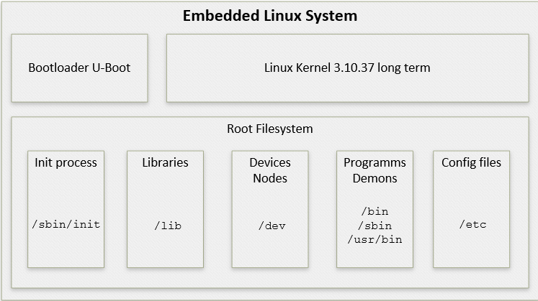
Embedded linux

