Slide 1

WLAN connectivity
CHALLENGES
BUILDROOT BEHAVIOR
settings
driver
firmware
CROSS COMPILER
makefile
compiler flags
CONNECTION
settings
IP-leasing

Slide 2
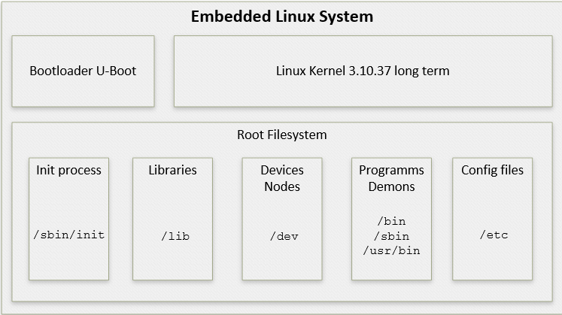
Embedded linux - buildroot

