Slide 1
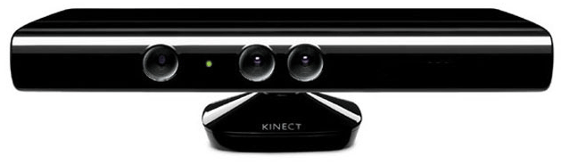
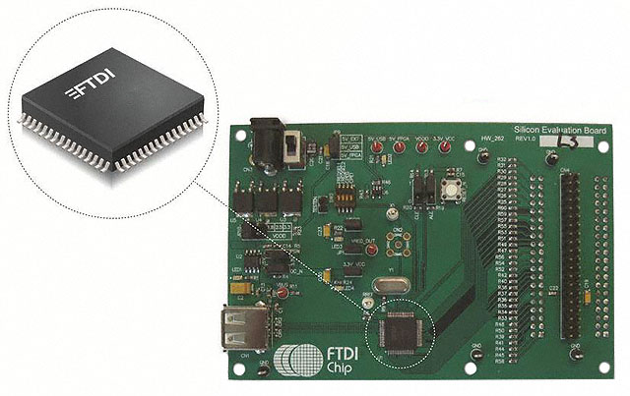
Kinect and USB Host Controller
Initial Situation
Requirements for the USB-Controller
Speed
Solderability
Linux Drivers
Possible USB-Controllers

Slide 2
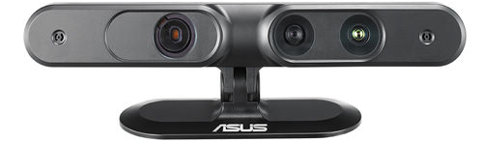
Kinect and USB Host Controller
Conclusion
Kinect unsuitable
Evaluation of ASUS Xtion PRO

