Slide 1
X-Copter
Development a platform to test several sensors or
processes for a autonomic aircraft

Slide 2
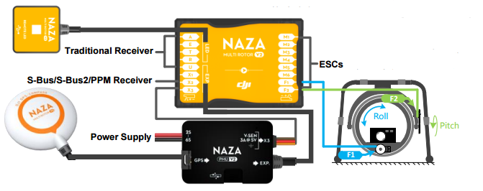
Commercial Flight controller
DJI NAZA m v2
Accelerometer, Gyro, GPS
Support for up to 8 motors

Slide 3
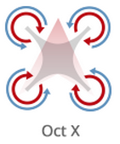
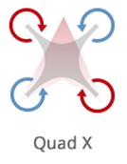
Configuration
DJI NAZA Assistant
Model type (Quad-/Hexacopter, Coaxial Quad)
Basic Sensor-/RC-Calibration

Slide 4
Flight-Modes
Manual
Atti. (Altitude hold)
GPS

