Slide 1





Team Details
  Team name: Xcore
  Team leader name: Thanveer Ahamed
  Problem Statement: Intelligent Risk, Fraud & Financial Experiences (BFSI). Lenders and insurers judge property risk from slow site visits or self-reported photos nobody can verify. We turn a 20-second phone video into a fraud-checked, explainable, underwriting-ready property risk file.
Property Inspection AI
Phone video → underwriting-ready property risk file
Thanveer Ahamed
Janitha Prathapa
Dinal Fernando
Notes:
Team Xcore, led by Thanveer Ahamed. BFSI track: Intelligent Risk, Fraud & Financial Experiences.

Slide 2
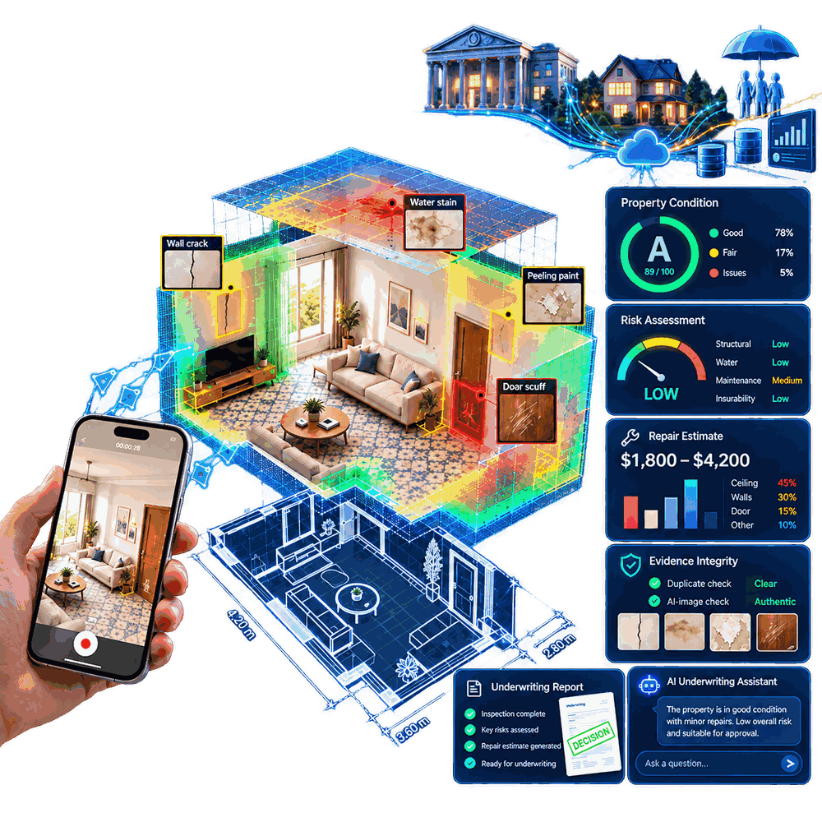
Brief about the idea
From a 20-second phone video to an underwriting-ready property risk file
Property Inspection AI is a Gen AI inspection service for mortgage lenders, insurers and inspectors. Upload a phone walkthrough video; in minutes it returns defects, condition grade A–E, perils, repair cost, valuation impact, premium loading, an underwriting decision with reasons, fraud flags and a 3D model that proves what was inspected.
THE PROBLEM: property risk is judged from photos nobody can verify
Slow site visits
Days of waiting; remote cases go unchecked
Unverifiable photos
Reused, edited, off-screen or wrong property
No proof of coverage
Which walls did the inspection see?
Subjective grading
Inspectors disagree; reasons unrecorded
Overvaluation
RBI has flagged inflated collateral values
WHO IT SERVES: one inspection record, five BFSI decision-makers
Lenders, HFCs, NBFCs
Collateral grade, valuation impact, REFER flag
Insurers: underwriting
Perils, risk level, premium loading
Insurers: claims
Repair-cost range, fraud-checked evidence
Inspectors & valuers
AI-drafted report, re-film list
Owners & buyers
Condition report, 3D model, floor plan
$308.6B
~$45B
$4.5–12.5B
yearly US insurance fraud, all lines (Coalition Against Insurance Fraud, 2022)
of that in property & casualty insurance (same study)
global home-inspection services market, 2025 (industry reports)
Minutes, not days · Fraud-resistant · Explainable
Concept illustration of the product
Notes:
One-liner: a 20-second phone video becomes an underwriting-ready property risk file. Insurance fraud is estimated at $308.6B a year in the US, about $45B of it in property and casualty. Five pains, five users.

Slide 3
Opportunities
How it is different, how it solves the problem, and our USP
HOW DIFFERENT IS IT FROM EXISTING IDEAS?
 | Site visit / photo-only AI tools | Property Inspection AI
Turnaround | Days (visit) / minutes (tools) | Minutes; ~10 min per 20 s video
Proof of what was inspected | Inspector's word / none | 10 cm coverage map + 3D-pinned findings
Evidence fraud checks | None / limited | Keyframe dHash reuse, Gemini screen / AI check
How the decision is made | Subjective / black-box score | Transparent YAML rules; Gemini explains
False-positive control | Human / single model | Find (LocateAnything) → verify (Gemma 4) → rules
BFSI outputs & integration | Report or damage list, PDF | Grade, perils, cost, valuation, premium; JSON via REST API
USP of the proposed solution
Proof of inspection. A 10 cm coverage map and 3D-pinned findings show exactly what the AI saw, and what to film again.
Find → verify → decide. Two models cut false positives; deterministic rules make every decision auditable.
Fraud-resistant evidence. Recycled videos, screen recordings and AI footage are flagged before a decision.
One record, five teams. Lending, underwriting, claims, inspectors and owners share one JSON record behind a REST API.
Under $1 per video. ≈ $0.50 of L4 time + ≈ $0.35 of Gemini per walkthrough; the GPU Job runs only per video.
HOW WILL IT SOLVE THE PROBLEM?
Slow site visits
full risk file in minutes; low-risk homes clear without a visit
Unverifiable photos
every walkthrough fraud-checked; any HIGH flag → REFER
No proof of coverage
< 60% AI-inspected surface → REFER with a re-film list
Subjective grading
score = 100 − Σ(points × severity × state weight)
Overvaluation
valuation-impact %, repair retention, REFER before disbursal

Slide 4
List of features offered by the solution
One upload gives a complete, explainable risk file
1
Defects localised & verified
2
Condition grade A–E
✓
Detection scope
18 defect types on 12 components
0–100 score, transparent formula
Walls, ceilings, floor & wall tiles, grout, wood/vinyl, countertops, doors, locks, windows, trim, kitchen exhausts in 8 room types. Look-alikes (grout, grain, shadows) rejected; locks, windows, fans always manual; cracks get a structural note, water/mold a moisture check.
3
Risk level & insurance perils
4
Indicative repair-cost range
Water, structural, moisture…
Per finding and per property
✓
Fraud & evidence integrity
Keyframe dHash reuse across every property, Gemini screen / render / AI check on every keyframe, blurred frames dropped, video coverage < 60% → REFER. Any HIGH flag → human review.
5
Valuation & collateral impact
6
Premium-loading suggestion
Impact % and repair retention
For quote and renewal
✓
3D digital twin & coverage map
Depth Anything 3 + OpenCV 5 SLAM + Open3D TSDF → clean & SLAM GLB, floor plan (PNG + SVG), navigation map. Every 10 cm of surface checked; greedy AI keyframes; findings pinned to a wall and video time.
7
Underwriting decision + reasons
8
Evidence-integrity flags
PROCEED / CONDITIONS / REFER
Recycled video, screens, AI footage
✓
Gemini co-pilot & product
9
Video → 3D, floor plan, coverage
10
Gemini analysis & Q&A
Property analysis, grounded Q&A, scene and object naming (explains, never changes results). Portfolio dashboard, live 3D-scan view, Lite / Advanced 3D, 3D viewer, HTML / Markdown / JSON reports, REST API at /docs.
GLB models, room areas, maps
Grounded answers citing issue IDs

Slide 5
Process flow diagram or Use-case diagram
Capture, inspect, decide, act: minutes instead of days
ACTORS
Inspector / owner captures
1 Capture
2 AI inspection
3 Risk decision
4 Act
Underwriter / claims reviews & decides
A phone walkthrough video. No special hardware.
Gemini reads the room; LocateAnything finds defects; Gemma 4 verifies each crop.
Rules set grade, perils, cost, valuation, premium, decision; Gemini explains.
Report, Gemini Q&A and a JSON record via the REST API to core systems.
Core systems LOS, policy, claims
DECISION OUTCOMES (back to underwriter and core systems)
PROCEED
PROCEED W/ CONDITIONS: note defects
PROCEED W/ CONDITIONS: repairs / retention
REFER: professional survey
REFER: evidence integrity
REFER: additional evidence
KEYFRAME
PIPELINE
1 Quality + integrity (dHash)
2 Gemini: room, components, authenticity
3 Prompt router: 18 defects, 12 components
4 LocateAnything-3B boxes → NMS
5 Full-res crops → Gemma 4 verify
6 Rule engine → status → risk engine
VIDEO
PIPELINE
1 Depth Anything 3 depth per frame
2 OpenCV 5 SLAM camera poses
3 Open3D TSDF surface fusion
4 Walls, floor, doors; Gemini names objects
5 10 cm coverage + AI keyframes
6 Keyframes → keyframe pipeline; pins in 3D

Slide 6
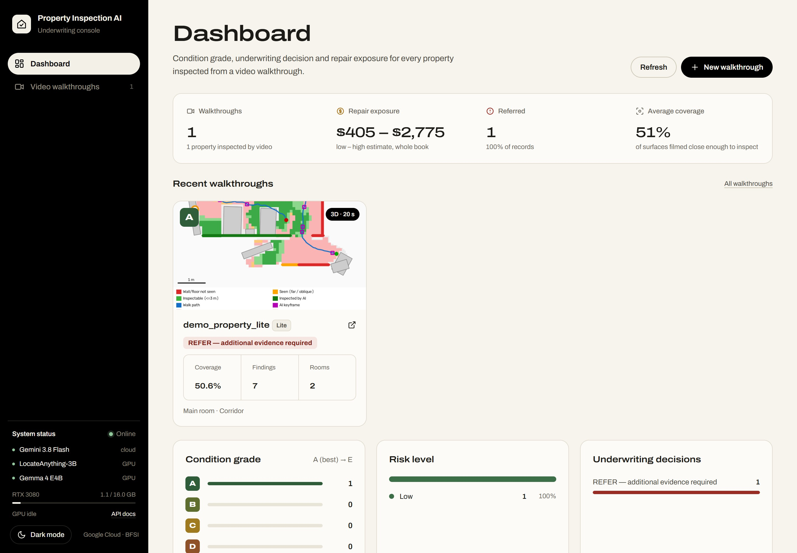
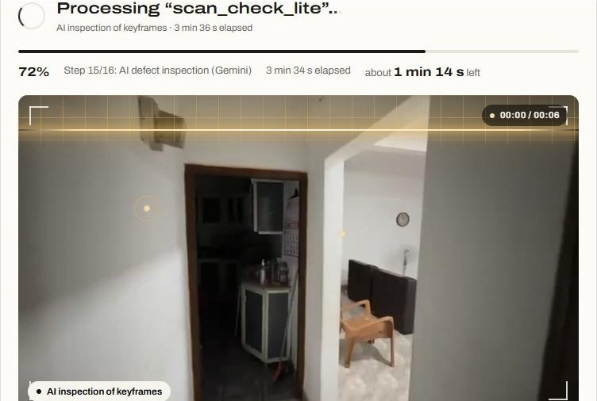
Wireframes/Mock diagrams of the proposed solution (optional)
Actual product screens: an inspection app built for underwriters
Video walkthrough: live 3D-scan progress while the video is processed
Dashboard → Video walkthroughs → 3D report → Ask Gemini
Video upload with a live 3D-scan view, Lite or Advanced
Interactive 3D viewer: walk inside, see coverage gaps
Reports in HTML, Markdown, JSON; REST API at /docs
Dashboard: walkthroughs, repair exposure, referrals, coverage and condition grades across the book

Slide 7
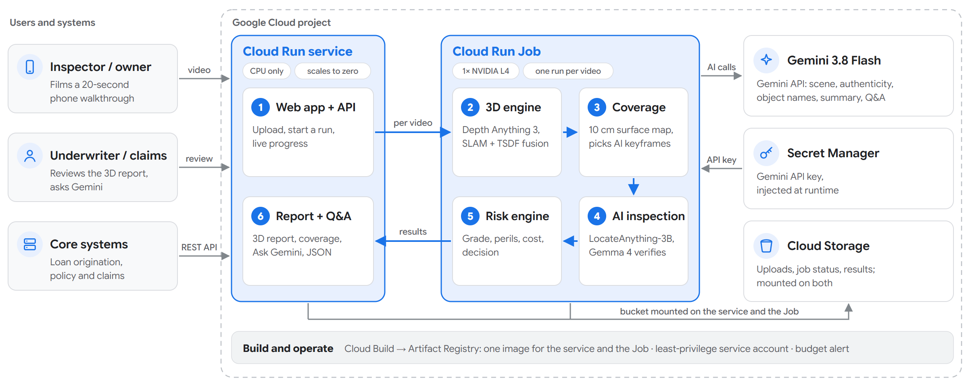
Architecture diagram of the proposed solution
Cloud Run web service + L4 GPU Job, powered by Gemini
Deployed layout (v1.0.0): web UI + API on a CPU-only Cloud Run service; 3D, coverage and AI inspection on a Cloud Run Job with one NVIDIA L4 per video; Cloud Storage bucket mounted on both; Gemini 3.8 Flash via the Gemini API (key in Secret Manager). BigQuery and Pub/Sub are not used.
Notes:
Architecture: one container image, two Cloud Run resources. A CPU-only Cloud Run service serves the web UI and API, accepts uploads, dispatches jobs and shows progress. A Cloud Run Job with one NVIDIA L4 processes each uploaded video: Depth Anything 3 and OpenCV SLAM for the 3D map and coverage, LocateAnything and Gemma 4 for defect detection and verification, Gemini for scene, labels and summary. The GPU is billed only while a video is processing. A Cloud Storage bucket mounted on both holds uploads, job status and results. Gemini 3.8 Flash is called through the Gemini API with the key in Secret Manager: no Vertex AI, BigQuery or Pub/Sub. Deployment is one script through Cloud Build with a least-privilege service account. The diagram still shows the earlier single-service layout; the caption gives the deployed one.

Slide 8
Technologies to be used in the solution
Built on Google AI and Google Cloud, with best-in-class open models
GOOGLE AI & CLOUD, IN THE PROTOTYPE
OPEN MODELS & LIBRARIES
NEXT ON THE ROADMAP
Gemini 3.8 Flash
Gemma 4 (E4B)
LocateAnything-3B open-vocabulary defect boxes
Document AI
Title deeds, valuation reports, repair invoices cross-checked with images
✓
✓
Gemini API: scene, authenticity, analysis, grounded Q&A, 3D object names
Open Google model that verifies every defect crop on the GPU
llama.cpp local GPU inference for Gemma 4
Cloud Run + L4 GPU Job
Cloud Storage
Depth Anything 3 monocular depth per frame
Vertex AI Search
Policy wording and lending guidelines for the assistant
✓
✓
CPU web service + one L4 Job per video; both scale to zero
Bucket mounted on both: uploads, job status, results
OpenCV 5 SLAM tracking, ICP, CV evidence
Secret Manager
Cloud Build
Open3D TSDF fusion, meshes, GLB export
Vertex AI + BigQuery ML
Claim-likelihood and collateral-risk models
✓
✓
Gemini API key injected at runtime; none in the image
Builds the ~12 GB image; weights fetched inside the build
gsplat Gaussian-splatting experiment
Artifact Registry
IAM service account + Logging
FastAPI + Python 18 REST endpoints, web UI, /docs
Cloud SQL / AlloyDB
Multi-tenant case management, audit trail, SSO
✓
✓
One image with baked-in models for the service and the Job
Least-privilege runtime account; no keys in files
YAML rule engine client-owned risk rules
Why this stack: Gemini does reasoning, authenticity and explanation; open models on the Cloud Run GPU Job do high-volume boxing and verification cheaply; deterministic rules keep decisions auditable. Data stays in the client's own Google Cloud project, and the JSON record and REST API plug straight into lending, underwriting and claims systems.

Slide 9
Estimated implementation cost (optional)
Priced per inspection, far below a physical site visit
UNIT ECONOMICS (INDICATIVE, FROM THE PROTOTYPE)
BUSINESS MODEL
Cost item | Basis | Estimate
Gemini calls (Gemini API) | ≈ $0.005 per call | ≈ $0.35 per walkthrough
NVIDIA L4 on a Cloud Run Job | 1× L4, 8 vCPU, 32 GiB; one run per video | ≈ $0.50 per 20-min walkthrough
Video inspection, all-in | L4 Job + Gemini calls | ≈ $0.85 per walkthrough
Web UI + API (Cloud Run) | 1 vCPU, 2 GiB, scales to zero | Within the free tier
Idle footprint | 12 GB image + data bucket | ≈ $1.20 per month
Deployment & ops | One-command deploy, $30/mo budget alert | No servers to manage
Pay-per-inspection API
Lenders and insurers send a walkthrough video from their own apps; get JSON, a report and a decision back.
Enterprise subscription
Portfolio dashboard, BigQuery export, custom risk rules, SSO, private deployment in the client's GCP project.
Inspector & valuer firms
White-label app: AI drafts every report and coverage control, so each inspector handles more cases.
≈ $0.35
≈ $0.50
$0
Pricing hypothesis to validate in pilots: a per-inspection fee well below a physical visit, with volume tiers for portfolios.
Gemini per walkthrough
L4 GPU time per video
GPU cost when idle (Job runs per video)

Slide 10
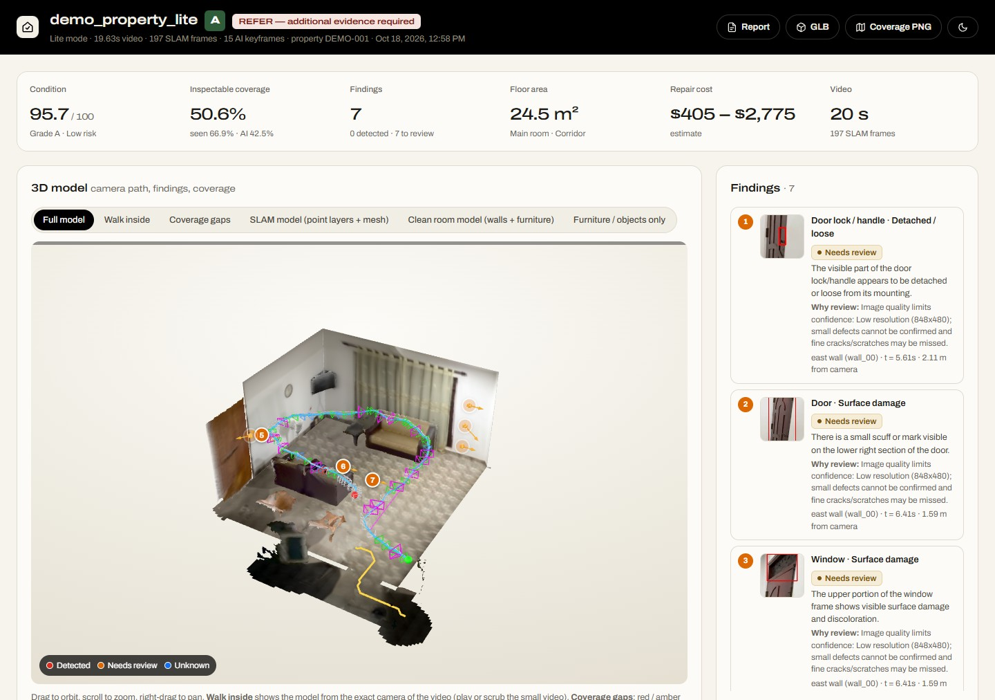
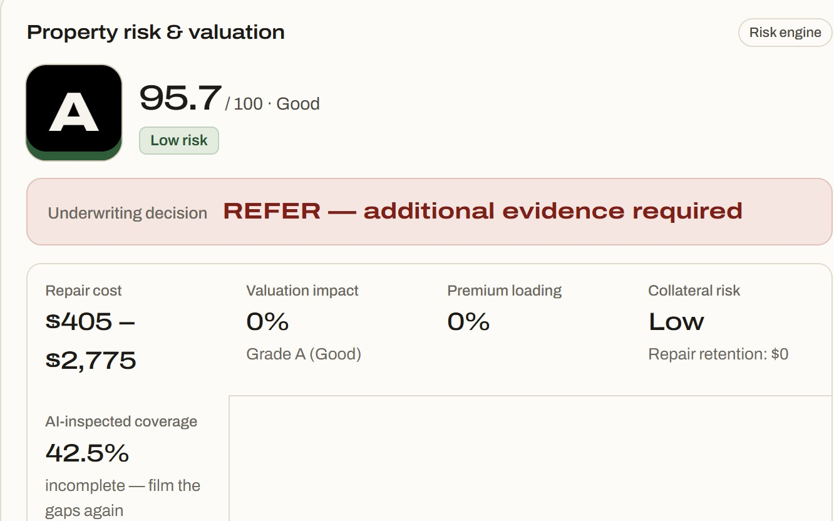
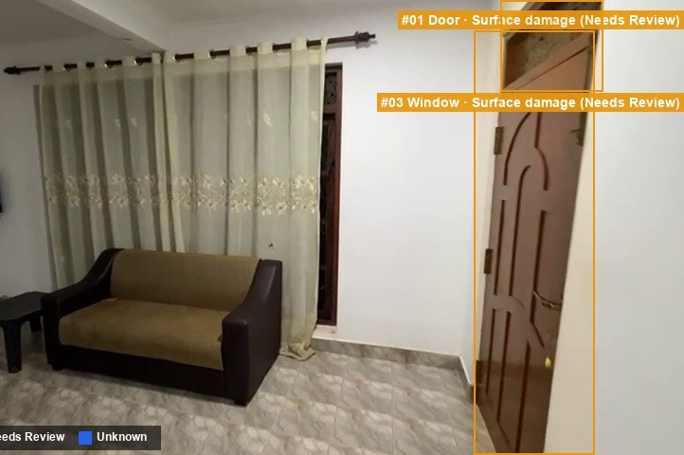
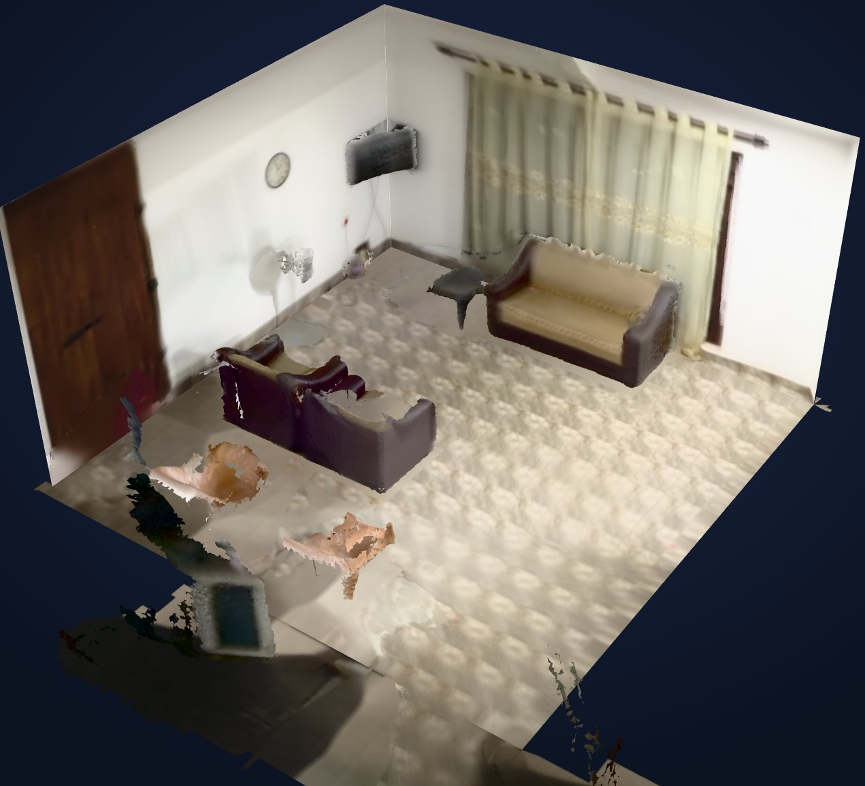
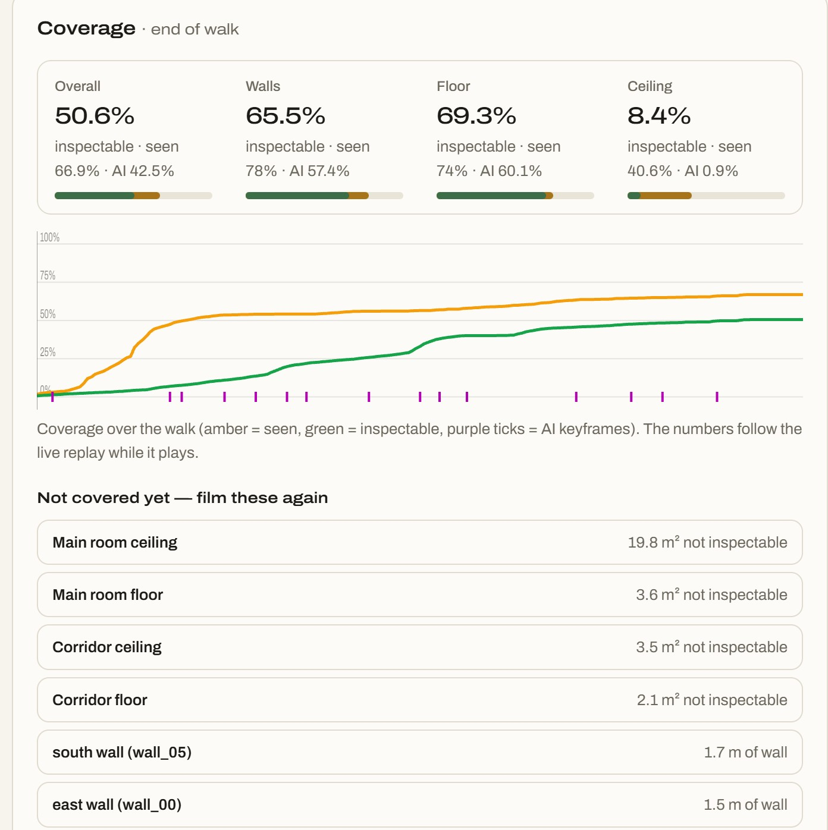
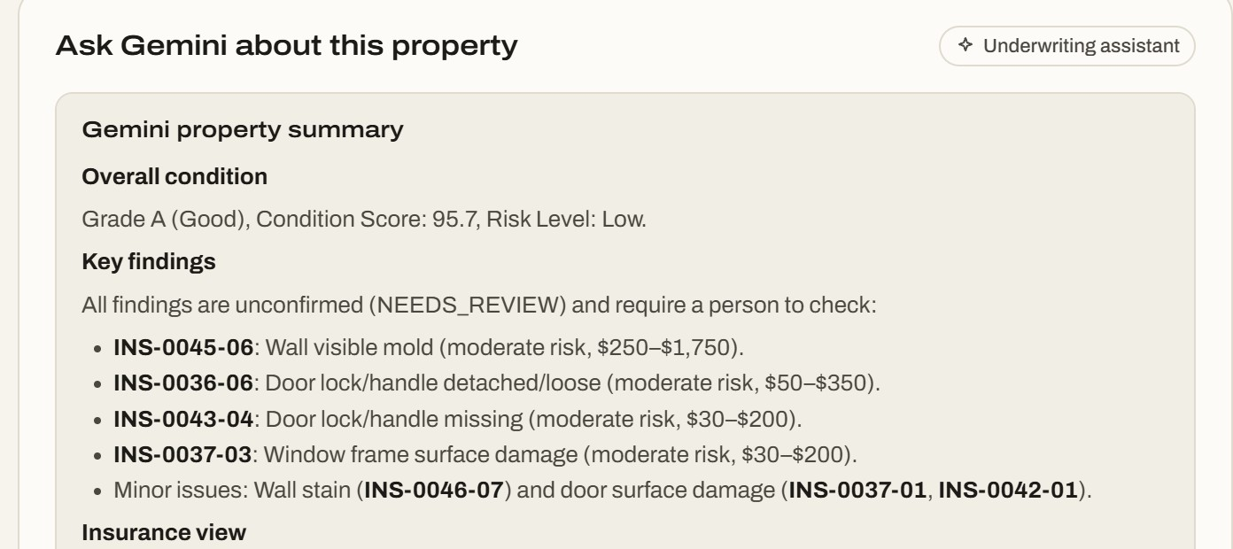
Snapshots of the prototype
Real screens and outputs from the working prototype v1.0.0
3D report: findings, grade A, decision
Risk & valuation panel: REFER with reasons
Keyframe detection: door and window damage
Phone video → clean 3D model (GLB)
Coverage map: what to film again
Gemini property analysis (co-pilot)

Slide 11
Prototype Performance report/Benchmarking
Measured on a real 20-second walkthrough, plus a fair 4-pipeline evaluation
CASE STUDY: REAL HOME WALKTHROUGH (MEASURED)
EVALUATION: 4 PIPELINES · 10 ROOMS · 100 REGIONS
19.6 s
197
15
phone video
SLAM frames
AI keyframes
24.5 m²
95.7 · A
$405–2,775
2 rooms measured
condition score
indicative repairs
Decision: REFER, additional evidence required
Only 42.5% of surfaces were AI-inspected (min 60%), so the app lists the walls and ceilings to film again. 7 possible defects pinned in 3D (Needs review).
SPEED & COST (FROM THE PROTOTYPE)
10.6 min
11.1 / 26.9 min
end to end, 20 s video, laptop GPU
3D build, Lite / Advanced
Simulated illustration, not yet measured: values show the report format and the expected gain; they will be replaced after running the protocol on D.
Fair test: same images, schema, Gemini settings and decision rule; test set frozen; 5 living rooms + 5 bedrooms incl. 2 clean controls; 40 defective / 60 clean regions.
Targets for D: ≥ 85% accuracy, precision, recall, F1; ≤ 1 false alarm on clean rooms; beat A on every metric.
21.8 / 21.6 dB
≈ $0.35
PSNR, Lite / Advanced
Gemini per walkthrough
Notes:
Case study and speed numbers are measured. The chart is a simulated example of the evaluation report, not a measured result; say so explicitly.

Slide 12
Additional Details/Future Development (if any)
Roadmap: documents, policies and predictive portfolio risk
NOW · v1.0.0
NEXT · 3 months
LATER · 6–12 months
Video walkthrough inspection
Risk and valuation engine
Fraud and coverage checks
Gemini analysis and Q&A
Cloud Run service + GPU Job
Mobile guided capture with live coverage
Document AI: deeds, valuations, invoices
Vertex AI Search over policy wording
Commercial localiser (Gemini / Vertex-tuned)
BigQuery ML claim & collateral-risk scoring
Before/after claim comparison in 3D
Multilingual reports (Gemini)
AlloyDB multi-tenant case management
WHAT WE BUILT: FROM DEPTH RESEARCH TO A DEPLOYABLE PRODUCT
01 Depth + SLAM
Depth Anything 3 visual SLAM, occupancy grid, A* path
02 Hybrid SLAM
OpenCV 5 tracking, ICP, Manhattan planes
03 Photo-real 3D
Gaussian Splatting experiment (gsplat)
04 Production 3D
Video → GLB models, floor plan (+SVG)
05 Inspection AI
Taxonomy, locate + verify, risk engine, fraud
06 Google Cloud v1.0.0
Gemini API, Cloud Run service + L4 Job
18
8
18
2
1
defect types, 12 components
room types
REST API endpoints
3D modes (Lite / Advanced)
command to deploy on GCP

Slide 13
Additional Details/Future Development (contd.)
Responsible AI and the go-to-market plan
RESPONSIBLE AI: HUMANS DECIDE, AI SHOWS EVIDENCE
GO-TO-MARKET: HOUSING FINANCE & HOME INSURANCE, APAC
1
Human in the loop
2
Explainable
PILOT · 0–3 months
Decision support only; a qualified surveyor or underwriter makes the final call.
Deterministic YAML rules; every decision lists its reasons and risk points.
1 housing-finance lender + 1 home insurer; AI alongside existing inspections on ~500 cases.
INTEGRATE · 3–6 months
3
Auditable
4
Safe wording
Pub/Sub into loan-origination and claims; BigQuery dashboards; custom rules per client.
Raw outputs archived; each inspection a stored JSON record; versioned config.
No structural-safety or root-cause claims; locks, fans, windows stay manual.
SCALE · 6–18 months
Google Cloud Marketplace, valuer & inspector networks, commercial property and claims.
5
Secure
6
Licence-aware
Secret Manager for the Gemini key; data stays in the client's project.
LocateAnything is non-commercial; Gemini localisation is the drop-in swap.
Pilot KPIs: turnaround · cost per inspection · % auto-cleared vs referred · fraud flags confirmed · re-inspection rate
“Every lender and insurer already asks for photos. We replace them with a short phone video that is trustworthy, explainable and ready for a decision.”

Slide 14
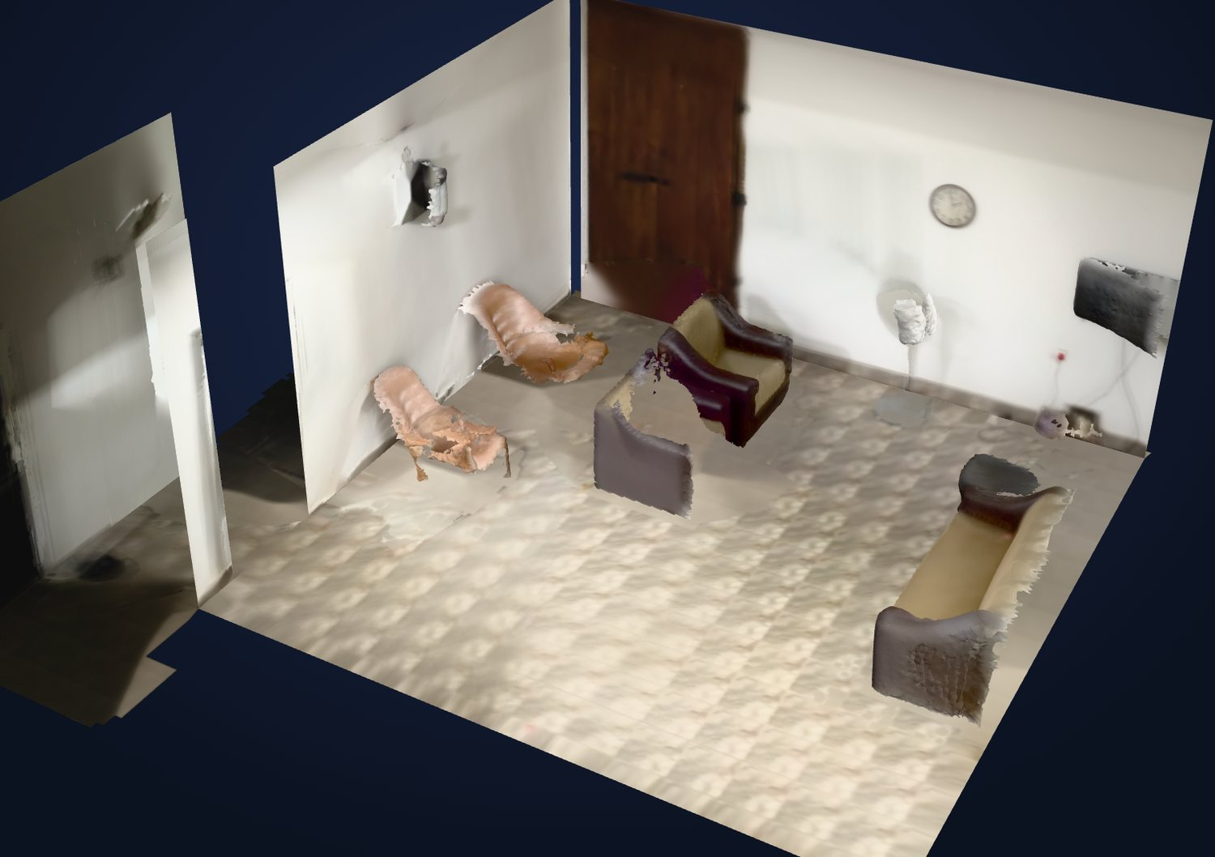
Provide links to your:
GitHub Public Repository: github.com/XCore-Lab/property-inspection-ai
Demo Video Link (3 Minutes): [paste link here]
Final Product Link: property-inspection-ai-77055350047.us-central1.run.app
Property Inspection AI · Prototype v1.0.0 · one-command Cloud Run deploy

Slide 15


