Slide 1

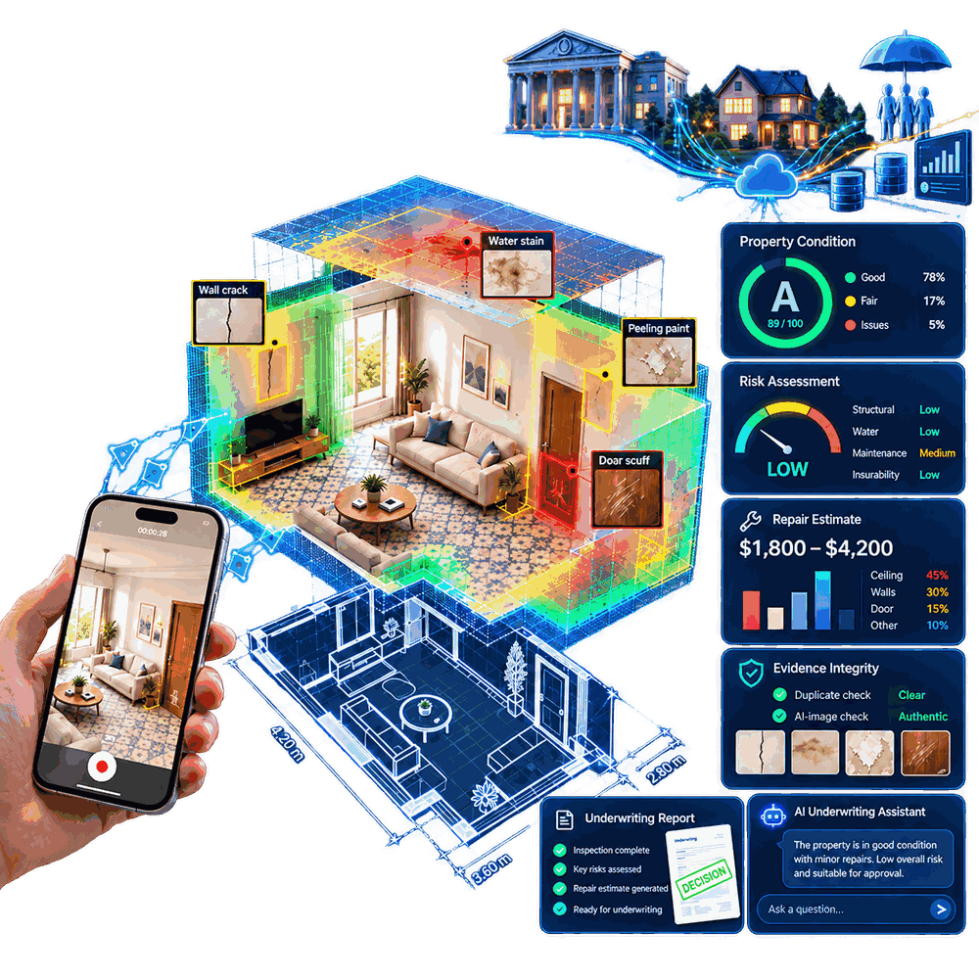
GOOGLE CLOUD AI BUILDER CUP 2026 · BFSI TRACK
Property Inspection AI
From a 20-second phone video to an underwriting-ready property risk file
Defects, condition grade, repair cost, valuation impact, fraud signals and a 3D proof of what was inspected, built for mortgage lenders, insurers and property inspectors.
Gemini 3.8 Flash
Gemma 4
Gemini API
Cloud Run + L4
Cloud Storage
Cloud Build
Team Xcore · Track: Intelligent Risk, Fraud & Financial Experiences · Prototype v1.0.0 · October 2026
Concept illustration of the product
Notes:
Open with the one-liner: a 20-second phone video becomes an underwriting-ready property risk file. We are in the BFSI track. Everything you will see is real output from our working prototype, built on Gemini, Gemma and Google Cloud.

Slide 2



Team Xcore
THE TEAM
Thanveer Ahamed
Janitha Prathapa
Dinal Fernando
Gen AI Lead
Vision AI Lead
Solution Architect
Three builders covering Gen AI, vision and cloud architecture, from research to a deployed product.
Gemini and Gemma reasoning, prompts, verification, analysis and the underwriting assistant
Defect detection, Depth Anything 3, SLAM, 3D model, floor plan and coverage map
Google Cloud architecture: Cloud Run service + GPU Job, Cloud Storage and deployment
Notes:
We are Team Xcore. Thanveer Ahamed leads Gen AI: the Gemini and Gemma reasoning, verification and the underwriting assistant. Janitha Prathapa leads vision AI: defect detection, depth, SLAM, the 3D model and the coverage map. Dinal Fernando is the solution architect for the Google Cloud deployment.

Slide 3





Property risk is judged from photos nobody can verify
THE PROBLEM
$308.6B
Slow, costly site visits
Lenders and insurers wait days for an inspector; remote cases go unchecked.
estimated yearly US insurance fraud, all lines
Coalition Against Insurance Fraud, 2022
Unverifiable self-reported photos
Photos get reused, edited, shot off a screen or taken at another property.
~$45B
No proof of what was inspected
of that in property & casualty insurance
Nobody can tell which walls or ceilings a remote inspection actually covered.
same study
Subjective, inconsistent grading
$4.5–12.5B
Two inspectors grade the same room differently, and the reasons go unrecorded.
global home-inspection services market, 2025
Collateral overvaluation
industry market reports
Regulators such as the RBI have flagged inflated valuations in housing-finance fraud.
Notes:
Property risk drives mortgages and home insurance, yet it is still judged from self-reported photos or slow site visits. Insurance fraud is estimated at $308.6B a year in the US alone, about $45B of it in property and casualty. Name the five pains: slow visits, unverifiable photos, no proof of coverage, subjective grading and collateral overvaluation.

Slide 4





One inspection record, five BFSI decision-makers
WHO IT SERVES
Mortgage lenders, HFCs & NBFCs
Insurers: underwriting
Insurers: claims
Inspectors & valuers
Real estate, owners & buyers
Collateral condition grade, valuation impact %, repair retention and a REFER flag before disbursal and over the loan's life.
Insurance perils, risk level and a premium-loading suggestion at quote and renewal, without a site visit for low-risk homes.
Claim-ready evidence with an indicative repair-cost range, plus recycled-video and screen or AI-footage detection.
The AI drafts the report and the coverage map shows what to film again, so one inspector can supervise many remote inspections.
A transparent condition report, 3D model and floor plan, with fraud-resistant evidence for listings and sales.
Same evidence, one record: every inspection is a JSON record behind a REST API that each team's own system can use
Notes:
One inspection record serves five decision-makers: lenders get collateral condition and valuation impact, underwriters get perils and premium loading, claims teams get fraud-checked evidence, inspectors get an AI-drafted report, and owners get a transparent report. Everything is one JSON record behind a REST API, so each team's system can use it.

Slide 5
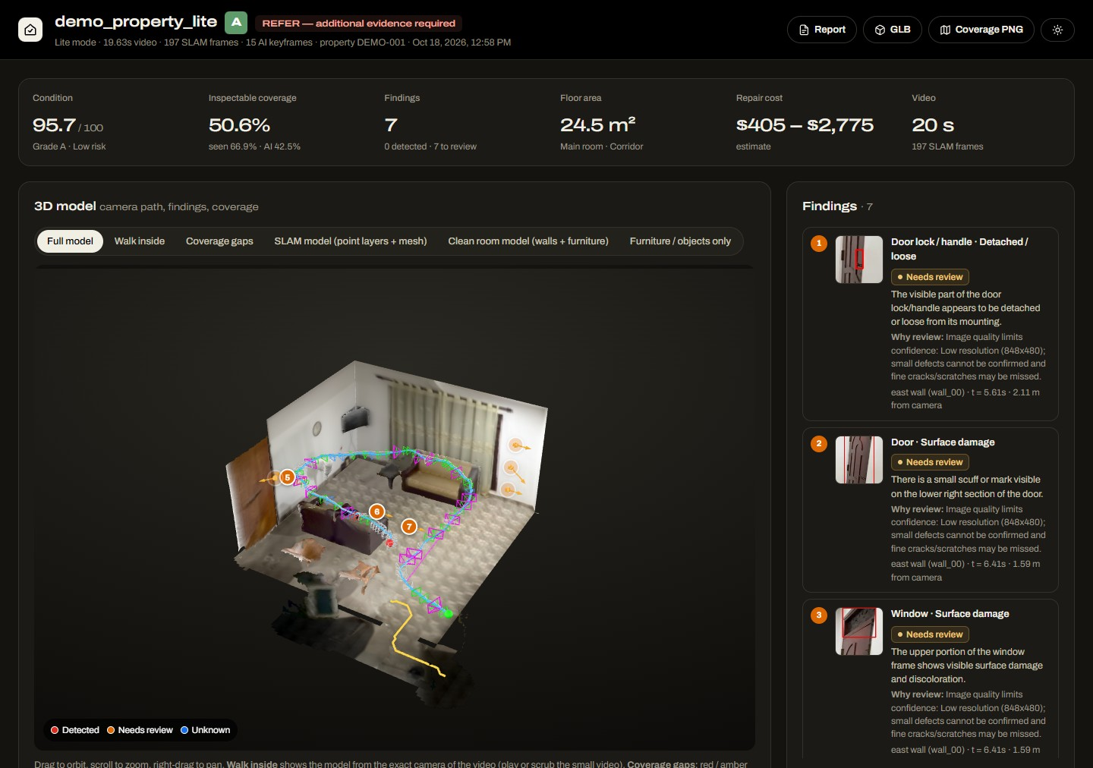










One upload gives you a complete, explainable risk file
THE SOLUTION
Defects localised and verified
Condition grade A–E (0–100 score)
Risk level and insurance perils
Indicative repair-cost range
Valuation and collateral impact
Premium-loading suggestion
Underwriting decision with reasons
Evidence-integrity (fraud) flags
3D model, floor plan, coverage map
Gemini analysis and underwriter Q&A
Live app: walkthrough report with the 3D model, findings, condition grade and underwriting decision
Notes:
Show the live app. One walkthrough video gives defects, a grade, risk, perils, repair cost, valuation impact, premium loading, a decision with reasons and fraud flags. The same video gives the 3D model, floor plan and coverage map.

Slide 6





Capture, inspect, decide, act: minutes instead of days
HOW IT WORKS
1 Capture
2 AI inspection
3 Risk decision
4 Act
Walk through the property with a phone and upload the video. No special hardware.
On each AI keyframe, Gemini reads the room, LocateAnything finds candidate defects and Gemma 4 verifies each one.
A transparent rule engine sets the grade, perils, repair cost, valuation, premium and decision; Gemini explains it.
HTML/PDF-ready report, Gemini Q&A and a JSON record over the REST API for underwriting and claims systems.
10.6 min
≈ $0.85
≈ $0.35
$0
end to end for a 20 s video, laptop GPU
cloud cost per walkthrough, L4 Job + Gemini
Gemini cost per walkthrough
GPU cost when idle: the L4 Job runs only per video
Notes:
Four steps: capture, AI inspection, risk decision, act. A 20-second walkthrough takes about 10.6 minutes end to end on a laptop GPU. In the cloud a walkthrough costs about 85 cents: roughly 50 cents of L4 time on a Cloud Run Job plus about 35 cents of Gemini, and nothing while idle because the GPU Job only runs per video and the web service scales to zero.

Slide 7
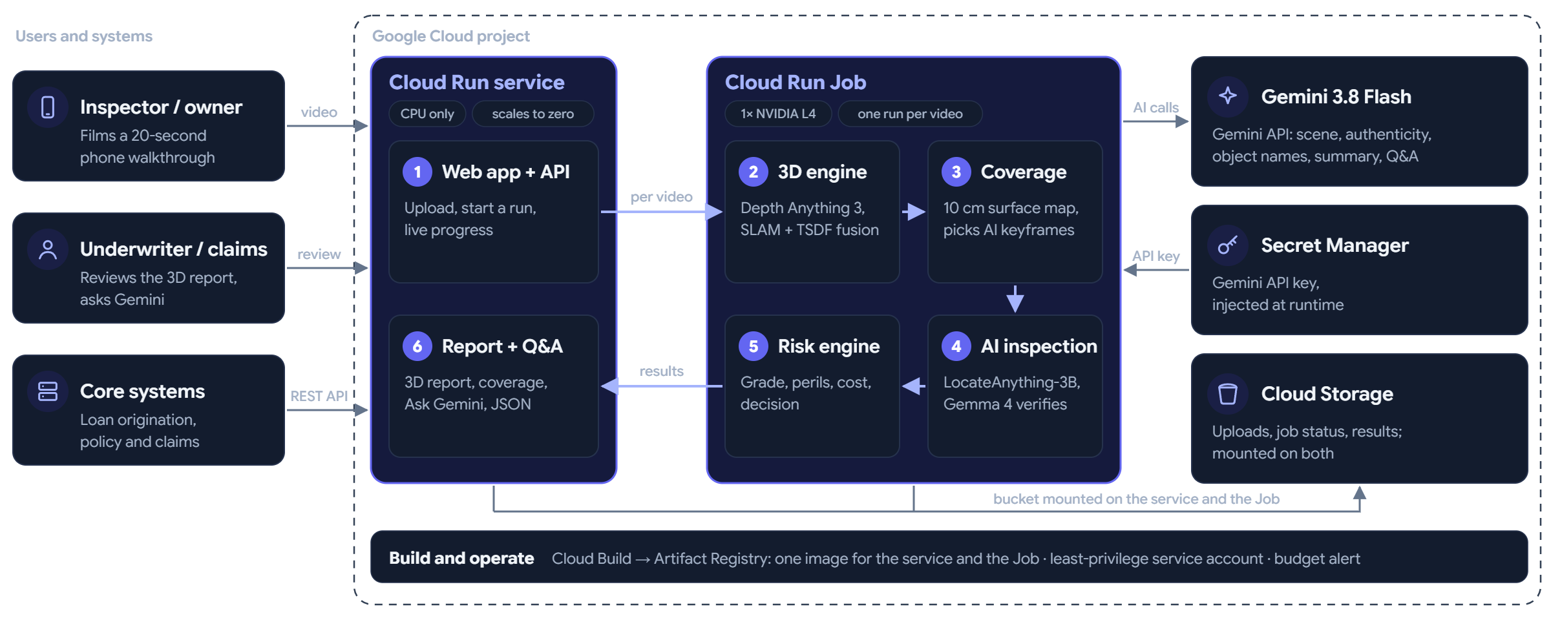
Cloud Run web service + L4 GPU Job, powered by Gemini
SOLUTION ARCHITECTURE
Deployed layout (v1.0.0): web UI + API on a CPU-only Cloud Run service; 3D engine, coverage and AI inspection on a Cloud Run Job with one NVIDIA L4 per video; a Cloud Storage bucket mounted on both for uploads, status and results; Gemini 3.8 Flash via the Gemini API (key in Secret Manager). BigQuery and Pub/Sub are not used.
Notes:
Architecture: one container image, two Cloud Run resources. A CPU-only Cloud Run service serves the web UI and API, accepts uploads, dispatches jobs and shows progress. A Cloud Run Job with one NVIDIA L4 processes each uploaded video: Depth Anything 3 and OpenCV SLAM for the 3D map and coverage, LocateAnything and Gemma 4 for defect detection and verification, Gemini for scene, labels and summary. The GPU is billed only while a video is processing. A Cloud Storage bucket mounted on both holds uploads, job status and results. Gemini 3.8 Flash is called through the Gemini API with the key in Secret Manager: no Vertex AI, BigQuery or Pub/Sub. Deployment is one script through Cloud Build with a least-privilege service account. The diagram still shows the earlier single-service layout; the caption gives the deployed one.

Slide 8
Hybrid AI: the right Google and open model for each job
AI MODELS
Job | Model | Runs on | Why this model
Room, visible components, keyframe authenticity | Gemini 3.8 Flash | Gemini API | Strong visual reasoning and reliable JSON output
Find candidate defects (boxes) | LocateAnything-3B | Cloud Run GPU Job | High-recall open-vocabulary localisation
Verify each defect on a full-resolution crop | Gemma 4 E4B | Cloud Run GPU Job | Open Google model, cheap per box, cuts false positives
DETECTED / NEEDS_REVIEW / NOT_DETECTED | Rule engine + Gemini | CPU + Gemini API | Rules decide, so the result is auditable; Gemini explains each finding
Grade, perils, repair cost, valuation, premium : risk_rules.yaml | Rule engine + Gemini | CPU + Gemini API | Rules are tunable per lender or insurer; Gemini writes the risk summary
Depth and 3D model from a phone video | Depth Anything 3 + OpenCV 5 SLAM | Cloud Run GPU Job | Room-scale 3D from a single phone camera
3D object names, summary, analysis, Q&A | Gemini 3.8 Flash | Gemini API | Grounded on the inspection record and cites issue IDs
Notes:
Hybrid AI: Gemini for scene understanding, authenticity and explanations, LocateAnything for high-recall boxes, and Gemma 4 to verify each box on a full-resolution crop. Rules, not an LLM, make the final decision, so it is auditable. Switching two environment variables runs everything on Gemini.

Slide 9
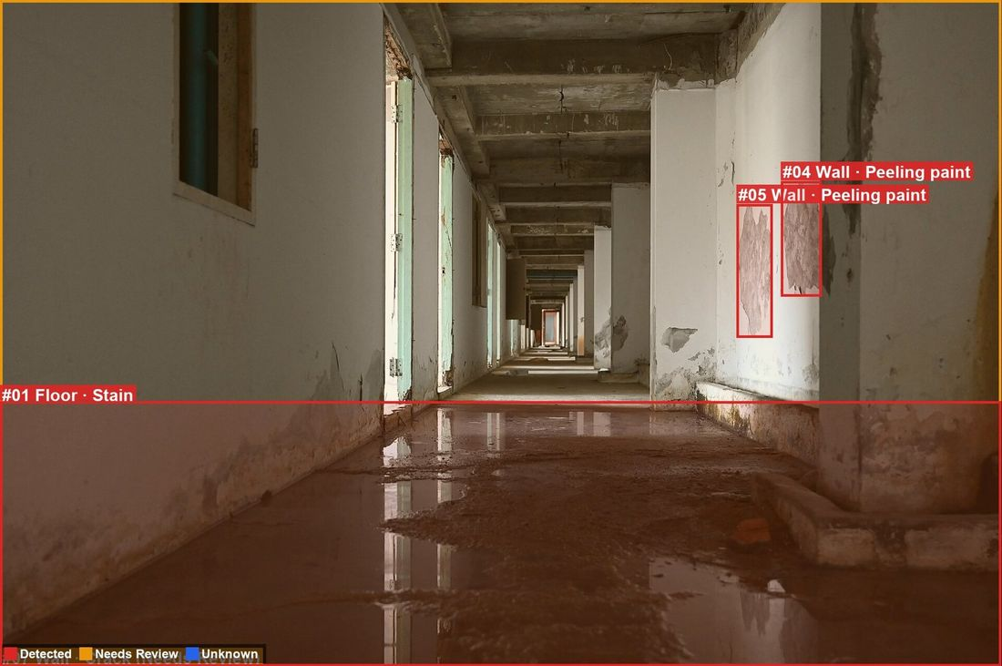
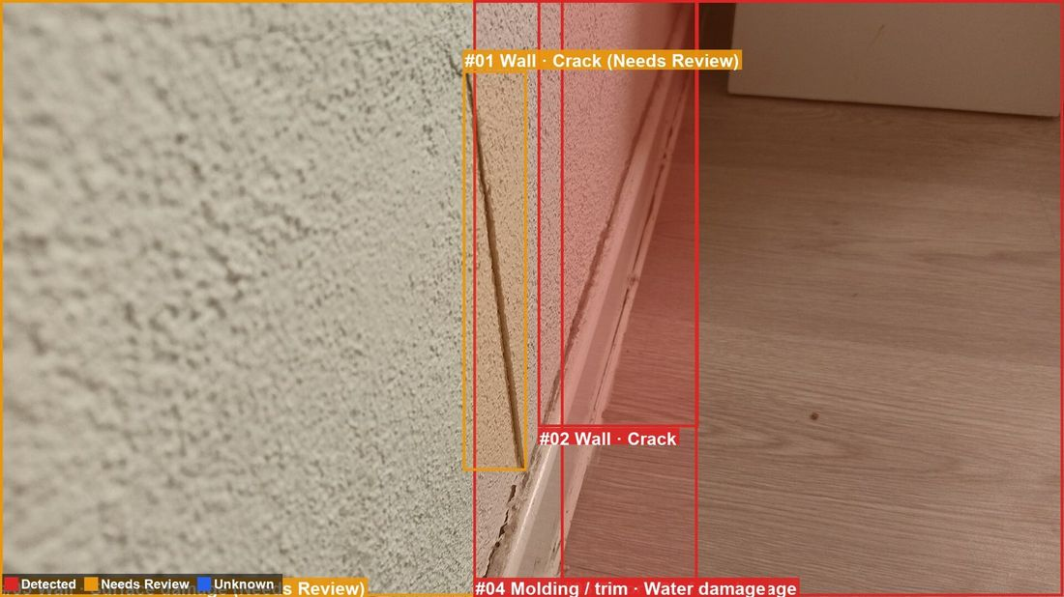
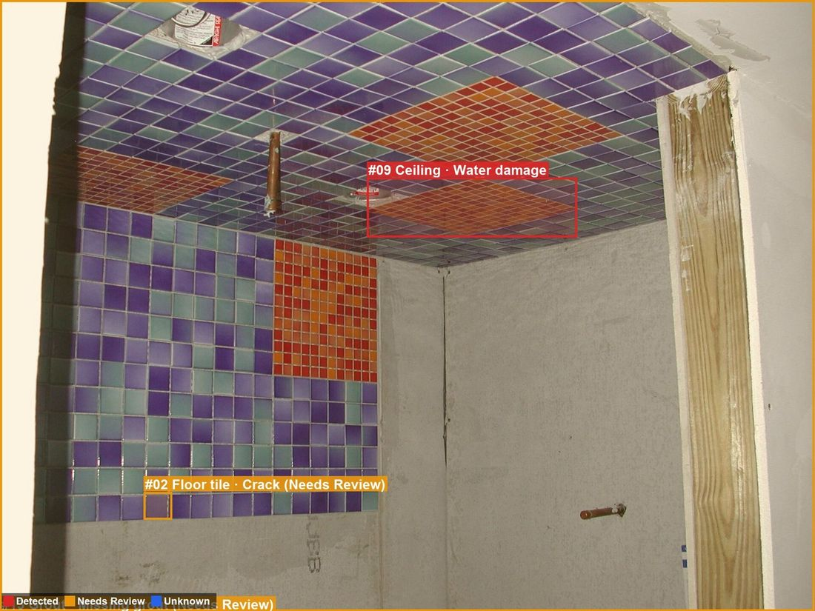
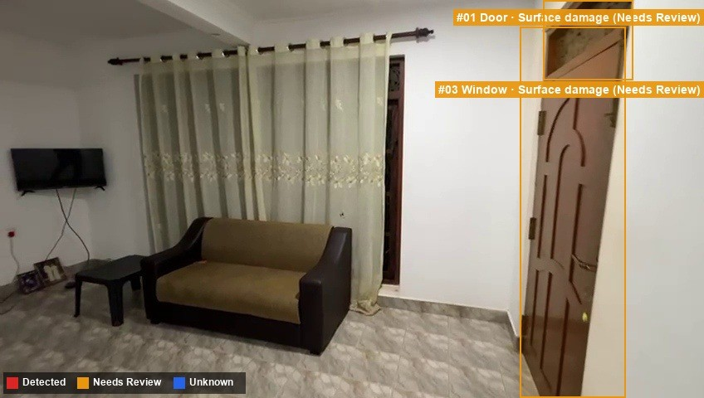
Find broadly, verify with a second model, then decide
KEYFRAME PIPELINE
1
Quality check + integrity (dHash fingerprint)
2
Gemini: room, components, authenticity
3
Prompt router: 18 defect types, 12 components
4
LocateAnything-3B boxes → NMS / merge
5
Full-res crops → Gemma 4 verify + CV evidence
6
Rule engine → status, then risk engine
Real outputs: wall crack, corridor peeling paint, bathroom water damage, walkthrough keyframe (door, window)
Notes:
Every AI keyframe chosen from the video runs through this pipeline. Pipeline detail: quality and integrity checks come first, then Gemini identifies the room and components, so we only search for relevant defects. LocateAnything proposes boxes and Gemma verifies each one. The rule engine then assigns Detected, Needs review or Not detected. These images are real outputs.

Slide 10




What we detect: 18 visible defect types on 12 components
DETECTION SCOPE
Wall
Ceiling
Floor tile
Wall tile
Professional review
Crack, stain, water damage, peeling paint, hole, mold, surface damage, discoloration, scratch
Crack, stain, water damage, peeling paint, hole, mold
Crack, chip, missing tile, stain
Crack, chip, mold, stain
Cracks and deformation get a structural note; water damage and mold get a moisture-source check.
Manual checks, never AI
Grout
Wood / vinyl floor
Countertop
Door
Doors and windows opening, locks and keys, exhaust fan and motor.
Crack, missing grout, discoloration, mold
Scratch, stain, water damage, damaged boards
Scratch, crack, chip, stain, burn mark, discoloration
Surface damage, hole, crack, scratch, chip, peeling paint
Look-alikes rejected
The verifier is shown grout lines, wood grain, shadows, reflections and outlets.
Door lock / handle
Window
Molding / trim
Kitchen exhaust
Missing, broken, rust, loose
Broken or cracked glass, frame damage, wet sill, mold
Chip, crack, detached, water damage, missing
Grease buildup, rust, broken grille, missing filter, dents
Not inspected
Furniture, cupboards, rugs and carpets.
Notes:
Scope: 18 visible defect types across 12 components in 8 room types: walls, ceilings, floors, tiles, grout, countertops, doors, locks, windows, trim and kitchen exhausts. Cracks and deformation get a structural note, and water damage and mold get a moisture note. Operation checks such as locks and windows are always manual. Furniture, cupboards and carpets are out of scope by design.

Slide 11
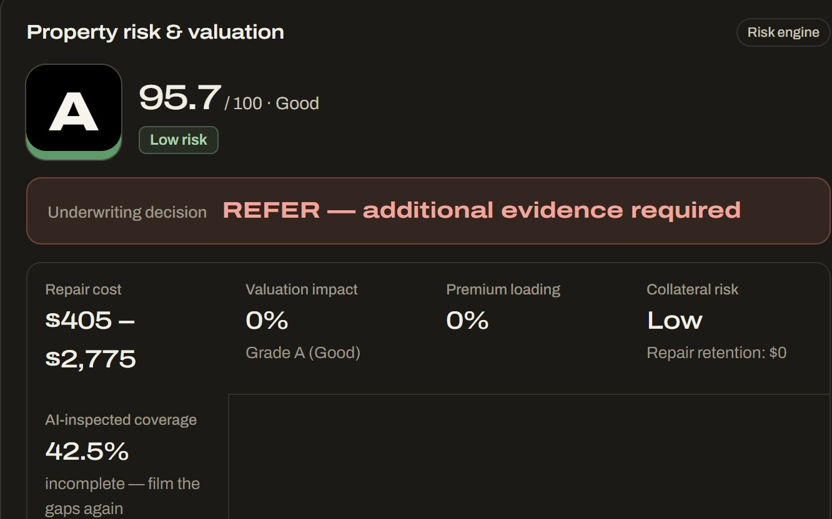
Every decision shows its reasons
EXPLAINABLE RISK ENGINE
Condition score
100 − Σ (points × severity × state weight)
A
≥85
B
≥70
C
≥50
D
≥30
E
<30
Underwriting decisions
PROCEED
PROCEED WITH CONDITIONS: note defects
PROCEED WITH CONDITIONS: repairs / retention
REFER: professional survey required
REFER: evidence integrity
Live app: property risk & valuation panel for the case-study walkthrough
REFER: additional evidence required
Notes:
Explainability is what lets a bank or insurer adopt this. The condition score is a transparent formula, the grades are A to E, and there are six decision outcomes. The rules sit in YAML that the client owns. Gemini explains the decision but never changes it.

Slide 12
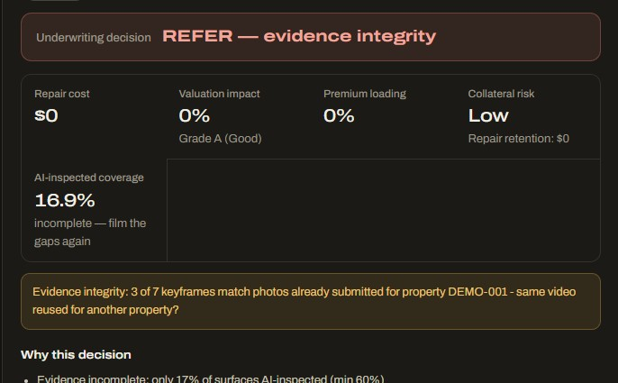






Fraud checks run on every walkthrough video
FRAUD & EVIDENCE INTEGRITY
Recycled video
Screen, render or AI footage
Every AI keyframe is fingerprinted (dHash) and compared with every property. A match to another property is flagged HIGH.
Gemini checks each keyframe for a screen recording, a rendering or AI imagery.
Low-quality frames
Traceable evidence
Blurred frames are dropped; low-resolution keyframes stay Needs review.
Every finding keeps its keyframe, close-up, wall and video time.
Any HIGH flag sends the case to
REFER: evidence integrity
Unfilmed areas
Incomplete video coverage
The coverage map names each wall and ceiling the video missed, to film again.
Under 60% AI-inspected surface → REFER: additional evidence required.
A human reviews the case before it can go ahead: it stops recycled-video and wrong-property claims and loan files.
Notes:
Fraud: every AI keyframe is fingerprinted and compared with every property, so a recycled walkthrough is caught; in our own test a re-uploaded clip was flagged REFER: evidence integrity. Gemini checks each keyframe for screen recordings, renders and AI imagery, blurred frames are dropped, every finding is traceable to its frame and wall, and incomplete coverage triggers a REFER. Any high flag goes to a human.

Slide 13
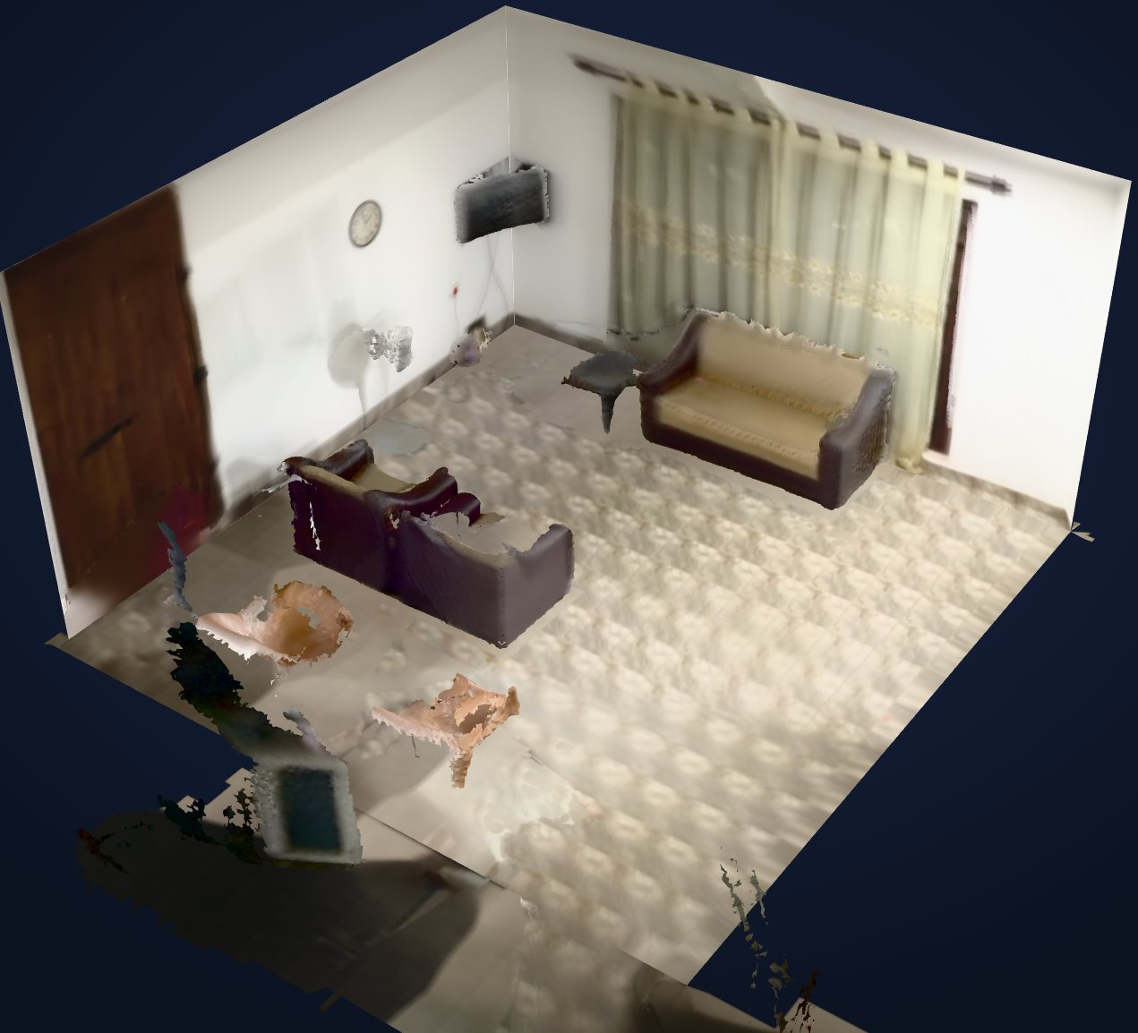
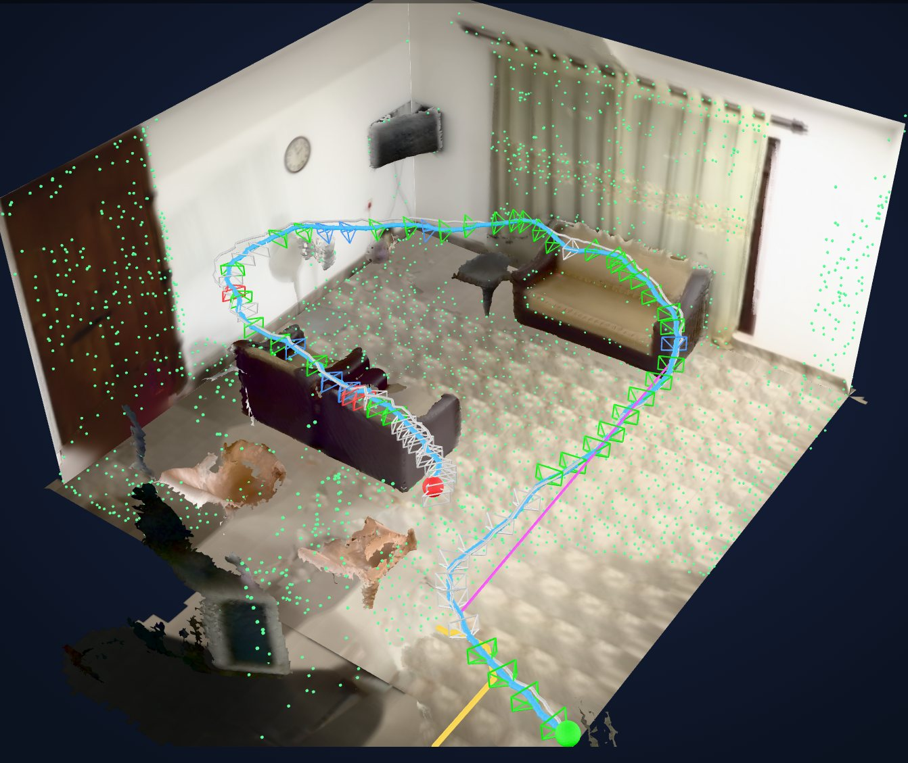
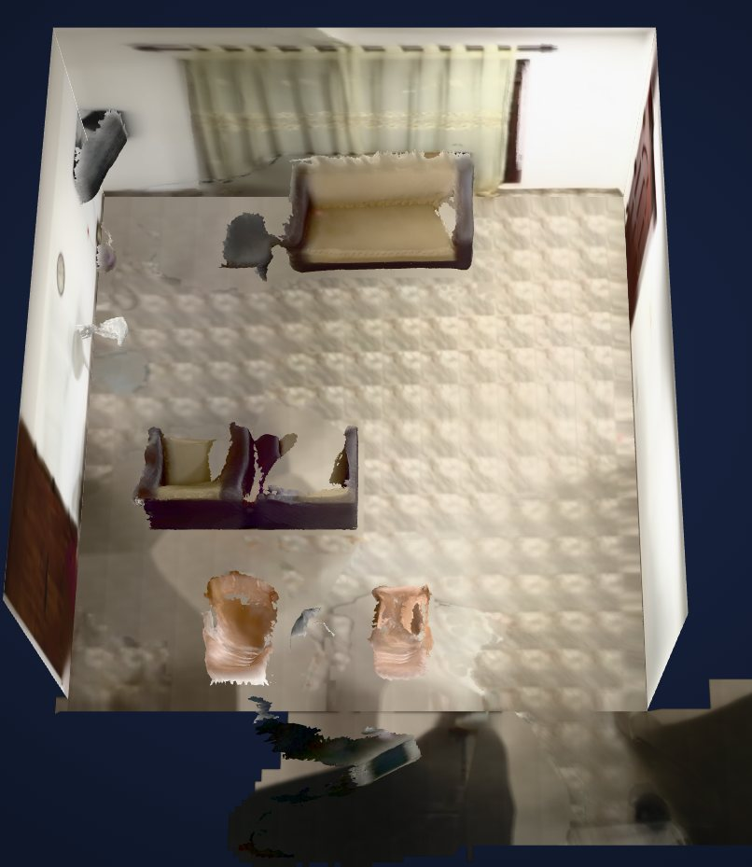
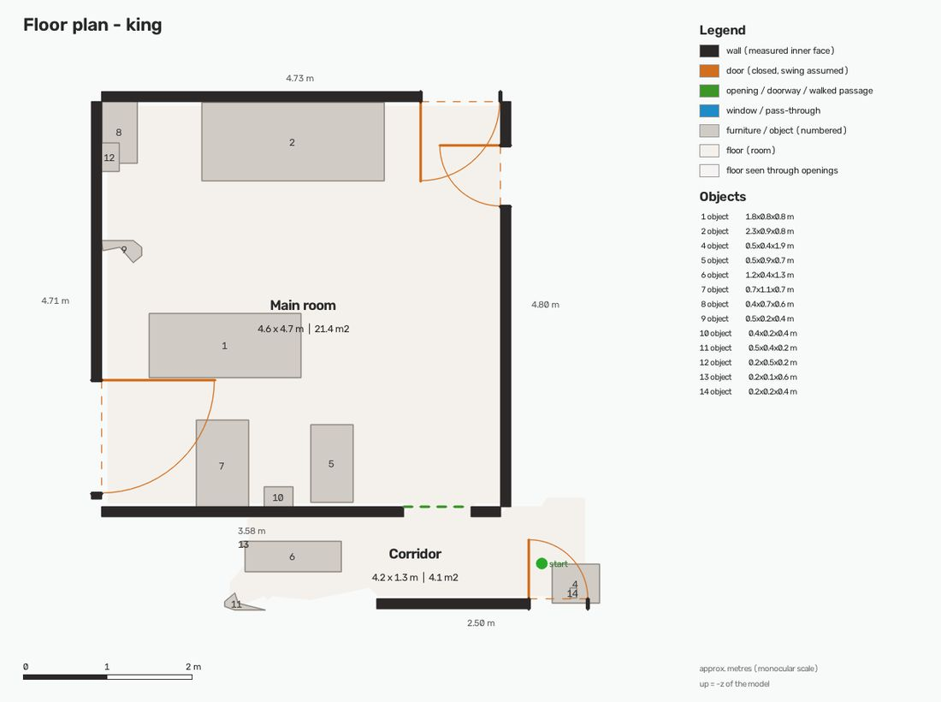
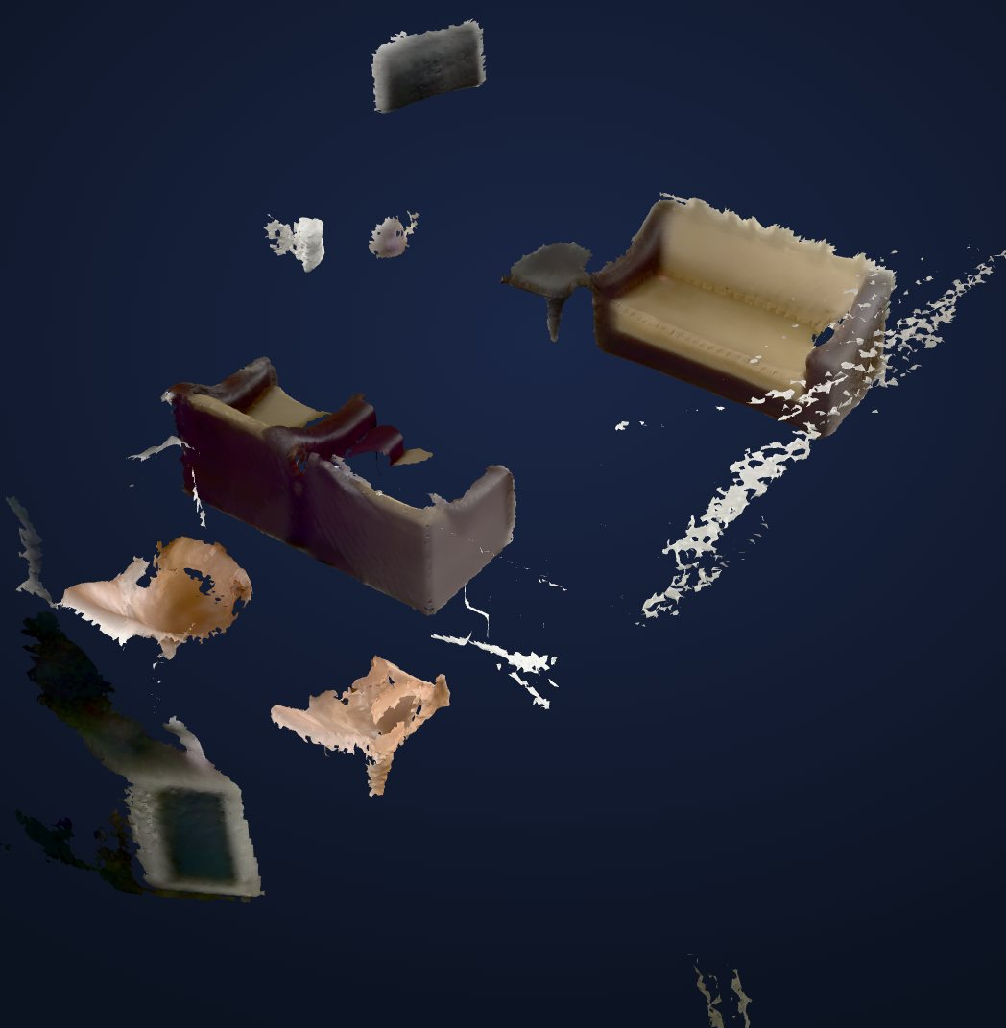
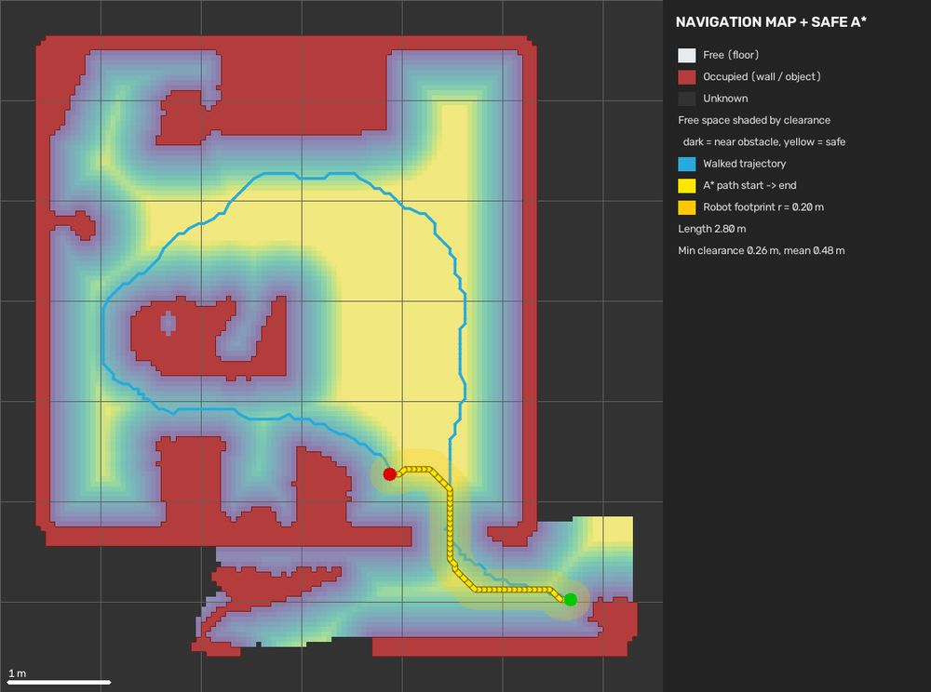
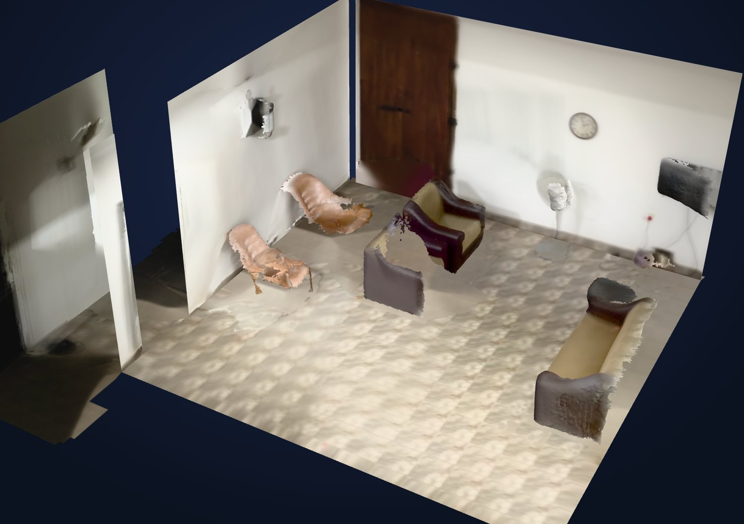
A phone video becomes a 3D model and floor plan
VIDEO → 3D DIGITAL TWIN
SLAM model + path
Top view
Floor plan
Side view
Navigation map
Clean 3D model
Objects (Gemini names)
Depth Anything 3 depth per frame → OpenCV 5 SLAM poses → Open3D TSDF surface → walls, floor, ceiling, doors → objects named by Gemini
Outputs: clean and SLAM GLB models, floor plan (PNG + SVG) with room areas, occupancy and navigation maps, in approximate metres
Notes:
A phone video becomes a 3D digital twin: Depth Anything 3 for depth, OpenCV 5 SLAM for camera poses, and TSDF fusion for the surface, with walls, floor, ceiling and doors detected and objects named by Gemini. Outputs include GLB models, a floor plan and navigation maps.

Slide 14
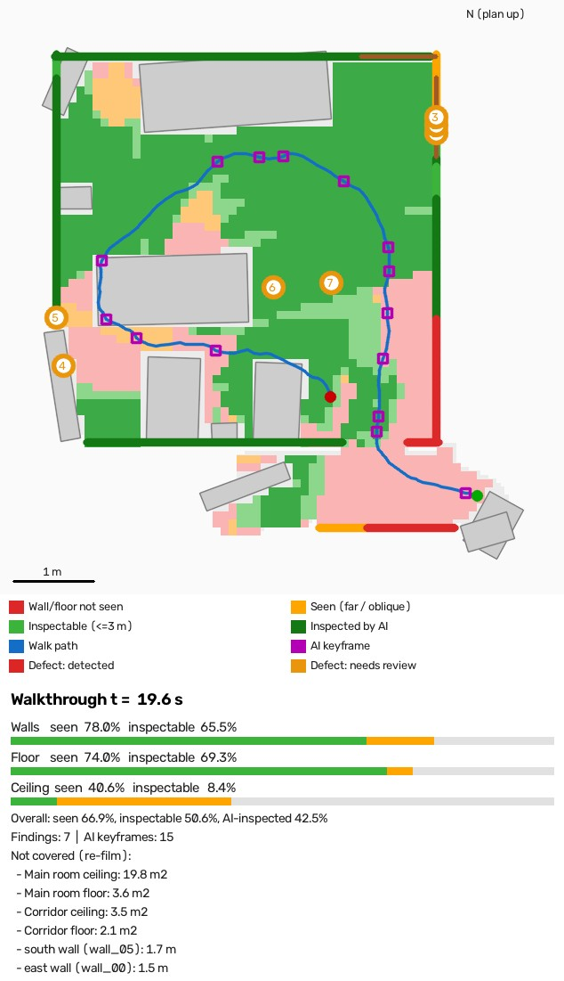
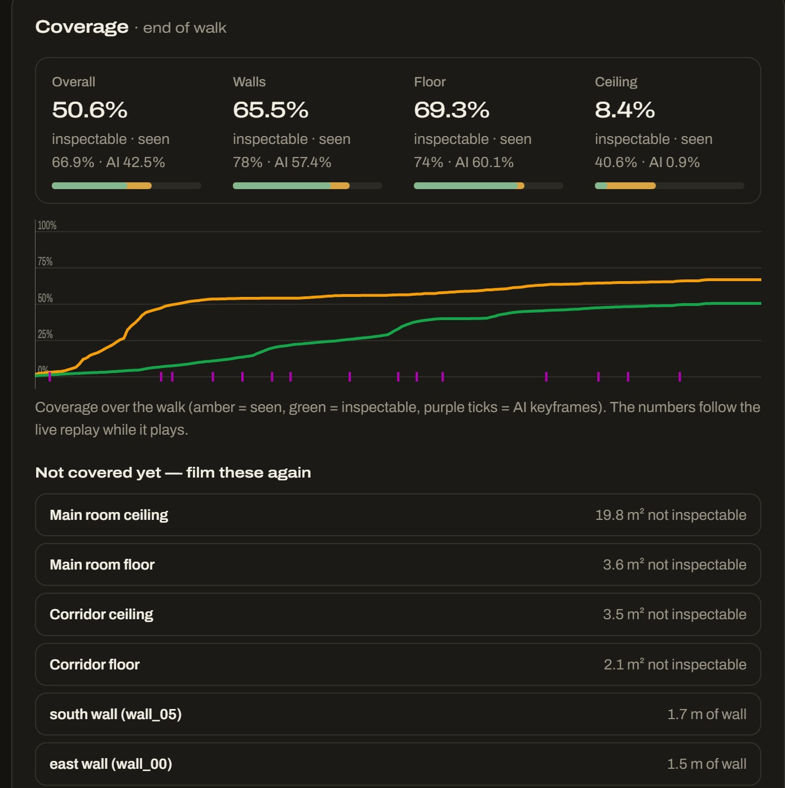

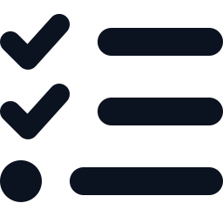


Proof of what was inspected, and what to film again
COVERAGE MAP: OUR KEY DIFFERENTIATOR
Every 10 cm of surface
is checked against every frame's depth: seen, inspectable (close and frontal) or AI-inspected.
Smart AI keyframes
A greedy set cover picks the fewest frames that cover the inspectable surface.
Findings pinned in 3D
Each defect gets a wall and a time in the video, and is merged across frames.
Re-film list
Below 60% AI-inspected → REFER, with the exact walls and ceilings to film again.
Notes:
This is our key differentiator. Every 10 cm of surface is checked against every frame, so we can prove what the AI actually inspected. Keyframes are picked by set cover and findings are pinned in 3D. Below 60% coverage the case is referred, with an exact list of what to film again.

Slide 15
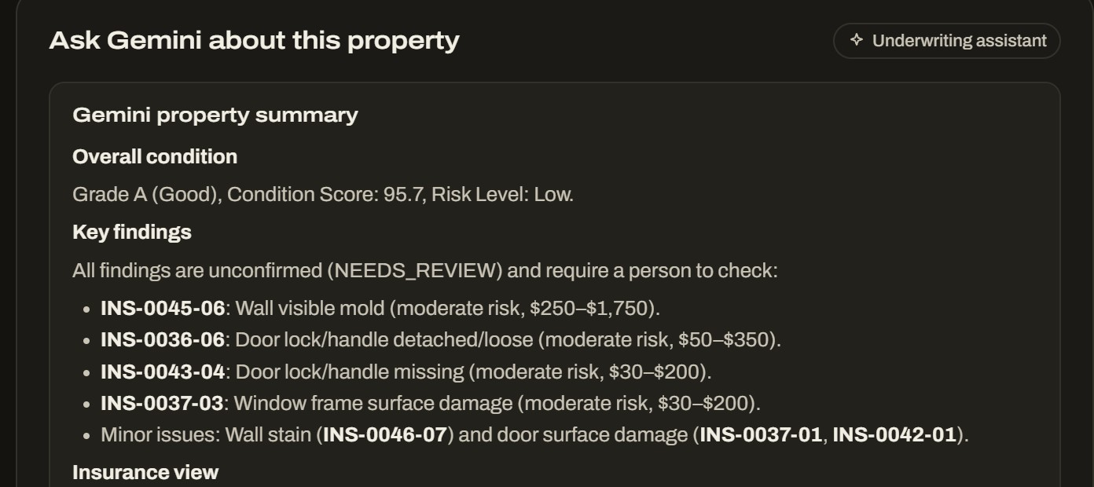
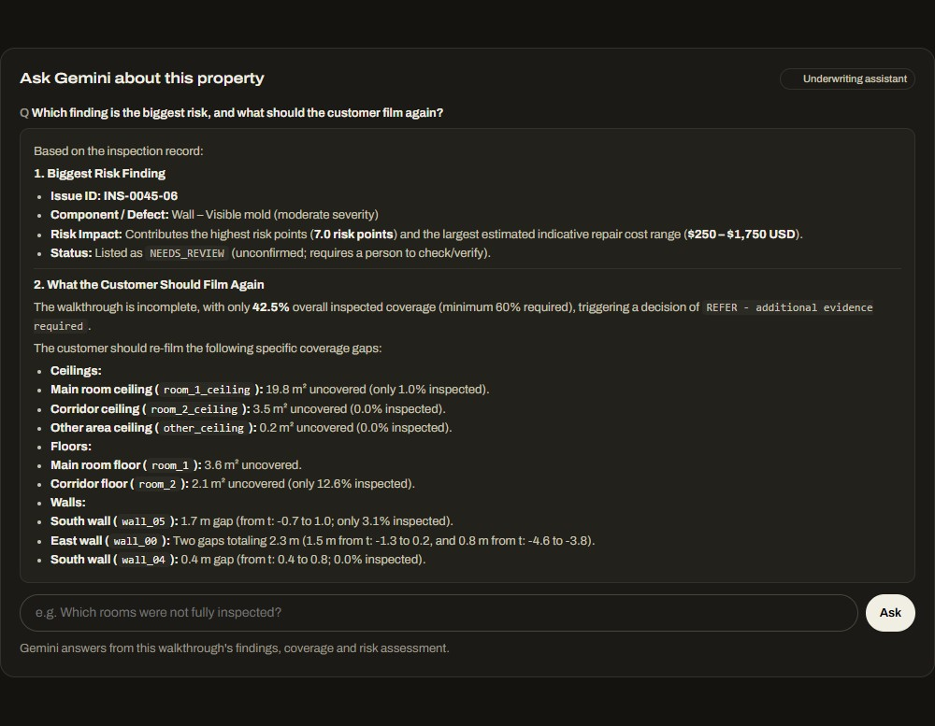
Gemini works as the underwriter's co-pilot
GEMINI 3.8 FLASH
Property analysis
Grounded Q&A
Summary, causes, action plan, insurance and lending views, and site-visit questions
Answers only from this inspection's findings, coverage and risk, and cites issue IDs
Scene and authenticity
3D object naming
Room type, visible components, and screen, render or AI-image detection
Names the furniture and fixtures segmented from the 3D model
Notes:
Gemini acts as the underwriter's co-pilot. It writes a property analysis covering causes, an action plan, insurance and lending views and site-visit questions, and it answers questions grounded in this inspection's data, citing issue IDs. Guardrail: it explains but cannot change results.

Slide 16
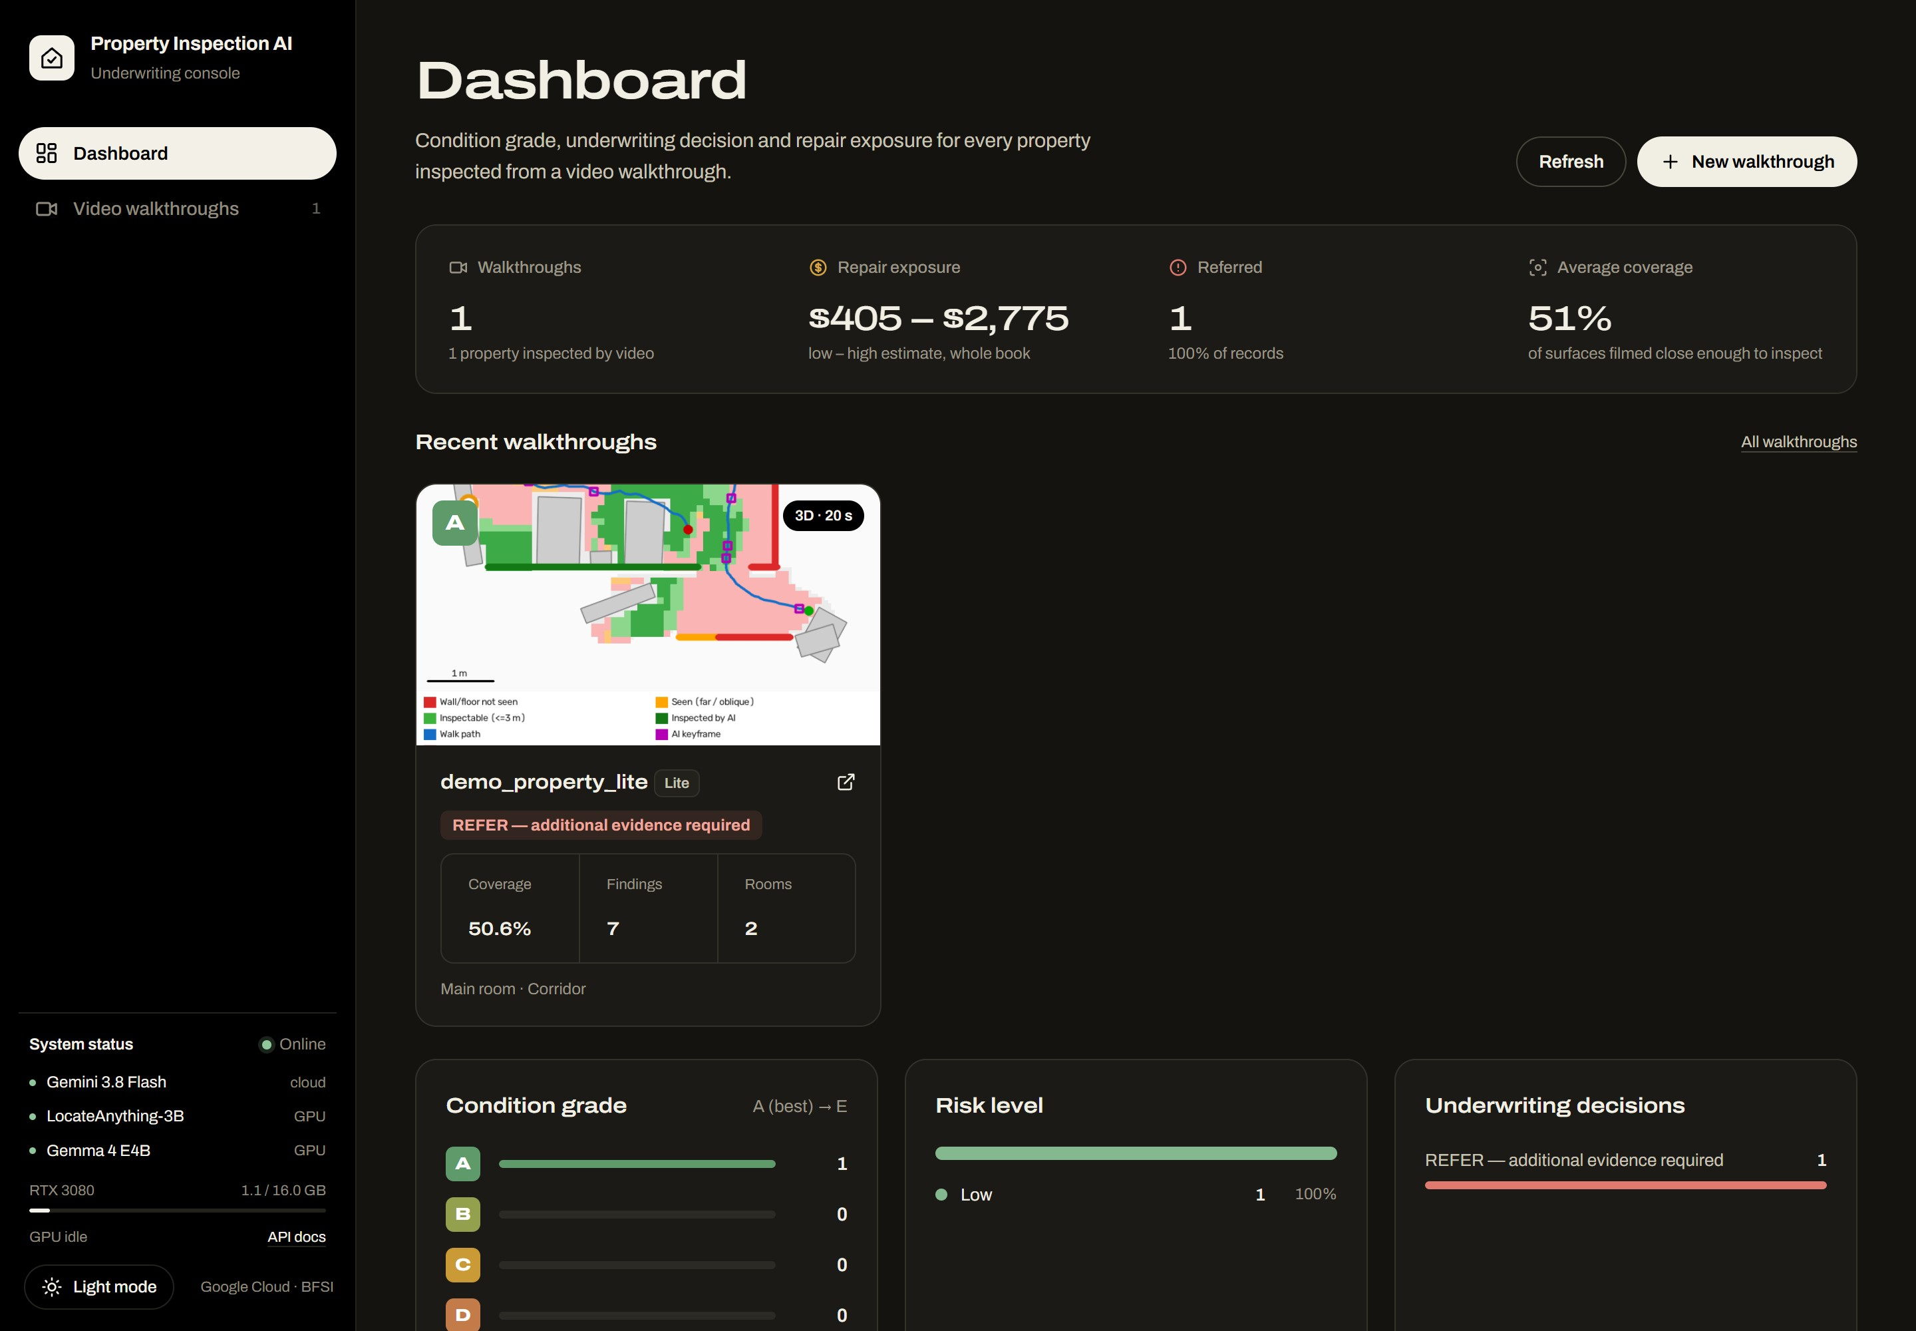
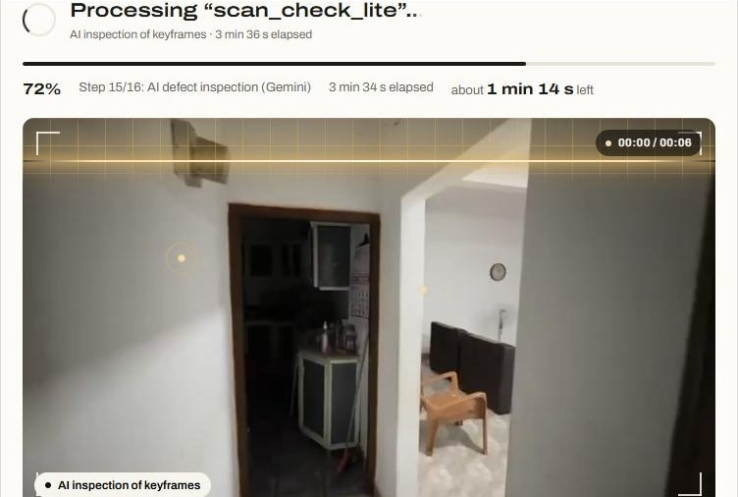
A product built for underwriters
PRODUCT EXPERIENCE
Video upload, live 3D-scan view, Lite or Advanced
Interactive 3D viewer: walk inside, coverage gaps
Reports in HTML, Markdown and JSON; REST API at /docs
Dashboard: walkthroughs, repair exposure, referrals and coverage across the whole book
Light and dark themes; live video-queue status
Notes:
UX: a portfolio dashboard with grade and decision distributions, video upload with a live 3D-scan progress view in Lite or Advanced mode, an interactive 3D viewer with Gemini Q&A, reports in three formats and an OpenAPI interface.

Slide 17
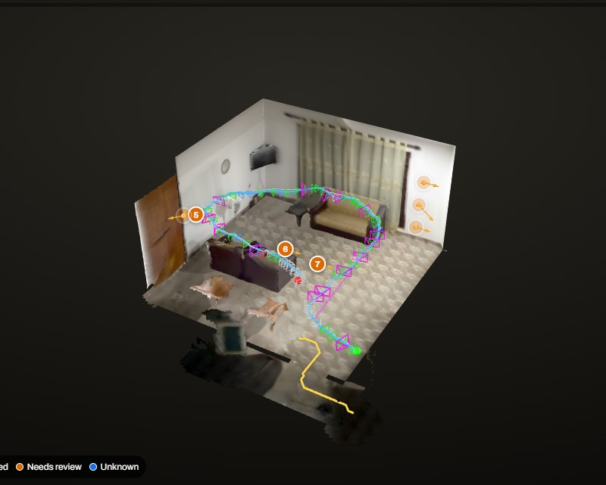
A real 20-second home walkthrough, end to end
CASE STUDY
19.6 s
197
phone video
SLAM frames
15
24.5 m²
AI keyframes
2 rooms measured
95.7 · A
$405–2,775
condition score
indicative repairs
Decision: REFER, additional evidence required
The home looks fine, but only 42.5% of its surfaces were AI-inspected (minimum 60%), so the app lists the ceilings and walls to film again. It does not over-promise.
Camera path · AI keyframes · findings pinned in 3D
7 possible defects pinned in 3D, all Needs review · 10.6 min end to end on a laptop RTX 3080 · 3D build Lite 11.1 vs Advanced 26.9 min (RTX 3050)
Notes:
Case study on a real home: a 19.6-second video, 197 SLAM frames, 15 AI keyframes, 24.5 square metres measured, and seven possible defects (door and window damage, a loose and a missing lock, a wall stain and possible mold) pinned in 3D for review. The grade is A, yet the decision is REFER because only 42.5% of surfaces were AI-inspected. The system is honest about what it did not see.

Slide 18
A fair test of four pipelines: 10 rooms, 100 regions
EVALUATION DESIGN
Gemini only
Test set
Fair procedure
A
Baseline: Gemini inspects the full room image.
10
Same images, taxonomy, output schema and decision rule
Same Gemini version and settings for every pipeline
Test set frozen before inference; no labels given to models
Raw outputs, failures, latency and cost all logged
rooms: 5 living rooms + 5 bedrooms
LocateAnything + Gemini
B
Localise candidates, then Gemini assesses each one.
2
clean control rooms (one of each)
Gemma 4 + Gemini
100
C
Gemma 4 checks the image, then Gemini gives the final assessment.
Acceptance targets for D
annotated regions per pipeline
Region accuracy of at least 85%
Precision, recall and F1 each at least 85%
At most 1 false alarm on the 2 clean rooms
Better than Gemini alone (A) on every metric
All three models
40 / 60
D
LocateAnything localises, Gemma 4 verifies each crop, Gemini decides. Our pipeline.
defective / non-defective regions
Notes:
Our evaluation design compares four pipelines fairly: A is Gemini alone, B is LocateAnything plus Gemini, C is Gemma 4 plus Gemini without the localiser, and D, our pipeline, is Gemma 4 plus LocateAnything plus Gemini. The test set is 10 rooms, 5 living rooms and 5 bedrooms, including 2 clean controls, with 100 annotated regions. Everything is fixed in advance: the same images, schema, Gemini settings and decision rule. Our targets for D are at least 85% accuracy, at least 85% precision, recall and F1, at most one false alarm on the clean rooms, and a clear win over Gemini alone on every metric.

Slide 19
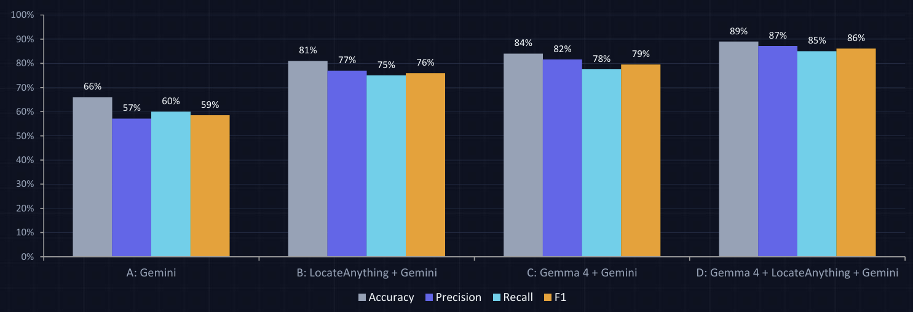
Expected gain from adding localisation and verification
EVALUATION
clean-room false alarms: A 2 · B 2 · C 2 · D 1 (2 clean rooms, 20 regions)
Notes:
Be explicit that the chart is a simulated example of the report, not a measured result. It shows the gain we expect: localisation and verification should cut both misses and false alarms, especially on clean rooms. Gemma 4 plus Gemini (C) helps, but it is still below D, because the localiser finds small defects that a full-image check misses. Next, we run this protocol on the shipped pipeline D and replace these values with measured ones.

Slide 20
From depth research to a deployable product
WHAT WE BUILT
01
02
03
04
05
06
Depth + SLAM
Hybrid SLAM
Photo-real 3D
Production 3D
Inspection AI
Google Cloud v1.0.0
Depth Anything 3 visual SLAM: trajectory, dense map, occupancy grid, A* path
OpenCV 5 tracking + ICP alignment and Manhattan planes: straight walls, sharp corners
Gaussian Splatting experiment (gsplat) on the same cameras
One command: video → clean GLB, SLAM GLB, floor plan (+SVG), evaluation
Defect taxonomy, locate + verify models, rule and risk engine, fraud checks
Gemini API, Cloud Run service + L4 Job, Cloud Storage, one-command deploy
18
8
18
2
1
defect types, 12 components
room types
REST API endpoints
3D modes (Lite / Advanced)
command to deploy on Google Cloud
Notes:
This was a real engineering journey: depth SLAM research, a hybrid OpenCV 5 SLAM, a Gaussian-splatting experiment and a production 3D pipeline, then the inspection AI and the Google Cloud version. In numbers: 18 defect types, 8 room types, 11 API endpoints, and deployment in one command.

Slide 21


Built on Google AI and Google Cloud
GOOGLE TECHNOLOGIES
IN THE PROTOTYPE
NEXT ON THE ROADMAP
Gemini 3.8 Flash
Gemma 4 (E4B)
Document AI
Via the Gemini API: scene, authenticity, analysis, grounded Q&A, 3D object names
Open Google model that verifies every defect crop on the GPU
Title deeds, valuation reports and repair invoices cross-checked against the images
Cloud Run service + L4 Job
Cloud Storage
Vertex AI Search
One image: CPU web service, L4 GPU Job per video; both scale to zero
Bucket mounted on both: uploads, job status, reports, 3D models
Policy wording and lending guidelines retrieved for the assistant
Secret Manager
Cloud Build
Vertex AI + BigQuery ML
Gemini API key injected at runtime; no keys in the image or repo
Builds the ~12 GB image; model weights fetched inside the build, never via a laptop
Claim-likelihood and collateral-risk models trained on the inspection history
Artifact Registry
IAM service account
Cloud SQL / AlloyDB
One image with baked-in weights, shared by the service and the Job
Least-privilege runtime account for the bucket, the secret and the Job
Multi-tenant case management, audit trail and SSO
Notes:
Google technology: Gemini 3.8 Flash through the Gemini API, Gemma 4, a Cloud Run service plus an L4 Cloud Run Job, Cloud Storage, Secret Manager, Cloud Build, Artifact Registry and IAM are in the prototype. Next come Document AI for deeds and valuation reports, Vertex AI Search for policy wording, BigQuery ML for risk scoring and AlloyDB.

Slide 22





Compliant by design: humans decide, AI shows evidence
RESPONSIBLE AI
Human in the loop
Explainable
Auditable
Decision support only: a qualified surveyor or underwriter makes the final call.
Deterministic YAML rules, and every decision lists its reasons and risk points.
Raw model outputs are archived, each inspection is a JSON record in Cloud Storage, and the config is versioned.
Safe wording
Secure
Licence-aware
No claims about structural safety or root cause. Locks, fans and windows always become manual checks.
Least-privilege service account, Gemini key in Secret Manager, no keys in files, and data stays in the client's own project.
LocateAnything weights are non-commercial; Gemini localisation is the drop-in swap for production.
Notes:
Responsible AI: a human makes every final decision, the rules are explainable, everything is auditable, the wording is safe, the system is secure, and we respect licences. We tell clients that LocateAnything is non-commercial, and Gemini localisation is the drop-in swap.

Slide 23



Priced per inspection, far below a site visit
BUSINESS MODEL
Pay-per-inspection API
Unit economics (indicative)
Lenders and insurers send a walkthrough video from their own apps and get JSON, a report and a decision back.
Gemini calls
≈ $0.005 each → ≈ $0.35 per walkthrough
L4 GPU Job
Enterprise subscription
≈ $0.50 of L4 time per 20-min walkthrough; no idle GPU
Video inspection
Portfolio dashboard, BigQuery export, custom risk rules, SSO, and private deployment in the client's Google Cloud project.
≈ $0.85 per walkthrough, L4 Job + Gemini
Idle footprint
≈ $1.20 per month (image storage); $30/month budget alert
Inspector & valuer firms
Pricing hypothesis to validate in pilots: a per-inspection fee well below a physical visit, with volume tiers for portfolios.
White-label app: the AI drafts every report and coverage control, so each inspector handles more cases.
Notes:
Business model: a pay-per-inspection API, enterprise subscriptions and white-label tools for inspector firms. Unit economics: about 35 cents of Gemini per walkthrough plus about 50 cents of L4 time on a Cloud Run Job, so about 85 cents per walkthrough; idle cost is about $1.20 a month for image storage. Pricing per inspection would sit well below a physical visit, to be validated in pilots.

Slide 24

Start with housing finance and home insurance in APAC
GO-TO-MARKET & PITCH
PILOT
0–3 months
INTEGRATE
3–6 months
SCALE
6–18 months
1 housing-finance lender + 1 home insurer. Run AI alongside existing inspections on ~500 cases and measure turnaround, cost and referral accuracy.
Pub/Sub into the loan-origination and claims systems, BigQuery portfolio dashboards, and custom risk rules per client.
Google Cloud Marketplace listing, partnerships with valuer and inspector networks, and expansion to commercial property and claims.
Pilot KPIs: turnaround time · cost per inspection · % cases auto-cleared vs referred · fraud flags confirmed · re-inspection rate
Every lender and insurer already asks for photos. We replace them with a short phone video that is trustworthy, explainable and ready for a decision.
Notes:
Go-to-market: start with housing finance and home insurance in APAC. Pilot alongside existing inspections, integrate through Pub/Sub, then scale through Google Cloud Marketplace and valuer networks. Close on the pitch line in the quote.

Slide 25
Next: an inspection agent, then portfolio-level risk
ROADMAP
NOW · v1.0.0
NEXT · 3 months
LATER · 6–12 months
Video walkthrough inspection
Risk and valuation engine
Fraud and coverage checks
Gemini analysis and Q&A
Cloud Run service + GPU Job
Inspection agent built with Gemini on Agent Platform (ADK)
Live capture guidance: tells the inspector what to film
Spatial reasoning over rooms, surfaces, objects, findings
Answers for every stakeholder, with human approval
BigQuery ML claim and collateral-risk scoring
Before/after claim comparison in 3D
Document AI and Vertex AI Search: deeds and policies
Agent hand-offs to loan and claims systems
Goal: from one trusted inspection to a portfolio-level risk signal for every loan and every policy.
Notes:
Roadmap: next, an inspection agent built with Gemini on Agent Platform (ADK) that guides capture live, reasons spatially over the 3D model and answers each stakeholder, with a person approving every decision. Later: agent hand-offs to loan and claims systems, Document AI and Vertex AI Search for deeds and policies, BigQuery ML risk scoring and before/after claim comparison in 3D.

Slide 26

THANK YOU
Trustworthy property evidence for every loan and every policy
Minutes, not days
A phone video becomes a decision-ready risk file.
Fraud-resistant
Recycled videos and screen or AI footage are caught, and coverage is proven in 3D.
Explainable
LocateAnything and Gemma 4 find, Gemini explains, transparent rules decide, and humans sign off.
Prototype v1.0.0 · one-command Cloud Run deploy · Gemini · Gemma · Cloud Storage
Notes:
Close: trustworthy property evidence for every loan and every policy. Minutes not days, fraud-resistant, explainable. Thank you, and we are happy to run a live demo.

