Slide 1
QISKIT FALL FEST 2026 × IIIT DELHI | TRACK 2: QUANTUM OPTIMIZATION
XD CLAN
QAOA for Constrained Portfolio Optimization
From a financial selection problem to a binary model, a quantum circuit, and evidence-based comparison.
6-ASSET CASE
12-ASSET CASE
RECORDED HARDWARE RUN
64 possible bitstrings
20 feasible portfolios
924 feasible portfolios
exact classical reference
IBM Marrakesh · 1,024 shots
LIVE OPTIMIZER
https://qiskit-fall-fest-2026-iiitd-ajiq5qdibj2ujasptcycxm.streamlit.app/
Updated explanatory presentation · figures grounded in saved project CSVs

Slide 2
01 / PROBLEM FRAMING
What does portfolio optimization mean?
The app and notebook treat portfolio selection as a discrete decision problem.
DECISION
TRADE-OFF
CONSTRAINT
Each asset is a binary choice:
1 = include the asset
0 = leave it out
Portfolio = vector x of 0s and 1s.
Expected return rewards attractive assets.
Risk penalizes portfolios with correlated or volatile assets.
Choose exactly K assets.
Advanced benchmark also limits how many assets can come from each sector.
Why it is hard: with n assets there are 2ⁿ binary portfolios. Constraints reduce the valid set, but the search space grows quickly.
Project objective: minimize a seeded risk/return cost while respecting the portfolio constraints.
XD CLAN • Qiskit Fall Fest 2026 × IIIT Delhi
02

Slide 3
02 / MATHEMATICAL MODEL
How the portfolio score is built
The experiment uses a seeded return vector and a positive-semidefinite covariance-like matrix.
OBJECTIVE
CARDINALITY PENALTY
C(x) = q xᵀΣx − μᵀx
Risk term − return term
Add λ(Σᵢxᵢ − K)² to penalize selecting too few or too many assets.
Inputs
Binary choice
Cost evaluation
μ: expected returns
Σ = AAᵀ: risk structure
xᵢ ∈ {0,1}
select K assets
compute risk/return
plus constraint penalty
Lower cost is better in this formulation. The random seed makes the recorded test instances reproducible.
XD CLAN • Qiskit Fall Fest 2026 × IIIT Delhi
03

Slide 4
03 / END-TO-END WORKFLOW
From a user problem to a measured result
This is the pipeline used by the project; simulator and hardware branches are reported separately.
1. Define
2. Encode
3. Optimize
4. Sample
5. Evaluate
assets, returns,
risk matrix, K
cost Hamiltonian
+ penalty
QAOA angles
γ and β
measure bitstrings
and count shots
feasibility, cost,
classical comparison
SIMULATION BRANCH
REAL HARDWARE BRANCH
Statevector sampling and synthetic noisy Aer tests.
Recorded IBM Quantum Runtime job on ibm_marrakesh.
Important: the 8-qubit noisy pilot is a simulation; the saved 6-qubit run is the documented real-QPU experiment.
XD CLAN • Qiskit Fall Fest 2026 × IIIT Delhi
04

Slide 5
04 / QAOA INTUITION
QAOA alternates cost and mixing operations
The circuit parameters are tuned by a classical optimizer using measured or simulated objective values.
Start
Cost unitary
Mixer unitary
Measure
Score
|+⟩ on each qubit
U_C(γ)
phase from cost
U_B(β)
explore bitstrings
bitstring counts
expected cost
Classical optimizer updates γ and β
Depth p
Important nuance
p counts the number of cost/mixer layers. Larger p adds expressive power and circuit cost.
More depth is not guaranteed to improve a finite-shot run; results depend on optimization and sampling.
XD CLAN • Qiskit Fall Fest 2026 × IIIT Delhi
05

Slide 6
05 / CONSTRAINTS
A good score is not enough: the portfolio must be feasible
For the small benchmark, exactly 3 of 6 assets must be selected.
Asset 1
Asset 2
Asset 3
Asset 4
Asset 5
Asset 6
SKIP
SELECT
SELECT
SKIP
SKIP
SELECT
Exact optimum: assets 2, 3, 6 • cost = −0.5030146903
Feasibility
Penalty λ
Exactly K assets selected; otherwise the candidate violates the cardinality constraint.
A penalty makes invalid portfolios costly, but too small or too large a λ can change sampling behaviour.
XD CLAN • Qiskit Fall Fest 2026 × IIIT Delhi
06

Slide 7
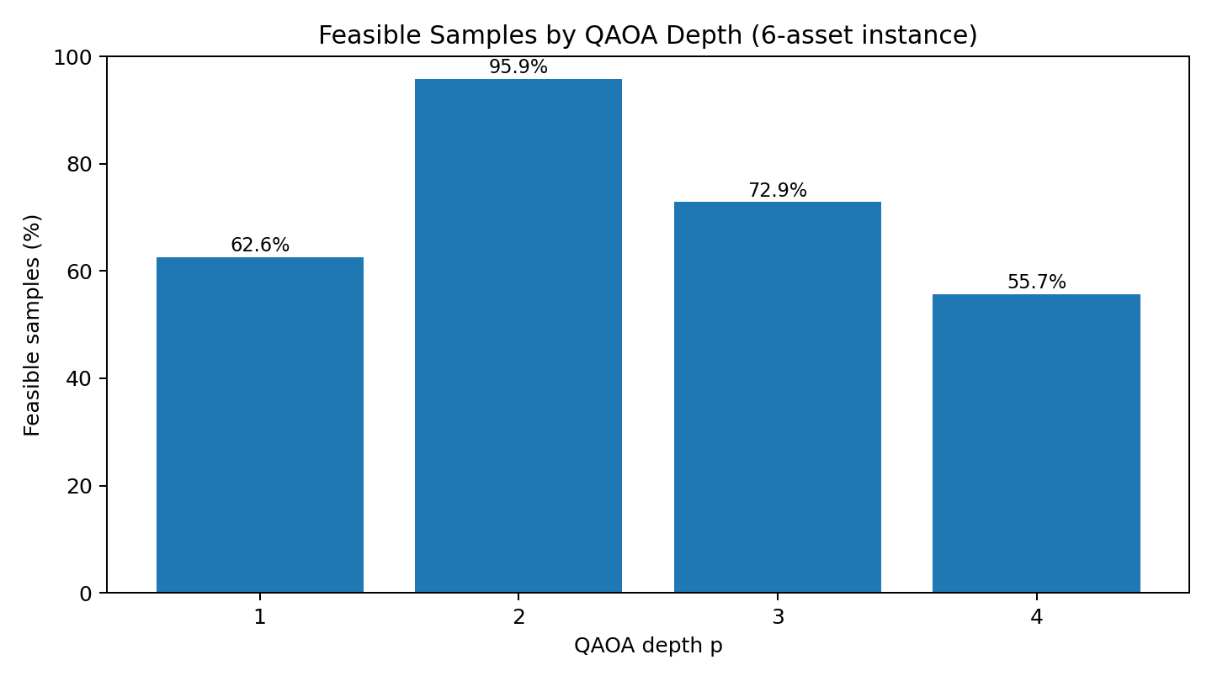
06 / RESULTS · QAOA DEPTH
Feasibility varies with QAOA depth
Each depth has 4,096 recorded simulator shots; a feasible sample selects exactly three assets.
BEST FEASIBLE RATE
p = 2: 95.87% of samples were feasible in this recorded run.
BEST-PORTFOLIO HIT RATE
p = 2: 183 / 4,096 shots = 4.47% matched the exact optimum.
This is a finite-shot simulator result, not a hardware comparison.
XD CLAN • Qiskit Fall Fest 2026 × IIIT Delhi
07

Slide 8
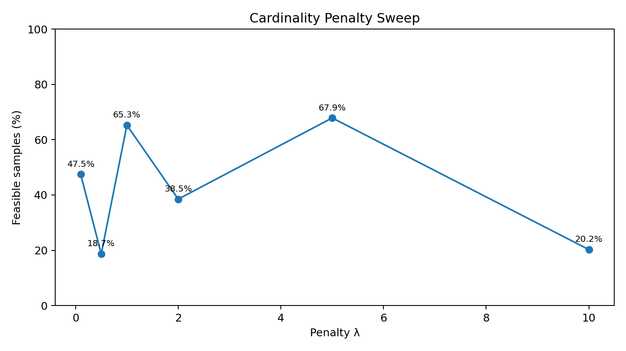
07 / RESULTS · PENALTY SWEEP
Penalty strength changes the feasible-sample rate
Recorded 4,096-shot evaluations for each tested λ.
HIGHEST OBSERVED
λ = 5.0 → 67.87% feasible samples in this sweep.
NOT MONOTONIC
λ = 0.5 gives 18.68%; λ = 10 gives 20.24%. Bigger penalty does not automatically mean better sampling.
A parameter sweep is empirical: it identifies promising settings for this instance, not a universal rule.
XD CLAN • Qiskit Fall Fest 2026 × IIIT Delhi
08

Slide 9
08 / RESULTS · INTERMEDIATE CASE
Exact classical search gives a ground-truth reference
The 12-asset case chooses 6 assets; there are 924 feasible combinations.
EXACT SEARCH
OPTIMUM COST
QAOA p = 1
924 feasible portfolios
fully enumerated
−0.6872192458
exact classical reference
4,096 shots
exact optimum appeared once
Optimal assets: 1, 4, 6, 8, 9, 12
Why keep the classical baseline? It tells us whether a sampled candidate is optimal, how far it is from the best-known cost, and whether the quantum heuristic adds value on the tested instance.
XD CLAN • Qiskit Fall Fest 2026 × IIIT Delhi
09

Slide 10
09 / RESULTS · ADVANCED SCALE
The 20-asset result is a classical exhaustive benchmark
It shows how the constraints can be checked at a larger portfolio size without mislabeling it as a quantum result.
SEARCH SPACE
SECTOR-FEASIBLE
BEST COST
184,756 combinations
choose 10 from 20
80,000 portfolios
passed the configured cap
−1.4913972690
classical exhaustive search
Recorded best portfolio: [1, 2, 5, 6, 7, 8, 12, 14, 15, 20]
This is not a 20-qubit QAOA experiment. Keeping the label explicit makes the evidence more credible and prevents overstating what the quantum circuit actually solved.
XD CLAN • Qiskit Fall Fest 2026 × IIIT Delhi
10

Slide 11
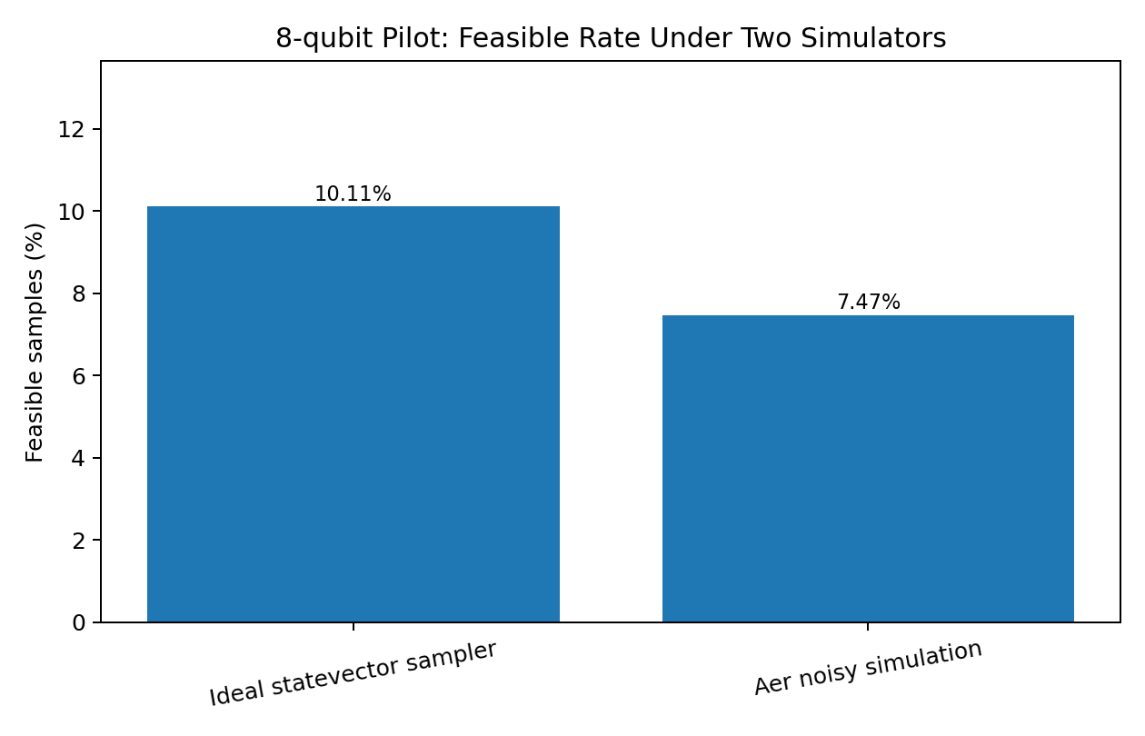
10 / RESULTS · NOISE SENSITIVITY
Synthetic noise reduced the pilot’s feasible rate
8-qubit pilot, 2,048 shots per simulator; noise settings are illustrative, not calibrated to a device.
IDEAL SAMPLER
10.11% feasible samples
NOISY AER
7.47% feasible samples
This compares two simulations. It is not the same as the real IBM hardware run.
XD CLAN • Qiskit Fall Fest 2026 × IIIT Delhi
11

Slide 12
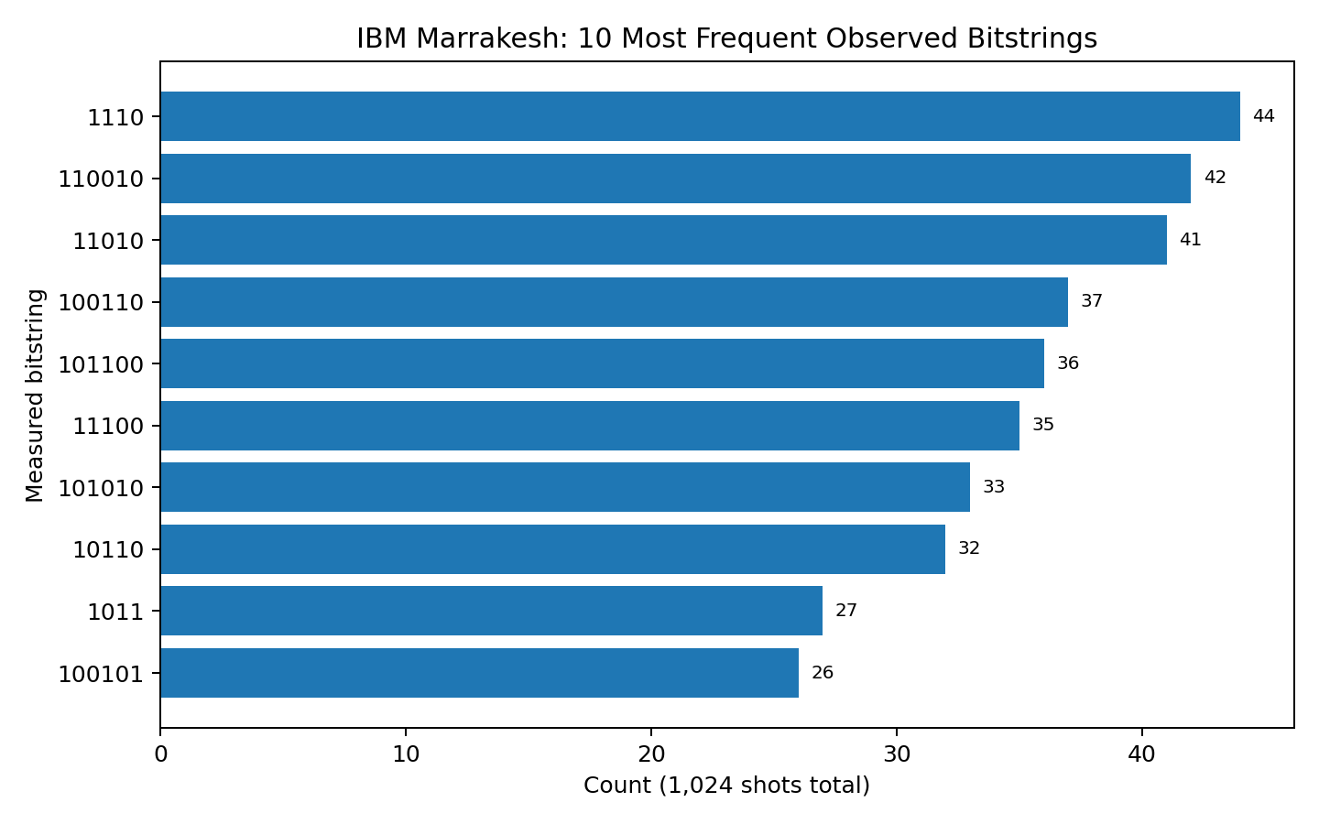
11 / HARDWARE EVIDENCE
A completed IBM Quantum job returned 1,024 shots
Recorded run details and saved counts are included with the package.
JOB
ibm_marrakesh
ID: db83qs0r1c5c738lmabg
CIRCUIT
6 logical qubits
transpiled depth 144
OPTIMAL SAMPLE
100110 appeared 37 times
3.61% of shots
The bitstring matches the recorded exact optimum under the notebook’s bit-order convention; this is not evidence of quantum advantage.
XD CLAN • Qiskit Fall Fest 2026 × IIIT Delhi
12

Slide 13
12 / COMPARE EVIDENCE FAIRLY
What each experiment can tell us
6 assets / QAOA
Simulator
Compare depth and penalty settings against exact optimum.
12 assets / QAOA
Simulator + exact search
Measure sampled quality against 924 feasible portfolios.
20 assets / 10 selected
Classical exhaustive search
Scale the classical constrained benchmark; not a QAOA result.
8-qubit pilot
Ideal + synthetic noisy Aer
Illustrate sensitivity to a noise model; not device-calibrated.
6-qubit IBM job
Real IBM Quantum Runtime run
Confirm completed execution and observed optimum sample; no advantage claim.
Separate labels matter: they distinguish measured device data from simulation and exact classical ground truth.
XD CLAN • Qiskit Fall Fest 2026 × IIIT Delhi
13

Slide 14
13 / LIMITATIONS
What the results do—and do not—show
SUPPORTED BY THE RECORD
NOT ESTABLISHED
Reproducible seeded instances, exact small-case references, saved simulator tables, and a completed IBM job with measurement counts.
Quantum advantage, a speedup over classical methods, device-calibrated noise conclusions, or generalization to real market portfolios.
Why this is useful: it is an end-to-end testbed for modeling, constraint handling, QAOA tuning, and evidence-based evaluation.
Next steps: repeat across seeds, compare more classical heuristics, calibrate noise assumptions, measure circuit/runtime costs, and document deployment behavior separately from algorithm results.
XD CLAN • Qiskit Fall Fest 2026 × IIIT Delhi
14

Slide 15
14 / LIVE DEMO
Open the Portfolio Optimizer
The deployed app is the interactive interface; the notebook and CSVs are the experiment record.
LIVE APP URL
https://qiskit-fall-fest-2026-iiitd-ajiq5qdibj2ujasptcycxm.streamlit.app/
Demo walkthrough
1. Open the app. 2. Inspect portfolio choices and constraints. 3. Compare the app’s output with the notebook’s seeded experiments and exact classical baselines. 4. Explain which results are simulated and which come from the recorded IBM job.
Optimizer deployment is external to this package; package checks verify the URL is embedded, not that the site is currently online.
XD CLAN • Qiskit Fall Fest 2026 × IIIT Delhi
15

Slide 16
15 / TAKEAWAYS
The contribution is the comparison framework—not a quantum advantage claim
MODEL
MEASURE
COMPARE
Translate portfolio choices into binary variables and explicit constraints.
Track feasibility, cost, hit rate, shots, and circuit details.
Use exact classical ground truth and label each experiment honestly.
XD CLAN — QAOA for Constrained Portfolio Optimization
https://qiskit-fall-fest-2026-iiitd-ajiq5qdibj2ujasptcycxm.streamlit.app/
Thank you
XD CLAN • Qiskit Fall Fest 2026 × IIIT Delhi
16

