Slide 1
Optimal Joint Offloading and Wireless Scheduling for Parallel Computing with Deadlines
Xudong Qin* Weijian Xu† Bin Li*
*Dept. of Electrical, Computer and Biomedical Engineering, University of Rhode Island, Rhode Island, USA
†Information Engineering College, Jimei University, Xiamen, China

Slide 2
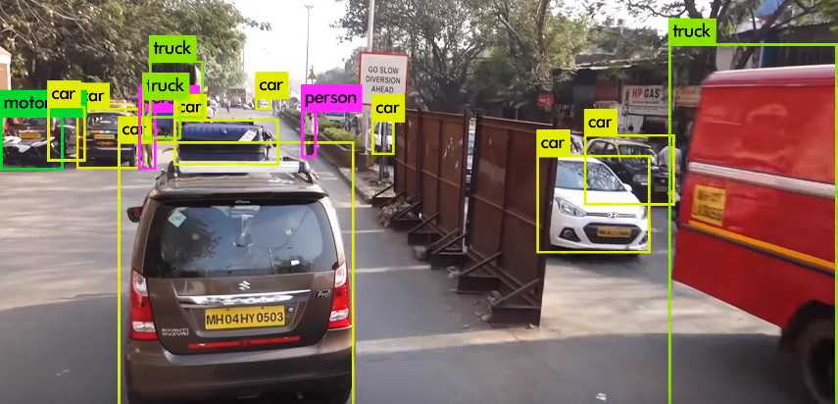
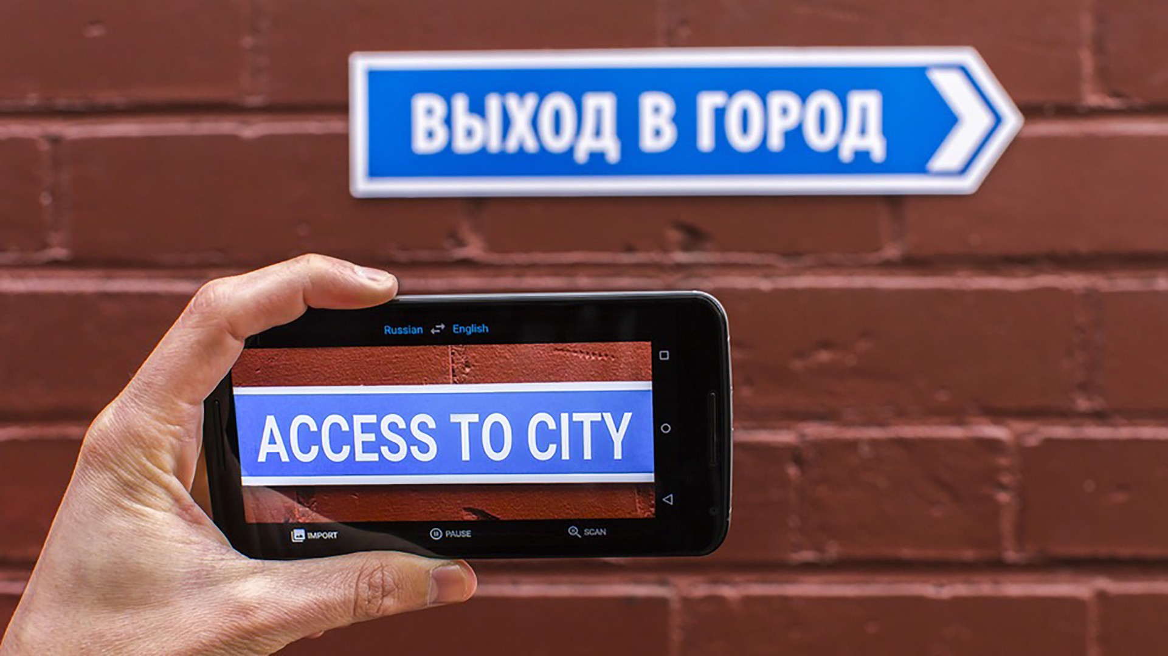
Real-time Mobile Applications
Real-time video analysis
Real-time language translation
Low energy consumption
Low latency requirements
Intensive computation requirements
Notes:
With the rapid growth of Artificial Intelligence (AI) technology, there is a strong need for real-time mobile applications such as real-time video analysis and real-time language translation. Those kinds of applications are faced with some difficult challenges, such as low energy consumption for mobile users, low latency and intensive computations requirements. In order to design algorithms to meet those challenges, we studied the joint offloading and wireless scheduling for parallel computing with deadlines.

Slide 3
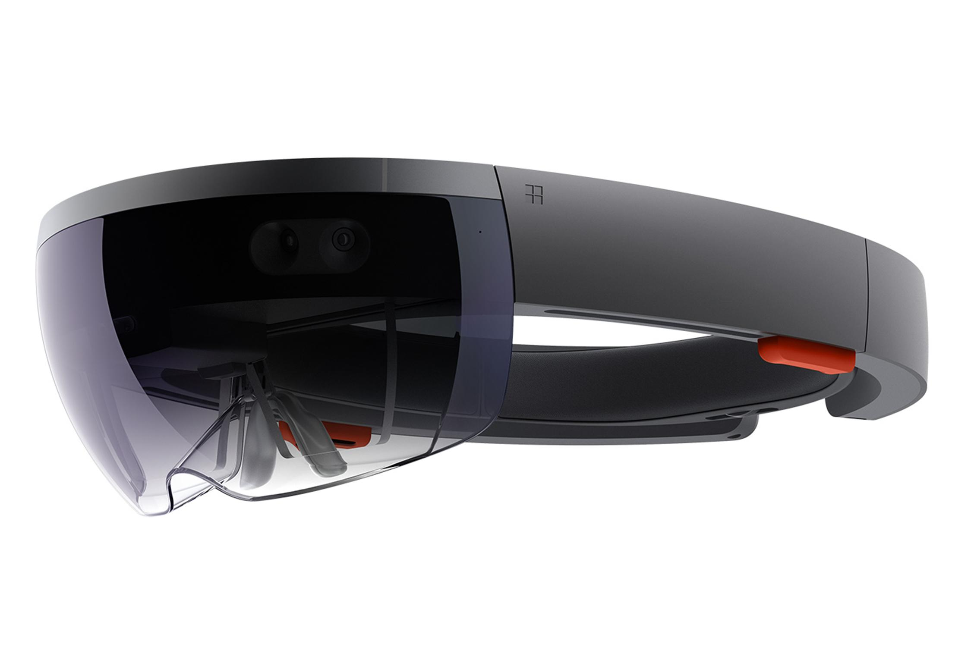

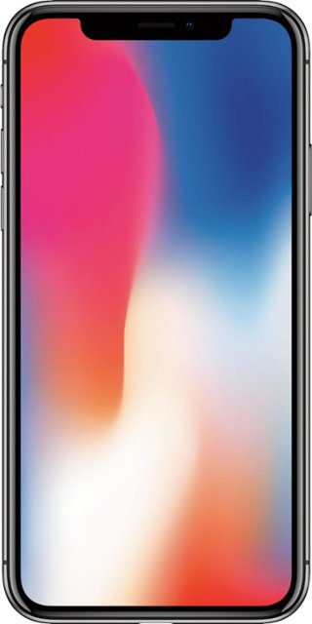



System Model
User 1
User 2
$$⋱$$
Access point
User N
Edge servers
Mobile users
Notes:
Here is the system model. We have N mobile users, one access point and some powerful edge servers.
Parallel computing
Applications. A world trade center there are people around the world need to use the real-time translation service to communicate with each other. i.e. the real-time translation
Applications runs in parallel manners. For example, real-time translation 1. capture the image , 2. image recognition 3. natural language processing
Basic System setup:
𝑁 mobile users;
One access point (AP);
Some powerful edge servers;

Slide 4

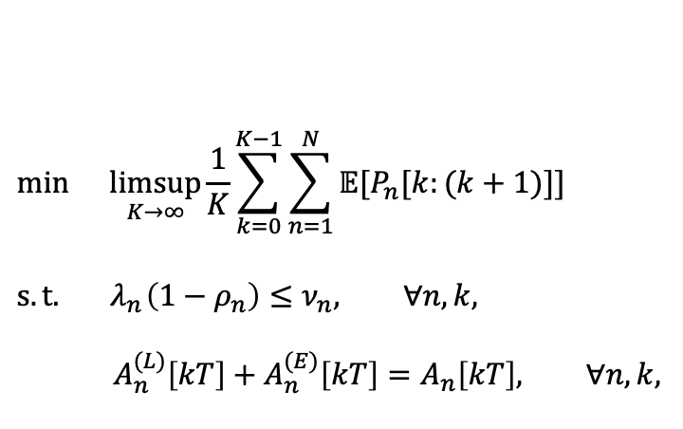



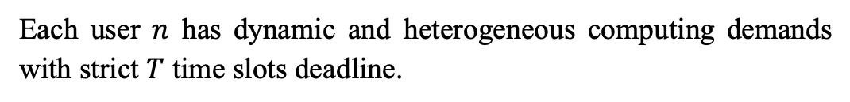


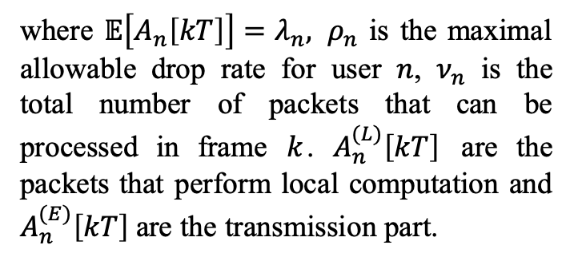
System Model (Cont’)
$$\min{\underset{K→∞}{limsup}{\frac{1}{K}\sum_{k=0}^{K−1}{\sum_{n=1}^{N}{𝔼[P_{n}[k:(k+1)]]}}{ }}}$$
$$s.t. { λ}_{n}\left(1−ρ_{n}\right)≤ν_{n}, ∀n, k,$$
$$A_{n}^{(L)}\left[kT\right]+A_{n}^{(E)}\left[kT\right]=A_{n}\left[kT\right], ∀n, k,$$
Each user $n$ has dynamic and heterogeneous computing demands with strict $T$ time slots deadline.
$↓{ A}_{n}\left[kT\right]$ packets
0
T slots
Local computation
where $𝔼\left[A_{n}\left[kT\right]\right]=λ_{n}, ρ_{n}$ is the maximal allowable drop rate for user $n$, $ν_{n}$ is the total number of packets that can be processed in frame $k$. $A_{n}^{(L)}\left[kT\right]$ are the packets that perform local computation and $A_{n}^{(E)}\left[kT\right]$ are the transmission part.
Transmission to edge server
Drop packets
$$D_{n} [kT]$$
Mobile User $n$
Energy Consumption: $P_{n}[k:\left(k+1\right)]$
In time frame $k$,
$ν_{n}$ packets can be processed
Time frame $k+1$
Notes:
Each user $n$ has dynamic and heterogeneous computing demands with strict $T$ time slots deadline. We group $T$ consecutive time slots into a frame.
At the beginning of each frame, there are A_n[kT] packets arriving at user n. Upon arrival, we split the arrival into two parts. One part perform local computations and the other part perform wireless transmissions. If there are still packets available at the end of frame, we drop the remaining packets.
Our object is to minimize the average energy consumption for each mobile user. (local computations and wireless transmissions)

Slide 5
A Motivating Example
Local-First Offloading and Scheduling (LFOS) Algorithm
Edge-First Offloading and Scheduling (EFOS) Algorithm
Arriving packets are processed at mobile device first
Remaining parts are transmitted to edge server
Arriving packets are transmitted to edge server first
Remaining parts are processed at mobile device
Notes:
First let’s take a look at a simple motivation example. There are two heuristic algorithm. LFOS algorithm and EFOS algorithm.
LFOS: the arriving packets are processed at mobile device first, then the remaining parts are transmitted to edge server.
EFOS: the arriving packets are processed at edge server first, then the remaining parts are processed at mobile device.

Slide 6
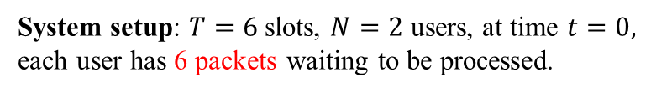
A Motivating Example (Cont’)
6 packets
Policy | User | t=0 | t=1 | t=2 | t=3 | t=4 | t=5
LFOS | 1
 | 2
EFOS | 1
 | 2
Better Choice | 1
 | 2
Access point
2 mobile users
Edge servers
System setup: $T=6$slots, $N=2$ users, at time $t=0,$ each user has 6 packets waiting to be processed.
In each slot, a mobile device can process 1 packet with 7 watt energy consumption;
In each slot, a mobile device can transmit 2 packets with 4 watt energy consumption;
Only one user can transmit packet within one slot.
Notes:
In this example, we assume that there are 2 mobile users, one access point and some edge servers.
Let’s compare the performance of LFOS and EFOS with the better choice.

Slide 7
A Motivating Example (Cont’)
Packets remaining
Policy | User | t=0 | t=1 | t=2 | t=3 | t=4 | t=5
LFOS | 1 | 3, 11
 | 2 | 5, 7
EFOS | 1 | 3, 11
 | 2 | 5, 7
Better Choice | 1 | 4, 4
 | 2
Access point
2 mobile users
Edge servers
System setup: $T=6$slots, $N=2$ users, at time $t=0,$ each user has 6 packets waiting to be processed.
In each slot, a mobile device can process 1 packet with 7 watt energy consumption;
In each slot, a mobile device can transmit 2 packets with 4 watt energy consumption;
Only one user can transmit packet within one slot.
Energy consumption
Notes:
In time slot 0, user 1 is allowed for both local computation and wireless transmission. User 2 is allowed for local computation only.

Slide 8
A Motivating Example (Cont’)
Packets remaining
Policy | User | t=0 | t=1 | t=2 | t=3 | t=4 | t=5
LFOS | 1 | 3, 11 | 0, 11
 | 2 | 5, 7 | 4, 7
EFOS | 1 | 3, 11 | 0, 11
 | 2 | 5, 7 | 4, 7
Better Choice | 1 | 4, 4 | 2, 4
 | 2
Access point
2 mobile users
Edge servers
System setup: $T=6$slots, $N=2$ users, at time $t=0,$ each user has 6 packets waiting to be processed.
In each slot, a mobile device can process 1 packet with 7 watt energy consumption;
In each slot, a mobile device can transmit 2 packets with 4 watt energy consumption;
Only one user can transmit packets within one slot.
Energy consumption

Slide 9
A Motivating Example (Cont’)
Packets remaining
Policy | User | t=0 | t=1 | t=2 | t=3 | t=4 | t=5
LFOS | 1 | 3, 11 | 0, 11
 | 2 | 5, 7 | 4, 7 | 1, 11
EFOS | 1 | 3, 11 | 0, 11
 | 2 | 5, 7 | 4, 7 | 1, 11
Better Choice | 1 | 4, 4 | 2, 4 | 0, 4
 | 2
Access point
2 mobile users
Edge servers
System setup: $T=6$slots, $N=2$ users, at time $t=0,$ each user has 6 packets waiting to be processed.
In each slot, a mobile device can process 1 packet with 7 watt energy consumption;
In each slot, a mobile device can transmit 2 packets with 4 watt energy consumption;
Only one user can transmit packet within one slot.
Energy consumption

Slide 10
A Motivating Example (Cont’)
Packets remaining
Policy | User | t=0 | t=1 | t=2 | t=3 | t=4 | t=5
LFOS | 1 | 3, 11 | 0, 11
 | 2 | 5, 7 | 4, 7 | 1, 11 | 0, 7
EFOS | 1 | 3, 11 | 0, 11
 | 2 | 5, 7 | 4, 7 | 1, 11 | 0, 4
Better Choice | 1 | 4, 4 | 2, 4 | 0, 4
 | 2 |  |  |  | 4, 4
Access point
2 mobile users
Edge servers
System setup: $T=6$slots, $N=2$ users, at time $t=0,$ each user has 6 packets waiting to be processed.
In each slot, a mobile device can process 1 packet with 7 watt energy consumption;
In each slot, a mobile device can transmit 2 packets with 4 watt energy consumption;
Only one user can transmit packet within one slot.
Energy consumption

Slide 11
A Motivating Example (Cont’)
Packets remaining
Policy | User | t=0 | t=1 | t=2 | t=3 | t=4 | t=5
LFOS | 1 | 3, 11 | 0, 11
 | 2 | 5, 7 | 4, 7 | 1, 11 | 0, 7
EFOS | 1 | 3, 11 | 0, 11
 | 2 | 5, 7 | 4, 7 | 1, 11 | 0, 4
Better Choice | 1 | 4, 4 | 2, 4 | 0, 4
 | 2 |  |  |  | 4, 4 | 2, 4
Access point
2 mobile users
Edge servers
System setup: $T=6$slots, $N=2$ users, at time $t=0,$ each user has 6 packets waiting to be processed.
In each slot, a mobile device can process 1 packet with 7 watt energy consumption;
In each slot, a mobile device can transmit 2 packets with 4 watt energy consumption;
Only one user can transmit packet within one slot.
Energy consumption

Slide 12
A Motivating Example (Cont’)
Packets remaining
Policy | User | t=0 | t=1 | t=2 | t=3 | t=4 | t=5
LFOS | 1 | 3, 11 | 0, 11
 | 2 | 5, 7 | 4, 7 | 1, 11 | 0, 7
EFOS | 1 | 3, 11 | 0, 11
 | 2 | 5, 7 | 4, 7 | 1, 11 | 0, 4
Better Choice | 1 | 4, 4 | 2, 4 | 0, 4
 | 2 |  |  |  | 4, 4 | 2, 4 | 0, 4
Access point
2 mobile users
Edge servers
System setup: $T=6$slots, $N=2$ users, at time $t=0,$ each user has 6 packets waiting to be processed.
In each slot, a mobile device can process 1 packet with 7 watt energy consumption;
In each slot, a mobile device can transmit 2 packets with 4 watt energy consumption;
Only one user can transmit packet within one slot.
Energy
consumption

Slide 13
A Motivating Example (Cont’)
Policy | User | t=0 | t=1 | t=2 | t=3 | t=4 | t=5
LFOS | 1 | 3, 11 | 0, 11
 | 2 | 5, 7 | 4, 7 | 1, 11 | 0, 7
EFOS | 1 | 3, 11 | 0, 11
 | 2 | 5, 7 | 4, 7 | 1, 11 | 0, 4
Better Choice | 1 | 4, 4 | 2, 4 | 0, 4
 | 2 |  |  |  | 4, 4 | 2, 4 | 0, 4
Access point
2 mobile users
Edge servers
System setup: $T=6$slots, $N=2$ users, at time $t=0,$ each user has 6 packets waiting to be processed.
Policy | LFOS | EFOS | Better choice
Average Energy consumption for each user(watt) | 4.5 | 4.25 | 2
In each slot, a mobile device can process 1 packet with 7 watt energy consumption;
In each slot, a mobile device can transmit 2 packets with 4 watt energy consumption;
Only one user can transmit packet within one slot.
A better choice can save energy consumption up to 55.6% compared to LFOS.

Slide 14
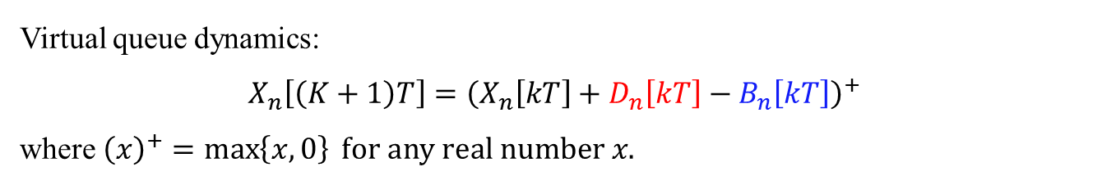
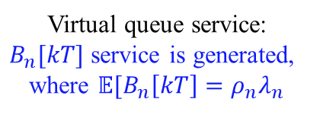

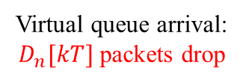
Algorithm Design
We introduce a virtual queue $X_{n}[kT]$ to keep track of the amount of packets that are dropped.
Virtual queue $X_{n}[kT]$
Virtual queue arrival:
$D_{n}[kT]$ packets drop
Virtual queue service:
$B_{n}[kT]$ service is generated,
where $𝔼[B_{n}\left[kT\right]=ρ_{n}λ_{n}$
Virtual queue dynamics:
$X_{n}\left[\left(K+1\right)T\right]={\left(X_{n}\left[kT\right]+D_{n}\left[kT\right]−B_{n}\left[kT\right]\right)}^{+}$
where ${\left(x\right)}^{+}=\max\left\{x,0\right\} for any real number x.$
Then the average drop rate of user $n$ meets the requirement if its virtual queue is stable (c.f. [1, Definition 2.2] ).
[1] M. Neely, Stochastic network optimization with application to communication and queueing systems. Morgan & Claypool, 2010
Notes:
Virtual queue that

Slide 15
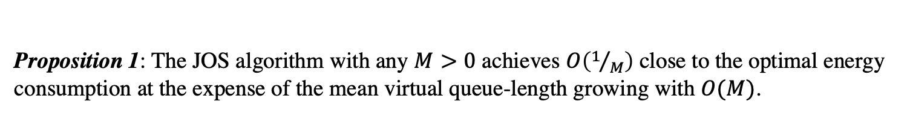
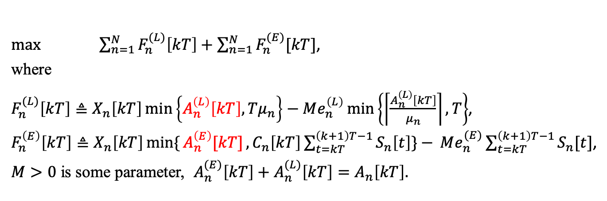
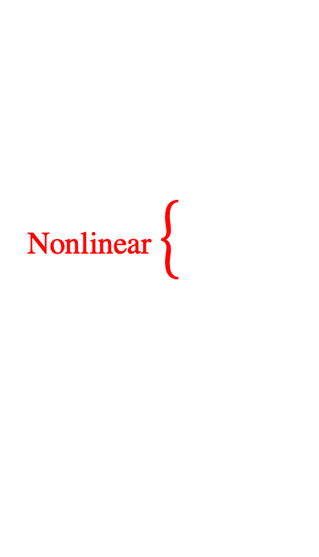
Joint Offloading and Scheduling Algorithm
Joint Offloading and Scheduling (JOS) algorithm
$\max{\sum_{n=1}^{N}{F_{n}^{(L)}\left[kT\right]+\sum_{n=1}^{N}{F_{n}^{(E)}[kT]}}}$,
where
$F_{n}^{(L)}\left[kT\right]≜X_{n}\left[kT\right]\min\left\{A_{n}^{\left(L\right)}\left[kT\right], Tμ_{n}\right\}−Me_{n}^{\left(L\right)}\min\left\{\left\lceil \frac{A_{n}^{\left(L\right)}\left[kT\right]}{μ_{n}}\right\rceil , T\right\}$,
$F_{n}^{\left(E\right)}\left[kT\right]≜X_{n}\left[kT\right]min\{{A_{n}^{\left(E\right)}[kT]},C_{n}\left[kT\right]\sum_{t=kT}^{\left(k+1\right)T−1}{S_{n}\left[t\right]\}− }Me_{n}^{(E)}\sum_{t=kT}^{\left(k+1\right)T−1}{S_{n}[t]}$,
$M>0$ is some parameter, $A_{n}^{(E)}\left[kT\right]+A_{n}^{(L)}\left[kT\right]=A_{n}\left[kT\right].$
Strongly coupled
Nonlinear
Proposition 1: The JOS algorithm with any $M>0$ achieves $O\left(1/M\right)$ close to the optimal energy consumption at the expense of the mean virtual queue-length growing with $O(M)$.

Slide 16
Algorithm Implement Roadmap
In JOS algorithm, the offloading decisions and wireless scheduling decisions are strongly coupled, which make it hard to implement
Decoupled Joint Offloading and Scheduling (DJOS) algorithm
Consider one time slot deadline setup, we build decoupled joint offloading and scheduling (DJOS) algorithm for the case with one time slot deadline.
Wireless scheduling decisions
Offloading decisions
Based on the insight of one time slot DJOS, we developed DJOS for the general case.

Slide 17









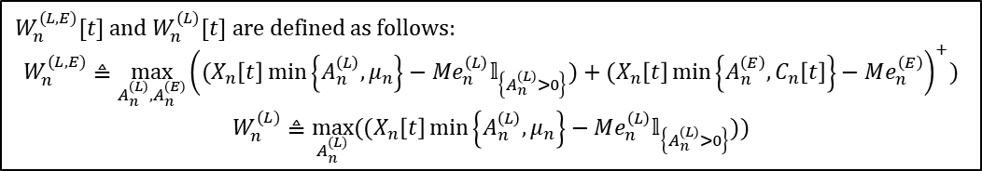

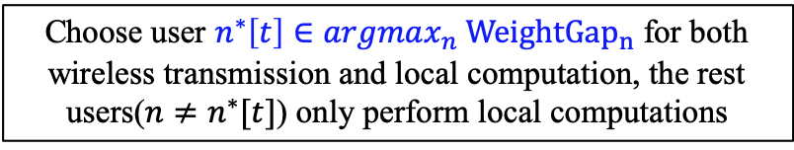
Wireless Scheduling Decisions (1 Time Slot)
User $1$
Calculate ${WeightGap}_{1}=W_{1}^{(L, E)}\left[t\right]−W_{1}^{(L)}[t]$
Compute weight $W_{n}^{(L)}[t]$
Only local computation
User $2$
Step 1:
Step 2:
Calculate ${WeightGap}_{2}=W_{2}^{(L, E)}\left[t\right]−W_{2}^{(L)}[t]$
Compute weight $W_{n}^{(L, E)}[t]$
Both local computation and wireless transmission
$$⋯⋯$$
User $N$
Calculate ${{WeightGap}_{N}=W}_{N}^{(L, E)}\left[t\right]−W_{N}^{(L)}[t]$
Choose user $n^{∗}\left[t\right]∈argmax_{n} {WeightGap}_{n}$ for both wireless transmission and local computation, the rest users($n≠n^{∗}[t]$) only perform local computations
Step 3:
$W_{n}^{(L,E)}[t]$ and $W_{n}^{(L)}[t]$ are defined as follows:
$$W_{n}^{(L,E)}≜\max_{A_{n}^{\left(L\right)},A_{n}^{\left(E\right)}}{\left((X_{n}\left[t\right]\min\left\{A_{n}^{\left(L\right)},μ_{n}\right\}−Me_{n}^{\left(L\right)}𝕝_{\left\{A_{n}^{\left(L\right)}>0\right\}})+{(X}_{n}\left[t\right]\min\left\{A_{n}^{\left(E\right)},C_{n}\left[t\right]\right\}−Me_{n}^{\left(E\right)}\right)}^{+})$$
$$W_{n}^{(L)}≜\max_{A_{n}^{(L)}}{((X_{n}\left[t\right]\min\left\{A_{n}^{\left(L\right)},μ_{n}\right\}−Me_{n}^{\left(L\right)}𝕝_{\left\{A_{n}^{\left(L\right)}>0\right\}}))}$$

Slide 18
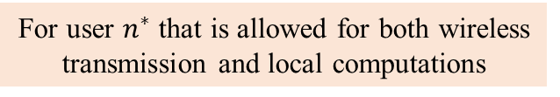
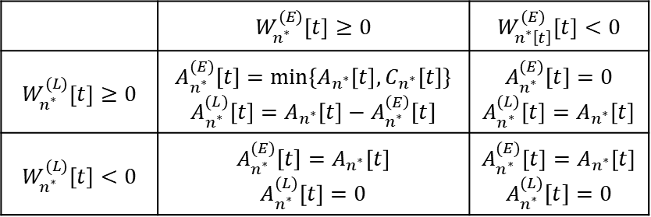
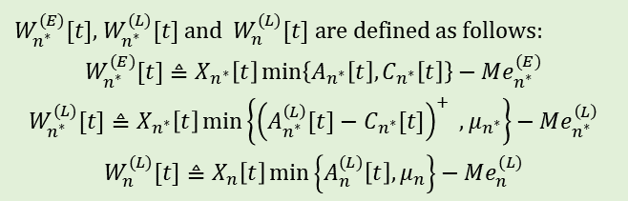
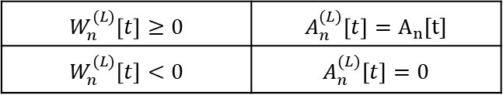
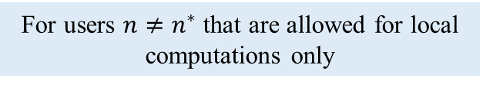
Offloading Decisions(1 Time Slot)
 | $$W_{n^{∗}}^{(E)}\left[t\right]≥0$$ | $$W_{n^{∗}\left[t\right]}^{(E)}\left[t\right]<0$$
$$W_{n^{∗}}^{(L)}\left[t\right]≥0$$ | $$A_{n^{∗}}^{(E)}[t]=\min{\{A_{n^{∗}}\left[t\right], C_{n^{∗}}[t]\}}$$ $$A_{n^{∗}}^{(L)}\left[t\right]=A_{n^{∗}}\left[t\right]−A_{n^{∗}}^{\left(E\right)}[t]$$ | $$A_{n^{∗}}^{(E)}[t]=0$$ $$A_{n^{∗}}^{(L)}\left[t\right]=A_{n^{∗}}\left[t\right]$$
$$W_{n^{∗}}^{(L)}\left[t\right]<0$$ | $$A_{n^{∗}}^{(E)}[t]=A_{n^{∗}}\left[t\right]$$ $$A_{n^{∗}}^{(L)}\left[t\right]=0$$ | $$A_{n^{∗}}^{(E)}\left[t\right]=A_{n^{∗}}\left[t\right]$$ $$A_{n^{∗}}^{(L)}[t]=0$$
For user $n^{∗}$ that is allowed for both wireless transmission and local computations
For users ${n≠n}^{∗}$ that are allowed for local computations only
$$W_{n}^{(L)}\left[t\right]≥0$$ | $$A_{n}^{(L)}\left[t\right]=A_{n}[t]$$
$$W_{n}^{(L)}\left[t\right]<0$$ | $$A_{n}^{(L)}\left[t\right]=0$$
$W_{n^{∗}}^{(E)}[t]$, $W_{n^{∗}}^{(L)}[t]$ and $W_{n}^{(L)}[t]$ are defined as follows:
$$W_{n^{∗}}^{(E)}[t]≜X_{n^{∗}}\left[t\right]\min\left\{A_{n^{∗}}\left[t\right], C_{n^{∗}}\left[t\right]\right\}−Me_{n^{∗}}^{(E)}$$
$$W_{n^{∗}}^{(L)}[t]≜X_{n^{∗}}\left[t\right]\min\left\{{\left(A_{n^{∗}}^{\left(L\right)}[t]−C_{n^{∗}}[t]\right)}^{+} ,μ_{n^{∗}}\right\}−Me_{n^{∗}}^{\left(L\right)}$$
$$W_{n}^{(L)}[t]≜X_{n}\left[t\right]\min\left\{A_{n}^{(L)}\left[t\right], μ_{n}\right\}−Me_{n}^{(L)}$$

Slide 19



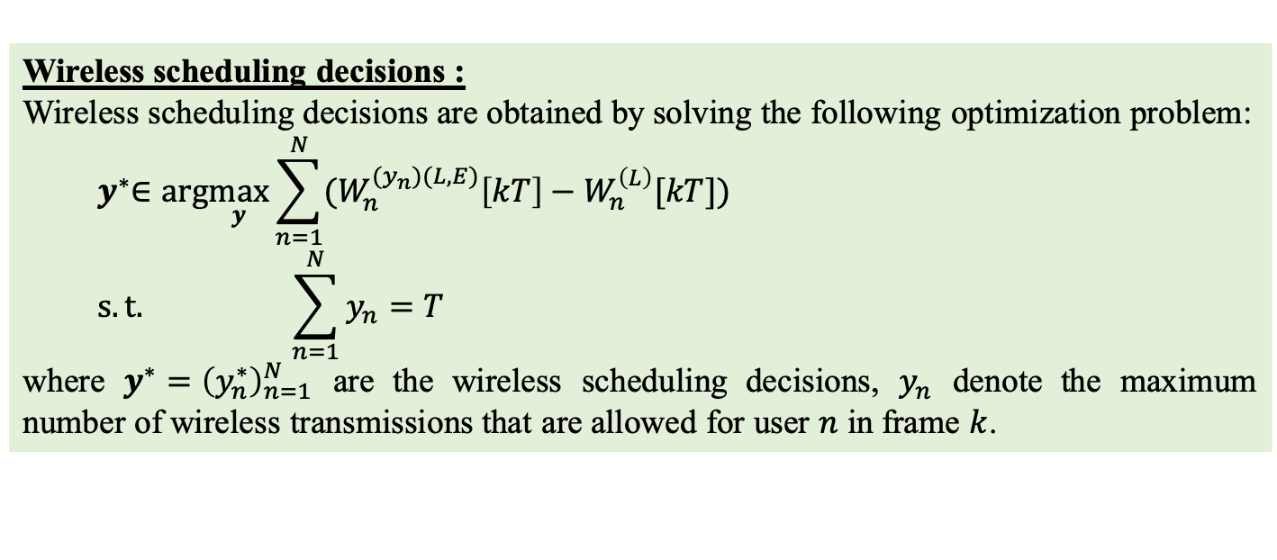


General Case (T Time Slots)
Wireless scheduling decisions :
Wireless scheduling decisions are obtained by solving the following optimization problem:
$${ y}^{∗}∈arg\max_{y}\sum_{n=1}^{N}{(W_{n}^{{(y}_{n})(L,E)}\left[kT\right]−W_{n}^{\left(L\right)}[kT])}$$
$$s.t. \sum_{n=1}^{N}{y_{n}=T}$$
where $y^{∗}={\left(y_{n}^{∗}\right)}_{n=1}^{N}$ are the wireless scheduling decisions, $y_{n}$ denote the maximum number of wireless transmissions that are allowed for user $n$ in frame $k$.
$T=5$ slots
User 1: schedule 3 time slots
$O(N^{T})$ complexity
User 2: schedule 2 time slots
$$y_{1}=3$$
$$y_{2}=2$$
$$y_{1}+y_{2}=T$$
Offloading Decision:
The offloading decisions for each user are similar with the case with one time slot

Slide 20
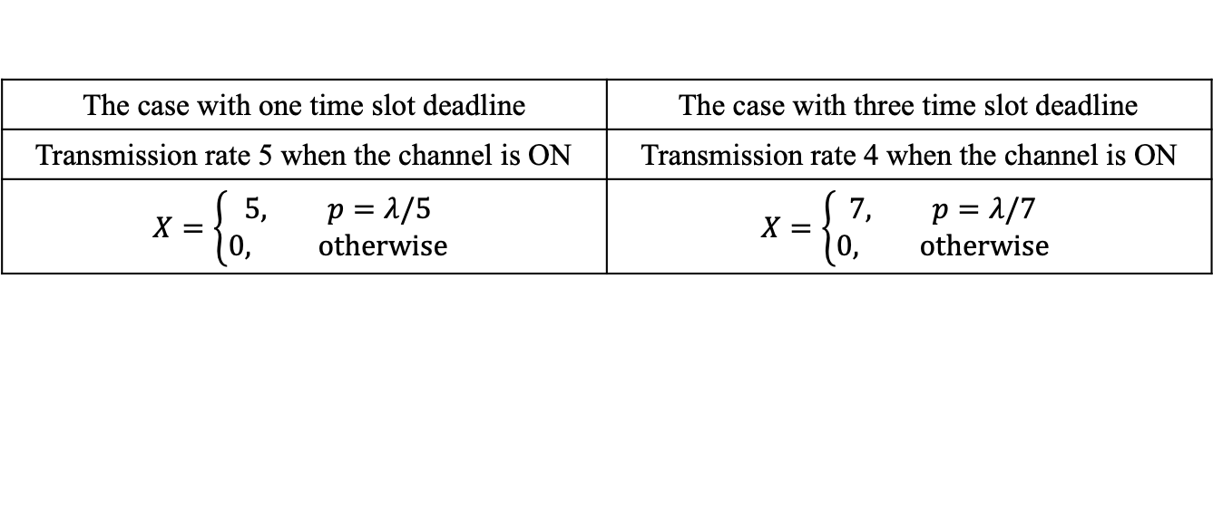
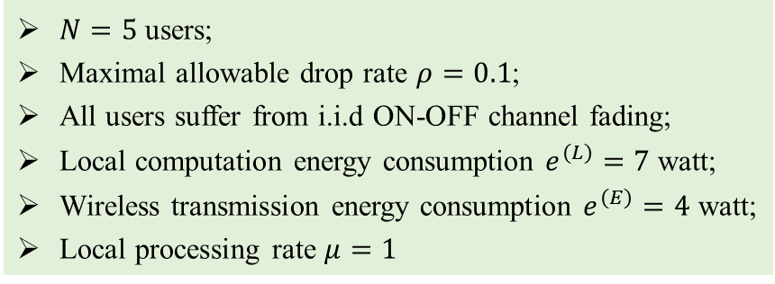
Simulation Setup
$N=5$ users;
Maximal allowable drop rate $ρ=0.1$;
All users suffer from i.i.d ON-OFF channel fading;
Local computation energy consumption $e^{(L)}=7$ watt;
Wireless transmission energy consumption $e^{(E)}=4$ watt;
Local processing rate $μ=1$
The case with one time slot deadline | The case with three time slot deadline
Transmission rate 5 when the channel is ON | Transmission rate 4 when the channel is ON
$$X=\left\{\begin{aligned}5, p=λ/5 \\ 0, otherwise\end{aligned}\right.$$ | $$X=\left\{\begin{aligned}7, p=λ/7 \\ 0, otherwise\end{aligned}\right.$$
Where $X$ denotes number of arriving packets and $p$ denotes the probability that have arrivals.

Slide 21
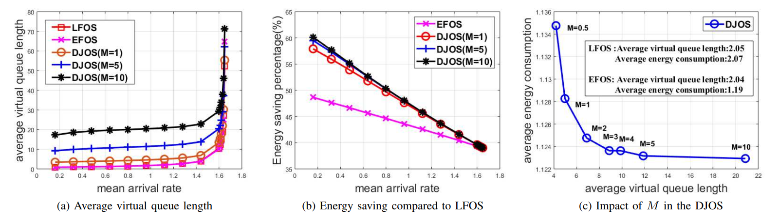
Simulation Results (1 Time Slot Deadline)
The case with one time slot deadline
Figure (a) implies that all users satisfy the maximum allowable drop rate
Figure (b) shows that our proposed DJOS algorithm significantly saves the energy compared to LFOS
Figure (c) studies the impact of parameter M

Slide 22
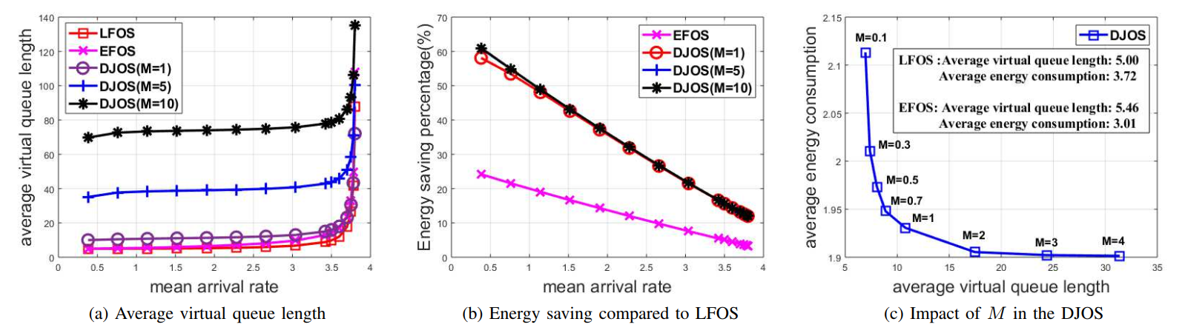
Simulation Results (3 Time Slots Deadline)
The case with three time slots deadline
Figure (a) implies that all users satisfy the maximum allowable drop rate
Figure (b) shows that our proposed DJOS algorithm significantly saves the energy compared to LFOS
Figure (c) studies the impact of parameter M

Slide 23
Conclusions & Future work
We developed the joint offloading and scheduling (JOS) algorithm;
We developed the decoupled joint offloading and scheduling (DJOS) algorithm for the case with one time slot deadline;
We further developed the decoupled joint offloading and scheduling (DJOS) algorithm for general case;
Low-complexity implementation for the decoupled joint offloading and scheduling (DJOS) algorithm.

Slide 24
Thank you! Q&A

