Slide 1
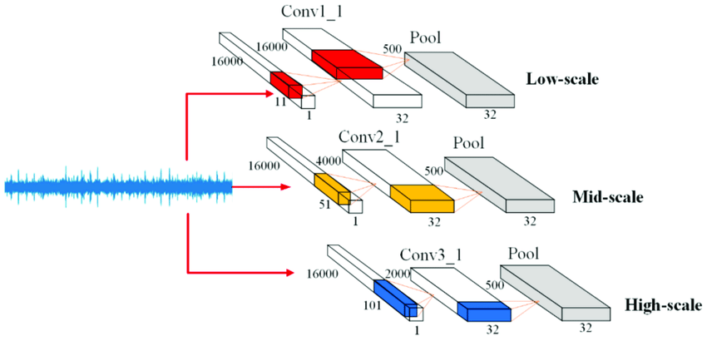

Slide 2
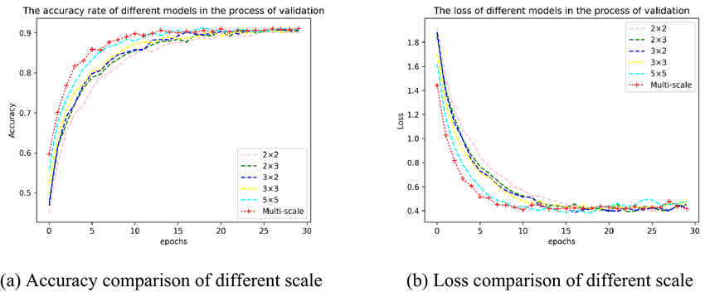
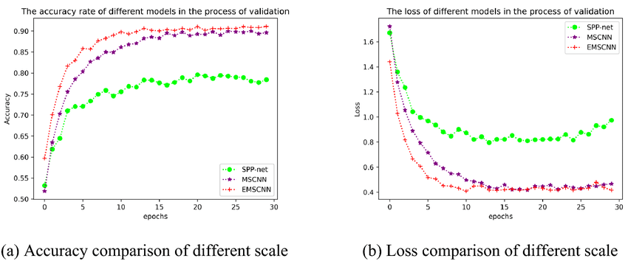

Slide 3
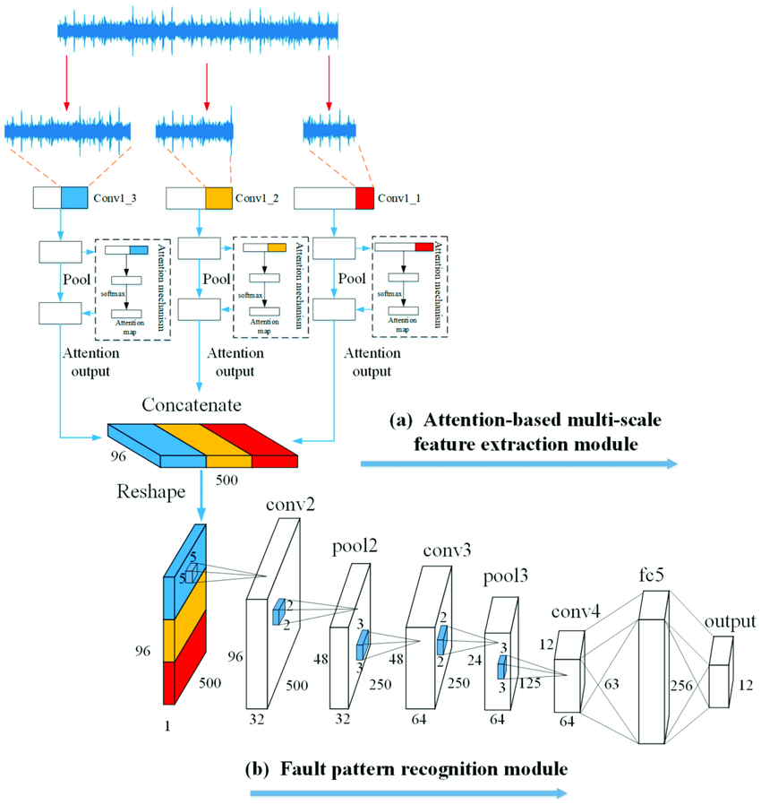

Slide 4
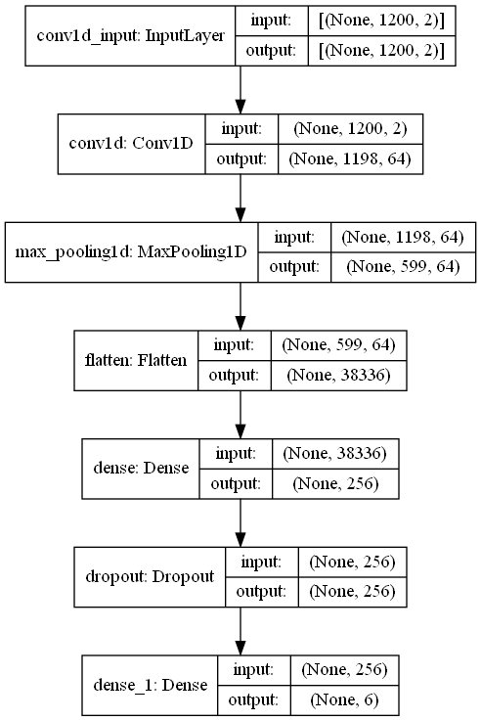

Slide 5
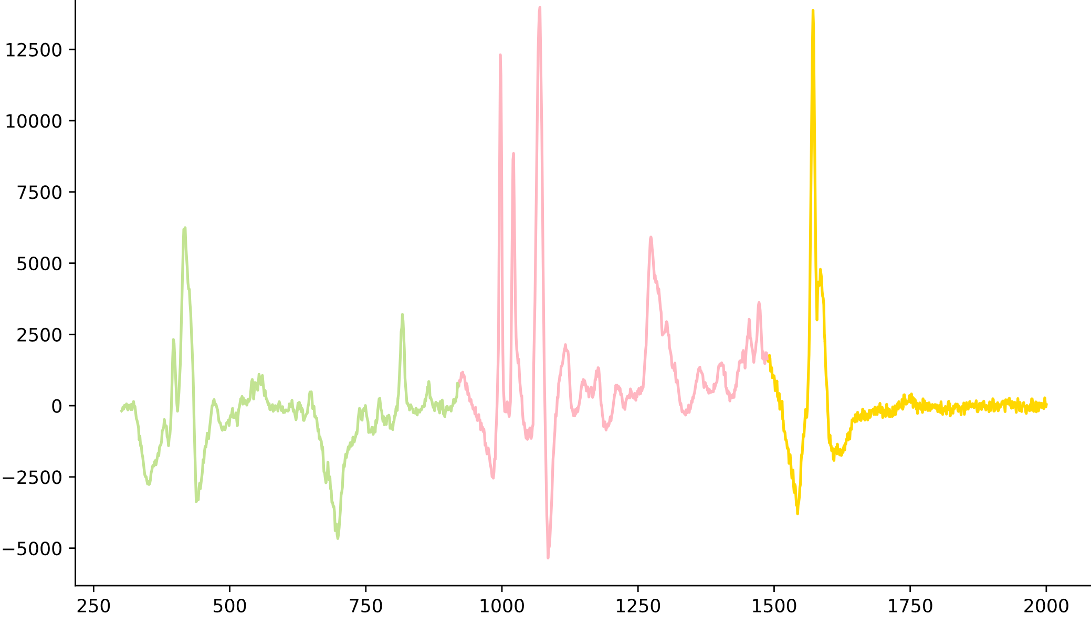
Conv1_3
Conv1_3
Conv1_3
Pool
Attention mechanism
Pool
Attention mechanism
Pool
Attention mechanism
softmax
softmax
softmax
Attention
map
Attention
map
Attention
map
Attention
output
Attention
output
Attention
output
Reshape
Pool
Flatten
Droupout
Conv 256
Output
1200
1200
1200
599
256
3
1
3
…
…
…
64
…
1
256
1200
1200
1200
1
3
3
1
Notes:
By @avsthiago

Slide 6
Conv1_3
Conv1_3
Conv1_3
Pool
Attention mechanism
Pool
Attention mechanism
Pool
softmax
softmax
Attention mechanism
softmax
Attention
map
Attention
map
Attention
map
Attention
output
Attention
output
Attention
output

Slide 7
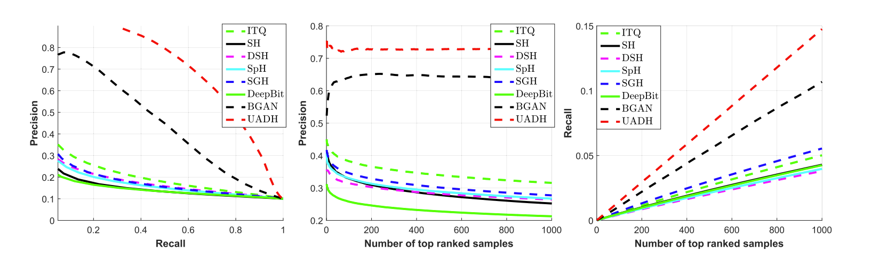
AM-CNN
AMCNN
AMCNN
AMCNN

