Slide 1
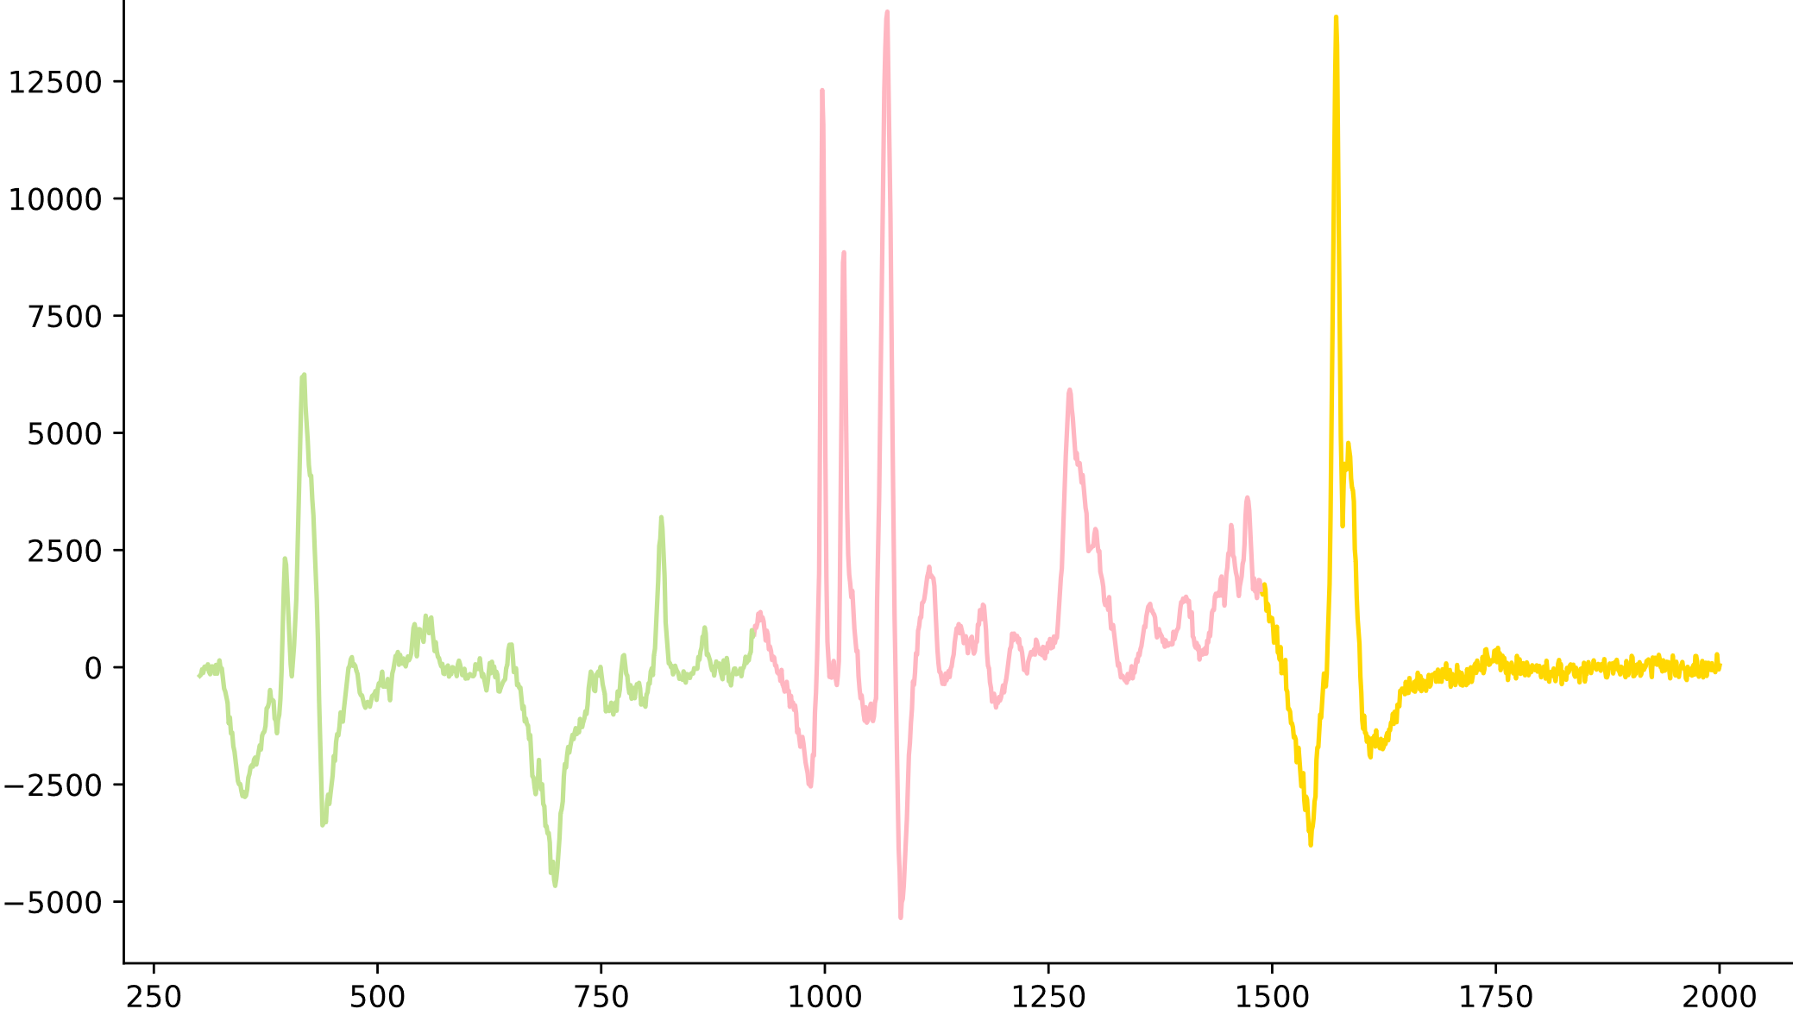
Conv1_3
Conv1_3
Conv1_3
Pool
Attention mechanism
Pool
Attention mechanism
Pool
Attention mechanism
softmax
softmax
softmax
Attention
map
Attention
map
Attention
map
Attention
output
Attention
output
Attention
output
Reshape
Pool
Flatten
Droupout
Conv 256
Output
1200
1200
1200
599
256
3
1
3
…
…
…
64
…
1
256
1200
1200
1200
1
3
3
1

Slide 2
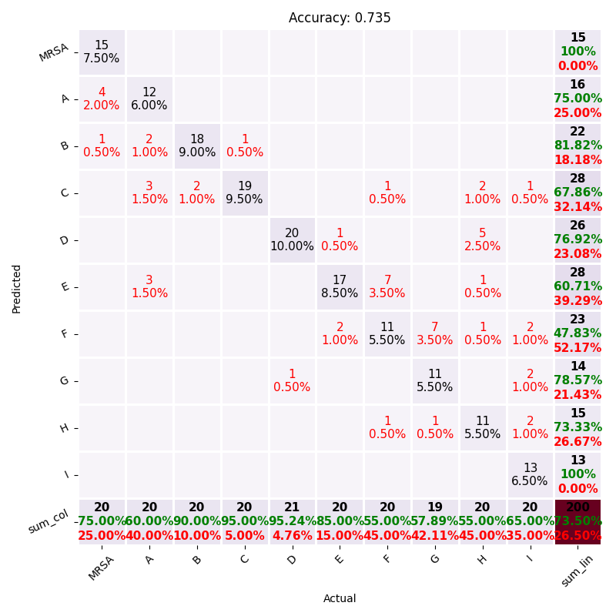
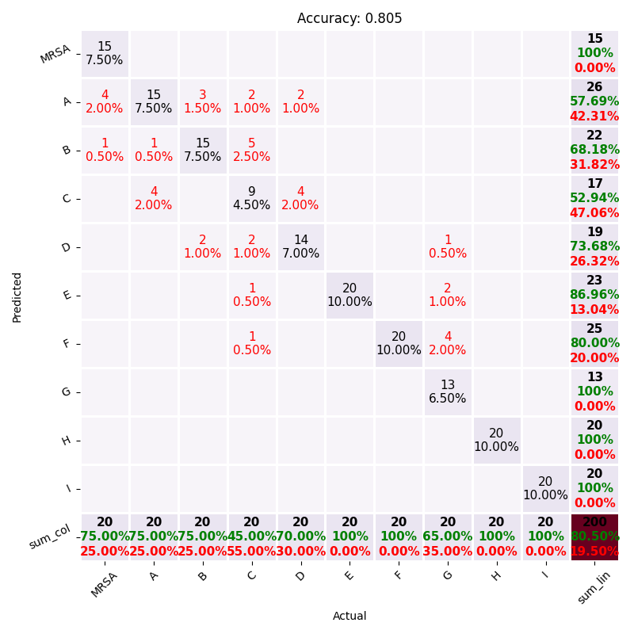
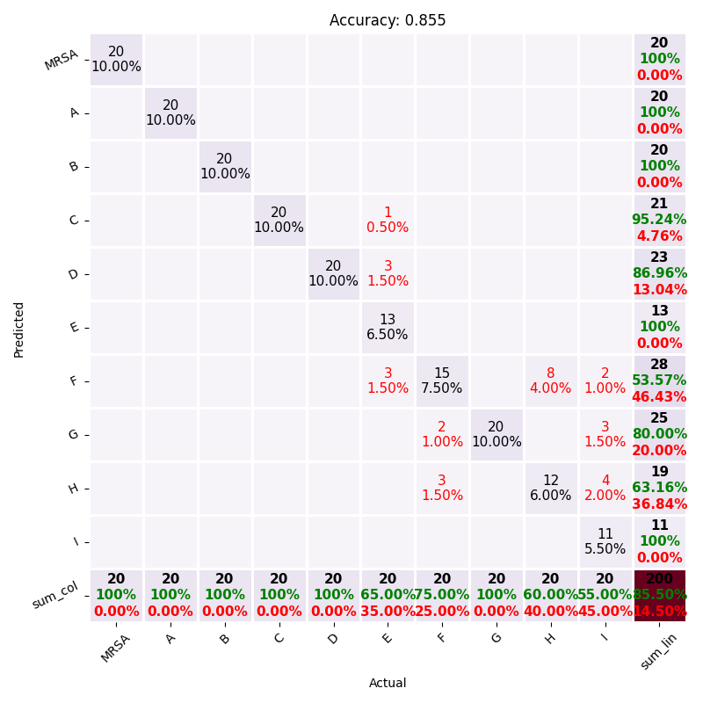
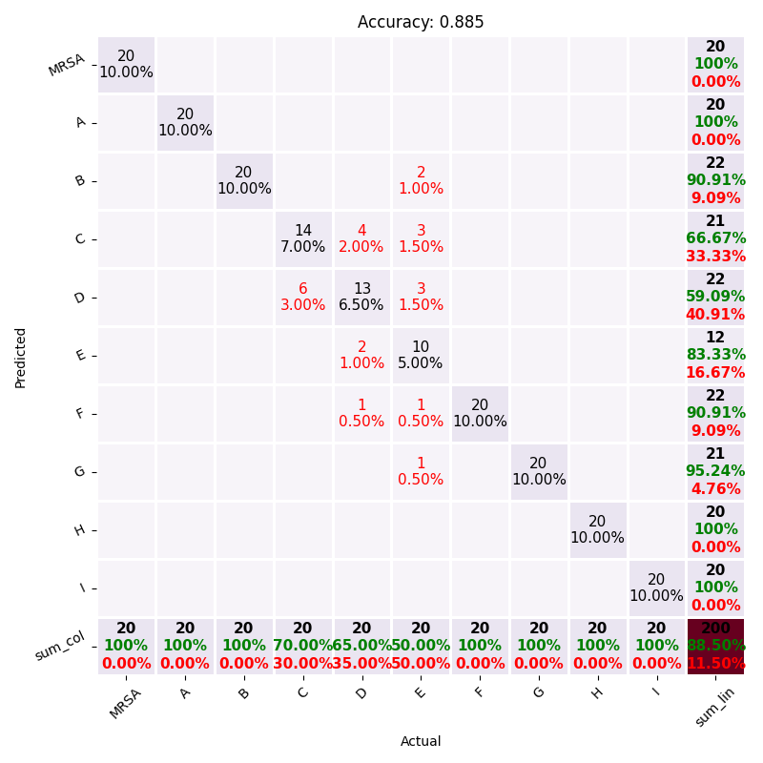
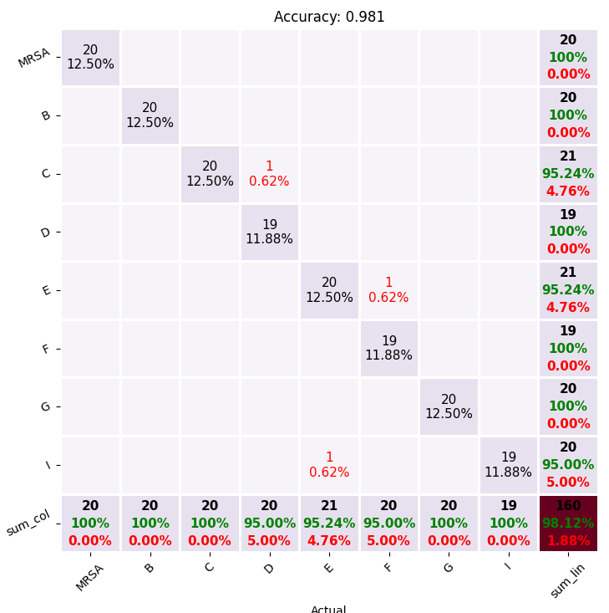
SVM
RNN
KNN
CNN
AM-CNN

Slide 3
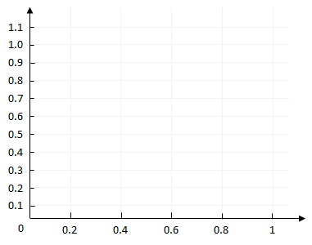
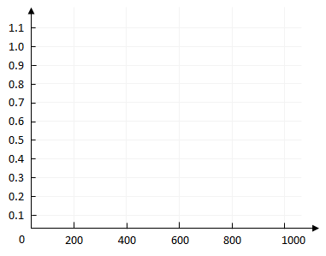
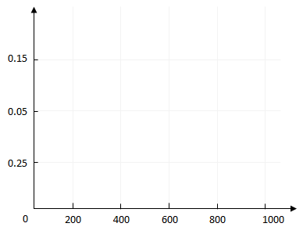
AMCNN
AMCNN
AMCNN
CNN
CNN
CNN
KNN
KNN
KNN
RNN
RNN
RNN
SVM
SVM
SVM
Precision
Precision
Recall
Recall
Number of top ranked samples
Number of top ranked samples
AM-CNN在准确率-召回率曲线中表现稳定；
同时在N轮训练下来
排名最高的样本数中准确率和召回率表现最好的仍然是AM-CNN模型

Slide 4
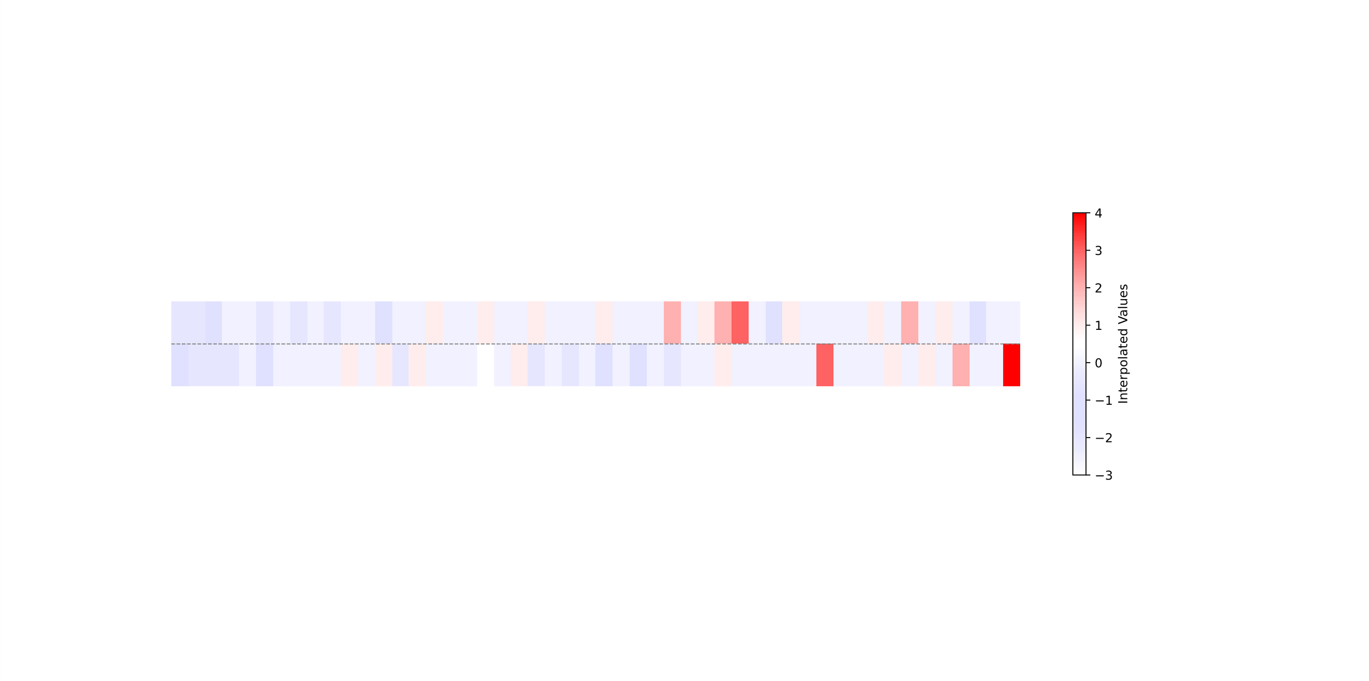
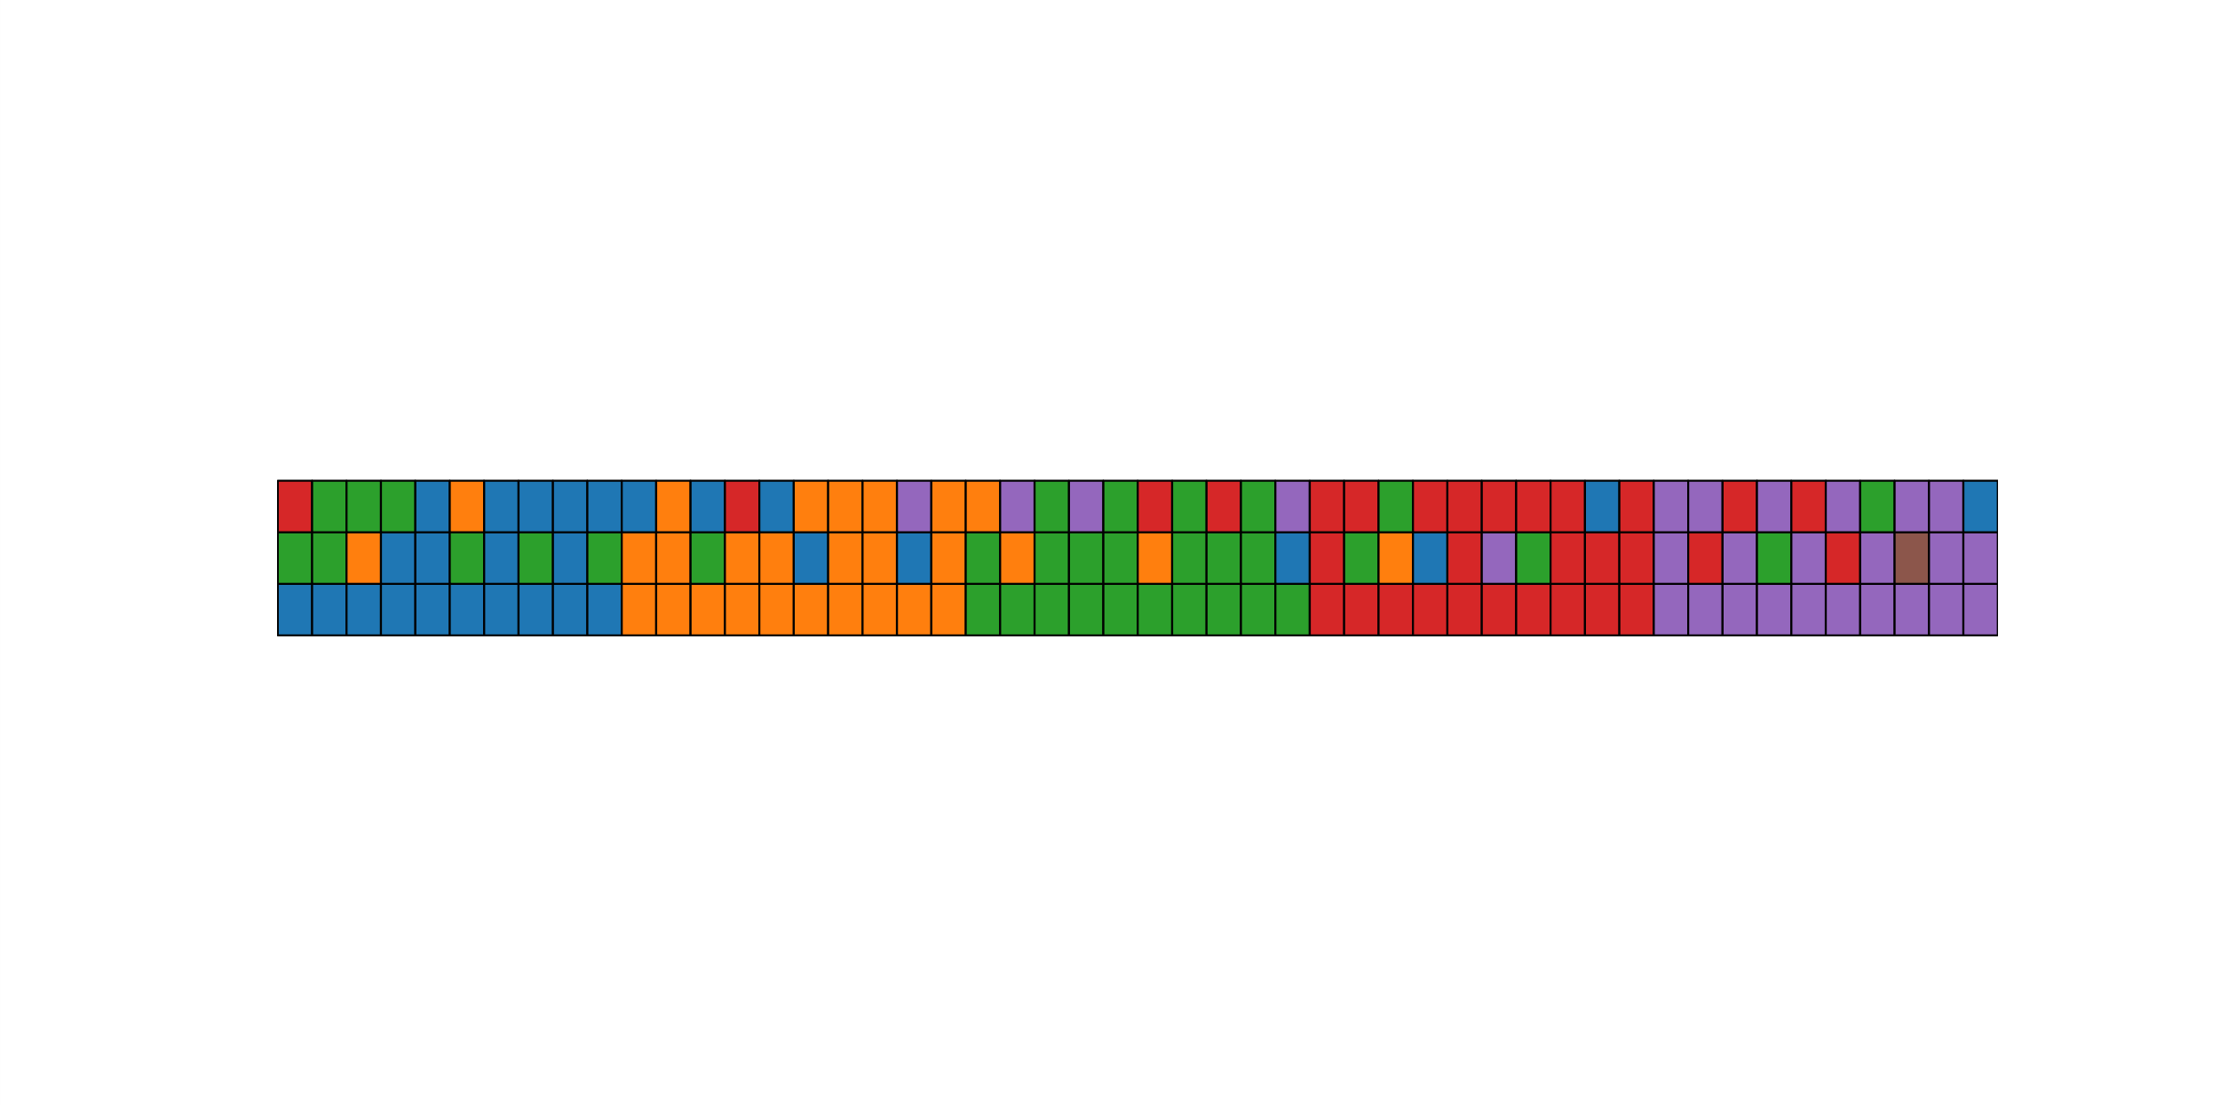
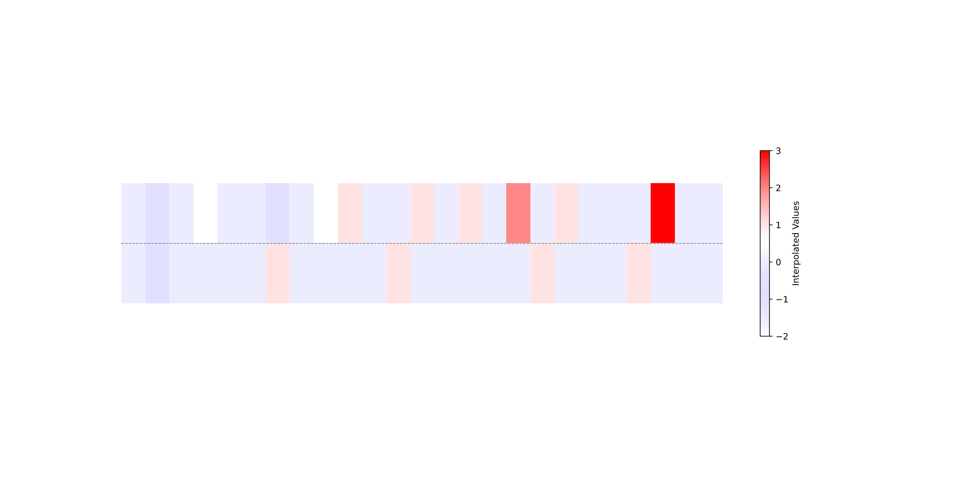
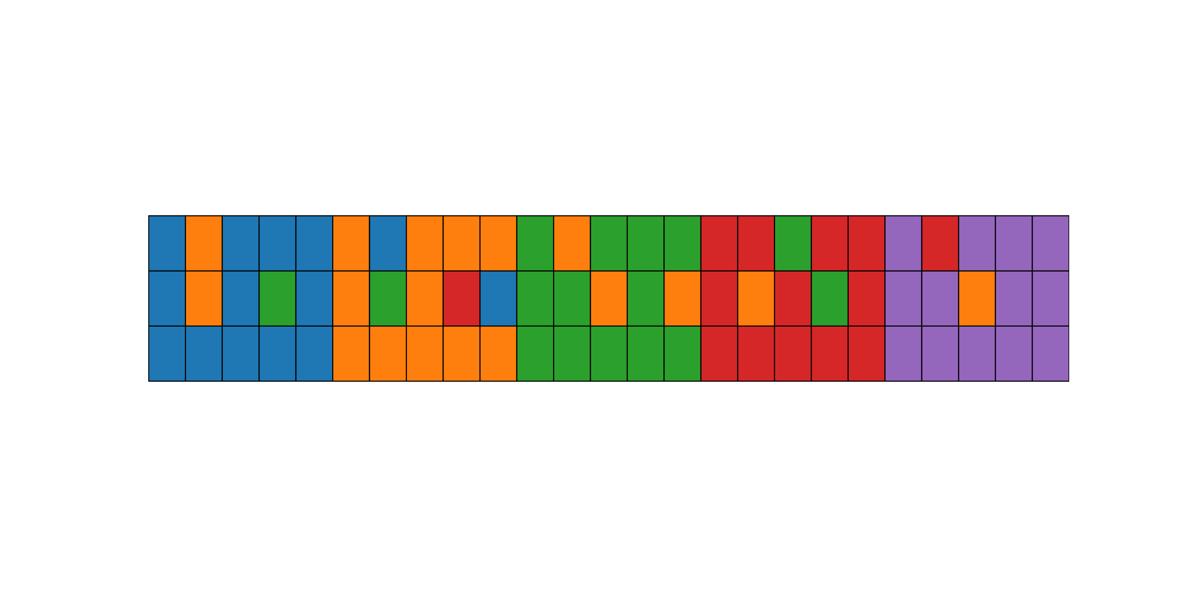
Training Dataset(n = 50)
UnLabel
Label
Δλ
Actual
Un_Predict
_Predict
Testing Dataset(n = 25)
UnLabel
变形杆菌
Label
大肠杆菌
金葡萄菌
Actual
卡他莫拉菌
Un_Predict
_Predict
阴沟肠杆菌

