Slide 1
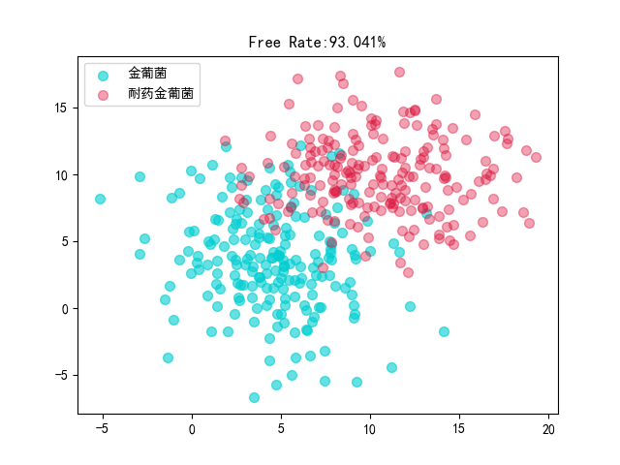
FREE

Slide 2
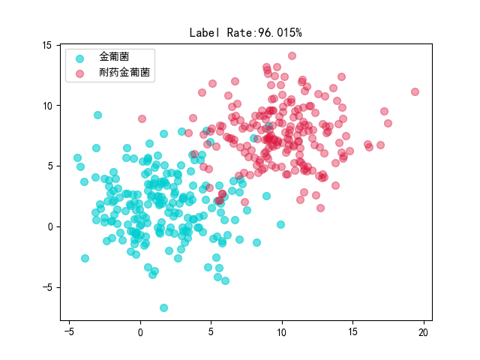
LABEL

Slide 3
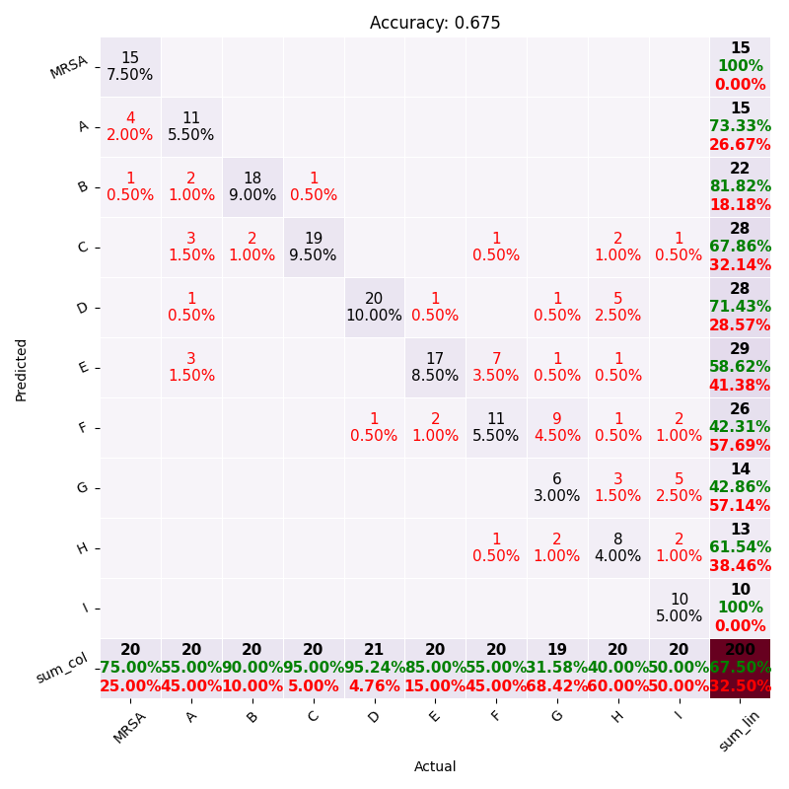
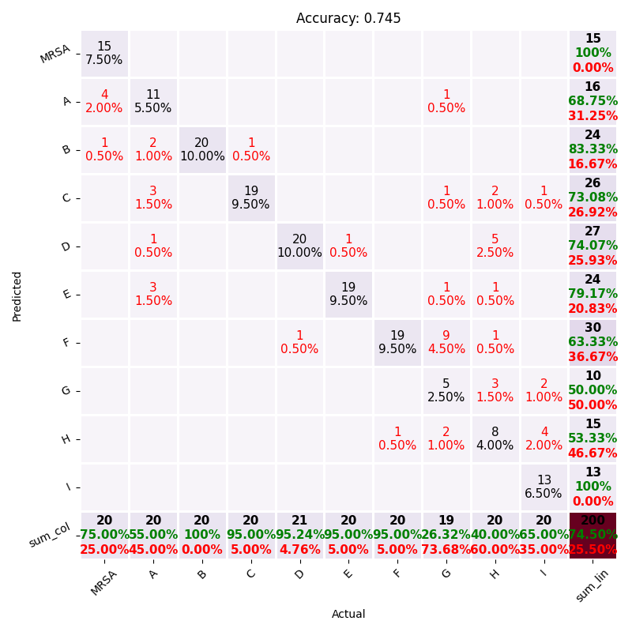

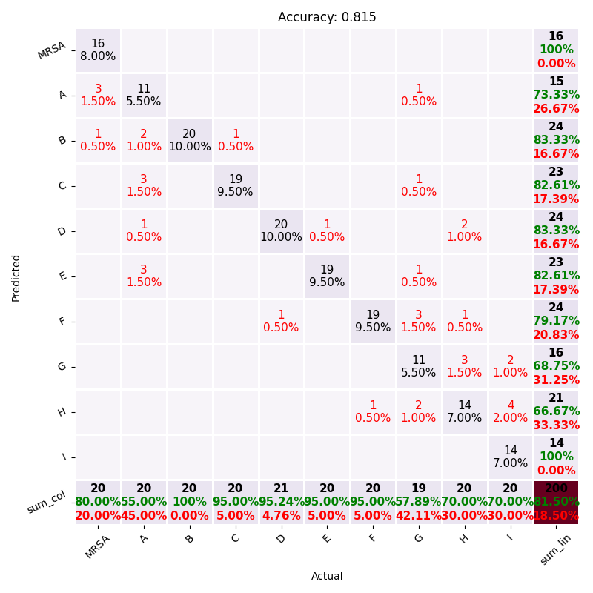
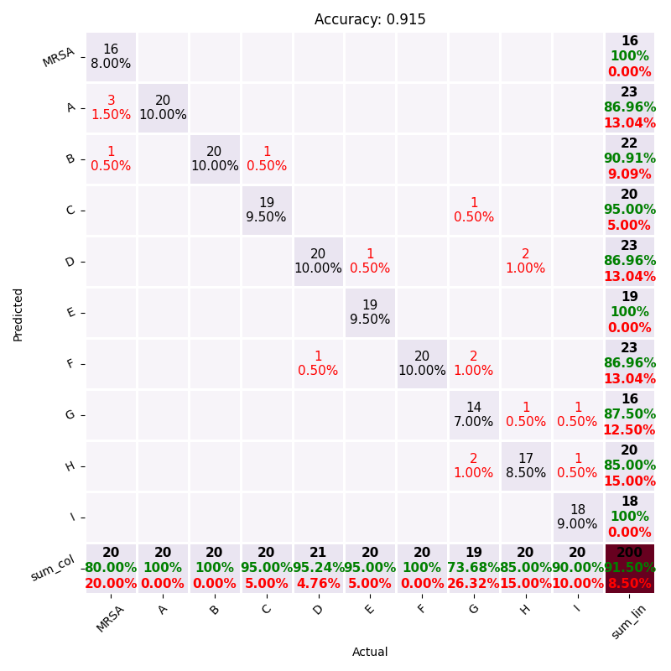
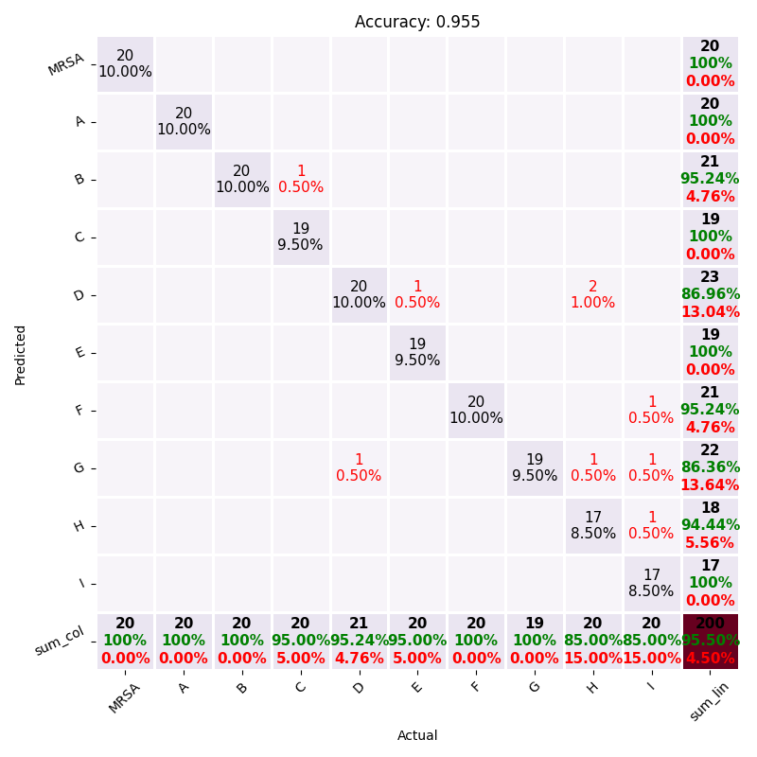
ITQ
SH
DSH
SpH
BGAN
AM-CNN

Slide 4
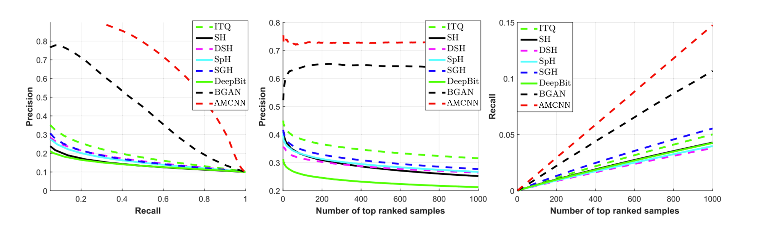
AM-CNN在准确率-召回率曲线中表现稳定；
同时在N轮训练下来
排名最高的样本数中准确率和召回率表现最好的仍然是AM-CNN模型

Slide 5
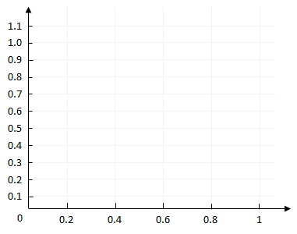
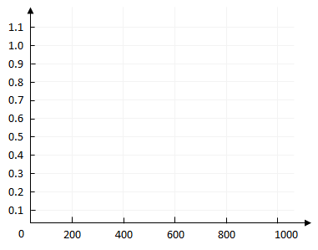
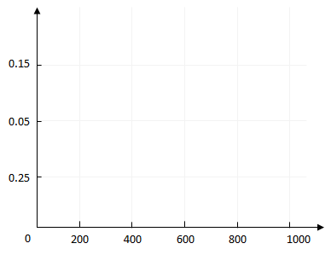
1.1
1.0
0.9
0.8
0.7
0.6
0.5
0.4
0.3
0.2
0.1
0.2
0.4
0.6
0.8
1
AMCNN
AMCNN
AMCNN
CNN
CNN
CNN
KNN
KNN
KNN
RNN
RNN
RNN
SVM
SVM
SVM
Precision
Precision
Recall
Recall
Number of top ranked samples
Number of top ranked samples

Slide 6
AMCNN
Conv1_3
Conv1_3
Conv1_3
0.15
CNN
KNN
Pool
Pool
Pool
Attention mechanism
Attention mechanism
Attention mechanism
0.05
RNN
softmax
softmax
softmax
SVM
Attention
map
Attention
map
Attention
map
Attention
output
Attention
output
Attention
output
0.25
0
200
400
600
800
1000
1.1
1.0
Reshape
Pool
Flatten
0.9
Droupout
0.8
Conv 256
1.1
0.7
1.0
0.6
Output
0.9
0.5
0.8
0.4
1200
1200
1200
599
256
3
0.7
0.3
3
…
…
1
0.6
0.2
…
…
64
256
0.5
0.1
1200
1200
1
1
0.4
0
0.2
0.4
0.6
0.8
1
1200
0.3
3
3
1
0.2
0.1
0
200
400
600
800
1000

