Slide 1
FPGA
Understanding and implementation

Slide 2
FPGA (Acronym for Field Programmable Gate Array)
It is a semiconductor IC where a large majority of the electrical functionality inside the device can be changed by the programmer.
FPGAs can be changed during the PCB assembly process, or even changed after the equipment has been shipped to customers out in the ‘field.
Thus FPGAs can be more customized than normal general purpose processors or compute boards.

Slide 3
Benefits Of Using FPGA
Characteristic | Benefit
Flexibility | Since FPGAs are ‘field’ programmable so it can be used as microprocessor, graphics unit, or for real-time intrusion detection, encryption systems, etc. The developer can directly write the code or the bit file for the FPGA functions. ASIC[1] also provide high performance but they have limited reconfiguration ability
Acceleration | The FPGAs can support high acceleration power when programmed properly by the developer No hardware reconfiguration is required for acceleration unlike ASIC based systems.
Total Cost Of Ownership | Low power consumption FPGAs generally support long life cycles
[1] ASIC- Application Specific Integrated Circuit

Slide 4
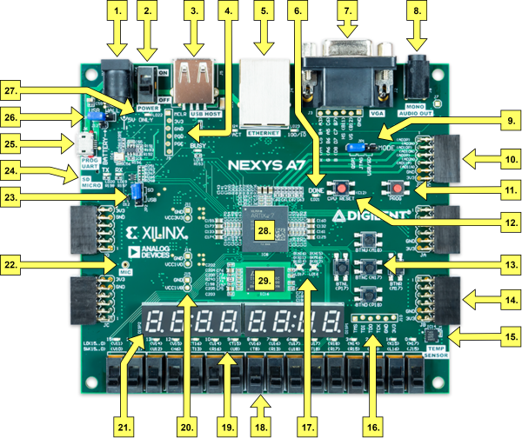
FPGA Board
This is the FPGA board that we are working on currently.
Xilinx NEXYS A7-100T
Features:
https://reference.digilentinc.com/reference/programmable-logic/nexys-a7/reference-manual
Used Image Available at https://reference.digilentinc.com

Slide 5
Current Implementation
Precision Time Measurement with an Accuracy of Sub-Nanoseconds In Between 2 input impulses
The time between 2 impulses/collisions should be measured to the accuracy of Picosecond
1 Picosecond = 10⁻¹² Second

Slide 6
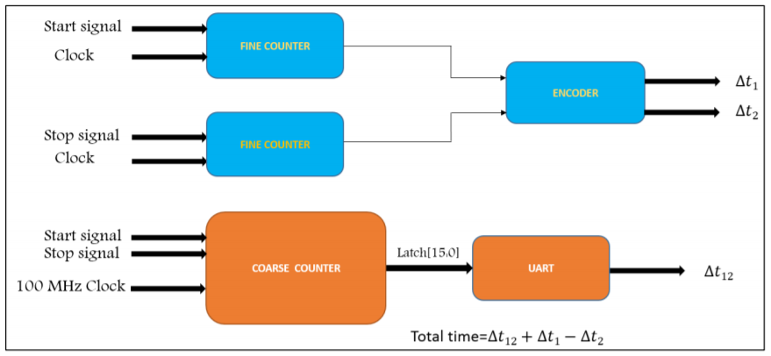
Proposed Block Diagram For Design

Slide 7
Image Processing On FPGA
Use of various software like MATLAB and Simulink presents the developer with black-box based designs, so the developer cannot customize or improve his system.
The image processing can be implemented in Verilog HDL(Hardware Description language) on Nexys A7 FPGA or Nexys 4 FPGA.

Slide 8
Design Architecture Of Image/Video Processing

Slide 9
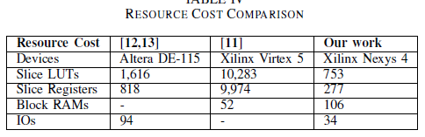
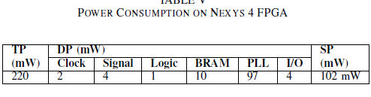
Outcomes Of A Research Paper
A Scalable Image/Video Processing Platform with Open Source Design and Verification Environment by X Yang, Y Zhang, L Wu
https://ieeexplore.ieee.org/document/8697816

Slide 10
ML Model Development on FPGA
Xilinx FPGA comes with Vivado HLS (High Level Synthesis).
Vivado HLS can be used to create IP files for codes in C, C++, SystemC, OpenCL kernel
The output of the HLS can be used to synthesize the code into Verilog and VHDL which can be simulated on the Vivado interface. Vivado can synthesize at RTL(Register Transfer Level)
The weights file have to be decompiled and fed to the FPGA in forms of C or C++ data structures
FPGAs don’t have large storage memory thus weight files have to be loaded in an external SD card.
Writing of the file can be done using Xilinx Adept2.

