Slide 1
Assignment-3 Changes
Completed the changes suggested for the assignment on synchronizing an asynchronous input with internal clock and counting
26-08-2019
TIFR-FCRIT

Slide 2
We were given the following targets-
Consider a situation where you have a asynchronous signal such as long pulse width (say 500 us, randomly occurring) aperiodic signal coming from outside to your FPGA. Now this is has to be synchronised to your internal clock of the FPGA. How would you do it ?
Now that you have synchronised the signal, can we detect only edge of the signal in a always block running on internal clock of the FPGA ?
Once first two assignments are done, now can you write a counter to count these ‘edges’ ?
Add a ‘Gating’ to the counter. I.e one more external signal ‘gate’ is added such that counter only counts when gate is present and on the falling edge of the gate, stores the current value of count to a local register and resets itself on falling edge of the gate.
Create a detailed presentation of this project including resource use summary, RTL schematics and post implementation FPGA layout. Try to explain what you see.
26-08-2019
TIFR-FCRIT

Slide 3
We were told to make the following changes to our code-
To put the instance of compare module outside the sync module.
To use only the clock signal in every always block of the code.
To only detect the upward edge of the input signal.
26-08-2019
TIFR-FCRIT

Slide 4
Solution-
Our solution still consists of the three modules with a few changes.
sync - This module synchronizes the input signal by using single D-flip flop.
compare - This module is used to detect only the upward edge of the input signal.
counter - This module makes an instance of the compare module to detect the upward edge of the input signal. The number of upward edges are counted only when the input gate signal is high and the count sent as output on the downward edge of the gate signal.
26-08-2019
TIFR-FCRIT

Slide 5
1.Synchronizing asynchronous input with system clock
This is achieved by using the sync module. This module takes the asynchronous signal (async_ip) and the system clock as inputs and gives a synchronized signal (sync_op) as an output.
26-08-2019
TIFR-FCRIT

Slide 6
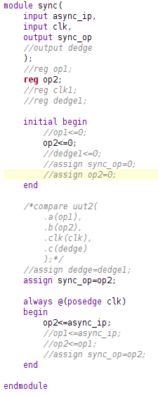
sync.v-
26-08-2019
TIFR-FCRIT

Slide 7
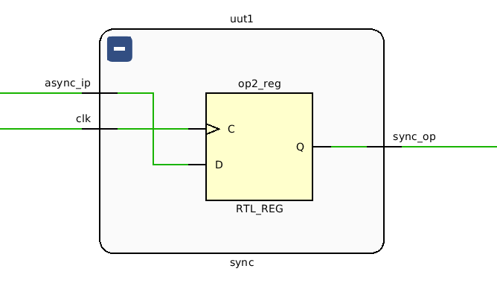
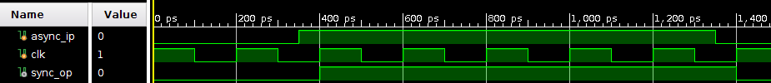
26-08-2019
TIFR-FCRIT

Slide 8
2. Detecting only the upward edges of the input signal
This is done using the compare.v module. This module takes the synchronized signal (ip) the system clock (clk) as inputs and returns a signal dedge which has value logic one whenever the input signal has an upward edge.
This is done by using a D-flip flop to delay the input signal by a single clock cycle. The delayed signal and the input signal are compared to detect the upward edge of the input signal.
26-08-2019
TIFR-FCRIT

Slide 9
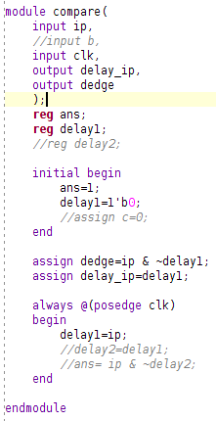
compare.v
26-08-2019
TIFR-FCRIT

Slide 10
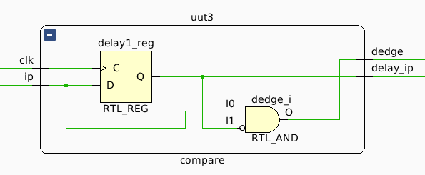
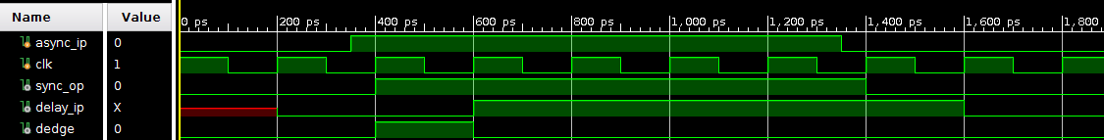
26-08-2019
TIFR-FCRIT

Slide 11
3. Counting the number of edges-
Here we made a counter module which takes the synchronized signal (ip), the system clock (clk) and a gate signal (gate) as inputs and gives a vector count (16 bit) as output. The counter module creates an instance of the compare module to detect the upward edge of the input signal. Initially the value of count is set to 0. The value of count is increased by 1 whenever the compare module detects a positive edge on input signal.
The counter module also uses a gating mechanism to only count when the gate signal is high.
26-08-2019
TIFR-FCRIT

Slide 12
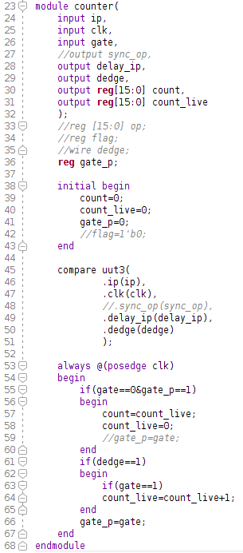
counter.v-
26-08-2019
TIFR-FCRIT

Slide 13
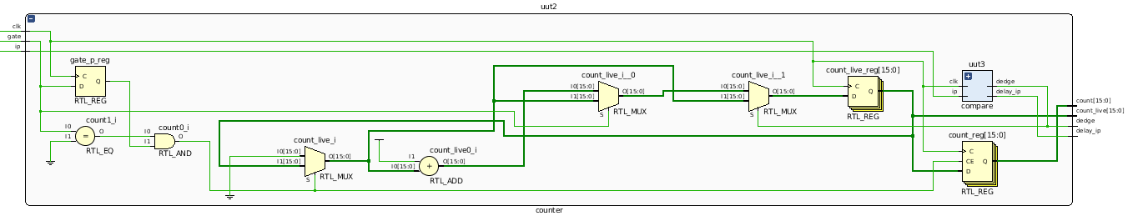
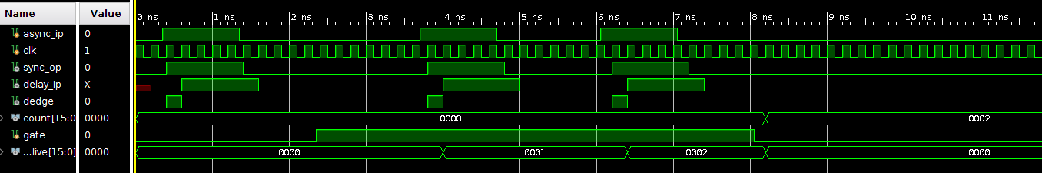
26-08-2019
TIFR-FCRIT

Slide 14
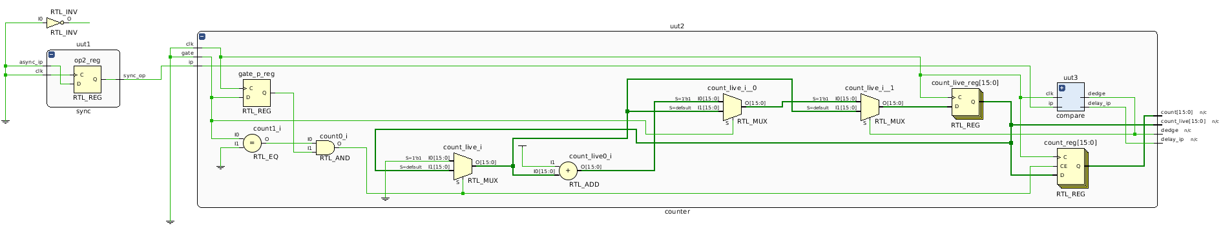
RTL Schematic-
26-08-2019
TIFR-FCRIT

