Slide 1
A Basic Understanding of TDC 7200(Time Measurement)

Slide 2
Introduction
TDC 7200 performs the function of a stopwatch and measures the elapsed time between a START pulse and up to five STOP pulses.
This elapsed time is also known as Time-of-Flight or TOF.
TDC 7200 has the ability to measure time with accuracy in the order of picoseconds.
This accuracy makes it for application such as flow water, where zero and low flow water require accuracy in the picoseconds range.

Slide 3
TDC 7200 consists of two counters: Coarse and Clock
TDC 7200 measures time using two measurement modes: Measurement Mode 1 and Measurement Mode 2
The Clock counter counts the number of integer clock cycles between the START and STOP pulses and is only used in Measurement Mode 2
Whereas, the Coarse counter counts the number of times the ring oscillator wraps in Measurement Mode 1

Slide 4
Calibration:
The time measurements performed by the TDC7200 are based on an internal time base which is represented as the LSB value of the TIME1 to TIME6 results registers.
However, the actual value of the LSB can vary depending on environmental variables (temperature, systematic noise, etc.).
This variation can introduce significant error into the measurement result. There is also an offset error in the measurement due to certain internal delays in the device.
The TDC7200 calibration consists of two measurement cycles of the external CLOCK. The first is a measurement of a single clock cycle period of the external clock; the second measurement is for the number of external CLOCK periods set by the CALIBRATION2_PERIODS(values are:2,10,20,40) in the CONFIG2 register.
The results from the calibration measurements are stored in the CALIBRATION1 and CALIBRATION2 registers.

Slide 5
Measurement Mode 1
In this mode, the TDC 7200 performs the entire counting from START to the last STOP using its internal ring oscillator
This method is recommended for measuring time durations < 500ns as using it for time durations > 500ns decreases the accuracy
TDC 7200 also has Coarse and Clock Counters Overflow registers which get set when the respective values exceed the limiting values.

Slide 6
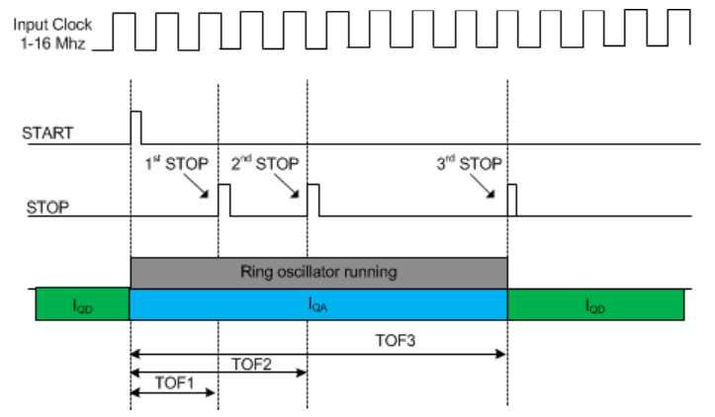

Slide 7
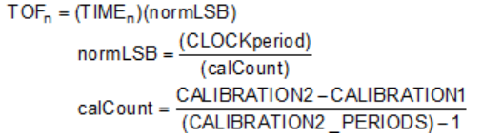
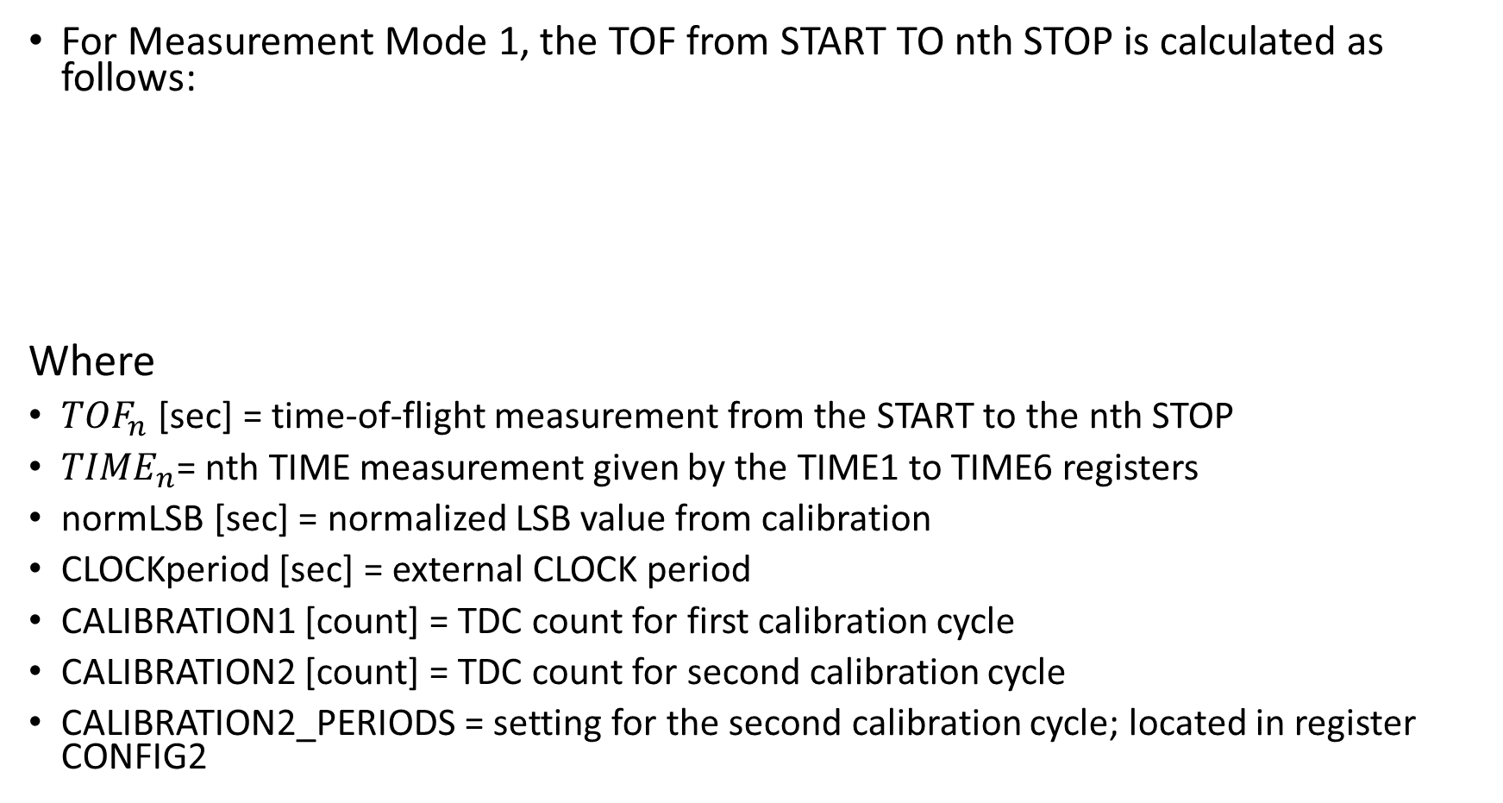
For Measurement Mode 1, the TOF from START TO nth STOP is calculated as follows:
Where
${TOF}_{n}$ [sec] = time-of-flight measurement from the START to the nth STOP
${TIME}_{n}$= nth TIME measurement given by the TIME1 to TIME6 registers
normLSB [sec] = normalized LSB value from calibration
CLOCKperiod [sec] = external CLOCK period
CALIBRATION1 [count] = TDC count for first calibration cycle
CALIBRATION2 [count] = TDC count for second calibration cycle
CALIBRATION2_PERIODS = setting for the second calibration cycle; located in register CONFIG2

Slide 8
For example, assume the time-of-flight between the START to the 1st STOP is desired, and the following readouts were obtained:
CALIBRATION2 = 21121 (decimal)
CALIBRATION1 = 2110 (decimal)
CALIBRATION2_PERIODS = 10
CLOCK = 8MHz
TIME1 = 4175 (decimal)
Therefore, the calculation for time-of-flight is:
calCount = (21121 – 2110) / (10 – 1) = 2112.33
normLSB = (1/8MHz) / (2112.33) = 5.917 x 10-11
TOF1 = (4175)(5.917 x 10-11) = 247.061 ns

Slide 9
Measurement Mode 2
In measurement mode 2, the internal ring oscillator of the TDC7200 is used only to count fractional parts of the total measured time.
The internal ring oscillator starts counting from when it receives the START signal until the first rising edge of the CLOCK.
Then, the internal ring oscillator switches off, and the Clock counter starts counting the clock cycles of the external CLOCK input until a STOP pulse is received.
The internal ring oscillator again starts counting from the STOP signal until the next rising edge of the CLOCK.
Here, 2 TIME registers are used to measure the fractional parts between a START and a STOP pulse.
The CLOCK_COUNT registers are used to measure the integral clock periods.

Slide 10
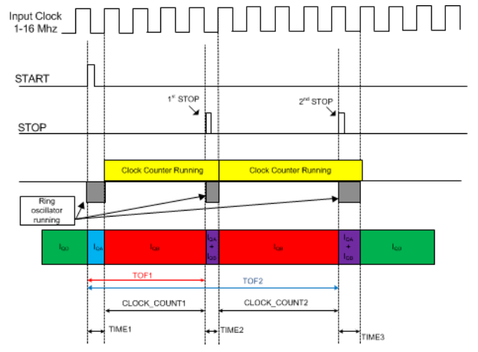

Slide 11
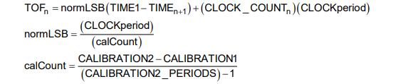
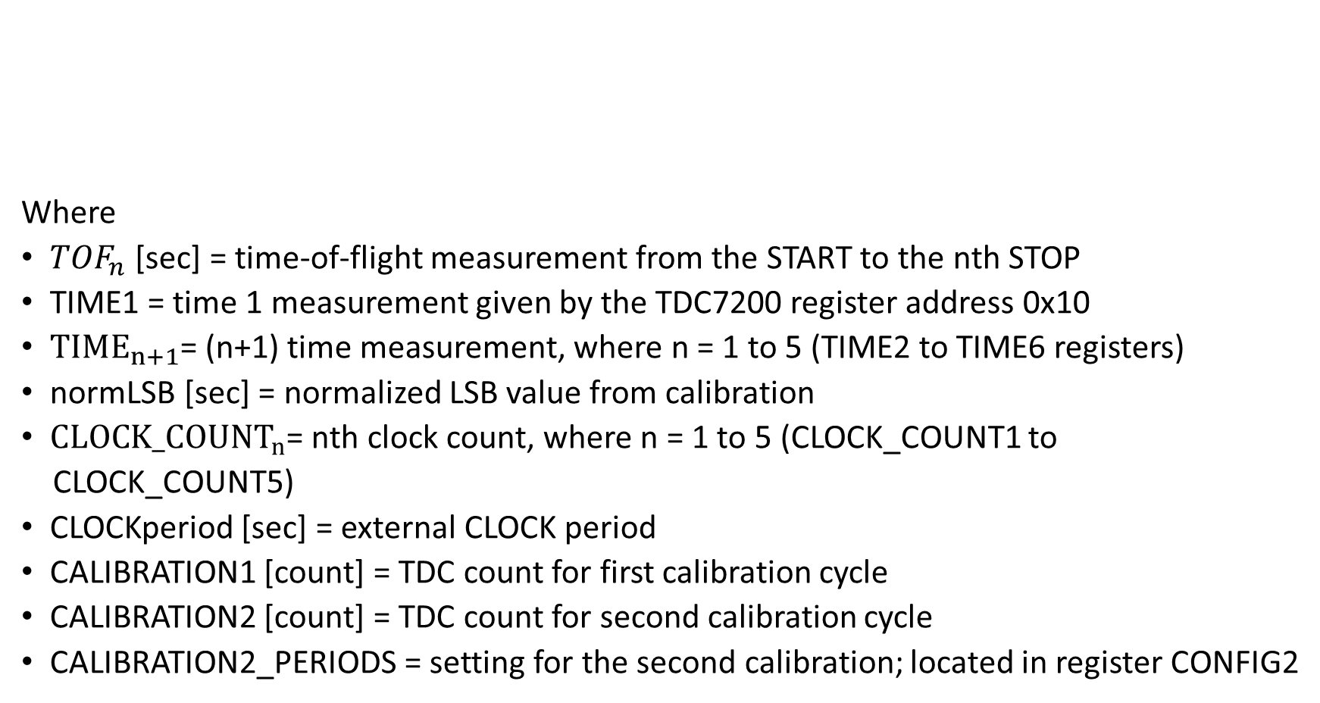
The time-of-flight between the START to the nth STOP can be calculated using
Where
${TOF}_{n}$ [sec] = time-of-flight measurement from the START to the nth STOP
TIME1 = time 1 measurement given by the TDC7200 register address 0x10
${TIME}_{n+1}$= (n+1) time measurement, where n = 1 to 5 (TIME2 to TIME6 registers)
normLSB [sec] = normalized LSB value from calibration
${CLOCK_COUNT}_{n}$= nth clock count, where n = 1 to 5 (CLOCK_COUNT1 to
CLOCK_COUNT5)
CLOCKperiod [sec] = external CLOCK period
CALIBRATION1 [count] = TDC count for first calibration cycle
CALIBRATION2 [count] = TDC count for second calibration cycle
CALIBRATION2_PERIODS = setting for the second calibration; located in register CONFIG2

Slide 12
For example, assume the time-of-flight between the START to the 1 st STOP is desired, and the following readouts were obtained:
CALIBRATION2 = 23133 (decimal)
CALIBRATION1 = 2315 (decimal)
CALIBRATION2_PERIODS = 10
CLOCK = 8MHz
TIME1 = 2147 (decimal)
TIME2 = 201 (decimal)
CLOCK_COUNT1 = 318 (decimal)
Therefore, the calculation for time-of-flight is:

