Slide 1
Kona Introduction
Java Common Library
Dean Xu
2018.12

Slide 2
Outline
What and Why Kona
Kona Status
For User: Kona User Guiding
For Contributor: Kona Contribute Flow
For SCM: Kona Release Flow
What’s next
Q&A
Notes:
First, I will discuss with you what is Kona and why we need Kona
After that, I will show you Kona current status
Then let’s learn Kona from 3 different aspects, User, Contributor and SCM

Slide 3
What and Why Kona

Slide 4
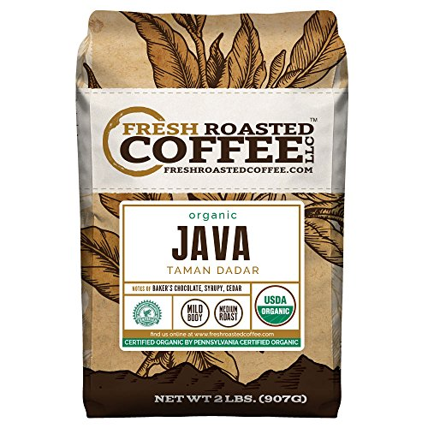

What’s Kona
Kona was named JEX (Java EXtension)
Kona is coffee just like Java
Kona is the common code in D4C/CHD/LT/SPMA
There were 50K lines common code in JEX
The common code is very “common”. They has nothing about production logic
Every project has its JEX, but all the JEX have similar content
It’s hard to maintain 3 copies of JEX at same time

Slide 5
What’s Kona
D4C
CHD
LT/SPMA
Since they have very similar content. Why not merge them together?
UI
UI
Who is the next?
How many jex will be copied?
Presentation
Layer
Domain
Service
Domain
Service
Business
Logic
Layer
DAO
DAO
Infrastructure
Layer
JEX
Other 3rd lib
JEX
Java Develop Kit
Notes:
Let’s back to the very beginning of the world. There is nothing.
One day, the first project comes, it’s D4C. We decide to construct our project on the Java platform. Then we build our project’s framework with different functional layers.
The first layer is presentation layer with UI module; then the business logic layer with Domain, Service and DAO; under that is our infrastructure layer, jex, rcpex and other 3rd lib.
You can see I marked modules with different colors. So the blue modules are our D4C codes.
Everything seems ok. But one day, a new project comes, it’s CHD. It has very similar structure like D4C.
It has presentation layer too with CHD’s UI. It has business logic layer with CHD’s business. It has infrastructure with CHD’s … Wait, it is INFRASTRUCTRE.
Well, I’m CHD RD, I should be honest to you. CHD’s jex was copied from D4C. Because D4C’s infrastructure is also CHD’s. That is what the word `infrastructure` means.

Slide 6
What’s Kona
Here Kona Comes!
D4C
CHD
Presentation
Layer
UI
UI
Domain
Service
Domain
Service
Business
Logic
Layer
DAO
DAO
Infrastructure
Layer
JEX
Other 3rd lib
Java Develop Kit
Notes:
So what is Kona? The idea of Kona is quite simple, let D4C be D4C, let CHD be CHD and let others infrastructure be Kona.
Standing on the shoulders of Kona, we can do better coding on the upper two layers.
Some company would call their infrastructure project 2nd party library. Because it’s not me, I’m CHD; neither him, he is apache, he is google, he is someone else; Kona is you, you are Brion itself, you are my colleague.
Kona is more safety (because it’s inside our company), better matched (because its functions are from our requirement) and more agile (because it’s maintained by ourselves)
This part is to reproduce the idea of Kona. Let’s consider some detail situations.

Slide 7
Kona Advantages
Scene | Without Kona | With Kona
A new project needs the common code | Copy all the tens of thousands code to the new project | Add Kona Dependency
A bug found in the code | Notify all related projects to fix the bug in their product code | Fix the bug just one time
A new feature added | Notify all related projects to add(copy) the new code | Upgrade the dependency version
Track changes | Track code history in jex folder for each project | Track SCL-Kona Tickets
Code quality | Track code quality in jex folder for each project | Track Kona Sonarqube
Notes:
Do you have any question about why we need Kona?

Slide 8
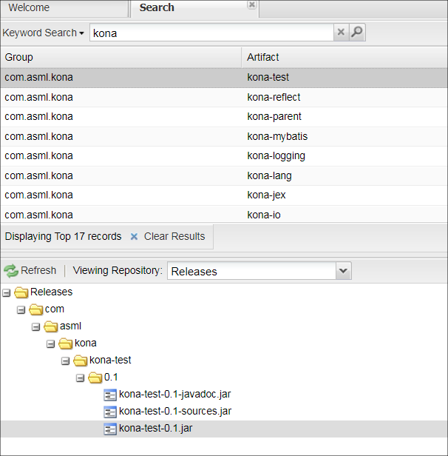


Kona Deployment
Use Kona just like other libraries
D4C
central
Private Repo
Public Repo
CHD
Build on Bamboo
Deploy to Nexus
Kona
SPMA

Slide 9
Kona Status

Slide 10
Kona Timeline
2017
07/27 Common Lib born
08/03 First Confluence Page
11/26 Kona born
11/29 First Commit
12/07 First JIRA Ticket
2018
05/08 First build on Bamboo
05/13 First preview version 0.1-SNAPSHOT
05/25 CHD use Kona
07/10 D4C use Kona
08/07 LT use Kona
09/04 First release version 0.1
Notes:
In last year’s July, the idea of common library born.
In last year’s November, the name of Kona born.
In this year’s May, the first version of Kona deployed.
Up to now, Kona has released its first release version and 3 projects are using Kona.

Slide 11
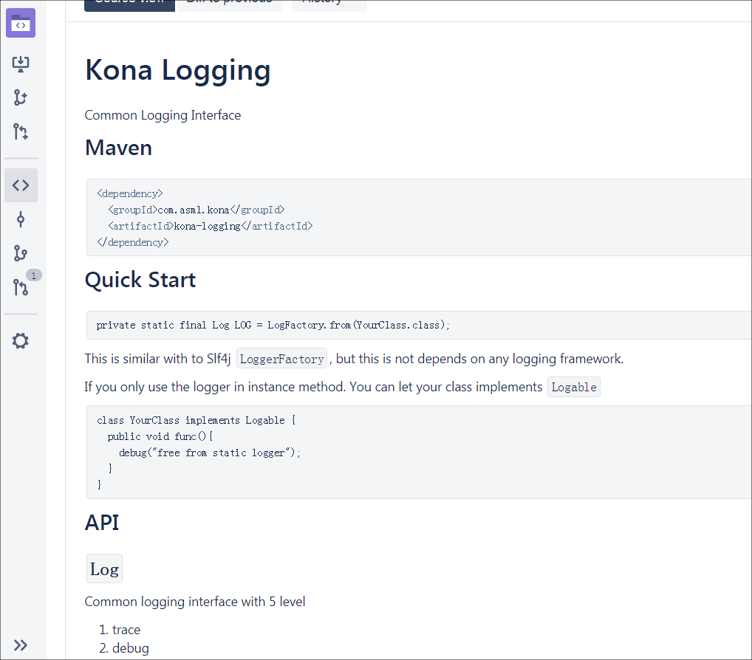
Kona Structure
Kona Logging Common logging framework
Kona Lang Common Java language infrastructure
Kona Reflect Reflect related utilities
Kona FX-Beans JavaFX beans extension
Kona Test Test utilities to do quick assert and diff
Kona EventBus Event bus implementation
Kona MyBatis MyBatis extension to do quick DB access
Kona Config Configuration management framework
Notes:
Now Kona has following modules. Every module has its README file to introduce its major functions.

Slide 12
Kona Code Quality
41K
Lines
470
Classes
2834
Functions
601
Unit Tests
KONA
66%
Test Coverage
0
Sonarqube
Bug
0
Sonarqube Vulnerability
0.8%
Sonarqube
Code Smell
Notes:
Then is the most important thing of a library. It’s code quality.
Now we have 41 thousand lines, we have 6 hundred unit tests and 66 percent coverage. We don’t have any sonarqube bug or vulnerability.

Slide 13
For User
Kona User Guiding
Notes:
The next topic is Kona User Guiding.
Who is our user? It’s D4C, It’s CHD, It’s LT and It’s all the new project.
So how to use Kona?

Slide 14
How to use Kona
Add dependency into your project
<dependency>
<groupId>com.asml.kona</groupId>
<artifactId>kona-lang</artifactId>
<version>0.1</version>
</dependency>
And then,
It’s done!
Notes:
It’s really simple to use Kona. Let’s go to the next topic, How to contribute to Kona.

Slide 15
For Contributor
Kona Contribute Flow
Notes:
The first question is, Who is Kona’s contributor?
Everyone could be.
As long as you have any good idea or find any bug of Kona you can contribute to Kona.

Slide 16
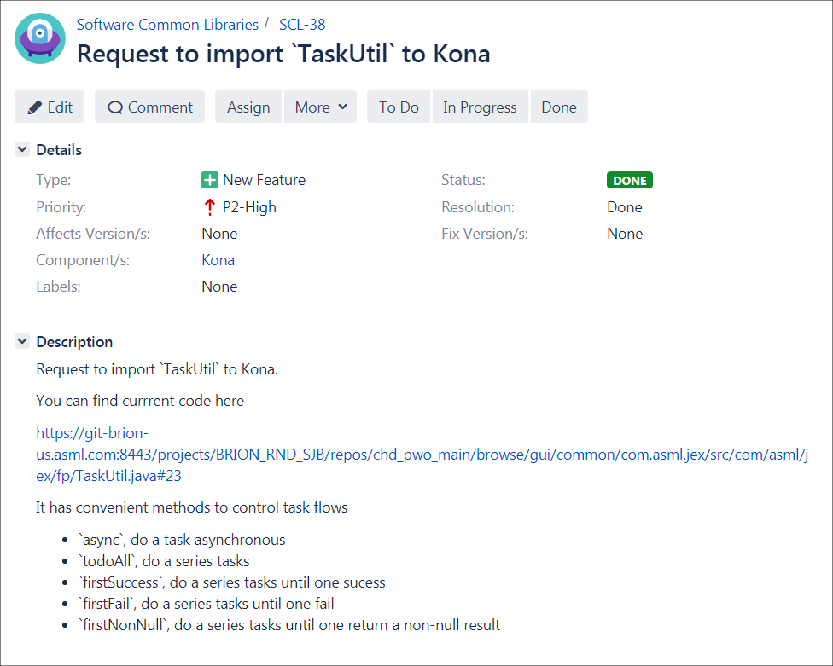
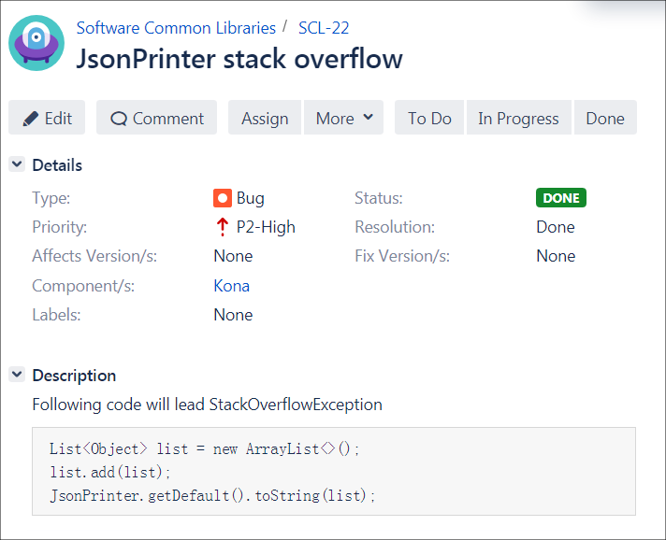
How to contribute to Kona
Create Issues just like other projects
Notes:
The first step is to create issue on Jira just like other projects.
If you have new idea, file a feature issue.
If you find any bug, file a bug issue.

Slide 17
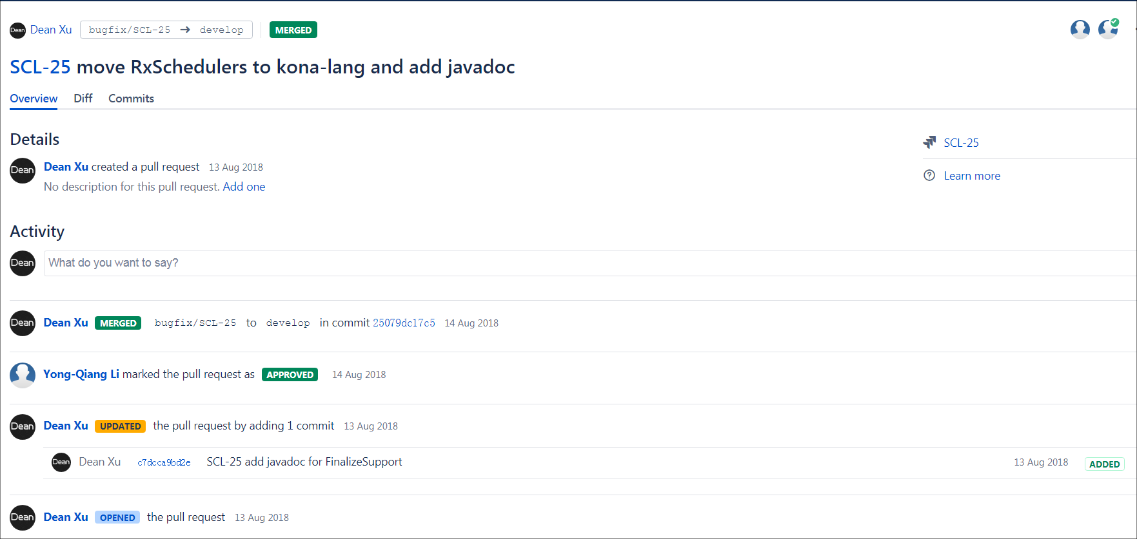
How to contribute to Kona
2. Create pull request
After one committee member approved, it can be merged.
Named with your ticket number

Slide 18
Contribute Specification
100% Java Doc coverage for Public Interface
80% Line Coverage , 70% Condition Coverage
0 Sonarqube issue
Code Format

Slide 19
For SCM
Kona Release Flow

Slide 20
Kona Version
A.B[.C][-SNAPSHOT|-rc<D>]
A, B, D are non-negative integer, C is positive integer
A is major version
0 means unstable preview version
versions in same major version are backward compatibility
versions in different major version may not be compatible
B is minor version
C is hotfix version
absent for stable release
present for hotfix release
D is release candidate version
Example:
0.1
0.1-rc2
1.0-SNAPSHOT
2.1.3

Slide 21
SNAPSHOT version
Every change in develop branch will trigger bamboo build.
A new SNAPSHOT version will be deployed onto Nexus.
New commit on develop branch will trigger SNAPSHOT build
branch
New commit NOT on develop branch will NOT trigger SNAPSHOT build
NOTE that develop branch must only have SNAPSHOT version. Non-SNAPSHOT version only present in release branch.
merge

Slide 22
Release version
Now the project version is v1.1-SNAPSHOT and we are going to release v1.1
Release Candidate version flow is similar with Release version except the last step.
develop
5. Update the project version to v1.2-SNAPSHOT
1. Create release branch release/v1.1
release/v1.1
4. Create release tag and delete the release branch
tag/release/v1.1
2. Update the project version to v1.1
3. Push the branch to remote and do the release build on Bamboo

Slide 23
Hotfix version
develop
Suppose we are at v10.0
tag/release/v1.1
tag/release/v1.1.1
5. Create release tag and delete the hotfix branch
Now v1.1 release has bug and need hotfix
1. Checkout tag/release/v1.1 as new hotfix branch hotfix/v1.1.1
4. Push to remote and do the hotfix build on Bamboo
hotfix/v1.1.1
2. Do your fix on the branch
3. Update the project version to v1.1.1

Slide 24
What’s next

Slide 25
What’s next?
Release Kona regularly (maybe every 3 month or 6 month)
Inspire more people to contribute to Kona
Continue improve code quality
75% test coverage
90% doc coverage
Improve JIRA flow
More states (Now there are only `To do`, `In progress` and `Done`)
Add Kona versions (Now there is only `Kona Future Release`)

Slide 26
Q&A

Slide 27
Thank You!

