Slide 1

Modelling difficulty of English exercises
Probabilistic programming approach

Slide 2
What exactly we want to do?

Slide 3
Why we want to do it and how?

Slide 4

What we gain?
Quality assessment with appropriate difficulty
Reducing the cost of new items

Slide 5
What we need to do it?
Item response theory
Probabilistic programming
Domain knowledge
Family of psychometric models for the analysis of latent traits and their observable manifestations.
Paradigm which automates whole process of building a statistical model and inference.
Everything we know about our exercises

Slide 6
What exaclty is IRT?

Slide 7
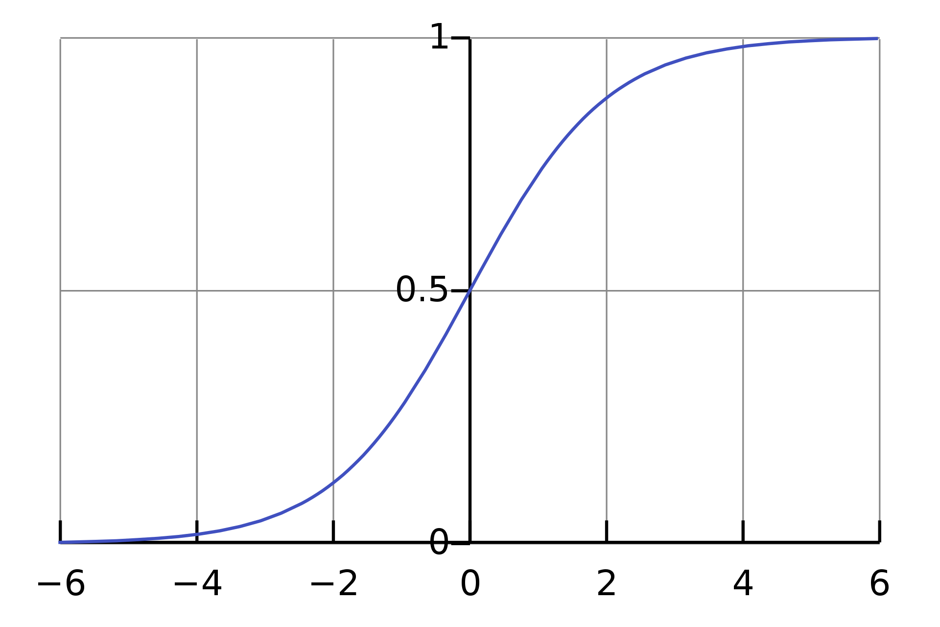
Idea behind IRT
Learners' responses reveal information about traits that couldn’t be directly observed.
Assumptions of IRT:
Traits are labelled as 𝜽
Exercises are locally independent
Learners responses are modeled by Item Response Function

Slide 8
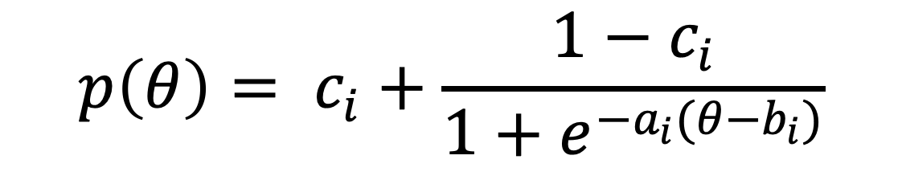
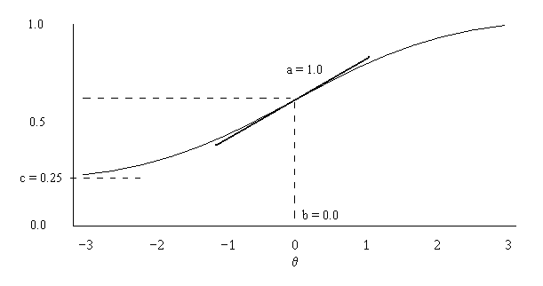
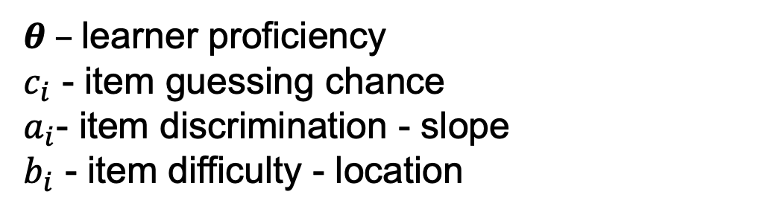
Item response function

Slide 9
What is probabilistic programming?

Slide 10
Main stages of probabilistic programming framework
Defining the model
Model fitting
Inference
We define a family of functions or distributions specified by some unknown model parameter.
We update prior likelihood functions based on provided data.
The inference goal is to find the posterior distribution of parameters, given the model.

Slide 11

Why greta?
Simplicity – models are written in native R
Scalability - greta uses Google TensorFlow so it's fast even on massive datasets and can be run on CPU and GPU
Funfact: The library was named after Greta Hermann, a mathematician and theoretical physicist who found an error in von Neuman's proof of the “No hidden variables theorem”

Slide 12
Let’s build a model!

Slide 13
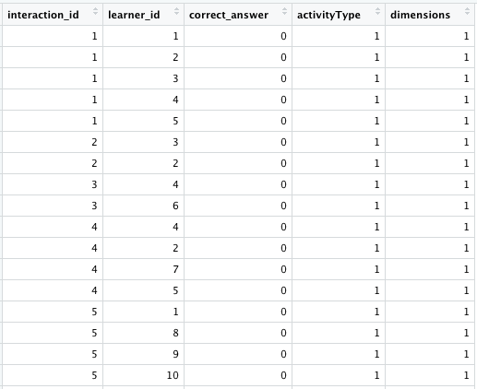
Data overview
100 learners
2000 responses
50 exercises
2 interaction types
3 interaction dimensions

Slide 14
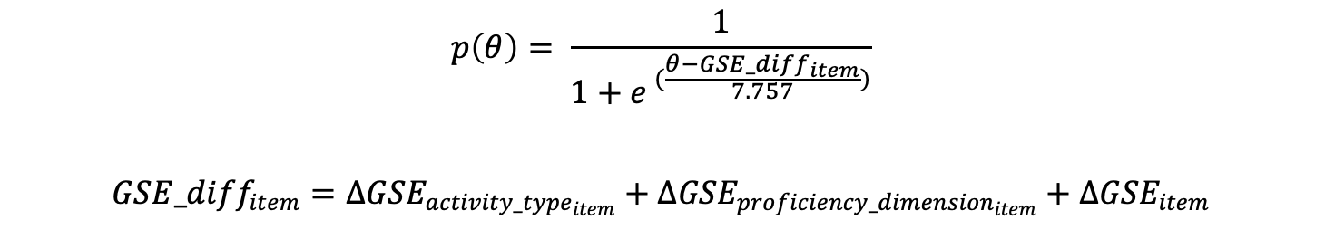
Definition of model

Slide 15
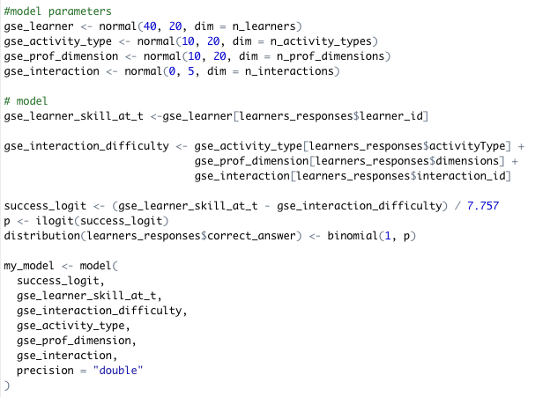
Model implementation

Slide 16
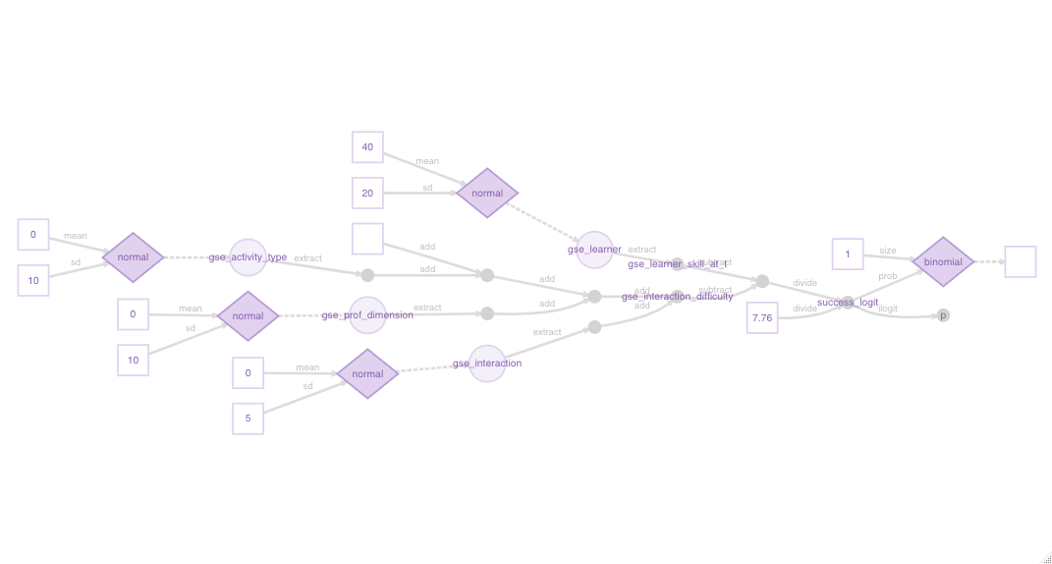
Graphical representation of model

Slide 17
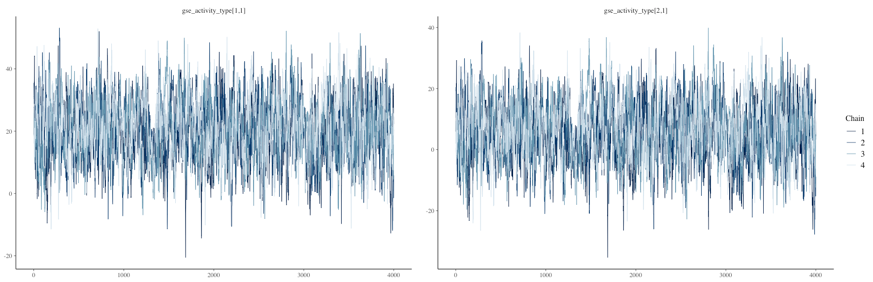
Sampling from posterior distribution using MCMC

Slide 18
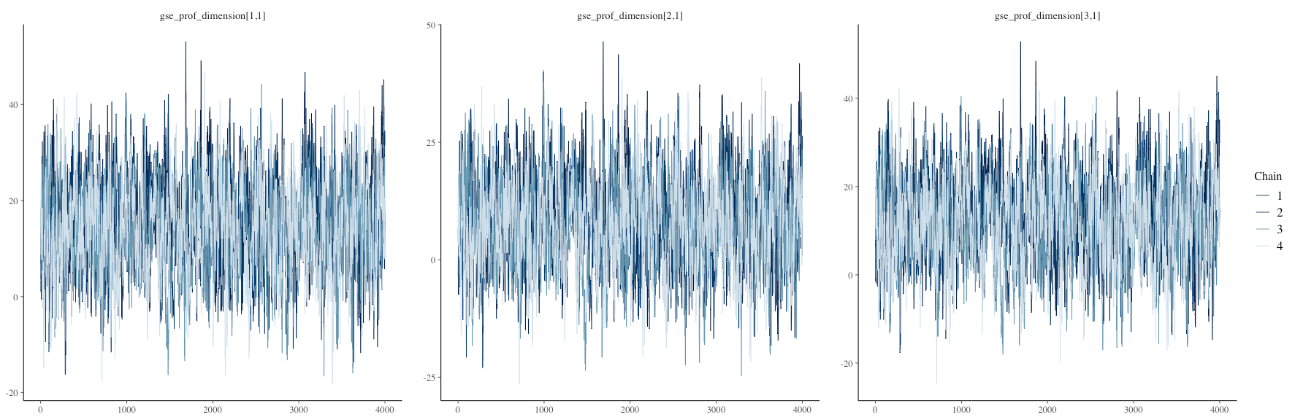
Sampling from posterior distribution using MCMC

Slide 19
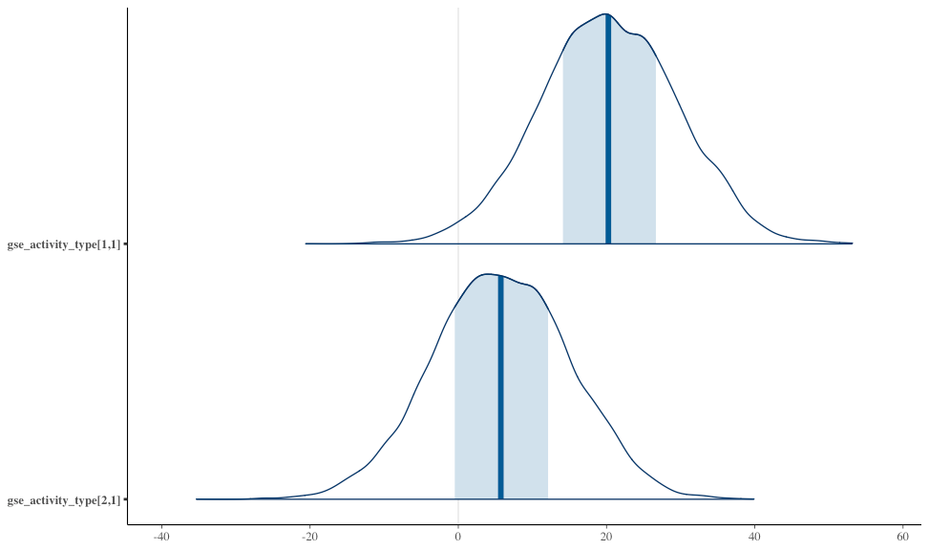
Posterior distributions – exercise types

Slide 20
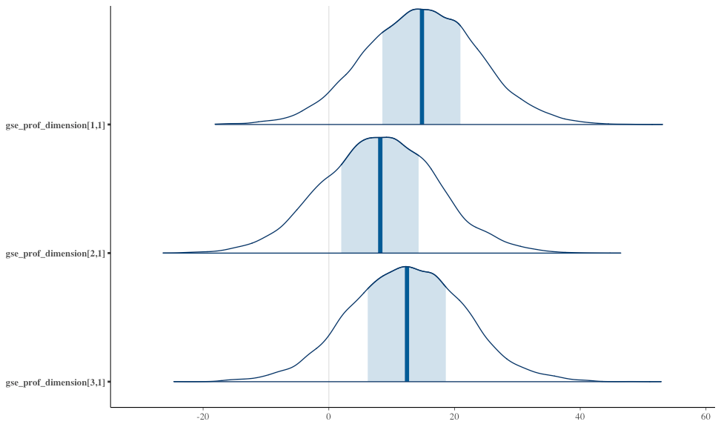
Posterior distributions – dimensions

Slide 21


