Slide 1
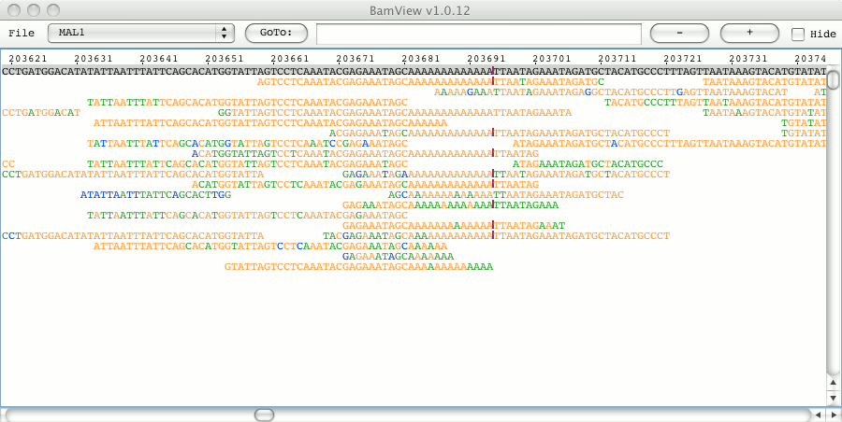
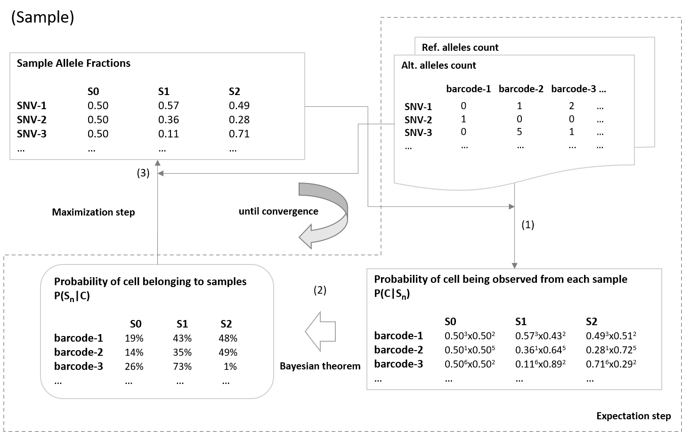
Overview of sc_Split (github.com/jon-xu/sc_split)
Sample genotypes are usually needed by available tools (e.g. demuxlet) to demultiplex them from mixed scRNA-seq data
High adjusted rand index compared to demuxlet predictions
Tested on scRNA datasets, simulated datasets, and manually mixed BAM files
No need of any source genotypes
Locate heterozygous SNVs from the mixed BAM
Count and calculate the ALT allele fractions at these sites
Find most likely individual cell assignment to clusters, based on baysian model with hidden states

