Slide 1

ProjectS presentation for neural networks – deep learning course
Author: Konstantinos Perros
AEM: 3713
Mail: knperros@csd.auth.gr

Slide 2
General information
Preprocessing, Allocation, Platform and Methods
The projects were implemented using Python in Notebook format.
All datasets derive from keras. Project 1 and 2 use MNIST, Project 3 uses Cifar10
Each project draws data from their respective datasets and reshapes them in 1-dimensional arrays to be used either in scale and dimension reduction or to be used in model fitting
For each project, the Nearest Centroid and Nearest Neighbor Classifiers were used for comparison
Project 1 and 2 issued MNIST to achieve peak performance, and Project 3 used CIFAR10 to apply and compare results in a more difficult and large dataset.
Models are either compiled with dense hidden layers, or 2D Convolution for better results

Slide 3
IN – between project
Algorithms and Results
We implement both kNN with 1, 3 and also 5 and 7 neighbors for a wider range of results to compare, as well as Nearest Centroid. Results:
knn1: 96.91%, 37s
knn3: 97.07%, 46s
knn5: 96.88%, 39s
knn7: 96.94%, 41s
clf: 82.03%, 1s
Although the fastest by far was the nearest centroid, the results were quite bad when compared to the kNN classifiers. Also, the kNN classifier with 3 neighbors yields the best results of the classifiers presented and takes about 46s for the entire MNIST dataset.

Slide 4
Project 1
Algorithms and Parameters, used in other projects as well
For the Neural Network models, we implement Sequential layers with 1 input and 1 output layer. Their activation is RELU based and their output is softmax. When compiled, they use the Adam optimizer, use Sparse Categorical Crossentropy for the loss function and sparse categorical accuracy for metrics. They are then trained using the reshaped validation data and training models, Shuffle, epochs and batch sizes.
The first model uses 3 simple Dense hidden layers with 64, 64, 32 neurons respectively. We train for 5 epochs and batch size of 32
The second model uses 6 simple Dense hidden layers with 64, 64, 128, 64, 64, 32 neurons respectively. We train for 10 epochs and batch size of 32
The third model uses 3 Convolution 2D hidden layers with 64, 64, 32 neurons respectively, feature map of 2x2, MaxPooling per layer of 2x2, RELU activation, Dropout of 10% on the final hidden layer and Flatten. We train for 5 epochs and batch size of 32
The fourth model uses 3 Convolution 2D hidden layers with 64, 128, 64 neurons respectively, same feature map and Maxpooling size as before, RELU activation, a Dropout of 40% and Flatten. We train for 10 epochs and batch size of 32

Slide 5
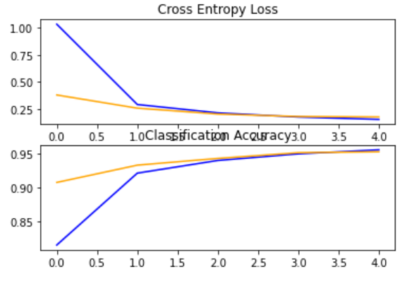
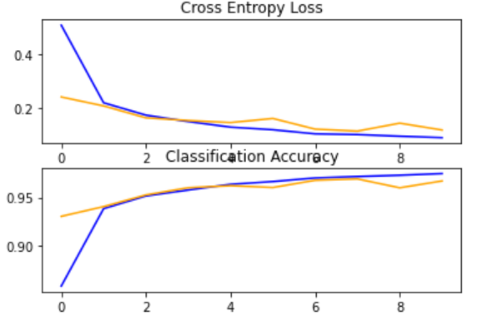
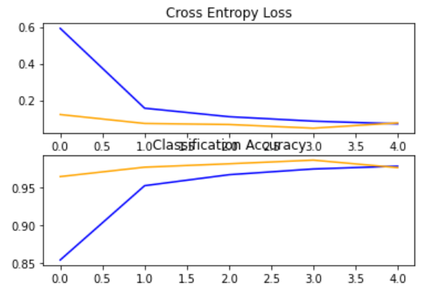
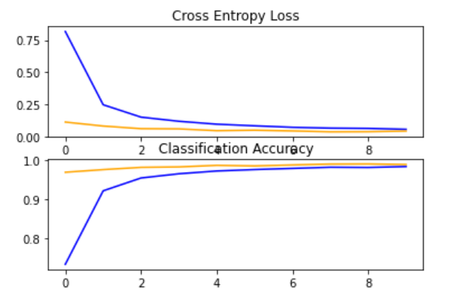
Project 1
Results (extra experiments are omitted)
model1: 95.37% (overtrained afterwards on 5th epoch), 26s
model1_1: 96.93% (overtrained afterwards on 8th epoch), 60s
model2: 98.59% (overtrained afterwards on 5th epoch), 329s
model2_1: 98.99% (slightly overtrained afterwards due to dropout on final epoch), 600s
knn3: 97.07%, 46s
model 1 model 1_1 model2 model2_1

Slide 6
Project 2
General Information
We will use the MNIST dataset from keras again and we will reshape the data accordingly.
We will create and train SVM models and compare them to the kNN and Nearest Centroid classifiers from Project 1.
We will train models for 2000 and 2500 data values from the dataset and compare times as well as results.
We will reduce dimensionality with PCA for faster data handling, using sci-kit learn.
We will train in both one vs one and one vs rest (ovo, ovr) conditions, multiple restrictions and models that include: linear, gamma, polynomial, RBF and sigmoid kernels.
On the poly models we will emphasize afterwards on finding the best possible degree for the best results
Further emphasis on the results as well as explanation are written in the comments of the code

Slide 7
Project 2
Best Results from each model
Linear with 2K data, 10M iterations on all restrictions and conditions: 50%, ~4s
All gammas with 2K Data, 1M iterations on all restrictions and conditions: 51.8% and ~6s. To be noted is that restrictions below 1 yield worse train accuracy
Polynomial with 2K data, 1M iterations, restriction of 1000, ovr condition and degree of 20: 54.4%, 2.93s
Polynomial with 2K data, 1M iterations, restriction of 1000, all conditions and degree of 23: 54,7%, 3.78s for ovo, 2.8s for ovr
RBF with all previous gammas, 1M iterations, all restrictions and conditions yield the same results as simple gamma with worse times, ~ 5.5s
Sigmoid with 2K data, 1M iterations, 0.01 restriction, all conditions: 53%, 4s for ovr, 4.5s for ovo
Linear with 2.5K data, 10M iterations, 0.01 restriction, all conditions: 51.1%, ~67s

Slide 8
Project 3
General Information
We will create autoencoders and compare results a PCA that preserves 90% of the original data.
We will use the CIFAR10 dataset for more interesting results than before on a harder dataset and we will reshape the data to 1-dimensional arrays accordingly as well as flatten them for faster results. We will also be using binary crossentropy for the loss functions for more interesting results. Each image is 32x32 pixels x3 for the RGB array, so each model will have 3 neurons for output before plotting and showing results and image comparisons for their predictions.
The first model will use a simple Dense hidden layer with a compression factor of 96. It will use 10 epochs, batch size of 256.
The second model will use Dense layers with high neuron count for both the input, encoding and decoding, with RELU activation, sigmoid output, 4 epochs and batch size of 256
The third model will use the effective Convoluion 2D layers which issued good results in the first project, this time with an initial kernel of 3x3, with MaxPooling for a 2x2 and UpSampling of 2x2. We will only put low neuron count to save on time cost, 4 epochs and batch size of 256.
Finally, we will create a simple PCA with 90% original data kept (99 components) and will train it over a simple Dense layer model with minimal neurons (128, 128, 64, 32 respectively). We will conduct training on 50 epochs and batch size of 128

Slide 9
Project 3
Results and Reconstruction
First autoencoder: loss: 0.5507 - val_loss: 0.5516, Time taken: 253s
Second autoencoder: loss: 0.5476 - val_loss: 0.5484, Time taken: 939s
Third autoencoder: loss: 4.9200e-04 - val_loss: 4.3757e-04, Time taken: 1044s
PCA: loss: 1.0278 - val_loss: 2.4188, Time taken: 118s
As for image prediction and reconstruction, the first 2 autoencoders yield mediocre to poor results, and the 3rd one yields decent results in high time intervals. Although the PCA results are lower, the time taken and the accuracy slope on it show that it is preferable and can yield much better results with more neurons, layers, complexity and time, and yield faster times more efficiently

Slide 10
Conclusion
Comparing everything
For the MNIST dataset, it is evident that more complex layers with higher neuron count and confusion on the model achieve better training and results but take a lot of time. Simpler model can yield decent to good results faster but reach their ceiling with overtraining fast.
The CIFAR10 dataset has more challenging data (images with more pixels and RGB) and needs a lot of complexity and training on neural models to achieve even decent results.
SVMs as shown yield poor results and skyrocket in time taken with just slightly larger data sets. They are inefficient and take too much time, so their actual usage should be very limited on very small training data.
Autoencoders achieve pretty decent reconstructions if trained correctly, but take a lot of time. They can generate pretty decent results in the long run and although PCA may surpass them in both accuracy and efficiency with respectively better networks, Autoencoders retain information created across the entire image, whereas on PCA all information after its first component gradually worsens in reconstruction.

