Slide 1
Proxy Mode In OpenQA
XiaoGen Wang
QA APACII Team

Slide 2
Agenda
IPMI Mode
  Existing issue on IPMI mode
  Weakness
Proxy Mode Introduction
  Goal
  Terms
  Policy
  Structure
  How to use
QA

Slide 3
IPMI Mode

Slide 4
What does IPMI mode do?
It can complete test on physical machine, like common qemu mode on openqa.
Tech
  IKVM
  IPMI Tools

Slide 5
IPMI Mode
Existing issue
  The ipmi mode now is not very stable
  Some resolution ratio issue
  API type_string issue
Weekness
  Only support on Supermirco Machine

Slide 6
Proxy Mode

Slide 7
  Goal
Create a new mode which can support more various physical machine with ipmi , not only supermicro machine.
Add the proxy mode as extension or backup of ipmi mode for using physical machine to do test.

Slide 8
Terms
Proxy machine : The machine is qemu vm which is created by openqa
Slave machine : The physical machine.

Slide 9
Policy
Using proxy machine as an agency to control physical machine to finish test

Slide 10
Structure
Problem
  How to interactive with slave machine
  How to redirect serial data from slave machine to proxy machine

Slide 11
Structure
Solution
  Using ipmitoll as interactive medium to connect slave machine.
  Using nc to redirect special file descriptor of slave machine to standard serial port of proxy machine, make all output in slave machine be redirected to serial port of proxy machine

Slide 12
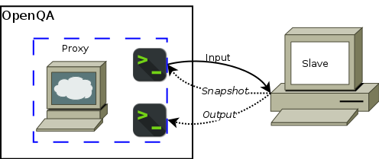
Structure
Digram

Slide 13
How to use
Refer to test suite with prefix proxy* in local openqa 147.2.212.248

Slide 14
Thank You!
Q&A

