Slide 1
CPU Virtualization and Scheduling
1
Notes:
<number>

Slide 2
CPU Virtualization
1

Slide 3
De-privileging OS
De-privileging OS
X86 protection ring (before HW-assisted virtualization)
Ring 0 – VMM
Ring 1 – Guest OS
Ring 3 – Application
OS
OS
VMM
VMM
OS
Application
Application
ring0
ring1
ring2
1/35
ring3

Slide 4
De-privileging OS
Trap-and-emulation
“Trap-and-emulate (virtualize)” privileged instructions
Guest OS execute a privileged instruction
Hardware exception (trap)
e.g. general protection fault
ring0
ring1
ring2
VMM’s exception handler emulate the privileged instruction
ring3
sensitive instructions
1/35

Slide 5
Sensitive Instructions
Class of instructions
Normal instructions
Not trapped by privilege layer
Privileged instructions
Automatically trapped by privilege layer
Sensitive instructions
Must be emulated (virtualized) for fidelity and safety
e.g., Processor mode changes, HW accesses, …
“Virtualizable architecture”
Sensitive instructions Privileged instructions
Trap-and-emulate every sensitive instruction
Decided by architecture
Decided by VMM
⊆
1/35

Slide 6
Virtualization-Unfriendly x86
x86 is not virtualizable before 2005
“Not all sensitive instructions are privileged”
Cannot emulate sensitive instructions that are not privileged
e.g., SGDT, SLDT, SIDT …
Running unmodified OSes w/o SW modification is impossible!
Full-virtualization by VMware in 1999
Binary translation
+ No OS source modification (Windows is possible!)
- Performance overhead
Para-virtualization by Xen in 2003
Hypercall
+ Near-native performance
- OS modification
1/35

Slide 7
Hypercall vs. Binary Translation
Source-level vs. Binary-level modification
OS source code
OS binary
...
…
…
val = store_idt()
…
…
…
...
…
…
mov val, idtr
…
…
…
Hypercall
val = emulate_store_idt()
call emulate_store_idt
Binary
Translation
Method to
optimize performance
(e.g., batching traps)
Optimization by
caching translated
instructions
VMM
emulate_store_idt(val) {
return virtual_idtr
}
1/35

Slide 8
Interrupt Virtualization
Interrupt redirection
Interrupts and exceptions are delivered to ring0
Interrupt redirection is handled by VMM or privileged VM
Interrupts or exceptions
IDT of VMM
IDT of Guest OS
ring0
ring1
ring2
Currently running VM
ring3
IDT of Guest OS
1/35

Slide 9
HW-Assisted Virtualization
x86 became finally virtualizable in 2005-2006
“SW trends drive HW evolution”
Intel VT and AMD-SVM
Intel VT
VMX non-root mode
Ring 3
Ring 2
Ring 1
Ring 0
Guest apps
VMCS
What events to trap
Why did a trap occur
Guest OS
Control data
VMExit
VMX root mode
Guest state
Load at VMEntry
VMEntry
Ring 3
Ring 2
Ring 1
Ring 0
Host apps
Host state
Load at VMExit
VMM or Host OS
1/35

Slide 10
HW-Assisted Virtualization
Advantages
No binary translation
No OS modification
Simplifying VMM
KVM was born and included in Linux mainline in 2007
Vmware, Xen, etc. adopt HW-assisted virtualization
Several lightweight VMMs were implemented
lguest, tiny VMM, …
Contributions to wide adoption of virtualization
Disadvantages
More expensive trap (VMEXIT)
Outdating sophisticated and clever SW techniques ☹
1/35

Slide 11
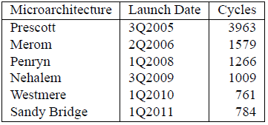
Technical Issues
Expensive VMEXIT cost
Save/restore whole machine states
HW: Reducing latency continuously
SW: Eliminating unnecessary VMEXIT and reducing the time of handling VMEXIT
Software Techniques for Avoiding Hardware Virtualization Exits [USENIX’12]
1/35

Slide 12
Nested-Virtualization-Unfriendly x86
Multi-level architecture support
IBM system z architecture
Single-level architecture support
Intel VMX and AMD SVM
Guest OS
Guest hypervisor
Bare-metal hypervisor
Guest OS
Guest hypervisor
Bare-metal hypervisor
What’s next?
1/35

Slide 13
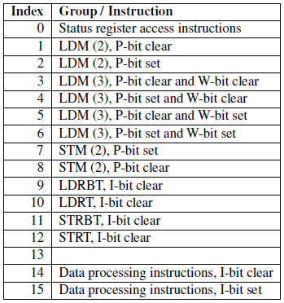
ARM CPU Virtualization
Para-virtualization
ARM is also not virtualizable before HW virtualization
Xen on ARM by Samsung
KVM for ARM [OLS’10]
Replacing a sensitive instruction with an encoded SWI
Taking advantage of RISC
Script-based patching
OKL4 microvisor
Sensitive instruction encoding types
Most ARM-based VMMs turn to supporting ARM HW virtualization for efficient computing
1/35

Slide 14
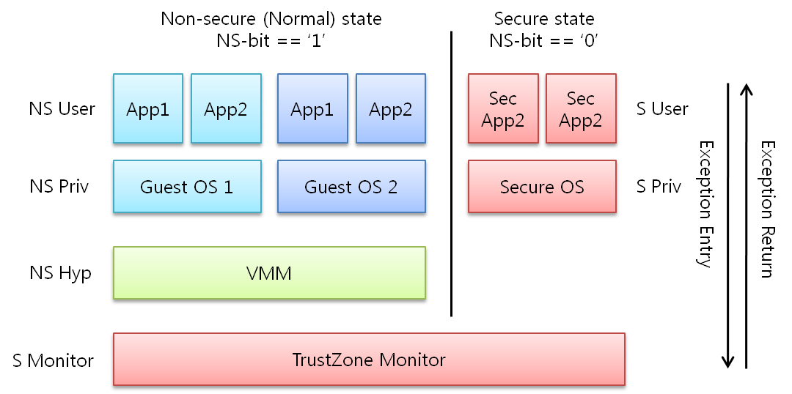
ARM CPU Virtualization
Hyp mode
Cortex-A15
Similar to VMX root mode
1/35

Slide 15
Summary
Incredibly rapid SW and HW evolutions driven by IT industry needs
Less than 10 years from VMware and Xen’s SW technologies to HW-assisted virtualization
Academia is tightly coupled with industry
Research groups and corporates are willing to share their state-of-the-art technologies in top conferences
Even mobile environments are ready for virtualization
ARM HW virtualization boosts this trend
1/35

Slide 16
CPU Scheduling
1

Slide 17
CPU Scheduling
Hierarchical scheduling
OS
VMM
Guest OS
Guest OS
Guest OS
Process
Process
Process
Process
thread
Process
Process
Process
thread
thread
thread
process
scheduler
process
scheduler
process
scheduler
thread
scheduler
thread
scheduler
thread
scheduler
Operating System
Virtual Machine Monitor
OS Scheduler
Virtual
CPU
VMM Scheduler
1/35

Slide 18
CPU Scheduling
The common role of CPU schedulers
Allocating “a fraction of CPU time” to “a SW entity”
Thread and virtual CPU are SW schedulable entities
Linux CFS (Completely Fair Scheduler) is used for both thread scheduling and KVM scheduling
Xen has adopted popular schedulers in OS domain
BVT (Borrowed-Virtual-Time) [SOSP’99]
SEDF (Simple Earliest Deadline First)
EDF is for real-time scheduling
Credit – Proportional share scheduler for SMP
Default scheduler
1/35

Slide 19
Priority vs. Proportional-Share
Priority-based scheduling
Scheduling based on the notion of “relative priority”
Fairness based on starvation avoidance
Suitable for dedicated environments
Desktop and mobile environments
Linux schedulers before CFS, Windows scheduler, Many mobile OS schedulers
1/35

Slide 20
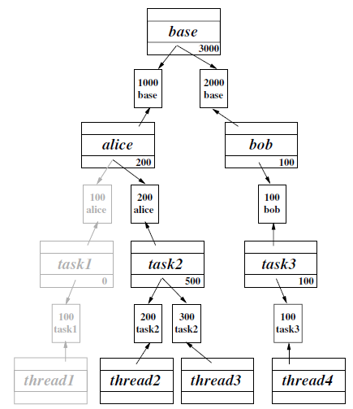
Priority vs. Proportional-Share
Proportional-share scheduling
Scheduling based on the notion of “relative shares”
Fairness based on shares
Suitable for shared environments
Shared workstations
Pay-per-use clouds
Virtual desktop infrastructure
Linux CFS, Xen Credit, VMware
Proportional-share scheduling fits for virtualized environments where independent VMs are co-located
1/35
Lottery Scheduling: Flexible Proportional-Share Resource Scheduling [OSDI’94]

Slide 21
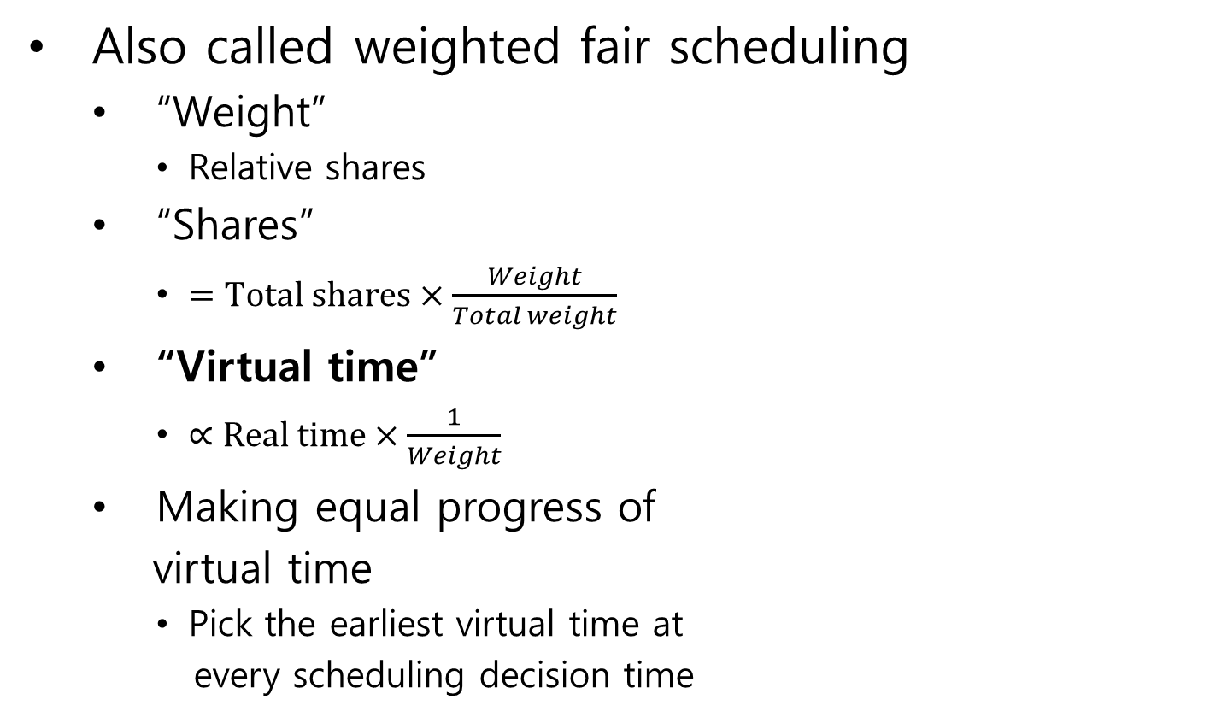
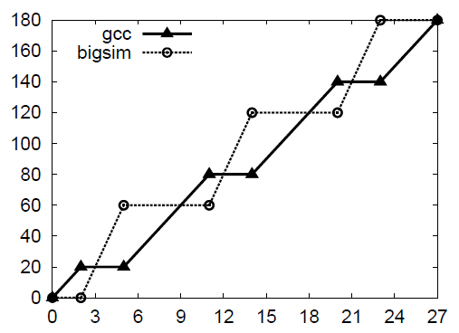
Proportional-Share Scheduling
Also called weighted fair scheduling
“Weight”
Relative shares
“Shares”
“Virtual time”
Making equal progress of
virtual time
Pick the earliest virtual time at
every scheduling decision time
Virtual time
gcc : bigsim = 2 : 1
Real time (mcu)
Borrowed-Virtual-Time (BVT) scheduling:
supporting latency-sensitive threads in
a general-purpose scheduler [SOSP’99]
1/35

Slide 22
Proportional-Share Scheduling
Proportional-share scheduler for SMP VMs
Common scheduler for commodity VMMs
Employed by KVM, Xen, VMware, etc.
VM’s shares (S) =
Total shares x (weight / total weight)
VCPU’s shares = S / # of active VCPUs
Active vCPU: Non-idle vCPU
e.g., 4-VCPU VM (S = 1024)
Single-threaded workload
Multi-threaded (programmed) workload
VCPU0
(1024)
VCPU0
(256)
VCPU1
(256)
VCPU2
(256)
VCPU3
(256)
Symmetric vCPUs
Existing schedulers view active vCPUs
as containers with identical power
1/35

Slide 23
Challenges on VMM Scheduler
Challenges due to the primary principles of VMM, compared to OS scheduling research
3. Inter-VM fairness
(← Performance isolation)
: Favoring a VM must not compromise inter-VM fairness
Process and thread information
Inter-process communications
I/O operations and semantics
System calls
etc…
VM
VM
VM
Task
Task
Task
Task
Task
Task
Task
Task
I believe I’m on a dedicated machine
OS scheduler
OS scheduler
OS scheduler
1. Semantic gap
(← OS independence)
: Two independent
scheduling layers
vCPU
vCPU
vCPU
vCPU
vCPU
2. Scarce Information
(← Small TCB)
: Difficulty in extracting
workload characteristics
VMM
VMM scheduler
Each VM is virtualized as a black box
pCPU
pCPU
I/O operations
Privileged instructions
Lightweightness
(No cross-layer optimization)
Efficiency
(Intelligent VMM)
1/35

Slide 24
Research on VMM Scheduling
Classification of VMM scheduling research
VMM scheduling
Explicit specification
Workload-based identification
Administrative specification
Guest OS cooperation
CaS[VEE’07], Boost[VEE’08], TAVS [VEE’09], Cache[ANCS’08], IO[HPDC’10], DBCS [ASPLOS’13]
VSched[SC’05], SoftRT[VEE’10], RT [RTCSA’10], BVT and sEDF of Xen
SVD[JRWRTC’07], PaS[ICPADS’09], GAPS[EuroPar’08]
1/35

Slide 25
CPU Scheduling
Task-aware Virtual Machine Scheduling for
I/O Performance
1

Slide 26
Problem of VM Scheduling
Task-agnostic scheduling
That event is mine
and I’m waiting for it
Run queue sorted based on CPU fairness
Head
Tail
vCPU
vCPU
I/O-bound task
Mixed task
CPU-bound
task
VMM
Your vCPU has low priority now!
I don’t even know this event is for your I/O-bound task!
Sorry not to schedule you immediately…
I/O event
1/35

Slide 27
Task-aware VM Scheduling [VEE’09]
Goals
Tracking I/O-boundness with task granularity
Improving the response time of I/O-bound tasks
Keeping inter-VM fairness
Challenges
VM
VM
I/O-bound task
Mixed task
I/O-bound task
Mixed task
CPU-bound
task
CPU-bound
task
VMM
1. I/O-bound task identification
I/O event
2. I/O event correlation
3. Partial boosting
PCPU
1/35

Slide 28
Task-aware VM Scheduling
1. I/O-bound Task Identification
Observable information at the VMM
I/O events
Task switching events [Jones et al., USENIX’06]
CPU time quantum of each task
Inference based on common OS techniques
General OS techniques (Linux, Windows, FreeBSD, …) to infer and handle I/O-bound tasks
1. Small CPU time quantum (main)
2. Preemptive scheduling in response to I/O events (supportive)
Example (Intel x86)
CR3 update
CR3 update
I/O event
Task time quantum
1/35

Slide 29
Task-aware VM Scheduling
2. I/O Event Correlation: Block I/O
Request-response correlation
Window-based correlation
Correlation for delayed read events by guest OS
e.g., block I/O scheduler
Overhead per VCPU = window size x 4bytes (task ID)
Inspection window
Any I/O-bound task in the window
user
T1
T2
T3
T4
kernel
read
VMM
Actual
read request
1/35

Slide 30
Task-aware VM Scheduling
2. I/O Event Correlation: Network I/O
History-based prediction
Asynchronous packet reception
Monitoring “the firstly woken task” in response to an incoming packet
N-bit saturating counter for each destination port number
Example: 2-bit counter
00
Non-
I/O-bound
01
Weak I/O-bound
Portmap
If the firstly woken task is I/O-bound
Destination
port number
Otherwise
10
I/O-bound
11
Strong I/O-bound
If portmap counter’s MSB is set,
this packet is for I/O-bound tasks
Overhead per VM = N x 8KB
1/35

Slide 31
Task-aware VM Scheduling
3. Partial Boosting
Priority boosting with task-level granularity
Borrowing future time slice to promptly handle an incoming I/O event as long as fairness is kept
Partial boosting lasts during the run of I/O-bound tasks
Run queue sorted based on CPU fairness
Head
Tail
VM1
VM2
VM3
I/O-bound task
CPU-bound
task
CPU-bound
task
VMM
If this I/O event is destined for VM3 and
is inferred to be handled by its I/O-bound task,
Initiate partial boosting for VM3 VCPU
I/O event
1/35

Slide 32
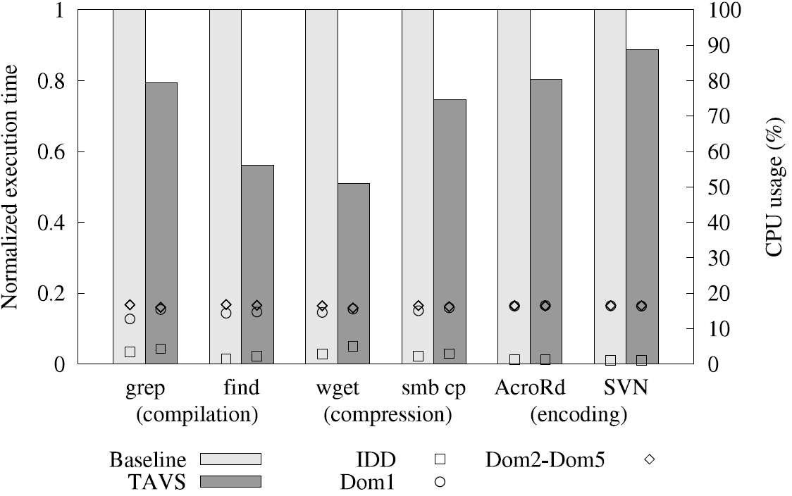
Task-aware VM Scheduling
- Evaluation
Real workloads
<Workloads>
1 VM: I/O-bound & CPU-bound task
5 VMs: CPU-bound task
Ubuntu Linux
Windows XP
I/O-bound
tasks
CPU-bound
tasks
12-50% I/O performance
improvement with
inter-VM fairness
1/35

Slide 33


How About Multiprocessor VMs?
Virtual Asymmetric Multiprocessor [ApSys’12]
Dynamically varying vCPU performance based on hosted workloads
The size of vCPU =
The amount of CPU shares
Virtual SMP (vSMP)
Virtual AMP (vAMP)
VM
VM
Interactive
Interactive
Background
Equally contended
regardless of
user interactions
Proposal
Background
vCPU
vCPU
vCPU
vCPU
vCPU
vCPU
Fast vCPUs
Slow vCPUs
Time
shared
vCPU
vCPU
vCPU
vCPU
vCPU
vCPU
vCPU
vCPU
vCPU
vCPU
vCPU
vCPU
pCPU
pCPU
pCPU
pCPU
pCPU
pCPU
pCPU
pCPU
1/35

Slide 34
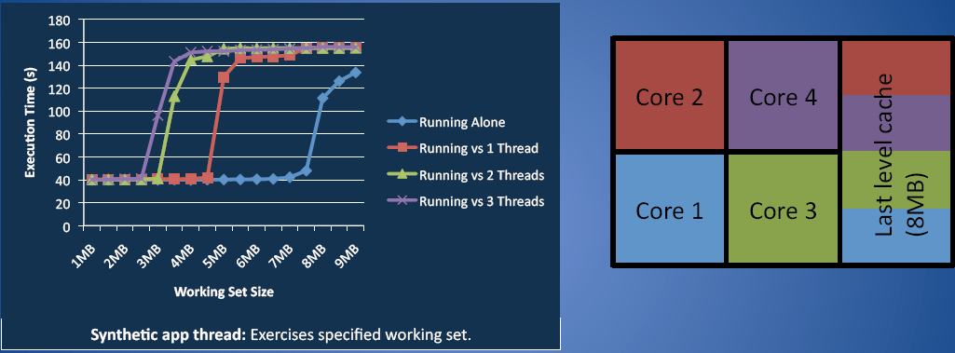
Other Issues on CPU Sharing
CPU cache interference issues
Most CPU schedulers are conscious only of CPU time
But, shared last-level cache (LLC) can also largely affect the performance
Q-Clouds: Managing Performance Interference Effects for QoS-Aware Clouds [EuroSys’10]
1/35

Slide 35
Summary
CPU scheduling for VMs
OS and VMM share their scheduling mechanisms and policies
Proportional-share scheduling well fits for VM-based shared environments for inter-VM fairness
But, the semantic gap weakens efficiency of CPU scheduling
Knowledge about OS and workload characteristics gives an opportunity to improve VMM scheduling
Other resources such as LLC should also be considered
1/35

