Slide 1
Memory Virtualization and Management
<number>
Notes:
<number>

Slide 2
Memory Virtualization
<number>

Slide 3
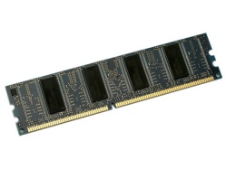
Memory Virtualization
VMM: “Virtualizing virtual memory”
Virtual → Physical → Machine
Virtual address
Level 2
Page
table
Pseudo physical memory
Machine memory
Page
table
. . .
Page
table
Physical
to
Machine
Page
table
Level 1
Page
table
[Goal] Secure memory isolation
A VM is NOT permitted to access
another VM’s memory region
A VM is NOT permitted to manipulate
“physical-to-machine” mapping
All mapping to machine memory MUST be verified by VMM
<number>/30

Slide 4
SW-Based Memory Virtualization
x86 was virtualization-unfriendly w.r.t. memory
Memory management unit (MMU) has only a page table root for “virtual-to-machine (V2M)” mapping
Virtual address
Level 2
Page
table
Pseudo physical memory
Machine memory
Page
table
. . .
Page
table
Physical
to
Machine
CR3
Page
table
MMU
Level 1
Page
table
“Pseudo” means SW, not HW
→ This P2M table is used to establish V2M,
not recognized by HW
<number>/30

Slide 5
Full- vs. Para-virtualization
How to maintain V2M mapping
Full-virtualization
No modification to V2P in a guest OS
Secretly modifying binary violates OS semantic
“Shadow page tables”
V2M made by referring to V2P and P2M
+ No OS modification
- Performance overheads for maintaining shadow page tables
Para-virtualization
Direct modification to V2P in a guest OS using hypercall
V2P → V2M
+ High performance (batching optimization is possible)
- OS modification
<number>/30

Slide 6
Full- vs. Para-virtualization
How to maintain V2M mapping
Shadow mode (full virtualization)
Direct mode (para-virtualization)
Page
directory
Page
directory
Page
table
Read
Page
table
Read
Page
table
Page
table
Page
table
Write
Page
table
Write
Page
table
Page
table
V2P
V2M
Page
fault
sync
Guest OS
Shadow
Page table
Page
directory
Page
table
Page fault handler
Verify that the machine
page to be updated
is owned by the domain?
Page
table
Page
table
Page
table
V2M
VMM
MMU
Hardware
MMU
<number>/30

Slide 7
Linux Virtual Memory (x86-32)
Virtual memory
Physical memory
Kernel (1G)
User (3G)
PFN N
PFN N-1
. . .
PFN 4
PFN 3
PFN 2
PFN 1
PFN 0
high_memory
cr3
PAGE_OFFSET
Page
directory
Page
table
Page
table
Page
table
Page
table
__alloc_pages
__free_pages
PFN N’s descriptor
PFN N-1’s descriptor
. . .
PFN 2’s descriptor
PFN 1’s descriptor
PFN 0’s descriptor
struct page
_count
flags
mapping
lru
Slab allocator
Buddy system allocator
mem_map
<number>/30

Slide 8
Xen Memory Virtualization
Para-virtualization
Machine memory
Virtual memory
Virtual memory
MFN N
MFN N-1
. . .
MFN 4
MFN 3
MFN 2
MFN 1
MFN 0
Xen(64M)
Kernel
User (3G)
Xen(64M)
Kernel
User (3G)
cr3
Page
directory
Page
table
Page
directory
Page
table
Page
table
Page
table
Page
table
Page
table
Page
table
Page
table
struct page_info
list
count_info
_domain
type_info
__alloc_heap_pages
__free_heap_pages
MFN N’s descriptor
MFN N-1’s descriptor
. . .
MFN 2’s descriptor
MFN 1’s descriptor
MFN 0’s descriptor
Buddy system allocator
<number>/30
frame_table

Slide 9
Page Table Identification
Auditing page table updates
Following mapping from a page table root (CR3) to identify page tables
Once identified, page table updates are carefully monitored and verified
Page
Page
table
Pin request
Page
directory
.
.
.
validated
.
.
.
.
.
.
Page Type
PD
PT
RW
Page
table
Page
<number>/30

Slide 10
HW Memory Virtualization
What if nested page table walking is supported by HW?
Eliminating SW overheads to maintain V2M
HW-assisted memory virtualization
Intel Extended Page Tables (EPT)
AMD Rapid Virtualization Indexing (RVI)
Shadow page tables (SPT)
Extended page tables (EPT)
Guest OS
Guest OS
V2P
GPT
V2P
GPT
1st walking
VMM
SPT
EPT
P2M
V2M
VMM
P2M
2nd walking
V2M
MMU
EPT MMU
<number>/30

Slide 11
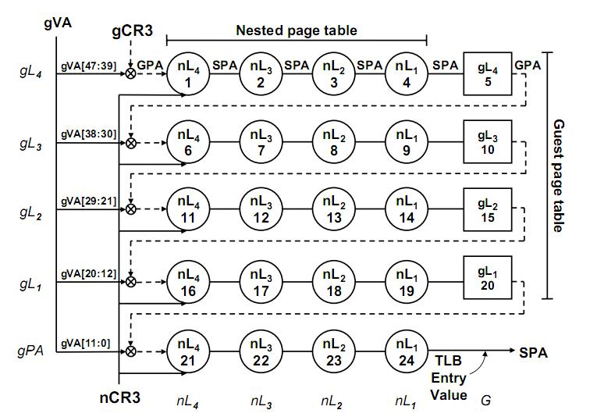
HW Memory Virtualization
AMD RVI (formerly Nested Page Tables (NPT))
Two page table roots: gCR3 and nCR3
<number>/30
Accelerating Two-Dimensional Page Walks for Virtualized Systems [ASPLOS’08]

Slide 12
HW Memory Virtualization
Advantages
Significantly simplifying VMM
Just informing MMU of a P2M root
No shadow page tables
No synchronizing overheads and memory overheads
No OS modification
Disadvantages
Not always outperforming SW-based methods
Page walking overheads on a TLB miss
SW solution: SW-HW hybrid scheme [VEE’11], Large pages
HW solution: Caching page walks [ASPLOS’08], Flat page tables [ISCA’12]
<number>/30

Slide 13
ARM Memory Virtualization
Two-stage address translation
Applications
Virtual Address (VA)
Applications
Guest OS
Virtual Address (VA)
Intermediate Physical Address (IPA)
OS
VMM
Physical Address (PA)
Physical Address (PA)
Hardware
Hardware
Virtual
Address Space
Intermediate Physical
Address Space
Physical
Address Space
Guest
Kernel
Stage 1
translation
Stage 2
translation
Guest
User
<number>/30

Slide 14
Summary
SW-based memory virtualization has been the most complex part in VMM
Before HW support, Xen continued optimizing its shadow page tables up to ver3
Virtual memory itself is already complicated, but virtualizing virtual memory is horrible
HW-based memory virtualization significantly reduces VMM complexity
The most complex and heavy part is now offloaded to HW
But, energy issues on ARM HW memory virtualization?
<number>/30

Slide 15
Memory Management
<number>

Slide 16
Process Memory Management
Memory sharing
Parent-child copy-on-write (CoW) sharing
On fork(), a child CoW-shares its parent memory
On write to a shared page, copy and modify a private page
Advantages
Reducing memory footprint
Lightweight fork
Memory overcommitment
Giving a process larger memory space than physical memory
Paging or swapping out to backing storage when memory is pressured
Advantage
Efficient memory utilization
<number>/30

Slide 17
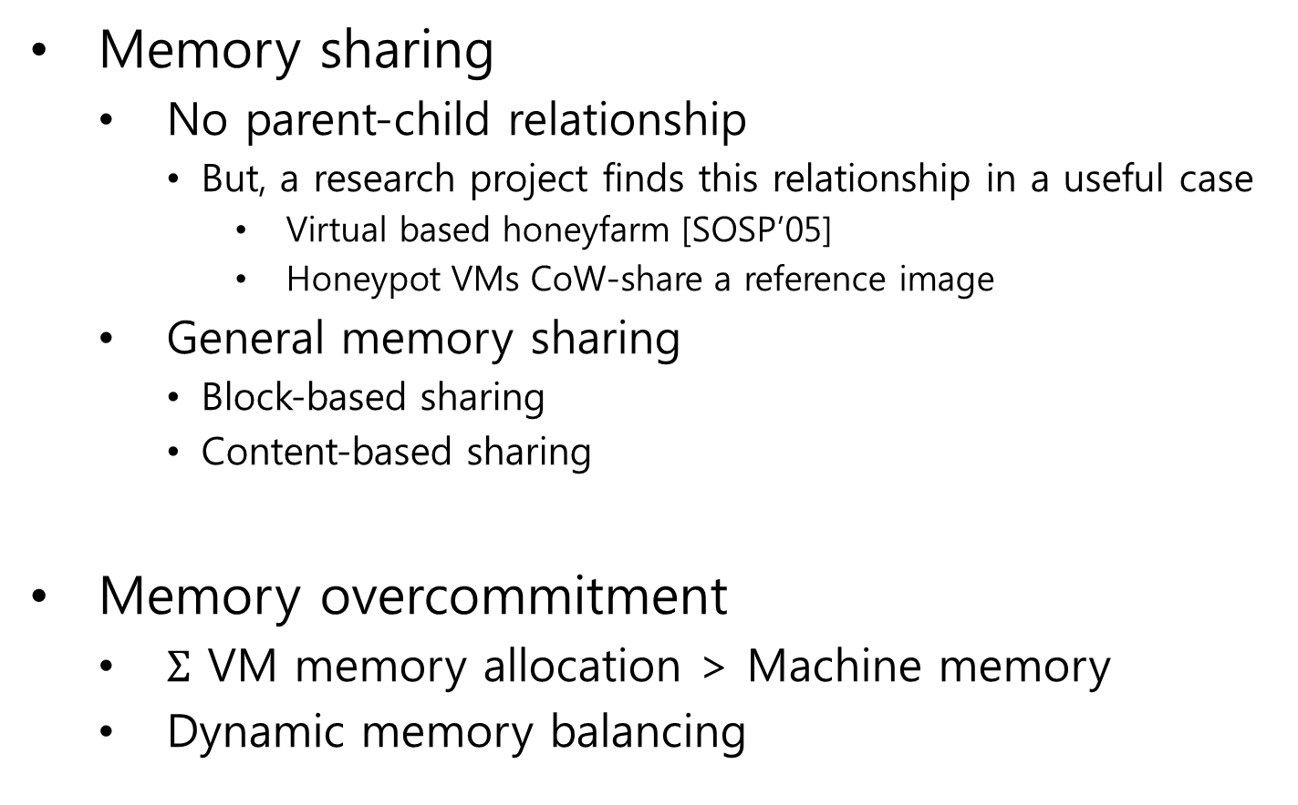
VM Memory Management
Memory sharing
No parent-child relationship
But, a research project finds this relationship in a useful case
Virtual based honeyfarm [SOSP’05]
Honeypot VMs CoW-share a reference image
General memory sharing
Block-based sharing
Content-based sharing
Memory overcommitment
VM memory allocation > Machine memory
Dynamic memory balancing
Parent Honeypot VM
Honeypot VM
Machine
Memory
VMM
Logging & Analysis
Scalability, Fidelity, and Containment in
the Potemkin Virtual Honeyfarm [SOSP’05]
<number>/30

Slide 18

Why VM Memory Sharing?
Why memory?
Memory limitation inhibits high consolidation density
Other resources wastage
HW cost
Memory itself
Limited motherboard slot
Energy cost
RAM energy consumption matters!
Main goal
Reducing memory footprint as much as possible even with more CPU computation
<number>/30

Slide 19
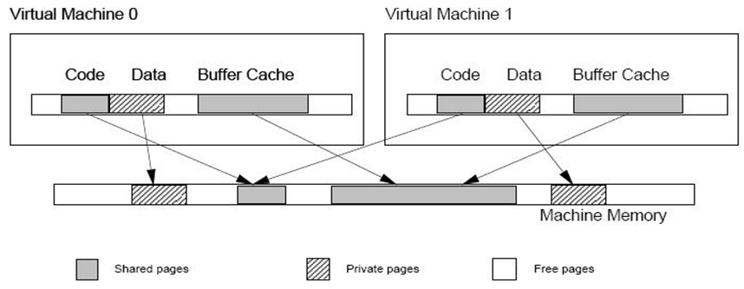
Memory Sharing
Block-based page sharing
Transparent page sharing of Disco [SOSP’97]
Sharing-aware block devices [USENIX’09]
On reading a common block from shared disk, only one memory copy is CoW-shared
Disco: Running Commodity
Operating Systems on
Scalable Multiprocessors [SOSP’97]
+ Finding identical pages is lightweight
- Sharing only for shared disk
<number>/30

Slide 20
Memory Sharing
Content-based page sharing
Sharing pages with identical contents
VMWare ESX server and KSM for KVM
2. Hashing page contents
Memory Resource Management in
VMware ESX Server [OSDI’02]
…2bd806af
1. Periodic scan
3. Hash
collision
PA
4. Byte-by-byte comparison
MA
5. CoW sharing &
reclaiming a redundant page
+ High memory utilization
- Finding identical pages is nontrivial
<number>/30

Slide 21
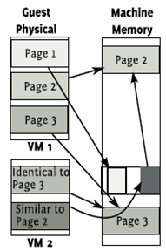
Memory Sharing
Subpage sharing
Difference Engine: Harnessing Memory Redundancy in Virtual Machine [OSDI’08]
Patching similar pages
Compressing idle pages
Reference & dirty bit tracking to find idle pages
Put it all together!
PA
MA
Reference page
+ Much higher memory utilization
- Computationally intensive
<number>/30

Slide 22
Memory Sharing
Kernel Samepage Merging (KSM)
Open source!!
Content-based page sharing in Linux
Increasing memory density by using KSM [OLS’09]
Linux kernel service
Applicable to all Linux processes including KVM
Target memory regions can be registered via madvise() system call
Content comparison is done by memcmp()
Red-black tree
<number>/30

Slide 23
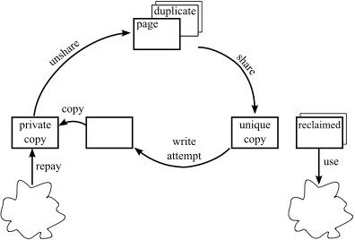
Memory Overcommitment
Two types of memory overcommitment
Using surplus memory reclaimed by sharing
Providing to memory-hungry VMs
Creating more VMs
When is memory pressured?
Shared pages are CoW-broken
Balancing memory between VMs
Providing idle memory to memory-hungry VMs
When is memory pressured?
Idle memory becomes busy
Sharing cycle
Satori: Enlightened page sharing [USENIX’09]
Research issues
How to detect memory-hungry VMs
How to detect idle memory in VMs
How to effectively move memory from a VM to another
Working set estimation techniques
<number>/30

Slide 24
How to Detect Memory-hungry VMs
Monitoring memory pressure of VMs
Swap I/O traffic
Simple method, but only for anonymous pages (e.g., heap)
How much memory is required?
Feedback-driven method
Allocate more memory → monitor swap traffics → …
Buffer cache monitoring (Geiger [ASPLOS’06])
Monitoring the use of unified buffer cache based on
Page faults, page table updates, and disk I/Os
How much memory is required?
LRU miss curve ratio (MRC)
VM
Associate memory and disk locations
Detect page reuse as cache eviction
Reused by CoW and demand paging
Unified buffer cache
Disk
<number>/30

Slide 25
How to Detect Idle Memory
Idle memory
Inactive memory
Not recently used memory
Monitoring page access frequency
Nontrivial
Page access is done solely by HW
Using memory protection of MMU
Sampling-based idle memory tracking
Memory Resource Management in VMware ESX Server [OSDI’02]
Invalidating access privilege of sample pages → Access to a sample page generates page fault to VMM → VMM estimates the size of idle memory
<number>/30

Slide 26
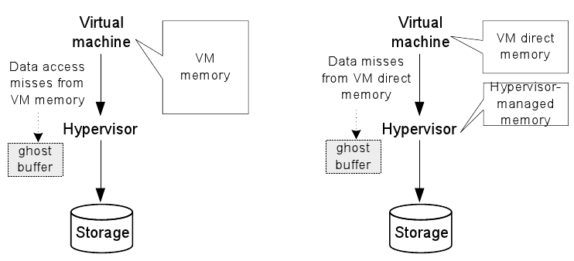
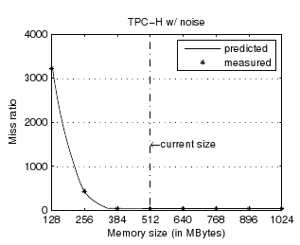
How to Detect Idle Memory
Para-virtualized approach
Ghost buffer with hypervisor exclusive cache
Paravirtualized paging
Transcendent memory (tmem)
Providing OS with explicit interface for hypervisor cache
When a page is evicted, put the page in hypervisor cache
Oracle’s project
https://oss.oracle.com/projects/tmem/
<Original>
<Hypervisor cache>
MRC
Virtual Machine Memory Access Tracking With Hypervisor Exclusive Cache [USENIX’07]
<number>/30

Slide 27
How to Move Memory
VMM-level swap (host swap)
Full-virtualization
VMM is responsible for reclaiming pages to be moved
VM1
VM2
Guest swap
Memory
Guest swap
Memory
VMM
swap-out
Host swap
Drawback
VMM cannot know which page is less important (VMM does not know OS policies)
Even if VMM chooses the same victim page as OS, double page fault occurs
if OS tries to swap out a “host-swapped page” to guest swap
<number>/30

Slide 28
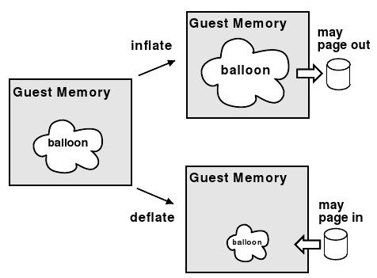
How to Move Memory
Memory ballooning
Para-virtualization
OS is responsible for reclaiming pages to be moved
Memory Resource Management in
VMware ESX Server [OSDI’02]
+ OS knows the best target of victim pages
+ VMM doesn’t need to track guest memory
- Guest OS support is required
Popular solution now!
Module-based implementation
Simple implementation
Balloon drivers for KVM and Xen are
maintained in Linux mainline
Windows versions are also available
<number>/30

Slide 29
How to Move Memory
Memory ballooning
Overcommitted memory
Guest OS 2 requests six pages, but four pages are available
Guest OS 1
Guest OS 1’s
page
Guest OS 2
Memory
allocator
Balloon
driver
Balloon page
Guest OS 1’s
Swap
Request
6 pages
Reclaim
2 pages
U
U
U
U
U
F
VMM
<number>/30

Slide 30
Summary
Memory is precious in virtualized environments
Sharing and overcommitment contribute to high consolidation density
But, we should take care of memory efficiency vs. QoS
Insufficient memory can largely degrade QoS
VM memory management issues will be more focused in mobile virtualization
High QoS
High memory utilization
The degree of consolidation
Low memory utilization
Low QoS
<number>/30

