Slide 1
OS vs. VMM
<number>
Notes:
<number>

Slide 2
OS vs. VMM
A common thing
Managing and Providing HW resources to SW entities
Differences
Abstraction (OS) vs. Virtualization (VMM)
But, a thread is also called virtual processor, and disk and network devices can be directly accessed in an OS…
So, fundamentally similar…
VMM is another layer of OS to provide “machine abstraction”
HW resources | OS (abstraction) | VMM (virtualization)
CPU | Thread & Process | Virtual CPU
Memory | Virtual memory | Virtual memory
Disk | File & Directory | Virtual disk
Network | Socket | Virtual network
<number>/15

Slide 3
CPU Virtualization
Privileged level
VMM makes OS step down to less-privileged layer
VMM must trap and virtualize any OS’s attempt to run privileged operations
OS
OS
VMM
VMM
OS
Application
Application
[Issue] How to trap and virtualize OS’s privileged operations
<number>/15

Slide 4
CPU Management
Another scheduling layer: “VMM scheduler”
OS
VMM
Guest OS
Guest OS
Guest OS
Process
Process
Process
Process
thread
Process
Process
Process
thread
thread
thread
process
scheduler
process
scheduler
process
scheduler
thread
scheduler
thread
scheduler
thread
scheduler
Operating System
Virtual Machine Monitor
OS Scheduler
Virtual
CPU
VMM Scheduler
[Issue] How to efficiently schedule virtual CPUs
<number>/15

Slide 5
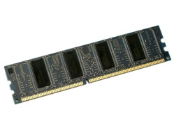
Memory Virtualization
OS: Virtual memory
Virtual address → Physical address
Virtual address
Level 2
Page
table
Physical memory
Page
table
. . .
Page
table
Page
table
Physical address
Level 1
Page
table
<number>/15

Slide 6
Memory Virtualization
VMM: “Virtualizing virtual memory”
Virtual → Physical → Machine
Virtual address
Level 2
Page
table
Pseudo physical memory
Machine memory
Page
table
. . .
Page
table
Physical
to
Machine
Page
table
Level 1
Page
table
Terminology
Xen
Virtual → (Pseudo) Physical → Machine
Others (general)
Guest-virtual → Guest-physical → Host-physical
[Issue] How to transparently and efficiently manage additional memory translation
<number>/15

Slide 7
Memory Management
Memory sharing
OS
Parent-child copy-on-write sharing
VMM
No semantic of parent-child relationship
Content-based page sharing invented by VMware [OSDI’02]
Memory oversubscription (to be explained later)
VM 1
VM 2
Machine Memory
[Issue] How to efficiently use limited memory by avoiding redundant and idle memory
<number>/15

Slide 8
I/O Virtualization
Two ways of I/O virtualization
I/O virtualization in VMM
Rewritten Device drivers in VMM
+ High performance
- High engineering cost
- Low fault tolerance (driver bugs)
Hosted I/O virtualization
Existing device drivers in a host OS
+ Low engineering cost
+ High fault tolerance
- Performance overheads
Guest VM
Guest VM
VMM
Block
device driver
Network
device driver
HW
Block device
Network device
Privileged VM
or Host OS
Guest VM
Guest VM
Block
device driver
Network
device driver
VMM
Most VMMs (except VMware ESX Server) adopt
hosted I/O virtualization
HW
Block device
Block device
<number>/15

Slide 9
Block I/O Virtualization
Block I/O virtualization
OS
VMM
Application
VM
VM
Filesystem
Privileged VM
or
Host OS
Application
Application
Block
device driver
Filesystem
Filesystem
HDD or SSD
Virtual
block driver
Virtual
block driver
Block
device driver
VMM
HDD or SSD
<number>/15

Slide 10
Network I/O Virtualization
OS: network I/O
Physical machine
Network
Application
TCP/IP
Network
Application
Network device driver
TCP/IP
Network device driver
Switch
Network
<number>/15

Slide 11
Network I/O Virtualization
VMM: Virtualizing network devices
Privileged VM or Host OS
VM
VM
Intrusion detection system
Firewall
Network
Application
Network
Application
TCP/IP
TCP/IP
Virtual
switch
Virtual network driver
Virtual network driver
Network device driver
VMM
[Issue] How to achieve near-native I/O performance?
<number>/15

Slide 12
OS over VMM
Nested resource virtualization
Complicating efficient resource management
“Commodity OSes have been designed and optimized assuming that HW is dedicated”
Semantic gap
Another level of indirection invalidates sophisticated OS-level optimizations
I believe my all CPUs are always online!
VM
VM
VM
Sorry, your CPUs are virtualized &
I don’t know what kinds of tasks are running on your VCPUs
Task
Task
Task
Task
Task
Task
Task
Task
OS scheduler
OS scheduler
OS scheduler
VCPU
VCPU
VCPU
VCPU
VCPU
VMM
VMM scheduler
Semantic gap
for CPU resources
PCPU
PCPU
<number>/15

Slide 13

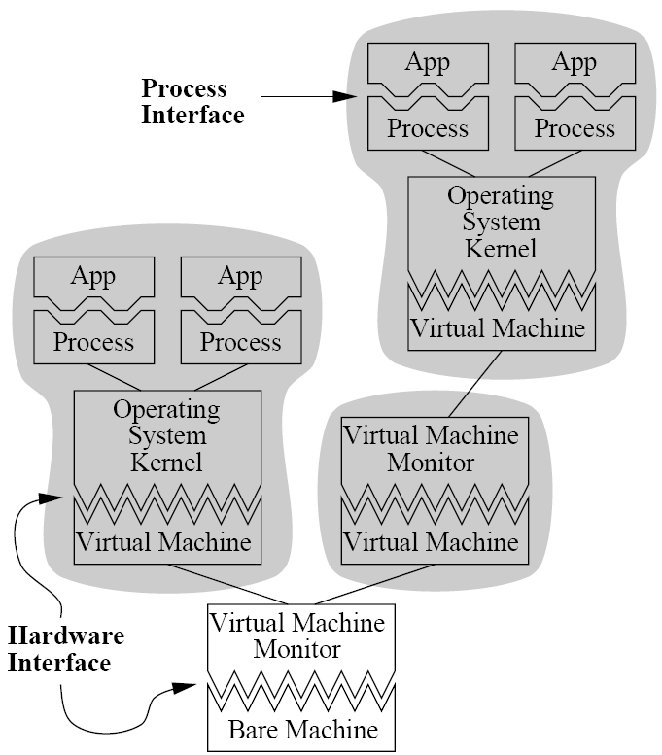
Nested Virtualization
IBM’s Turtles project [OSDI’10]
Nesting is being continued…
Nesting is being needed…
Cloud of cloud
Gang migration
Hypervisor development
Guest VM
Guest VM
Guest VM
Guest VM
Guest VMM
Guest VMM
Host VMM
HW
<number>/15
Microkernels Meet Recursive Virtual Machines [OSDI’96]

Slide 14
Nested Virtualization is Not New
Theoretical analysis
[IEEE Computer’74], [Commun. ACM’74], [SIGOPS rev’75]
Hardware architecture
[ACM’75]
Nested virtualization on IBM z/VM
[IBM system journal’91]
Microkernel-based nested virtualization
[OSDI’96]
Nested virtualization on KVM with AMD
[Linux Plumbers Conference’09]
Nested virtualization on Xen
[Xen summit’09]
Blue Pill
[Blackhat’09]
<number>/15

Slide 15
Summary
VMM is another OS
But, giving machine abstraction
Nested resource virtualization complicates computer systems
OS and apps should consider that underlying HW is not real!
ASPLOS RESoLVE workshop
Runtime Environments/Systems, Layering, and Virtualized Environments (RESoLVE) Workshop
<number>/15

