Slide 1
飞机大战
The user can demonstrate on a projector or computer, or print the presentation and make it into a film to be used in a wider field

Slide 2
CONTENTS
添加功能介绍
1
2
项目演示

Slide 3
PART ONE
功能添加
1.增加Boss类敌机
2.增加敌人发射子弹
3.增加一键清屏功能
4.增加隐形小敌机
5.增加游戏音效
6.优化奖励类型、游戏风格

Slide 4
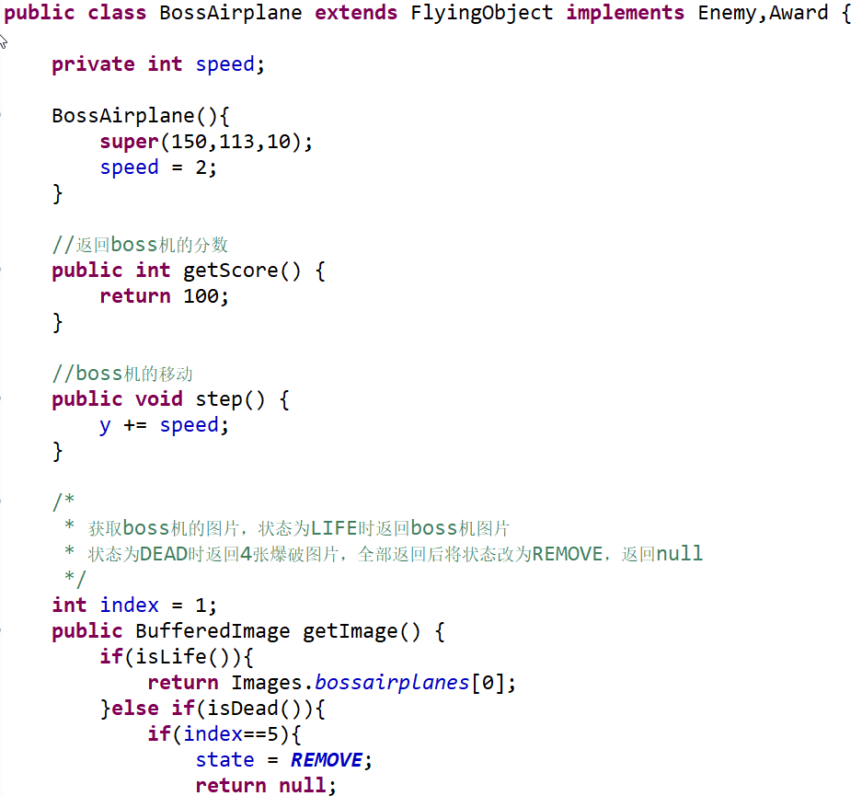
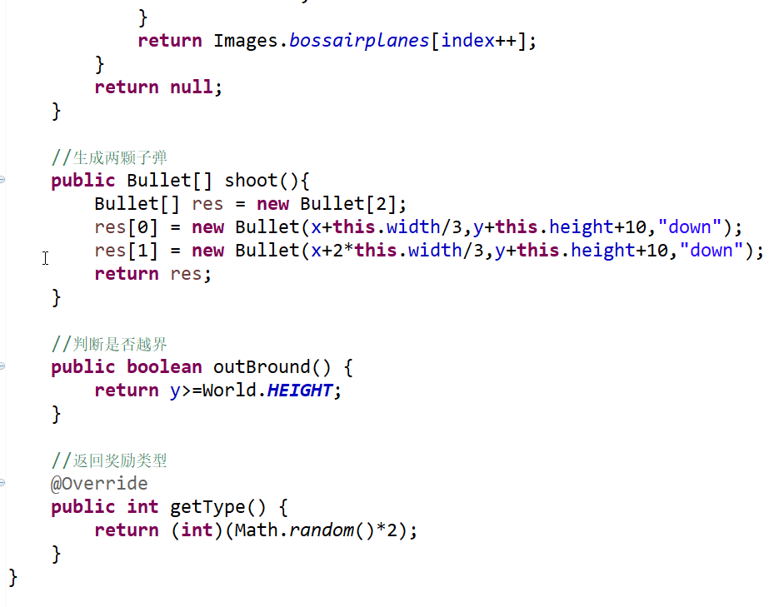
1.增加Boss类敌机

Slide 5
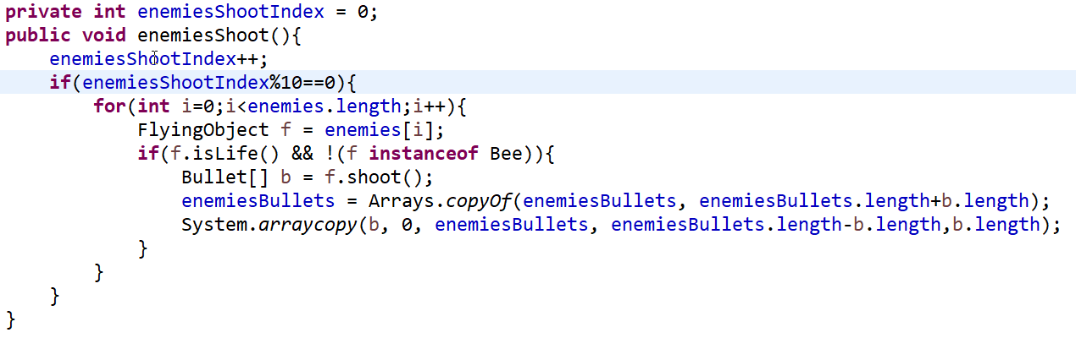
2.增加敌人发射子弹

Slide 6
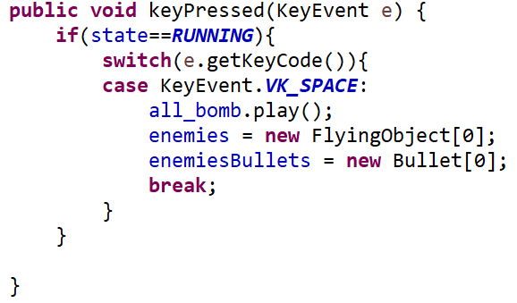
3.增加一键清屏

Slide 7
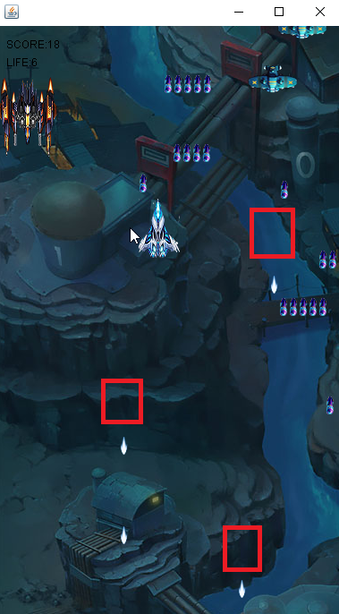
4.增加隐形小敌机

Slide 8
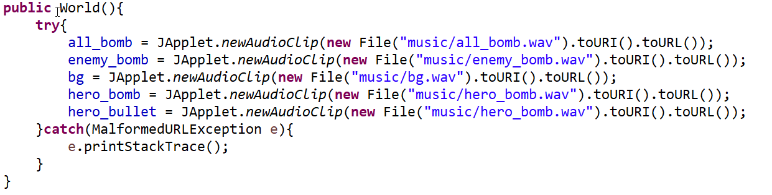
5.增加游戏音效

Slide 9
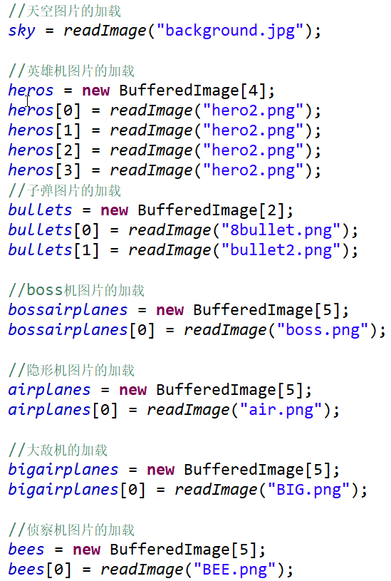
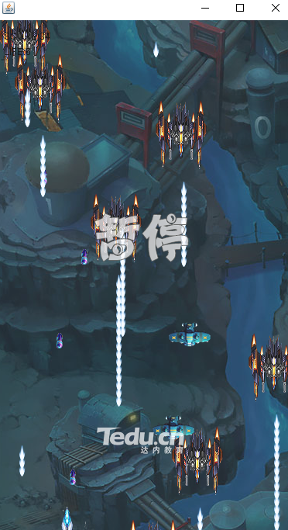
6.优化奖励类型、游戏风格
01
02
03
04

Slide 10
演讲完毕感谢观看
The user can demonstrate on a projector or computer, or print the presentation and make it into a film to be used in a wider field

