Slide 1
Deep Structured Models
BMCV 2015
Citation: 21

Slide 2
Author
Zhiwei Deng
Mengyao Zhai
Lei Chen
Yuhao Liu
Srikanth Muralidharan
Mehrsan Javan Roshtkhari
Greg Mori

Slide 3
observations
deep learning techniques achieve competitive results
Probabilistic graphical models are powerful to incorporate the hierarchical structure of group activities and interactions
local pairwise and global relationships in a social context and interaction are important

Slide 4
ideas
combine a CNN with a probabilistic graphical model as additional layers
  learning individual activities
  describing the scene
  considering the pair-wise interactions between individuals and their global relationship in the scene

Slide 5
Achivement
CNN
a probabilistic graphical model
  a refining process for predicting class labels by considering dependencies between individual actions, body poses, and group activities.
  a multi-step message passing neural network and the predicted label refinement is carried out through belief propagation layers

Slide 6
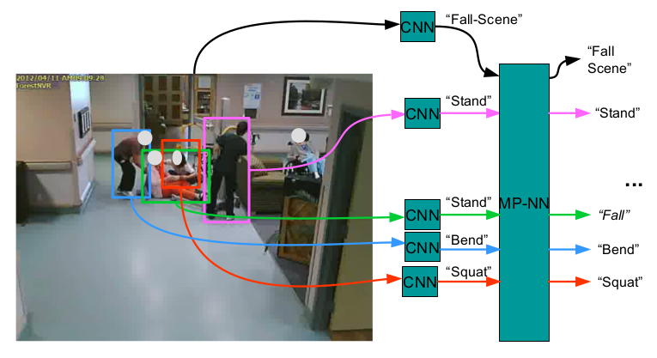
overview

Slide 7
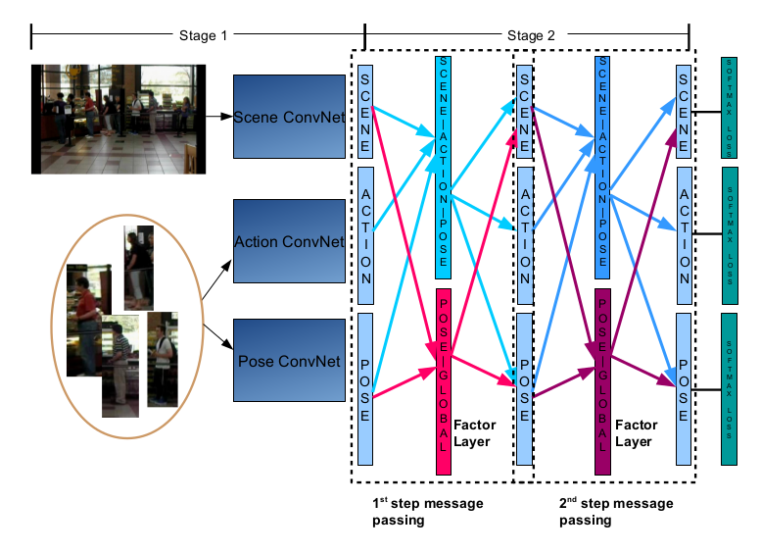
detail

Slide 8

Model——Graphical models
Factor Graph
  each φ_{i} corresponds to a factor over a set of related variable nodes x_{i} and y_{i}
  X represents the inputs
  Y is the predicted labels
  with a weighted (w_{k}) feature functions f_{k}

Slide 9
Model——Graph models
Inference
  belief propagation
    infer states or probabilities of the variables
  each step of message passing involves two parts
    the relevant information from the connected nodes to a factor node are collected
    marginalizing over states of irrelevant variables

Slide 10
Model——Graph models
factor neuron
  mimic the message passing process by representing each combination of states as a neuron
  predict dependencies between states and pass messages to the variable nodes

Slide 11
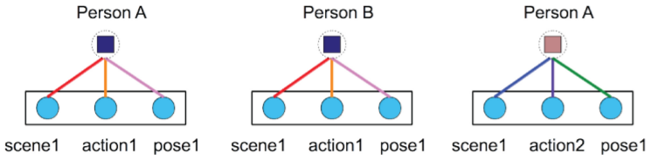
Model——Graph models
The factor nodes of same type share the same template of the parameters.

Slide 12
CNN
Fine-tuned from an AlexNet architecture pre-trained using the ImageNet data
5个卷积层，2个全连接层，一个softmax

Slide 13
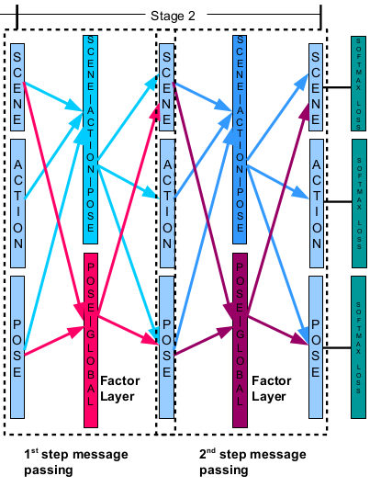

Model——MP NN
First Pass
  From variable nodes to factor nodes

Slide 14
r is all output nodes for all people
t is the factor neuron index for scene g.
T latent factor neurons are used for a scene g.
parameters α and β are shared within factors that have the same semantic meaning.

Slide 15


Model——MP NN
Second Pass
  From factor nodes to variable nodes

Slide 16
Model——MP NN
ε = {ε₁^{s} , ε₂^{s} , ε₁ª , ε₁^{r} , ε₂^{r} }
  connection configurations in the second pass
Parameter W
  the concatenation of weights connected from factor layers to output layer
α, β
  weights from the input layer of the k th message passing to factor layers

Slide 17
Components in the Factor Layers
Unary component
Group activity-action-pose factor layer φ
  ternary factor layer to capture dependencies between a person’s fine-grained action (e.g. talking facing front-left) and the scene label for a group of people
  Use scheme sharing scheme to mimic belief propagation
Poses-all factor layer ψ
  Instead of naively enumerate all combination of poses for all people, simply use T factor nodes for one scene label.(set T=10 in experiments)

Slide 18
Multi Step MP CNN Training
Multi-loss training
  For the kth message passing step
    remove the loss layers for actions and poses to learn parameters for group activity classification alone.
    fix the softmax loss layer for scene classification and learn the model for actions and poses
Learning semantic features for group activity

Slide 19
Implementation details
denoting M max as the maximum number of people contained in one frame
do a dummy-image padding when the number of people is less than M max
filter out dummy data by de-activating neurons connected with them in related layers
normalize the raw scores to feed them to next step

Slide 20
Experiments
defining two types of sparsely connected and weight shared inner product layers
  One is from variable nodes to factor nodes
  another is the reverse direction
用tanH神经元作为非线性单元

Slide 21
Experiments
Dataset
  Collective Activity
  nursing home dataset
For compare
  trained an RBF kernel SVM on features extracted from the graphical model layer after each step of message passing model

Slide 22
Experiments-Collective Activity
concatenate the global features for a scene with AC descriptors by HOG features
averaged AC descriptors features for all people and use this feature to serve as additional global information, namely this feature does not truly participated in the message passing process. This additional global information assists in classification with the limited amount of training data available for this dataset

Slide 23
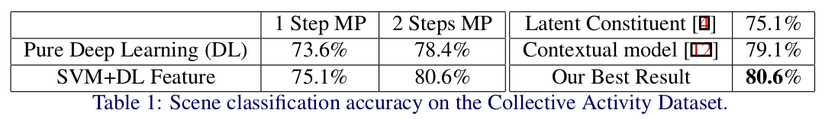
Experiments

Slide 24
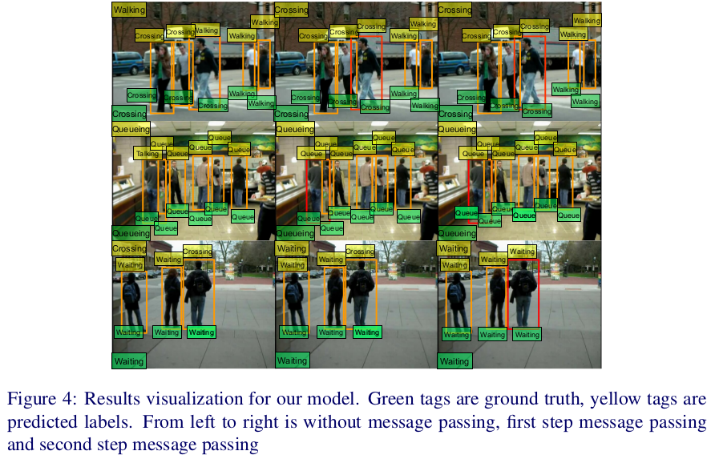
Experiments

Slide 25
Experiments-Nursing Home
consist 80 videos and captured in a nursing home
including a variety of rooms such as dining rooms, corridors, etc
recorded at 640 by 480 pixels at 24 frames per second
Action type
  walking, standing, sitting,bending, squatting, and falling

Slide 26
Experiments-Nursing Home
A frame is assigned “fall” if any person falls and “non-fall” otherwise
sampled 1 out of every 10 frames for training and evaluation
no pose attribute, use the interaction between scene and actions instead to perform the two step message passing

Slide 27
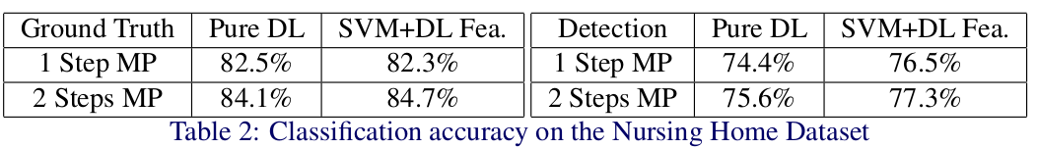

Slide 28
Thanks!

