Slide 1
HIRF
Hierarchical Random Field
ECCV 2014
Citation: 24

Slide 2
作者简介
Mohamed Rabie Amer
Peng Lei
Sinisa Todorovic
From Oregon State University
Object recognition、Activity recognition、Image segmentation、Boundary detection、2.1D sketch extraction、Video segmentation

Slide 3
贡献
已有的工作主要是活动的识别
  本文增加了对前景的定位
已有的HCRF/F-HCRF不是垂直结构
  改进成垂直结构

Slide 4
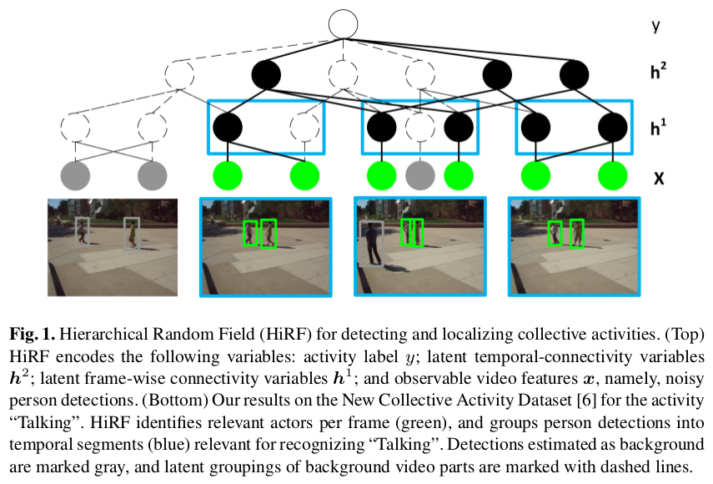

Slide 5
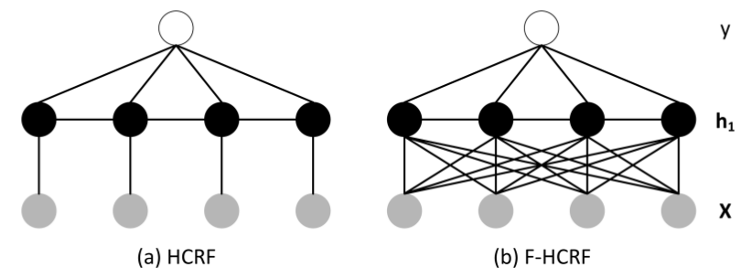
HCRF

Slide 6
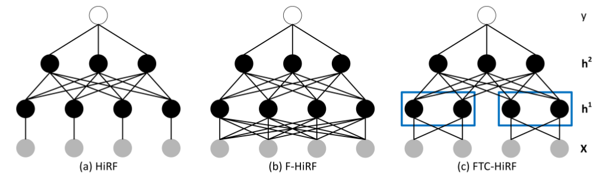
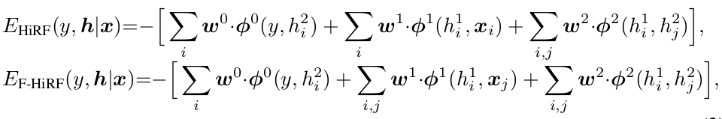
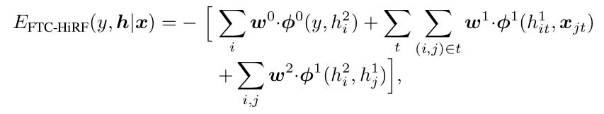
HiRF

Slide 7
details
h_{i}² ∈ {0, 1}, indicating figure-ground assignment of video features ——Add a layer of hidden variables
h_{i}¹ ∈ H = {0, . . . , |H|}, indicating latent groupings of video features into “topics” —— Remove lateral temporal connections
FTC-HiRF: Enforcing local constraints on temporal connections between the hidden variables for capturing latent subactivities

Slide 8

Potential Functions

Slide 9

Inference
Bottom-up pass
  use the observable variables x and ĥ²(τ −1) to estimate ĥ¹(τ)
  from ĥ¹(τ) and ŷ(τ −1) , compute ĥ 2 (τ)
  use ĥ²(τ) to estimate ŷ(τ)
Top-up pass

Slide 10
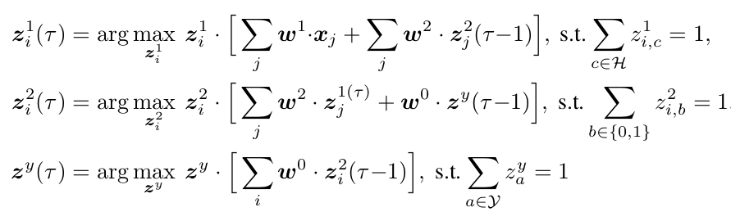
Inference
auxiliary binary vectors z_{i}¹ ∈ {0, 1}^{|H|} , z_{i}² ∈ {0, 1}² , and z^{y} ∈ {0, 1}^{|Y|}

Slide 11
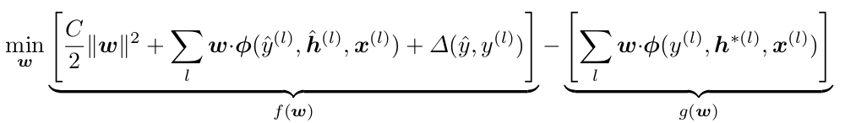
Max-Margin Learning
use the latent-SVM to learn w on labeled training examples D = {(x^{(l)} , y^{(l)}) : l = 1, 2, . . . }
∆( ŷ, y^{(l)} ) is the 0-1 loss
w · φ( ŷ^{(l)}, ĥ^{(l)}, x^{(l)} ) = max_{y,h} w · φ( y, h, x^{(l)} )
w · φ( y^{(l)}, h^{∗(l)}, x^{(l)} ) = max_{h} w · φ( y^{(l)}, h, x^{(l)} ).

Slide 12
Max-Margin learning
The presence of hidden variables h make the overall optimization problem non-convex.
The problem can be expressed as a difference of two convex terms f (w) and g(w),
thus can be solved using the CCCP algorithm

Slide 13
Max-Margin learning
(i) Given w, each ŷ^{(l)} ,ĥ^{(l)}, and h^{∗(l)} can be efficiently estimated using our bottom-up/top-down inference
(ii) Given the 0-1 loss ∆(ŷ, y^{(l)}) and all features φ(ŷ^{(l)} , ĥ^{(l)} , x^{(l)}) and φ(y^{(l)} , h^{∗(l)} , x^{(l)} ), w can be estimated by the CCCP algorithm.

Slide 14
Results
Collective Activity Dataset
  44 videos
  5 collective activities
    Crossing, waiting, queuing, walking, and talking
  standard split of 3/4 and 1/4 of the videos from each class

Slide 15
Results
New Collective Activity Dataset
  32 videos
  6 collective activities
    gathering, talking, dismissal, walking together, chasing, queuing

Slide 16
Results
New Collective Activity Dataset
  9 interactions(not used during the training)
    approaching, walking-in-opposite-direction, facing-each-other, standing-in-a-row, walking-side-by-side, walking-one-after-the-other, running-side-by-side, running-one-after-the-other, and no-interaction

Slide 17
Results
New Collective Activity Dataset
  3 individual actions
    walking, standing still, and running
    The annotations include 8 poses
  divide New-CAD into 3 subsets, and run 3-fold training and testing.

Slide 18
Implement details
each person detection corresponds to one leaf node in HiRF, is assigned an action descriptor x_{i}
X_{i} is a concatenation of
  a person descriptor that captures the person’s pose and action
  Another contextual descriptor that captures the poses and actions of nearby persons

Slide 19
Implement details
use HOG features of the person’s detection bounding box to construct descriptor
  confidences of SVM over |Y| action classes
  confidences of the 8-way pose detector
The contextual descriptor is a |Y|·8-dimensional vector that computes the maximum confidences over all person descriptors associated with the neighboring person detections

Slide 20
Implement details
10 nodes at the h₁ level
20 nodes at the h₂ level
To enforce temporal constraints in FTC-HiRF, split the video into T time intervals, and allow connections between h_{it}¹ nodes and leaf nodes x_{jt} only within their respective intervals t = 1, . . . , T . The optimal T = 10 is empirically evaluated.

Slide 21
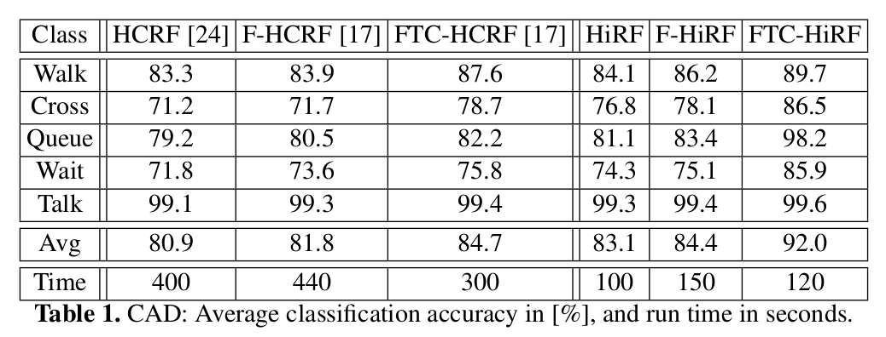
Results

Slide 22
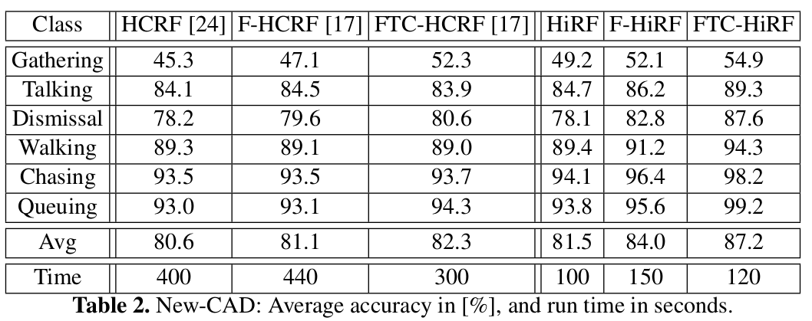
Results

Slide 23
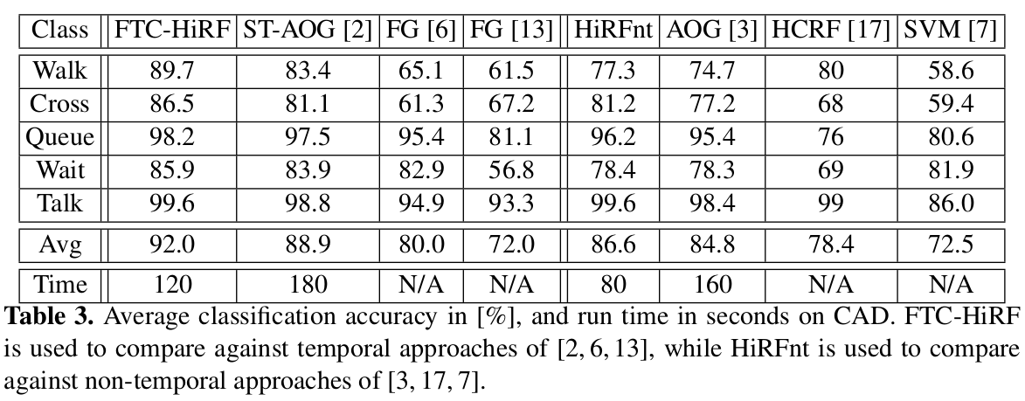
Results
[2] [6] [13] use tracking infomation while FTC-HiRF not

Slide 24
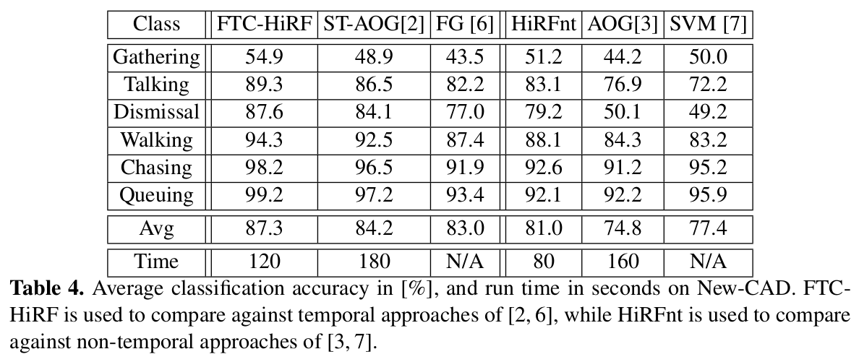
Results

Slide 25
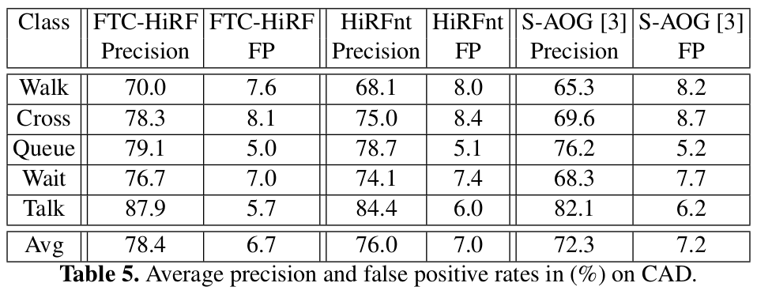
Results

Slide 26
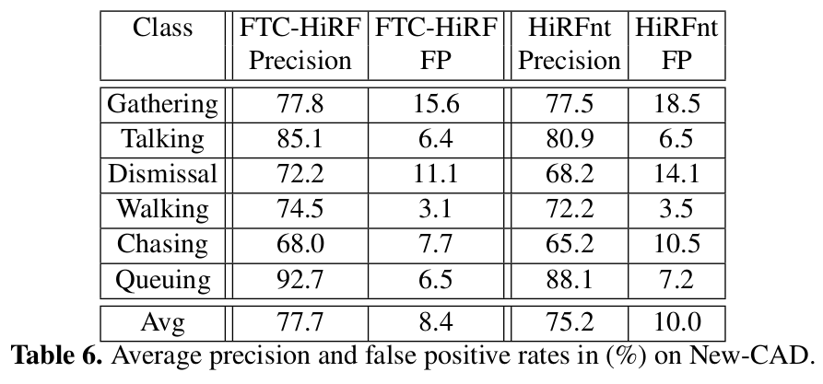
Results

Slide 27
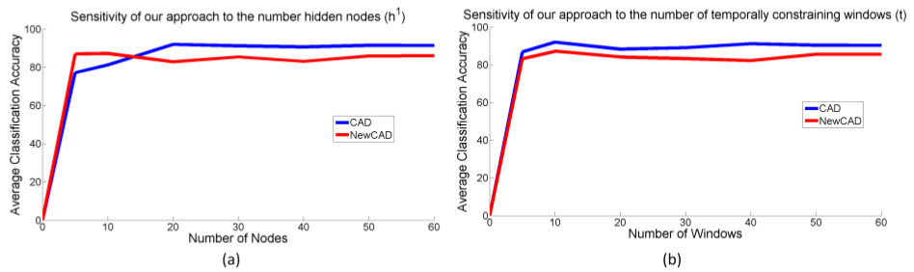
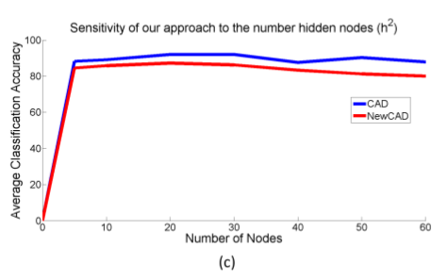
Results

Slide 28
Thanks!

