Slide 1
A Hierarchical Deep Temporal Model
CVPR 2016
被引量：27
https://github.com/Lucas2012/cvpr16

Slide 2
Author
Mostafa S. Ibrahim,
Srikanth Muralidharan,
Zhiwei Deng,
Arash Vahdat,
Greg Mori
Simon Fraser University, Burnaby, Canada

Slide 3
要点
Temporal Infomation:
  LSTM(RNN)
Spatial infomation:
  CNN
Two-stage model:
  Temporal Model of Individual Action
  Hierarchical Model for Group Activity Recognition

Slide 4
Three cues
Person-level actions
Temporal dynamics of a person’s action
  Knowing how each person’s action is changing over time can be used to infer the group’s activity.
Temporal evolution of group activity
  in a volleyball game a team may move from defence phase to pass and then attack.

Slide 5
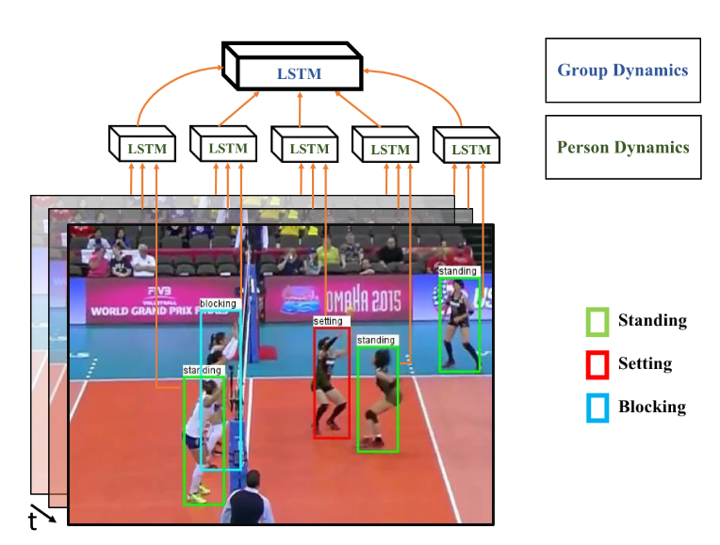

Slide 6
Stage 1-Individual Action
CNN
  extract features from the bounding box around the person in each time step on a person trajectory ——x_{t}
LSTM
  Next page

Slide 7
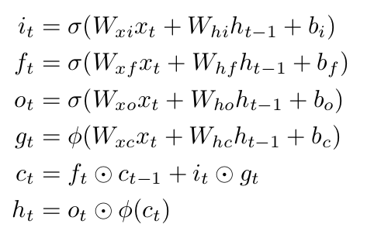
LSTM cell
xi: image-based feature describing the spatial region around a person
σ:sigmoid function
φ:tanh function
h_{t} ∈ R_{N} is the hidden state with N hidden units
i_{t} ∈ R_{N} input gate
f_{t} ∈ R_{N} forget gate
o_{t} ∈ R_{N} output gate
g_{t} ∈ R_{N} input modulation gate

Slide 8
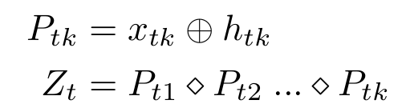
Stage 2——Group Activity
第k个人在时间t的空间特征和时间特征连接，然后max pooling
Z_{t}经过一个Fully connected layer
输出给LSTM layer
LSTM layer的隐层状态H_{t}^{group}被送到softmax层分类

Slide 9
Implement details——1
The person-level CNN and the first LSTM layer are trained in an end-to-end fashion
initialize CNN model with the pre-trained AlexNet network and fine-tune the whole network for the first LSTM layer
9 timesteps and 3000 hidden nodes are used for the first LSTM layer

Slide 10
Implement details——2
concatenate the fc7 layer of AlexNet and the LSTM layer for every person and pool over all people in a scene
The pooled features, fed to the second LSTM network
This network consists of a 3000-node fully connected layer followed by a 9-timestep 500-node LSTM layer which is passed to a softmax layer trained to recognize group activity labels.
a fixed learning rate of 0.00001 and a momentum of 0.9

Slide 11
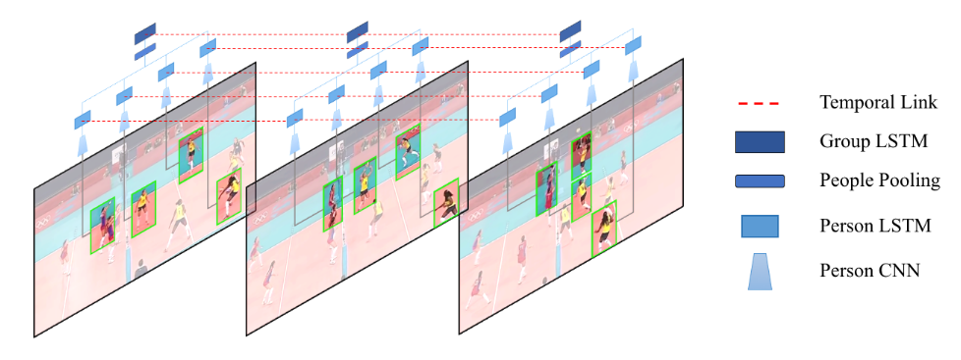

Slide 12
Experiments
Baseline1: Image Classification
Baseline2: Person Classification
Baseline3: Fine-tuned Person Classification
Baseline4: Temporal Model with Image Features
Baseline5: Temporal Model with Person Features
Baseline6: Two-stage Model without LSTM 1
Baseline7: Two-stage Model without LSTM 2

Slide 13
Dataset 1
Collective Activity Dataset
consists of 44 videos, eight person-level pose labels (not used), five person level action labels, and five group-level activities.

Slide 14
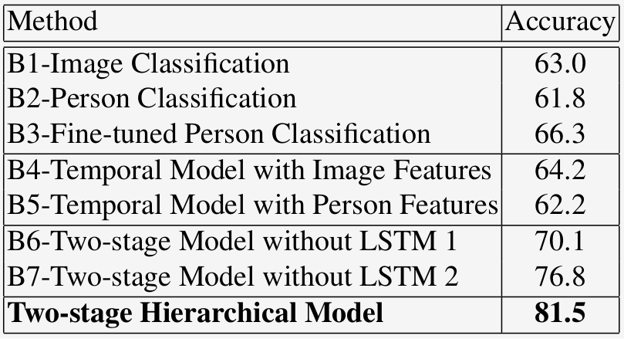
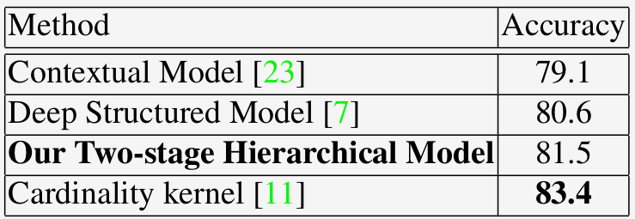
Accuracy

Slide 15
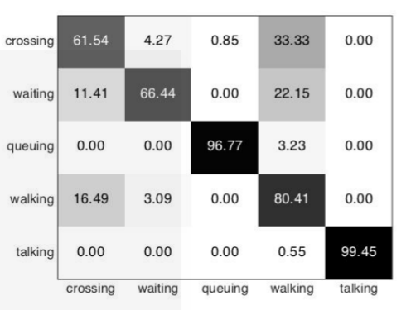
Confusion matrix

Slide 16
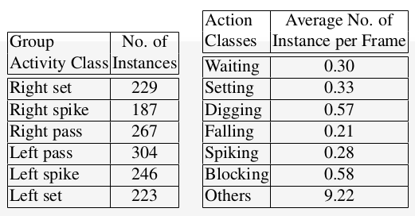
Dataset 2
Volleyball Dataset
annotated 1525 frames that were handpicked from 15 videos with seven player action labels and six team activity labels
https://github.com/mostafa-saad/deep-activity-rec

Slide 17
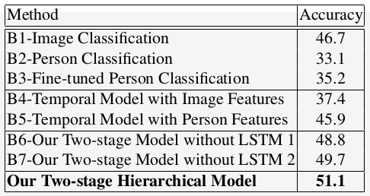
Accuracy

Slide 18
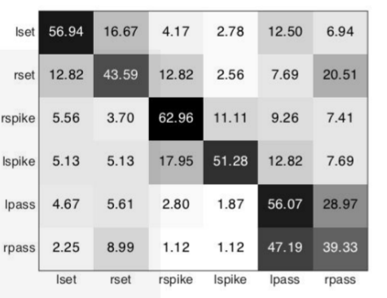
Confusion matrix

Slide 19
Thanks!

